Slide 1
Examples for Elasto-plastic Material Behavior
ECI280
Professor: Boris Jeremić
PhD student: Yuan Feng
02/09/2017

Slide 2
Overview
http://cml01.engr.ucdavis.edu/yuan/education_examples/
http://sokocalo.engr.ucdavis.edu/~jeremic/Real_ESSI_Simulator/

Slide 3
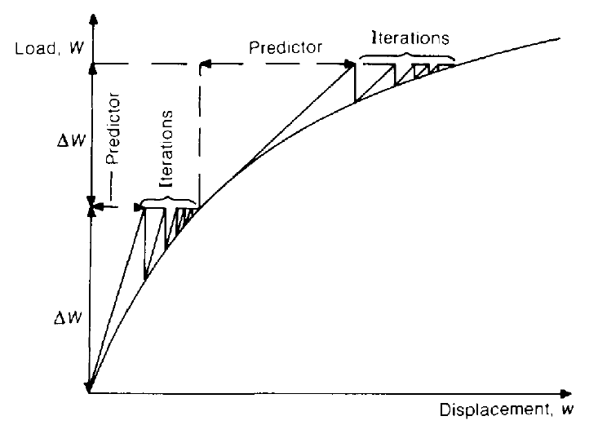
Overview
Nonlinear FEM Procedures:
First Level Iteration:
External Incremental Force.
Incremental Displacement from Tangent Stiffness and incr Force.
Incremental Strain from Incremental Displacement and strain-disp relation.
Incremental Stress from Incremental strain
Internal Incremental Force from Incremental Stress at Gauss Sampling.
Use Step 1 and Step 5 to obtain the unbalanced Force.
Input unbalance to Step 1 Again.
Until unbalanced Force is within the Tolerance.

Slide 4
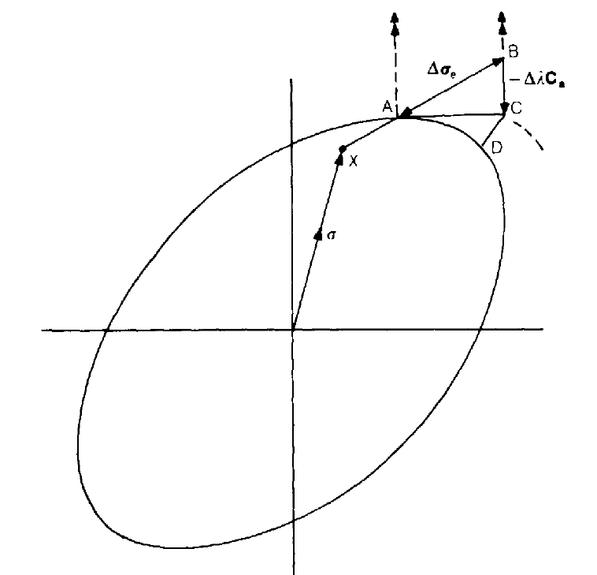
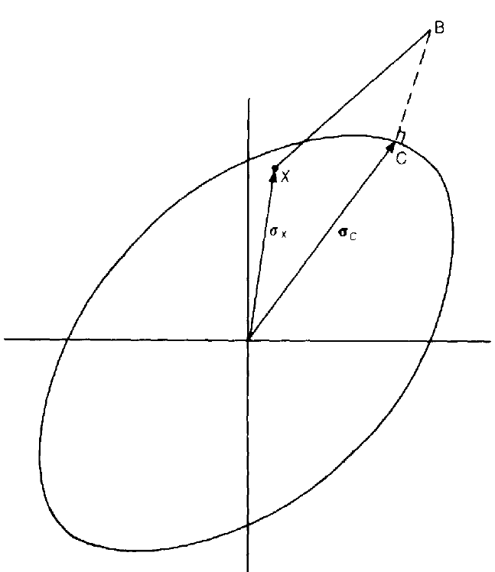
Overview
Nonlinear FEM Procedures:
Second Level Iteration:
Elastic Predictor 2. Plastic Corrector
Forward Euler Algorithm
Backward Euler Algorithm

Slide 5
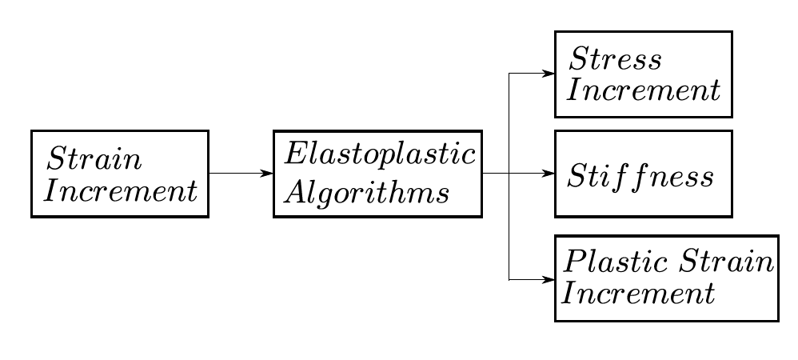

Slide 6
Elasto-plastic Materials
Elastic Predictor
Elastic Stiffness
Plastic Corrector
Yield Surface
Plastic Flow Rule
Hardening Law

Slide 7
Elasto-plastic Materials
Elasticity
Yield Surface
Plastic Flow Rule
Hardening Law

Slide 8
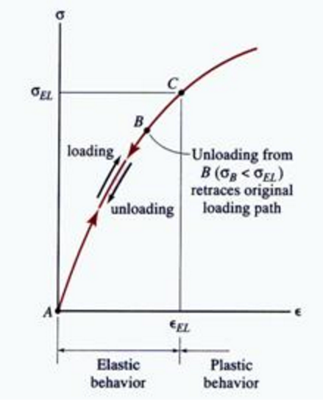
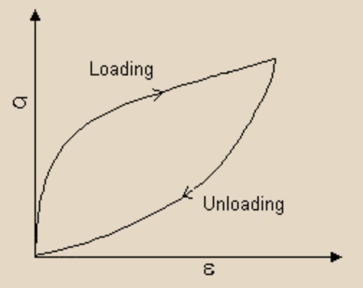
Elasticity
Linear Elasticity
Nonlinear Elasticity
Show Examples

Slide 9
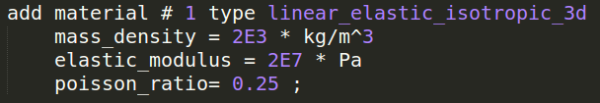
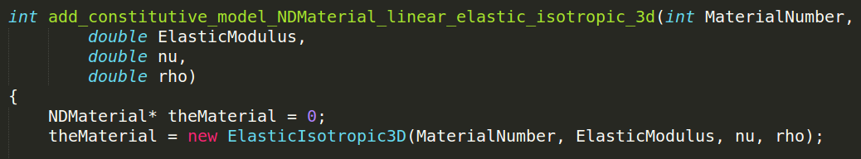
Domain Specific language
User-Input: Before the Translation
DSL-Output: After the Translation

Slide 10
Execute ESSI by command
ESSI: Earthquake Soil-Structure Interaction
FEI: Finite Element Interface

Slide 11
Elasto-plastic Materials
Elasticity
Yield Surface
Plastic Flow Rule
Hardening Law

Slide 12
Yield surface
Von-Mises Yield Surface
Drucker-Prager Yield Surface
Hyperbolic Drucker-Prager Yield Surface
Show Examples

Slide 13
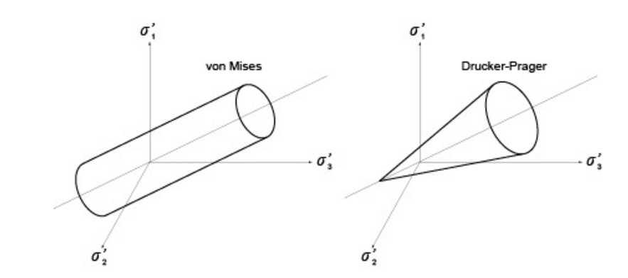

Slide 14
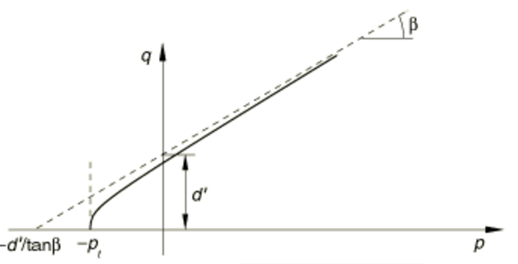
Hyperbolic Drucker-Prager

Slide 15
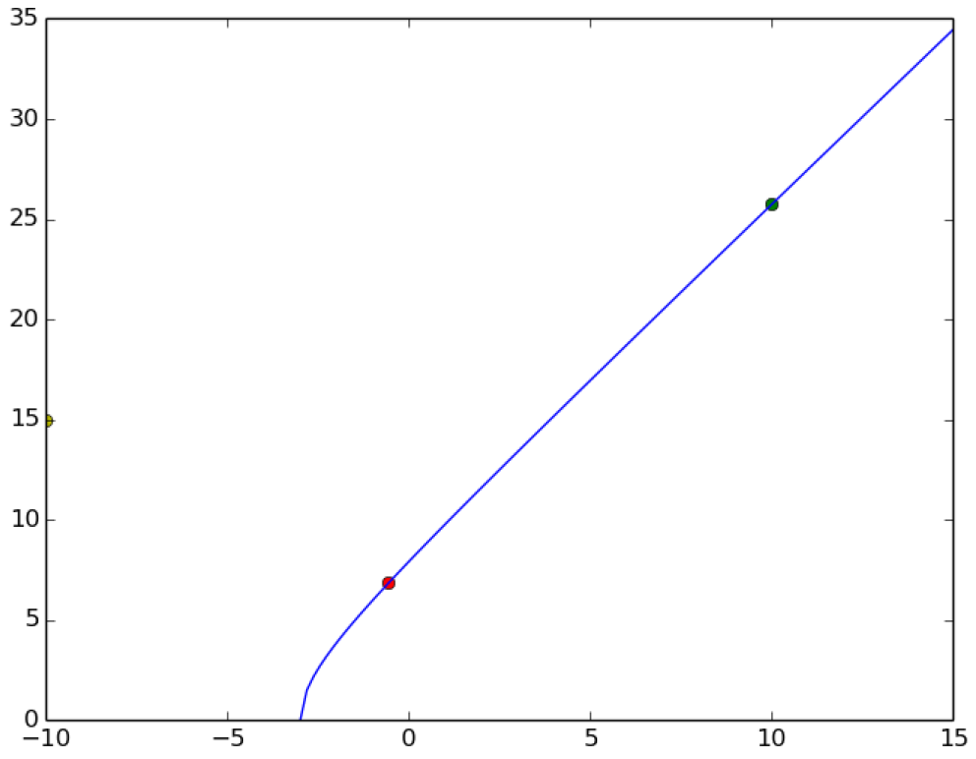
Hyperbolic Drucker-Prager

Slide 16
Elasto-plastic Materials
Elasticity
Yield Surface
Plastic Flow Rule
Hardening Law

Slide 17
Plastic flow rule
Associative Plastic Flow Rule
Non-associative Plastic Flow Rule
Show Examples

Slide 18
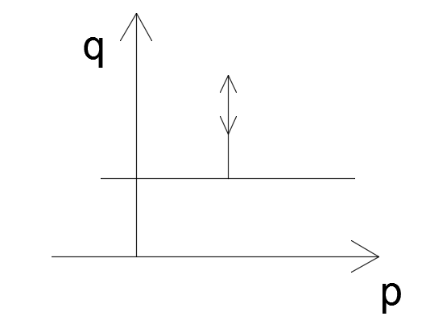
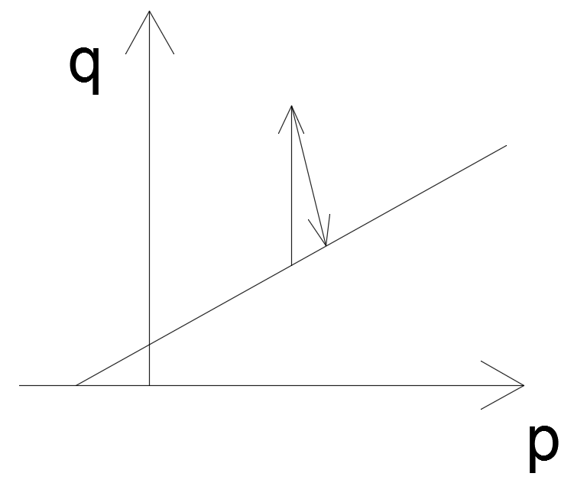
Von-Mises
Drucker-Prager

Slide 19
p = -1/3 * (sigma_11 + sigma_22 + sigma_33)
q = sqrt(3/2*s_ij * s_ij)

Slide 21
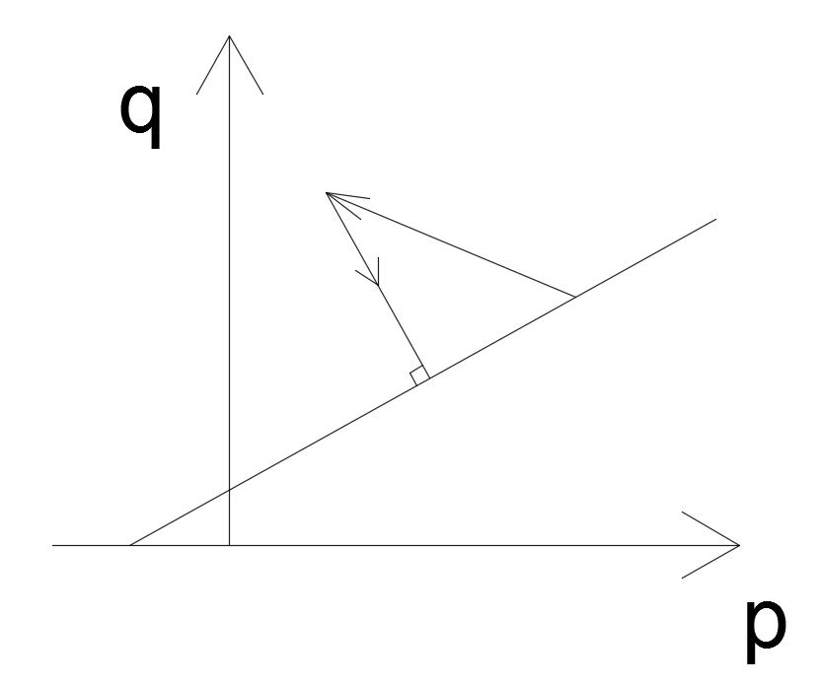
Drucker-Prager Yield Surface
In Drucker-Prager associative plastic flow rule, should the plastic corrector be perpendicular to the yield surface in the p-q plane?
Wrong:
Associative Flow Rule
Should Not Return Perpendicularly to the yield surface in the
p-q plane.
Reference:
Analytical CPP in energy-mapped stress space: application to a modified Drucker–Prager yield surface

Slide 22
Elasto-plastic Materials
Elasticity
Yield Surface
Plastic Flow Rule
Hardening Law

Slide 23
Hardening law
Isotropic Hardening Rule
Kinematic Hardening Rule
Armstrong-Frederick Hardening Rule
Multi-Surface Hardening Rule

Slide 24
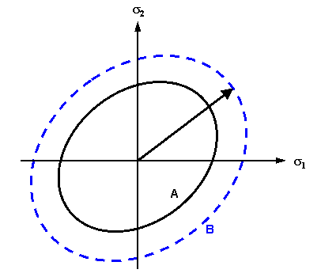
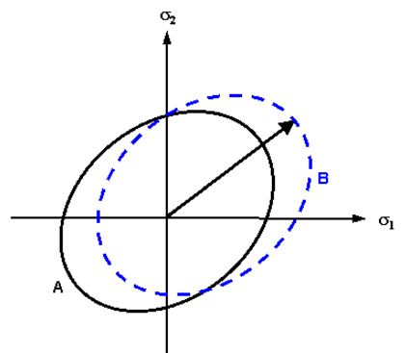
Isotropic & kinematic Hardening
Show Examples

Slide 25
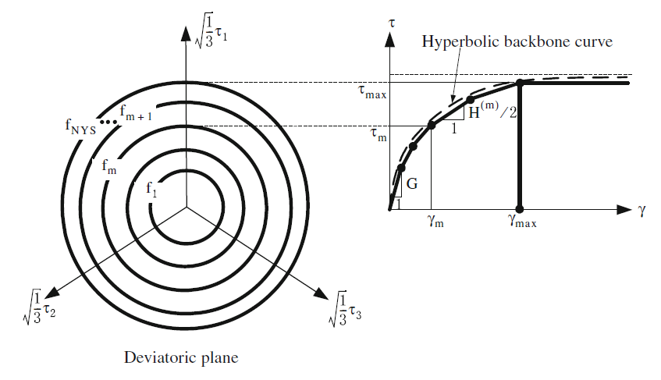
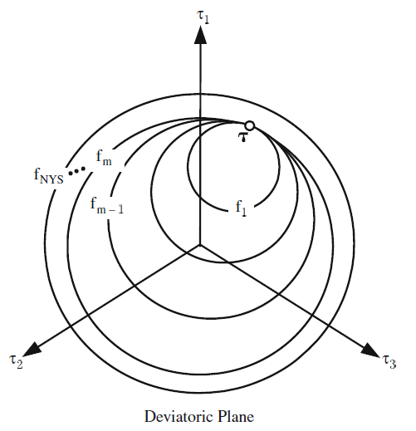
Multi-Yield-surface hardening law

Slide 26
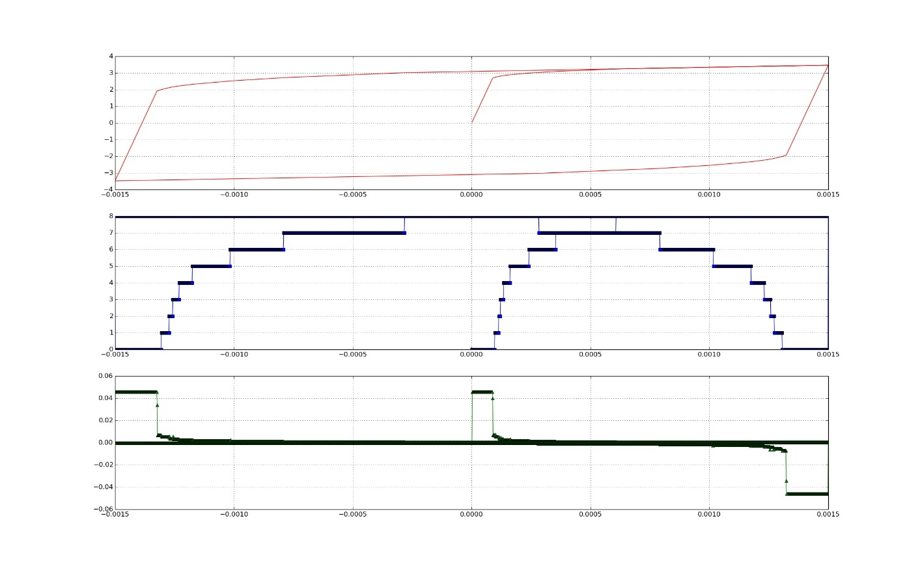
Multi-Yield-surface hardening law

Slide 27
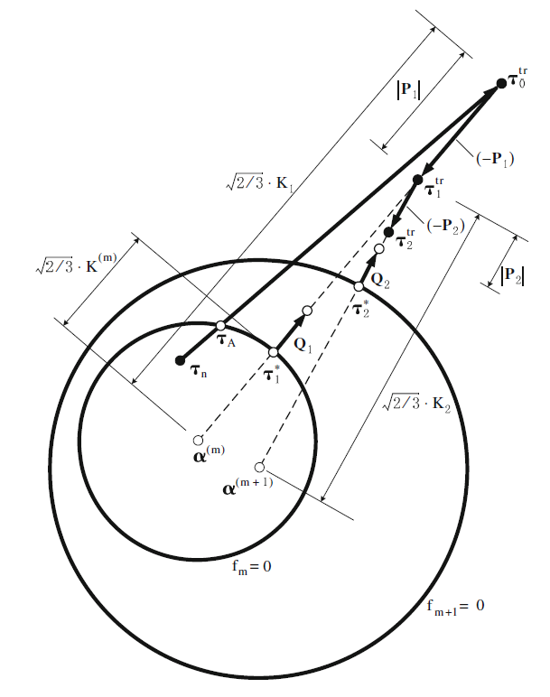
Multi-yield-surface algorithms
Reference
Prevost. JH. A simple plasticity theory for frictional cohesionless soils. 1985.

Slide 28
Application in finite element solid brick

Slide 29
Overview
Nonlinear FEM Procedures:
Second Level Iteration:
Elastic Predictor 2. Plastic Corrector
Forward Euler Algorithm
Backward Euler Algorithm

Slide 30
Overview
Nonlinear FEM Procedures:
First Level Iteration:
External Incremental Force.
Incremental Displacement from Tangent Stiffness and incr Force.
Incremental Strain from Incremental Displacement and strain-disp relation.
Incremental Stress from Incremental strain
Internal Incremental Force from Incremental Stress at Gauss Sampling.
Use Step 1 and Step 5 to obtain the unbalanced Force.
Input unbalance to Step 1 Again.
Until unbalanced Force is within the Tolerance.

Slide 31
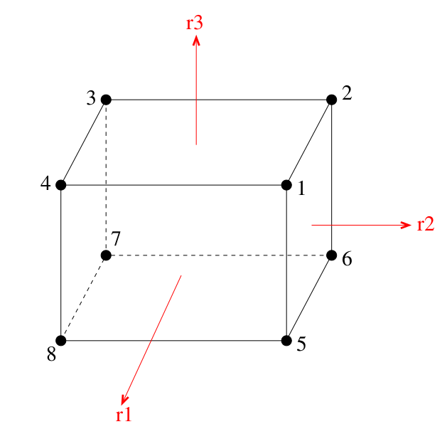
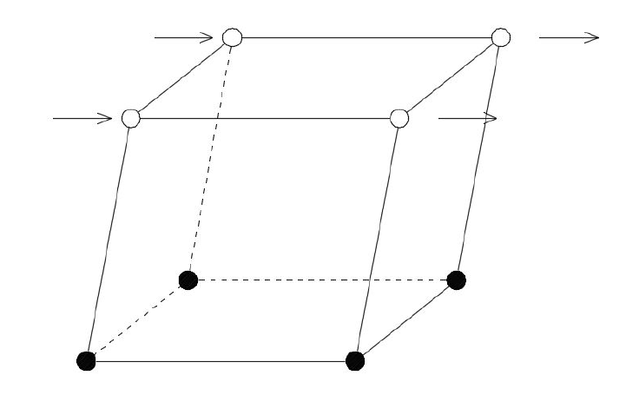
Brick Element Example

Slide 32
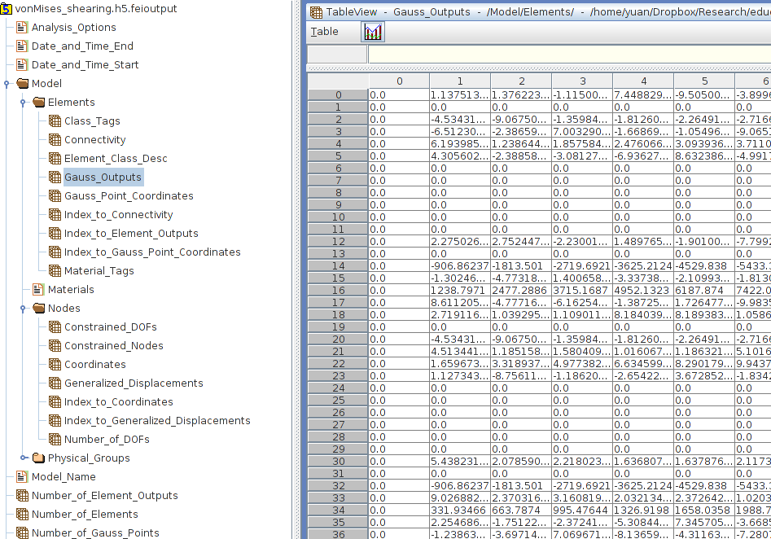
HDF5 output:
Hierarchical Data Format

Slide 33
Gauss output format
18 Items * Number_of_Timestep
18 items includes
6 total strain
6 plastic strain
6 stress
Each Gauss Point has
Order of output in every 6 output
Sigma_11
Sigma_22
Sigma_33
Sigma_12
Sigma_13
Sigma_23

Slide 34
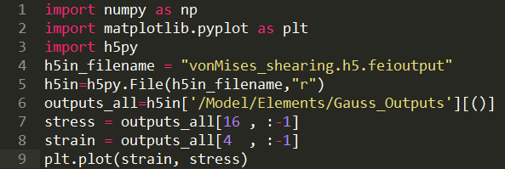
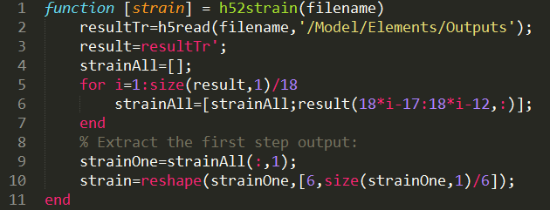
Read hdf5 by python or matlab

Slide 35
Common Modeling Mistakes
1. Forget to add confinement on the Drucker-Prager Materials.
2. Use load control with the perfectly plastic materials or materials with plateau.
3. Use large strain increment without sub-increments.
3.1 Newton Algorithms requires a good initial guess
3.2 Infinitesimal Strain Assumptions

Slide 36
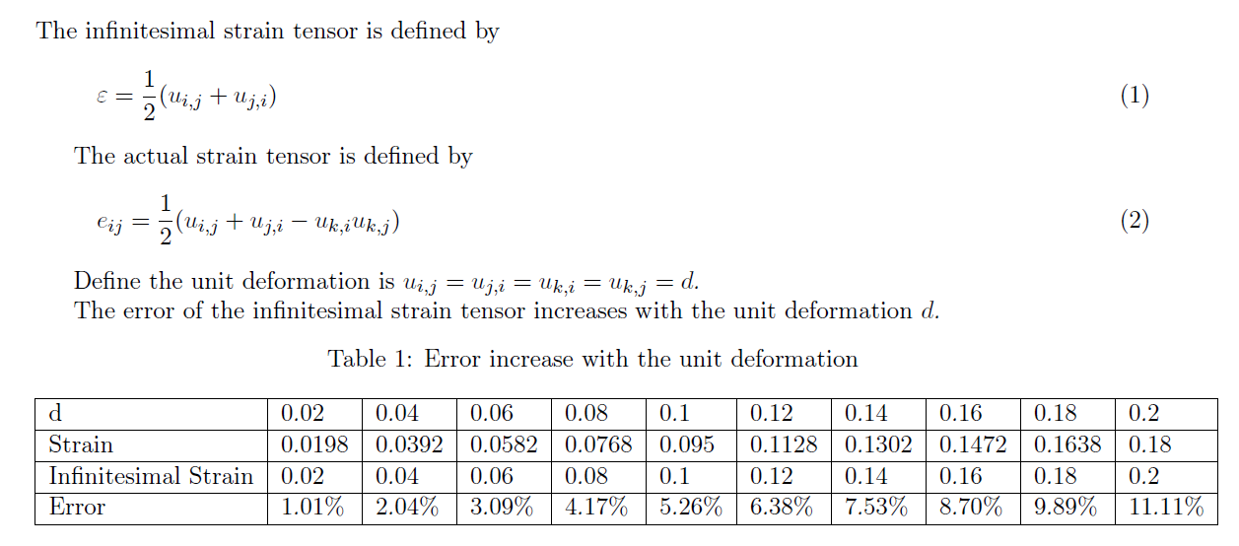
Infinitesimal strain error estimation

Slide 37
Materials available
http://cml01.engr.ucdavis.edu/yuan/education_examples/
http://sokocalo.engr.ucdavis.edu/~jeremic/Real_ESSI_Simulator/

Slide 38
Thanks!

