Slide 1
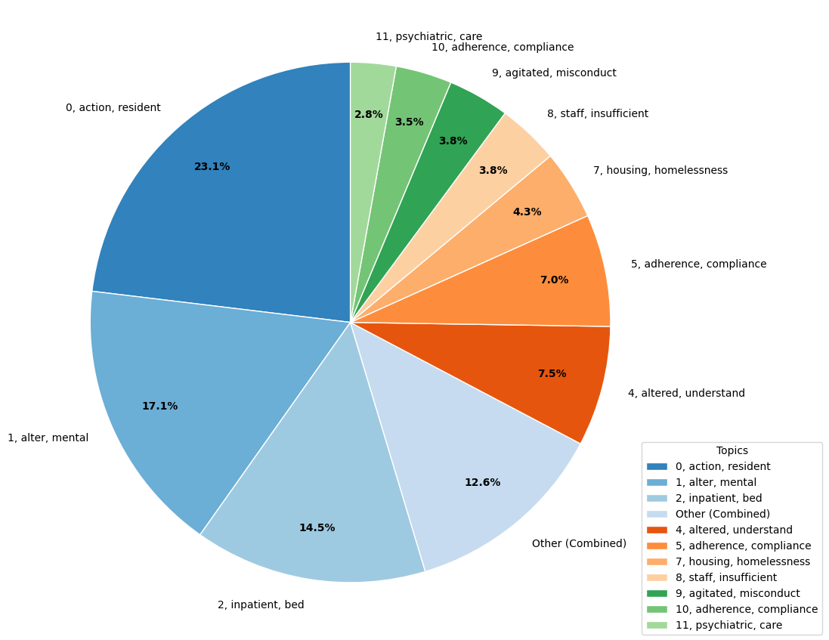
11, understand, factor
10, psychiatric, care
9, agitated, misconduct
0, action, resident
8, staff, insufficient
7, housing, homelessness
5, adherence, compliance
4, altered, understand
1, alter, mental
Other (Combined)
2, inpatient, bed

Slide 2
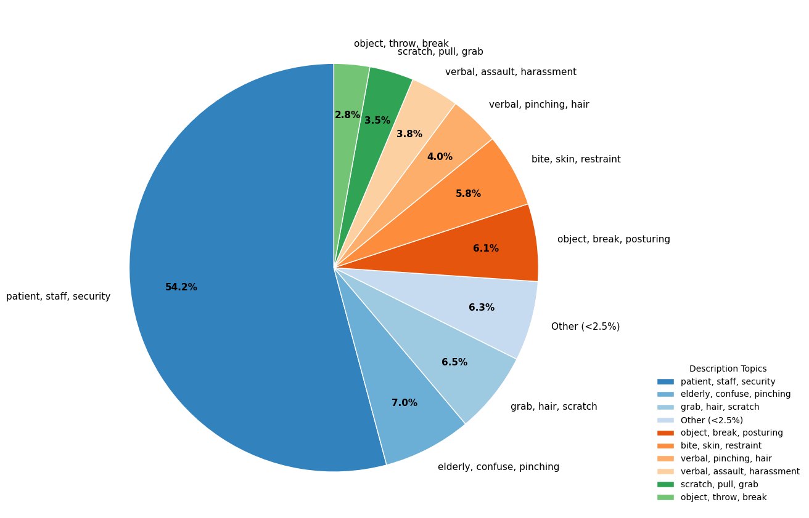
Object, throw, break
Scratch, pull, grab
Verbal, assault, harassment
Verbal, pinching, hair
Bite, skin, restraint
Object, break, posturing
Patient, staff, security
Other (<2.5%)
Grab, hair, scratch
Elderly, confuse, pinching

Slide 3
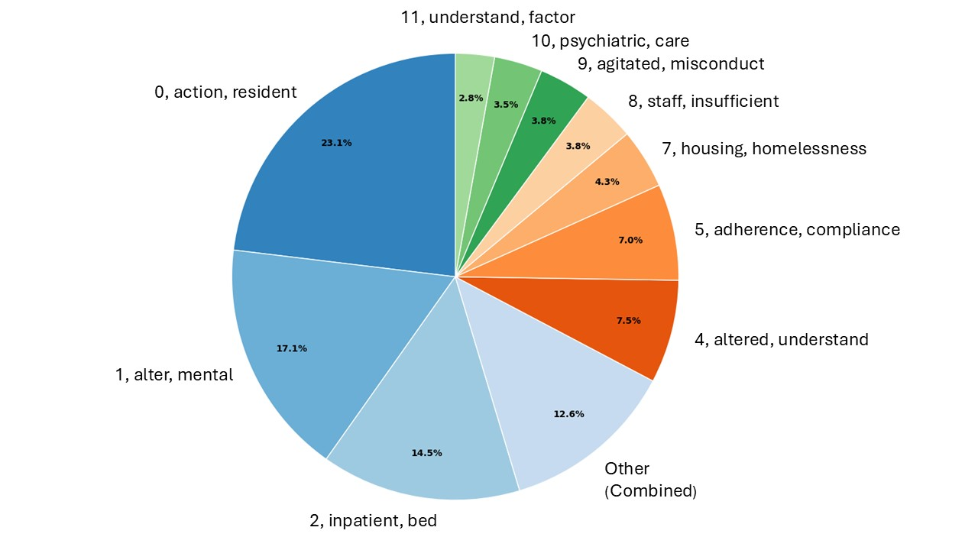
WPV in Hospital – Distribution of Primary Contributing Factors

Slide 4
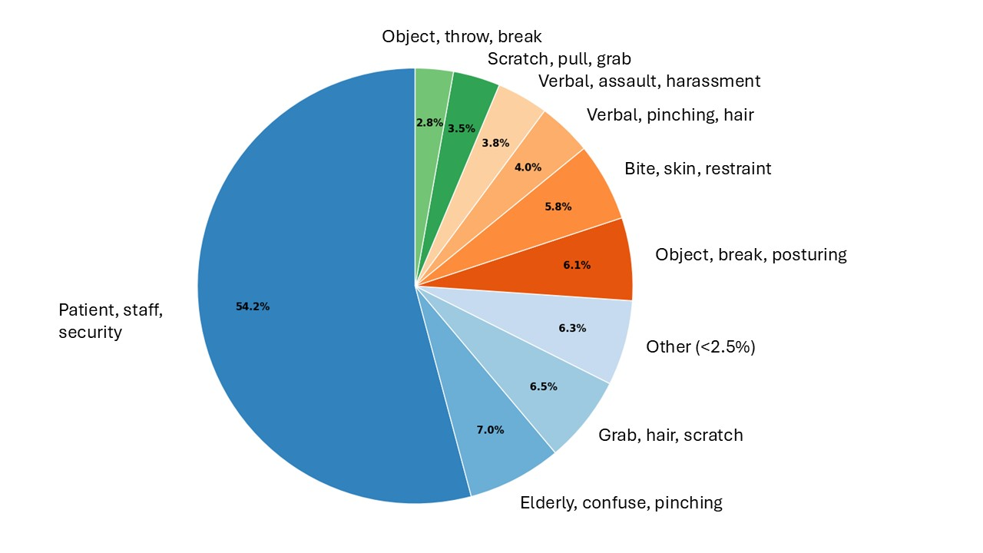
WPV in Hospital – Distribution of Assault Description

