Slide 1
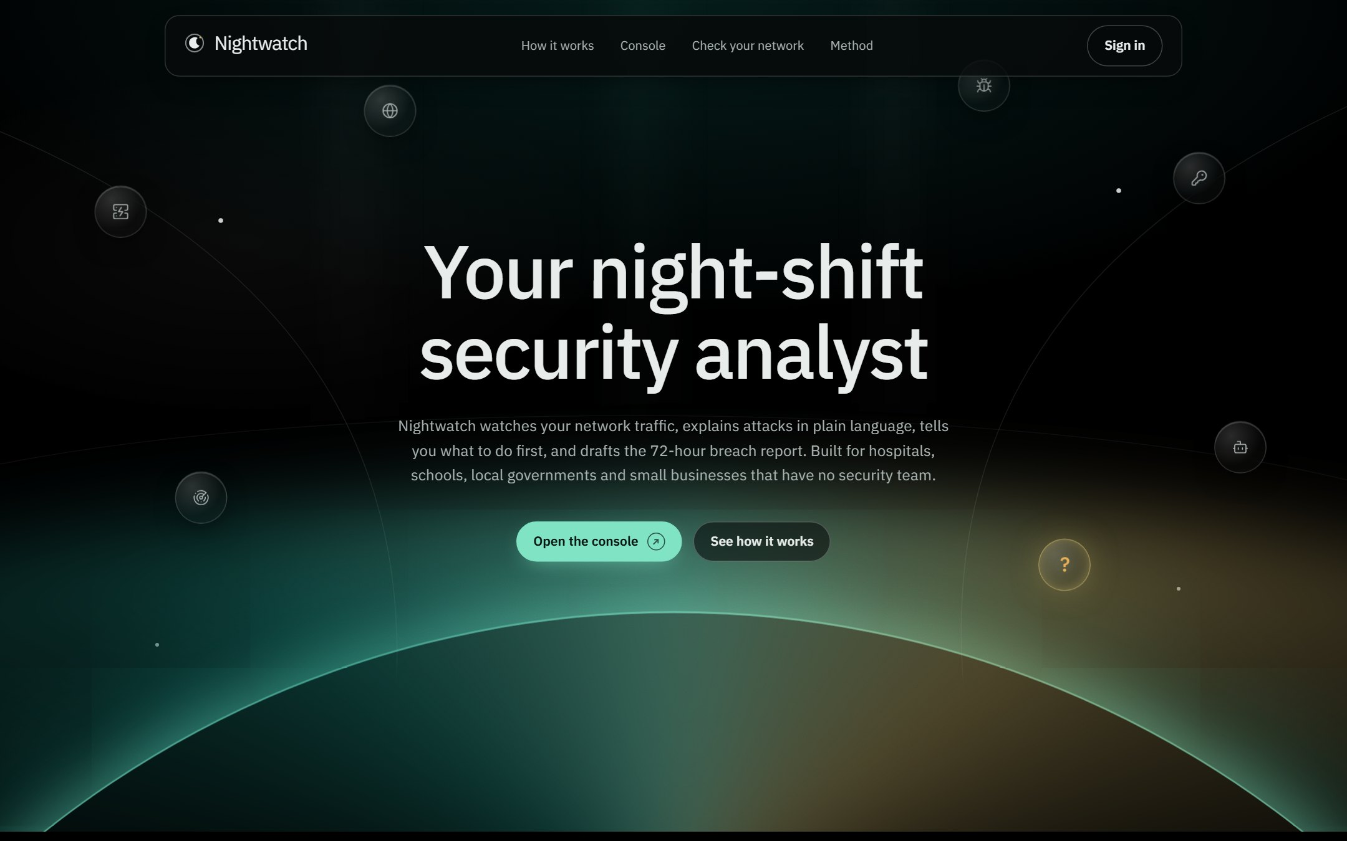
Nightwatch
Your night-shift security analyst
Network intrusion detection that explains every alert in plain language, ranks what to fix first, and drafts the breach report the law requires within 72 hours. For hospitals, schools, local governments and small businesses with no security team.
DataNova 2026 Global Data-thon
Cybersecurity and Fraud Detection, DN-CY-01
Notes:
Nightwatch is a night-shift security analyst for organizations that cannot afford one. In one sentence: it watches network traffic, tells you in plain language which attacks matter most, and drafts the breach notification the law requires within 72 hours.

Slide 2
PhilHealth, 2023: the attack nobody was watching for
On 22 September 2023 the Medusa ransomware group hit the Philippine Health Insurance Corporation. About 72 workstations were encrypted, a $300,000 ransom was refused, and the stolen data was published. The antivirus licence had lapsed five months earlier.
If a national agency with an IT department missed it, a provincial hospital with one IT staff member and no night shift has little chance.
~13M
72 h
46%
members whose data was reported compromised
to notify the National Privacy Commission after discovering a breach
of security alerts are false positives, even in staffed SOCs
Sources: PhilHealth public notice UN2023-10-03; HIPAA Journal (Oct 2023); NPC Circular 16-03; Microsoft and Omdia, State of the SOC 2026. Full list in docs/RESEARCH.md.
Notes:
Start with a story judges in the Philippines will remember. PhilHealth was not a small organization, yet the attack went unnoticed until it was too late. Small organizations face the same attackers with even less: one IT person, no 24/7 monitoring. And the Data Privacy Act still requires them to notify the NPC within 72 hours.

Slide 3
Three jobs small organizations cannot staff
1
2
3
Notice the attack
Decide what comes first
Report it in time
Detection tools fire thousands of alerts a day. 73% of security teams name false positives as their top problem.
An IT generalist has maybe half an hour a day for security. Reviewing alerts oldest-first spends it on noise.
The Data Privacy Act asks for the nature of the breach, the data involved, measures taken and a contact person, within 72 hours.
Most alerts are never looked at.
The real attack waits in line.
Hours lost to piecing together logs.
Sources: SANS 2025 Detection and Response Survey; NPC Circular 16-03, Section 17. Full list in docs/RESEARCH.md.
Notes:
This is the gap Nightwatch fills. Not another detector, but the analyst work around detection: noticing, prioritizing, and reporting.

Slide 4
Nightwatch does the analyst's night shift in five steps
1
2
3
4
5
Monitor
Detect
Prioritize
Investigate
Report
Reads network flow logs (CICFlowMeter format) from a live replay or an uploaded file.
A model trained on corrected, real attack traffic names the attack, or says it does not recognize it.
Groups alerts into incidents and ranks them Critical, High, Medium or Low.
Explains each incident in plain words, with the MITRE ATT&CK technique and the evidence.
Turns the analyst's decisions into a draft breach report and counts down its deadline.
Nightwatch never blocks traffic on its own. It tells a person what happened, how sure it is, and what to do first; the person decides.
Notes:
Walk through the five steps. Emphasize the last panel: a human stays in charge. Automatic blocking on a model's guess can take down a hospital's own systems.

Slide 5
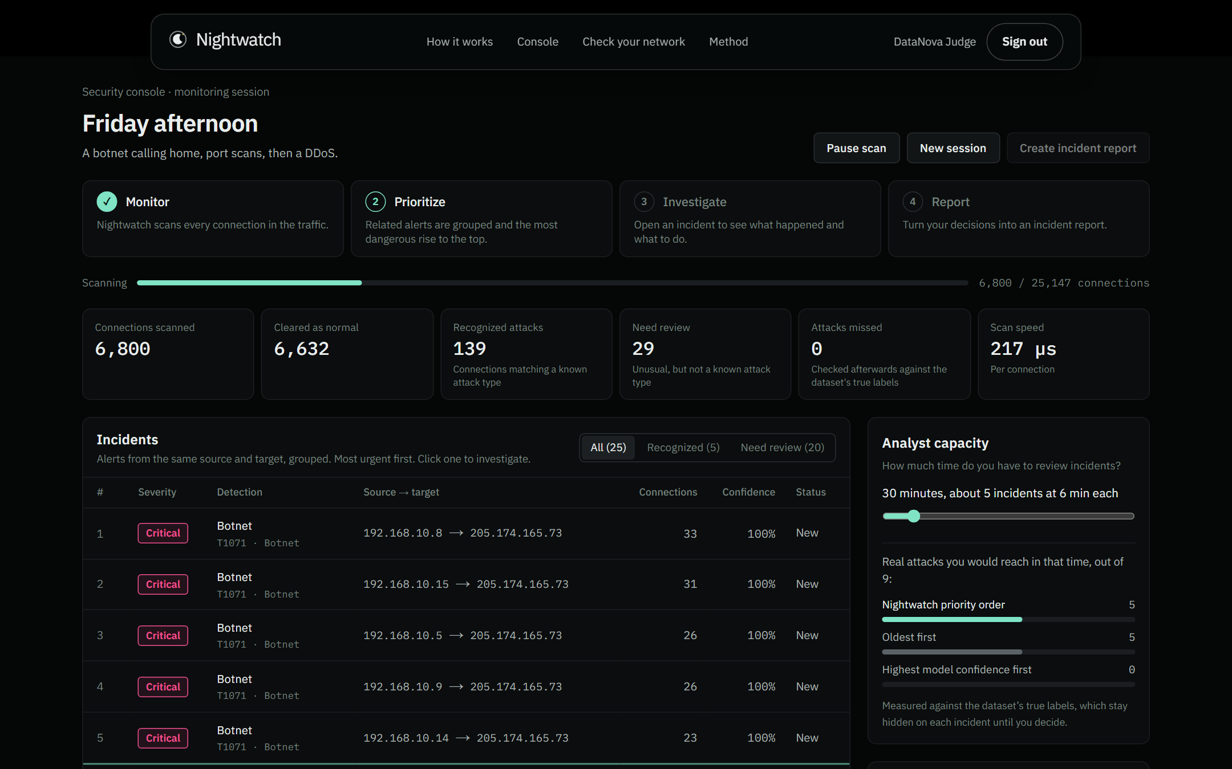
The console: real attacks rise to the top
Live scoring
Each connection is scored as it streams in. The replay is held-out traffic the model never trained on.
Severity first
Botnet command-and-control traffic is Critical and sorts above everything else.
Your time
The capacity slider shows which incidents fit in the time you have, against oldest-first.
Notes:
Live demo point. Start a Friday replay. Point at the severity column: five Critical botnet incidents at the top. Then move the capacity slider and show how many real attacks fit into 30 minutes compared with reviewing oldest-first.

Slide 6
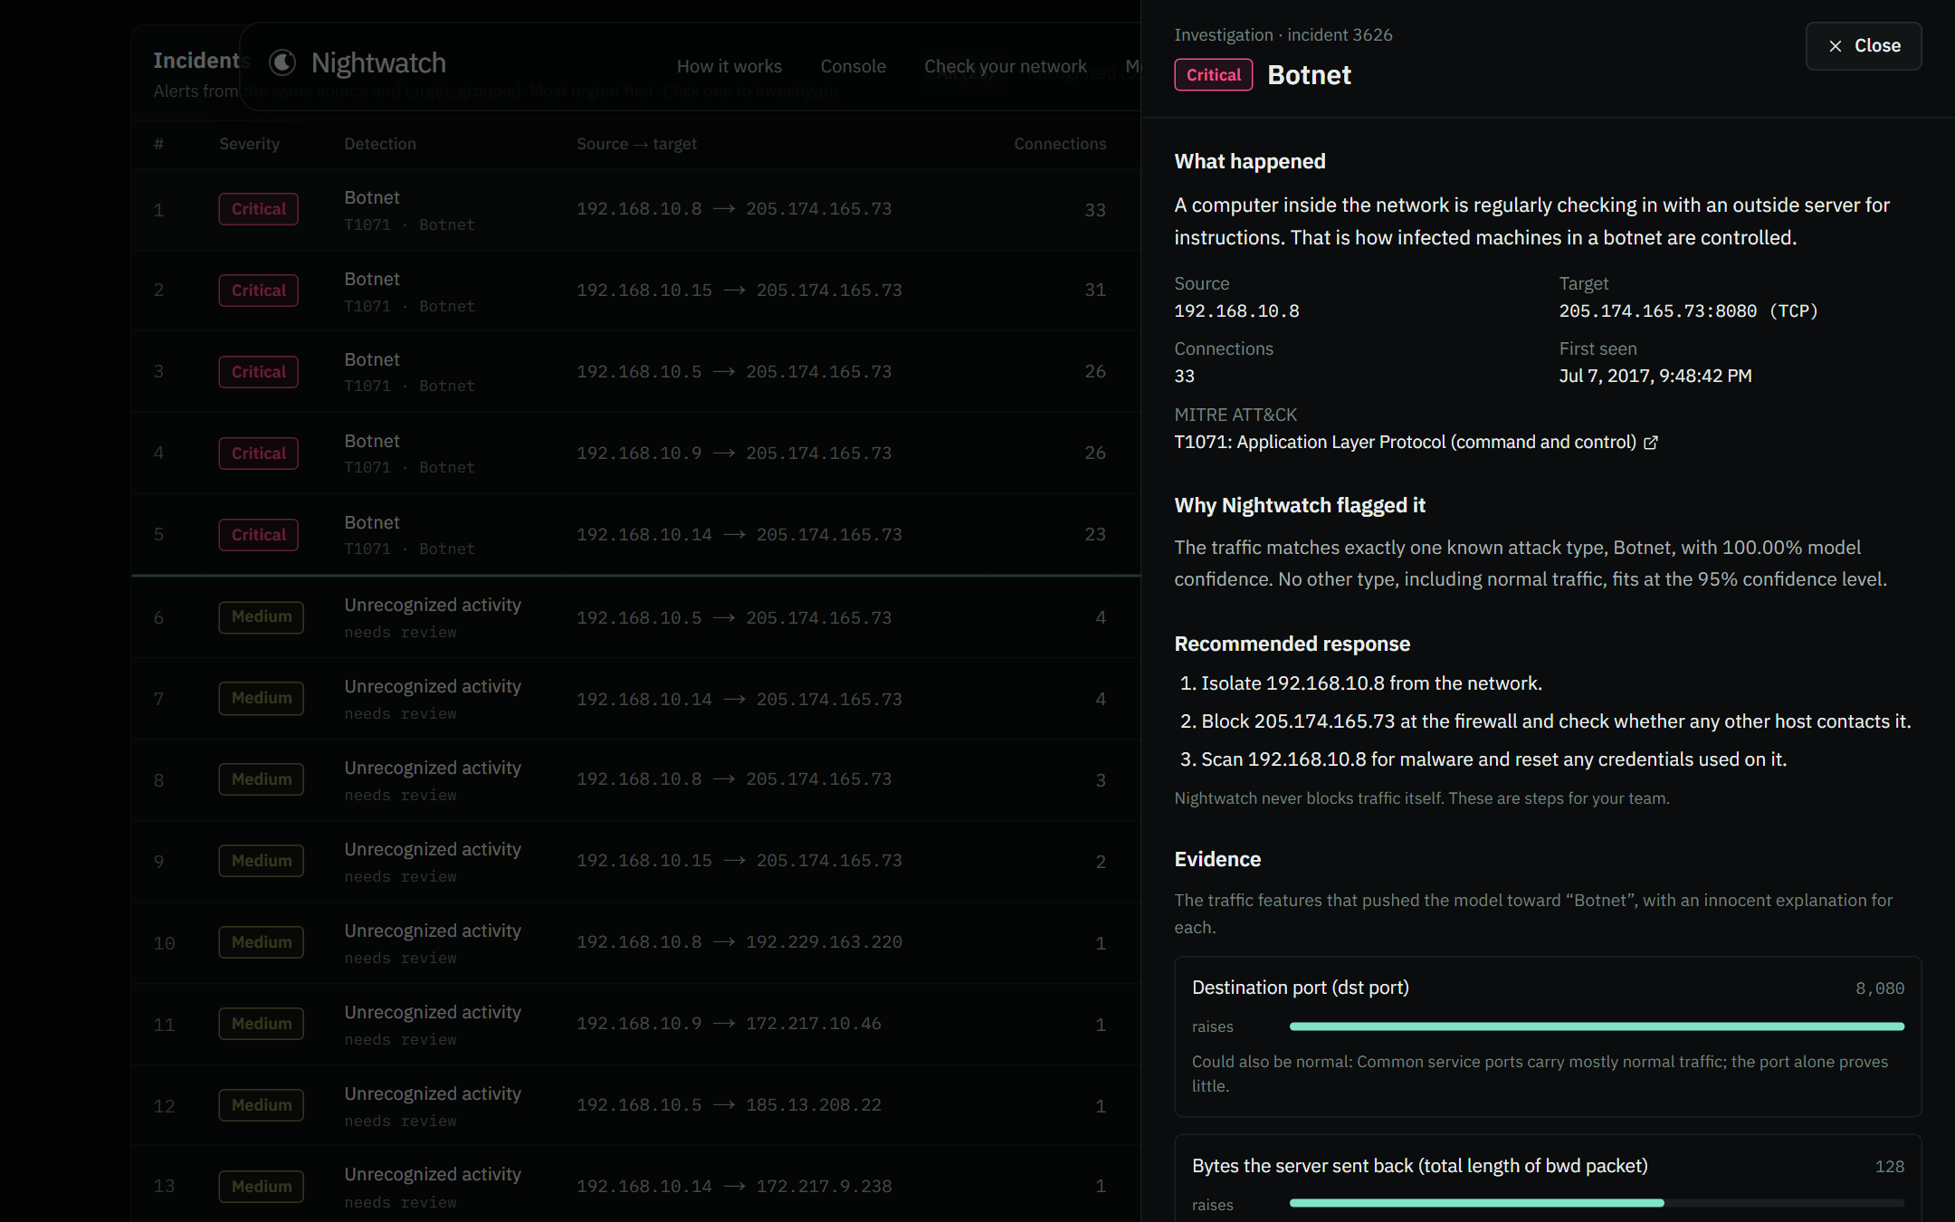
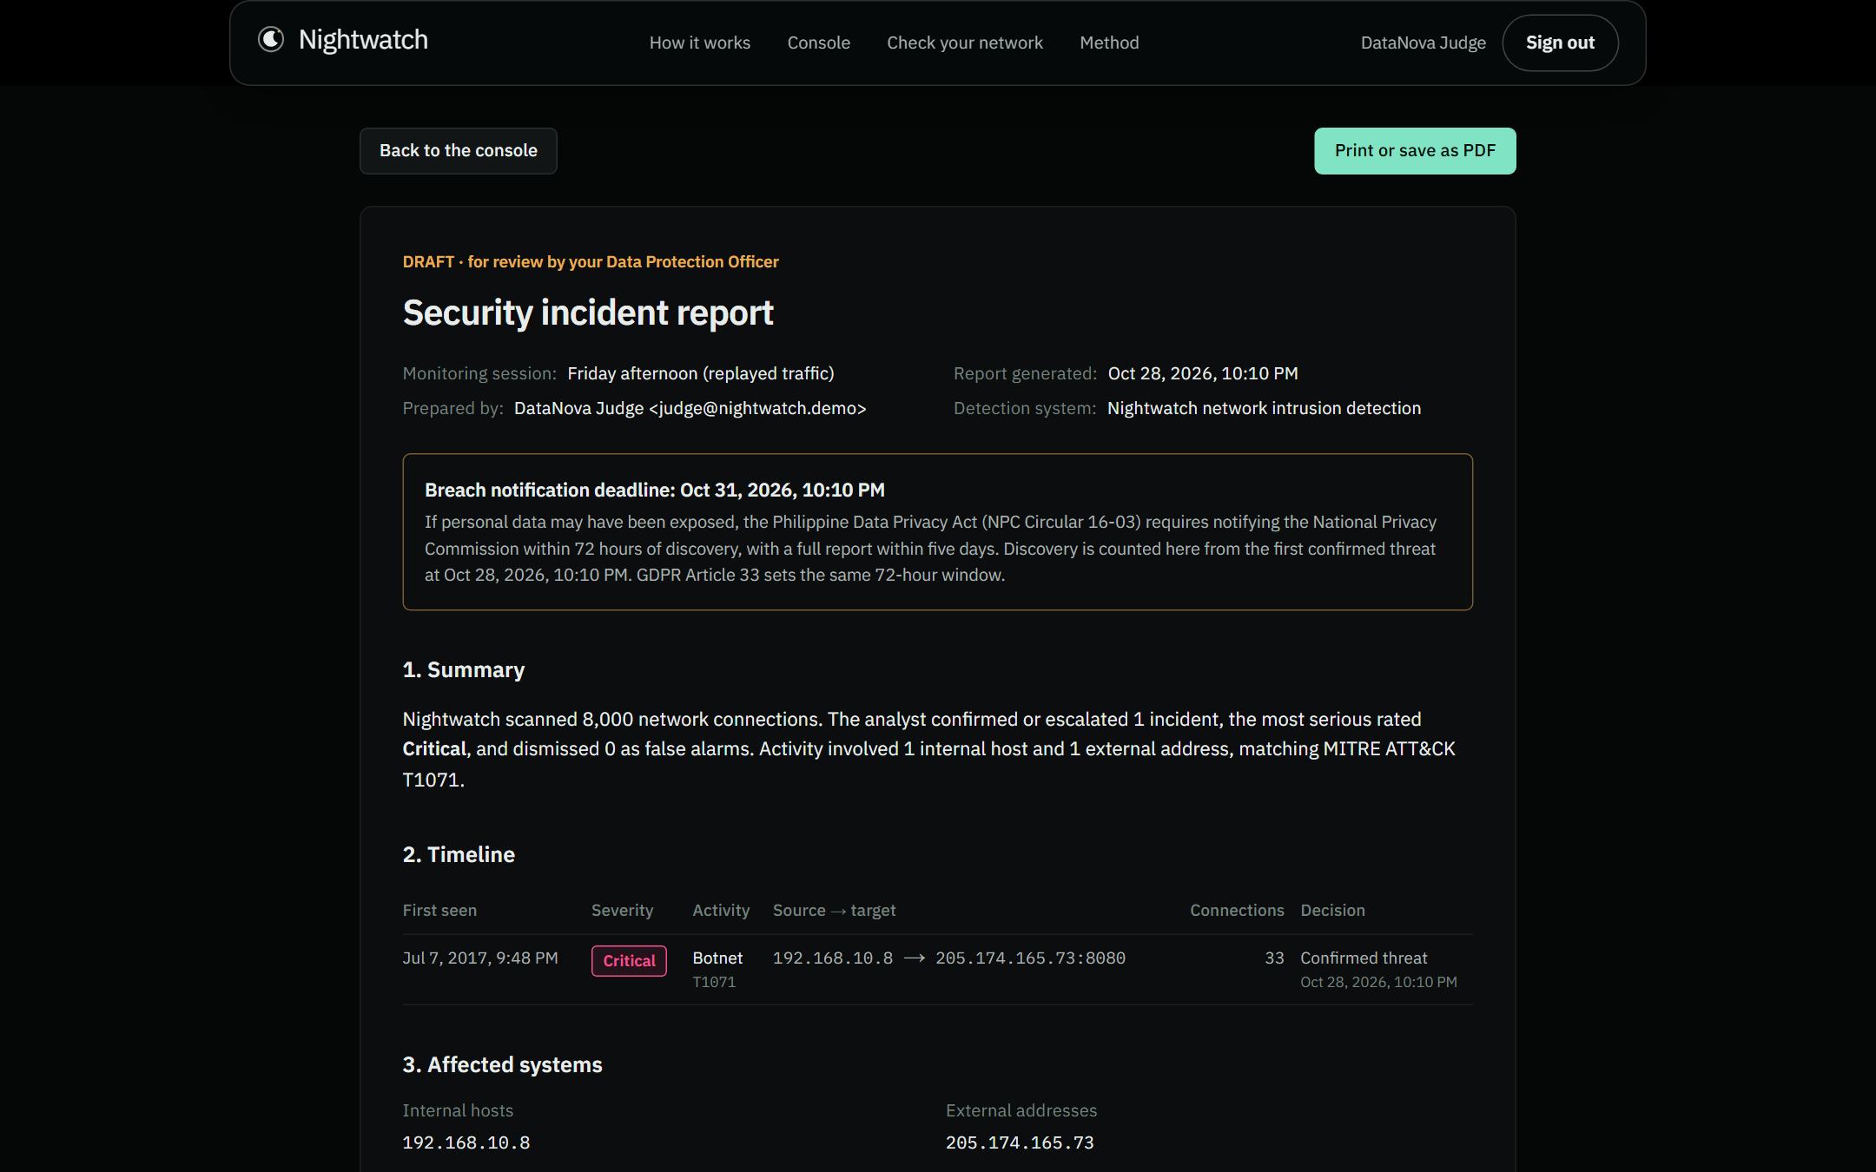
From one click to a breach report draft
Investigate
Report
What happened in plain words, MITRE ATT&CK T1071, the model's evidence with an innocent explanation beside each signal, and the first response steps.
Confirmed incidents become a draft with the NPC's four required fields, a timeline, affected hosts and the deadline. Marked as a draft for the Data Protection Officer.
Notes:
Open an incident, read the plain-language explanation, confirm the threat, then click Create incident report. The deadline is counted from the first confirmed threat. Be clear that this is a draft for a human, not legal advice.

Slide 7
Why 99.9% accuracy proves almost nothing
Our own model scores 99.99% accuracy on a random split. That number is mostly normal traffic being called normal. The question that matters is how well it catches each kind of attack on traffic from later in time.
>25%
of flows in the original CIC-IDS2017 were mislabeled or broken. We use the corrected release.
30 of 30
top security ML papers had at least three evaluation pitfalls. We check ourselves against all ten.
86.8%
macro-F1 with port and protocol removed. It reads behavior, not port numbers.
Sources: Engelen et al., IEEE SPW 2021; Liu et al., IEEE CNS 2022; Arp et al., USENIX Security 2022. Numbers: ml/reports/illusion.json, no_port.json.
Notes:
This is our rigor slide. Accuracy barely moves between the two tests, because 99% of traffic is normal. Macro-F1 over attack classes is the honest number, and we test on traffic later in time than training, the way a real deployment works.

Slide 8
Rare attacks get a fair vote
Rarest attacks in the test set
Attack class | Flows | Alerted | Named right
Heartbleed | 2 | 100% | 100%
Web SQL Injection | 3 | 100% | 0%
Web XSS | 4 | 100% | 75%
Infiltration | 7 | 100% | 29%
Web Brute Force | 15 | 100% | 93%
Botnet | 147 | 100% | 95%
We chose class-balanced weighting because it scored best on calibration data, before looking at the test set. Every rare attack raised an alert, but some only as Needs review: with a handful of training examples the model is not sure enough to name them.
Numbers: ml/reports/ablation.json (calibration split) and final.json (test split). Alerted: named as an attack or sent to Needs review. Named right: the single correct attack type.
Notes:
The track asks for robust minority-class performance. We compared three imbalance strategies and chose on calibration data only. The table shows the rarest classes: Heartbleed has two test flows, SQL injection three. Every one of them raised an alert, though not always with the right name, which is why the uncertain ones go to Needs review.

Slide 9
It says “I'm not sure” instead of staying silent
A normal classifier must pick a label, so an attack it has never seen is quietly called normal. Nightwatch uses conformal prediction: it lists every label it cannot rule out at 95% confidence. One attack label means a recognized attack. Anything ambiguous goes to Needs review. Only flows that look clearly normal are cleared.
99.96%
of attack flows in the test set raised an alert
0.42%
of normal flows raised a false alert
Recognized attack
One attack type, 95% confidence
Needs review
Neither a known attack nor normal
0.039%
of attack flows were missed
Cleared
Only normal fits
Test split: 393,993 held-out flows. Numbers: ml/reports/final.json. Method: split conformal prediction (Angelopoulos and Bates, 2021).
Notes:
This is the innovation slide. Conformal prediction gives a calibrated guarantee instead of a guess. The false alert rate is a policy we set before testing: 0.2% per class, which lands at 0.42% overall. We also show the trade-off curve on the Method page.

Slide 10
New attacks: what it catches and what it misses
Caught
Attacks that look structurally new: DDoS floods and the Heartbleed probe were flagged 100% of the time without ever being trained on.
Missed
Attacks that imitate normal traffic: botnet check-ins, password guessing and port scans mostly passed as normal when their family was unseen.
We show this on the site and in the FAQ. No detector catches everything; overclaiming is how organizations get surprised.
Leave-one-family-out test, model retrained eight times. Numbers: ml/reports/zero_day.json.
Notes:
The track asks for adapting to evolving attacks. We tested it the hard way: remove a whole attack family from training, then see if it gets flagged. Structurally new attacks are caught. Mimicry attacks are not. We disclose this rather than hide it, because the competition rules and real users both punish misleading claims.

Slide 11
Thousands of alerts become a short, ranked list
65,728
alerts on the Friday replay
126
incidents after grouping by source and target
Across all five replayed days: 102,268 alerts became 471 incidents, 217 times fewer things to look at.
Five held-out days, scored by the same ranking the console uses (severity tier first, then confidence and size). Numbers: ml/reports/triage.json.
Notes:
Reviewing ten incidents a day in Nightwatch's order reaches 19 of 22 real attack incidents; oldest-first reaches 16; trusting the model's confidence alone reaches 1, because confident alerts are mostly repeats of the same flood.

Slide 12
Built to run cheaply and to be trusted
Training
Python, LightGBM, conformal calibration and an Isolation Forest, trained on the corrected CIC‑IDS2017.
Security of Nightwatch itself
Every data route checks the signed-in user on the server
Uploaded logs are scored in memory and never stored
Rate limits on uploads and session starts
Append-only audit log of every analyst decision
Strict security headers (HSTS, frame denial, no sniffing)
Database credentials never reach the browser
No automatic blocking; a person always decides
Scoring
The model runs in TypeScript inside the web app. It matches Python to within 0.000001 on 901 test flows.
Data and sign-in
Neon Postgres stores sessions, incidents and decisions; Neon Auth handles accounts.
Hosting
Next.js on Vercel. Free tiers cover a pilot for a small organization.
Code: ml/ (pipeline, 28 tests) and web/ (app, 12 tests including the scoring parity check).
Notes:
A security product should be secure itself. Mention that scoring in TypeScript means no cold-starting Python server during judging, and that the parity test proves the web app runs the exact model we evaluated.

Slide 13
What it takes to adopt, and what comes next
Adopt this week
Known limits
Next
Export flow logs with the free CICFlowMeter tool
Upload them on the Check your network page
Review the ranked list and confirm or dismiss
Hand the draft report to the Data Protection Officer
Trained on one public lab dataset from 2017
Attacks that imitate normal traffic can slip through
A quiet day still produced 96 low-priority items to review
Reports are drafts, not legal advice
Test on the corrected 2018 dataset for drift
Learn from analyst decisions to cut repeat false alarms
Tune the false-alert budget per site
Pilot with a school or local government office
Quiet-day figure: Monday replay, no attacks, ml/reports/triage.json.
Notes:
Close the evidence section with feasibility and honesty. The limits column is deliberate; judges trust a team that knows where its system breaks.

Slide 14
Nightwatch
A security analyst for the organizations attackers count on being unwatched
Try it
Code
nightwatch-olive.vercel.app
Press “Use the judge demo account” to sign in.
github.com/yuan05-afk/nightwatch
Every number in this deck is regenerated from it.
Data: corrected CIC-IDS2017 (Liu et al., IEEE CNS 2022; Sharafaldin et al., 2018). Libraries: LightGBM, scikit-learn, imbalanced-learn, Next.js, Drizzle, Neon.
Notes:
End on the mission. Invite judges to try the console with the demo account.

