Slide 1
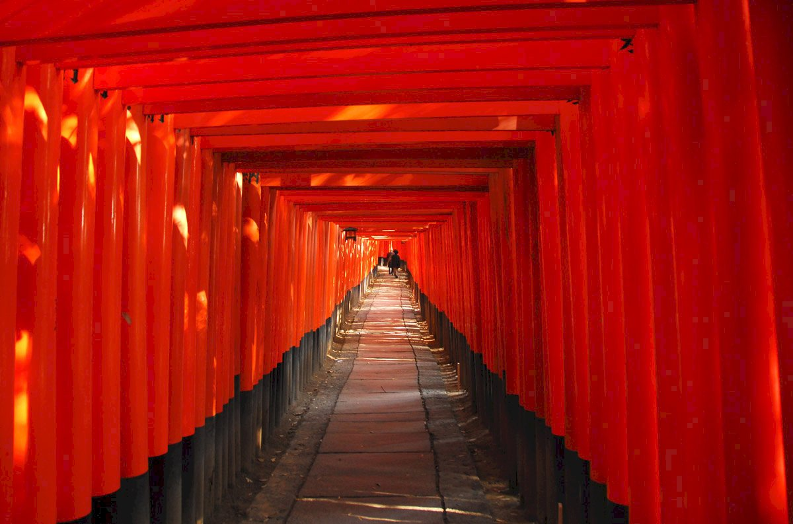
Japan Shrine & Temple Navigator:
Personalized Guidance with GPT & Interactive Maps
2025/05/16
Advisor：Yi-Chung Chen
Members： Po-Yuan Chu, Bo-Min Zheng

Slide 2

Progress
Flowchart
Dataset
Expect Results
Conclusion
This week, we've completed the following:
Established the initial version of shrine introduction information: We've compiled and drafted the preliminary content for introducing shrines.
Planned the anticipated presentation effects: We've also conceived and planned how this information will be presented to users in the future.
Notes:
本週進度如下：
初步完成神社／寺廟介紹資訊的建立
規劃了預期的展示效果
Here’s what we got done this week:
We built the first version of the shrine introduction content.
We planned out how we want the final presentation to look.

Slide 3
Progress
Flowchart
Dataset
Expect Results
Conclusion
Part I
Data Collection
Web Scraped Data
Data Cleaning
Content Standardization
Format Conversion
Organize and retain desired information
Use GPT to
format output
Convert to Markdown
Data Collection
Government
Open Data
Part II
Data Vectorization
Map Construction
Model Application
Input into vector database
Create interactive map
Build Japanese temple Q&A system
Notes:
附圖為我們根據上次會議討論內容整理出的實驗流程圖。
Here’s the experimental flowchart we put together based on our last meeting discussion.

Slide 4
Progress
Flowchart
Dataset
Expect Results
Conclusion
Part I
Data Collection
Web Scraped Data
Data Cleaning
Content Standardization
Format Conversion
Organize and retain desired information
Use GPT to
format output
Convert to Markdown
Data Collection
Government
Open Data
Part II
Data Vectorization
Map Construction
Model Application
Input into vector database
Create interactive map
Build Japanese temple Q&A system
Notes:
本次的進度主要聚焦於資料收集（Data Collection）與資料清理（Data Cleaning），接下來的說明會進一步介紹我們的處理細節。
This time, we focused on data collection and data cleaning. We’ll go over the details of how we handled these in the following section.

Slide 5
Progress
Flowchart
Dataset
Expect Results
Conclusion
Fukui Prefecture Shrine Information Collection Progress
We've currently gathered over 10+ pieces of information regarding shrines in Fukui Prefecture.
The collected information is formatted as follows…
Notes:
在資料處理方面，我們目前已蒐集超過 10 筆關於福井縣神社的相關資訊。 這些資料已依照以下格式進行整理……
As for data processing, we’ve now gathered over 10 pieces of information on shrines in Fukui Prefecture. The data has been organized in the following format...

Slide 6
Progress
Flowchart
Dataset
Expect Results
Conclusion
Shrine’s Data Format
Official Website [Insert the official website URL of the shrine here]
Historical Introduction [Briefly introduce the shrine's historical background, significant status.]
Main Prayer Themes
4. Visiting & Service Hours
Enshrined Deity | Scope of Prayers
[Deity Name 1] | [Prayer Scope 1]
[Deity Name 2] | [Prayer Scope 2]
… | …
Category/Item | Hours/Description | Notes
Gate Opening/Closing | April–September: 05:00–17:00 / Open 24/7 | …
Amulet/Shrine Office | 08:45–16:45 / 10:00–15:00 | …
… | … | …
Notes:
我們整理神社資訊時，採用以下欄位格式：
Here’s the format we’re using to organize shrine information:
官方網站：填入神社的官方網站連結。
First,Official Website – The URL link to the shrine’s official site.
歷史簡介：簡要介紹神社的歷史背景與重要地位。
Second,Historical Introduction – A short background on the shrine’s history.
主要祈福主題：說明神社主要祈求的願望類型（如健康、學業、交通安全等）。
Third,Main Prayer Themes – What people typically pray for at the shrine (e.g., health, success, safety).
參拜與服務時間：標示可參拜時間及是否提供御守、抽籤等服務。
Fourth,Visiting & Service Hours – Information about visiting times and available services like charms or fortune slips.

Slide 7
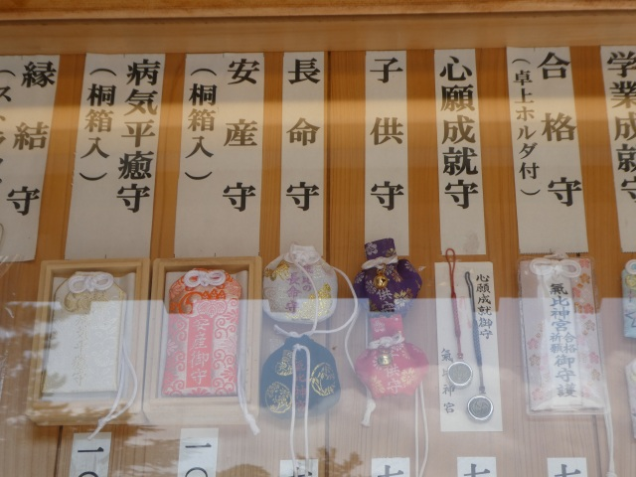
Progress
Flowchart
Dataset
Expect Results
Conclusion
Example1：Kehi Jingu Information
Official Website：https://kehijingu.jp/
Historical Introduction：The main enshrined deity of Kehi Jingu is Isasawake-no-Mikoto. With a long history,…。
Main Prayer Themes
4. Opening Hours
Enshrined Deity | Scope of Prayers
Isasawake-no-Mikoto | Family Safety, Business…
Emperor Chuai | Ward Off Evil, Good Health
… | …
Category/Item | Hours/Description | Notes
Gate Hours | Apr.–Sep.: 05:00–17:00 Mar.: 06:00–17:00 | …
Amulet Office | 08:45–16:45 | …
… | … | …
5. Merchandise Sold
Notes:
以下是我們所設計的神社資訊格式，以「氣比神宮（Kehi Jingu）」為範例，內容包含官方網站連結、歷史介紹、營業時間，以及主要販售物品類型等資訊。
Here’s the standard format we use to present shrine information, using Kehi Jingu as an example. It includes the official website, a historical introduction, opening hours, and details on items available for purchase.

Slide 8
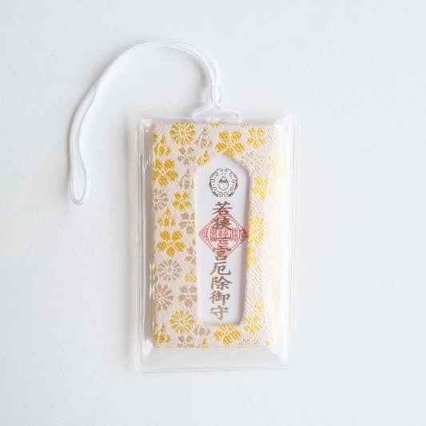
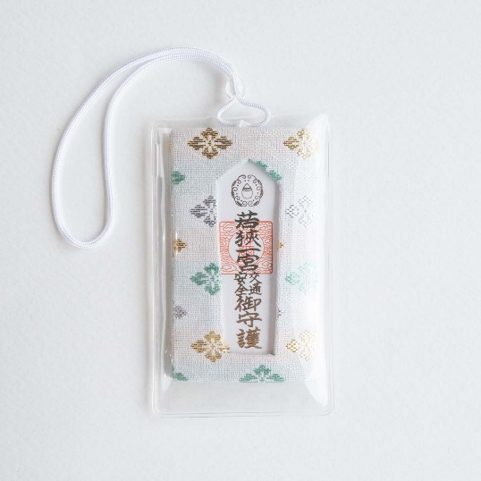
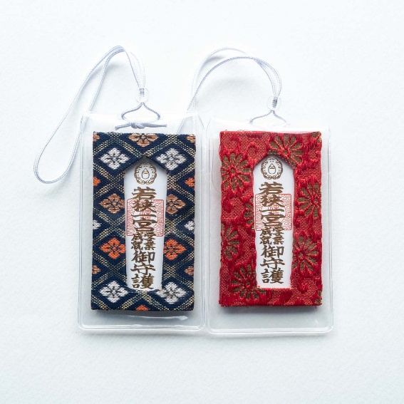
Progress
Flowchart
Dataset
Expect Results
Conclusion
Example1：Wakasahiko Shrine Information
Official Website：https://wakasahiko-jinja.jp/
Historical Introduction："Wakasa no Kuni Ichinomiya," representing the most significant shrines in the Wakasa…
Prayer Themes
4. Opening Hours
Enshrined Deity | Scope of Prayers
… | Ward Off Evil
… | Safe Childbirth
… | …
Category/Item | Hours/Description | Notes
Gate Hours | Open 24/7 | …
Amulet Office | 10:00 – 15:00 | …
… | … | …
5. Merchandise Sold
Notes:
接下來這部分則是範例二：「若狹彥神社（Wakasahiko Shrine）」的資訊整理。
The next example shows the information format for Wakasahiko JinJa.

Slide 9
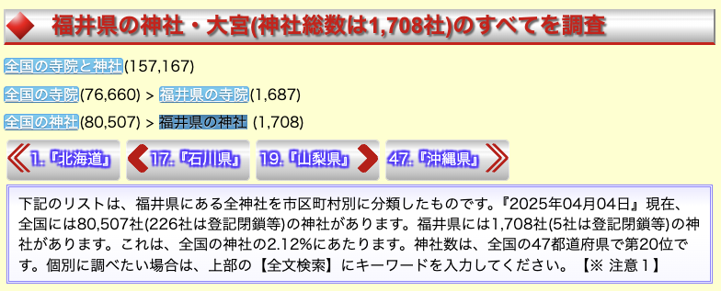
Progress
Flowchart
Dataset
Expect Results
Conclusion
Data Collection Challenges and Solutions
Current Situation Overview
During the process of collecting data on shrines in Fukui Prefecture, we found that manual searching is indeed very time-consuming.
Furthermore, according to our reference materials (Link1, Link2), there are over 1,700 shrines in Fukui Prefecture, which further highlights the inefficiency of traditional collection methods.
Link1：https://www.fukuishimbun.co.jp/articles/-/1974368
Link2：https://www.saikouji.com/BukySaikou/Shrine/ShrSaikou18/PreShrPNo18.html
Notes:
在資料處理的過程中，我們目前面臨的最大挑戰是：景點資訊仍需仰賴人工逐一搜尋與整理，這相當耗時且容易產生疏漏。
One of the biggest challenges we’re facing in data processing is that collecting information on each tourist spot still requires a lot of manual effort, which is both time-consuming and easy to make mistakes.
甚至透過下方的資料來源，我們進一步發現光是在福井縣，登記在案的神社數量就超過 1,700 間，這也說明了為何人工蒐集資訊會變得更加困難與耗時。
What’s more, based on the link below, we found that there are over 1,700 shrines registered in Fukui Prefecture — which makes manual data collection even more challenging and time-intensive.

Slide 10
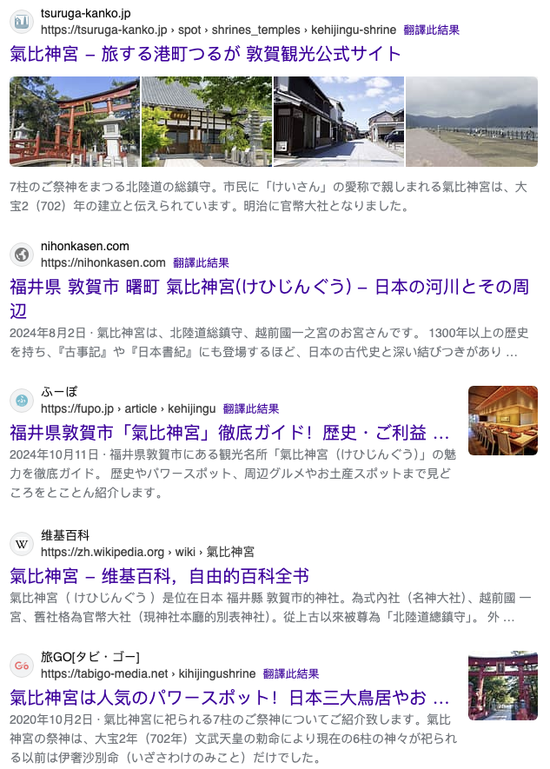



Progress
Flowchart
Dataset
Expect Results
Conclusion
Data Collection Challenges and Solutions
Solution
To significantly accelerate the search for shrine information, we will utilize Google Search Engine and ChatGPT 4o-mini for data retrieval and processing.
Official Website：…
Historical Introduction：…
Main Prayer Themes：…
Opening Hours：…
Transfer Format
Google Seach Engine
GPT 4o-mini
気比神宮
Notes:
為了解決上述人工蒐集資訊耗時的問題，我們決定利用 Google 搜尋引擎，查找與神社相關的熱門文章，並將搜尋結果中的內容交由 GPT-4o mini 進行格式轉換，使其符合我們預設的資訊架構。
To address the time-consuming of data collection, we decided to use Google Search to find popular articles related to shrines. We then used GPT-4o mini to reformat the content into our predefined structure.

Slide 11
Progress
Flowchart
Dataset
Expect Results
Conclusion
Base on our data, what will provide for user?
Notes:
在完成上述資料蒐集與格式化處理後，我們也進一步思考：該如何將這些資訊有效地呈現給使用者。 Building on the collected and reformatted data, we’ve also started thinking about how to deliver this information to users.
目前的方向是透過視覺化的網頁介面，讓使用者能夠快速查詢、瀏覽神社資訊，並根據地理位置或主題類別進行篩選與探索。
Our current approach is to design a visual,and user-friendly web interface, where users can easily browse shrine information, and filter results based on location or prayer theme.

Slide 12
Progress
Flowchart
Dataset
Expect Results
Conclusion
Two core features of our project
1
AI Knowledge Expert
2
Interactive Map Exploration
Users can ask questions and we answers about shrine history, customs, and cultural meanings
User can easily discover shrines that match their interests on the map.
Notes:
首先，我們將針對上次的 AI 小幫手成果進行展示與說明。
To start, we’ll present the results from our previous AI assistant prototype.

Slide 13
Progress
Flowchart
Dataset
Expect Results
Conclusion
Two core features of our project
1
AI Knowledge Expert
2
Interactive Map Exploration
Users can ask questions and we answers about shrine history, customs, and cultural meanings
User can easily discover shrines that match their interests on the map.

Slide 14
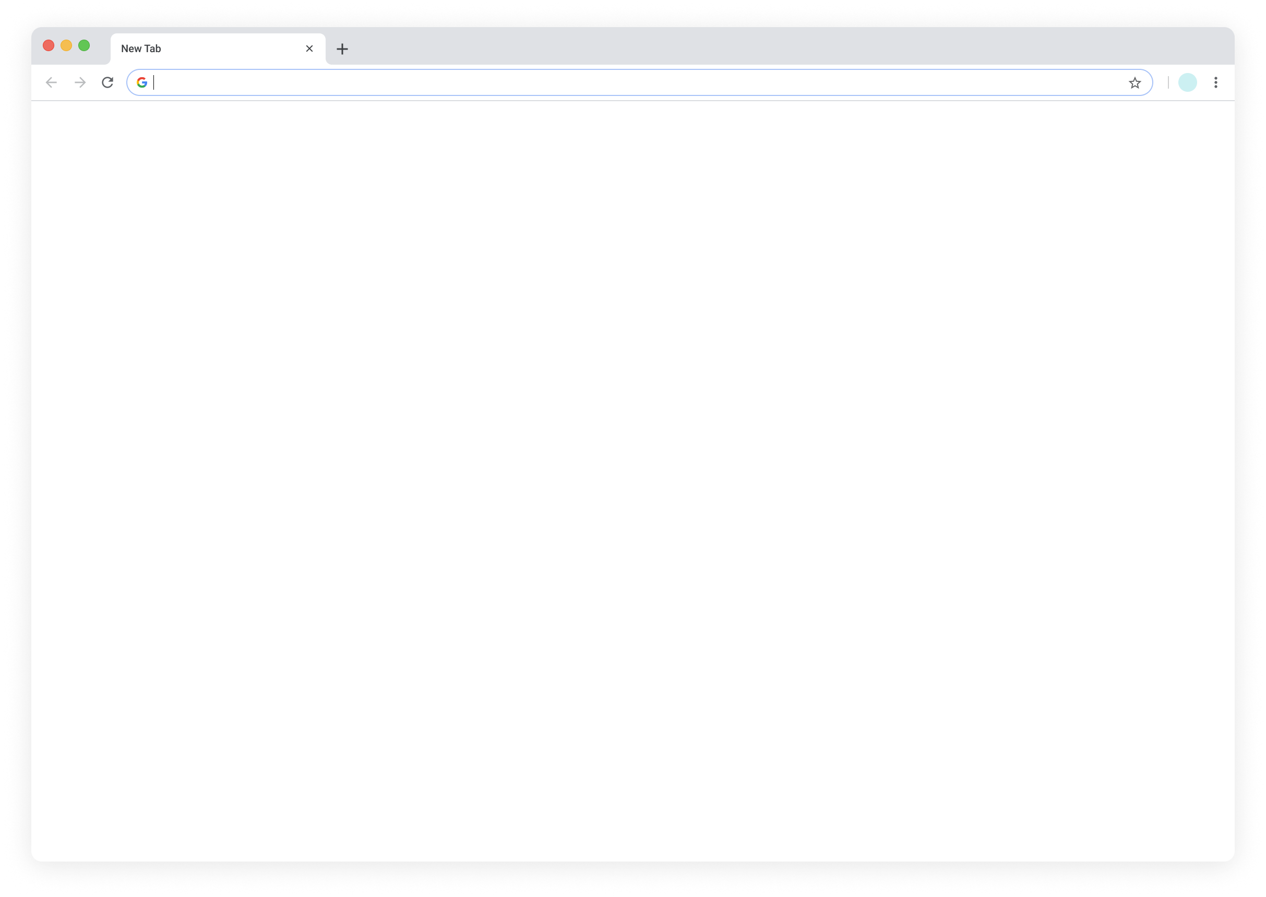
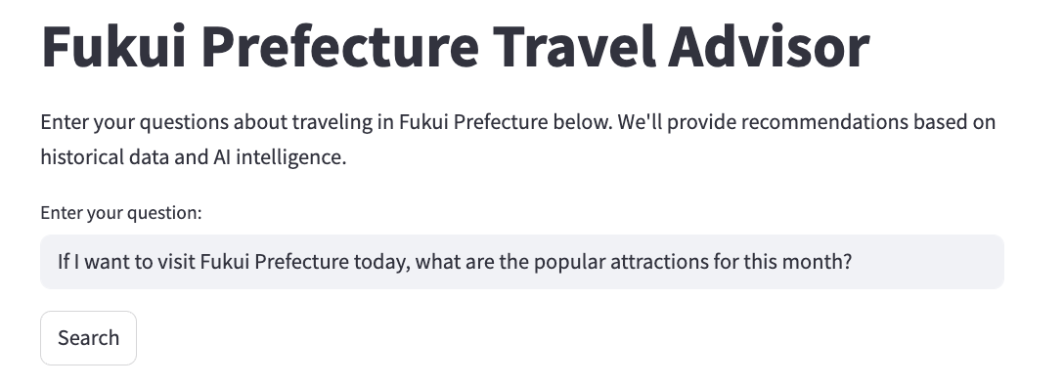
Background
Objectives
Dataset
Flowchart
Expect Results
Conclusion
AI Shrine & Temple Knowledge Expert
Have any questions about the history, culture, worship methods, or main deities of Japanese shrines and temples? The AI assistant will answer based on our knowledge base
Enter your question:
気比神宮
気比神宮（けひじんぐう）を紹介（しょうかい）してください。
Official Website：…
Historical Introduction：…
Main Prayer Themes：…
Opening Hours：…
Merchandise：
Answer：
…
…
…
…
…
Notes:
當使用者詢問「氣比神宮」的相關資訊時，系統會根據我們事先整理好的資料格式，自動進行語句潤飾，並以清晰易讀的方式輸出給使用者參考。
When a user asks for information about Kehi Jingu, the system will retrieve the pre-formatted data we’ve prepared, refine the wording, and present it in a clear and user-friendly way.

Slide 15
Progress
Flowchart
Dataset
Expect Results
Conclusion
Two core features of our project
1
AI Knowledge Expert
2
Interactive Map Exploration
Users can ask questions and we answers about shrine history, customs, and cultural meanings
User can easily discover shrines that match their interests on the map.
Notes:
接下來，我們將展示具備互動功能的地圖介面，讓使用者能夠透過地理位置視覺化地探索各個神社資訊。
Next, we’ll showcase the interactive map interface, which allows users to explore shrine information visually based on geographic location.

Slide 16
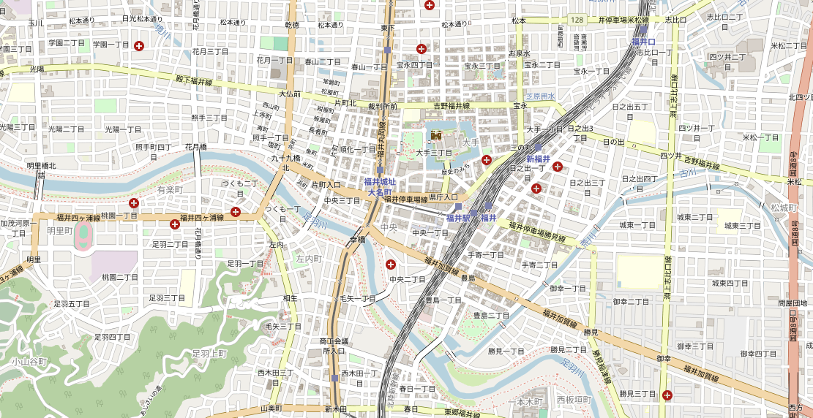
Background
Objectives
Dataset
Flowchart
Expect Results
Conclusion
Shrine/Temple History...
📖 Historical Introduction
🔖 Main Prayer Themes
⏰ Opening Hours
🛍️ Merchandise Sold
Notes:
在互動式介面中，使用者可以更直覺地透過地圖查詢各個神社的基本資訊，點選地圖上的標記即可快速瀏覽每間神社的簡要介紹。
With the interactive interface, users can intuitively explore basic information about each shrine by simply clicking on map markers to view a brief overview.

Slide 17
Background
Objectives
Dataset
Flowchart
Expect Results
Conclusion
Validation Metrics
Based on our last meeting, we aim to provide a more intuitive verification method.
Question | Response | This Info. Is Useful?
 |  | Useful | Unuseful
… | … | … | …
… | … | … | …
This organized format will serve as a tool,
allowing us to manually verify, or have the professor confirm…
we’ll compile all questions and outputs into a CSV or Excel file for easy review and assessment.
Notes:
延續上次在驗證指標方面的討論，本週我們針對「如何評估系統回覆的品質」有了新的想法。
Following up on the evaluation metrics we discussed last time, we’ve developed some new ideas this week.
我們將根據事先設定的問題情境，透過系統的回答內容，讓教授或我們自身進行主觀評分，以判斷輸出結果的好壞。 We plan to use a set of predefined questions and evaluate the system’s responses based on their quality—either by ourselves or with feedback from our professor.
未來我們也會整理所有問題與回覆結果，提供 CSV 或 Excel 檔案格式，方便教授進行檢視與回饋。
Later on, we’ll compile all questions and outputs into a Excel file for easy review and assessment.

Slide 18
Background
Objectives
Dataset
Flowchart
Expect Results
Conclusion
This Week's Conclusion
Finalized the preliminary training data format.
Next meeting we will expanded the current dataset size.
The search method will use of Google Search and ChatGPT to automate data organization.
Notes:
本週我們已完成訓練資料的格式設計。 下週將持續擴充資料集，並透過 Google 搜尋引擎與 ChatGPT 協助進行內容蒐集與格式整理。
This week, we finalized the format for our training data. Next week, we’ll continue expanding our dataset with the help of Google Search and ChatGPT to gather and structure the content.

Slide 19
Thank you!
2025/06/06

Slide 20
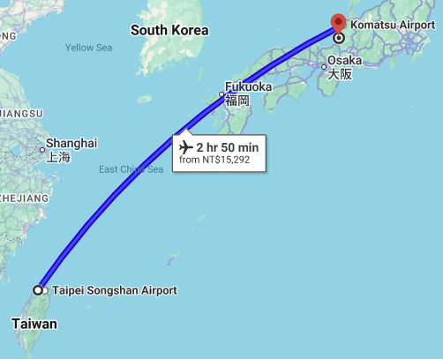
Background
Objectives
Dataset
Flowchart
Expect Results
Conclusion
We anticipate arriving in Japan on July 14th. At that time, we will contact the professor regarding meeting arrangements or any other related matters.
Notes:
另外，老師您好，我們預計將於 7 月 14 日抵達日本。 未來若有任何與會議或專題相關的問題，我們會再透過電子郵件與您聯繫，並向您報告進度。
Also, Professor, we’re planning to arrive in Japan on July 14. If there are any updates or questions regarding the project or upcoming meetings, we’ll be sure to reach out to you via email.

