Slide 1
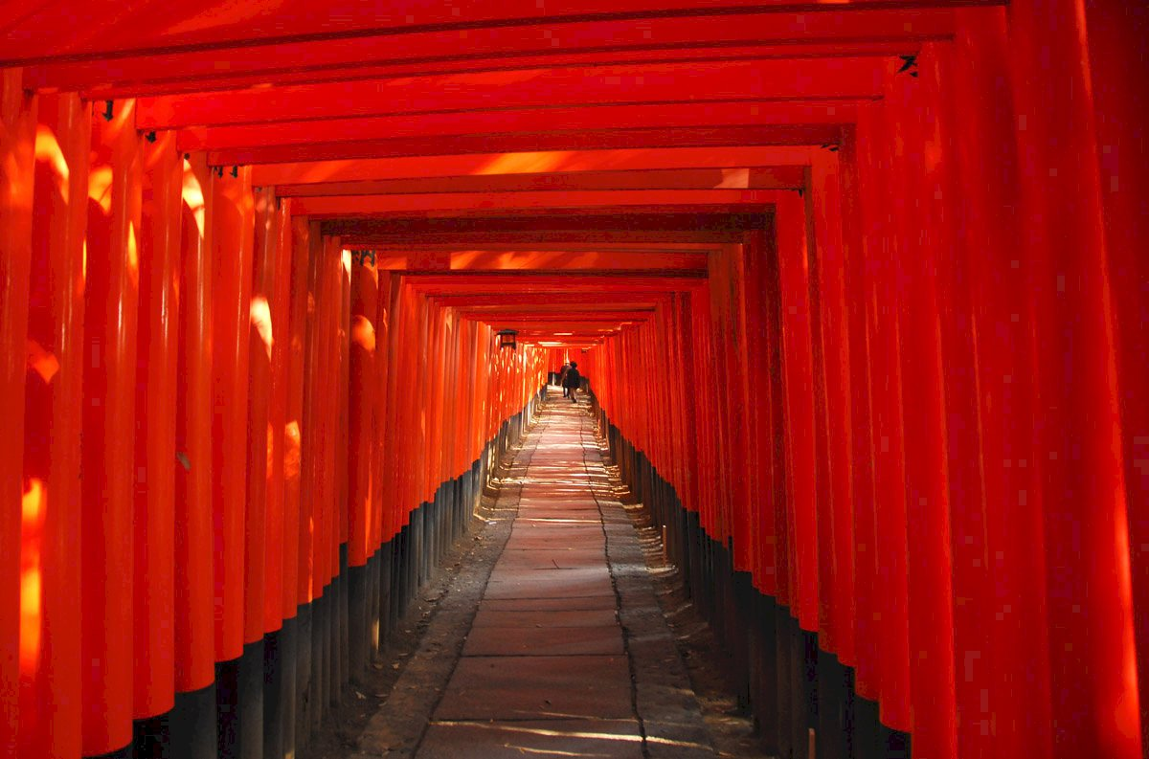
Before the meeting
The main agenda for today's meeting is to report on the progress and planning of the project we are preparing for our presentation in Fukui this July.
Notes:
由於教授目前正在接待來訪的國外學者，可能無法出席今天的會議。因此，我想我們可以開始今天的會議了。
As the professor is currently hosting visiting scholars from abroad, may not be able to attend today's meeting. Therefore, should we can begin today's meeting.

Slide 2
Question
With the conclusion of the ICASI conference, discussions on the two topics of "Travel Recommendation" and "Poster Design" have come to a successful close. Next, we will begin to organize the outcome reports for these two summer projects, and we will also provide the source code for this ICASI project later. If here is anything further prof. would like us to supplement or adjust regarding these two topics in ICASI?

Slide 3
Japan Shrine & Temple Navigator:
Personalized Guidance with GPT & Interactive Maps
2025/05/16
Advisor：Yi-Chung Chen
Members： Po-Yuan Chu, Bo-Min Zheng
Notes:
關於我們今天報告的這兩個主題，未來各組在報告時，也將會是由兩位組員負責。
Regarding the two topics we are presenting today, in the future, when other groups present on these topics, they will also have two members responsible for them.

Slide 4







Background
Objectives
Dataset
Flowchart
Expect Results
Conclusion
Discoveries from the ICASI Conference Journey…
Confusing
Worship Rules
Not Understanding Prayer Themes
Missed Special Charms/Souvenirs
Language Barrier
Unclear about the correct worship procedures, worried about being impolite.
Not knowing what specific shrines/temples mainly offer blessings for (e.g., career, love).
Only discovering desired special charms or prayer items after the visit.
Japanese information is not easy to understand, diminishing the in-depth experience.
Notes:
好，關於專案背景，主要來自我們參加ICASM會議時的觀察。
Okay, regarding the project background, it mainly stems from our observations during the ICASI conference.
首先，很多人對日本神社的參拜規矩感到困惑，怕失禮。
First, many people find the worship rules at Japanese shrines confusing and worry about being impolite.
其次，大家常不清楚各神社主要祈求什麼主題，例如事業或愛情。
Second, it‘s common for people to be unsure about the main prayer themes of each shrine, like for academic or love.
再來，就是容易錯過特色的御守或紀念品，常常是離開後才發現。
Then, it's easy to miss out on special charms or souvenirs, often realizing it only after leaving.
最後，語言不通是一大問題，日文資訊多，影響深度體驗。
Lastly, the language barrier is a significant issue, as much of the information is in Japanese, which impacts the in-depth experience.

Slide 5

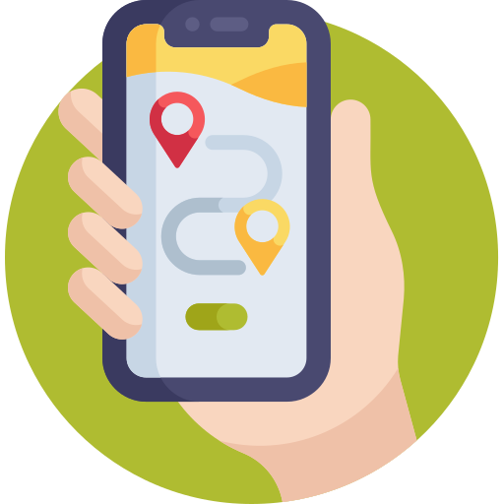


Background
Objectives
Dataset
Flowchart
Expect Results
Conclusion
Challenges of Existing
Information Channels
1
Outdated information, incomplete coverage.
Guidebooks
When visiting Japanese shrines and temples, information sources are often lacking: guidebooks are outdated, map apps are shallow, online resources are unreliable, and language barriers—mainly in Japanese—limit access to cultural insights, affecting the overall experience.
Mostly basic navigation, lacking in-depth cultural information.
2
Map Apps
Scattered blog/website info, inconsistent quality, lacks integration.
3
Web
Most detailed information is still primarily in Japanese, making it difficult to understand.
4
Language Barrier
Notes:
延續剛剛提到的問題，我們發現，在規劃日本神社寺廟行程時，現有的資訊管道其實有不少挑戰。
Continuing from the issues just mentioned, we found that when planning trips to Japanese shrines and temples, current information channels present quite a few challenges.
首先，傳統的旅遊指南，內容常常過時，而且涵蓋不夠全面。
First, traditional guidebooks often have outdated information and incomplete coverage.
再來，手機上的地圖App，大多只有基本的導航功能，缺乏深度的文化介紹。
Next, map apps on our phones mostly offer only basic navigation, lacking in-depth cultural information.
然後，如果上網找資料，會發現資訊很分散，品質參差不齊，而且缺乏整合。
Then, if you search for information online, you'll find it's very scattered, the quality is inconsistent, and it lacks integration.
最後，還是老問題，最重要的詳細資訊，很多都還是日文的，理解起來很困難。
Finally, it's the same old problem: much of the most detailed information is still primarily in Japanese, making it difficult to understand.
這些問題都限制了我們對文化深層的認識，影響了整體的旅遊體驗。
All these issues limit our access to deeper cultural insights and affect the overall travel experience.

Slide 6



Background
Objectives
Dataset
Flowchart
Expect Results
Conclusion
Objectives of This Project
For Users (Tourists): Enable efficient trip planning and deep cultural exploration. Overcome language barriers, discover unique content, and enhance the overall Japan travel experience, enjoyment, and value.
For Cultural Promotion: Promote Japanese religious culture internationally through an innovative digital education and communication platform. Deepen global understanding, appreciation, and cultural exchange regarding its unique values.
For Tourism Industry: Enhance regional charm and attractiveness by providing rich, in-depth tourism content. Effectively guide tourist flow, revitalize local economies, and inject new momentum and sustainable value into the tourism industry.
Notes:
所以，基於前面提到的這些挑戰，我們這個專案設定了幾個主要目標，希望能從不同層面帶來幫助。
So, based on the challenges we just discussed, our project has set several main objectives, aiming to provide benefits on different levels.
首先，對一般使用者，也就是遊客來說，我們希望他們能更有效率地規劃行程，並進行更深度的文化探索。目標是幫助大家克服語言隔閡，發掘一些獨特的景點內容，全面提升日本旅遊的體驗、樂趣和價值。
First, for users, meaning tourists, we want to enable them to plan their trips more efficiently and engage in deeper cultural exploration.
The goal is to help everyone overcome language barriers, discover unique content, and enhance the overall Japan travel experience, enjoyment, and value.
其次，在文化推廣方面，我們希望透過一個創新的數位平台，向全世界推廣日本的宗教文化。加深大家對這些文化獨特價值的理解、欣賞，並促進文化交流。
Second, in terms of cultural promotion, we aim to promote Japanese religious culture internationally through an innovative digital platform. We want to deepen global understanding and appreciation of its unique values and foster cultural exchange.
最後，對整體觀光產業而言，我們希望能提供豐富深入的旅遊內容，提升各個地區的魅力和吸引力。透過有效引導遊客，活絡地方經濟，為觀光業注入新的活力和永續發展的價值。
Finally, for the tourism industry as a whole, we hope to provide rich, in-depth tourism content to enhance regional charm and attractiveness.
By effectively guiding tourists, we help boost the local economy and bring new energy and sustainable value to the tourism industry.

Slide 7




Background
Objectives
Dataset
Flowchart
Expect Results
Conclusion
Government Open Datasets | Travel Websites | Other Websites
e-Gov Data Portal | matcha-jp.com | Wikipedia
e-Stat | jalan.net | -
Official Websites | Tripadvisor | -
This project integrates government open data (e-Gov, e-Stat) and authoritative facts from official websites, real user experiences from travel platforms (matcha-jp.com, jalan.net, Tripadvisor), and background context from Wikipedia. The aim is to provide accurate, practical, and in-depth cultural tourism information.
Notes:
為了達到我們的目標，資料的蒐集與整合非常重要。這一頁大家可以看到我們主要的資料來源。我們主要整合了三方面的資料：
To achieve our goals, data collection and integration are crucial. On this slide, you can see our main data sources. We primarily integrate data from three areas:
第一是政府的開放資料，像是e-Gov資料平台、e-Stat統計數據，以及各神社寺廟的官方網站，這些能提供比較權威性的事實。
First, government open datasets, like the e-Gov Data Portal, e-Stat statistics, and official websites of shrines and temples, which provide reliable information.
第二是來自各大旅遊網站，例如matcha-jp、jalan.net和Tripadvisor，這些平台上有許多真實的用戶體驗和評價。
Second, data from major travel websites, such as Tripadvisor, these platforms offer many real user experiences and reviews.
最後，我們也參考了其他網站，像是維基百科，來獲取一些背景知識。
Finally, we also reference other websites, like Wikipedia, to gather background context.
我們專案的核心概念，就是把這些來自官方、使用者以及百科的資訊整合起來，目標是提供給大家既準確、又實用，而且有深度的文化旅遊資訊。
The core concept of our project is to integrate this information from official sources, user experiences, and Wikipedia.
Our aim is to provide everyone with cultural tourism information that is accurate, practical, and in-depth.

Slide 8
Background
Objectives
Dataset
Flowchart
Expect Results
Conclusion
Part I
Data Collection
Web Scraped Data
Data Cleaning
Content Standardization
Format Conversion
Organize and retain desired information
Use GPT to
format output
Convert to Markdown
Data Collection
Government
Open Data
Part II
Data Vectorization
Map Construction
Model Application
Input into vector database
Create interactive map
Build Japanese temple Q&A system
Notes:
接下來，這張流程圖展示了我們系統的主要運作方式，大致可以分成兩個部分。
Next, this flowchart shows the main workflow of our system, which can be broadly divided into two parts.
第一部分主要是資料的處理。
The first part is mainly about data processing.
我們會先從網路爬取資料以及收集政府的開放資料。接著，進行資料清理，把需要的資訊整理出來。
We start by collecting data through web scraping and from government open data sources.
Then, we perform data cleaning to organize and retain the desired information.
然後，透過GPT來做內容的標準化，讓格式統一。 最後，再將這些資料轉換成Markdown格式，方便後續使用。
After that, we use GPT "Make the format consistent.
Finally, we convert this data into Markdown format for subsequent use.
第二部分則是系統的建置與應用。
The second part focuses on system construction and application.
首先，我們會將處理好的資料進行向量化，輸入到向量資料庫中。 然後，利用這些資料來建置互動式地圖。
First, we vectorize the processed data and input it into a vector database. Then, we use this data to construct an interactive map.
最終，則是應用這些模型，打造出我們的日本寺廟問答系統。
And ultimately, we apply these models to build our Japanese temple Q&A system.

Slide 9
Background
Objectives
Dataset
Flowchart
Expect Results
Conclusion
Two core features of our project
1
AI Knowledge Expert
Users can ask questions in Chinese or other languages and receive instant, in-depth answers about shrine history, customs, and cultural meanings—making each visit more meaningful.
2
Interactive Map Exploration
User can easily discover shrines that match their interests on the map. Each click reveals rich details, unique highlights, and historical insights—making trip planning intuitive and exploration more engaging.
Notes:
接著，我們聚焦在專案的兩大核心功能
Next, let's focus on the two core features of our project.
第一，是『AI知識專家』。
First, the 'AI Knowledge Expert.
簡單說，就是您的隨身神社顧問。有任何疑問，直接問，AI立刻用中文回答，解決您看不懂、找不到資訊的困擾。
it‘s your personal shrine consultant. Ask any question, and the AI instantly answers in your preferred language, solving problems of understanding or finding information.
第二，是『互動地圖探索』。
Second, 'Interactive Map Exploration.’
您可以依主題快速篩選神社，點擊地圖就能看詳細介紹，包括歷史、特色等。讓您輕鬆規劃，深度遊覽。
You can quickly filter shrines by theme and click on the map for detailed info, including history and unique features. Plan easily and explore deeply.

Slide 10
Background
Objectives
Dataset
Flowchart
Expect Results
Conclusion
Two core features of our project
1
AI Knowledge Expert
Users can ask questions in Chinese or other languages and receive instant, in-depth answers about shrine history, customs, and cultural meanings—making each visit more meaningful.
2
Interactive Map Exploration
User can easily discover shrines that match their interests on the map. Each click reveals rich details, unique highlights, and historical insights—making trip planning intuitive and exploration more engaging.
Notes:
Let’s begin with Module 1: the AI Knowledge Expert.

Slide 11
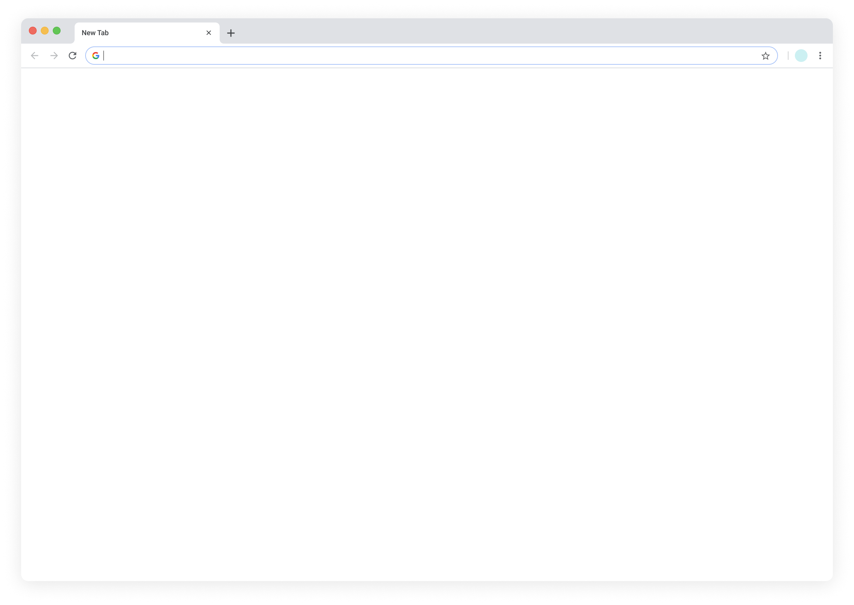
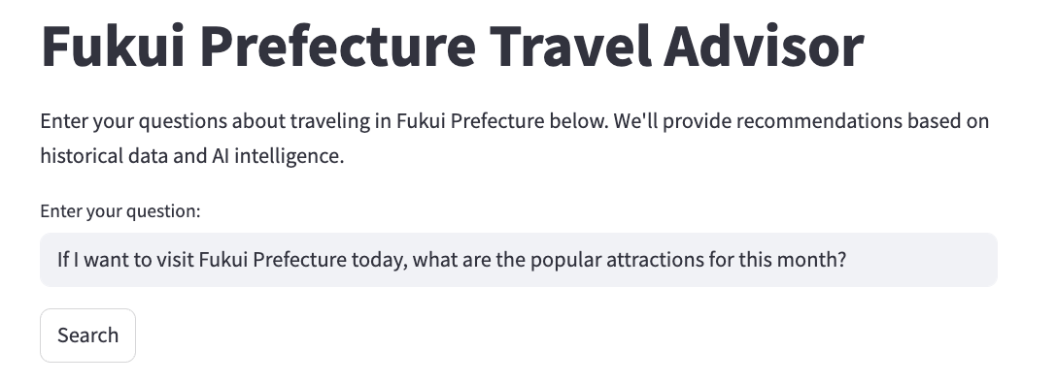
Background
Objectives
Dataset
Flowchart
Expect Results
Conclusion
AI Shrine & Temple Knowledge Expert
Is there anything special about the worship method at Tokyo Daijingu? Are there any recommended omamori
Have any questions about the history, culture, worship methods, or main deities of Japanese shrines and temples? The AI assistant will answer based on our knowledge base
Enter your question:
Regarding the "Otowa Waterfall" at Kiyomizu-dera Temple, what blessings do the three streams of water represent respectively?
What is the correct worship order at Senso-ji Temple?
Answer：
…
…
…
…
…
The ema (votive plaques) at this shrine look very special! But I don't quite understand the Japanese explanation next to it. Could you tell me what one can primarily pray for at this shrine
Notes:
在我們的AI神社寺廟知識專家系統。
In ours AI Shrine & Temple Knowledge Expert system.
使用者如果對日本神社寺廟的歷史、文化、參拜方式，或是主要供奉的神祇有任何疑問，都可以直接提問。我們的AI助理會根據建立好的知識庫來提供解答。
If users have any questions about the history, culture, worship methods, or main deities of Japanese shrines and temples, they can directly ask.
Our AI assistant will provide answers based on our

Slide 12
Background
Objectives
Dataset
Flowchart
Expect Results
Conclusion
AI Shrine & Temple Knowledge Expert
Have any questions about the history, culture, worship methods, or main deities of Japanese shrines and temples? The AI assistant will answer based on our knowledge base
Enter your question:
What is the correct worship order at Senso-ji Temple?
Answers your specific questions & suggests nearby shrines to enhance your discovery.
Answer：
…
…
…
…
…
Notes:
我們的系統提供的推薦結果會直接回應使用者的具體需求，同時也會建議鄰近地區的其他相關神社，以擴展他們的選擇。
Our system provides recommendation results that directly address the user's specific needs, while also suggesting other relevant shrines in nearby areas

Slide 13
Background
Objectives
Dataset
Flowchart
Expect Results
Conclusion
Two core features of our project
1
AI Knowledge Expert
Users can ask questions in Chinese or other languages and receive instant, in-depth answers about shrine history, customs, and cultural meanings—making each visit more meaningful.
2
Interactive Map Exploration
User can easily discover shrines that match their interests on the map. Each click reveals rich details, unique highlights, and historical insights—making trip planning intuitive and exploration more engaging.
Notes:
Then talk about the module2 Interactive Map Exploration

Slide 14
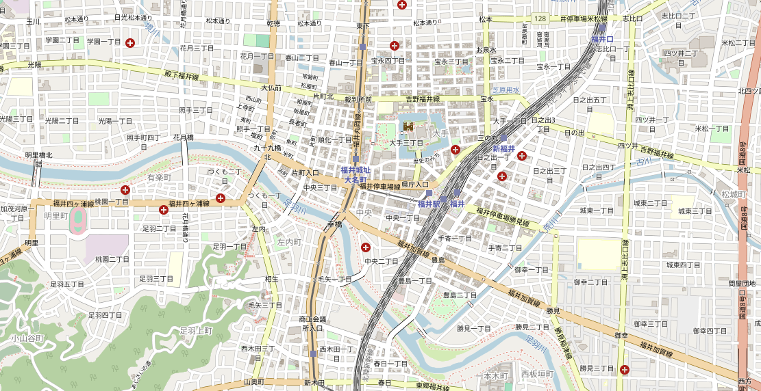


Background
Objectives
Dataset
Flowchart
Expect Results
Conclusion
Interactive Map
Construction
Utilizing Leaflet.js or Mapbox technology, users can conveniently filter by location for specific prayer themes (e.g., love, career, health), quickly find precise targets, and easily obtain personalized worship site guidance.
Notes:
在成果展示的部分，首先是我們的互動式地圖建置。
Moving on to the results, the first highlight is our Interactive Map Construction.
我們主要運用了像是Leaflet.js或Mapbox這樣的技術。透過這個地圖，使用者可以非常方便地依照自己感興趣的特定祈福主題，例如要求愛情、事業或健康等，來篩選地點。
We primarily utilized technologies like Leaflet.js or Mapbox. With this map, users can very conveniently filter locations based on specific prayer themes they are interested in, such as for love, career, or health.

Slide 15
Background
Objectives
Dataset
Flowchart
Expect Results
Conclusion
Shrine/Temple History...
In-depth Cultural
Information
📖 Historical Introduction
🔖 Main Prayer Themes
⏰ Opening Hours
🛍️ Merchandise Sold
Comprehensive details from historical background and main deities to correct worship methods and important cultural tips are provided. This information will effectively help users deepen their cultural understanding and enhance the richness and meaning of their visit.
Notes:
除了地圖功能，我們也非常重視提供深度的文化資訊。
In addition to the map features, we also place great emphasis on providing in-depth cultural information.
如大家在畫面上看到的，點擊地圖上的標示，就能獲得關於神社寺廟的詳細介紹。這包括了它們的歷史背景、主要供奉的神祇、正確的參拜方式，以及一些重要的文化小提示等等。
As you can see on the screen, by clicking on the markers on the map, users can access detailed introductions about the shrines and temples.
This includes their historical background, main deities, correct worship methods, and some important cultural tips, among other things.
我們希望透過這些全面的資訊，能有效地幫助使用者更深入地理解每個地點的文化意涵，進而提升他們參訪的豐富度和意義。
Through this comprehensive information, we hope to effectively help users gain a deeper understanding of the cultural significance of each location, thereby enhancing the richness and meaning of their visit.

Slide 16
Background
Objectives
Dataset
Flowchart
Expect Results
Conclusion
System Curation & Local Empowerment
We first organize and present the data,
Then we provide an update interface for local governments to maintain the content, ensuring it stays timely and locally relevant
(Update the latest event information or merchandise details)
Notes:
關於資料維護
For data maintenance
初期，我們團隊負責整理核心資料。
Initially, our team organizes the core data.
接著，我們會提供更新介面，讓地方政府或神社能自行維護，例如更新最新的活動訊息或周邊商品資訊，確保內容最新、最在地。
Then, we provide an update interface for local governments or shrines to maintain it themselves—
for example, to update the latest event information or merchandise details—ensuring the content is current and locally relevant.

Slide 17
Background
Objectives
Dataset
Flowchart
Expect Results
Conclusion
Validation Metrics
Metric 1: AI Assistant – Accurate & Considerate
Information Accuracy: Compare AI answers with our database's standard answers, striving for high consistency.
User Satisfaction: Evaluate AI answer practicality and overall satisfaction through user feedback.
Metric 2: Shrine/Temple Information – Rich & Clear
Content Coverage: Does the number of Japanese shrines/temples in the app/website meet most users' search needs?
Information Practicality: Is the introduction for each location (including key worship info, cultural background) clear, easy to understand, and applicable for users?
Notes:
為了確保我們系統的品質和實用性，我們設定了兩大類的驗證指標。
To ensure the quality and usability of our system, we've established two main categories of validation metrics.
第一類是針對AI助理的表現，我們希望它能做到「準確與周到」。
The first category focuses on the performance of the AI assistant; we want it to be 'Accurate & Considerate'.
這裡面包含兩個小點：首先是資訊的準確性，我們會比對AI的答案跟資料庫裡的標準答案，看是否一致。其次是使用者的滿意度，透過收集使用者回饋，來評估AI助理的實用性和大家的整體感受。
This includes two points:
first is information accuracy, where we'll compare the AI's answers with the standard answers in our database for consistency.
Second is user satisfaction, evaluated by collecting user feedback on the AI assistant's usability and overall user experience.
第二類是針對神社和寺廟資訊的呈現，目標是「豐富與清晰」。
The second category is about the presentation of shrine and temple information, aiming for it to be 'Rich & Clear’.
這也包含兩點：第一是內容的涵蓋度，確認我們App或網站裡的神社寺廟數量，能不能滿足大部分使用者的搜尋需求。第二是資訊的實用性，也就是每個地點的介紹，包括參拜資訊和文化背景，是不是夠清楚、容易懂，而且對使用者來說是真正有用的。
This also includes two points:
first is content coverage, ensuring that the number of shrines and temples in our app or website meets most users' search needs.
Second is information usability, meaning whether the introduction for each location, including worship information and cultural background, is clear, easy to understand, and Truly useful for users.

Slide 18


Background
Objectives
Dataset
Flowchart
Expect Results
Conclusion
The " Personalized Guidance with GPT & Interactive Maps " leverages interactive maps, AI Q&A, and bilingual cultural content to overcome common travel challenges like scattered information and language barriers. It provides a convenient, personalized tool for users to deeply explore Japan's unique faith and cultural essence.
We anticipate this project will significantly enhance tourist experiences, promote Japanese culture globally, and boost local tourism, offering high practical value. We seek your support to realize this cultural technology vision.
Notes:
最後，來到我們的結論。
Finally, let's move to our conclusion.
我們這個『結合GPT與互動式地圖的個人化指引』專案，主要是利用互動地圖、AI問答和雙語的文化內容，來解決像資訊分散、語言不通這些常見的旅遊痛點。我們希望能提供一個方便又個人化的工具，讓使用者可以深度探索日本獨特的信仰和文化精髓。
Our project, primarily uses interactive maps, AI Q&A, and bilingual cultural content to address common travel pain points like scattered information and language barriers.
We aim to provide a convenient and personalized tool for users to deeply explore Japan's unique faith and cultural essence.
我們期待這個專案能顯著提升遊客的體驗，同時在全球推廣日本文化，並且帶動地方觀光，創造實質的價值。
We anticipate this project will enhance tourist experiences, promote Japanese culture globally, and boost local tourism.

Slide 19
Thank you!
2025/05/16
Notes:
教授，請問您對我們這組的報告有什麼想進一步了解或提問的地方嗎？
Professor, do you have any further questions or anything you'd like to understand about our report?
如果教授沒有其他問題，那我們就準備進行下一組的專題簡報了。
If the professor has no further questions, then we will proceed with the next group's project presentation.

