Slide 1
GWAS & Polygenic Risk Score
Workshop Lead: Yuan Ding
Date: 2025-08-14

Slide 2
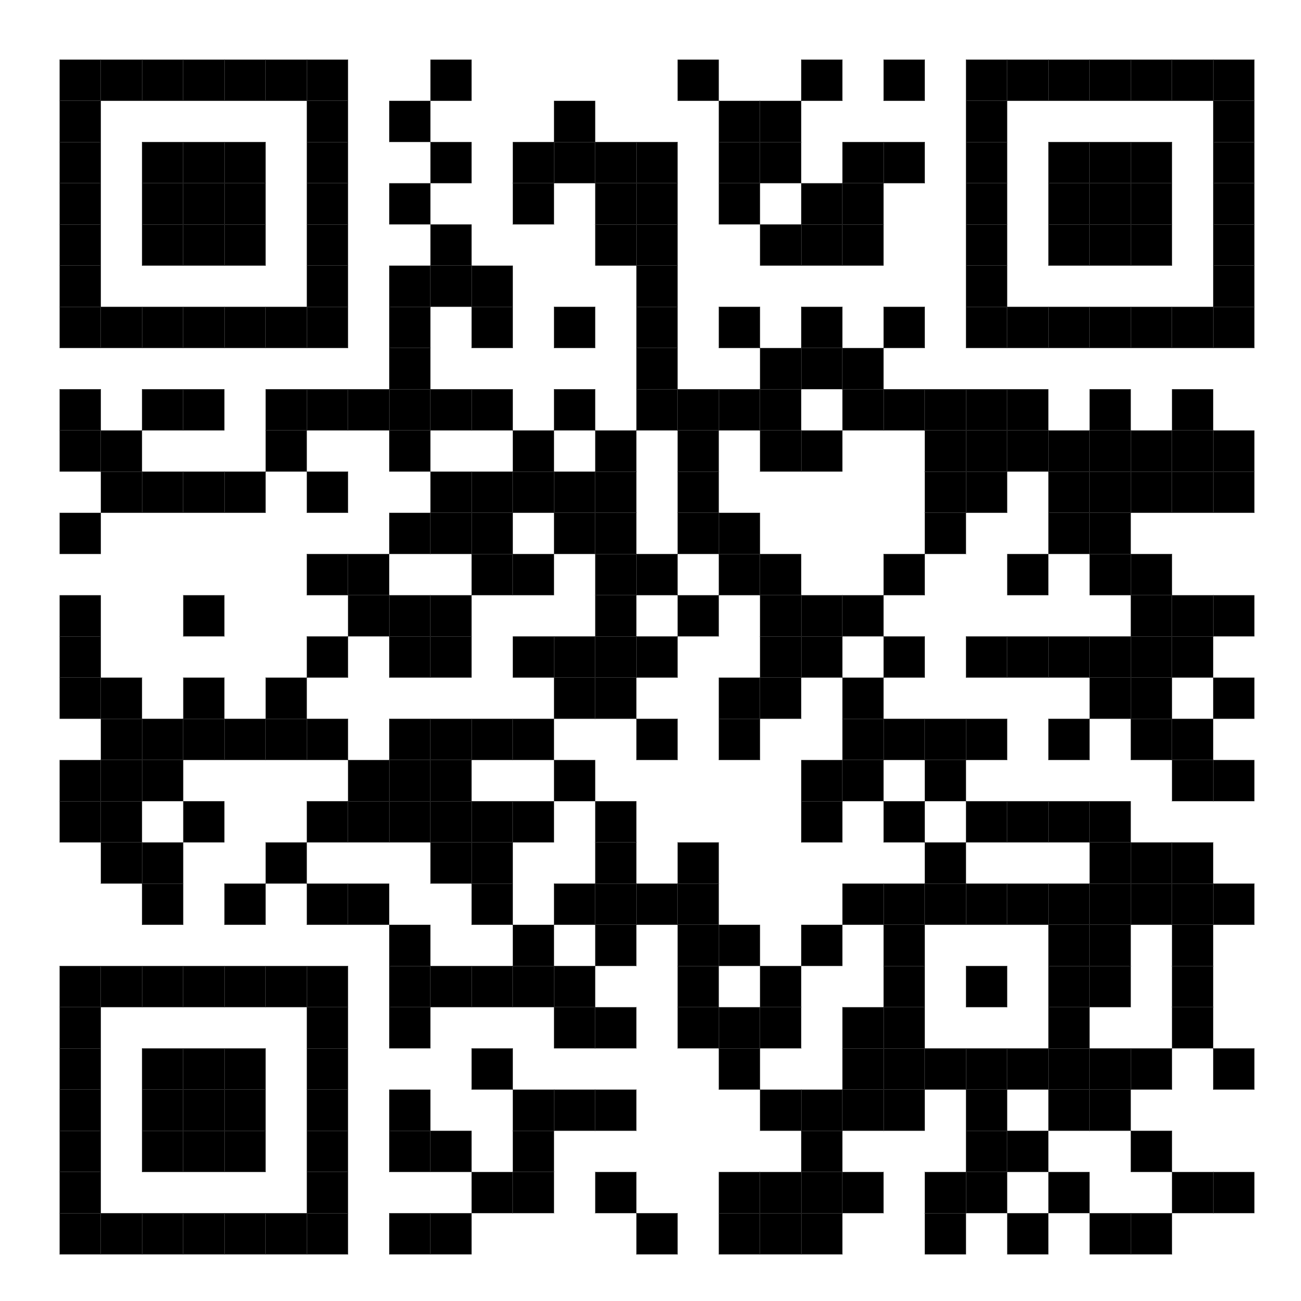
Notes:
The McGill initiative on Computational Medicine was formed in 2017 and aims to deliver inter-disciplinary research programs and empower the use of data in health research and health care delivery
Located at the Genome Center
They have a newsletter were you can subscribe to
more info on the web site

Slide 3
Learning outcomes
Fundamental understanding of GWAS
Fundamental understanding of PRS
Access and interpret GWAS summary statistics.
Compute PRS and interpret results.
Understand the pitfalls and limitations of GWAS and PRS studies.

Slide 4
Outline of this workshop
Part 1. Genome-wide association studies (GWAS)
Part 2. Polygenic risk scores (PRS)
Part 3. Tutorial for PRS of coronary artery disease

Slide 5
Outline of this workshop
Part 1. Genome-wide association studies (GWAS)
Part 2. Polygenic risk scores (PRS)
Part 3. Tutorial for PRS of coronary artery disease

Slide 6
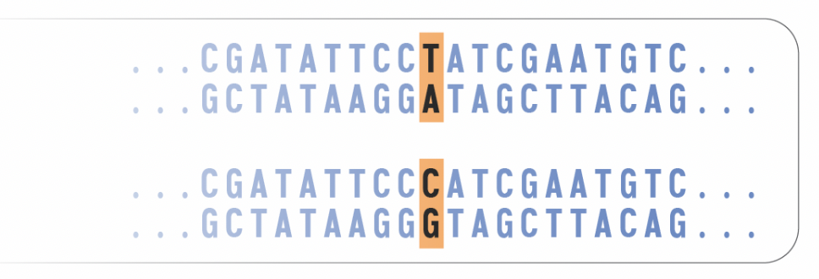
Genetic variants
What are genetic variants?

Slide 7
Genetic variants
SNP
Indels
CNVs
I WILL TAKE A CAR
I WILL TAKE A CAB
I WILL TAKE A CAR
I WILL TAKE A CARBONARA
I WILL TAKE A CAR
I WILL TAKE A CAR A CAR A CAR

Slide 8
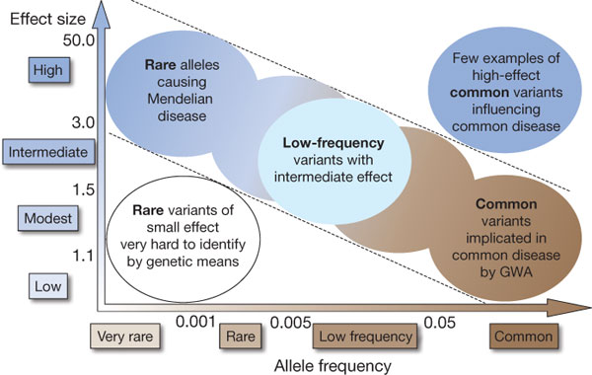
Contribution of genetic variants
Not all variants affect phenotypes equally
Manolio et al. 2009. Nature

Slide 9
Mendelian diseases vs complex traits
Mendelian traits | Complex traits
Large effect size Variants are often deleterious Clear inheritance pattern | Across many genes Variants are often less deleterious Small effect size No distinct inheritance pattern

Slide 10
Mendelian diseases vs complex traits
Mendelian diseases | Complex diseases
Cystic fibrosis Phenylketonuria Color blindness Hemophilia | Obesity Type 2 diabetes Type 1 diabetes Multiple sclerosis Coronary artery disease Schizophrenia

Slide 11
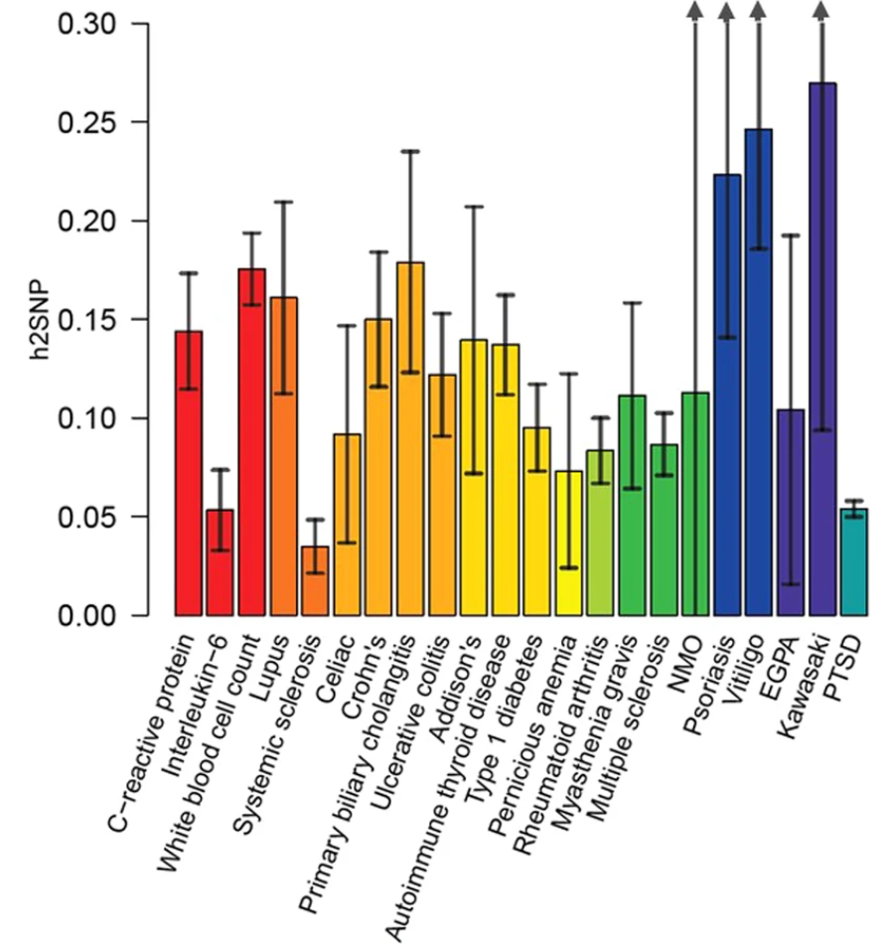
What is SNP-based heritability?
How much phenotypic variance can be explained by SNPs
High SNP-based heritability: common variants play a big role in the genetic architecture of the trait
Maihofer et al. 2024. Translational Psychiatry

Slide 12
What is SNP-based heritability?
SNP heritability does not capture variance explained due to:
Extremely rare variants
Structural variants
Epigenetic modifications
Gene-gene and gene-environment interactions

Slide 13
Capturing variants across the genome
Whole-genome sequencing | Genotyping
DNA is fragmented, sequenced, and aligned Annotate aligned reads to identify SNPs | DNA hybridizes to microarray chips with probes to known SNPs When DNA is hybridized (binds to probe), it generates a fluorescent signal The intensity of the signals is processed Variants are annotated against reference genome

Slide 14
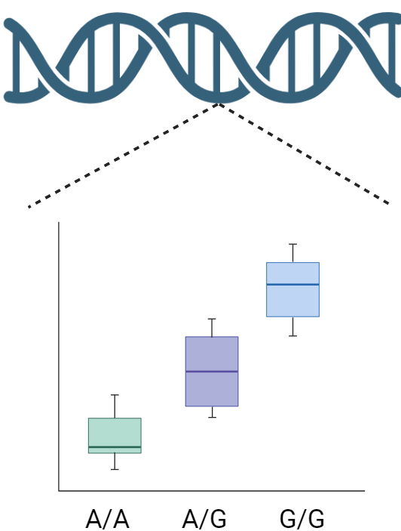

Genome-wide association studies
Goal: test the effect of genetic variants on a trait/disease
Continuous traits: linear regression
Binary traits: logistic regression

Slide 15
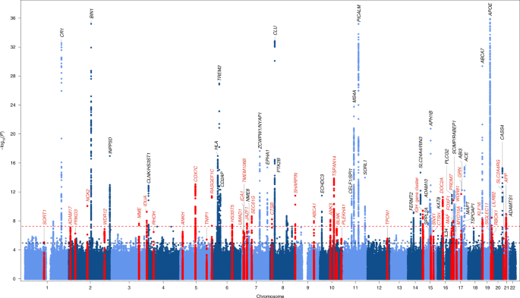
Genome-wide association studies
Bellenguez et al. 2022. Nature Genetics

Slide 16
Genome-wide significance
P < 0.05 cannot be used (multiple testing burden)
Adjust for number of independent LD blocks across the entire genome
There are roughly 1 million blocks of SNPs (LD blocks) independent of each other
Apply Bonferroni P-value correction: P = 0.05 / 1,000,000 = 5x10e-8

Slide 17
GWAS summary statistics
Each SNP has an effect size and P-value
For binary trait: odds ratio = e ^ beta
Each copy of C allele on rs1800693 increases the odds of multiple sclerosis by about 14%.
Chr | BP (hg19) | Effect Allele | Other Allele | Beta | SE | P-value
12 | 6440009 | C | T | 0.127 | 0.0166 | 1.01E-13
IMSGC et al. 2019. Science

Slide 18
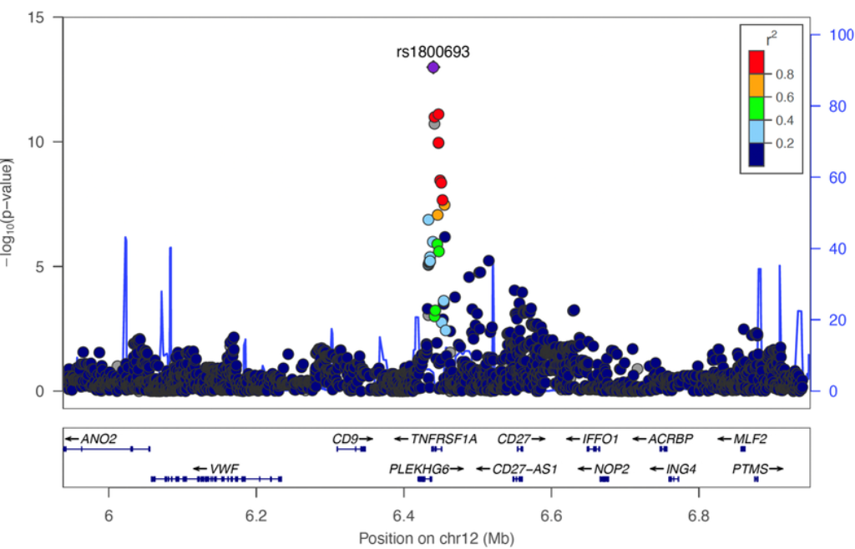
Pitfalls of GWAS (1)
Pitfall: raw summary statistics association cannot be used directly
True risk variant will “tag” other variants through LD
Kim & Patsopoulos et al. 2022. Seminars in Immunopathology

Slide 19
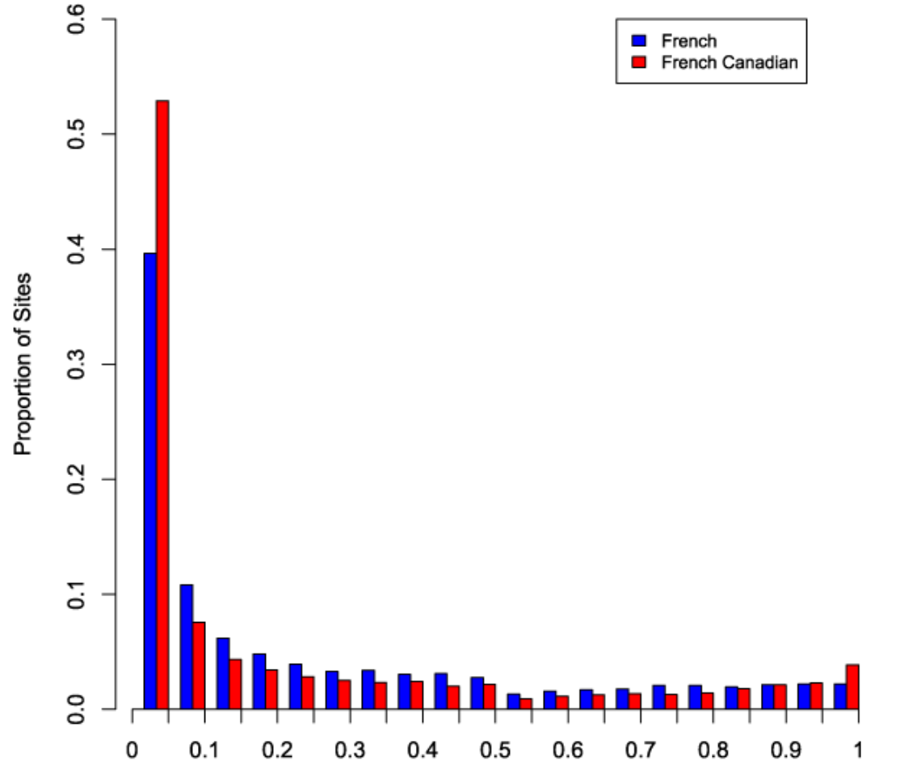
Pitfalls of GWAS (2)
Allele frequencies can vary between different ancestries
Migrations, genetic drift, selection pressures:
Differences in allele frequencies
Differences in how genetic variants are inherited together (LD)
Casals*, Hodgkinson* et al. 2013. PLOS Genetics

Slide 20
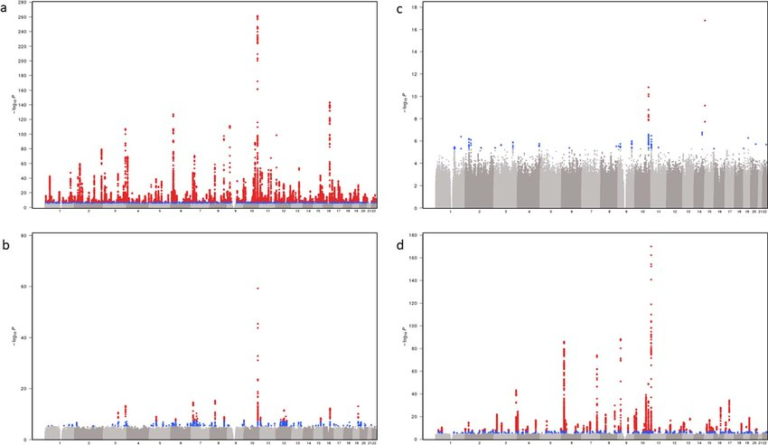
Pitfalls of GWAS (2)
European
African American
Hispanics
Asians
Vujkovic et al. 2020. Nature Genetics
Notes:
Type 2 diabetes GWAS
https://www.researchgate.net/figure/Trans-ethnic-and-ancestry-specific-GWAS-Manhattan-plots-a-d-Each-graph-represents-a_fig1_342184407

Slide 21
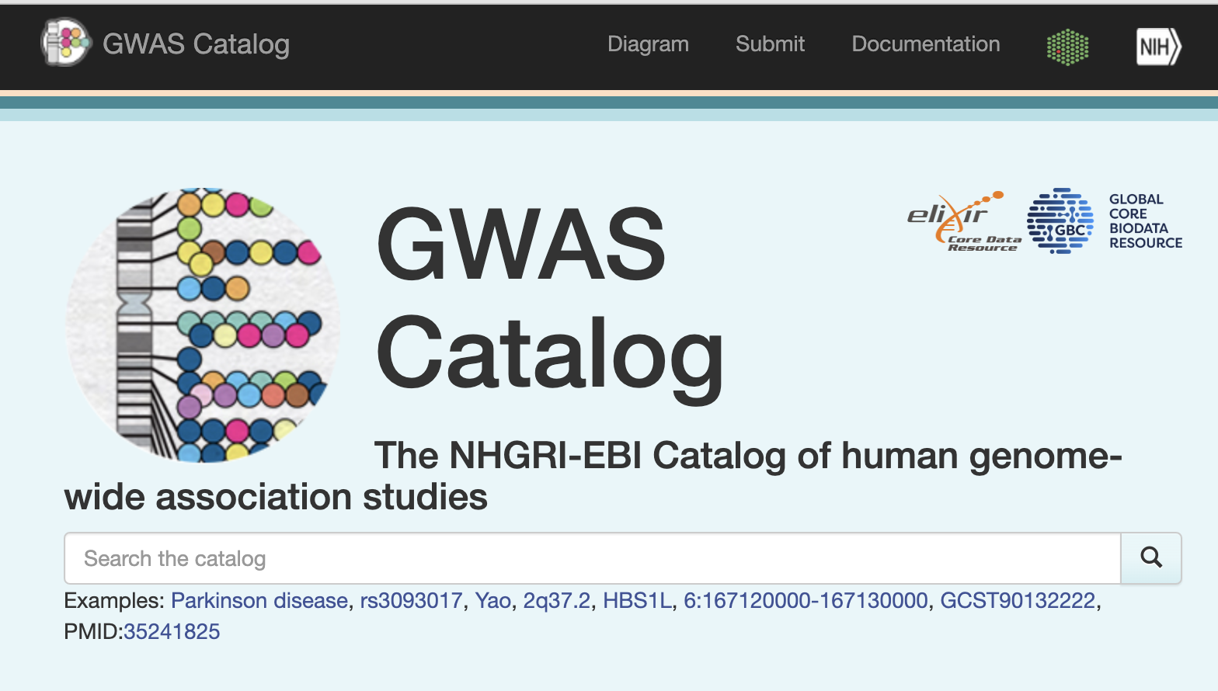
Hands-on Activity: GWAS Sumstats
Where can I search for GWAS summary statistics?
Visit https://www.ebi.ac.uk/gwas/ to look through GWAS summary statistics.

Slide 22
Summary of GWAS
Genome-wide association studies identify SNPs that are associated to traits.
LD prevents direct use of GWAS for risk stratification and inference of causal gene
GWAS performed in European populations may not generalize to other ancestries.
Open sources (like GWAS catalog) contain summary statistics for GWAS.

Slide 23
Outline of this workshop
Part 1. Genome-wide association studies (GWAS)
Part 2. Polygenic risk scores (PRS)
Part 3. Tutorial for PRS of coronary artery disease

Slide 24
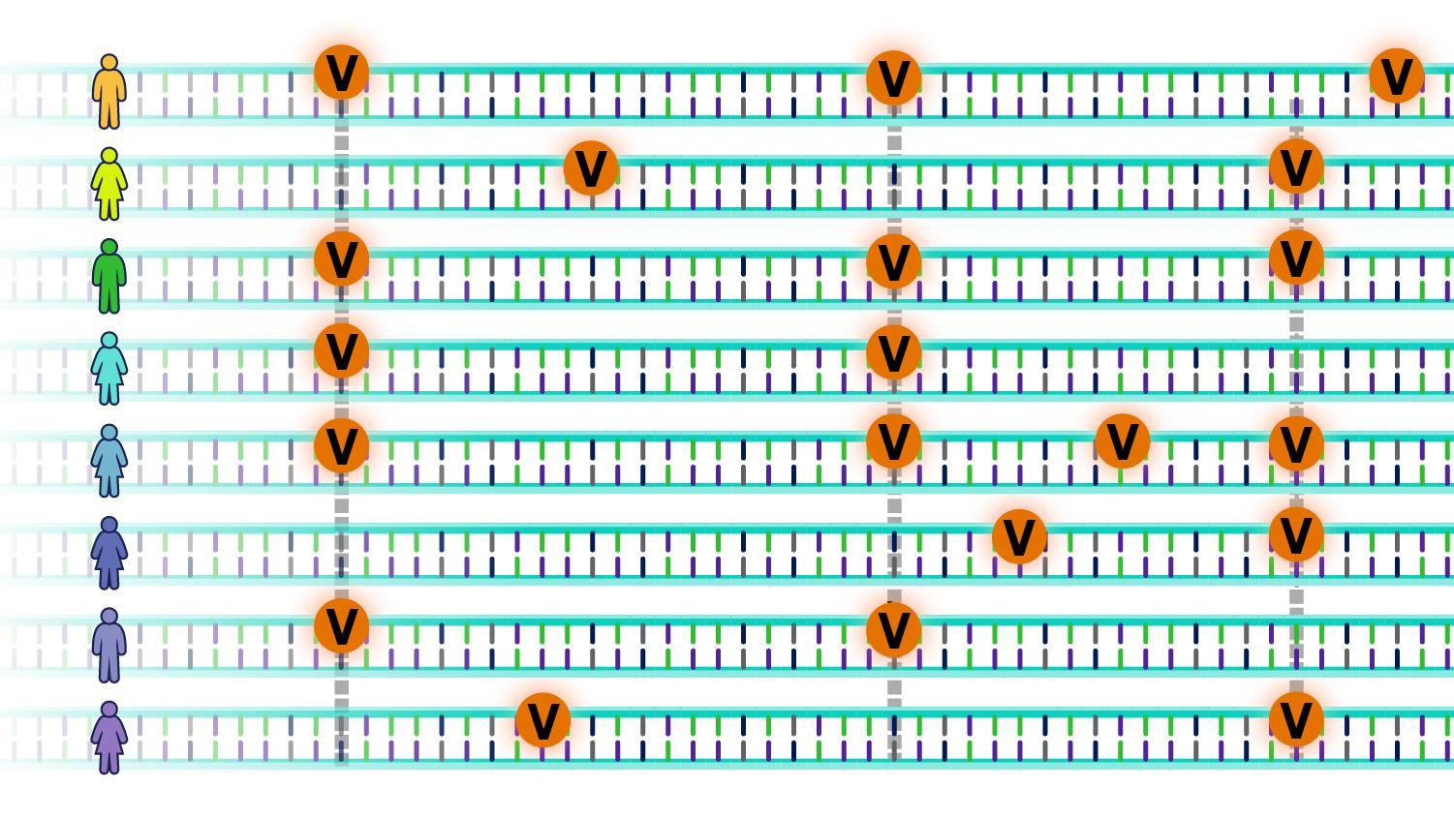
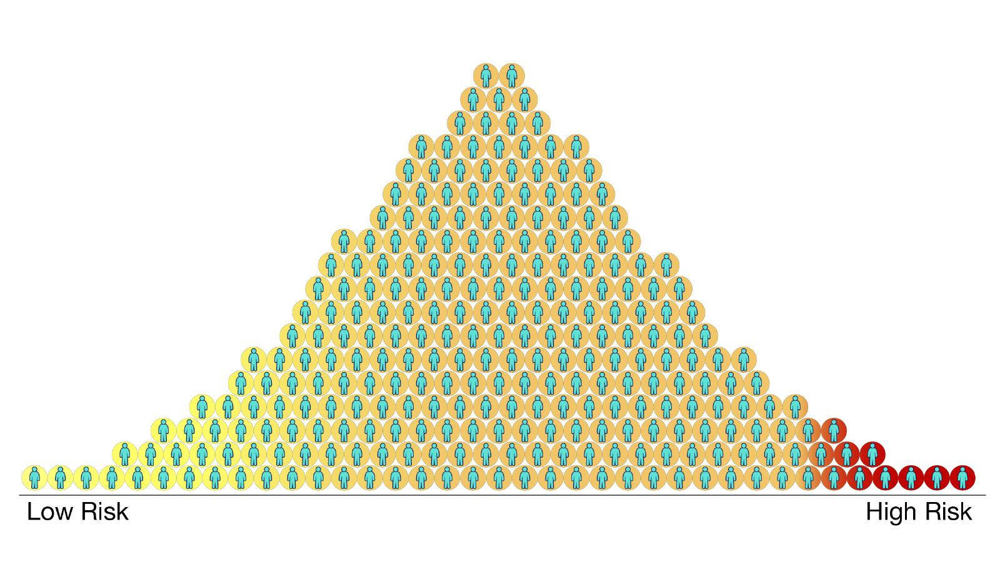
Polygenic risk scores
Notes:
Figure from: https://www.genome.gov/Health/Genomics-and-Medicine/Polygenic-risk-scores

Slide 25
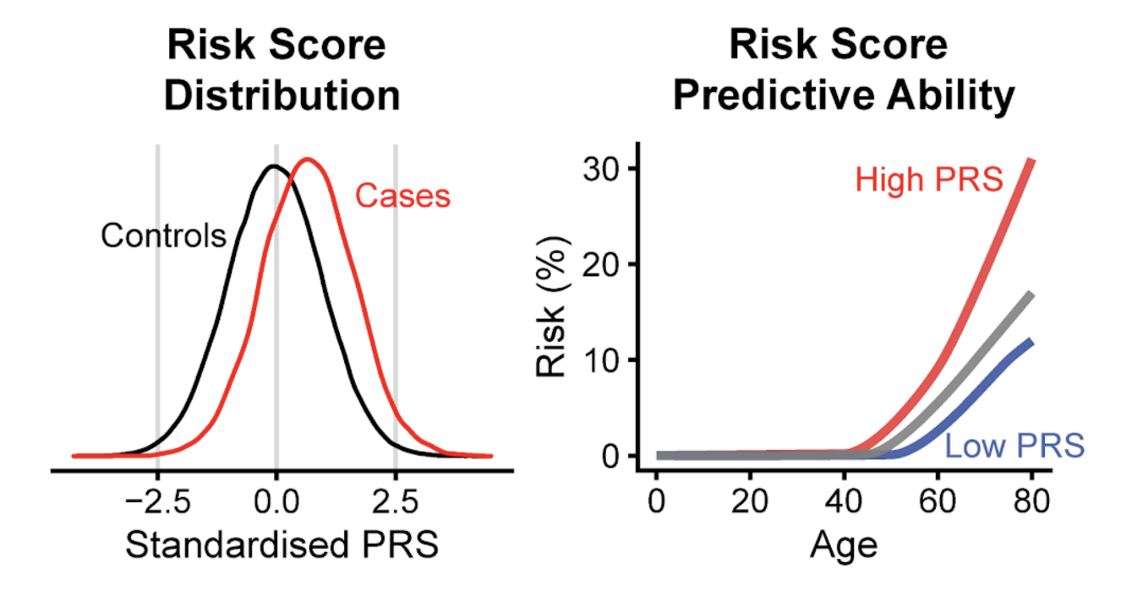
Polygenic risk scores
Goal: early screening, stratification of high-risk individuals

Slide 26
Polygenic risk scores
Target data
Individual-level genotype
Training data GWAS summary statistics
Linkage disequilibrium (LD) reference panel
Process genetic data to keep high-quality common SNPs.
Ancestry/population stratification check.
Samples from GWAS ≠ sample from target data
Matched ancestry with target data.
Well-powered, large sample size.
Correlation between SNPs.
Ancestry of reference panel = ancestry of target data = ancestry of base data

Slide 27
PRS strategies
Clumping and thresholding | LD prediction | Bayesian estimation of SNP effect sizes
Ex.: PRSice Uses independent SNPs that are significant at a p-value threshold | Ex.: LD pred Predict effect sizes of SNPs based on LD correlation Needs an LD matrix (correlation between all SNPs) | Ex.: PRScs LD reference panel to adjust for the correlation between SNPs Adjust SNP effect sizes before computing PRS

Slide 28
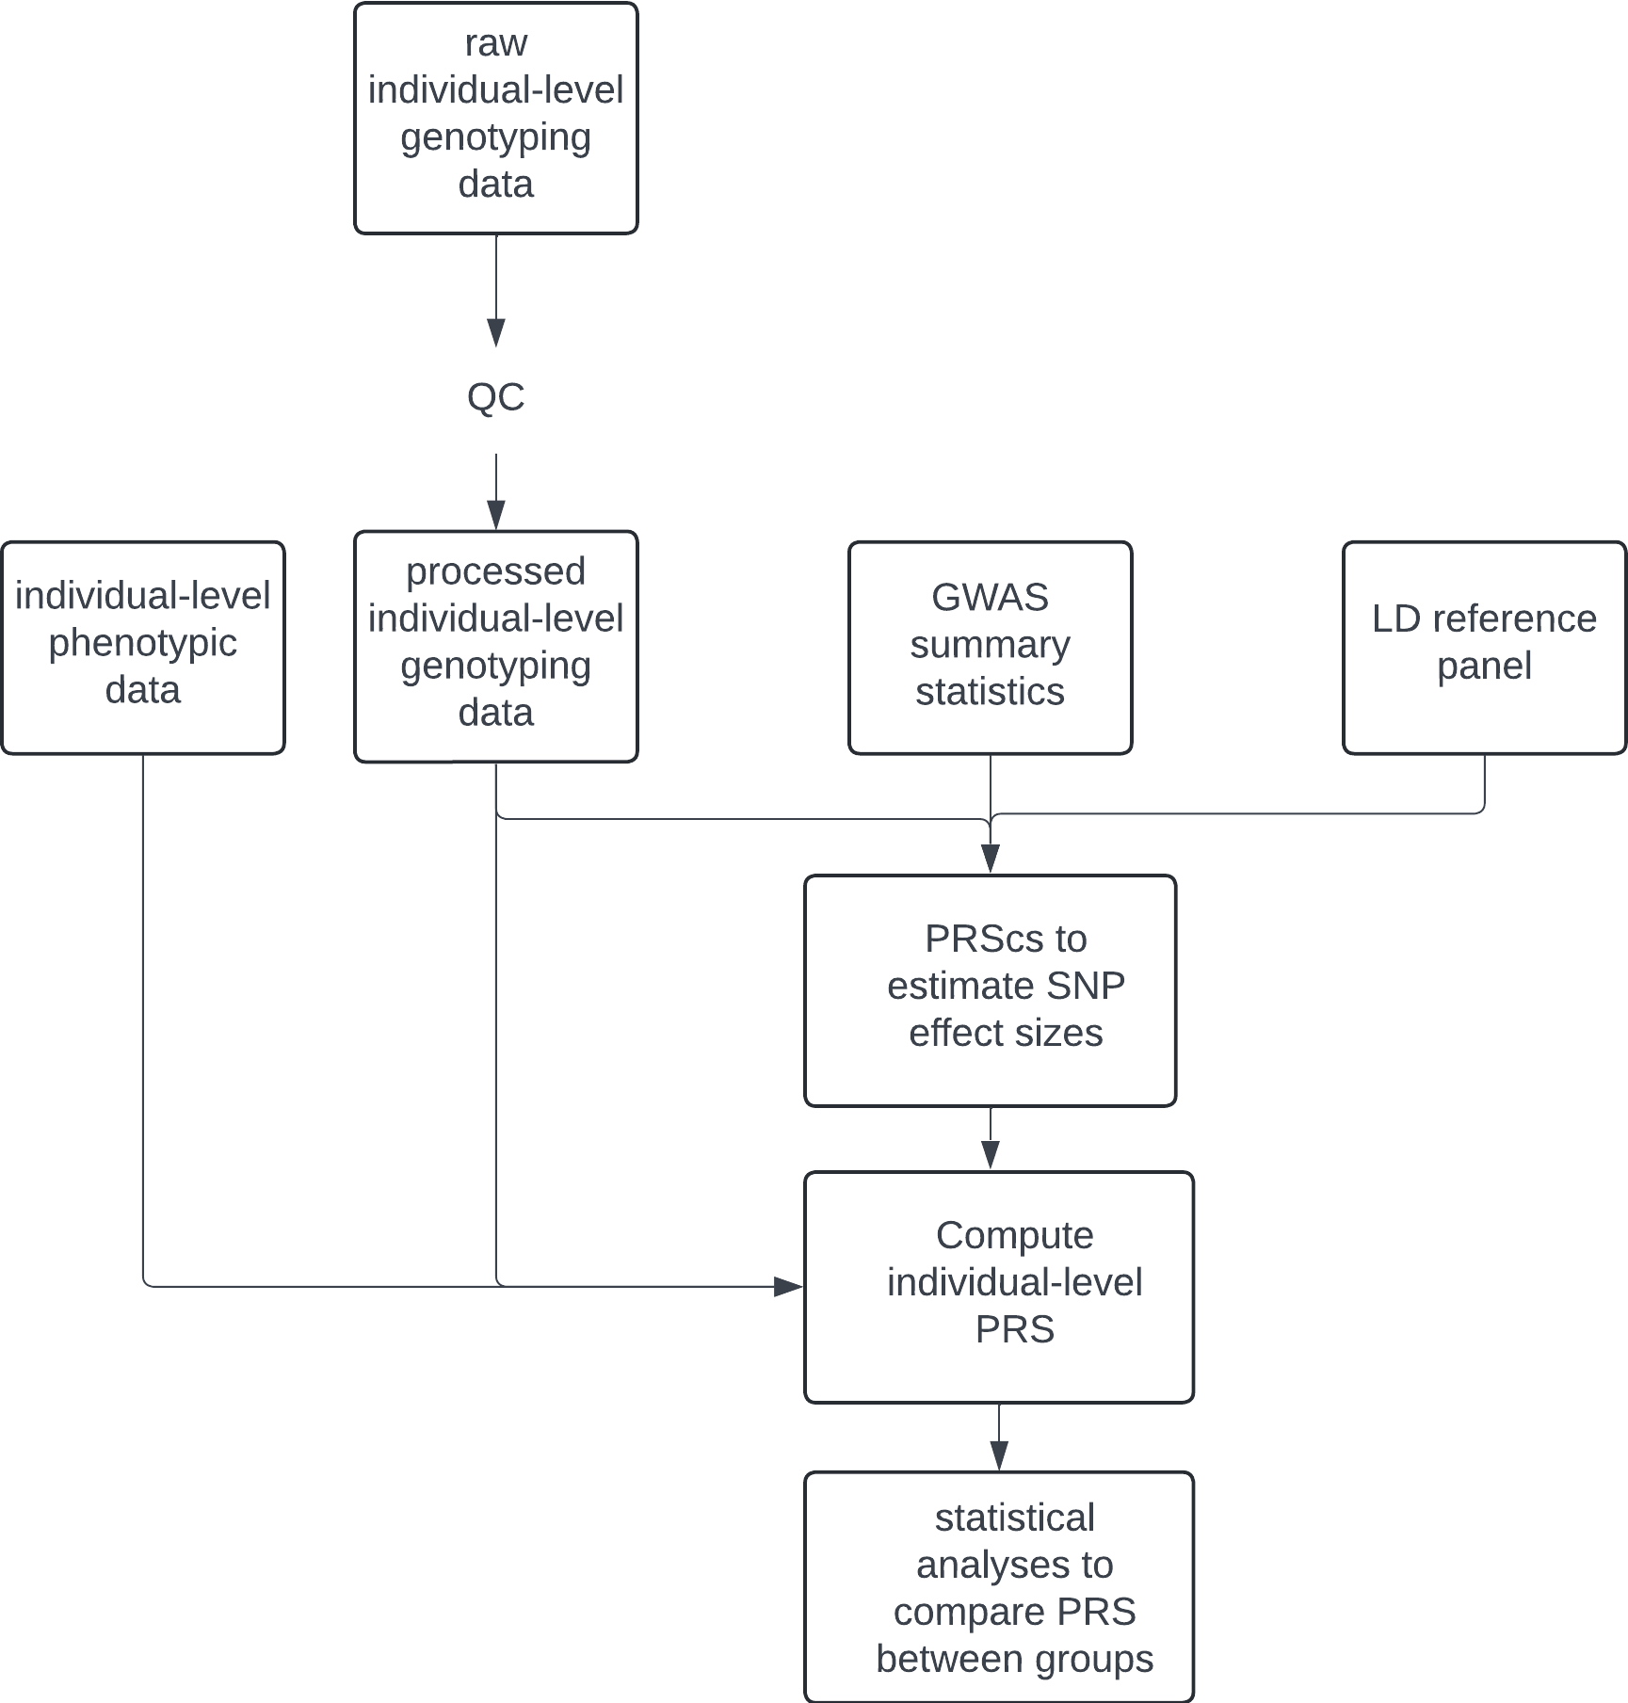
PRS flowchart

Slide 29
PRS flowchart
Removes SNPs that are missing in more than a certain proportion of samples
Remove SNPs that are occur at extremely low frequencies
Remove SNPs that violate Hardy-Weinberg equilibrium
Out of all SNPs that are correlated, select only one (LD pruning)
Remove individuals who have more than a certain portion of missing genotype
Notes:
Fig from : https://www.ncbi.nlm.nih.gov/pmc/articles/PMC9828290/

Slide 30
Outline of this workshop
Part 1. Genome-wide association studies (GWAS)
Part 2. Polygenic risk scores (PRS)
Part 3. Tutorial for PRS of coronary artery disease

Slide 31
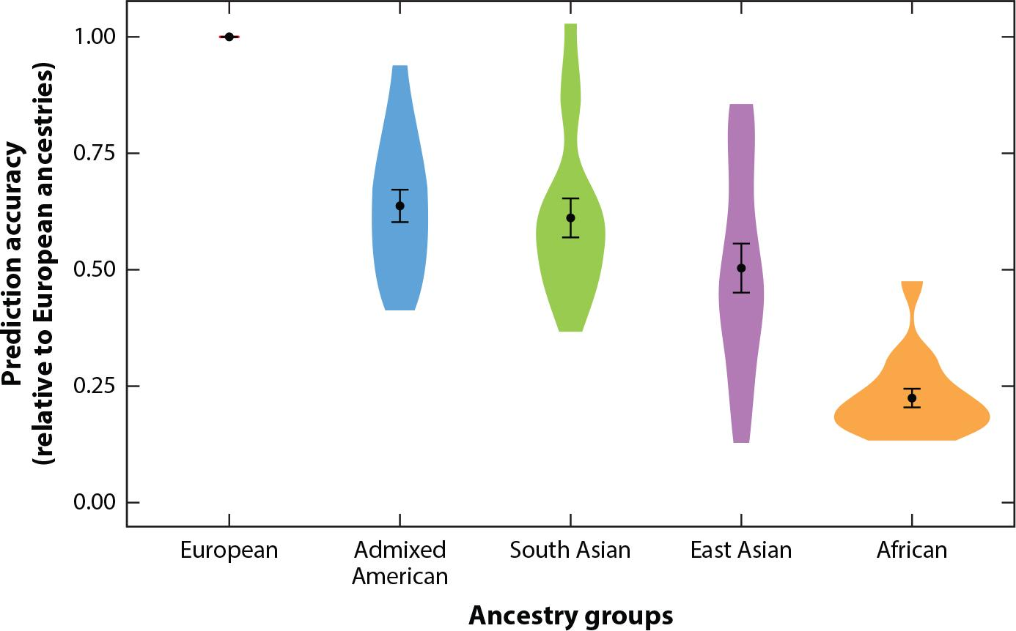
Pitfalls of PRS
Limited clinical utility for non-European populations
Exacerbate health disparities
Wang et al. 2022. Annual Review of Biomedical Data Science
Notes:
Fig from : https://www.ncbi.nlm.nih.gov/pmc/articles/PMC9828290/

Slide 32
Summary of PRS
1. PRS: estimated genetic susceptibility for a disease
2. PRS weights are typically derived from GWAS summary statistics
3. PRS trained on one ancestry does not perform well on another

Slide 33
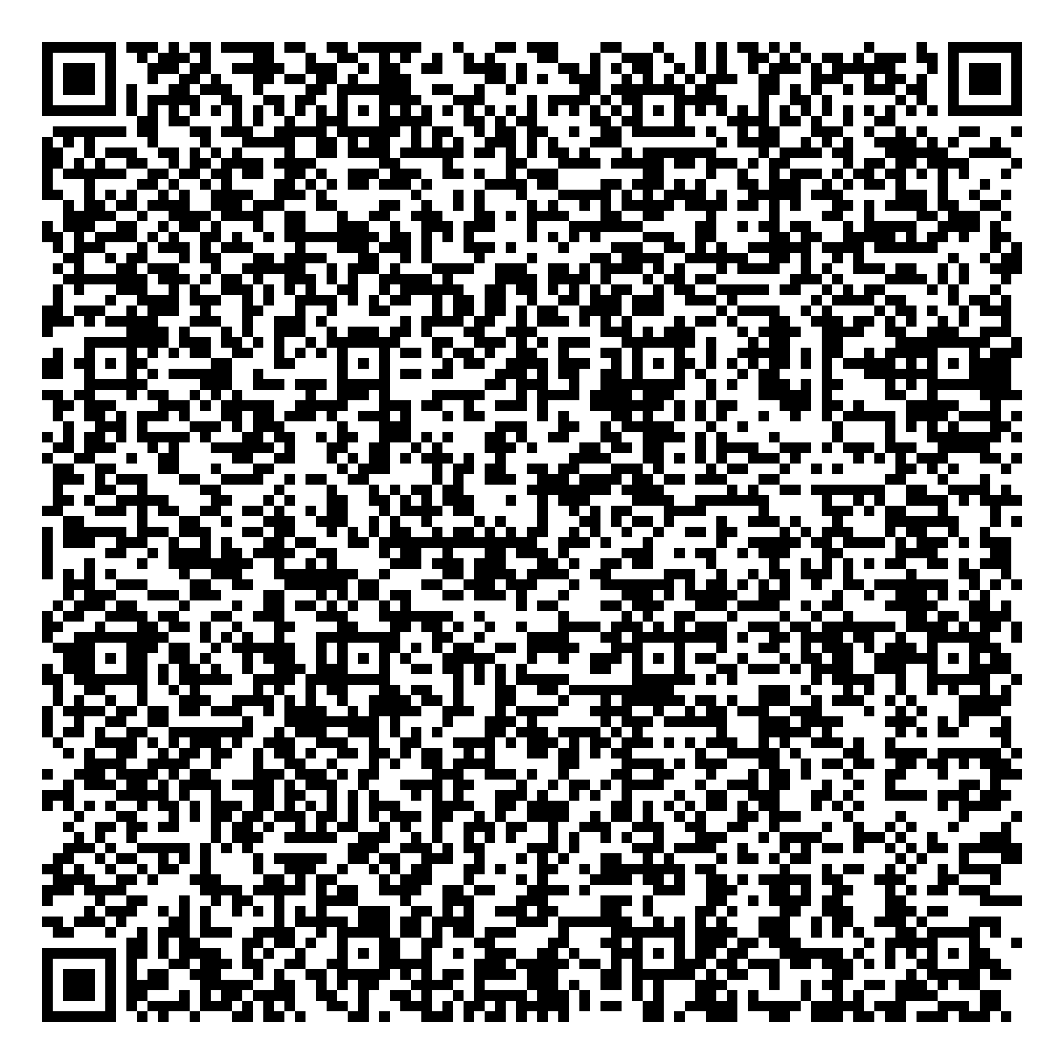


Thank you for attending!
1
2
3
Scan the QR code to confirm you attended today’s workshop.
Fill out the feedback survey in the next 72h.
Get recognition for this workshop on your
co-curricular record.

