Slide 1
Flow of introduction
Basic idea of TLVA → TVLA’s advantage (simplicity, no expert knowledge needed) → TVLA’s drawbacks
lack of an obvious
relationship between
leakage and the exploitability
of the attack
False negatives
Threshold settings
measurement sufficient for exposure?
Threshold has to be adjusted based on different settings
Get more measurements to increase to confidence?
Repeat Multiple times to increase the confidence?
Not Efficient! (Yuan question: argue the disadvantage or distinguish our work from others? )
Not Efficient!
Boostrap extract more information with the existing data at hand → provide another reference parameter + decrease the number of traces needed for exposure
Boostrap-TVLA provide extra information using Boostrap method

Slide 2
Related work
Discuss recent work proposed to solve the drawbacks of TVLA in difference aspect:
Chi-square → higher–order leakage detection
Multi-tuple → dependency assumption in the original TVLA
TVLA + HC → take the other p-value into consideration vs mini-p approach
Confidence interval 0--> improve the certainty of the test (Yuan question: the way to argue our novelty over their work)

Slide 3
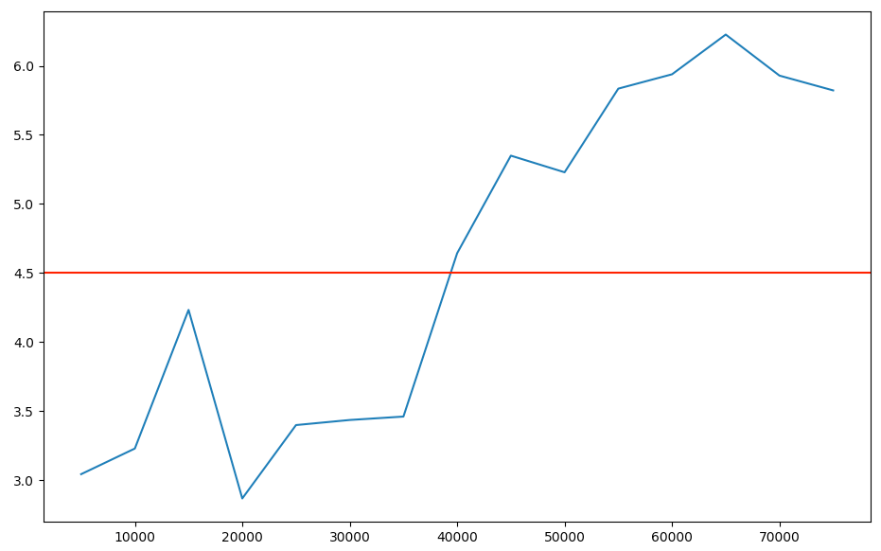
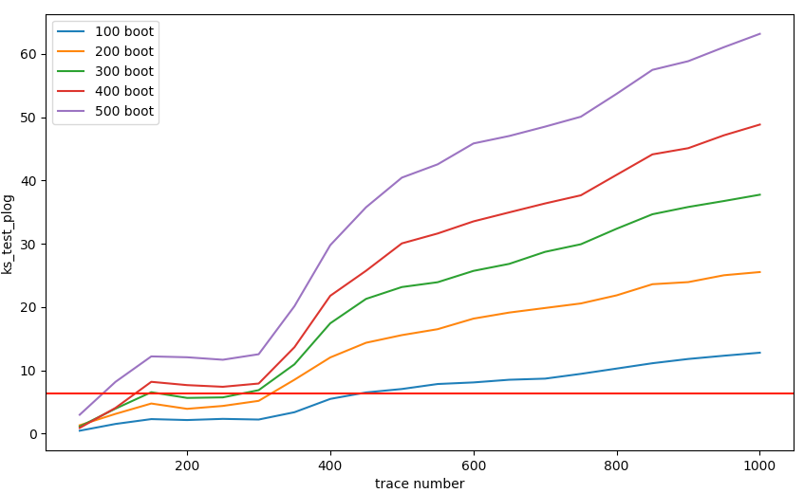
Experiment on hw-AES-protected

Slide 4
Practical issues
False positive experiment (go on the experiment with ML approach? or put for another independent project)
Method to improve the computational efficiency for Bootstrapping
Poisson Bootstrap
Bag of Little Bootstraps
Cutting off the traces
github folder
Experiment we have
simulated traces (FVR, FvR, RvR)
software AES (Boolean mask protected)
hardware AES (protected & unprotected)

Slide 5

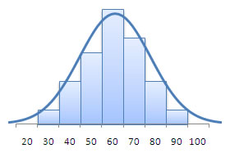

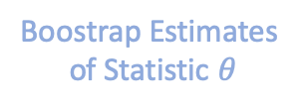








$$S_{1}^{′}$$
$$θ_{1}^{′}$$
$$S_{2}^{′}$$
$$θ_{2}^{′}$$
$$S_{3}^{′}$$
$$θ_{3}^{′}$$
$$S_{orig}$$
.
.
.
.
.
.
$$S_{B}^{′}$$
$$θ_{B}^{′}$$
Population
Original Samples
Boostrap Samples
Boostrap Estimates
of Statistic $θ$
Construct Distribution

