Slide 1
Jenkins with Unit Test for Continuous Integration (CI)
Instructions fo Jenkins CI tutorial

Slide 2
Step 1: Set up Jenkins server on Ubuntu
wget -q -O - https://pkg.jenkins.io/debian-stable/jenkins.io.key | sudo apt-key add -
sudo sh -c 'echo deb https://pkg.jenkins.io/debian-stable binary/ > \
/etc/apt/sources.list.d/jenkins.list'
sudo apt-get update
Sudo apt -get install jenkins
https://www.jenkins.io/doc/book/installing/linux/

Slide 3
Configure Jenkins server on Ubuntu
In manage plugins, under Python, find and install shiningpandas plugin
Create a new project in Jenkins, and add python installation using “global tool configuration”, and points the Python installation to the absolute path of python executable on the server
In the project configuration, in “build” section, select the python installation name you set up in the previous steps, in “nature” dropdown list, select “shell”, and in “command” section, type in “nosetests absolute_path_to_PyProject”. The absolute_path_to_PyProject could be /home/your user name/PyProject. By doing this, Jenkins will use the your Python installation to run the nosetests on your PyProject on the server

Slide 4
Config VS code, install nose, and set file permissions
Install nose by python3 -m pip install nose
In VS code, set the unittest framework to nose, and select the tests folder for nosetest to search the tests
Set the folder permission by chmod - R 755 PyProject to give Jenkins read and execute permission access to the PyProject folder
Set the test_project.py file to have only read permission by chmod 644 test_proect.py (operate in tests folder)
Run nosetests . (in Pyproject folder) to check all the tests pass

Slide 5
Build and configure Jenkins project for CI
Build the project in Jenkins to make sure Jenkins can access and run nosetests
In terminal, in PyProject folder, type in git init to make the folder a git repo
Type in git add -A and git commit -m “initital commit” to commit everything to master branch
In Jenkins project, configure the source code management section by selecting “git”, then setting you local folder absolute path as the repository url, and choosing “master” branch
In “building trigger” section, select both “poll SCM” and “GitHub hook trigger for GITScm polling” and set H/5 * * * * to check every 5 mins

Slide 6
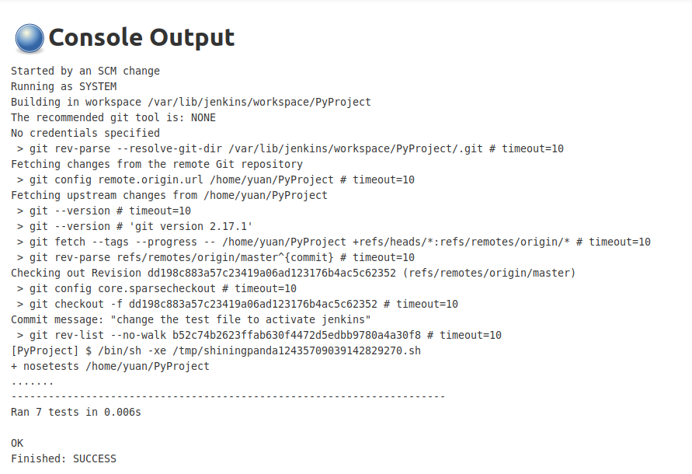
Check the console output after Jenkins build project
Build the project by either clicking “build Now”, or change and commit your PyProject to trigger Jenkins to build the project
After the build process completes, click the new build, and then click console output, you should see the information similar to the following: which shows “Ran 7 tests in 0.006s” and “Finished: success”

