Slide 1

A More Advanced Model for GW Tests of the Kerr Metric with Binary Black Holes
20307110478 杨媛冰 Yuanbing Yang
2024/06/04
Notes:
Good afternoon everyone! I’m honored to stand here to give a speech of my graduation thesis. The title of this thesis is ...

Slide 2
Contents
Introduction
Post-Newtonian Formalism
Effective One Body Formalism
Calculation on Effective Spin
Constraints on KRZ deformation parameters
Discussion

Slide 3
Introduction
test GR (general relativity) in strong fields
GR +
black hole
Kerr Hypothesis
Kerr Metric
KRZ metric
Parameterized Mectric
Notes:
A century ago, the theory of general relativity has been proposed. While it has been successfully tested in the weak fields, only recently the strong field predictions have become testable. To test the strong field, black hole is a perfect candidate. We know that, in general relativity, the solution to EFE is the Kerr metric. The assumption that astrophysical black holes are described by the Kerr metric is known as the Kerr hypothesis. We can test the Kerr hypothesis to test general relativity.
To achieve this goal, we add additional parameters into the Kerr metric to get a parameterized metric. We construct observational models using this parameterized metric. And then, through experiments, we use the model to measure the additional parameters. If all the parameters is measured to be zero, then the metric will converge to the Kerr metric and Kerr hypothesis can be tested.
We take the KRZ metric to be the parameterized metric. In people’s previous work, they assumed two nonspinning black holes to do the calculation. In this thesis, we take the spin effect into consideration to make the model more accurate.

Slide 4
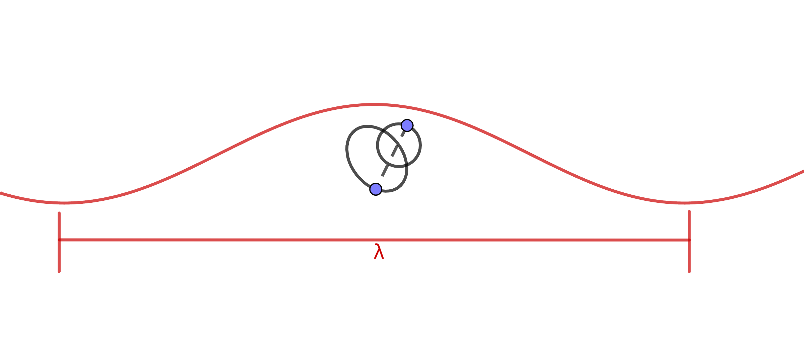
Post-Newtonian Formalism
approximation method
isolated, self-gravitating
slowly moving, weakly pressed objects
valid in the near zone
1/c expansion
Notes:
In the next, I’m going to introduce two important method in gravitational wave analysis. First is the post-Newtonian Formalism. This is an approximation method to solve the Einstein’s Field Equation. It is suitable for treating the isolated and self-gravitating system. The objects in the matter source is slowly moving and weakly pressed. This method is only valid in the near zone, whose size is way smaller than the wavelength of the gravitational waves. The result is in terms of 1 over c expansion.

Slide 5
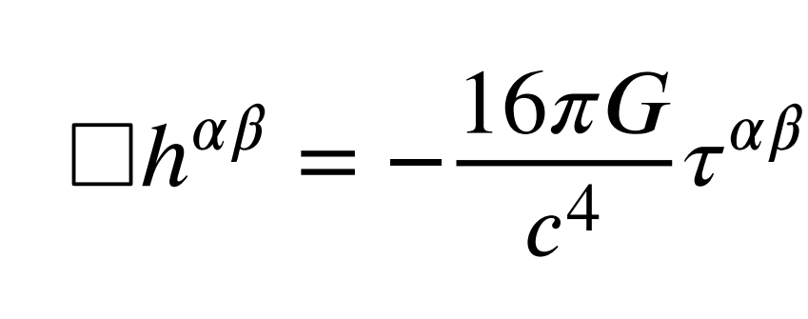
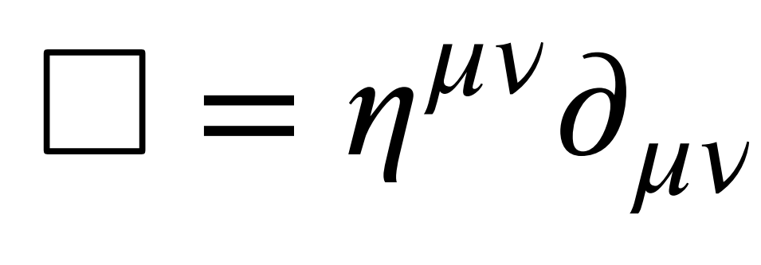
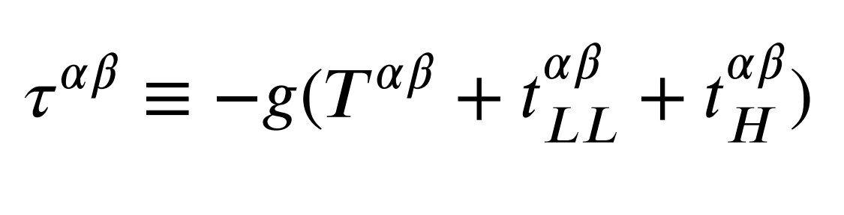
Post-Newtonian Formalism
Einstein’s Field Equation
Landau-Lifshitz Formulation
Notes:
Then I will introduce the approximation process of this method in detail. At start, we rewrite the Einstein’s Field Equation into the Landau-Lifshitz Formulation. In this formulation, the equation looks like a typical wave equation. h is called potential. It is the difference between the current metric and the flat spacetime metric. The source term on the right hand side contains 3 parts. T : The first term is the energy-momentum tensor of the matter source. t_LL&t_H：The second term and the third term is corresponding with the metric.

Slide 6
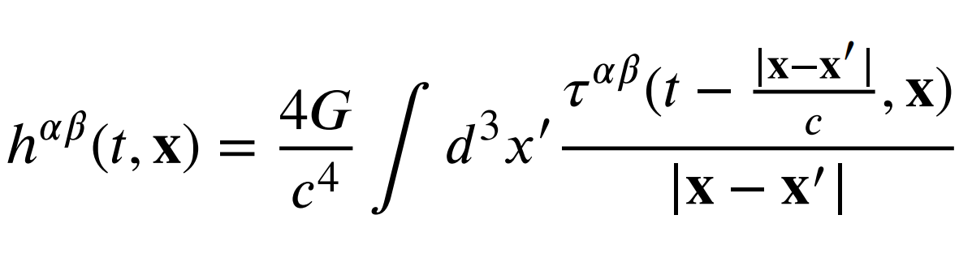
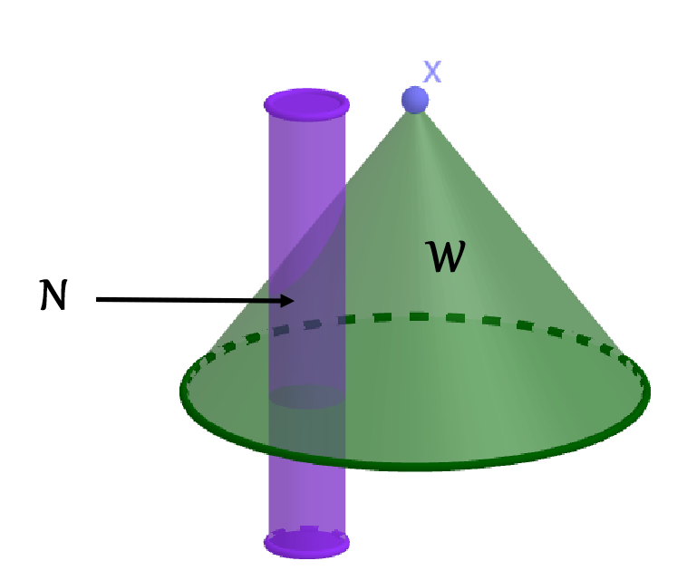
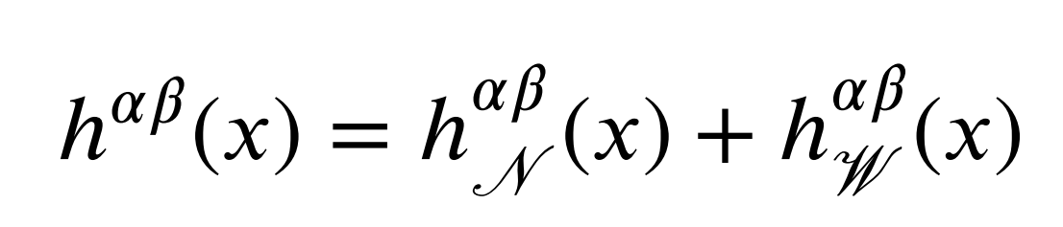
only care about near zone term!!
iterate till we obtain the expected precision (PN order)
Notes:
We can write down the solution of this wave equation formally. You can see that this solution is the same with the retarded potential of the electromagnetic waves. The integration domain is the past light cone of the field point x. We partition the integration domain into two parts----near zone and wave zone. The purple Cylinder is the near zone world tube. the matter source is confined to it. the wave zone is then the past light cone subatrct the near zone. For most physical systems we are interested in, the integrate in the wave zone is not dominant, it correspond to higher order corrections. So we only care about the near zone integral term.
In this formal solution, we should notice that, the potential h is in both sides. So it is, of course, not the final solution. We have to set initial conditions that h=0, plug it in the right hand side and start iterative calculation, then we can obtain the desired solution to some PN order. After getting the explicit solution, we insert it back into the action to get the Fokker action. Then use this action, we can figure out the dynamics of the compact binary systems. That mean we can get the explicit expression of physical quantities like EOM, Lagrangian, Hamiltonian, etc, to the expected precission.

Slide 7
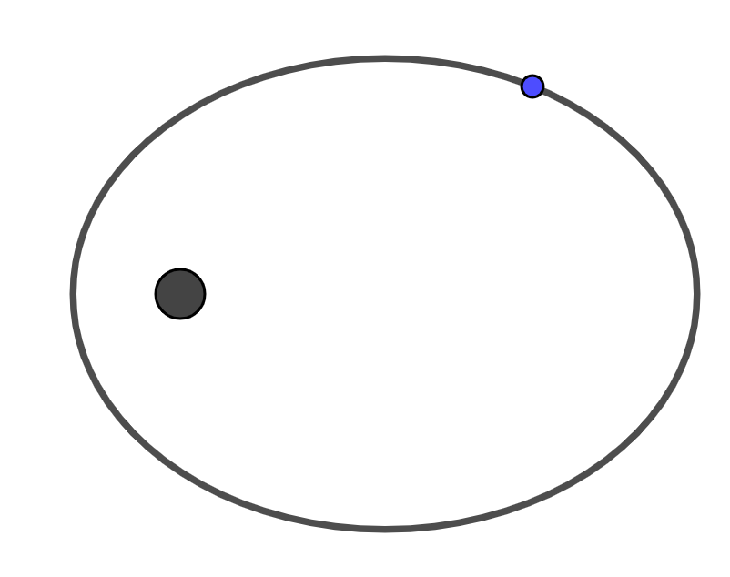
Effective One Body Formalism
two-body system
one-body system
Notes:
Another important method of gravitational wave analysis is the effective one body formalism. The main idea of this method is to transform a two-body problem to an effective one body problem. In the effective one body system, the central mass is at rest and we only need to consider the motion of a test particle in some effective external metric.

Slide 8
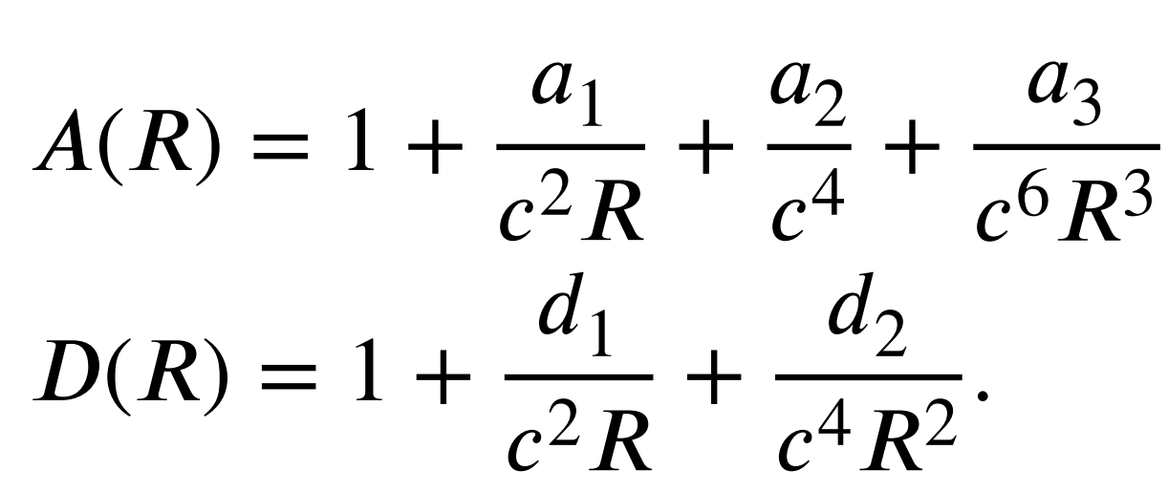

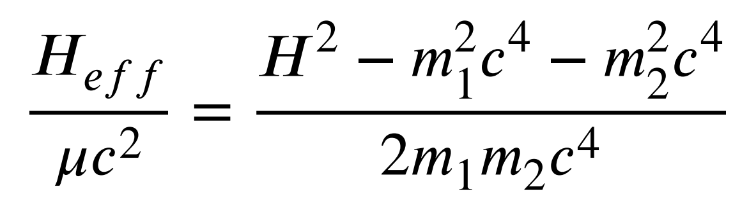
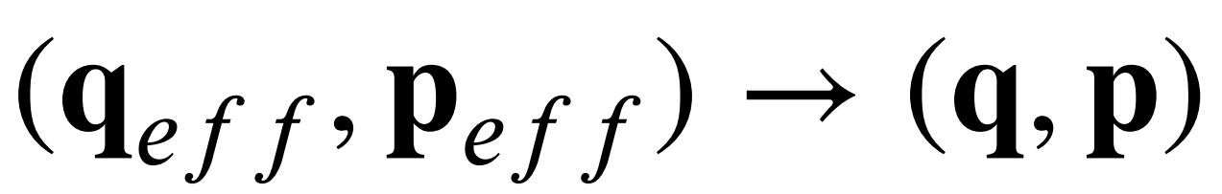
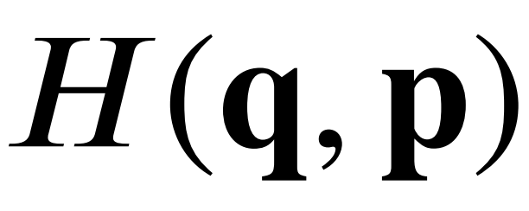
Notes:
We assume the effective metric read like this. with this effective metric, we can figure out the effective Hamiltonian. Also, Through PN calculation, we can obtain the explicit expression of real Hamiltonian of the two body system. By canonical transformaion and an energy map between the effective and the real system, we can obtain the parameters in the assumed effective metric. With this metric, we can get the dynamics of the test particles in the effective one body system.

Slide 9
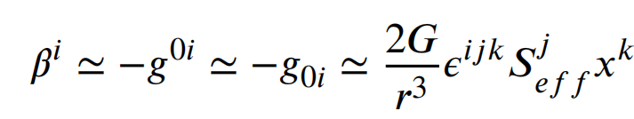
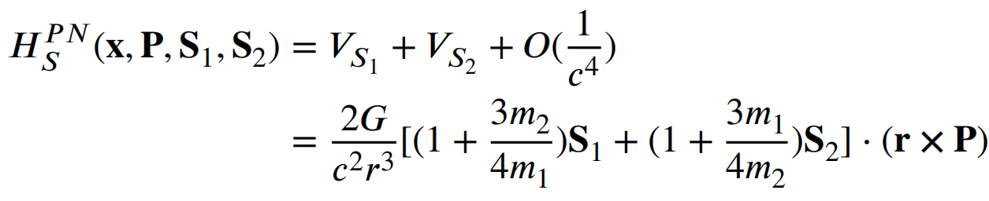
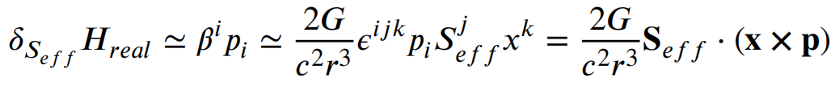
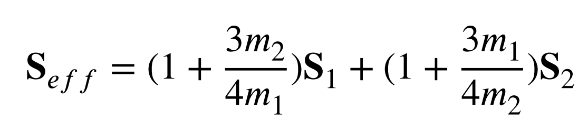
Calculation on Effective Spin
EOB (effective one body)
QFT (quantum field theory)
Notes:
After introducing the post-Newtonian method and the effective one body method, I will move to the calculation of the effective spin. The calculation contains two parts ---- the QFT method gives the explicit expression and the EOB method gives the transformation relation. In QFT method, people consider the one-graviton exchange interaction of two particles of spin one-half and take the nonrelativistic approximation to get the gravity potential. In EOB method, people found that the effective spin of the central mass brings about this term in the real Hamiltonian. Comparing the two expression, we obtain the explicit spin transformation relation. notice that we only considered the linear term of spin.

Slide 10
Constraints on KRZ deformation parameters
Work in the effective one body system
KRZ metric
the effective metric
inspiral phase
Notes:
Then we move to the calculation. The most important idea is that we work in the effective one body system and take the KRZ metric to be the effective metric. Also, since we only consider the inspiral phase, we can impose the equatorial geodesics conditions. Then we can just follow the analysis proposed in the reference[24].

Slide 11
Discussion
—— Effective Deformation Parameters？
Similar to Effective Spin?
no transformation function for metric
QFT method is indispensible in effective spin calculation
Notes:
Finally I’m going to discuss a little bit about the effective deformation parameters.
Actually, in our initial evision of this thesis, we thought we could follow the treatment of spin to find out the explicit expression of the effective deformation parameters. However, after we had a careful study of the derivation of the effective spin, we find it difficult to get the effective deformation parameters in the same way. Because there’s no transformation function for metric like that for energy. We only have an assumed effective metric.
spin is some intrinsic property of a black hole but deformation parameters are not
deformation parameters correspond to higher orders of the multipole moments of the black hole source
Also, the QFT method is indispensible in effective spin calculation, and the two spin-1/2 particles can only become two spherically symmetric spinning balls in the nonrelativistic approximation. Their metrics are not deformed respectively.

Slide 12
Thank You !

