Slide 1
Chapter 8
Building the Analysis Model
( I )

Slide 2
8.1 Requirements Analysis
Objectives
  Describe what the customer requires
  Establish a basis for the creation of a software design
  Define a set of requirements that can be validated
Allows the software engineer to:
  elaborate on basic requirements established during earlier requirement engineering tasks
  build models that depict
    user scenarios
    functional activities
    problem classes and their relationships
    system and class behavior
    the flow of data as it is transformed
    constraints that software must meet
1/5

Slide 3
A Bridge
8.1 Requirements Analysis
system
description
analysis
model
design
model
2/5

Slide 4
8.1 Requirements Analysis
Rules of Thumb
  Focus on business domain. Don’t get bogged down in details.
  Each element of the analysis model should add to an overall understanding of software requirements and provide insight into the information domain, function and behavior of the system.
  Delay consideration of infrastructure and other non-functional models until design.
  Minimize coupling throughout the system.
  Be certain that the analysis model provides value to all stakeholders.
  Keep the model as simple as it can be.
3/5

Slide 5

Domain Analysis
8.1 Requirements Analysis
Goal: Software domain analysis is the identification, analysis, and specification of common requirements from a specific application domain, typically for reuse on multiple projects within that application domain.
technical literature
class taxononmies
existing applications
SOURCES OF
DOMAIN
KNOWLEDGE
reuse standards
DOMAIN
ANALYSIS
MODEL
customer surveys
DOMAIN
ANALYSIS
functional models
expert advice
Analysis
Patterns
current/future
requirements
domain languages
4/5

Slide 6
8.2 Analysis Modeling Approaches
Scenario-based
elements
Flow-oriented
elements
Structured
Analysis
Analysis Model
Use-cases (text)
Use-case diagrams
Activity diagrams
Swim lane diagrams
Data flow diagrams
control flow diagrams
Processing narratives
Object-
Oriented
Analysis
Class-based
elements
Behavioral
elements
Class diagrams
Analysis packages
CRC models
Collaboration diagrams
State diagrams
Sequence diagrams
5/5

Slide 7
Chapter 8
Building the Analysis Model
(II)

Slide 8
8.3 Data Modeling Concepts
Creates a model at the customer’s level of abstraction
Indicates how data objects relate to one another
1/35

Slide 9
8.3 Data Modeling Concepts
What is a Data Object?
— something that is described by a set of attributes (data items) and that will be manipulated within the software system
Each instance of an object (e.g., a book) can be identified uniquely (e.g., ISBN#)
Each plays a necessary role in the system i.e., the system could not function without access to instance of the object
Each is described by attributes that are themselves data items
2/35

Slide 10
8.3 Data Modeling Concepts
What are Data Attributes?
— A data object contains a set of attributes that act as an aspect, quality, characteristic, or descriptor of the object
object: automobile
attributes:
make
model
body type
price
options code
3/35

Slide 11
8.3 Data Modeling Concepts
What is a Relationship?
— indicates connectedness; a "fact" that must be "remembered" by the system and cannot or is not computed or derived mechanically
Cardinality: One-to-one, One-to-many, Many-to-many
Modality: Mandatory, Optional
4/35

Slide 12
8.4 Object-Oriented Analysis
Key concepts:
  Classes and objects
  Attributes and operations
  Encapsulation and instantiation
  Inheritance
Tasks
  Basic requirements must be communicated
  Classes (attribute and method) must be identified
  A class hierarchy is defined
  Object relationship should be represented
  Object behavior must be modeled
  Above tasks are reapplied iteratively
5/35
Notes:
What is OO?

Slide 13



8.4 Object-Oriented Analysis
杭 州
北 京
Message
Post-office
Send by method
Attributes:
location;
employee;
……
我想把邮局搬到
我家门口，多加几个
邮递员，24小时都开门
……
Object
Encapsulation
对不起，
本邮局不提供
此类服务
唉，那就先送束花吧 ——
Post_office.Send (request, payment)
Methods:
send;
sell;
……
6/35

Slide 14
8.4 Object-Oriented Analysis
occurrences
roles
things
organizational units
places
external entities
structures
Methods
attributes:
class name
attributes:
operations:
Taylor’s notation
7/35

Slide 15
8.4 Object-Oriented Analysis
Encapsulation: the object encapsulates both data and the logical procedures required to manipulate the data.
 Information hiding – reduces the propagation of side effects when changes occur.
 Interface is simplified and the system coupling tends to be reduced.
 Data structures and the operations that manipulate them are merged in a single named entity – the class. This facilitates component reuse.
8/35
Notes:
Why encapsulation?

Slide 16
8.4 Object-Oriented Analysis
Inheritance
furniture
(superclass)
subclasses
table
chair
desk
"chable"
instances of chair
9/35

Slide 17

8.4 Object-Oriented Analysis
Multiple inheritance
CardDeck
GraphicalObject
Method:
Draw := take
a card from
a deck
Method:
Draw := display
a graphical object
GraphicalDeck
Method:
Draw := ?
overriding
Inheritance is no longer transitive
10/35

Slide 18
8.5 Scenario-Based Modeling
Review Section 7.5 for developing use-cases.
Use-cases are simply an aid to defining what exists outside the system (actors) and what should be performed by the system
Steps:
List the functions performed by a specific actor
Develop primary scenarios for each of the functions
Evaluate for alternative behavior and develop a set of secondary scenarios
11/35

Slide 19
8.5 Scenario-Based Modeling
Use-Case
SafeHome
Access camera
surveillance via the
Internet
Cameras
Configure SafeHome
system parameters
Home owner
Set alarm
12/35

Slide 20
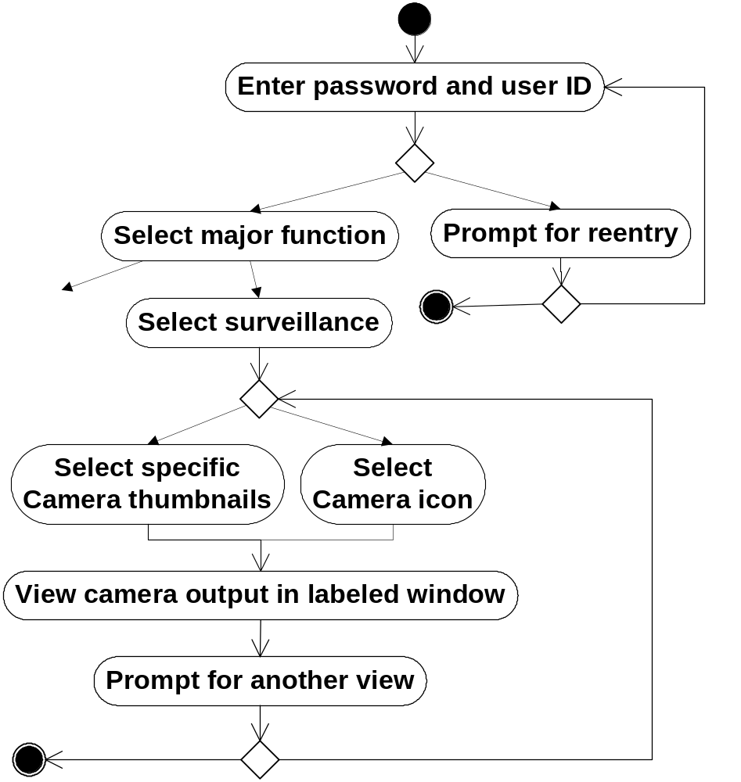
Activity diagram
Valid passwords/ID
Invalid passwords/ID
Other
functions
No input
Tries remain
Input tries
remain
Thumbnail views
Select a specific camera
Exit
See another camera
13/35

Slide 21
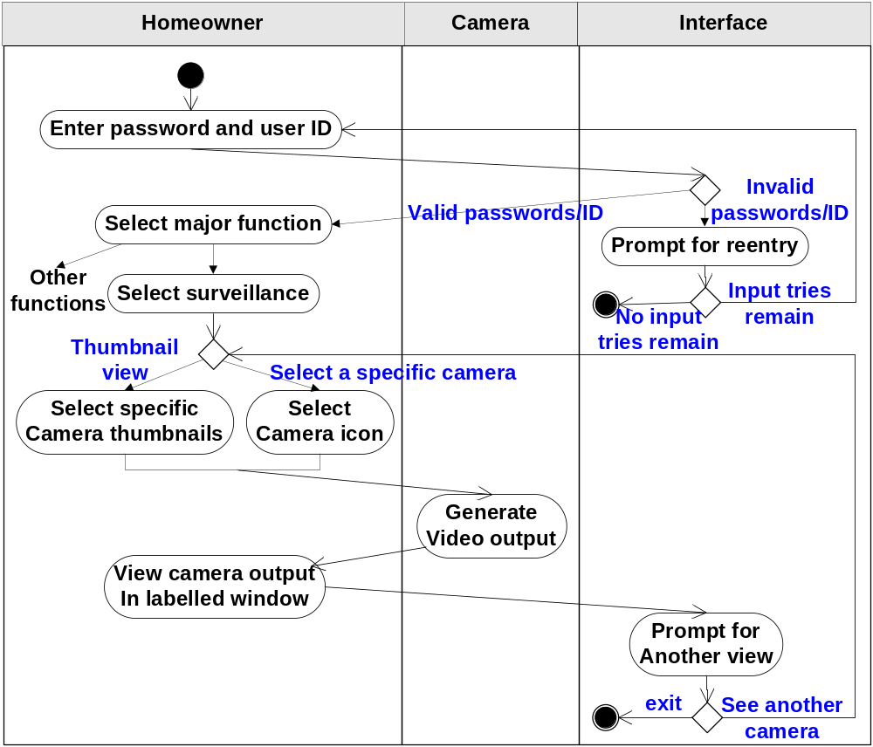
Swimlane diagram
14/35

Slide 22
8.6 Flow-Oriented Modeling
computer
based
system
input
output
System = data + function
Data Flow Diagram
Data
External Entity
Process
Data Stores
15/35

Slide 23
8.6 Flow-Oriented Modeling
Example: [ From《Fundamentals of Software Engineering》]
Information System of a Public Library
if { user requests a book (title, author, user’s name) }
{ Get a book }
→ book, and user’s list of books borrowed;
if { user searches a book by topics }
{ Search by topics }
→ list of book titles referring to the topic.
16/35
Notes:
Try it.

Slide 24
8.6 Flow-Oriented Modeling
Book
Book request by the user
Shelves
Title and author of requested book;
name of user
Author
List of Authors
Get a
book
Book
Book
reception
Title
Book title;
user name
List of titles
List of books borrowed
Title
Search
by topics
List of topics
Display of list of titles
List of titles
referring to the topic
Topic
Topic
Topic request by the user
17/35

Slide 25
8.6 Flow-Oriented Modeling
Refinement:
Book request = Find book position + Get a book
Book
Get a
book
Shelves
Book
Book
reception
Author
<shelf#, book#>
List of Authors
Find book
position
Title
Book title;
user name
List of titles
Title and author
of requested book;
name of the user
List of books borrowed
Book requested
by the user
18/35

Slide 26
8.6 Flow-Oriented Modeling
The Data Flow Hierarchy
a
b
x
P
y
level 0
Please read the SafeHome example
in Section 8.6.1
a
c
P2
level 1
f
P1
P4
b
d
P5
P3
e
g
level 2
f
f1
f2
P4.1
P4.2
P4.5
g
e
e1
e2
P4.3
P4.4
19/35

Slide 27
8.6 Flow-Oriented Modeling
Control Flow Diagrams
Represents events and the processes that manage events
An “event” is a Boolean condition that can be ascertained by:
  listing all sensors that are "read" by the software
  listing all interrupt conditions
  listing all switches that are actuated by an operator.
  listing all data conditions
  review all control items as possible for control flow inputs/outputs
  identify system’s states, how each state is reached, and the transition between states
  Is there any other way I can get to this state or exit from it?
20/35

Slide 28
8.6 Flow-Oriented Modeling
Resetting
Entry/set systermStatus “inactive”
Entry/set displayMsg1 “Starting system”
Entry/set displayMsg2 “Please wait”
Entry/set displayStatus slowBlinking
Do: run diagnostics
Idle
Entry/set systermStatus “inactive”
Entry/set displayMsg1 “Ready”
Entry/set displayMsg2 “”
Entry/set displayStatus steady
KeyHit / handleKey
System OK
Start/switch power “on”
Reset
Off/powerOff
Activate
Deactivate password
failureDetected /
Set displayMsg2 “contact Vendor”
Deactivate password
Senser triggered / Start timer
ActingOnAlarm
Entry/set systermStatus “MonitorAndAlarm”
Entry/set displayMsg1 “ALARM”
Entry/set displayMsg2 triggeringSenser
Entry/set displayStatus fastBlinking
Do: MonitorAndControlSystem
Do: soundAlarm
Do: notifyAlarmResponders
KeyHit / handleKey
MonitoringSystem
Entry/set systermStatus “monitoring”
Entry/set displayMsg1 “Armed”
Entry/set displayMsg2 “”
Entry/set displayStatus steady
Do: MonitorAndControlSystem
KeyHit / handleKey
Time out
False alarm
Senser triggered / Restart timer
21/35

Slide 29
8.7 Class-Based Modeling
Identify analysis classes by examining the problem statement
Use a grammatical parse to isolate potential classes
Identify the attributes of each class – define the object
Identify operations – manipulate the attributes
22/35

Slide 30
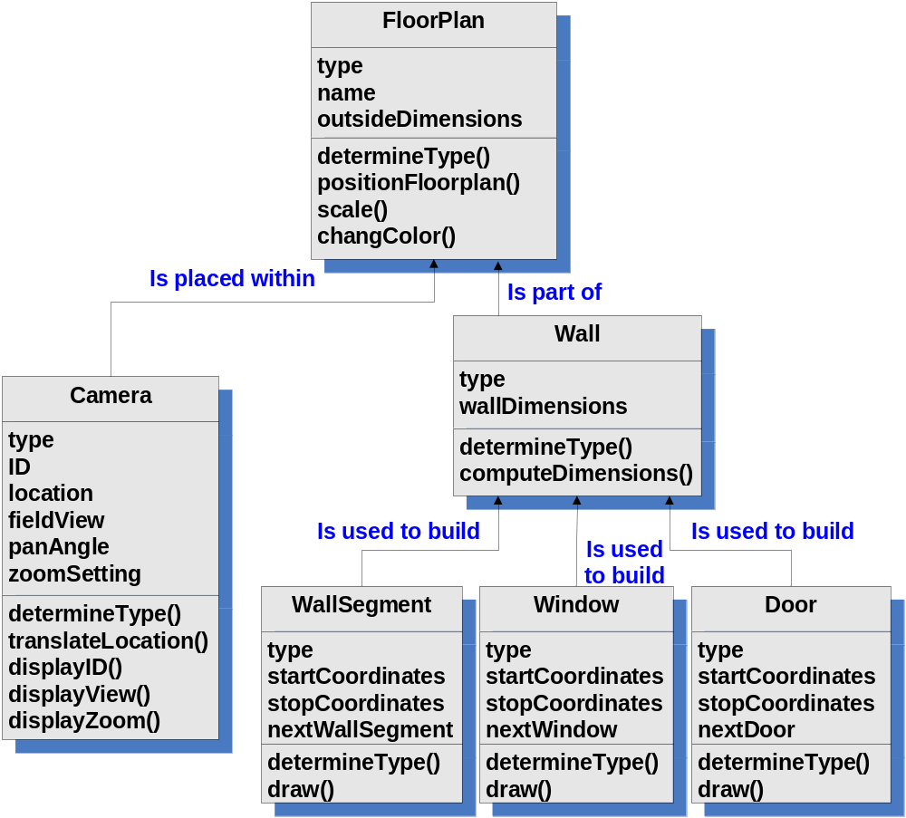
8.7 Class-Based Modeling
Class Diagram
23/35

Slide 31
8.7 Class-Based Modeling
CRC Modeling
Class:
Class:
Description:
Class:
Description:
Class:
FloorPlan
Description:
Responsibility:
Collaborator:
Description:
Responsibility:
Collaborator:
Responsibility:
Collaborator:
Responsibility:
Collaborator:
defines floor plan name/type
manages floor plan positioning
scales floor plan for display
Anything the class knows (attributes) or does (operations)
Those classes required to provide the info needed to complete a responsibility
scales floor plan for display
incorporates walls, doors and windows
Wall
shows position of video cameras
Camera
24/35

Slide 32

8.7 Class-Based Modeling
Composite Aggregate Class
25/35

Slide 33
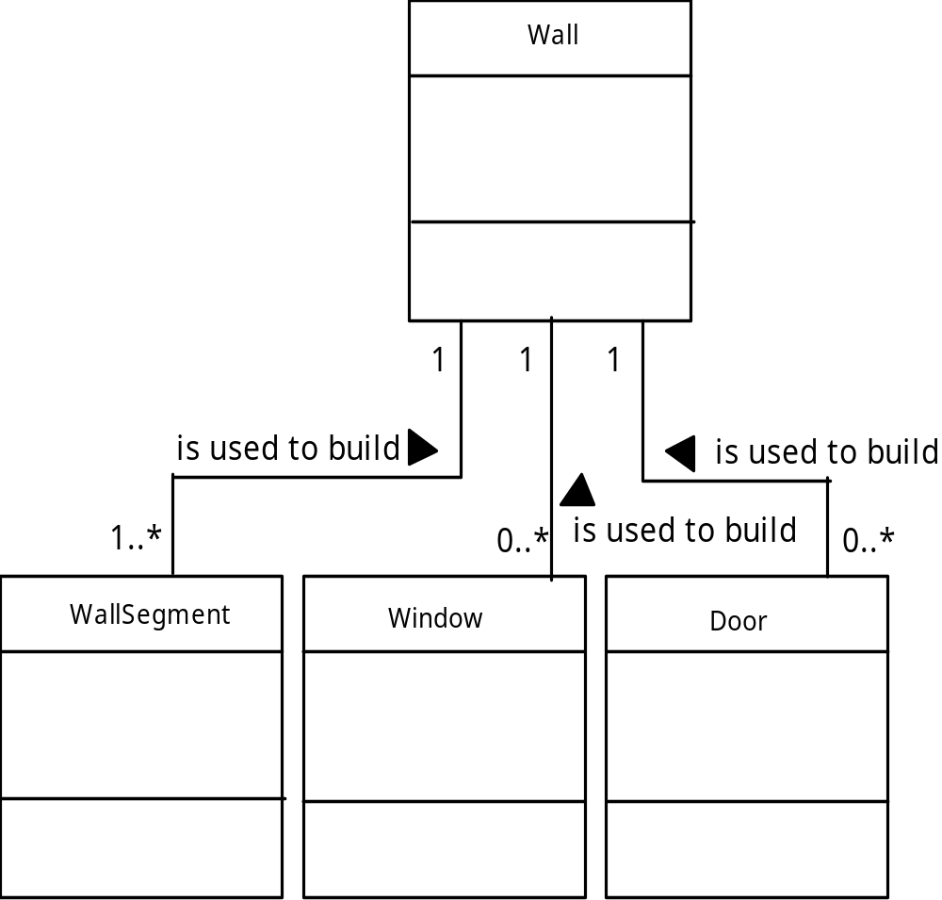
8.7 Class-Based Modeling
Multiplicity
26/35

Slide 34
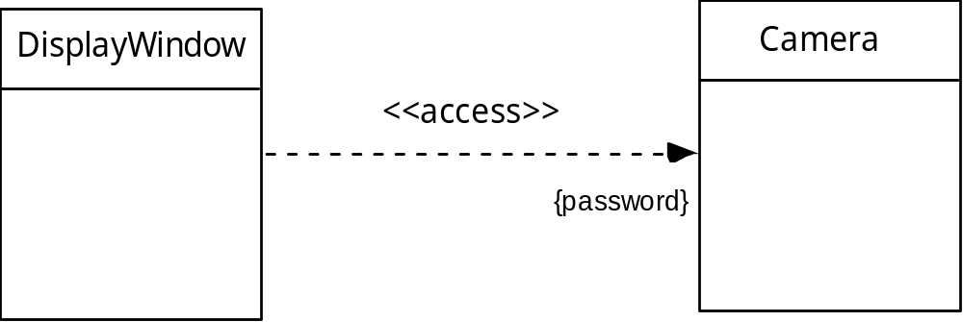
8.7 Class-Based Modeling
Dependencies
27/35

Slide 35
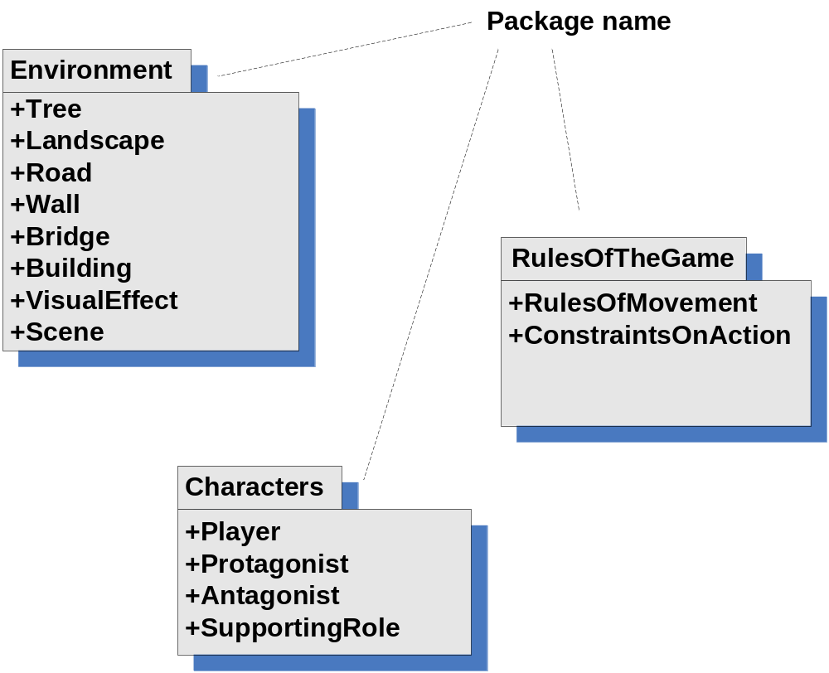
8.7 Class-Based Modeling
Analysis Packages
+ public
– hidden
# accessible only to a given package
28/35

Slide 36
8.8 Creating a Behavioral Model
The behavioral model indicates how software will respond to external events or stimuli. To create the model, the analyst must perform the following steps:
  Evaluate all use-cases to fully understand the sequence of interaction within the system.
  Identify events that drive the interaction sequence and understand how these events relate to specific objects.
  Create a sequence for each use-case.
  Build a state diagram for the system.
  Review the behavioral model to verify accuracy and consistency
29/35

Slide 37
8.8 Creating a Behavioral Model
In the context of behavioral modeling, two different characterizations of states must be considered:
  the state of each class as the system performs its function and
  the state of the system as observed from the outside as the system performs its function
The state of a class takes on both passive and active characteristics.
  A passive state is simply the current status of all of an object’s attributes.
  The active state of an object indicates the current status of the object as it undergoes a continuing transformation or processing.
30/35

Slide 38
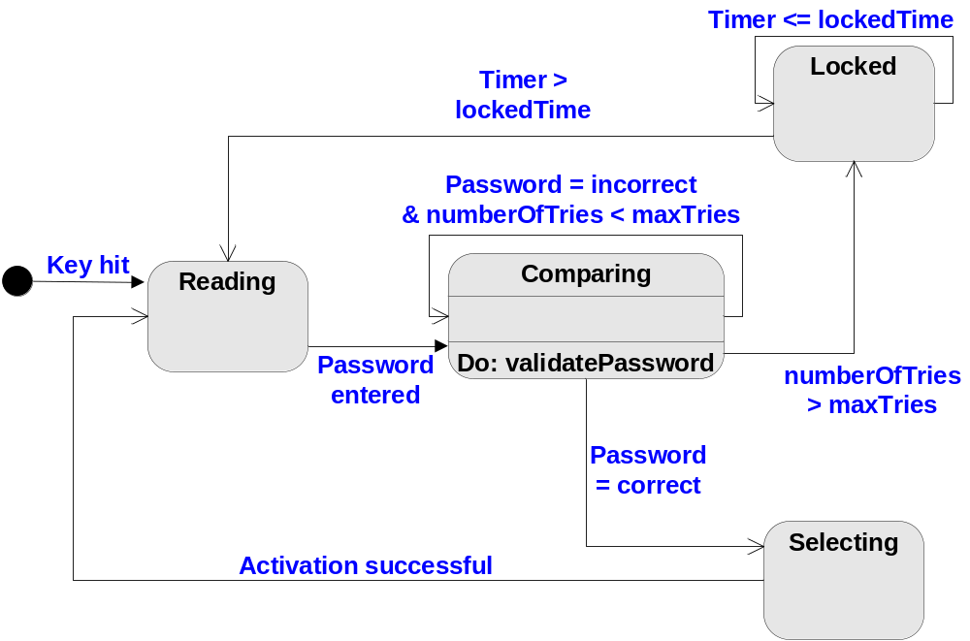
8.8 Creating a Behavioral Model
State Diagram
ControlPanel
31/35

Slide 39
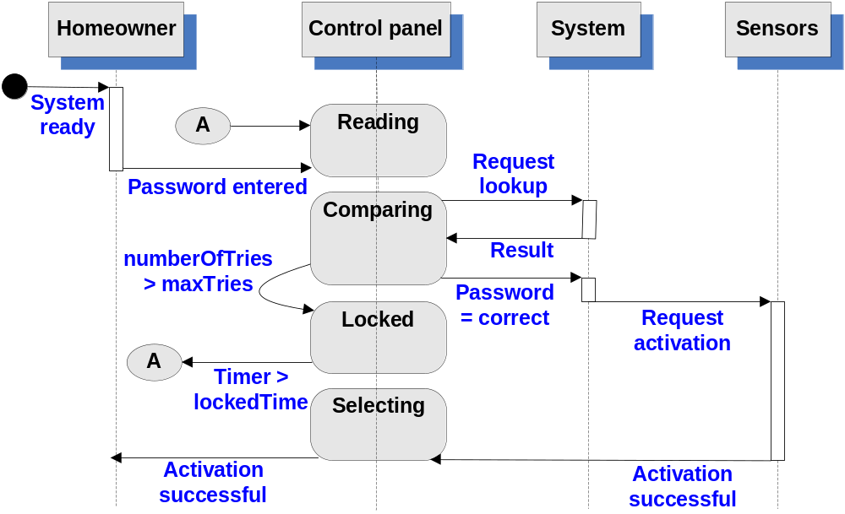
8.8 Creating a Behavioral Model
Sequence Diagram
32/35

Slide 40
Writing the Software Specification
Everyone knew
exactly what had to be
done until someone
wrote it down!
33/35

Slide 41
Specification Guidelines
use a layered format that provides increasing detail
as the "layers" deepen
use consistent graphical notation and apply textual
terms consistently (stay away from aliases)
be sure to define all acronyms
be sure to include a table of contents; ideally,
include an index and/or a glossary
write in a simple, unambiguous style
always put yourself in the reader's position, "Would
I be able to understand this if I wasn't intimately
familiar with the system?"
34/35

Slide 42
《Software Requirements Specification》
Due: 22:00 on April 9th, 2012
Minimum requirement of contents:
Introduction (2 points);
User Scenarios(8 points); Data Flow Diagram (7 points); State Diagrams(5 points); Class Diagrams(5 points) and CRC Cards (5 points);
Validation Criteria (15 points).
Concerned points:
The accuracy of the validation criteria: full marks can be obtained if more than 90% of the functions are covered. The acceptance testing of the subsystem version 1.0 will strictly go by the criteria.
The language and style of the document must be uniformed (3 points).
Grading: The full mark = 50 points × number of participants
35/35

