Slide 1
Ginger-derived exosome-like nanoparticles (GiNV)
Intraperitoneal

Slide 2
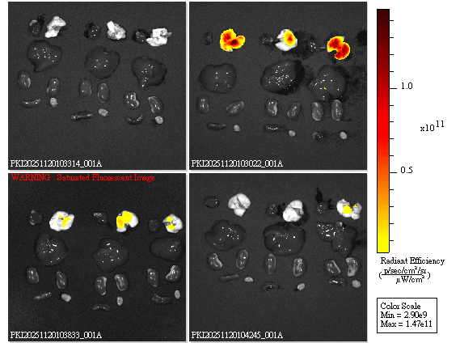
Ginger-derived exosome-like nanoparticles (GiNV)
Intratracheal

Slide 3
Ginger-derived exosome-like nanoparticles (GiNV)
Oral

Slide 4
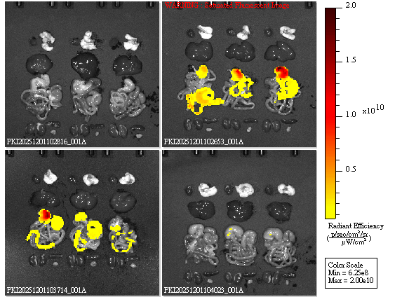
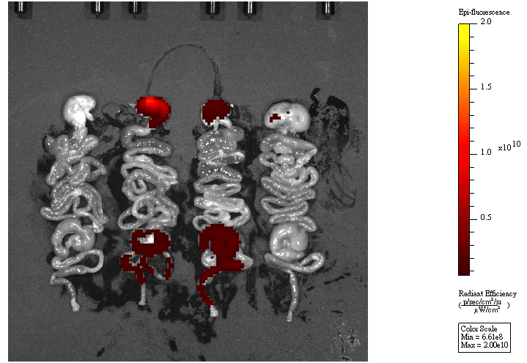
Garlic-derived exosome-like nanoparticles (GaNV)
Oral

Slide 5
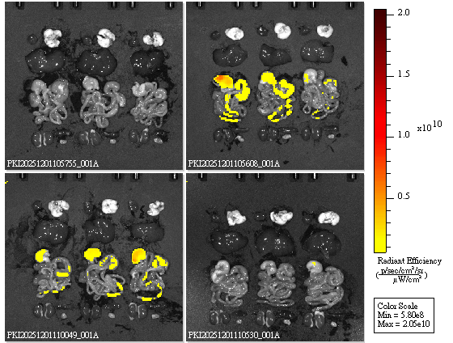
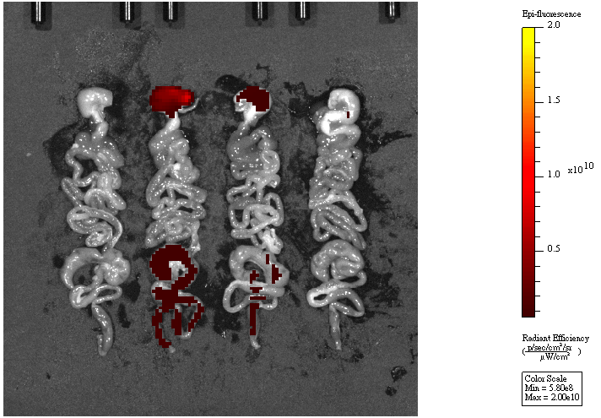
Kale-derived exosome-like nanoparticles (KaleNV)
Oral

