Slide 1
Sham vs Sham10W: 健康基準線綜合分析
Sham vs Sham10W: Healthy Baseline Integrated Analysis
DN_GaExo Project | 2026-05-01

Slide 2
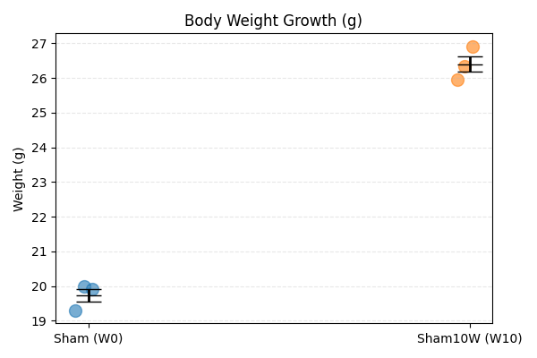
生理成長動態 (Physiological Growth)

Slide 3
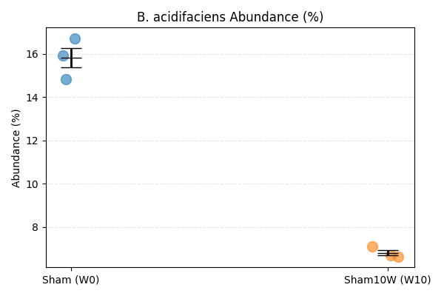
優勢菌種演替 (Microbial Succession: B. acidifaciens)

Slide 4
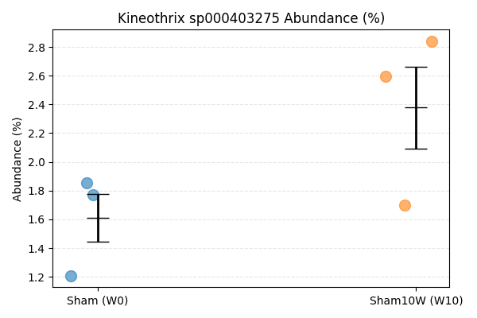
功能菌群穩定性 (Functional Stability: Kineothrix)

Slide 5
科研啟發 (Scientific Insights)
1. 排除時間干擾 (Excluding Time Interference):
- Kineothrix 在健康組中穩定，顯示其在疾病組的下降為病理特異性。
- Stable Kineothrix in health indicates its loss in disease is pathologically specific.
2. 基準線價值 (Baseline Value):
- 建立 GaExo 修復力的「健康金標準」。
- Establishing the 'Healthy Gold Standard' for GaExo restoration potential.

