Slide 1
Microbiome Analysis: Sham vs Sham10W
DN_GaExo Project
Visualized Abundance & Significance Markers

Slide 2
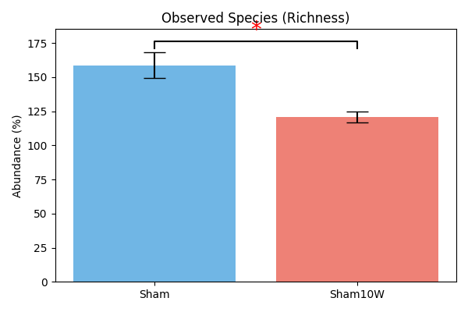
Alpha Diversity: Observed Species

Slide 3
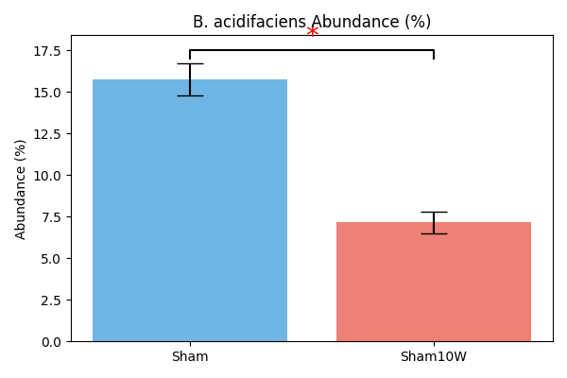
Significant Decrease: B. acidifaciens

Slide 4
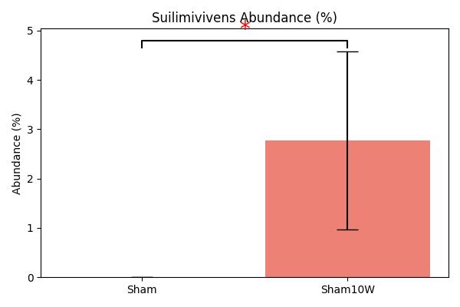
Significant Increase: Suilimivivens sp000403495

Slide 5
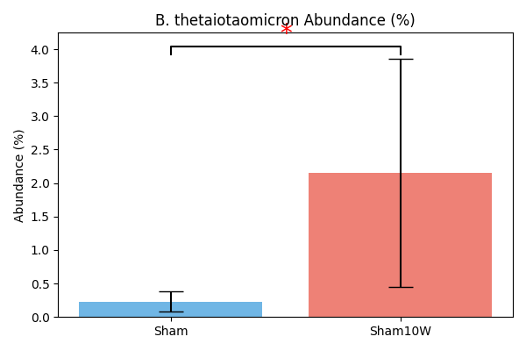
Significant Increase: B. thetaiotaomicron

Slide 6
Summary of Significant Changes
Key Findings (p < 0.05):
- Significant loss of microbial richness (Observed species)
- Major reduction in core commensal B. acidifaciens
- Emergence/Proliferation of B. thetaiotaomicron & Suilimivivens
- Markers (*) indicate p < 0.05 via Kruskal-Wallis

