Slide 1


MERR: Improving Security of Persistent Memory Objects via Efficient Memory Exposure Reduction and Randomization
Yuanchao Xu, Yan Solihin, Xipeng Shen

Slide 2

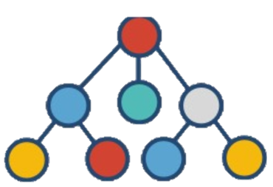

Persistent Memory (PM)
Processor
ld/st Instructions
DRAM
Persistent Memory
Persistent Data Structure
Fast
Disk
Non-volatile
Notes:
2: In the traditional memory hierarchy, DRAM prodive a good performance. But the data is volatile. The data in the disk is non-volatile. But accessing disk data is slow. Now, there is a new technology, persistent memory. It combines the advantages of DRAM and Disk. Persistent memory provides DRAM-like performance, non-volitile and high density features. Processors can use regular ld/st instructions to access persistent data without serialization of the file system. Persistent memory also keeps fruitful data structure as persistent data to avoid re-construction. However, when we enjoy the benifits of persistent memory. We also meet security problems.

Slide 3



Security is more Important for PM
No System calls
Dangling Pointer
Victim Data
DRAM
Persistent Memory
Attacker
Users
Notes:
3: Security in the PM is more important. Without system calls protection, like open or close files. The attacker is able to use a dangling pointer to perform unauthorized reads and writes to the data. After they corrupted data, the corrupted data in the DRAM won’t be propagated to other processes beyond this process lifetime. However, the corrupted persistent memory data is able to propagate to other users beyond this process lifetime. To improve the security of persistent memory

Slide 4
Idea: Memory Exposure Reduction & Randomization
mmap (PM)
access PM
access PM
access PM
munmap (PM)
Program:
Time
Memory Exposure
Attacker
Notes:
We propose an idea:~
In the traditional program, the program will malloc the data and then perform acessess. After the last access, the program free the data. Between the malloc and free, the data is memory maped to this process. We regard this memory is exposed. This period time is memory exposure. The attacker is able to use the vulnerabilities to lauch attacks during the memory exposure. Our idea is to reduce the memory exposure into small temperature windows.

Slide 5
Idea: Memory Exposure Reduction & Randomization
mmap (PM)
access PM
access PM
access PM
munmap (PM)
Program:
Time
Memory Exposure Reduction
Address Randomization
Info.
Attacker
Notes:
The data is not mapped to a process out size these windows. Every time when we open the small temperature window, we also perform a runtime randomization. In this way, when the attackers try to launch software attacks outside the windeos, they will recive segement faults since the data is not mapped. Even though the attcker obtain some information, like memory layout, from a previous window. These infomation is useless in the next window due to runtime re-randomization.
Our method is not spefici to a perticular kind of attacks. We generally reduce vulbility to perform software memory discure and memory currption attacks. To efficently support this idea, we design MERR

Slide 6
MERR
Page Table Design
Architectural Support
MERR
Time
Notes:
It includes a simple but efficent page table design and a novel architecture support

Slide 7
MERR
Page Table Design
Architectural Support
MERR
70% Reduction 10% Overhead
Time
80us Temporal Window
10^5 Randomization Frequency
Notes:
The entire design is able to reduce 70% memory exposure rate with 10% overhead. Meanwhile, it provides a maximum 80us temporal window. At the same time, it provides 100 thougs randomization frequency with similar overhead compared to state-of-art heap data randomization work.

Slide 8
Outline
Attach and Detach system calls
Page table design
Randomization
Architecture support
Evaluation
Notes:
The following presentation

Slide 9
Attach & Detach
Process Address Space
Physical Address Space
Attach
(PMO ID, Permission)
PTEs
PMO
Detach(PMO ID)
Persistent Memory Object (PMO)
Notes:
One programming model of persistent memory uses attach and detach system calls. The persistent data is ognized as persistent memory objests in the physcial memory space. When an attach system call is invoked with PMO ID and permission. The process will initialied PETs that point to this PMO. The process can just use regular ld/st instructions to access this PMO. We assume the system has relocality support. This support can be either hardware or software. When a detach system call is invoked with PMO ID. This process will clean these PETs. Then, this data is removed from process address space. However, the overhead of attach/detach is not small.

Slide 10
Efficiency Challenge
Process Hierarchy Page Table
Physical Address Space
L3 Directory
L2 Directory
L1 Directory
Attach
(PMO ID, Permission)
PTE
PTE
PTE
PTE
PTE
I GB PMO
PMO Access
PTE
PTE
PTE
…
PTE
…
262657 PTE Initiations!
Page Faults
Notes:
Because current system use a hiereachy page table. For a 1GB PMO, when a attach system call is invoked, it needs to initalied 1 PTE in L3 dircotry, 512 PTEs in L2 dirctory, 200 thousand PTEs in L1 dirtory. There are 200 thousand PTE initilizations. The memory access to a recently-mapped PMO also incurs page faults. The challenge is how to support attach detach efficently.

Slide 11
Embedding Page Table Subtree
Process Hierarchy Page Table
Physical Address Space
L3 Directory
L2 Directory
L1 Directory
PTE
PTE
PTE
PTE
I GB PMO
PTE
PTE
PTE
…
PTE
…
Notes:
Our idea is embeding the page table subtree into PMO.

Slide 12


Embedding Page Table Subtree
Process Hierarchy Page Table
Physical Address Space
L3 Directory
1GB PMO
Attach
(PMO ID, Permission)
PTE
Metadata
Data
Detach (PMO ID)
Page Table Sub Tree
Data
PTE
PTE
PTE
PTE
PTE
PTE
PTE
PTE
One PTE Modification!
Notes:
This page table subtree is a part of metadata in the PMO. Now, when an attach system call is invoked for a 1GB PMO, the process only need to initlied one PTE. Then this PMO is mapped to this process. The process can use regular ld/st instruction to access entire PMO under the permission control. When an detach system call is invoed to this PMO. The process only need to clean one PTE to remove entire 1GB PMO from the process address space. This process is not able to access any data in this PMO. Whater how large the PMO is, both attach and detach system calls only need to modify one PTE.

Slide 13
PMO Space Layout Randomization
Process Hierarchy Page Table
Physical Address Space
L3 Directory
1GB PMO
Attach
(PMO ID, Permission)
PTE
Metadata
Data
PTE
Page Table Sub Tree
Data
PTE
PTE
PTE
PTE
PTE
PTE
PTE
PTE
PTE
…
Notes:
Based on this design, we are able to perform fast address space re-randomization. We call it PMO space layout randomization. For the attach system call, the random selector can select one of many possible PTEs. Then, it just intilied one PTE, the rerandomization is finished. For the relocatability support, perisistent memory programming model already has the relocalability support in software or hardware. we already have all reduction and randomization support. However, a new problem raises

Slide 14
Permission Control Challenges
Process Hierarchy Page Table
Physical Address Space
L3 Directory
1GB PMO
Attach
(PMO ID, Permission)
PTE
Metadata
Data
Page Table Sub Tree
Data
PTE
PTE
PTE
PTE
PTE
PTE
PTE
PTE
Notes:
The problem is permission control of PMO. When the process finishes the attach system call as previous steps.

Slide 15
Permission Control Challenges
Process Hierarchy Page Table
Physical Address Space
Default
Permission
1GB PMO
L3 Directory
Attach
(PMO ID, RW)
PTE
PTE
PTE
PTE
PTE
Data
PTE
PTE
PTE
…
PTE
…
Permission
Notes:
The requested read write permission is actually supported. In the current system, permission is per page permission which is checked in TLB. The permission is set and stored in the last level page table directory. We may use a default permission of this PMO. But when the requested permission is different from the default permission. All of last level PTEs need to be changed.

Slide 16
Permission Control Challenges
Process 1 Hierarchy Page Table
Physical Address Space
1GB PMO
L3 Directory
Attach
(PMO ID, RW)
PTE
PTE
PTE
PTE
PTE
Data
Process 2 Hierarchy Page Table
PTE
PTE
PTE
…
L3 Directory
PTE
Attach
(PMO ID, RO)
…
PTE
Different Permission
Notes:
Moreover, when a PMO is shared by two process with different permission, read write and read only. Only one embedded page table subtree cannot support this.

Slide 17
Permission Matrix
Attach
Detach
Permission
Matrix
Process-wide PMO Permission
ld/st instruction
Most Strict Permission
TLB
Page-level Permission
Notes:
Therefore, we propose an on-chip permission matrix per core to support Process wide PMO permissions in different processes. The basic idea is following, the ld/st instruction will use viritull address to check agained both TLB and permission matrix. Then, the process-wide PMO permission and page-level permission are obtained. After that, this access will check against most strict permission among these two to decide whether this access is legmaticl. Entires in the permission matrix are added by attach and entires are removed by detach.

Slide 18
Permission Matrix Basic Design
Permission Matrix
VA Start
VA End
Permission
Virtual Address (VA)
VA Start
VA End
Permission
VA Start
VA End
Permission
…
High Overhead in Critical Path!
Notes:
A basic design of this idea is following: For attached PMO, the entiry of this PMO in the permission matrix has virtual address start, virtual address end and the permission. There are several entries in the permission matrix. The virtual address need to check all of them to find a match. Because this permission matrix check is on the crtital path. Even several cycles overhead is critial. To solve this problem, we propose a virtual address tag to check against virtual addresses.

Slide 19
Virtual Address Tag in Permission Matrix
VA Prefix
VA Suffix
Process Hierarchy Page Table
Physical Address Space
PMO
L2 Directory
4KB~2MB
Page Table Subtree
PTE
VA Start
PTE
Data
PTE
…
PTE
VA End
Invalid
…
Never Used
Invalid
Notes:
Let’s go back to the page table. For a PMO, the size is larger than 4KB and it is smaller than or equal to 2MB. During attach system call, a L2 directory entry will point to the embedding page table subtree in this PMO. The direcotry is also page alined. So some of above entires in this direcotry page point to actual data. Other bottom entires are invalied. The VA start is the VA that the first valid PTE points to. The VA end is the VA that the last valid PTE point to. Actually, these invalid PTE won’t be used by process address space. Then, we can partition the VA address range for a PMO into two parts. The prefix is used to locate the last level PTE outside PMO page table subtree. The suffix is used to locate the PTE inside PMO subtree. All data in the PMO can use the same size suffix to locate. Then, we can design VA tag to represent virtual address range of a PMO. VA tag has two parts.

Slide 20
Virtual Address Tag in Permission Matrix
VA Tag
VA Prefix
VA Suffix
Notes:
first part is the prefix. The second part are represetn as several x

Slide 21
Virtual Address Tag in Permission Matrix
0 bit
PMO Size = 4KB
VA Tag
VA Prefix
9-bit x…x
4KB < PMO Size <= 2MB
xxx…x
18-bit x…x
2MB < PMO Size <= 1GB
Content Addressable Memory (CAM) Locate Exact one Entry From VA!
x means all match in Content Addressable Memory
Notes:
X means all match when it compare against VA. Then dependes on the PMO size, the suffix has differnt wide. For the PMO has 4KB. There is 0 bit suffix. For the PMO is larger than 4KB smaller than or equal to 2MB, VA tag with 9bits x suffix can represent all virtual address of this size PMO. For the PMO is larger than 2MB but smaller than or equal to 1GB. VA tag with 18bits x suffix can represent all virtual address of this size PMO. These VA tag are non-overlapped. With this tag design, we can use content addressable memory to locate the entry in on shot.

Slide 22
Permission Matrix Design
Virtual Address (VA)
Permission Matrix (CAM)
VA Tag
Permission
Process-wide PMO Permission
VA Tag
Permission
VA Tag
Permission
…
Notes:
In this way, permission matrix entires have VA tag and permission. The virtual address is compared against all entires in CAM. The permission is derived when these is a match.

Slide 23
Evaluation Methodology
Workloads:
WHISPER benchmarks
Operating System Overhead:
Implement attach and detach library to replace mmap() and munmap()
Architectural Overhead:
Intel Pin toolkit
Trace-Driven Simulation
Notes:
Then, it is the time to evaluate the whole design. We use WHIPSER benchamrks to evaluation our results. This benchmarks are built from real world perisistent memory application. For the operating system overhead, we implement attach/detach libary to replace mmap() and munmap(). We obtain the operating system overhead on the real matchine. We use Trace driven simulatoion to obtain the architectural overhead.

Slide 24

Evaluation Metrics
Attached Memory Exposure Rate (AMER)
Time
AMER =$\frac{Reduced Time}{Original Time}$
Notes:
We mainly use 3 metrics during the evaluation. First is attached memory exposure rate.

Slide 25
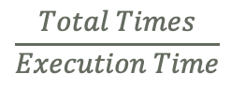
Evaluation Metrics
Attached Memory Exposure Rate (AMER)
Memory Exposure Window (MEW)
PMO Space Layout Randomization Frequency (PSLR Frequency)
Time
AMER =$\frac{Reduced Time}{Original Time}$
MEW
$$\frac{Total Times}{Execution Time}$$
PSLR Frequency =
Notes:
This represent the overall exposure time after the reduction. Second is memory exposure window. This represent the size of temporal memory exposure window. The third is PMO space layout randomization frequency. This present how much time a PSLR is perform.

Slide 26

Evaluation Metrics
Attached Memory Exposure Rate (AMER)
Memory Exposure Window (MEW)
PMO Space Layout Randomization Frequency (PSLR Frequency)
Time
AMER =$\frac{Reduced Time}{Original Time}$
MEW
$$\frac{3}{ Execution Time}$$
PSLR Frequency =
Notes:
In this example, there are 3 times randomization during the exeuction.

Slide 27
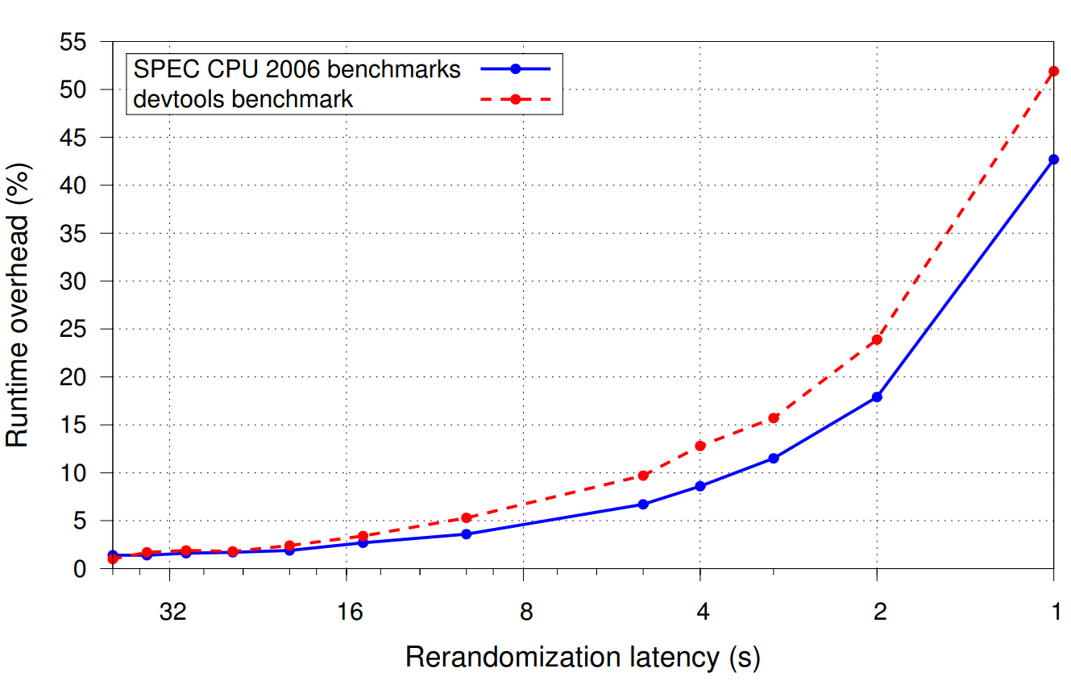
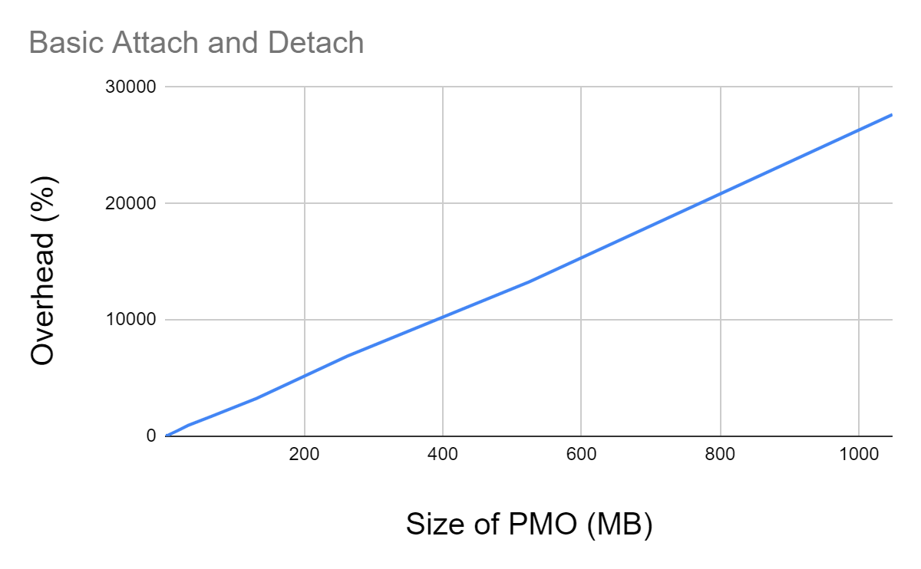
Performance
About 10% overhead
30% AMER (70% Reduction)
80us Maximal MEW
PSLR per 41us
To achieve above goals
Enhanced ASLR
2700x Speedup
More results in the paper
10^5 per Second Frequency
Notes:
Lets take a look of performance overhead. The value of these three metrics are strong related to the overhead. There are many sensitive study of these metrics in the paper. Now, we only introduce that, with 10% overhead, our design is able to provide 70% memory exposure reduction, maximal 80us MEW, PSLR is perform every 41 us. How much efficieny we obtained from these design? To achieve above goals, basic attach/detach system call overhead is linearly with the size of PMO. For 1 GB PMO, our method is 2700 faster than default attach/detach. How is the performance with other work. Enhanced ASLR provides heap data runtime randomization. At the 10% overhead, our frequency is 100 thousand higher than this work.

Slide 28

Security of MERR
No Protection
Probe
Weaponize
Attack
~10ms
Probe
Weaponize
Attack
Onetime ASLR
More analysis in the paper
~seconds
80us Maximal MEW
Probe
Error
Probe
Error
Probe
Error
+ PSLR
Probe
Error
Probe
Error
Probe
Error
…
80us Attacker Surface
Time
Notes:
Lets take a look of securty analysis. For a no protection program, The attack needs to prob to get information, weaponize the attack, then lauch the attack. Attacks typically use 10mill seconds at the probe stage. With one timeASLR support, attacker just need seconds to probe the information. With our 80us maximal MEW, the when the attackers probe outside the window, they actualy perform a false probe for a PMO since they will just recieve error. Even though the meltdown can bypass kernel space isolation, it still can’t read unmapped data. Combined with PSLR, the memory layout information is changed every time when the data is exposed. The memory layout information the attacker obtained is invalid every times when they are able to perform a real probe. They only have 80us attack surface to perform attacks. There are more examples and analysis in the paper.

Slide 29
Conclusion
New angle to improve security through reduce memory exposure and randomization
Improved efficiency by page table design and architectural support
Achieved 70% memory exposure reduction and 80us memory exposure window with about 10% overhead on real world applications
Provided An Order-of-magnitude speedup compared to state-of-art runtime randomization

