Slide 1



Hardware-Based Domain Virtualization for Intra-Process Isolation of Persistent Memory Objects
Yuanchao Xu, ChenCheng Ye, Yan Solihin, Xipeng Shen

Slide 2

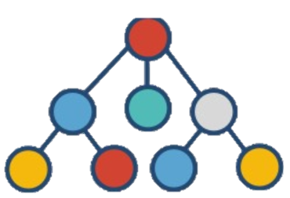

Persistent Memory (PM)
Processor
ld/st Instructions
DRAM
Persistent Memory
Persistent Data Structure
Fast
Disk
Non-volatile
Notes:
In the traditional memory hirachy. DRAM provide fast data access but the data in the dram is volital . Disk can keep data persistent but accesing Disk is slow.

Slide 3
Attach & Detach Programing Model
Process Address Space
Physical Address Space
Attach
(PMO ID, Permission)
PTEs
PMO
Detach(PMO ID)
Persistent Memory Object (PMO)
Notes:
The persisent memory is origninzed as PMOs. They are stored in the physical address space.
Attach system that mmap PMO to the process address space by initaliing PTEs. Process use ld /st
Detach

Slide 4
Security is more Important for PM
Process Address Space
Physical Address Space
PTEs
PMO1
Corruption is persistent!
Thread 1: Attach(PMO1, RW)
Thread 2: Attach(PMO2, RW)
PTEs
PMO2
Notes:
title -> Here is an example
There are two PMOs in the PAS. Thread 1 invokes the attach system call to mmap PMO1 to the process address space.
Thread 2 from the same process also invokes the attach system calls to mmap PMO2 to the address space.
The thread 2 may use the bugs of the vulenrbility to currpt the data in PMO 2
After the termination of the process. The cupprted data is still there. The curroptin is persisetnt and it will be propogated to all future usage
We proposed to improve the security by using intra-process isoltaion

Slide 5

Intra-process Isolation
Process Address Space
Set Permission
Unset Permission
Domain 1
Domain 2
Data
Data
Intentional or accidental access
Notes:
intra-process isolation will saperate the process address space into several partions. In the example, we speart it into two parts.

Slide 6
Intra-process Isolation for PM
Persistent Memory
Intel Memory Protection Keys
Domain
(unique ID =PMO ID)
16 protection keys
Domains→PKeys
PMO
Notes:
each PMO => domain
PM => many domains
runtime time domain->pkeys

Slide 7
Intra-process Isolation for PM
Persistent Memory
Intel Memory Protection Keys
Domain
(unique ID =PMO ID)
16 protection keys
Domains→Keys
PMO
Application (process)
Hundreds of active domains
Client
Client
Client
Client
Client
Client
…
Notes:
Howerever, server application
frequent remapping from domains to pkeys subsential overhead
two effcietn scalability problem

Slide 8
Contribution
Intra-process Isolation for PM
MPK Virtualization
Domain Virtualization
Modest Aera Overhead
10X Software Virtualization
50X Software Virtualization

Slide 9
Outline
Intel Memory Protection Keys (MPK)
Virtualization Analysis
MPK Virtualization
Domain Virtualization
Evaluation

Slide 10
Intel Memory Protection Keys (MPK)
Memory
PKey 1
Page 1
Page 3
Page 2
Thread 1
Page 4
WRPKRU (PKey 1, RW)
Thread 1 PKRU Register
PKey 1 Permission (--) | …
Thread 2 PKRU Register
PKey 1 Permission (--) | …
Notes:
In memory. many pages
tag with pyhsical kesp
thread private PKRU register recordes the permission of pkeys
thread give

Slide 11
Intel Memory Protection Keys (MPK)
Memory
PKey 1
Page 1
Page 3
Min(Page permission, PKey permission)
Page 2
Thread 1
Page 4
WRPKRU (PKey 1, --)
Thread 1 PKRU Register
Page permission ^ PKey permission
PKey 1 Permission (RW) | …
Thread 2 PKRU Register
Thread 2
PKey 1 Permission (--) | …
Notes:
thread on access pages belong to pkeys 1
min page, pkey
success when minmum
when thred 2 wants
after access,

Slide 12
Intel Memory Protection Keys (MPK)
Memory
PKey 1
Page 1
Page 3
Page permission ^ PKey permission
Page 2
Thread 1
Page 4
Thread 1 PKRU Register
PKey 1 Permission (--) | …
Thread 2 PKRU Register
PKey 1 Permission (--) | …

Slide 13
Intel MPK Workflow
Page Table
TLB
PKRU Register
PFN
Pkeys
PFN
Pkeys
NULL(0)
100
1
PKey 0 Perm. | PKey 1 Perm. | …
100
1
NULL(0)
101
1
NULL(0)
Pkey (1)
102
1
NULL(0)
103
1
NULL(0)
104
1
…
…
Access to 100
Notes:
More detal about MPK
to tag the memory pages, all of these pages for a domain need to be tagged
Then, when an access to one of these pages, TLB will load the PTE from page table with the pkey
after that, the pkyes is used to index the permission in PKRu register
acctually the second permission is the pkey 1 permission

Slide 14
Inefficiency of Software Virtualization
Clean Pkeys
Set Pkeys
TLB invalidations
Store and restore permissions
Page Table
TLB
PKRU Register
PMO 1
PMO 2
PMO 2 Perm.
PFN
Pkeys
100
1
Pkey 0 Perm. | Pkey 1 Perm. | …
PFN
Pkeys
PFN
Pkeys
NULL(0)
103
1
NULL(0)
1
100
1
200
PMO 1 Perm.
PMO 2 Perm.
NULL(0)
NULL(0)
1
101
1
201
NULL(0)
NULL(0)
1
102
1
202
NULL(0)
NULL(0)
1
103
1
203
NULL(0)
1
1
104
NULL(0)
204
…
…
…
…
All steps are needed when access evicted domain/PMO!
~4000 cycles, 1 eviction per 1000 instructions ~ 400% overhead
Notes:
The inef is f
when a PMO alraedy occupy the pkey and we wants to assing this pkey to another PMO.
we need to clcean ,set
permisison
TLB stores out

Slide 15
Two Hardware Virtualization Design
Clean Pkeys
Set Pkeys
TLB invalidations
Store and restore permissions
MPK Virtualization

Slide 16
Two Hardware Virtualization Design
Clean Pkeys
Set Pkeys
TLB invalidations
Store and restore permissions
Domain Virtualization

Slide 17
MPK Virtualization
PTE with PKey
PKey
Page Table
TLB
PKRU Register
PMO 1
PMO 2
PFN
Pkeys
PFN
Pkeys
NULL(0)
NULL(0)
200
1
100
1
NULL(0)
NULL(0)
201
1
101
1
NULL(0)
NULL(0)
202
1
102
1
NULL(0)
NULL(0)
203
1
103
1
NULL(0)
NULL(0)
204
1
104
1
…
…
…
…
…
…
Consecutive Virtual Address
Notes:
basiclly need to clean and set pkeys to finish the remapping in page table level
consetive

Slide 18
MPK Virtualization
PTE with PKey
PKey
Page Table
TLB
PKRU Register
PMO 1
PMO 2
PFN
Pkeys
PFN
Pkeys
NULL(0)
NULL(0)
200
1
100
1
NULL(0)
NULL(0)
201
1
101
1
NULL(0)
NULL(0)
202
1
102
1
NULL(0)
NULL(0)
203
1
103
1
NULL(0)
NULL(0)
204
1
104
1
…
…
…
…
…
…
Consecutive Virtual Address

Slide 19
MPK Virtualization
PTE with PKey
PKey
Page Table
TLB
PKRU Register
PMO 1
PMO 2
PFN
Pkeys
PFN
Pkeys
Virtual Address Range
Pkey
1
…
NULL(0)
200
1
203
1
100
1
1
201
1
200
1
202
204
…
NULL(0)
201
1
101
1
NULL(0)
202
1
102
1
NULL(0)
203
1
103
1
1
204
1
104
NULL(0)
…
…
…
…
Consecutive Virtual Address

Slide 20
MPK Virtualization
PMO 20
Access (VA)
TLB
PKRU Register
TLB Miss
Store
Page Table
Domain Translation TLB
VA Range
PKey
Perm.
PMO1 VA
1
RW
Notes:
here is the work flow of our MPK virtulization design
Memory access to PMO 20, it carrys the virtual address.
When TLB miss, will chenge in parallel
in the domain tra..
then the evicted pkye is selected.
we need to store the permission from PKRU register to

Slide 21
MPK Virtualization
PMO 20
Access (VA)
TLB
PKRU Register
TLB Miss
Store
Page Table
Domain Translation TLB
VA Range
PKey
Perm.
PMO1 VA
1
R-
Writeback
Domain Translation Table
Notes:
write back the content of PMO 1 or domain 1 to the in memory table

Slide 22
MPK Virtualization
PMO 20
Access (VA)
TLB
PKRU Register
TLB Miss
Page Table
Domain Translation TLB
VA Range
PKey
Perm.
PMO1 VA
1
R-
Miss (VA)
Info.
Domain Translation Table
Notes:
after that the VA of PMO 20 access is used to obtain the imformation of PMO20.
these infor will update the entry to map the pkey 1 to domain 20

Slide 23
MPK Virtualization
PMO 20
Access (VA)
TLB
PKRU Register
TLB Miss
Page Table
Domain Translation TLB
VA Range
PKey
Perm.
PMO20 VA
1
RW
Domain Translation Table

Slide 24
MPK Virtualization
No extra runtime overhead
Fast permission changes
PMO 20
Access (VA)
Pkey
PKey Permission
TLB
PKRU Register
PTE
PKey
Update (PKey 1 Perm)
Page Table
Domain Translation TLB
VA Range
PKey
Perm.
PMO20 VA
1
RW
No system calls
Two entry updates
Domain Translation Table
Programmer Transparent
Notes:
After that, the permission of domain 20 will update pkey 1 permission.
Then the pkeys 1 will added to PTE obtained from page table. The composed entry will be put into the TLB.
This the access will get the pkyes from TLB and use the PKyes to index the permission in PKRU register to get the pkeys permission.
All the logic of TLB hit doesn't change . For TLB hits it keeps the promissing feature provided by defualt MPK. no runtime overhead

Slide 25
Second Hardware Virtualization Design
Clean Pkeys
Set Pkeys
TLB invalidations
Store and restore permissions
Domain Virtualization
Notes:
I will introduce .
further TLB invalidations

Slide 26
Inefficiency from TLB invalidations
PKey
Index represents PKey
TLB
PKRU Register
PKey 5 Perm
Thread 0 PKRU register
… | PMO X | …
Thread 1 PKRU register
… | PMO X | …
…
Thread 20 PKRU register
… | PMO X | …
Notes:
before the inefficcy of TLB invalidation,
it is the logic
reasong
same mapping, index represent ID

Slide 27
Inefficiency from TLB invalidations
PKey
Index represents PKey
TLB
PKRU Register
PKey 5 Perm
TLB invalidation
Thread 0 TLB
Thread 0 PKRU register
… | PMO Y | …
PMO X
PKey 5
Thread 1 PKRU register
… | PMO X | …
…
Thread 20 PKRU register
… | PMO X | …
Notes:
when we mapping the pkey 5 from PMO X to PMO Y
The thread 0 holds the old mapping PMO

Slide 28
Inefficiency from TLB invalidations
Pkey
Index represents PKey
TLB
PKRU Register
PKey 5 Perm
TLB invalidation
Thread 0 TLB
Thread 0 PKRU register
… | PMO Y | …
Buffer to replace Pkey mapping
Thread 1 TLB
Thread 1 PKRU register
… | PMO Y | …
…
…
Thread 20 TLB
Thread 20 PKRU register
… | PMO Y | …
Notes:
And all threads holds the same mapping. TLB invalidations are needed for all threads TLBs
our idea is to use the buffer to repalce the key mapping to avoid TLB invalidations

Slide 29
Domain Virtualization
PMO 20
Access (VA)
Extend TLB
TLB Miss
Page Table
Domain Table
VA Range
Domain ID
Notes:
The work flow of domain virtuzation is following
for the PMO 20 access that carry the virtual address
TLB misses , till wil lchage both page table and domain table.
the domain table is used to obtain the domain id from the virtual address

Slide 30
Domain Virtualization
PMO 20
Access (VA)
Domain ID
Domain Perm.
Extend TLB
Permission TLB/Permission Table
PTE
Domain ID
Domain ID
Permission
Page Table
Domain Table
VA Range
Domain ID
Not found → Inaccessible
Thread-private permission control
No TLB invalidation
Fast permission grant/change/removal
Notes:
After that the PTE will add the domain ID and the new PTE will be put into exnted TLB.
Then the access will obtain the domain ID from TLB. the domain ID is ued to check the permission TLB and tnres are backedup with a in memory permission table
e permission TLB will give the permission from the domain ID and not found domain ID will be repated as inaccessble
After that, the domain permission is obtained

Slide 31
Evaluation Methodology
Workloads:
WHISPER benchmarks for 1 PMO
Microbenchmarks with multiple PMOs
Access pattern of multiple PMOs
Randomly choose a PMO ID to access
Architectural Overhead:
Sniper Simulator (details in the paper)

Slide 32
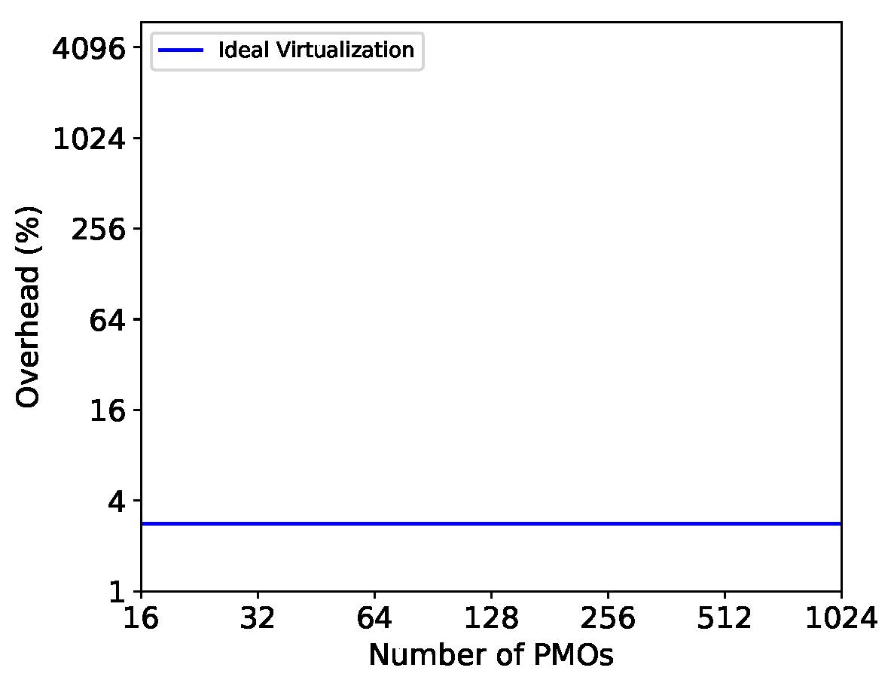
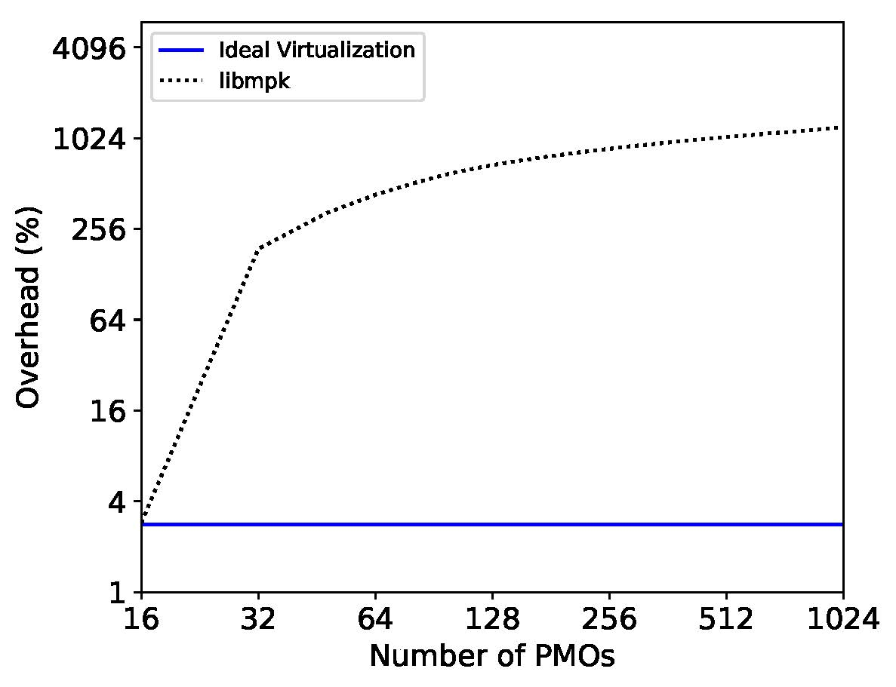
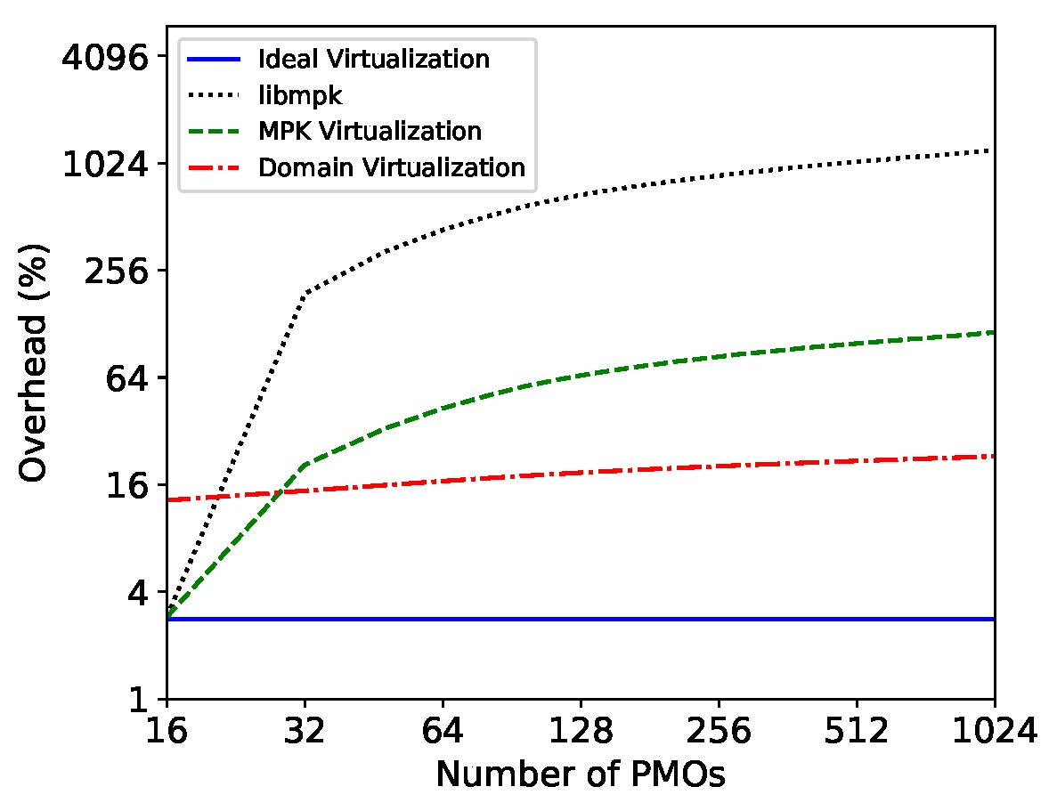
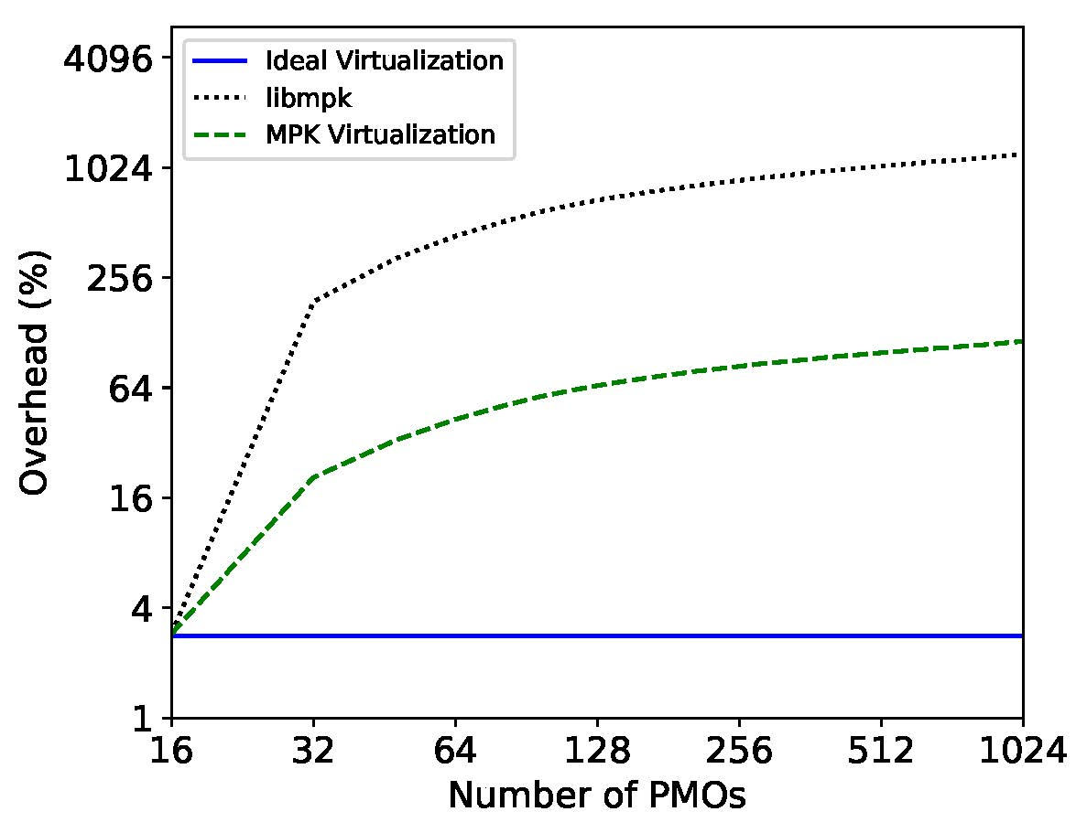
Performance
Microbenchmarks for multiple PMOs
More results & analysis
in the paper
TLB Invalidation
50X Speedup
Cross-point for 16 entries
6X Speedup
10X Speedup
Notes:
I will present microbenchmark resuts. eans the number of active PMOs
yxais is the ovehread compared to no protection program.
ideal vritual means we assume there is no overhead of the virtulzation, it is the unrealict lower bound of the virtulization
Then the dot line is soft. subsitencail for 32 PMOs
the dash line is the hardw MPK virtlza

Slide 33
Conclusion
Proposed protecting PMO by using intra-process isolation
Uncovered scalability limitations of software MPK virtualization for PMOs
Designed the hardware MPK virtualization that builds on top of MPK, achieving 10X speedup for 1024 domains
Designed the domain virtualization that achieves 50X speedup for 1024 domains

