Slide 1
FaaS Slack Bot
Weiguang Yang

Slide 2
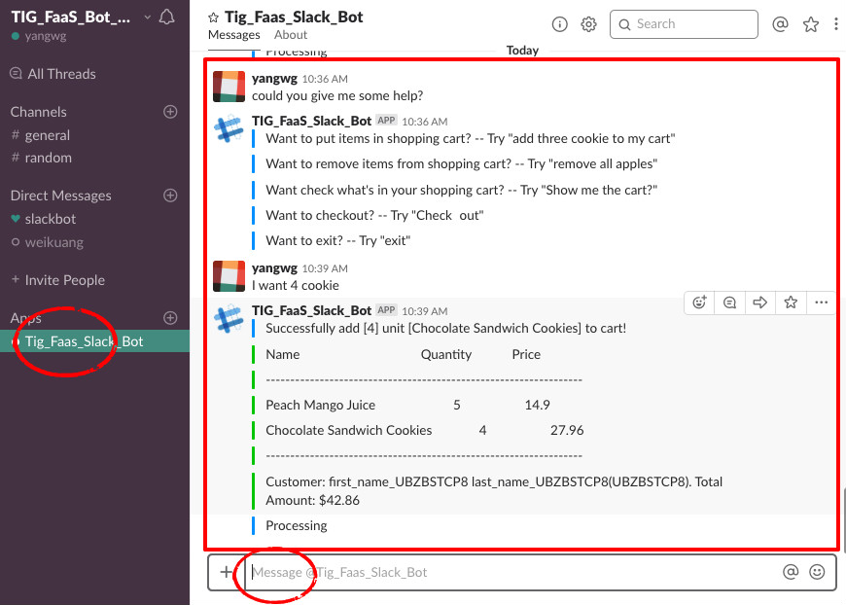
Intro
Build for demonstrating features of FaaS
Receive messages from a user and performs actions like:
add items
remove
check out
help
greeting

Slide 3
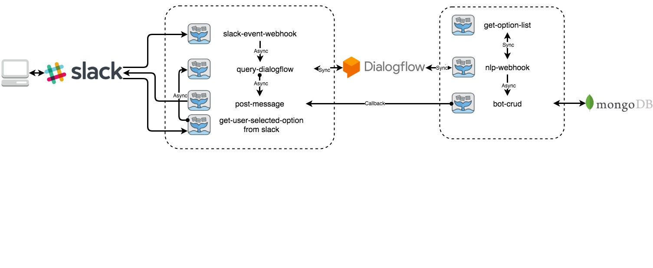
Components
Slack for input and output chat messages
Dialogflow for Natural Language Understanding(NLU)
MongoDB for data persistence
7 FaaS functions for processing running logic

Slide 4
Components
slack-event-webhook: receive events happened in chat window
query-dialogflow: extract user-input from event and query Dialogflow
nlp-webhook: get processed intent/parameters/contexts from Dialogflow, perform corresponding operations
get-option-list: get options when input contains synonym

Slide 5
Components
bot-crud: data persistence
post-message: post response for user-input as a bot user
get-user-selected-options from slack: handle select operation from the user

Slide 6
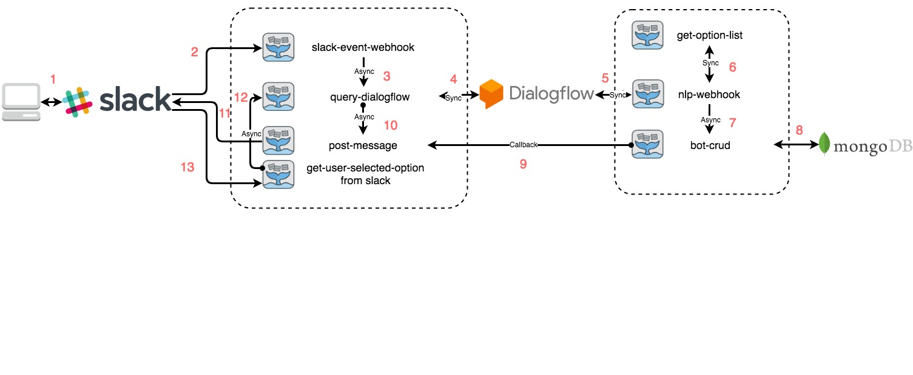
Workflow
Step 1 - Route 1: User input “add 36 juice to the cart” in the Slack Interface
Step 2 - Route 2: Slack sent user input as a event to FaaS function slack-event-webhook
Step 3 - Route 3: Webhook check the message was from user, not the bot, forward this message to function query_dialogflow
Step 4 - Route 4: query-dialogflow initiate an HTTP request to Dialogflow

Slide 7
Workflow
Step 5 - Route 5: Dialogflow process user_input, get intent, extract parameters, send it to function nlp-webhook
Step 6 - Route 6: Webhook handle the request by intent type. For this input, the intent is addToCart, parameter: {quantity: 36, product_name: juice}, nlp-webhook ask get-option-list what kind of juice the store have?

Slide 8
Workflow
Step 7: get-option-list check what kind of juice it has, return option list to nlp-webhook
Step 8 - Route 5, 4: There are 3 kinds of juice, juice a, juice b, juice c. So the webhook return option list, prompt messages back to query-dialogflow
Step 9 - Route 10: query-dialogflow send the dialogflow response to post-message

Slide 9
Workflow
Step 10 - Route 11: post-message post those responses back to slack as a bot user.
Step 11 - Route 1: The bot post a drop-down menu, let user select which juice he/she want to buy.
Step 12 - Route 1: User selects one juice from the list, for example, juice b.

Slide 10
Workflow
Step 13 - Route 13: User's select action (juice b) sent to function get-user-selected-option-from-slack.
Step 14 - Route 12: get-user-selected-option-from-slack extract parameters and send a message ”I choose number 2” on behalf of the user to query-dialogflow

Slide 11
Workflow
Step 15 - Route 4, 5: Again, query-dialogflow send a query request to Dialogflow, then dialogflow send the processed message to nlp-webhook, Now, the intent is addToCart-followup, and know the user want juice b, it could get quantity 36 from Dialogflow context. nlp-webhook call function bot-crud, and send the response. Follow the Route 5, 4, 10, 11, 1, like steps before.

Slide 12
Workflow
Step 16 - Route-7, 9: webhook ask function bot-crud to update cart info, send execute result to callback post-message
Step 17 - Route 11, 1: post-message receives messages from bot-crud, post it back to slack chat window.

Slide 13
Dialogflow - Intents
8 Intents
Greeting: “hi”/ “hey there”/...
Help: “help”/ “I need some help”/...
End: “exit shopping”/ “quit”/...
Check Out: “check out”/ ...
Show Cart: “show me the cart”
Add to Cart: “juice, please”/ “two bottle tea”/ “can I have two milk” /...
follow-up: “I want number 3”/ “the third one” /...
Remove From Cart: ”remove three tea” / ...
follow-up
Remove all: “remove cookie” / “clear the cart” /...
follow-up

Slide 14
Dialogflow - Entities
A POC dataset contains 16 products
7 Juice
3 Sausage
3 Tea
2 Milk
1 Cookie
tea: “Organic Breakfast Blend Black Tea”, “Organic Earl Grey Black Tea”,“Sencha Shot Japanese Green Tea”
black tea: “Organic Breakfast Blend Black Tea”,“Organic Earl Grey Black Tea”
blend tea: “Organic Breakfast Blend Black Tea”
breakfast tea: “Organic Breakfast Blend Black Tea”

Slide 15
Thanks

