Slide 1
JOB POSTING ANALYSIS SUMMARY
NAME: Yuan Chen DATE: DECEMBER - 2024

Slide 2
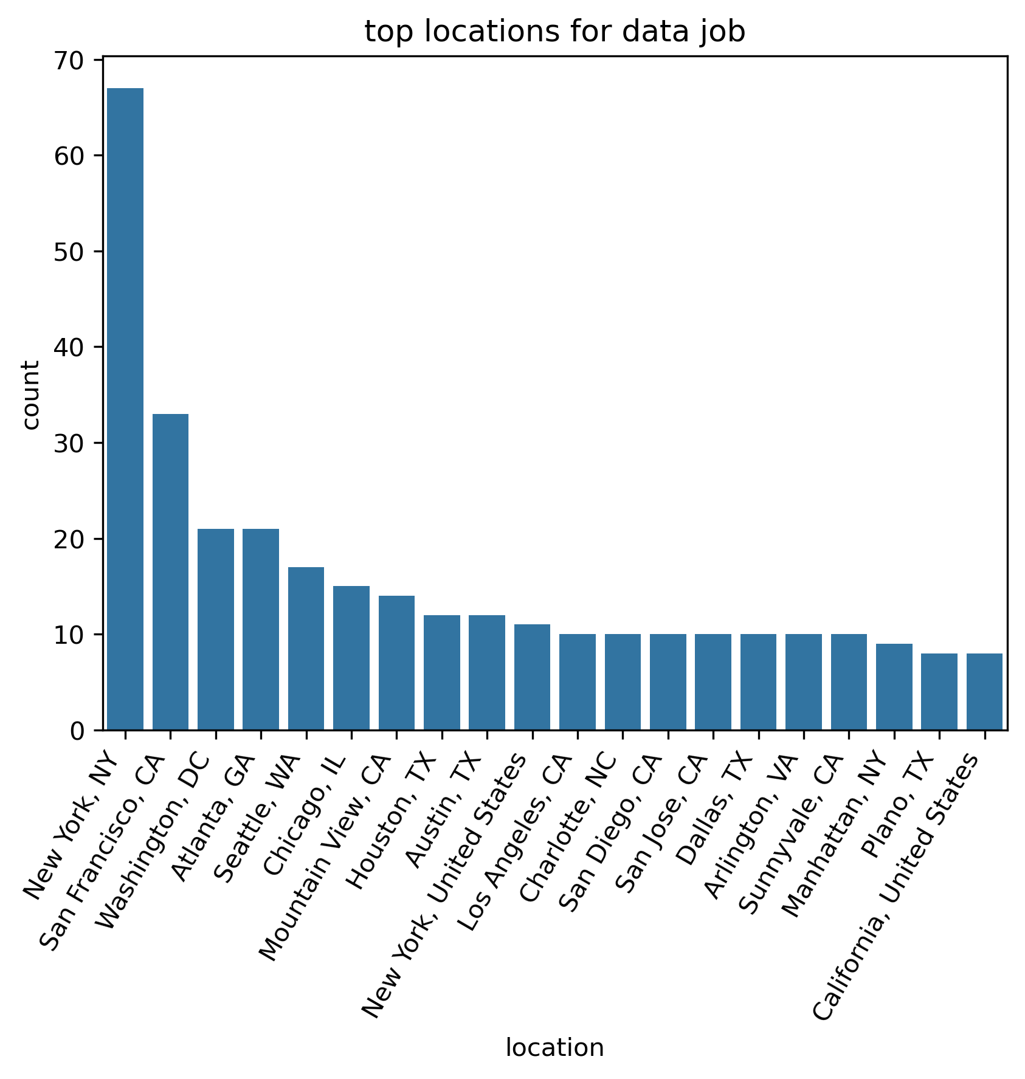
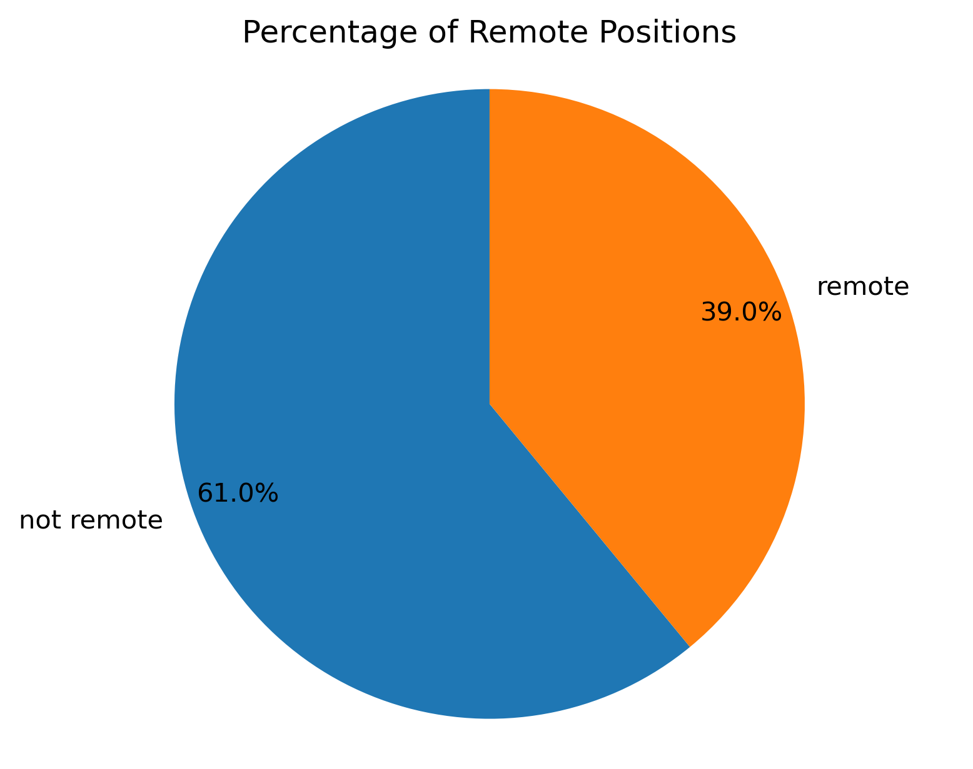
TOP JOB
LOCATIONS
There is a good amount of remote data job, which consist of 39% of the total job postings.
For on-site jobs, New York City has the highest job openings, followed by San Francisco, and Washington DC.

Slide 3
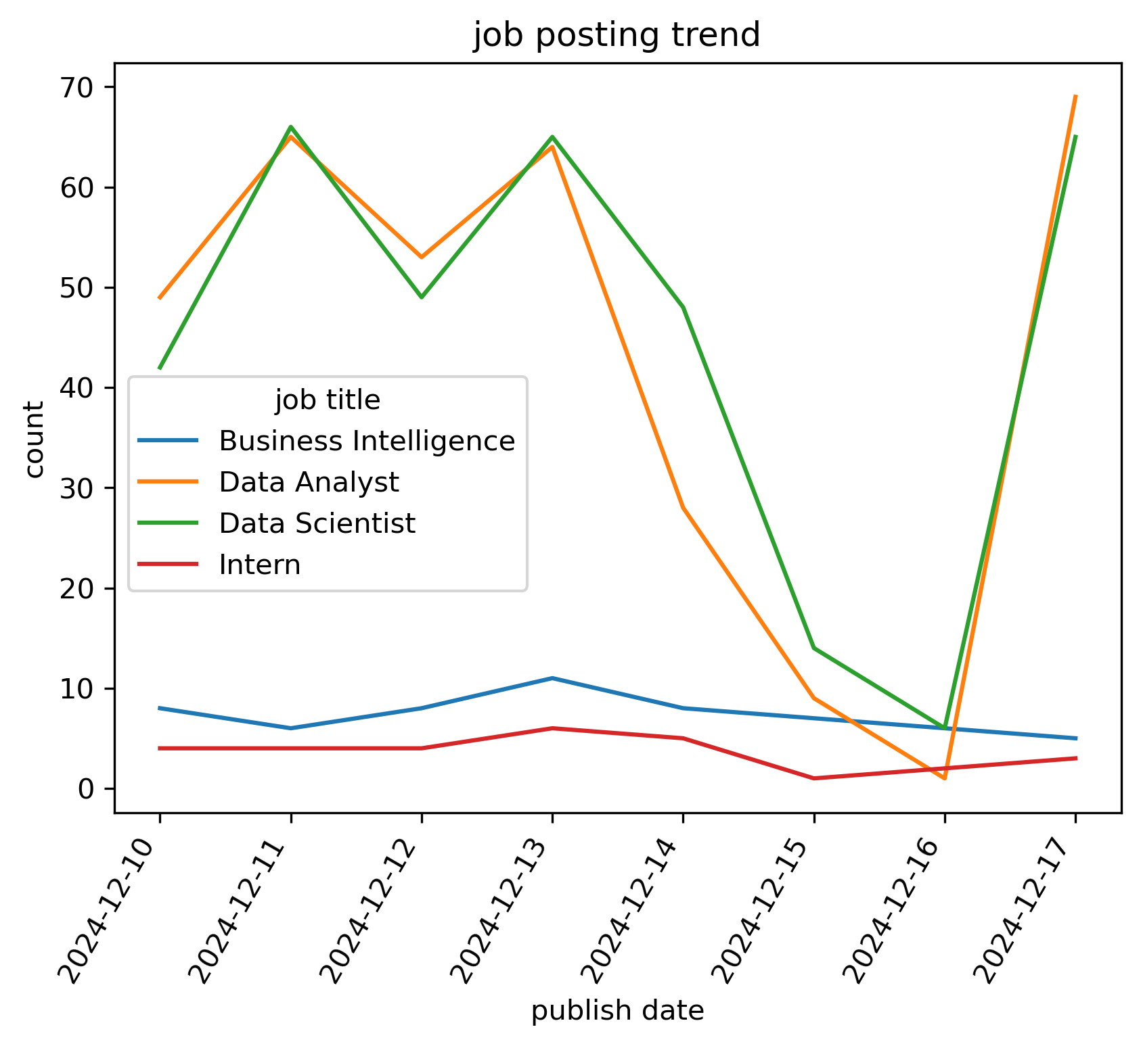
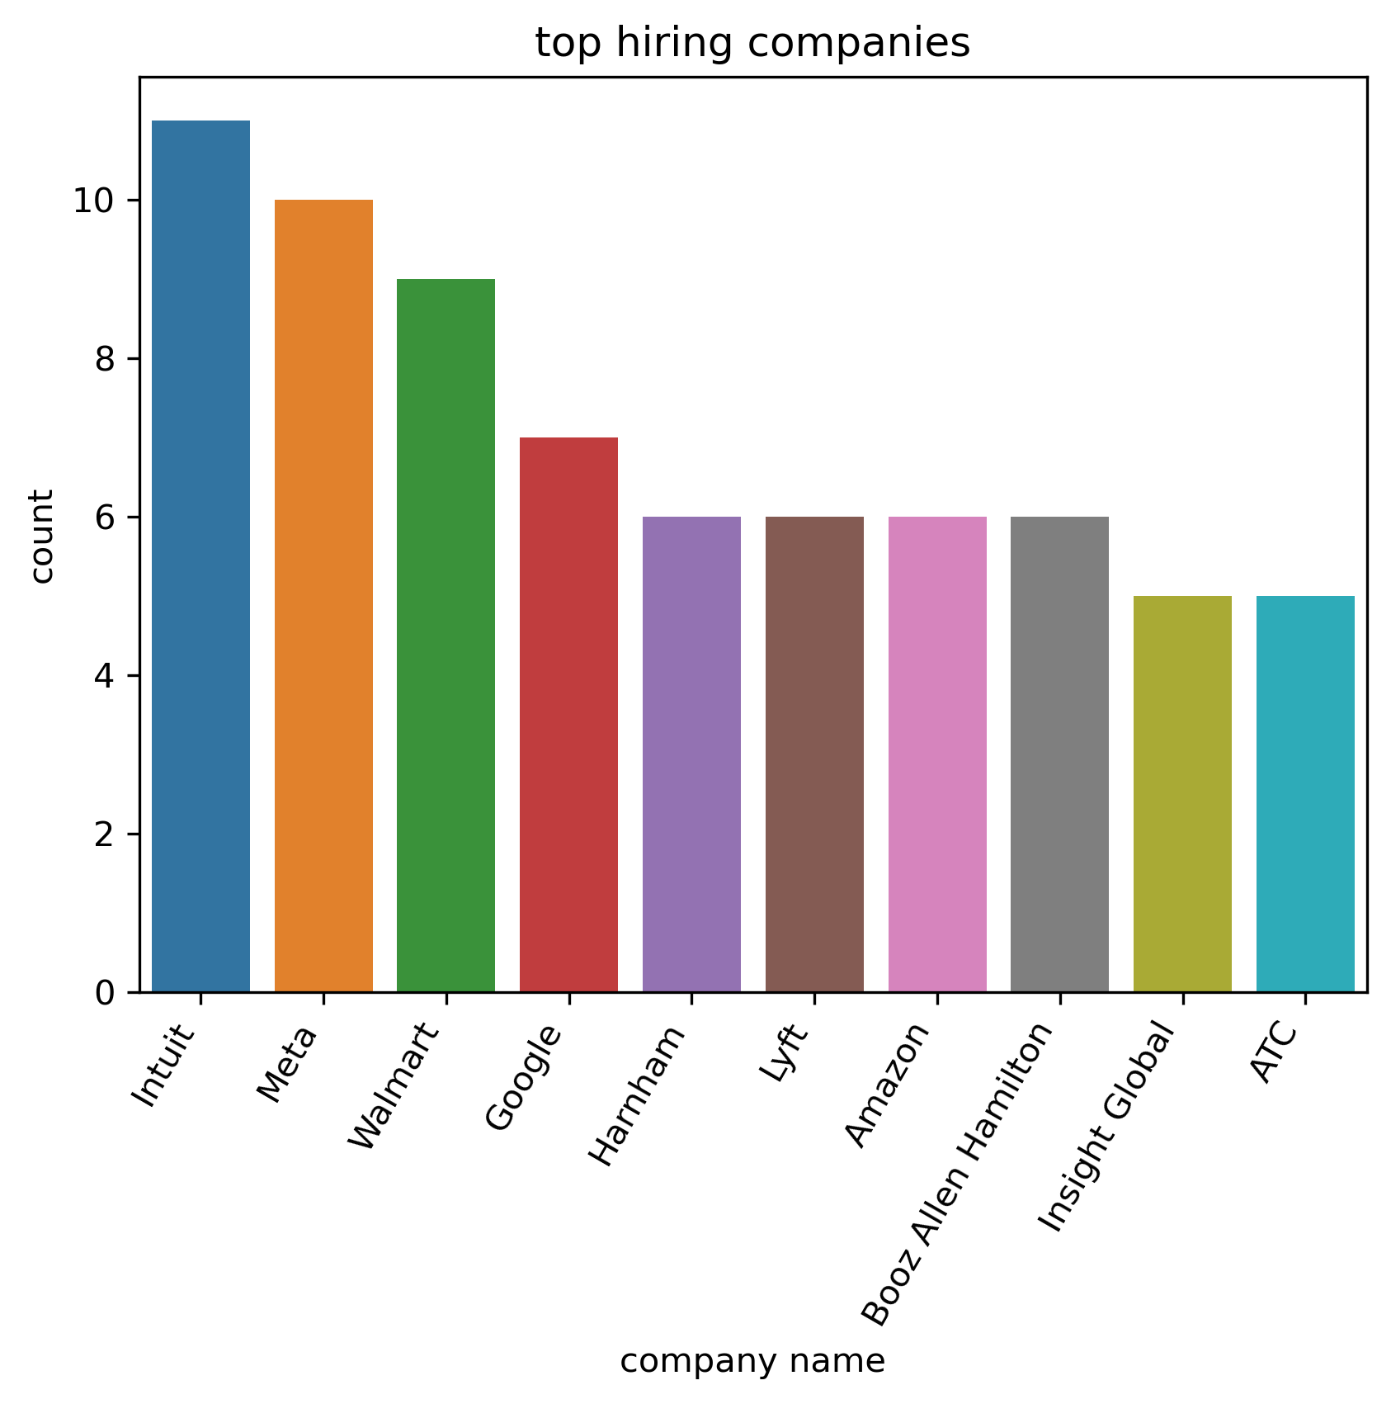
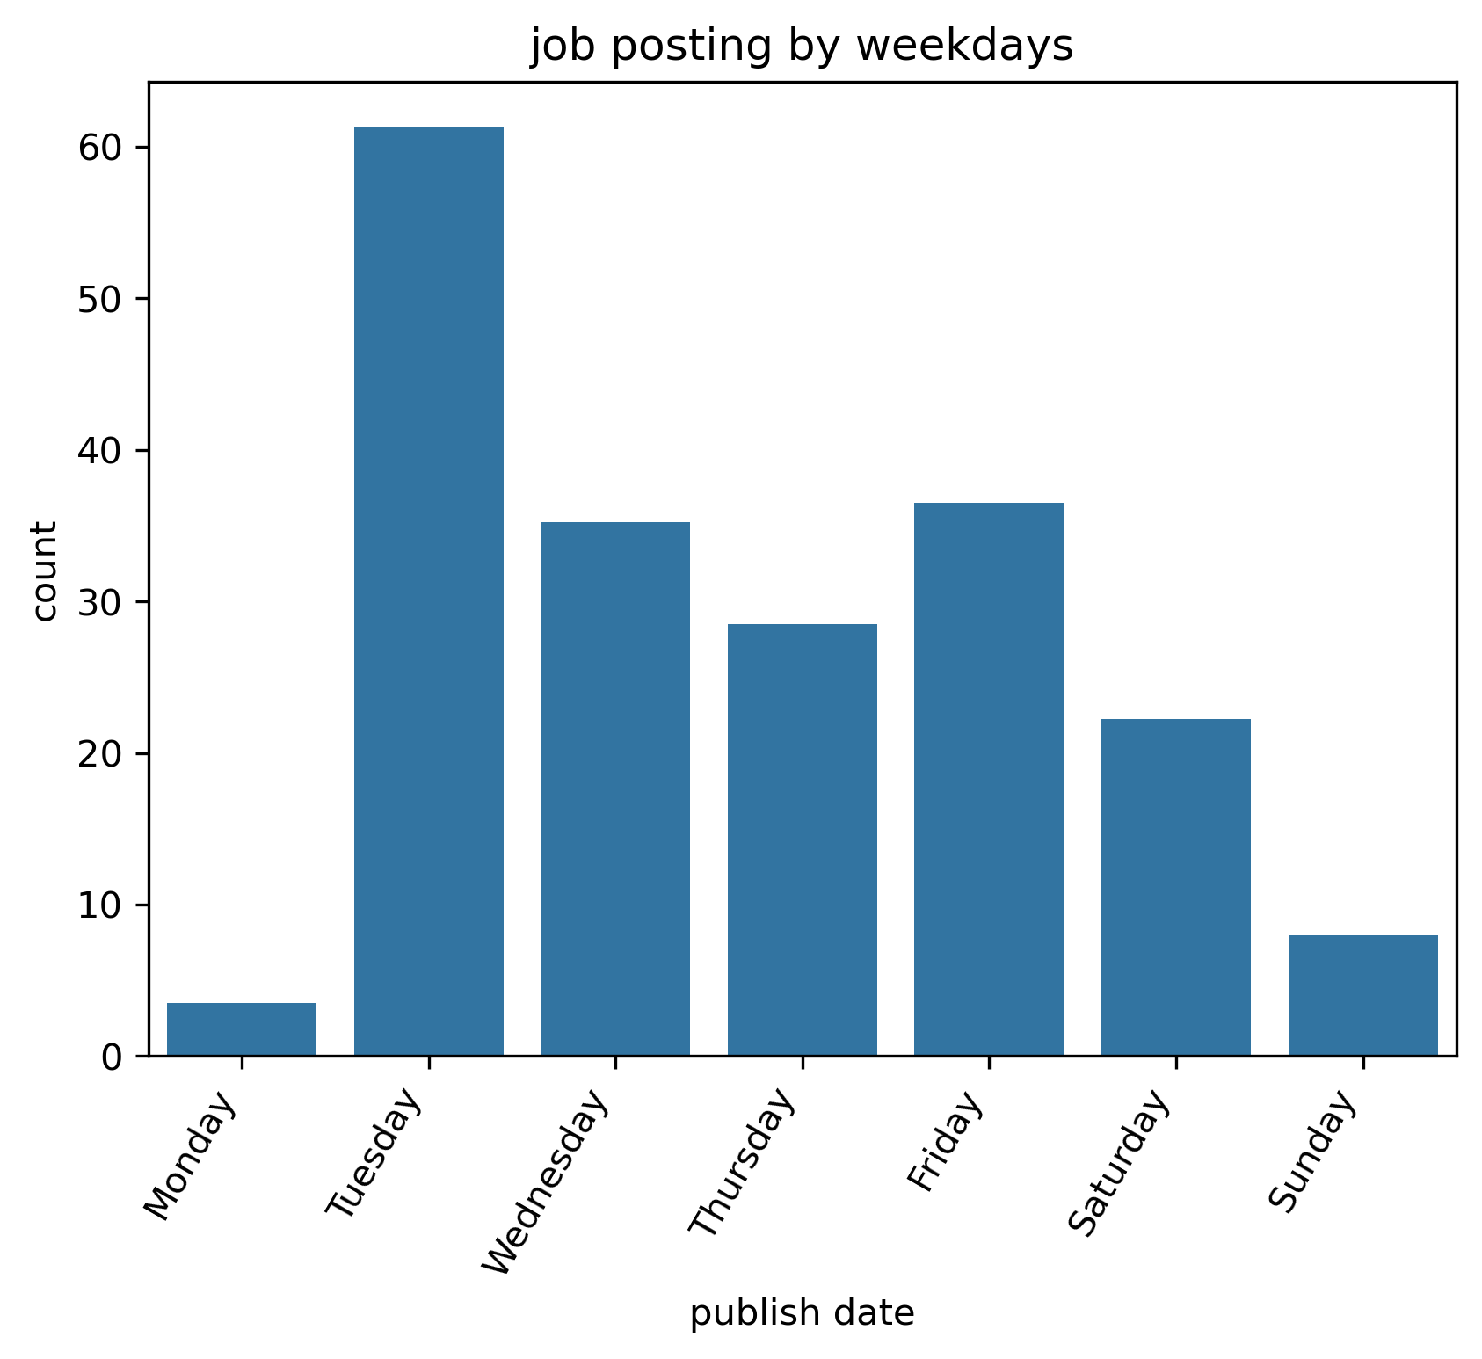
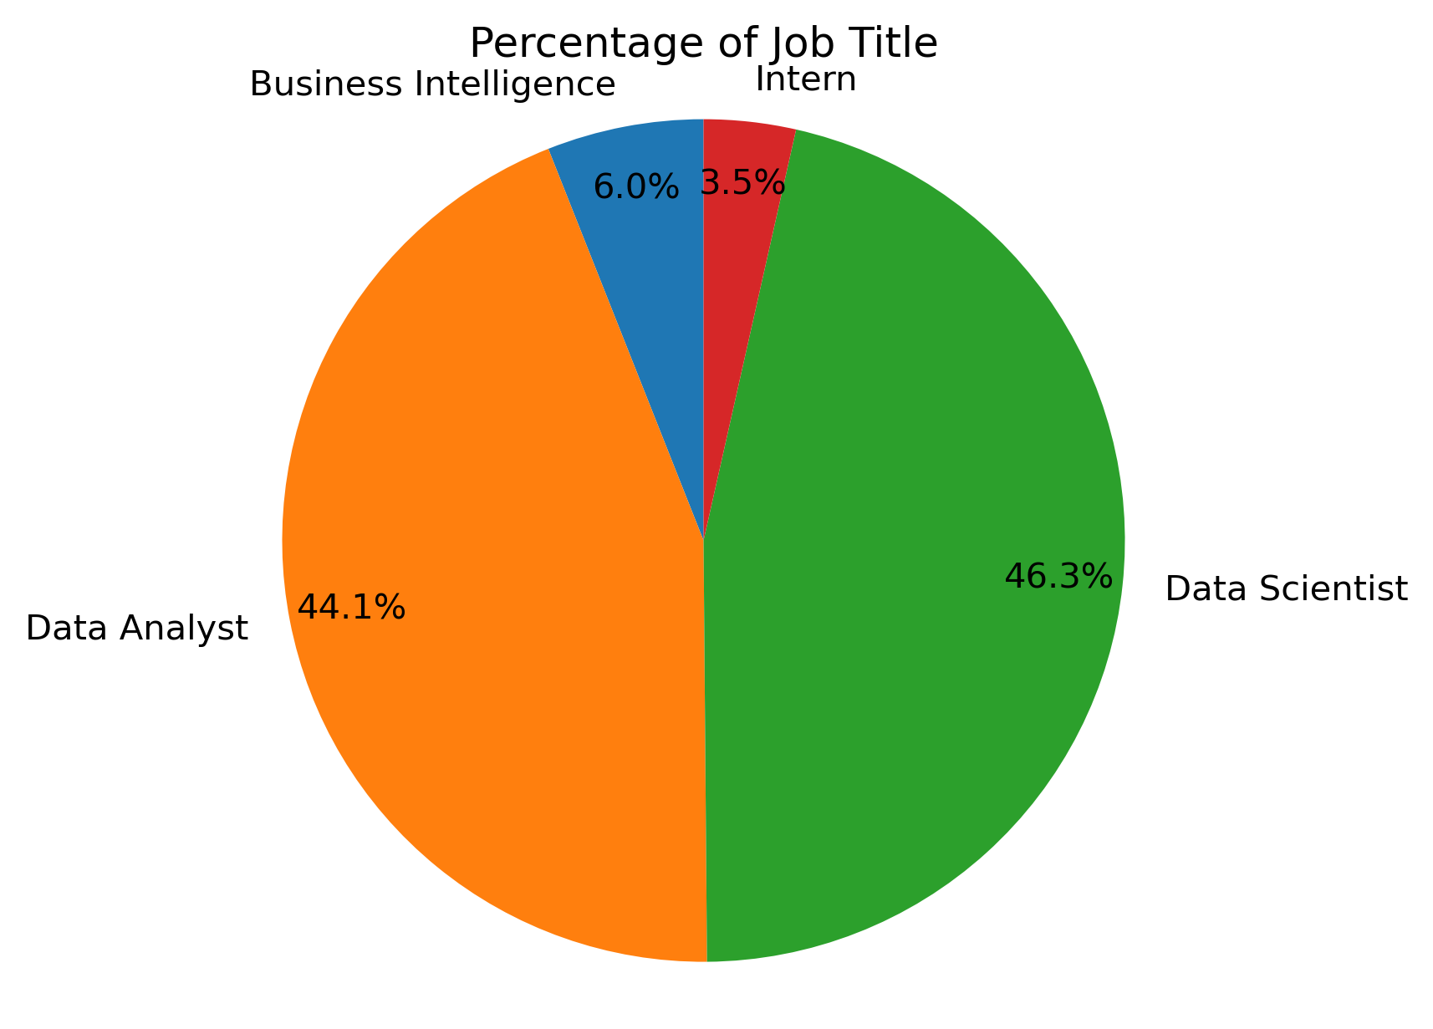
JOB OPPORTUNITY
Total 766 unique data job found in the past week
>90% of the job postings are consisted of Data Analyst and Data Scientist, and the two jobs are about 1:1 ratio
Top hiring companies are Intuit, Meta, Walmart
There is not enough data to see long turn trend
Interestingly, job postings varies a lot across the weekdays, they peak on Tuesday and gradually decrease to the lowest point on Monday

Slide 4
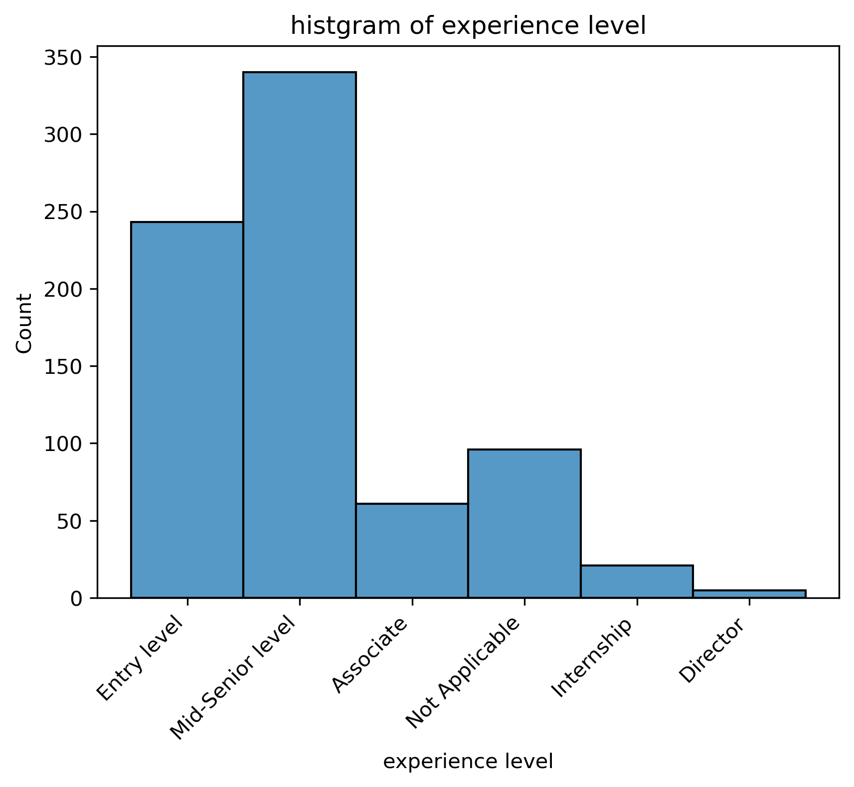
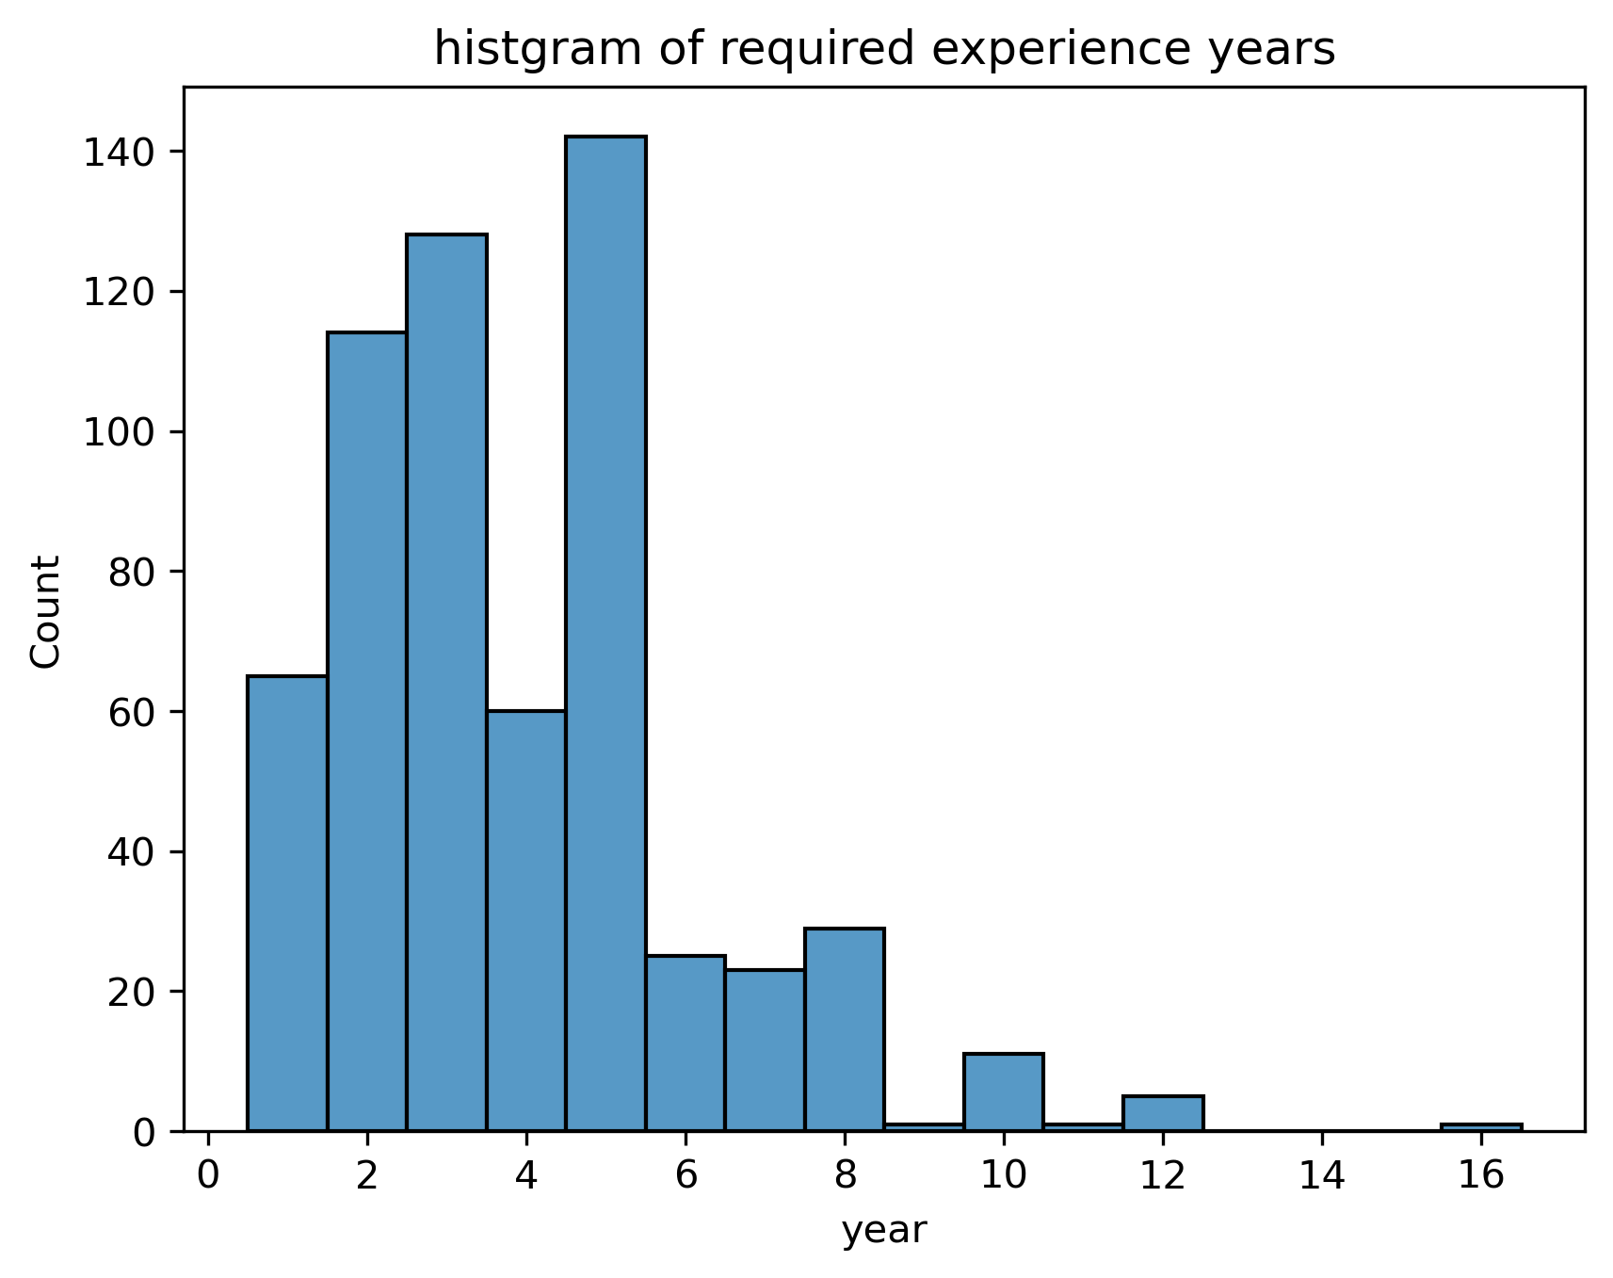
EXPERIENCE
The majority of jobs are Entry level and Mid-Senior Level
They usually require 1-5 years of experience

Slide 5
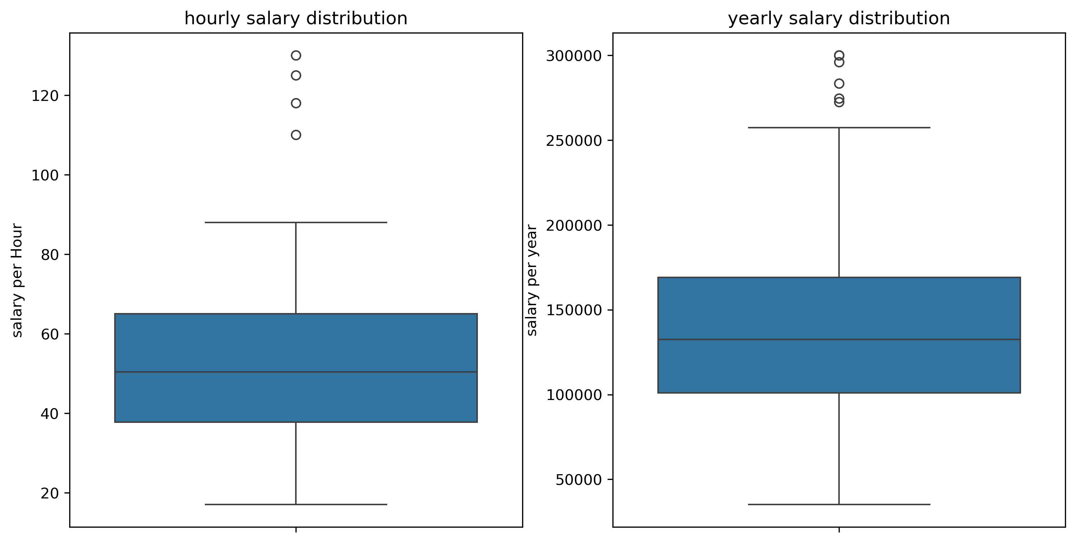
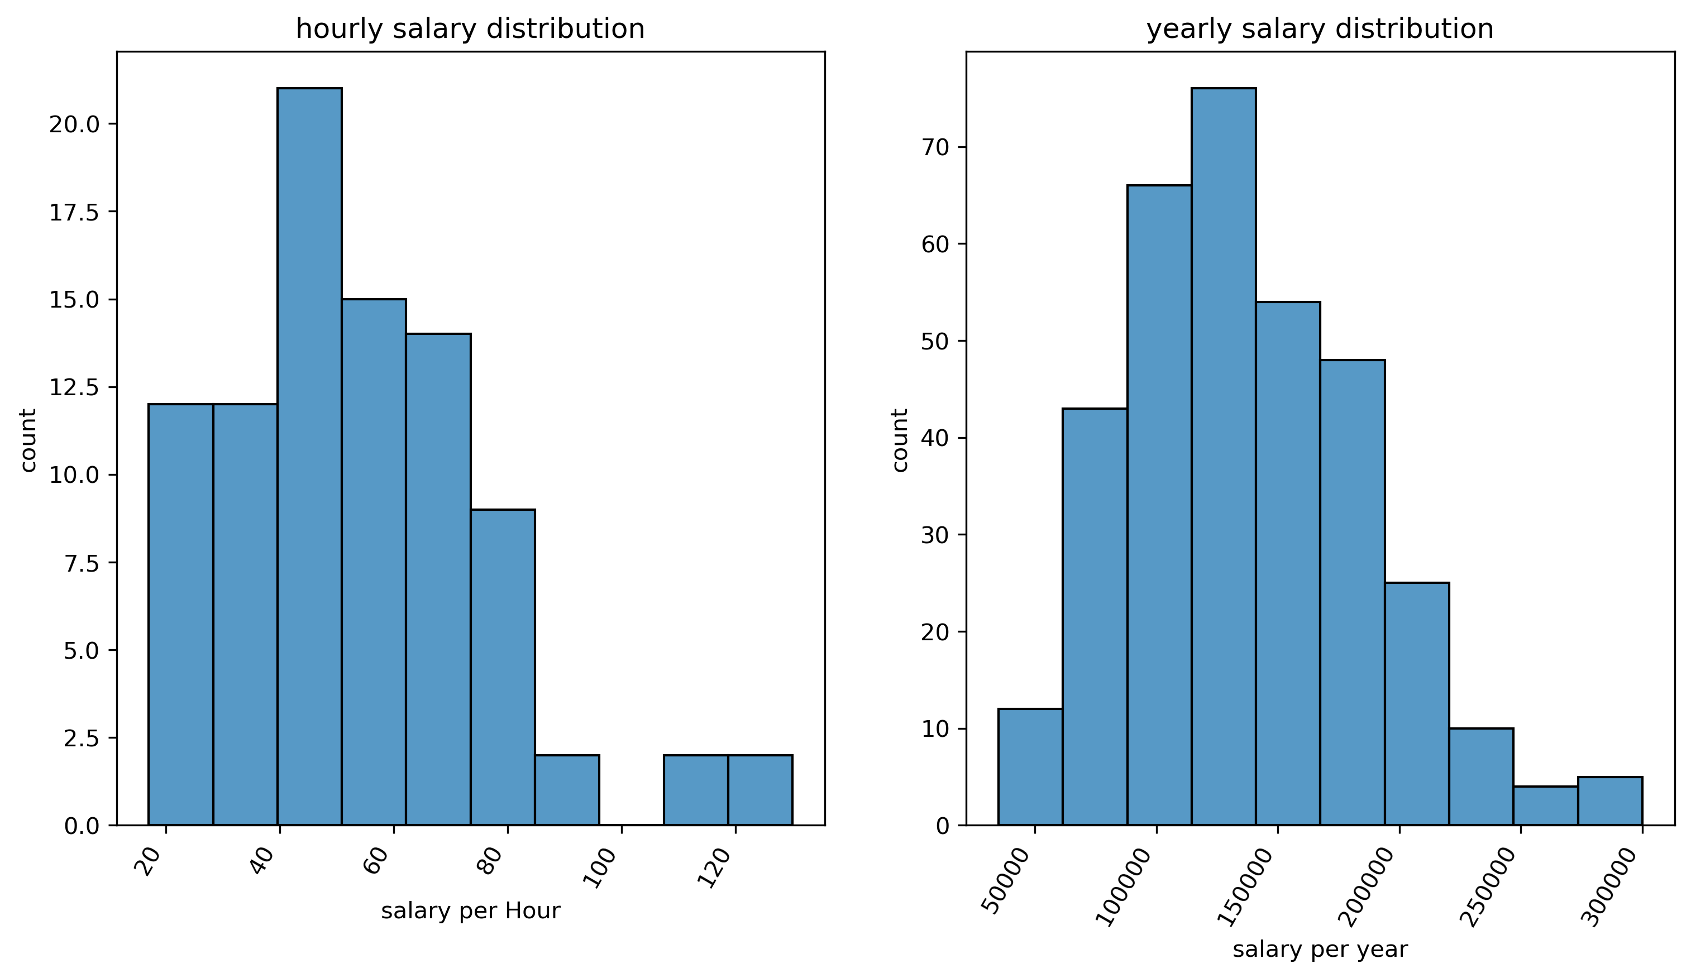
SALARY
DISTRIBUTION
These graph and table summarizes the salary ranges and averages. It highlights the potential earning opportunities by comparing salaries.
The avg salary is $130K while the highest can be up to $300K.
Table. salary stats for different job titles
 | Hourly($) | Yearly($)
Mean | 54 | 137813
Std | 23 | 50072
Min | 17 | 35040
25% | 37 | 100918
50% | 50 | 132500
75% | 65 | 169150
max | 130 | 300000

Slide 6
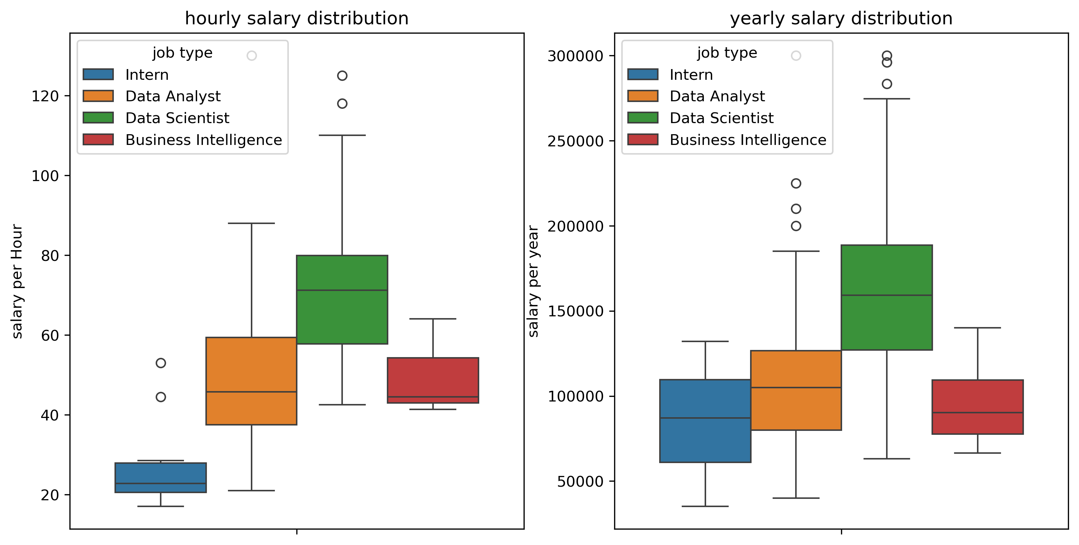
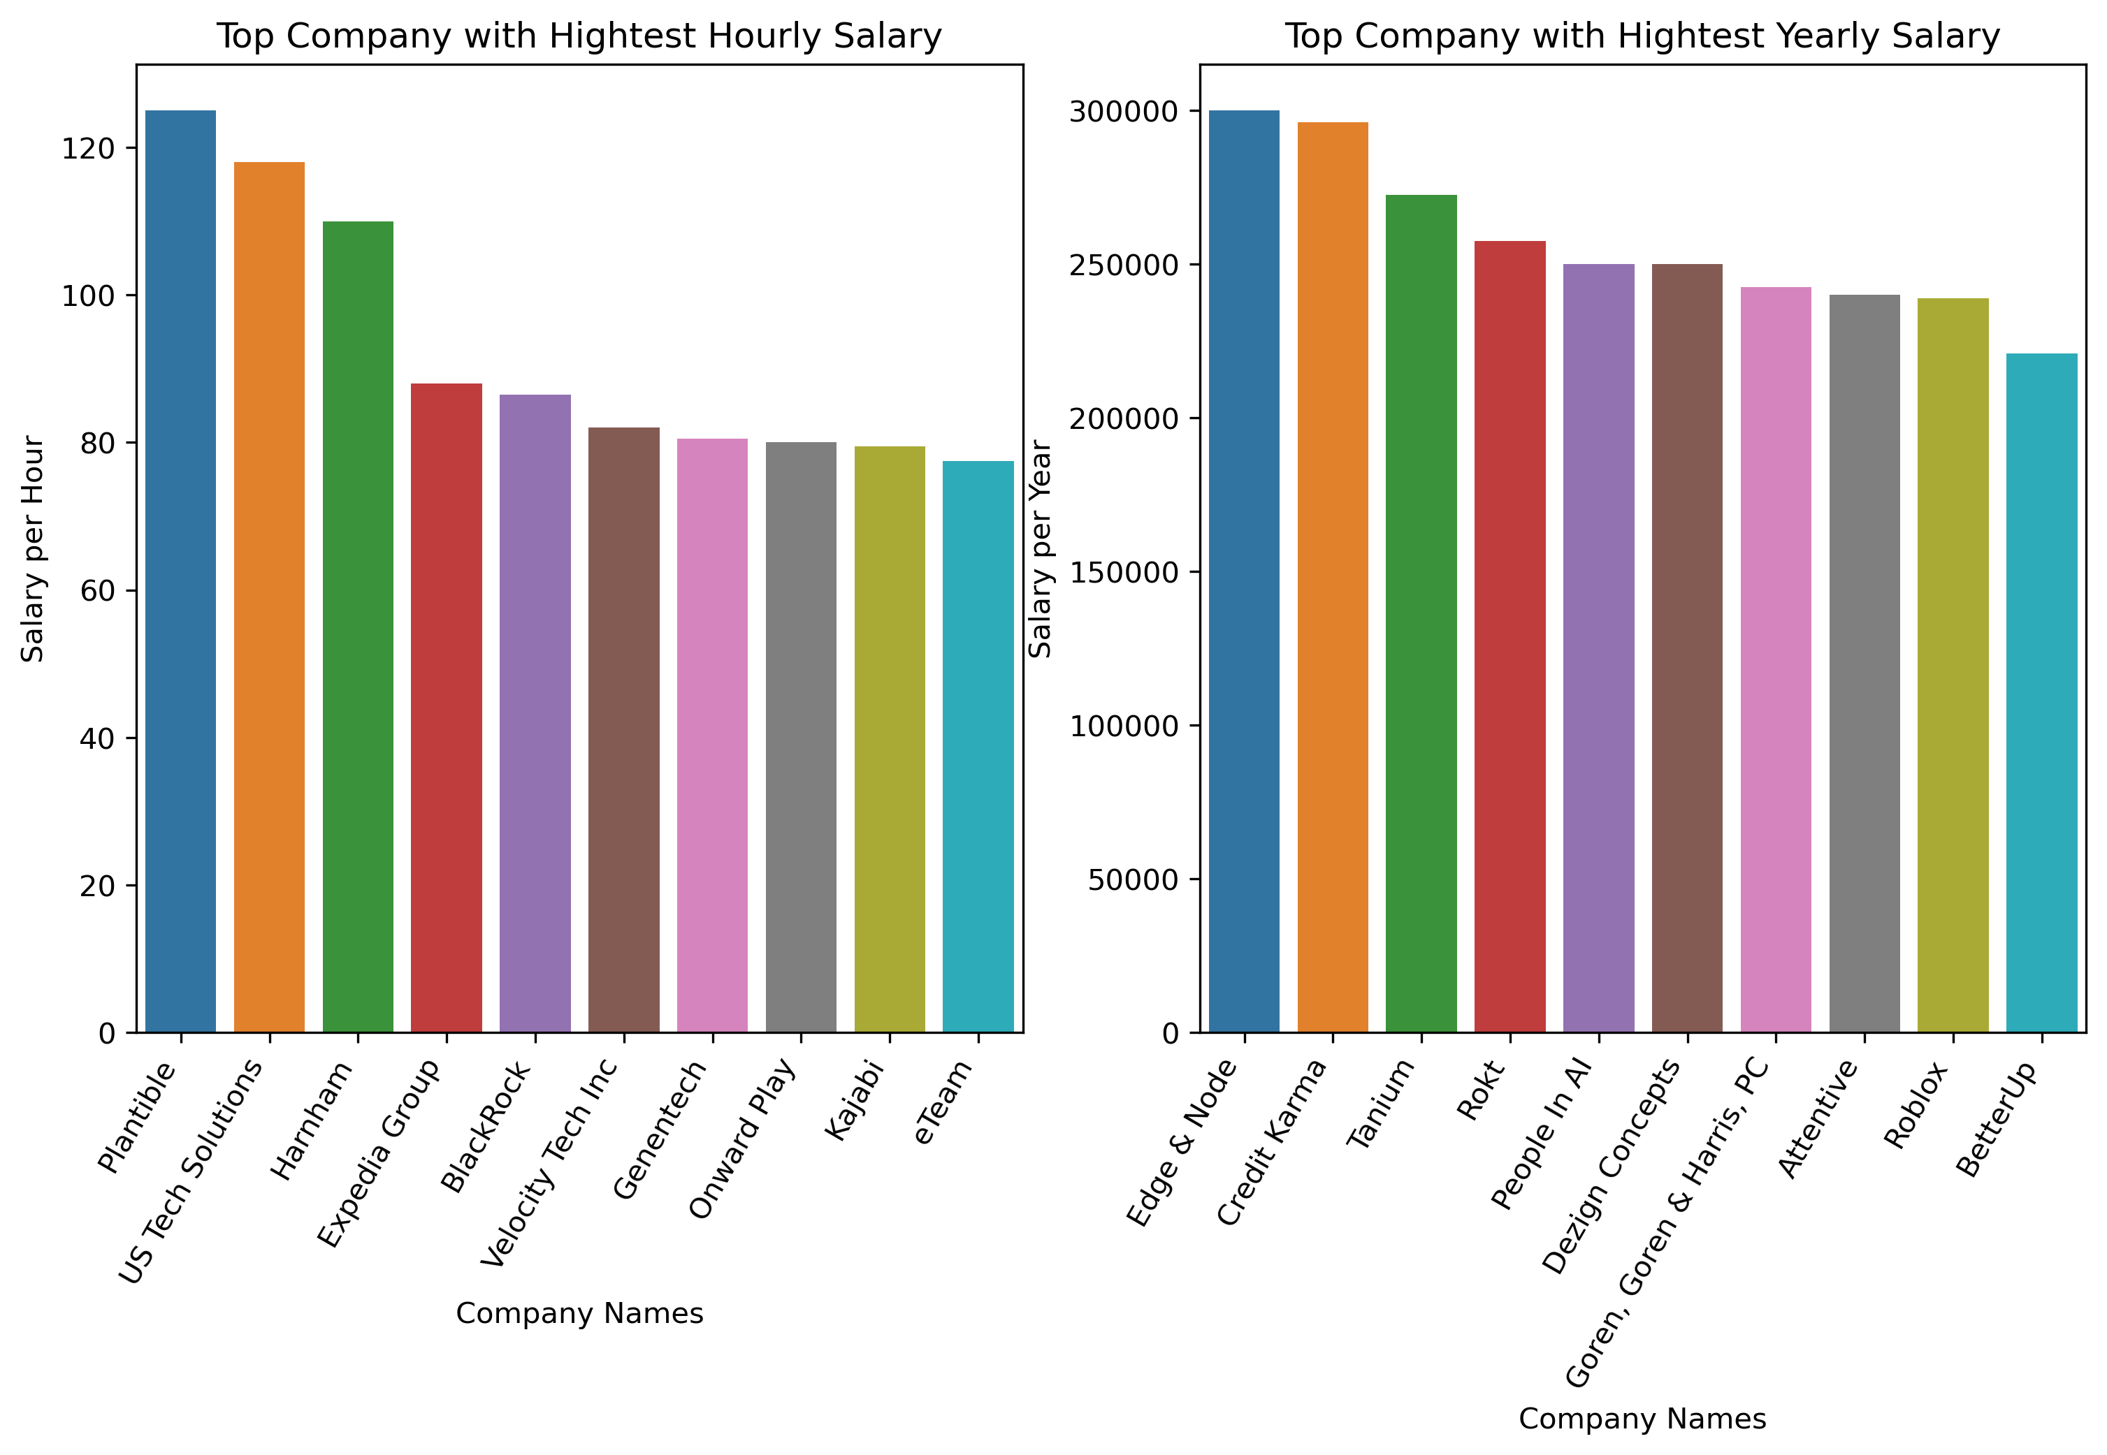
These graph and table summarizes how salary differ at different position and companies. Data Scientists got the highest pay while Analysts and Business Intelligence have lower and similar pay.
Table. salary stats for different job titles
 | Intern | Data Analyst | Data Scientist | Business Intelligence
Mean | 84680 | 108173 | 160419 | 94907
Std | 48522 | 39143 | 45263 | 22388
Min | 35040 | 40000 | 63000 | 66500
25% | 61020 | 80000 | 127010 | 77625
50% | 87000 | 105000 | 159150 | 90225
75% | 109500 | 126625 | 188625 | 109375
Max | 132000 | 300000 | 300000 | 140000

Slide 7
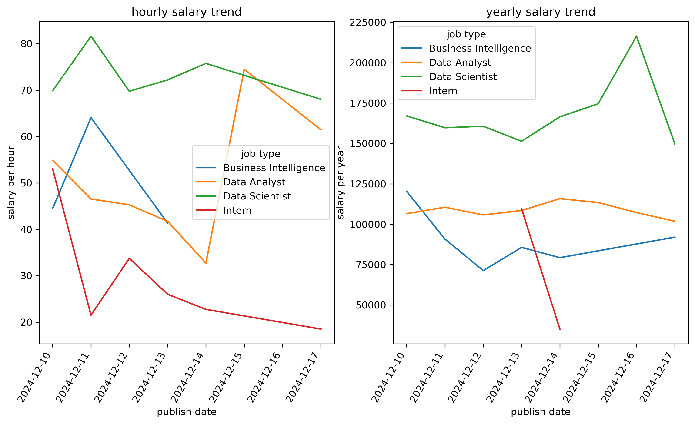
This graph demonstrates the salary changes overtime in the data analysis related industry. Due to the limited quantity of data, the trend is not clear.

Slide 8
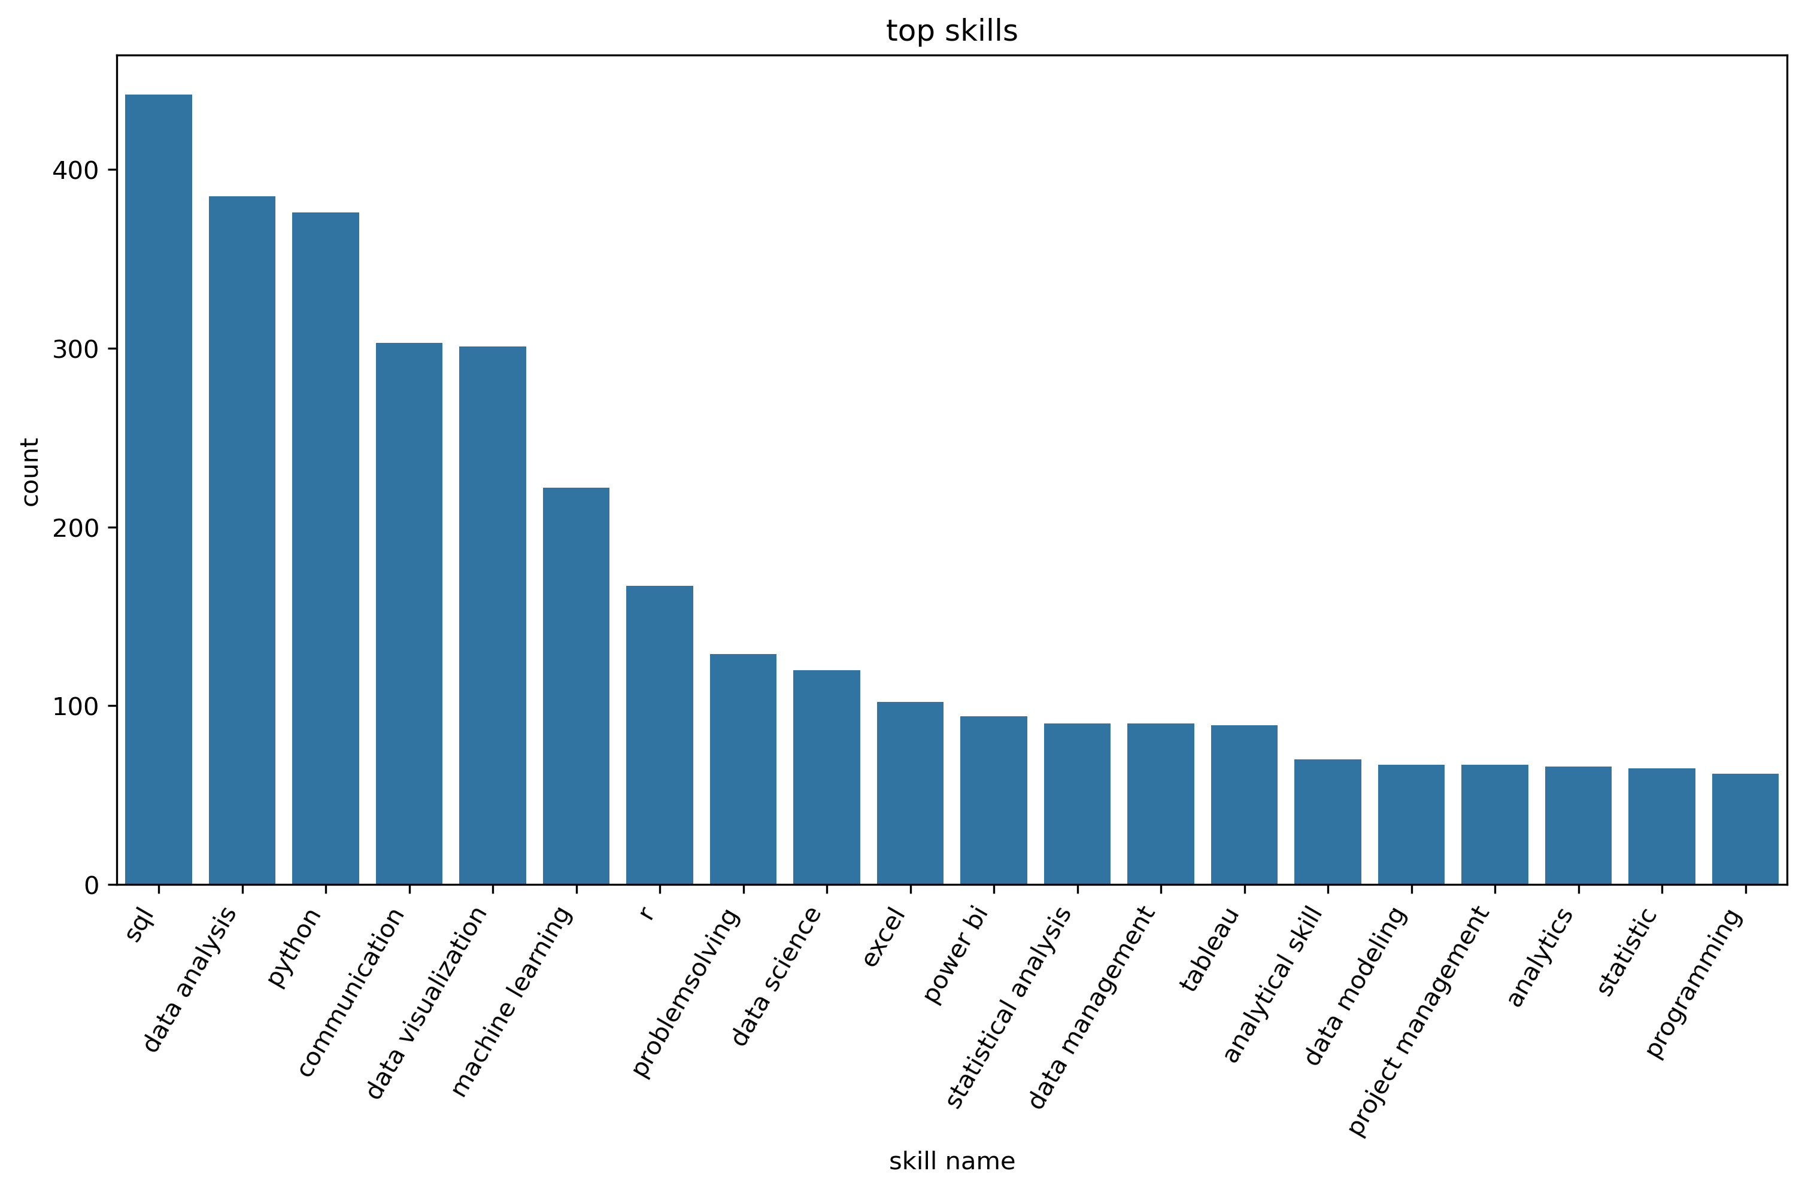
TOP SKILLS IN DEMAND
Other than data analysis, the following skills are in high demand:
SQL
PYTHON
COMMUNICATION
DATA VISUALIZATION
MACHINE LEARNING
R
PROBLEM SOLVING
EXCEL
POWER BI
TABLEAU
STATISTICS
DATA MODELING
DATA MANAGEMENT
PROJECT MANAGEMENT

Slide 9
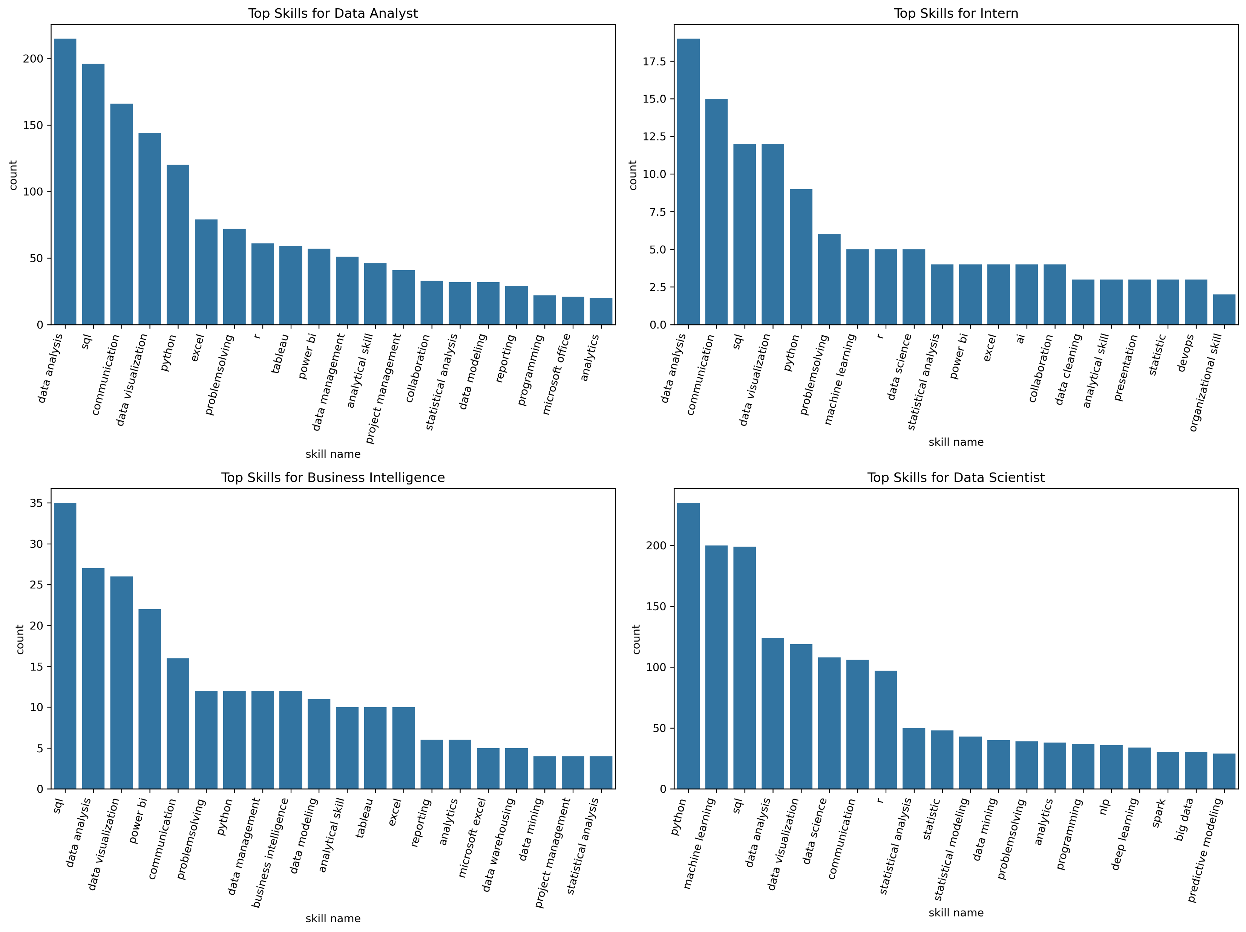
Top skills by job title:
The required skills are almost the same across different job titles. However, the order are slightly different. For Analyst and Interns analysis and communication skills become more important than technical skills. Programming skills are lower in the Business Intelligence field. Python and machine learning are top skills in Data Science.

Slide 10
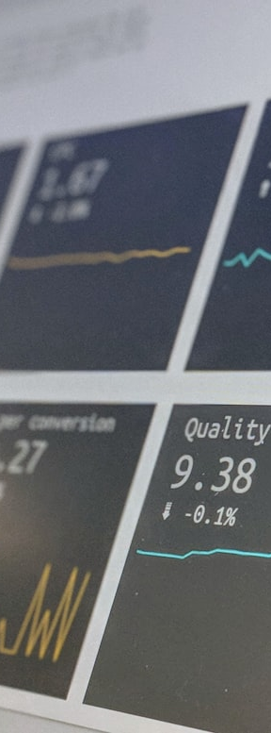
CONCLUSION & INSIGHTS
KEY TAKEAWAYS FROM THE ANALYSIS
The analysis provides valuable insights into trends in job postings, location, salary expectations and skill requirements.
Total 766 job openings in one week on LinkedIn
39% jobs are remote, and on-site opportunities concentrated in NYC, Bay Area and Washington DC
Data Analyst and Scientist are good paying jobs with average salary of $108K and $160K, respectively
Most positions require some experience, ranging from 1 to 5 years.
Top skills in demand are Python, R, SQL, Communication, Data Visualization and ML
IMPACT & FUTRUE WORK
This project improved my job search efficiency by 3-fold or more and I gain more insight into the market trend
More data should be collected to reveal long term trend in the industry
Explore more AI tools to help improve the analysis
Collect user feedback for improvement

