Slide 1
Hierarchical Clustering
Boston University CS 506 - Lance Galletti

Slide 2
Hierarchical Clustering
Two main types of hierarchical clustering:
Agglomerative:
Start with every point in its own cluster
At each step, merge the two closest clusters
Stop when every point is in the same cluster
Divisive:
Start with every point in the same cluster
At each step, split until every point is in its own cluster

Slide 3
Hierarchical Clustering
Our main focus will be on agglomerative methods

Slide 4
Agglomerative Clustering Algorithm
Let each point in the dataset be in its own cluster
Compute the distance between all pairs of clusters
Merge the two closest clusters
Repeat 3 & 4 until all points are in the same cluster

Slide 5
Hierarchical Clustering
At every step, we record which clusters were merged in order to produce a dendrogram:
6
5
3
4
1
2
3
4
6
1
2
5

Slide 6
Hierarchical Clustering
At every step, we record which clusters were merged in order to produce a dendrogram:
6
5
3
4
1
2
3
4
6
1
2
5

Slide 7
Hierarchical Clustering
At every step, we record which clusters were merged in order to produce a dendrogram:
6
5
3
4
1
2
3
4
6
1
2
5

Slide 8
Hierarchical Clustering
At every step, we record which clusters were merged in order to produce a dendrogram:
6
5
3
4
1
2
3
4
6
1
2
5

Slide 9
Hierarchical Clustering
At every step, we record which clusters were merged in order to produce a dendrogram:
6
5
3
4
1
2
3
4
6
1
2
5

Slide 10
Hierarchical Clustering
At every step, we record which clusters were merged in order to produce a dendrogram:
6
5
3
4
1
2
3
4
6
1
2
5

Slide 11
Hierarchical Clustering
We can “cut” the dendrogram at any threshold to produce any number of clusters
6
5
3
4
1
2
3
4
6
1
2
5

Slide 12
Hierarchical Clustering
We can “cut” the dendrogram at any threshold to produce any number of clusters
6
5
3
4
1
2
3
4
6
1
2
5

Slide 13
Hierarchical Clustering
We can “cut” the dendrogram at any threshold to produce any number of clusters
6
5
3
4
1
2
3
4
6
1
2
5

Slide 14
Hierarchical Clustering
Can we implement this? Are we missing anything?
How do we compute the distance between clusters?
Distance between clusters can be thought of as distance between two sets of points. What ideas come to mind?

Slide 15
Hierarchical Clustering - Distance Functions
Let’s first define:
Distance between points: d(p₁, p₂)
Distance between clusters: D(C₁, C₂)

Slide 16
Single-Link Distance
Is the minimum of all pairwise distances between a point from one cluster and a point from the other cluster.
6
5
3
4
1
2
Depends on choice of d

Slide 17
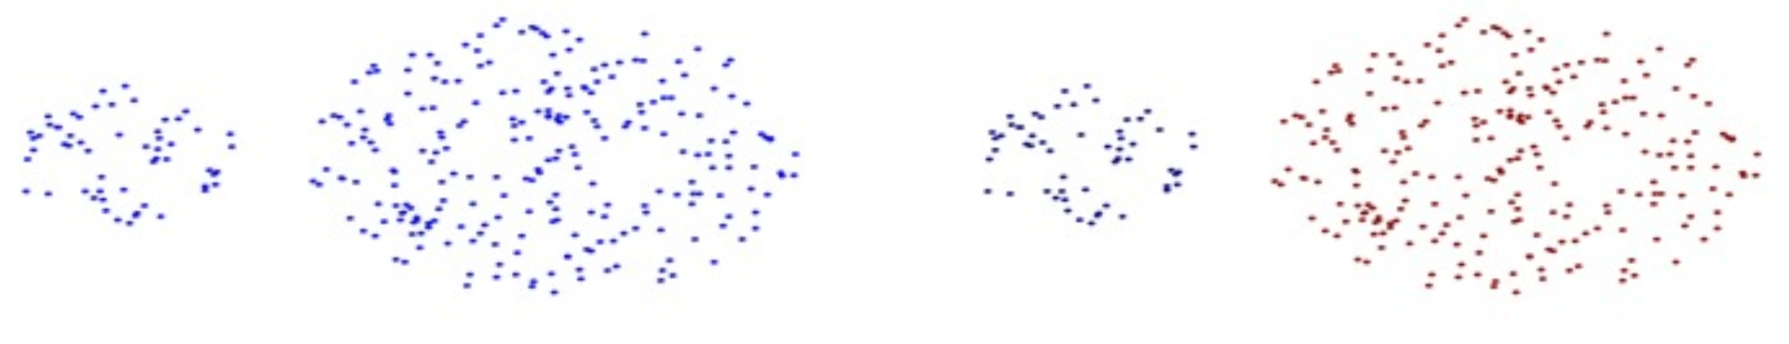
Single-Link Distance
Can handle clusters of different sizes

Slide 18
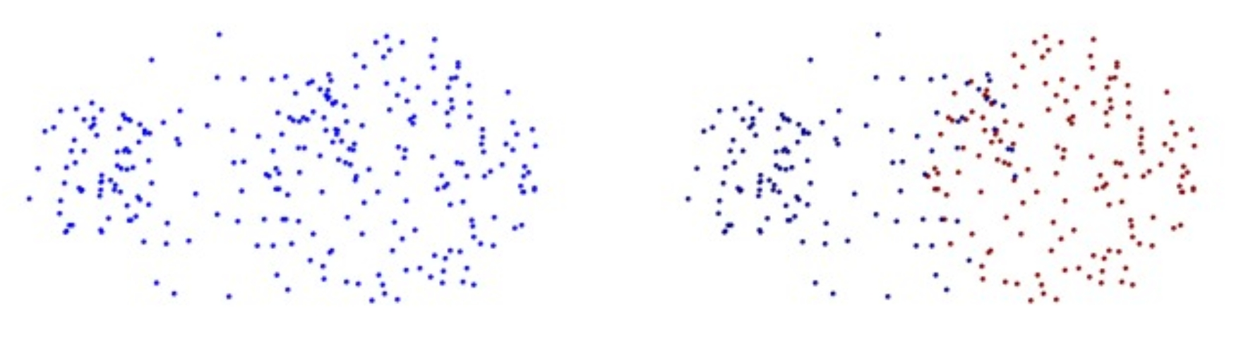
Single-Link Distance
But… Sensitive to noise points
Tends to create elongated clusters

Slide 19
Complete-Link Distance
Is the maximum of all pairwise distances between a point from one cluster and a point from the other cluster.
6
5
3
4
1
2

Slide 20
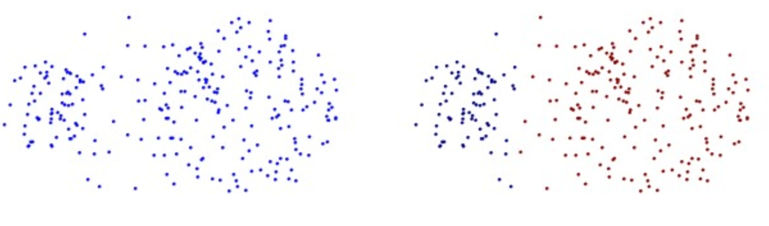
Complete-Link Distance
Less susceptible to noise
Creates more balanced (equal diameter) clusters

Slide 21
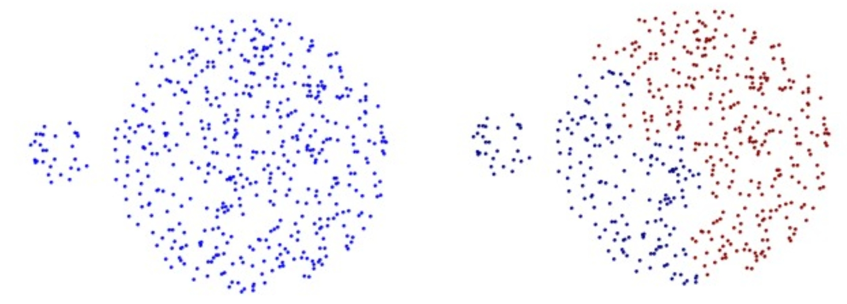
Complete-Link Distance
But… Tends to split up large clusters.
All clusters tend to have the same diameter

Slide 22

Average-Link Distance
Is the average of all pairwise distances between a point from one cluster and a point from the other cluster.
6
5
3
4
1
2

Slide 23
Average-Link Distance
Less susceptible to noise and outliers.
But… Tends to be biased toward globular clusters

Slide 24

Centroid Distance
The distance between the centroids of clusters.
6
5
3
4
1
2

Slide 25
Ward’s Distance
Is the difference between the spread / variance of points in the merged cluster and the unmerged clusters.
6
6
5
5
3
3
VS
4
4
1
1
2
2

Slide 26
Agglomerative Clustering Algorithm
Let each point in the dataset be in its own cluster
Compute the distance between all pairs of clusters
Merge the two closest clusters
Repeat 3 & 4 until all points are in the same cluster

Slide 27
Example
d = Euclidean
D = Single-Link
Distance Matrix
 | A | B | C | D
A
B
C
D
B (1,1)
A (0,0)
C (3,0)
D (0,-2)

Slide 28
Example
d = Euclidean
D = Single-Link
Distance Matrix
 | A | B | C | D
A | 0
B |  | 0
C |  |  | 0
D |  |  |  | 0
B (1,1)
A (0,0)
C (3,0)
D (0,-2)

Slide 29
Example
d = Euclidean
D = Single-Link
Distance Matrix
 | A | B | C | D
A | 0 | √2 | 3 | 2
B | √2 | 0 | √5 | √10
C | 5 | √5 | 0 | √13
D | 2 | √10 | √13 | 0
B (1,1)
A (0,0)
C (3,0)
D (0,-2)

Slide 30
Example
d = Euclidean
D = Single-Link
Distance Matrix
 | A | B | C | D
A | 0 | √2 | 3 | 2
B | √2 | 0 | √5 | √10
C | 5 | √5 | 0 | √13
D | 2 | √10 | √13 | 0
B (1,1)
A (0,0)
C (3,0)
D (0,-2)

Slide 31
Example
d = Euclidean
D = Single-Link
Dendrogram
B (1,1)
A (0,0)
C (3,0)
√2
D (0,-2)
A
B

Slide 32
Example
d = Euclidean
D = Single-Link
Distance Matrix
 | A & B | C | D
A & B | 0
C |  | 0 | √13
D |  | √13 | 0
B (1,1)
A (0,0)
C (3,0)
D (0,-2)

Slide 33
Example
d = Euclidean
D = Single-Link
Distance Matrix
 | A & B | C | D
A & B | 0 | √5 | 2
C | √5 | 0 | √13
D | 2 | √13 | 0
B (1,1)
A (0,0)
C (3,0)
D (0,-2)

Slide 34
Example
d = Euclidean
D = Single-Link
Distance Matrix
 | A & B | C | D
A & B | 0 | √5 | 2
C | √5 | 0 | √13
D | 2 | √13 | 0
B (1,1)
A (0,0)
C (3,0)
D (0,-2)

Slide 35
Example
d = Euclidean
D = Single-Link
Dendrogram
B (1,1)
2
A (0,0)
C (3,0)
√2
D (0,-2)
A
B
D

Slide 36
Example
d = Euclidean
D = Single-Link
Distance Matrix
 | A & B & D | C
A & B & D | 0
C |  | 0
B (1,1)
A (0,0)
C (3,0)
D (0,-2)

Slide 37
Example
d = Euclidean
D = Single-Link
Distance Matrix
 | A & B & D | C
A & B & D | 0 | √5
C | √5 | 0
B (1,1)
A (0,0)
C (3,0)
D (0,-2)

Slide 38
Example
d = Euclidean
D = Single-Link
Distance Matrix
 | A & B & D | C
A & B & D | 0 | √5
C | √5 | 0
B (1,1)
A (0,0)
C (3,0)
D (0,-2)

Slide 39
Example
d = Euclidean
D = Single-Link
Dendrogram
√5
B (1,1)
2
A (0,0)
C (3,0)
√2
D (0,-2)
A
B
D
C

Slide 40
Hierarchical Clustering
Finding the threshold with which to cut the dendrogram requires exploration and tuning. But in general hierarchical clustering is used to expose a hierarchy in the data (ex: finding/defining species via DNA similarity).
To capture the difference between clusterings you can use a cost function, or methods that we will discuss later when we look at clustering aggregation.

