Slide 1
Density-Based Clustering
Boston University CS 506 - Lance Galletti

Slide 2
Density-Based Clustering
Goal: cluster together points that are densely packed together.
How should we define density?
Given a fixed radius 𝝴 around a point, if there are at least min_pts number of points in that area, then this area is dense.

Slide 3
Example
Min_pts = 3

Slide 4
Example
𝝴-neighborhood of this point
Min_pts = 3
𝝴
dense ✔

Slide 5
Example
Min_pts = 3

Slide 6
Example
Min_pts = 3
𝝴
Not dense 𐄂

Slide 7
Example
Min_pts = 3

Slide 8
Example
Min_pts = 3
𝝴
Not dense 𐄂
But… That point was part of a dense section earlier…

Slide 9
Density-Based Clustering
We need to distinguish between points at the core of a dense region and points at the border of a dense region.
Let’s define:
Core point: if its 𝝴-neighborhood contains at least min_pts
Border point: if it is in the 𝝴-neighborhood of a core point
Noise point: if it is neither a core nor border point

Slide 10
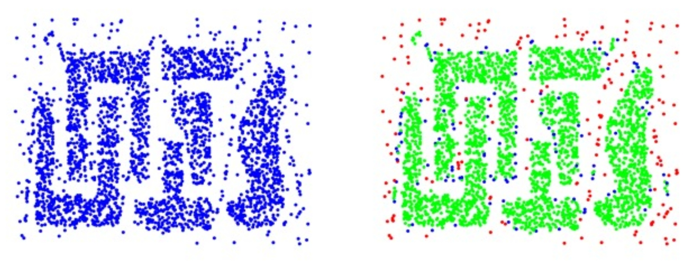
Density-Based Clustering
Core | Border | Noise

Slide 11
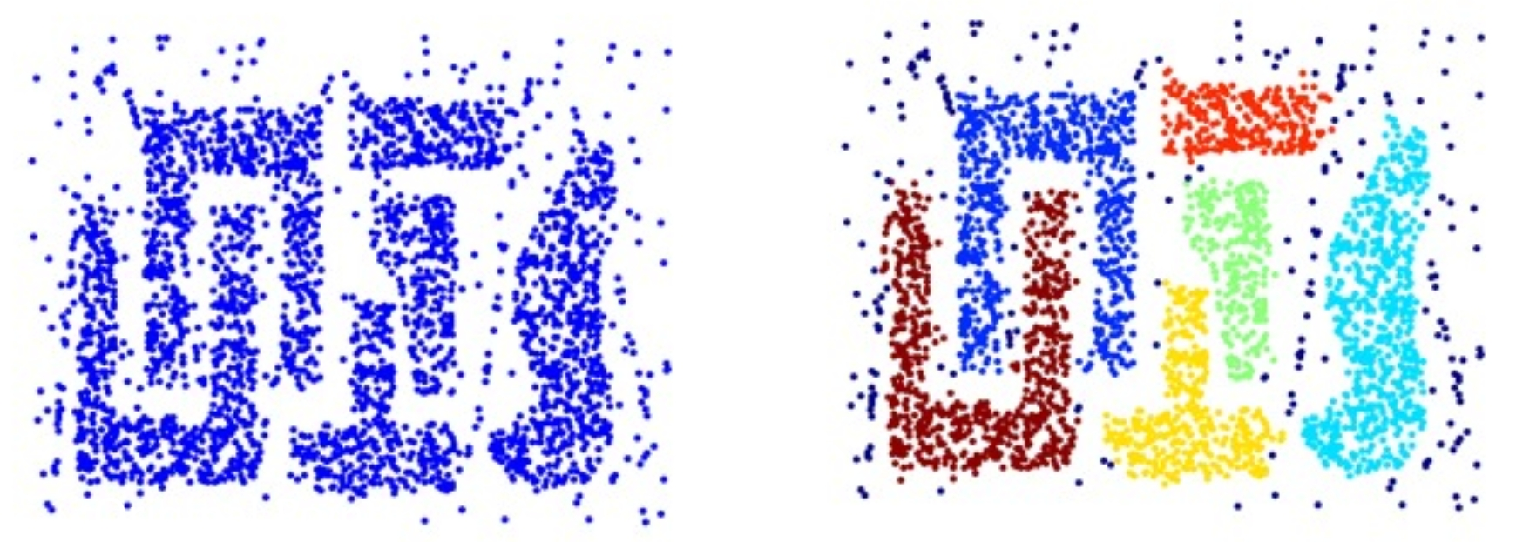
Density-Based Clustering
Create clusters by connecting core points

Slide 12
DBScan Algorithm
𝝴 and min_pts given:
Find the 𝝴-neighborhood of each point
Label the point as core if it contains at least min_pts
Label points in its neighborhood that are not core as border
Label points as noise if they are neither core nor border
For each core point, assign to the same cluster all core points in its neighborhood (crux of the algorithm)
Assign border points to nearby clusters

Slide 13
DBScan visualized
Min_pts = 3
Iterate through the dataset
𝝴
Core point ✔

Slide 14
DBScan visualized
Min_pts = 3
If core point - iterate through its neighborhood to find more core points that should also be part of this cluster
𝝴

Slide 15
DBScan visualized
Min_pts = 3
If core point - iterate through its neighborhood to find more core points that should also be part of this cluster

Slide 16
DBScan visualized
Min_pts = 3
Border point but let’s just assign it to this cluster
If core point - iterate through its neighborhood to find more core points that should also be part of this cluster

Slide 17
DBScan visualized
Min_pts = 3
If core point - iterate through its neighborhood to find more core points that should also be part of this cluster

Slide 18
DBScan visualized
Min_pts = 3
If core point - iterate through its neighborhood to find more core points that should also be part of this cluster

Slide 19
DBScan visualized
Min_pts = 3
If core point - iterate through its neighborhood to find more core points that should also be part of this cluster

Slide 20
DBScan visualized
Min_pts = 3
Go to next data point in the dataset

Slide 21
DBScan visualized
Min_pts = 3
Iterate over its neighborhood since it’s a core point

Slide 22
DBScan visualized
Min_pts = 3
Found another core point so we need to iterate over its neighborhood too

Slide 23
DBScan visualized
Min_pts = 3
Found another core point so we need to iterate over its neighborhood too

Slide 24
DBScan visualized
Min_pts = 3
Found another core point so we need to iterate over its neighborhood too

Slide 25
DBScan visualized
Min_pts = 3
Found another core point so we need to iterate over its neighborhood too

Slide 26
DBScan visualized
Min_pts = 3
Border point but let’s assign it to the cluster now

Slide 27
DBScan visualized
Min_pts = 3
Core point but all its neighborhood is already tracked

Slide 28
DBScan visualized
Min_pts = 3
Core point but all its neighborhood is already tracked

Slide 29
DBScan visualized
Min_pts = 3

Slide 30
DBScan visualized
Min_pts = 3

Slide 31
DBScan visualized
Min_pts = 3

Slide 32
DBScan visualized
Min_pts = 3

Slide 33
DBScan visualized
Min_pts = 3

Slide 34
DBScan visualized
Min_pts = 3

Slide 35
DBScan visualized
Min_pts = 3

Slide 36
DBScan visualized
Min_pts = 3

Slide 37
DBScan visualized
Min_pts = 3

Slide 38
DBScan - Benefits
Can identify clusters of different shapes and sizes
Resistant to noise

Slide 39
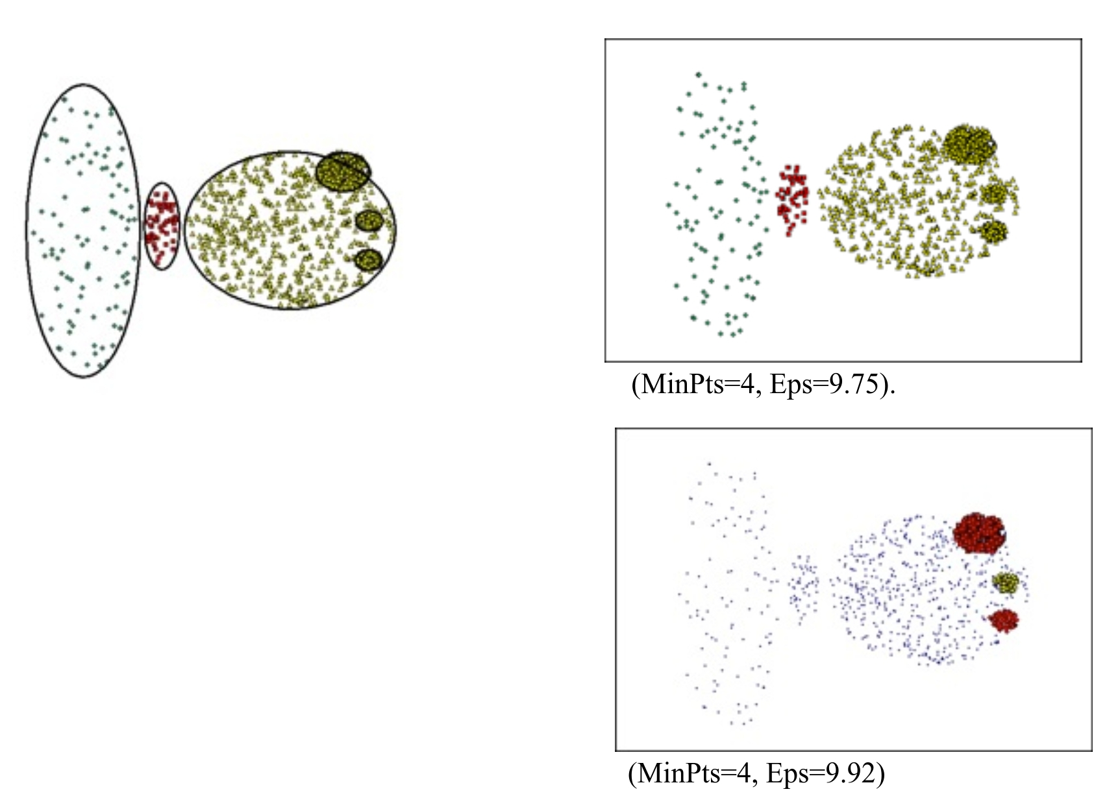
DBScan - Limitations
Can fail to identify clusters of varying densities.
Tends to create clusters of the same density.
Notion of density is problematic in high-dimensional spaces

Slide 40
Demo

