Slide 1
Soft Clustering
Boston University CS 506 - Lance Galletti

Slide 2
Soft Clustering
So far, clustering was done using hard assignments (1 point -> 1 cluster)
Sometimes this doesn’t accurately represent the data: it seems reasonable to have overlapping clusters.
In this case, we can use soft assignment to assign points to every cluster with a certain probability.

Slide 3
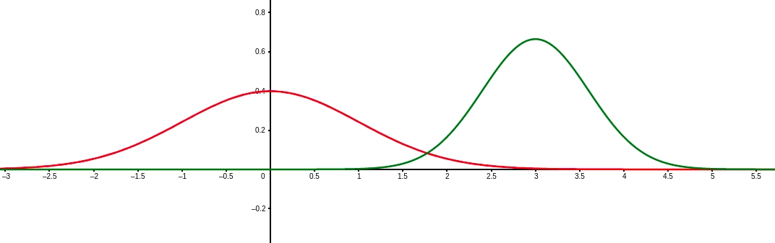
Soft Clustering - Example
Generate data where P(C₁) = P(C₂) = ½ and within C₁ and C₂ the distributions are N(𝝻₁, 𝞂₁) and N(𝝻₂, 𝞂₂)
Ex: we are given the weights of animals. Unknown to us these are weights from two different species.
Can we determine the species (group / assignment) from the height?

Slide 4
Soft Clustering - Example
Things to consider:
There is a prior probability of being one species (i.e. we could have an imbalanced dataset or there could just be more of one species than the other)
Weights within a particular group / species follow a particular distribution

Slide 5
Soft Clustering - Example
Generate data where P(C₁) = P(C₂) = ½ and within C₁ and C₂ the weight distributions are N(𝝻₁, 𝞂₁) and N(𝝻₂, 𝞂₂)

Slide 6
Soft Clustering - Example
Generate data where P(C₁) = P(C₂) = ½ and within C₁ and C₂ the weight distributions are N(𝝻₁, 𝞂₁) and N(𝝻₂, 𝞂₂)
Any of these points could technically have been generated from either curve.

Slide 7
Soft Clustering - Example
Generate data where P(C₁) = P(C₂) = ½ and within C₁ and C₂ the weight distributions are N(𝝻₁, 𝞂₁) and N(𝝻₂, 𝞂₂)
For each point we can compute the probability of it being generated from either curve

Slide 8
Soft Clustering - Example
Generate data where P(C₁) = P(C₂) = ½ and within C₁ and C₂ the weight distributions are N(𝝻₁, 𝞂₁) and N(𝝻₂, 𝞂₂)
We can create soft assignments based on these probabilities.

Slide 9
Example
What is the probability density here?

Slide 10
Example

Slide 11
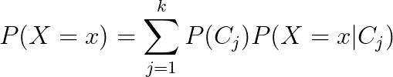
Mixture Model
X comes from a mixture model with k mixture components if the probability distribution of X is:
Mixture proportion
Represents the probability of belonging to C_{j}
Probability of seeing x when sampling from C_{j}

Slide 12
Gaussian Mixture Model
A Gaussian Mixture Model (GMM) is a mixture model where

Slide 13
Example

Slide 14
Maximum Likelihood Estimation (intuition)
Suppose you are given a dataset of coin tosses and are asked to estimate the parameters that characterize that distribution - how would you do that?
MLE: find the parameters that maximized the probability of having seen the data we got

Slide 15
Maximum Likelihood Estimation (intuition)
Example: Assume Bernoulli(p) iid coin tosses
Val
H
T
T
H
T
P(having seen the data we saw) = P(H)P(T)P(T)P(H)P(T)
= p²(1-p)³
Goal: find p that maximized that probability

Slide 16
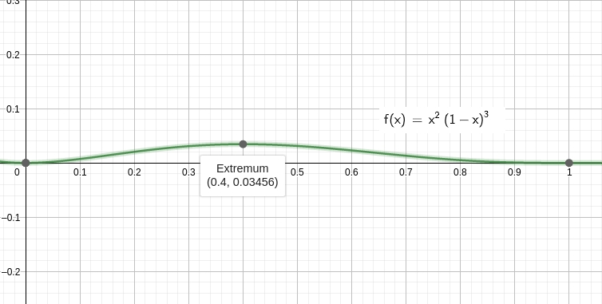
Maximum Likelihood Estimation (intuition)
Val
H
T
T
H
T
The sample proportion ⅖ is what maximizes this probability

Slide 17
GMM Clustering
Goal: Find the GMM that maximizes the probability of seeing the data we have.
The probability of seeing the data we saw is (assuming each data point was sampled independently) the product of the probabilities of observing each data point.
Finding the GMM means finding the parameters that uniquely characterize it. What are these parameters?
P(C_{i}) & 𝝻_{i} & 𝞂_{i} for all k components.
Lets call Θ = {𝝻₁, …, 𝝻_{k} , 𝞂₁, …, 𝞂_{k}, P(C₁), ..., P(C_{k})}

Slide 18
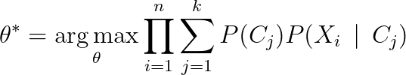
GMM Clustering
Goal:
Where Θ = {𝝻₁, …, 𝝻_{k} , 𝞂₁, …, 𝞂_{k}, P(C₁), ..., P(C_{k})}
Joint probability distribution of our data
Assuming our data are independent

Slide 19
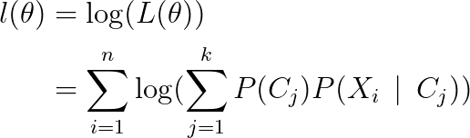
GMM Clustering
How do we find the critical points of this function?
Notice: taking the log-transform does not change the critical points
Define:

Slide 20


GMM Clustering
For 𝝻 = [𝝻₁, …, 𝝻_{k}]^{T} and 𝝨 = [𝝨₁, …, 𝝨_{k}]^{T}
We can solve

Slide 21



GMM Clustering
To get

Slide 22
GMM Clustering
Do we have everything we need to solve this?
Still need P(C_{j} | X_{i}) (i.e. the probability that X_{i} was drawn from C_{j})

Slide 23
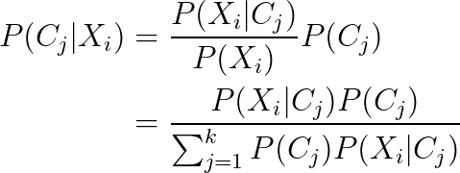
GMM Clustering
Looks like a loop! Seems we need P(C_{j}) to get P(C_{j} | X_{i}) and P(C_{j} | X_{i}) to get P(C_{j})

Slide 24
Expectation Maximization Algorithm
Start with random θ
Compute P(C_{j} | X_{I}) for all X_{i} by using θ
Compute / Update θ from P(C_{j} | X_{I})
Repeat 2 & 3 until convergence

Slide 25
Demo

