Slide 1
Singular Value Decomposition
Boston University CS 506 - Lance Galletti

Slide 2
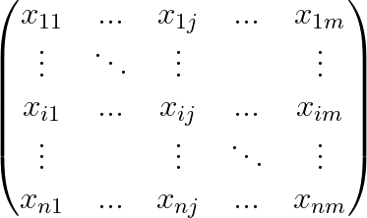
Recall
n data points
m features

Slide 3
Goal
Examine this matrix and uncover its linear algebraic properties to:
Approximate A with a smaller matrix B that is easier to store but contains similar information as A
Dimensionality Reduction / Feature Extraction
Anomaly Detection & Denoising

Slide 4
Linear Algebra Review
Definition: The vectors in a set V = { v⃗₁, …, v⃗_{n} } are linearly independent if
a₁v⃗₁+ … + a_{n}v⃗_{n} = o⃗
can only be satisfied by a_{i} = 0
Note: this means no vector in that set can be expressed as a linear combination of other vectors in the set.

Slide 5

Linear Algebra Review
Definition:
The determinant of a square matrix A is a scalar value that encodes properties about the linear mapping described by A.
2x2:
det(A) = ad - bc

Slide 6
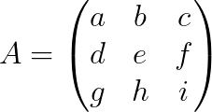
Linear Algebra Review
Definition:
The determinant of a square matrix A is a scalar value that encodes properties about the linear mapping described by A.
3x3:

Slide 7
Linear Algebra Review
Definition:
The determinant of a square matrix A is a scalar value that encodes properties about the linear mapping described by A.
n X n:
Can recursively compute it. How?

Slide 8
Linear Algebra Review
Property:
n vectors { v⃗₁, …, v⃗_{n} } in an n-dimensional space are linearly independent iff the matrix A:
A = [ v⃗₁, …, v⃗_{n} ] (n x n)
has non-zero determinant.
Q: Can m > n vectors in an n-dimensional space be linearly independent?

Slide 9
Linear Algebra Review
Definition:
A basis B of a vector space (over a field F) is a linearly independent subset of V that spans V. B spans V if for every vector v in V it is possible to choose v₁, …, v_{n} in F and b⃗₁, …, b⃗_{n} in B such that:
v = v₁b⃗₁ + … + v_{n}b⃗_{n}
Ex: North & East in 2d-plane

Slide 10
Linear Algebra Review
Definition:
The rank of a matrix A is the dimension of the vector space spanned by its column space. This is equivalent to the maximal number of linearly independent columns / rows of A.
Definition:
A matrix A is full-rank iff rank(A) = min(m, n)
Note: Get the rank of a matrix through the Gram-Schmidt process

Slide 11
Approximation
In practice, matrices describing our dataset contain a lot of redundant information.
It would be great to capture all the information of our dataset in the least amount of space possible.

Slide 12
Approximation
To store an n x m matrix A requires storing m · n values.
However, if the rank of the matrix of A is k, A can be factored as
A = UV
where
U is n x k
V is k x m
which requires storing k(m + n) values.

Slide 13
Approximation
Goal:
Approximate A with A^{(k)} (low-rank matrix) such that
d(A, A^{(k)}) is small
k is small compared to m & n

Slide 14
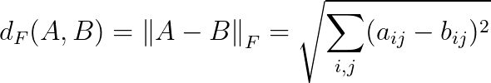
Frobenius Distance
i.e. the pairwise differences in values of A and B

Slide 15

Approximation
Definition:
When k < rank(A), the rank-k approximation of A (in the least squares sense) is

Slide 16
Approximation
Definition:
The Singular Value Decomposition of a rank-r matrix A has the form
A = U𝝨V^{T}
where
U is n x r
The columns of U are orthogonal & unit length (U^{T}U = I)
V is m x r
The columns of V are orthogonal & unit length (V^{T}V = I)

Slide 17
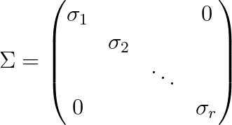
Approximation
Definition:
The Singular Value Decomposition of a rank-r matrix A has the form
A = U𝝨V^{T}
where
with 𝞂₁≥ 𝞂₂≥ … ≥ 𝞂_{r} > 0
𝞂_{i} is the square root of the eigenvalues of A^{T}A and are called singular values

Slide 18
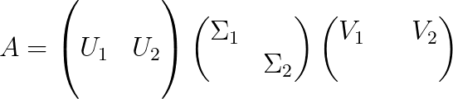
Approximation
Find A^{(k)} by decomposing A:
A^{(k)} = U₁𝝨₁V₁^{T}
Where
U₁ is n x k
𝝨₁ is k x k
V₁ is m x k

Slide 19
Approximation
1 | 1 | 1 | 0 | 0
2 | 2 | 2 | 0 | 0
1 | 1 | 1 | 0 | 0
5 | 5 | 5 | 0 | 0
0 | 0 | 0 | 2 | 2
0 | 0 | 0 | 3 | 3
0 | 0 | 0 | 1 | 1
0.18 | 0
0.36 | 0
0.18 | 0
0.90 | 0
0 | 0.53
0 | 0.80
0 | 0.27
9.64 | 0
0 | 5.29
0.58 | 0.58 | 0.58 | 0 | 0
0 | 0 | 0 | 0.71 | 0.71
=
x
x

Slide 20
Approximation
1 | 1 | 1 | 0 | 0
2 | 2 | 2 | 0 | 0
1 | 1 | 1 | 0 | 0
5 | 5 | 5 | 0 | 0
0 | 0 | 0 | 2 | 2
0 | 0 | 0 | 3 | 3
0 | 0 | 0 | 1 | 1
0.18 | 0
0.36 | 0
0.18 | 0
0.90 | 0
0 | 0.53
0 | 0.80
0 | 0.27
9.64 | 0
0 | 0
0.58 | 0.58 | 0.58 | 0 | 0
0 | 0 | 0 | 0.71 | 0.71
~
x
x

Slide 21
Approximation
1 | 1 | 1 | 0 | 0
2 | 2 | 2 | 0 | 0
1 | 1 | 1 | 0 | 0
5 | 5 | 5 | 0 | 0
0 | 0 | 0 | 2 | 2
0 | 0 | 0 | 3 | 3
0 | 0 | 0 | 1 | 1
0.18 | 0
0.36 | 0
0.18 | 0
0.90 | 0
0 | 0.53
0 | 0.80
0 | 0.27
9.64 | 0
0 | 0
0.58 | 0.58 | 0.58 | 0 | 0
0 | 0 | 0 | 0.71 | 0.71
~
x
x

Slide 22
Approximation
1 | 1 | 1 | 0 | 0
2 | 2 | 2 | 0 | 0
1 | 1 | 1 | 0 | 0
5 | 5 | 5 | 0 | 0
0 | 0 | 0 | 2 | 2
0 | 0 | 0 | 3 | 3
0 | 0 | 0 | 1 | 1
1 | 1 | 1 | 0 | 0
2 | 2 | 2 | 0 | 0
1 | 1 | 1 | 0 | 0
5 | 5 | 5 | 0 | 0
0 | 0 | 0 | 0 | 0
0 | 0 | 0 | 0 | 0
0 | 0 | 0 | 0 | 0
~

Slide 23

Approximation
Property:
Note: the larger k is, the smaller the distance.

Slide 24
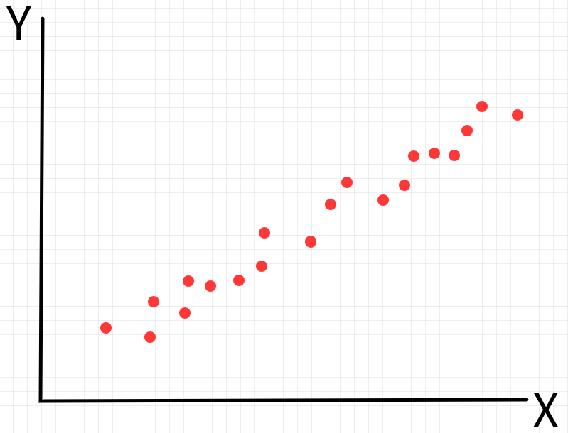
Approximation
The i^{th} singular vector represents the direction of the i^{th} most variance.
Singular Values express the importance / significance of a singular vector

Slide 25
Approximation
To find the right k you can:
Look at the singular value plot to find the elbow point
Look at the residual error of choosing different k

Slide 26
Demo

Slide 27
Dimensionality Reduction - Principal Component Analysis
Idea: project the data onto a subspace generated from a subset of singular vectors / principal components.
We want to project onto the components that capture most of the variance / information in the data.

Slide 28
Principal Component Analysis
A
B
Which principal component should we project on?

Slide 29
Demo

Slide 30
Latent Semantic Analysis
Inputs are documents. Each word is a feature. We can represent each document by:
The presence of the word (0 / 1)
Count of the word (0, 1, … )

Slide 31
Latent Semantic Analysis
 | data | information | retrieval | brain | lung
CS-paper-1 | 1 | 1 | 1 | 0 | 0
CS-paper-2 | 2 | 2 | 2 | 0 | 0
CS-paper-3 | 1 | 1 | 1 | 0 | 0
CS-paper-4 | 5 | 5 | 5 | 0 | 0
Med-paper-1 | 0 | 0 | 0 | 2 | 2
Med-paper-2 | 0 | 0 | 0 | 3 | 3
Med-paper-3 | 0 | 0 | 0 | 1 | 1

Slide 32
Latent Semantic Analysis
1 | 1 | 1 | 0 | 0
2 | 2 | 2 | 0 | 0
1 | 1 | 1 | 0 | 0
5 | 5 | 5 | 0 | 0
0 | 0 | 0 | 2 | 2
0 | 0 | 0 | 3 | 3
0 | 0 | 0 | 1 | 1
0.18 | 0
0.36 | 0
0.18 | 0
0.90 | 0
0 | 0.53
0 | 0.80
0 | 0.27
9.64 | 0
0 | 5.29
0.58 | 0.58 | 0.58 | 0 | 0
0 | 0 | 0 | 0.71 | 0.71
=
x
x

Slide 33
Latent Semantic Analysis
CS concept
MD concept
0.18 | 0
0.36 | 0
0.18 | 0
0.90 | 0
0 | 0.53
0 | 0.80
0 | 0.27
9.64 | 0
0 | 5.29
0.58 | 0.58 | 0.58 | 0 | 0
0 | 0 | 0 | 0.71 | 0.71
x
x

Slide 34
Latent Semantic Analysis
CS concept
MD concept
doc-to-concept similarity
0.18 | 0
0.36 | 0
0.18 | 0
0.90 | 0
0 | 0.53
0 | 0.80
0 | 0.27
9.64 | 0
0 | 5.29
0.58 | 0.58 | 0.58 | 0 | 0
0 | 0 | 0 | 0.71 | 0.71
x
x

Slide 35
Latent Semantic Analysis
doc-to-concept similarity matrix
0.18 | 0
0.36 | 0
0.18 | 0
0.90 | 0
0 | 0.53
0 | 0.80
0 | 0.27
9.64 | 0
0 | 5.29
0.58 | 0.58 | 0.58 | 0 | 0
0 | 0 | 0 | 0.71 | 0.71
x
x

Slide 36
Latent Semantic Analysis
doc-to-concept similarity matrix
0.18 | 0
0.36 | 0
0.18 | 0
0.90 | 0
0 | 0.53
0 | 0.80
0 | 0.27
“strength” of the CS concept
9.64 | 0
0 | 5.29
0.58 | 0.58 | 0.58 | 0 | 0
0 | 0 | 0 | 0.71 | 0.71
x
x

Slide 37
Latent Semantic Analysis
doc-to-concept similarity matrix
0.18 | 0
0.36 | 0
0.18 | 0
0.90 | 0
0 | 0.53
0 | 0.80
0 | 0.27
“strength” of the each concept
9.64 | 0
0 | 5.29
0.58 | 0.58 | 0.58 | 0 | 0
0 | 0 | 0 | 0.71 | 0.71
x
x

Slide 38
Latent Semantic Analysis
doc-to-concept similarity matrix
0.18 | 0
0.36 | 0
0.18 | 0
0.90 | 0
0 | 0.53
0 | 0.80
0 | 0.27
term-to-concept similarity
“strength” of the each concept
9.64 | 0
0 | 5.29
0.58 | 0.58 | 0.58 | 0 | 0
0 | 0 | 0 | 0.71 | 0.71
x
x

Slide 39
Latent Semantic Analysis
doc-to-concept similarity matrix
0.18 | 0
0.36 | 0
0.18 | 0
0.90 | 0
0 | 0.53
0 | 0.80
0 | 0.27
“strength” of the each concept
term-to-concept similarity matrix
9.64 | 0
0 | 5.29
0.58 | 0.58 | 0.58 | 0 | 0
0 | 0 | 0 | 0.71 | 0.71
x
x

Slide 40
Latent Semantic Analysis
We can better represent each document by:
Frequency of the word (n_{i} / 𝚺n_{i} )
TfiDf
tf · idf
log (
number of documents
-------------------------------------
number of documents that contain the term
)
Term frequency in the document

Slide 41
Demo

Slide 42
Anomaly Detection
Define O = A - A^{(k)}
The largest rows of O could be considered anomalies

Slide 43
Demo

