Slide 1
Classification
Boston University CS 506 - Lance Galletti

Slide 2
What is Classification?
Given a training set where data is labeled with a special attribute called a class (a discrete value)
We want to find a model for the class attribute as a function of the values of the other attributes
Goal: use this model on unlabeled data to assign a class as accurately as possible

Slide 3
Example
age | Tumor size | malignant?
20 | 10 | no
30 | 15 | yes
40 | 20 | no
50 | 25 | yes
Model
f : age x tumor size ---> {yes, no}
learn model

Slide 4
Example
age | Tumor size | malignant?
25 | 5 | ?
35 | 10 | ?
45 | 25 | ?
Model
f : age x tumor size ---> {yes, no}
Apply model

Slide 5
Classification Tasks
Predicting tumor cells as benign or malignant
Classifying images
Classifying credit card transactions as being legitimate or fraudulent
Many more

Slide 6
Classification Techniques
Instance-Based Classifiers
Decision Trees
Naive Bayes
Support Vector Machines
Neural Networks

Slide 7
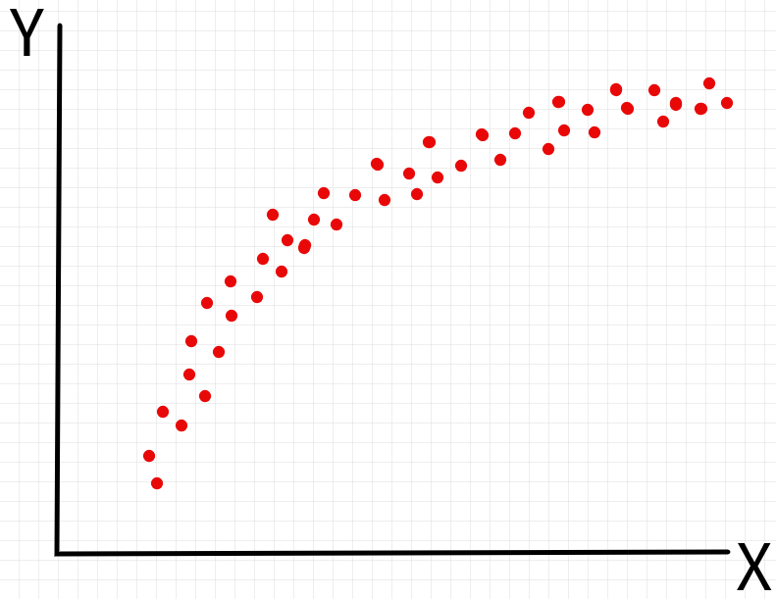
Underfitting VS Overfitting

Slide 8
Model Evaluation (simply)
Evaluating a model on the data it was trained on is cheating - can just memorize.
Distinction between data used for training and data left out used for testing / evaluation.
# mistakes made by the model
Stop here
Test
Train
Complexity of the model

Slide 9
Instance-Based Classifiers
Use the stored training records to predict the class label of unseen cases
Rote-learners:
Perform classification only if the attributes of the unseen record exactly match a record in our training set
Nearest Neighbor:
Use the k closest records to perform classification

Slide 10
Instance-Based Classifiers
age | Tumor size | malignant?
20 | 10 | no
30 | 15 | yes
40 | 20 | no
50 | 25 | yes
age | Tumor size | malignant?
25 | 5 | ?

Slide 11
K Nearest Neighbor Classifier
Requires:
Training set
Distance function
Value for k
How to classify an unseen record:
Compute distance of unseen record to all training records
Identify the k nearest neighbors
Aggregate the labels of these k neighbors to predict the unseen record class (ex: majority rule)

Slide 12
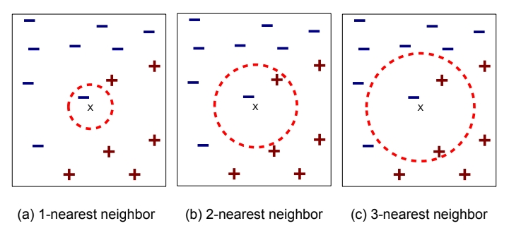
K Nearest Neighbor Classifier

Slide 13
K Nearest Neighbor Classifier
Aggregation methods:
Majority rule
Weighted majority based on distance (w = 1/d²)
Scaling issues:
Attributes should be scaled to prevent distance measures from being dominated by one attribute. Example:
Height: 1m -> 2m
Income: 10k -> 1million

Slide 14
K Nearest Neighbor Classifier
Aggregation methods:
Majority rule
Weighted majority based on distance (w = 1/d²)
Scaling issues:
Attributes should be scaled to prevent distance measures from being dominated by one attribute. Example:
Height: 1m -> 2m
Income: 10k -> 1million
height
income

Slide 15
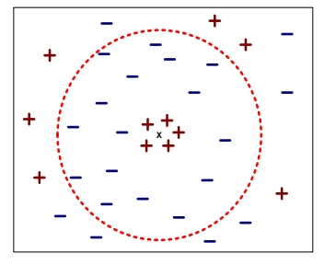
K Nearest Neighbor Classifier
Choosing the value of k:
If k is too small -> sensitive to noise points + overfitting (doesn’t generalize well)
If k is too big -> neighborhood may include points from other classes

Slide 16
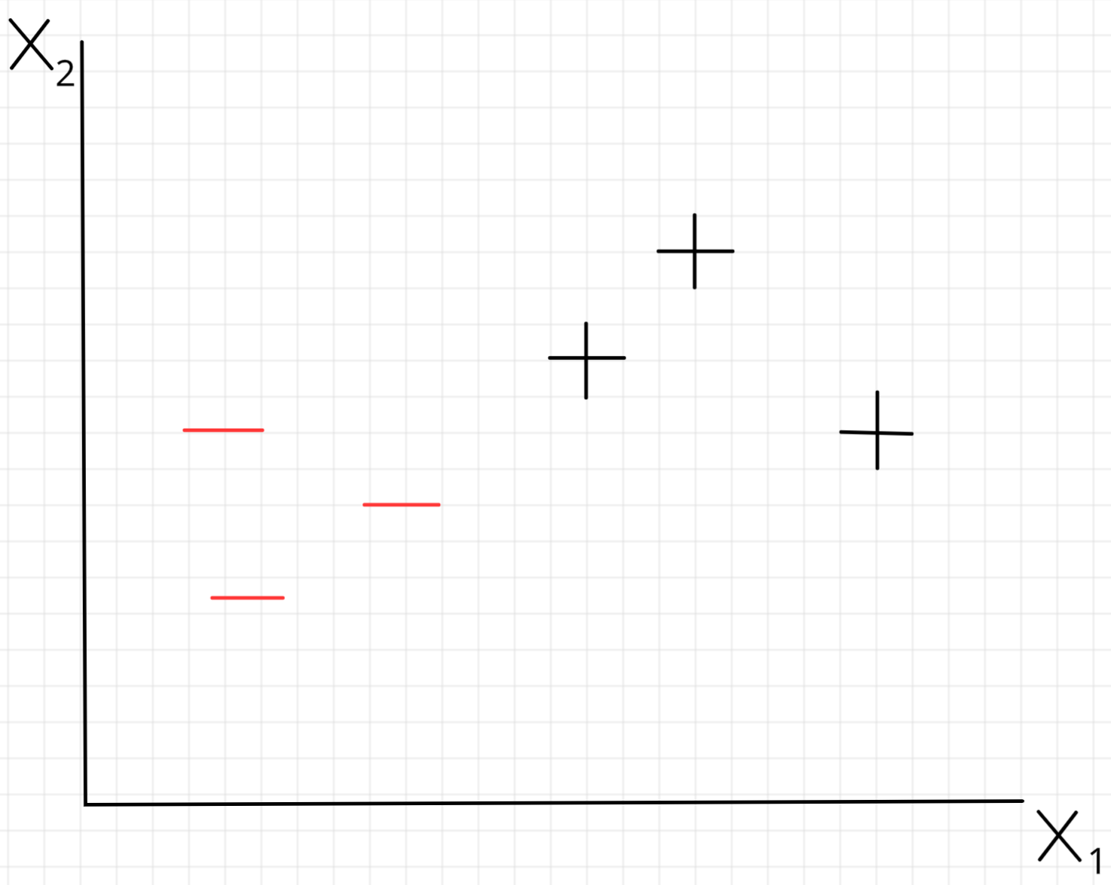
Nearest Neighbor decision boundary

Slide 17
K Nearest Neighbor Classifier
Pros:
Simple to understand why a given unseen record was given a particular class
Adapts to new attributes
Cons:
Expensive to classify new points
KNN can be problematic in high dimensions (curse of dimensionality)

