Slide 1
Support Vector Machines
Boston University CS 506 - Lance Galletti

Slide 2
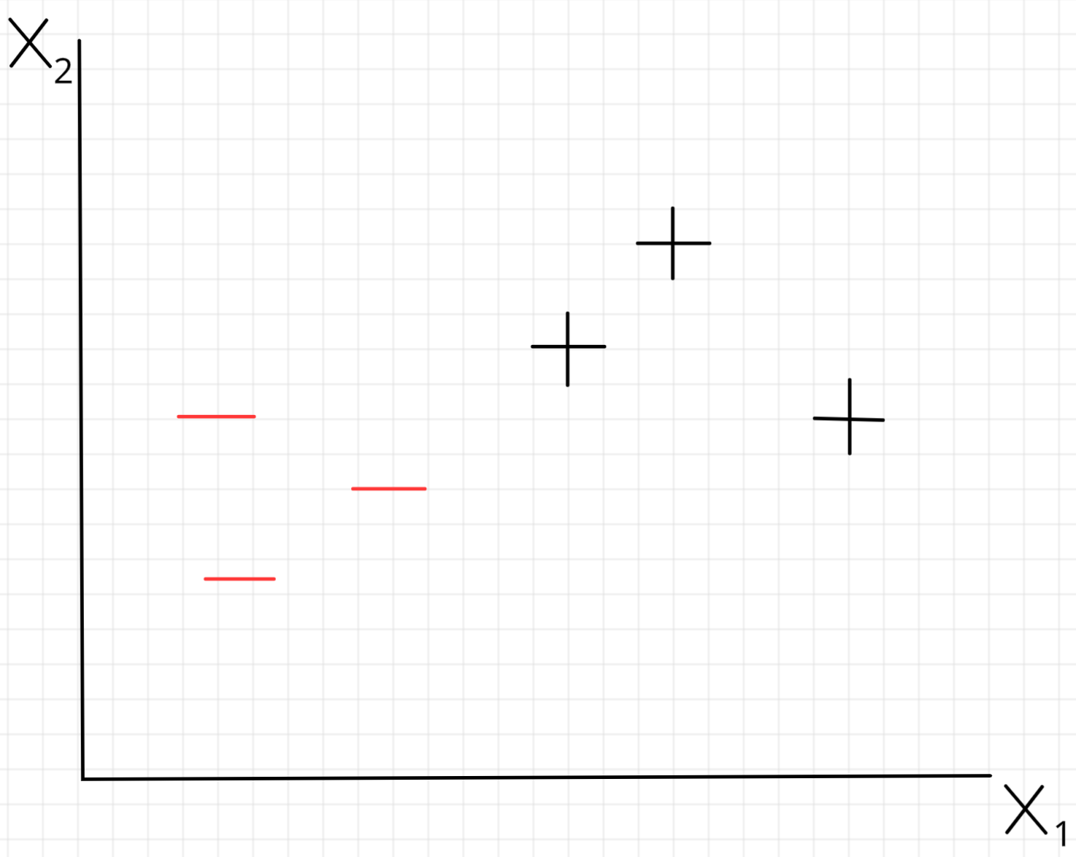
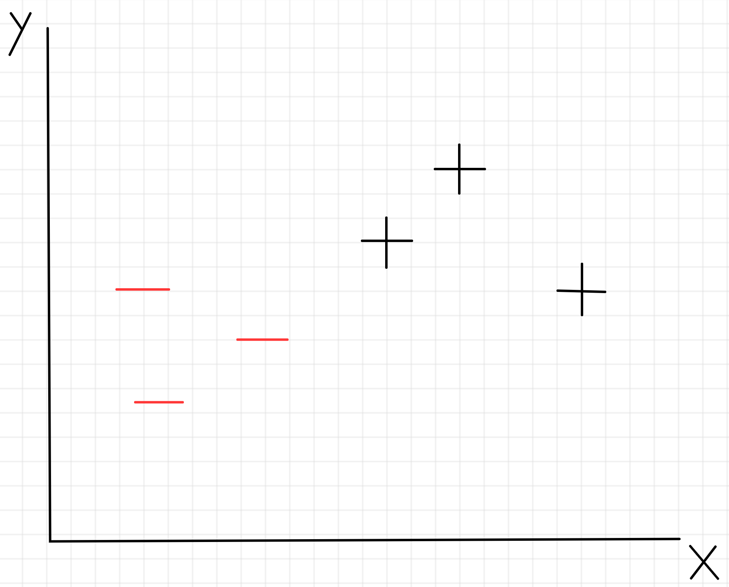

Slide 3
Decision Tree split on attribute x1

Slide 4
Nearest Neighbor decision boundary

Slide 5
Find the best line that separates our classes
?
w₁x₁ + w₂x₂ + b = 0

Slide 6
SVM: Find the widest street that separates our classes - the dotted line in the middle is our decision boundary
Notes:
What do all these lines have in common? Only a few points determine them.

Slide 7
Suppose we found this decision boundary, how would we classify an unknown input u?
u
wx + b = 0

Slide 8
Suppose we found this decision boundary, how would we classify an unknown input u?
Let w be a vector perpendicular to the decision boundary
w₁
w₂
w
u
w₁x₁ + w₂x₂ + b = 0

Slide 9
Suppose we found this decision boundary, how would we classify an unknown input u?
We could project u onto w and depending on the size of that projection (which side of the street it ends up on), we can classify it as + or -
Let w be a vector perpendicular to the decision boundary
w · u
w₁x₁ + w₂x₂ + b = 0

Slide 10
Suppose we found this decision boundary, how would we classify an unknown input u?
In math terms:
Or:
w · u
wx + b = 0

Slide 11
Just need to find w and b.
Questions:
Lots of w’s perpendicular to the street - which is the best one?
What is b?
DECISION RULE
w · u
wx + b = 0

Slide 12
What contributes to the widest street?
Intuitively:
wx + b = 0

Slide 13
What contributes to the widest street?
Intuitively:
These points don’t contribute. If we were to move them they would not affect the decision boundary
wx + b = 0

Slide 14
What contributes to the widest street?
Intuitively:
This point does contribute. If we were to move it, it could totally change the decision boundary
wx + b = 0

Slide 15
What contributes to the widest street?
Intuitively:
This point is called a support vector
wx + b = 0

Slide 16

How to find the widest street
We want our samples to lie beyond the street. That is:
Note: for an unknown u, we can have

Slide 17
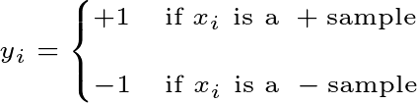
How to find the widest street
Let’s introduce a variable
Note: this is effectively the class label of

Slide 18
How to find the widest street
If we multiply our sample decision rules by this new variable:
Meaning, for on the decision boundary, we want:

Slide 19
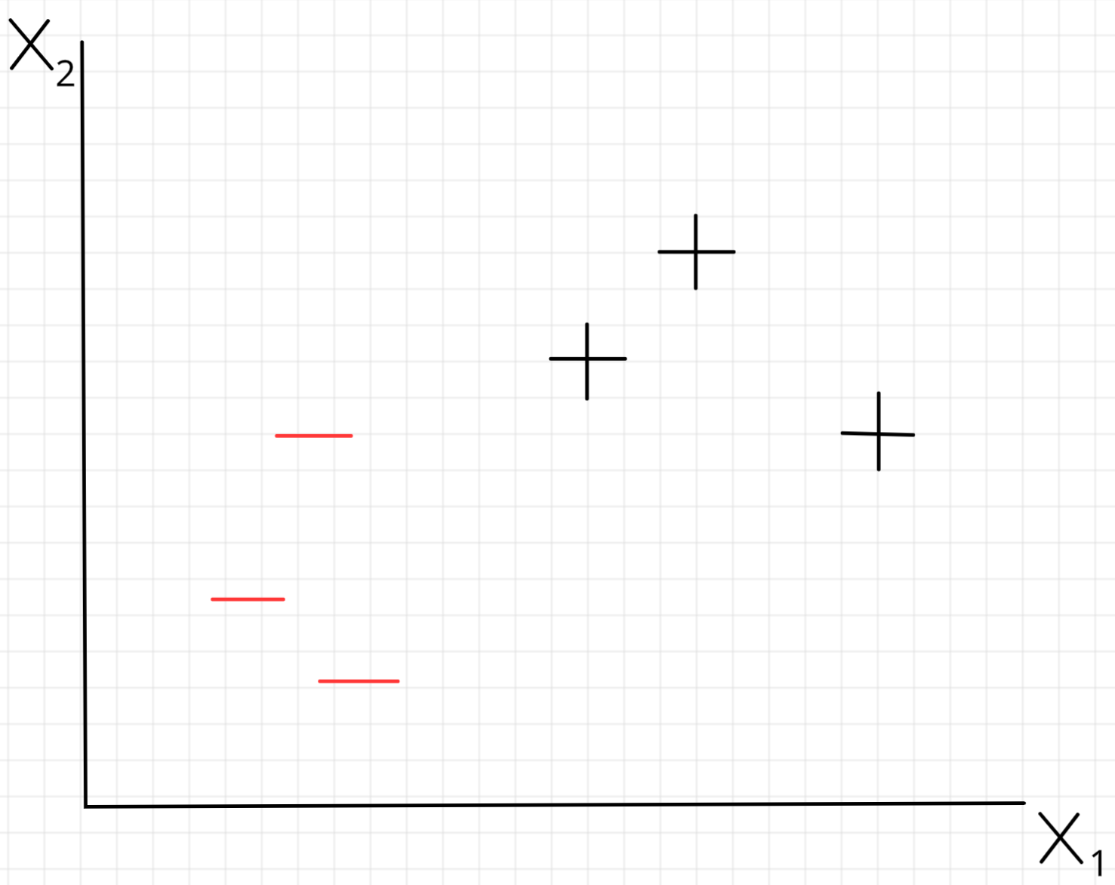
For and
points on the boundary

Slide 20

WIDTH
WIDTH
w

Slide 21

How to find the widest street
We know that WIDTH
And, since they are on the boundary, we know that
Hence, WIDTH
(as an exercise, try to show this)
for and points on the boundary

Slide 22
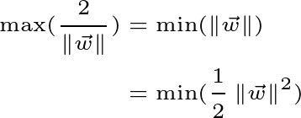
How to find the widest street
Goal is to maximize the width
Subject to:

Slide 23
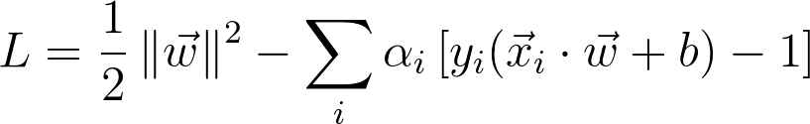
How to find the widest street
Can use Lagrange multipliers to form a single expression to find the extremum of
where is 0 for not on the boundary.
Now we can take derivatives to find the extremum of L.

Slide 24
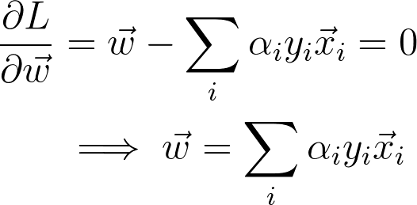
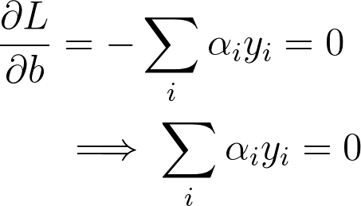
How to find the widest street
Means w is a linear sum of vectors in our sample/training set!

Slide 25
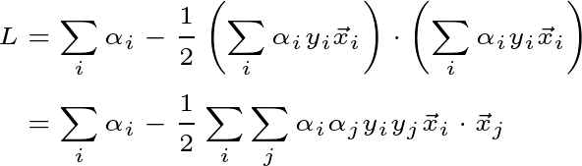
How to find the widest street
Let’s plug these values back into L to see what happens to L at its extremum
Simplifying, we get:

Slide 26

DECISION RULE
u
wx + b = 0

Slide 27
DECISION RULE
w
u
wx + b = 0

Slide 28
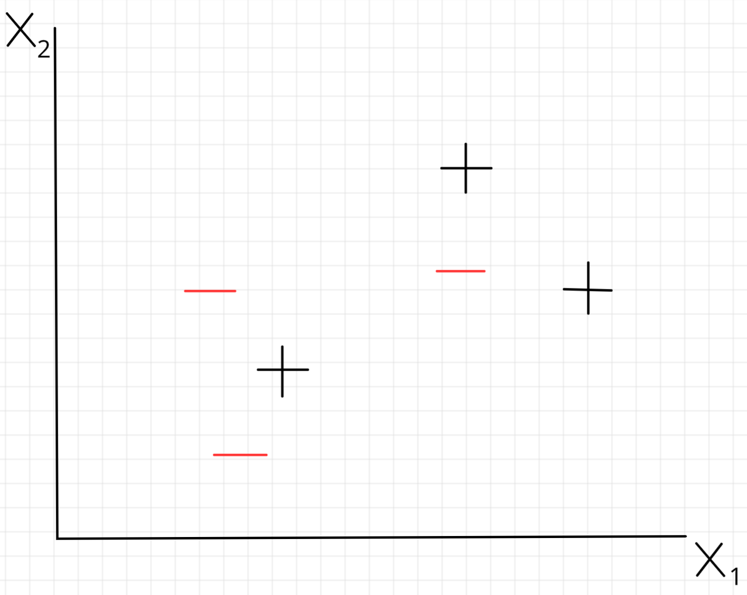
?

Slide 29
Option 1: Soft Margins
Can allow for some points in the dataset to be misclassified.

Slide 30
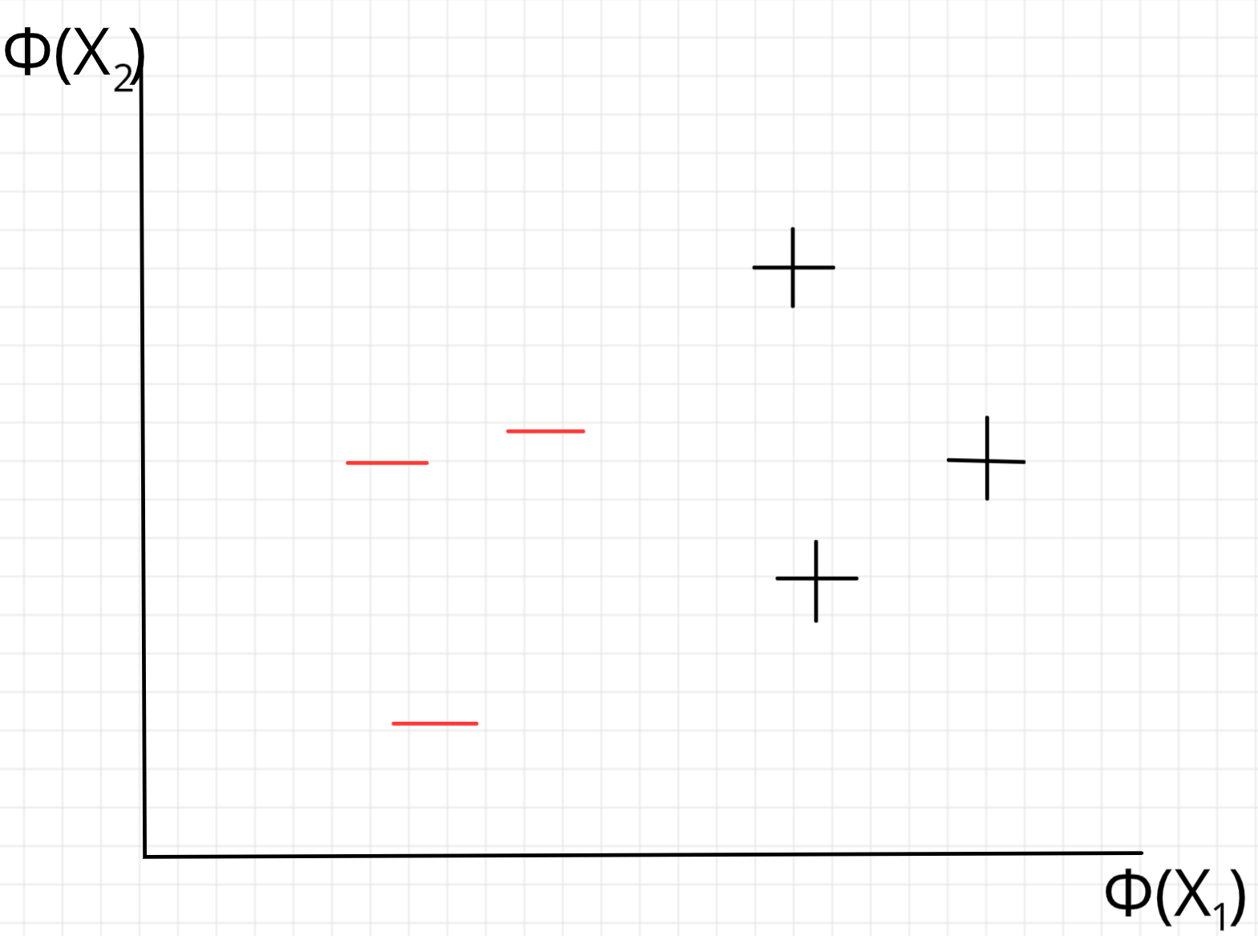
Option 2: Change perspective
Φ

Slide 31
But how to find Φ?
Turns out we don’t need to find or define a transformation Φ!
Looking back at L, since it depends only on the dot product of our input, we only need to define the dot product in our transformed space.
i.e. we only need to define
Called a Kernel function. This is often referred to as the “kernel trick”.

Slide 32
Kernel Function (intuition)
The inner product of a space describes how close / similar points are
Kernel Functions allow for specifying the closeness / similarity of points in a hypothetical transformed space
The hope is that with that new notion of closeness, points in the dataset are linearly separable.

Slide 33

Example Kernel Functions
Polynomial Kernel
Radial Basis Function Kernel

Slide 34
Demo

