Slide 1
Recommender Systems
Boston University CS506 - Lance Galletti

Slide 2
An Example: Movie Recommendations
Given
Users: U₁, … , U_{n}
Movies: M₁, … , M_{m}
Ratings: R_{ij}
Goal: Recommend movies to users
Challenges:
Scale (millions of users, millions of movies)
Cold Start (change in user base, change in content)
Sparse Data (Not many users rank movies)

Slide 3
An Example: Movie Recommendations
 | M₁ | M₂ | M₃ | M₄
U₁ | R₁₁ | R₁₂ | R₁₃ | R₁₄
U₂ | R₂₁ | R₂₂ | R₂₃ | R₂₄
U₃ | R₃₁ | R₃₂ | R₃₃ | R₃₄
Use Rating prediction as proxy for recommendation!

Slide 4
An Example: Movie Recommendations
 | M₁ | M₂ | M₃ | M₄
U₁ | 5 | ? | 0 | 0
U₂ | ? | 4 | 0 | 0
U₃ | 0 | ? | 4 | ?

Slide 5
An Example: Movie Recommendations
 | M₁ | M₂ | M₃ | M₄
U₁ | 5 | 5 | 0 | 0
U₂ | 5 | 4 | 0 | 0
U₃ | 0 | 0 | 4 | 5

Slide 6
How to predict ratings?
Data exists for both users and movies
Neighborhood methods
Data only exists for movies
Content-based filtering
Only have access to ratings
Collaborative filtering

Slide 7
Neighborhood Methods
(user, user) similarity measure
i.e. recommend same movies to similar users (requires info about users)
(item, item) similarity measure
i.e. recommend movies that are similar (requires info about movies)
Pros: Intuitive / easy to explain No training Handles new users/items | Challenges: Users rate differently (bias) Ratings change over time (bias)

Slide 8
Feature Extraction - Content-Based
Realistically:
It’s difficult to characterize movies and users with the right features
Characterization of users and movies may not be accurate
If you are using genres for example, movies with varying degree of “comedy” will get the tag “comedy”.
Goal:
Discover the best features in an automated way
Content-Based: assume you have features for movies - want to learn features for users
Collaborative filtering: want to learn features for both users and movies

Slide 9
Feature Extraction - Content-Based
Suppose we have a set of features that characterizes each movie (ex: category, genre…), we could obtain the following feature-to-movie similarity matrix:
 | M₁ | M₂ | M₃ | M₄
F₁ (Romance) | .9 | 1 | .1 | 0
F₂ (Action) | 0 | .01 | 1 | .9

Slide 10
Feature Extraction - Content-Based
Given this feature-to-movie similarity matrix, how can we predict rating for User 2 or Movie 1 (i.e. R₁₂)?
If we had a user-to-feature similarity matrix, we could multiply:
user-to-feature x feature-to-movie = user-to-movie = R_{ij}

Slide 11
Feature Extraction - Content-Based
 | F₁ (Romance) | F₂ (Action)
U₁ | 5 | 0
U₂ | 5 | 0
U₃ | 0 | 5
 | M₁ | M₂ | M₃ | M₄
F₁ (Romance) | .9 | 1 | .1 | 0
F₂ (Action) | 0 | .01 | 1 | .9
X

Slide 12
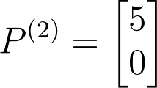
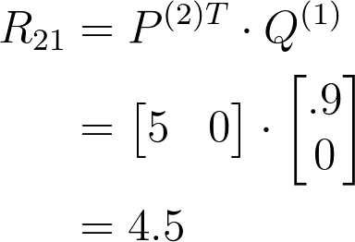
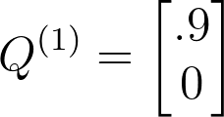
Feature Extraction - Content-Based
But, how to we find p⁽¹⁾, … , p^{(n)}?

Slide 13
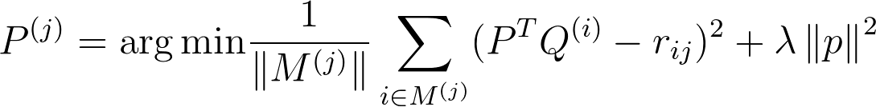

Feature Extraction - Content-Based
Regularization Term: a penalty on the size of the parameter p

Slide 14
Feature Extraction - Collaborative Filtering
Challenge with content-based:
How to get the right features f₁, …, f_{k} and p⁽¹⁾, … , p^{(n)} ?
Can we learn these features?
R = PQ

Slide 15
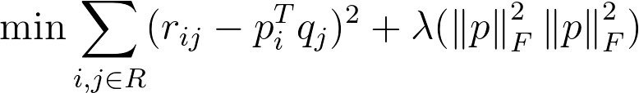

Feature Extraction - Collaborative Filtering
Can’t use SVD because R is sparse… BUT, we can formulate an optimization problem to solve:
To solve, take derivatives wrt P & Q. Then, just like Expectation-Maximization Algorithm from GMM:
Start with random Q
Get P
Improve Q
Repeat 2 & 3

Slide 16
Feature Extraction - Collaborative Filtering
You can use the python library “scikit-surprise” for implementation

