Slide 1
Linear Regression
Boston University CS 506 - Lance Galletti

Slide 2
Challenge for those who have LR experience
Find the data.csv file in the regression folder of our course repo
Challenge:
Every day my alarm goes off at seemingly random times…
I’ve recorded the times for the past year of so (1 - 355 days)
Today is day 356
Can you predict when my alarm will ring?
Notes:
Note: I know the alarm will ring during class

Slide 3
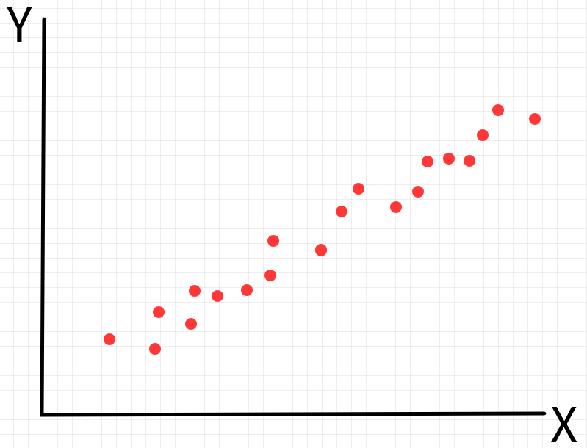
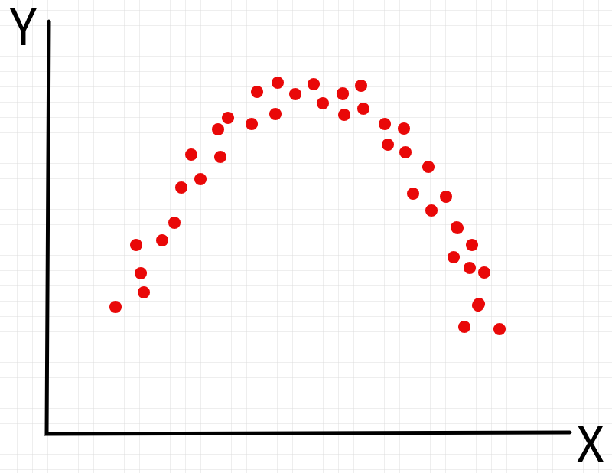
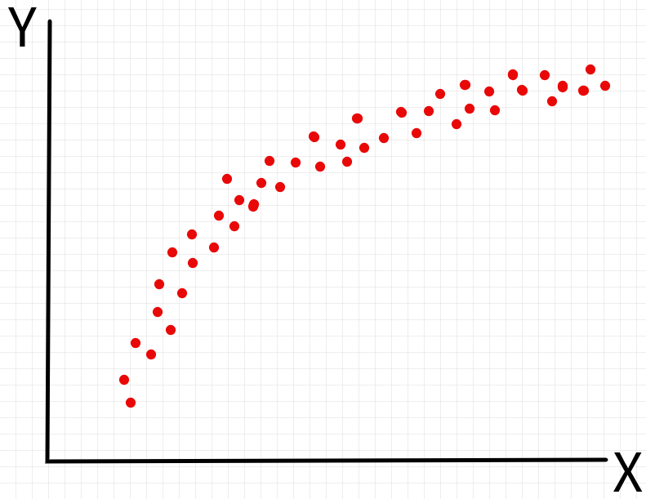
Motivation
Given n samples / data points (y_{i} , x_{i}). Y is a continuous variable (as opposed to classification).

Slide 4
Motivation
Understand/explain how y varies as a function of x (i.e. find a function y = h(x) that best fits our data)

Slide 5
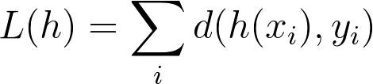
Motivation
Suppose we are given a curve y = h(x), how can we evaluate whether it is a good fit to our data?
Compare h(x_{i}) to y_{i} for all i.
Goal: For a given distance function d, find h where L is smallest.

Slide 6
Motivation
Should h be the curve that goes through the most samples? I.e. do we want h(x_{i}) = y_{i} for the maximum number of i?
h may be too complex
overfitting - may not perform well on unseen data

Slide 7
Motivation
The following curves seem the most intuitive “best fit” to our samples. How can we define this best fit mathematically? Is it just about finding the right distance function?

Slide 8
Motivation
Another way to define this problem is in terms of probability.
Define P(Y | h) as the probability of observing Y given that it was sampled from h.
Goal: Find h that maximizes the probability of having observed our data.

Slide 9
Motivation
To sum up we can either:
Minimize
Maximize
L(h) = P(Y | h)

Slide 10
Getting Started
Do we have enough to get started?
Seems like there are too many possible h and our problem statements are still too vague to effectively find solutions.
What can we do to constrain the problem?
Let’s make some assumptions!

Slide 11

Assumptions
Let’s start by assuming our data was generated by a linear function plus some noise:
Where h is linear in a parameter 𝜷.
Which functions below are linear in 𝜷?
h(𝜷) = 𝜷₁x
✔
h(𝜷) = 𝜷₀ + 𝜷₁x
✔
h(𝜷) = 𝜷₀ + 𝜷₁x + 𝜷₂x²
✔
h(𝜷) = 𝜷₁log(x) + 𝜷₂x²
✔
h(𝜷) = 𝜷₀ + 𝜷₁x + 𝜷₁²x
✘

Slide 12
Assumptions
The relation between x (independent variable) and y (dependent variable) is linear in a parameter 𝜷.
ϵ_{i} are independent, identically distributed random variables following a N(0, σ²) distribution. (Note: σ is constant)

Slide 13
Assumptions
~ N(x𝜷, σ²)
Y = X𝜷
X = x

Slide 14
Assumptions
Y = X𝜷
ϵ_{i} ~ N(0, σ²)

Slide 15
Goal
Given these assumptions, let’s try to solve the max and min problems we defined earlier!
Q: What does solving these mean?
A: Finding 𝜷 is equivalent to finding h

Slide 16
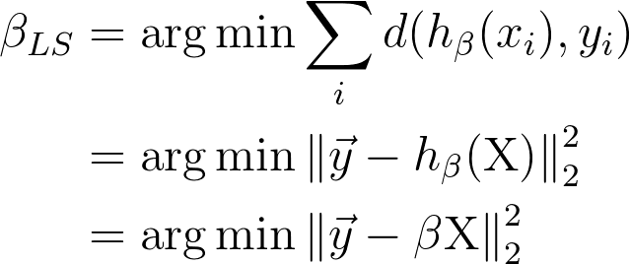
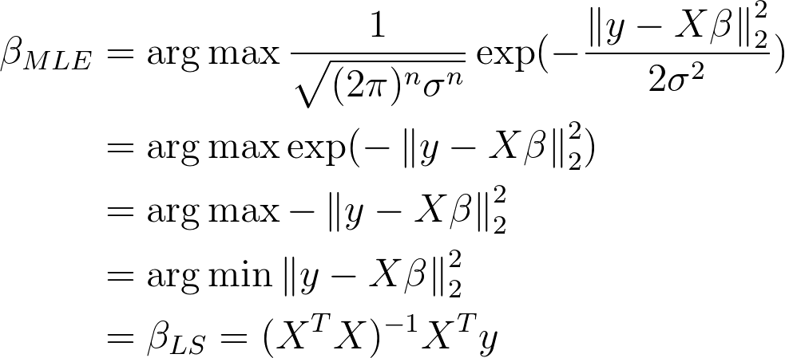
Least Squares
𝜷
𝜷
𝜷

Slide 17
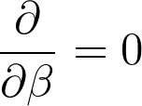
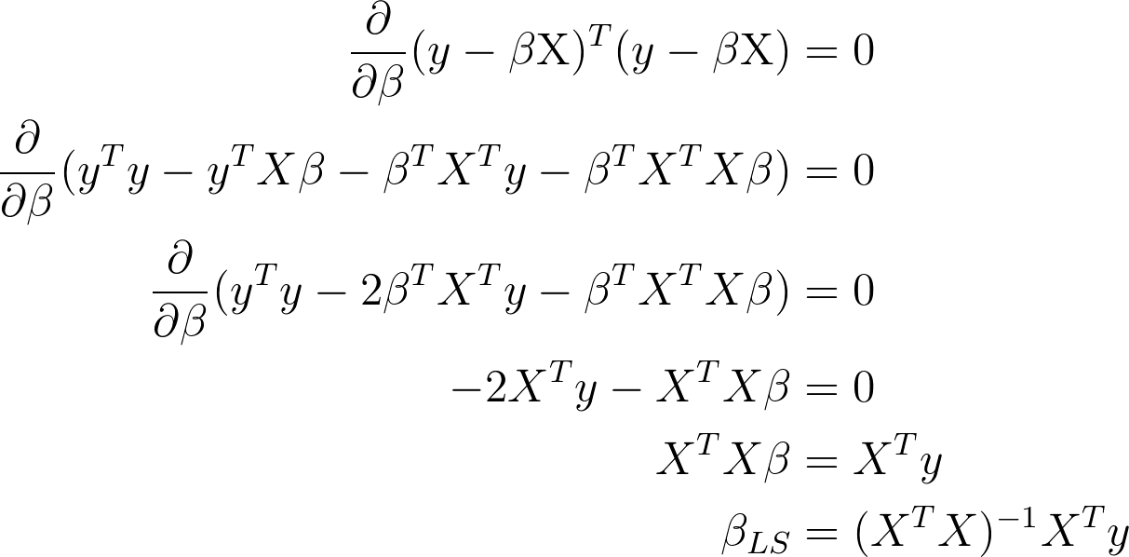
Least Squares
Notes:
X𝜷 not 𝜷X

Slide 18
Maximum Likelihood
Since ϵ ~ N(0, σ²) and Y = X𝜷 + ϵ then Y ~ N(X𝜷, σ²).
𝜷
𝜷
𝜷
𝜷

Slide 19
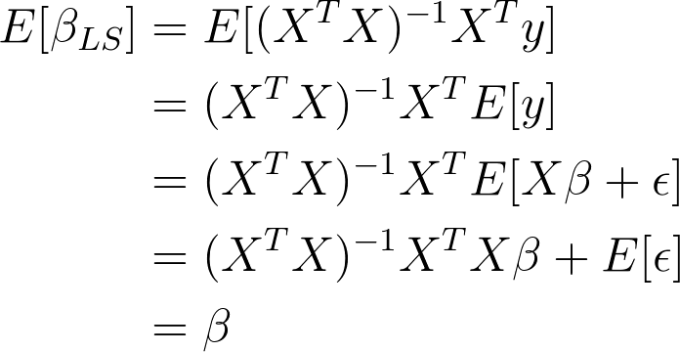
An Unbiased Estimator
𝜷_{LS} is an unbiased estimator of the true 𝜷. That is E[𝜷_{LS}]=𝜷.

Slide 20
Demo

Slide 21
Logistic Regression
So far y_{i} was a continuous variable. What if y_{i} is categorical? Can we use a linear function to predict y_{i}?
Assume we have 2 classes.

Slide 22
Logistic Regression
So far y_{i} was a continuous variable. What if y_{i} is categorical? Can we use a linear function to predict y_{i}?
Assume we have 2 classes.

Slide 23
Logistic Regression
What will a linear model look like?
Y = X𝜷
1
0

Slide 24
Logistic Regression
What will a linear model look like?
Y = X𝜷
1
?
0
x

Slide 25
Logistic Regression
What if the numerical values of the classes change?
Y = X𝜷
100
3
x

Slide 26
Logistic Regression
What if the numerical values of the classes change?
Y = X𝜷
100
3
x

Slide 27
Logistic Regression
The numerical values associated with the class are arbitrary. A model based on these numbers would be meaningless…
So we probably shouldn’t try to predict the class itself.

Slide 28
Logistic Regression
Notice that a linear function will predict a continuum of values. So we should find an interpretation / transformation of the class that is continuous for us to predict.

Slide 29
Logistic Regression
Can we use the probability of belonging to a given class as a proxy for how confidently we can classify a given point?
P( )
P(Y) = X𝜷
?
1
0
x

Slide 30
Logistic Regression
Can we use the probability of belonging to a given class as a proxy for how confidently we can classify a given point?
P( )
P(Y) = X𝜷
?
1
0
x

Slide 31
Logistic Regression
So it’s not just a continuum of values - the range of values needs to be (-∞, ∞)!
Define the odds = p / 1 - p where p = P(Y = class 1 | X)
Now the range of X𝜷_{LS} is [0, ∞)
In order to get (-∞, ∞), let’s take the log of the odds! This is also convenient numerically because in the odds format, tiny variations in p have large effects on the odds!

Slide 32
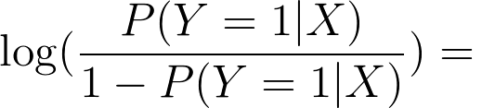
Logistic Regression
Our goal is to fit a linear model to the log-odds of being in one of our classes (in the 2-class case) i.e.

Slide 33
Logistic Regression
logodds( )
logodds(Y) = X𝜷

Slide 34
Logistic Regression
Creates a linear decision boundary between the classes. Why?
The decision boundary is where the probability is ½ (for binary classification).

Slide 35
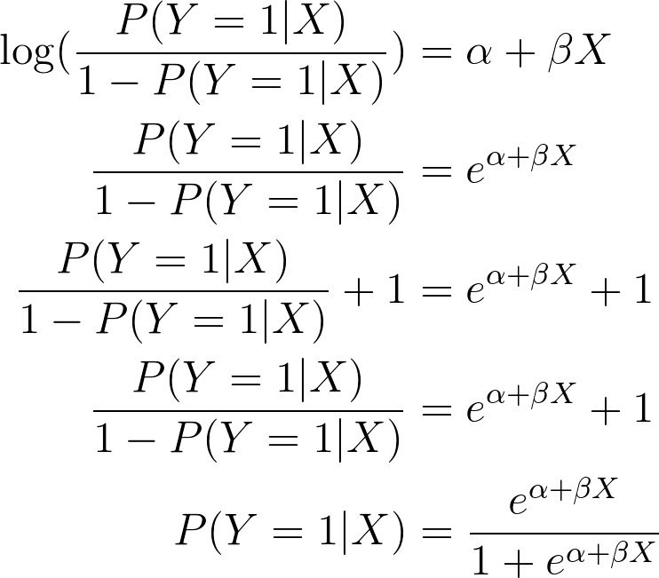
Logistic Regression
Suppose we have such a model. How do we recover the P(Y=1|X)?
The function we apply to our probability to obtain the log odds is called the logit function. The function used to retrieve our probability from the log odds is called logit⁻¹

Slide 36
Logistic Regression
The probability is ½ only when X𝜷 = 0 which is the equation of a line.

Slide 37
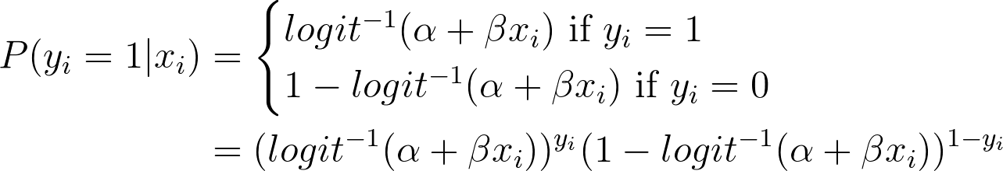
Logistic Regression
How do we learn our model? I.e. the α and 𝜷 parameters.
We know:

Slide 38
Logistic Regression
So we can define the probability of having seen the data we saw:
And try to maximize this quantity!
Unfortunately, there is no closed form solution here and we need to use numerical approximation methods to solve this optimization problem - we will talk about these soon!

Slide 39
Demo

Slide 40
Evaluating Our Regression Model
Some Notation:
y_{i} is the “true” value from our data set (i.e. x_{i} 𝜷 + ϵ_{i})
ŷ_{i} is the estimate of y_{i} from our model (i.e. x_{i} 𝜷_{LS})
ȳ is the sample mean all y_{i}
y_{i} - ŷ_{i} are the estimates of ϵ_{i} and are referred to as residuals

Slide 41
Y = X𝜷
Y = X𝜷_{LS}
Y_{i} = X_{i}𝜷 + ϵ_{i}
e_{i} ~ N(0, σ²)
ϵ_{i} ~ N(0, σ²)

Slide 42
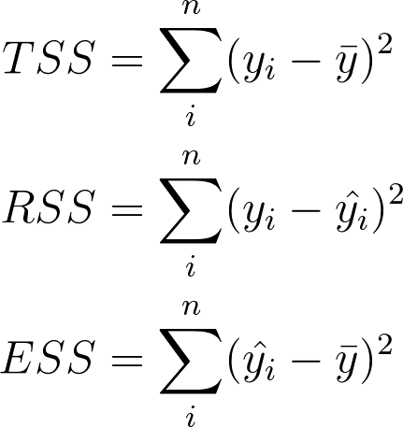
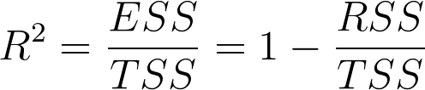
Evaluating Our Regression Model
This is what our linear model is minimizing
R² measures the fraction of variance that is explained by ŷ

Slide 43
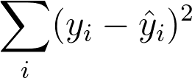
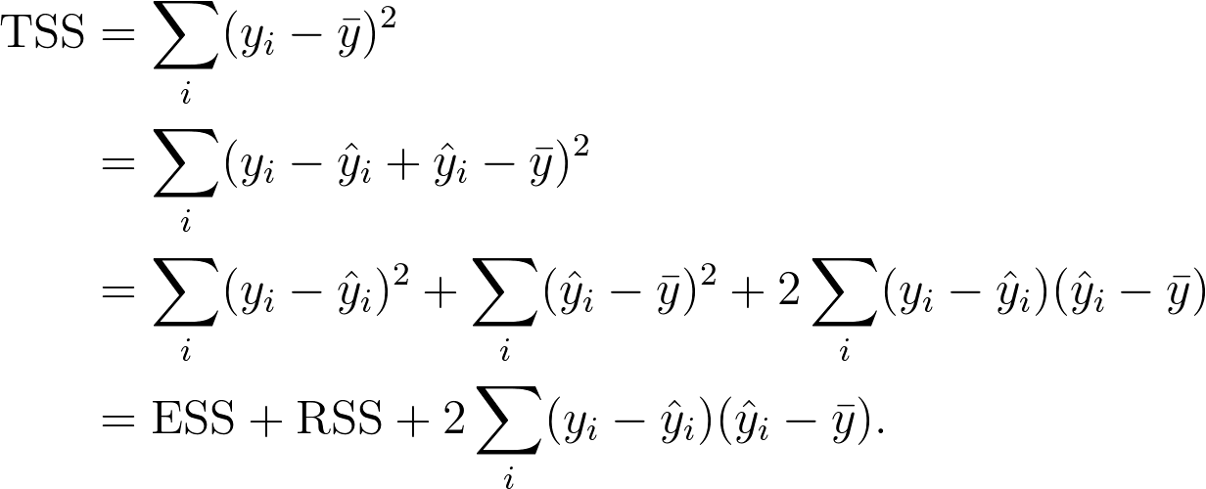
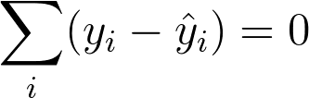
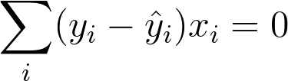
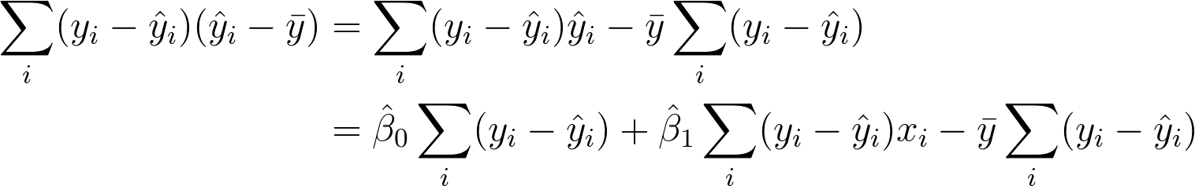
Exercise
Assume for simplicity that ŷ_{i} = 𝜷₀ + 𝜷₁x_{i}
Since 𝜷₀ and 𝜷₁ are least squares estimates, we know they minimize
Show that TSS = ESS + RSS
By taking derivatives of the above with respect to 𝜷₀ and 𝜷₁ we discover that
and

Slide 44
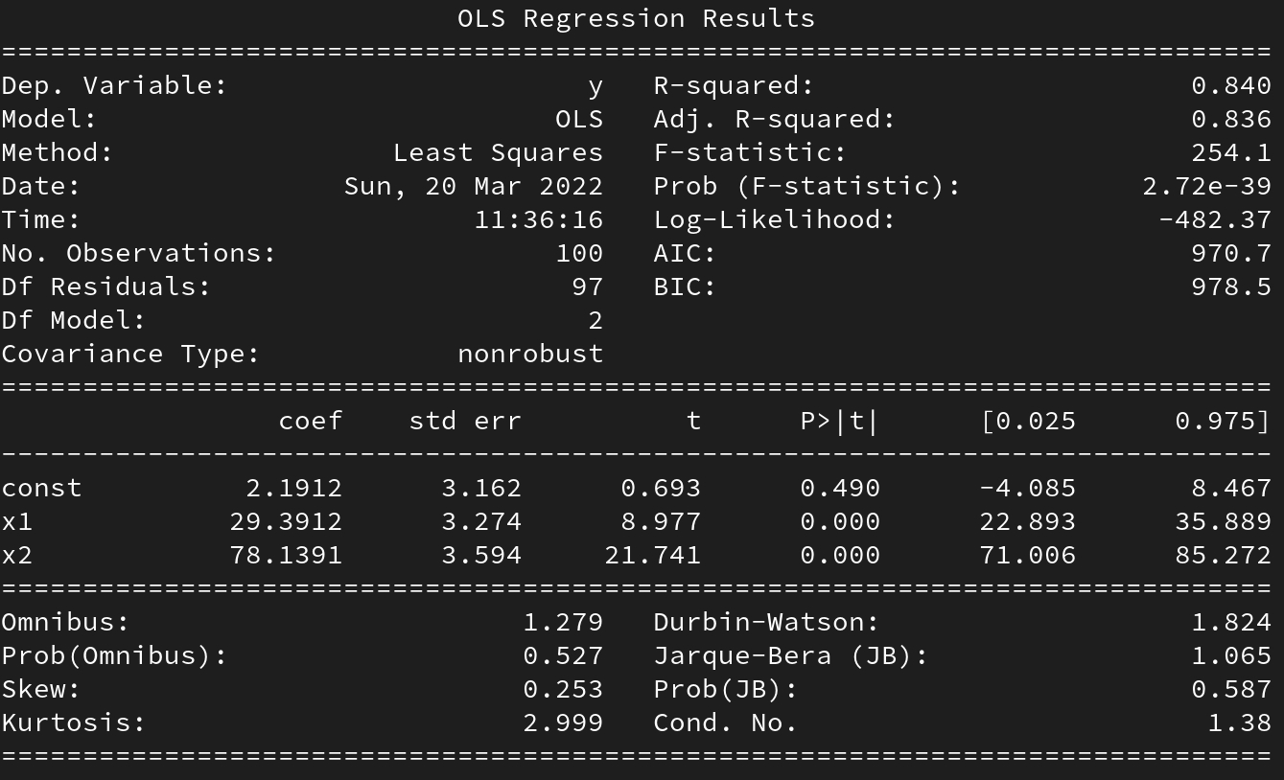
Evaluating our Regression Model

Slide 45
Evaluating our Regression Model
Each parameter of an independent variable x has an associated confidence interval and t-value + p-value.
If the parameter / coefficient is not significantly distinguishable from 0 then we cannot assume that there is a significant linear relationship between that independent variable and the observations y (i.e. if the interval includes 0 or if the p-value is too large)

Slide 46
Hypothesis Test
We want to know if there is evidence to reject the hypothesis H0 : β = 0 (i.e. that there is no linear relation between X and Y) using the information from β hat.
We want to know the largest probability of obtaining the data observed, under the assumption that the null hypothesis is correct.
How do we obtain that probability?

Slide 47
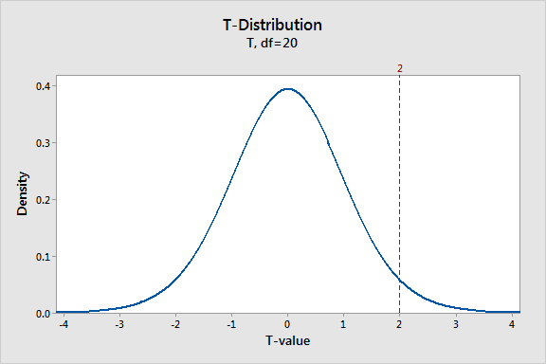
Hypothesis Test
Under the null hypothesis what should be the distribution of the estimates? T-distribution (parametrized by the sample size)

Slide 48
Hypothesis Test
We can then compute the t-value that corresponds to the sample we observed.

Slide 49
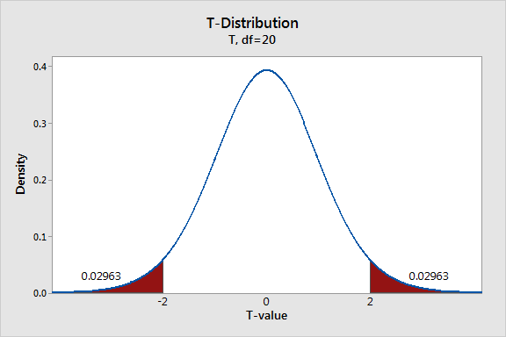
Hypothesis Test
And then compute the probability of observing estimates of β at least as extreme as the one observed. (i.e. trying to find evidence against H0)

Slide 50
Hypothesis Test
This probability is called a p-value.

Slide 51
Hypothesis Test
A p-value smaller than a given threshold would mean the data was unlikely to be observed under H0 so we can reject the hypothesis H0. If not, then we lack the evidence to reject H0.

Slide 52
Hypothesis Test
Which parameters should we not include in our linear model?

Slide 53
Confidence Intervals
An interval that describes the uncertainty around an estimate (here this could be β hat).
Goal: for a given confidence level (let’s say 90%), construct an interval around an estimate such that, if the estimation process were repeated indefinitely, the interval would contain the true value (that the estimate is estimating) 90% of the time.

Slide 54
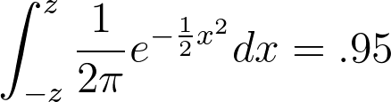
Z-values
These are the number of standard deviations from the mean of a N(0,1) distribution required in order to contain a specific % of values were you to sample a large number of times.
To find the .95 z-value (the value z such that 95% of the observations lie within z standard deviations of the mean ( μ ± z * σ )) you need to solve:

Slide 55
Z-values
The .95 z-value is 1.96.
This means 95% of observations from a N(μ, σ) lie within 1.96 standard deviations of the mean ( μ ± 1.960 * σ)
If we get a sample from a N(μ, σ) of size n, how would we create a confidence interval around the estimated mean?

Slide 56
Confidence Intervals
How do we build a confidence interval?
Assume Y_{i} ~ N(5, 25) , for 1 ≤ i ≤ 100 and y_{i} = μ + ϵ where ϵ ~ N(0, 25). Then the Least Squares estimator of μ (μ_{LS}) is
the sample mean ȳ
What is the 95% confidence interval for μ_{LS}?
CI_{.95} = [ȳ - 1.96 x SE(μ_{LS}), ȳ + 1.96 x SE(μ_{LS})]
= [ȳ - 1.96 x .5, ȳ + 1.96 x .5]
SE(μ_{LS}) = σ_{ϵ} / √n
= 5 / √100
= .5
Z-value for 95% Confidence Interval

Slide 57
Checking our Assumptions
Normal Distribution?
Constant Variance?

Slide 58
QQ plot
Quantiles are the values for which a particular % of values are contained below it.
For example the 50% quantile of a N(0,1) distribution is 0 since 50% of samples would be contained below 0 were you to sample a large number of times.

Slide 59
QQ plot
We need to check our assumption that our residuals / noise estimates are normally distributed.
How do can you check that a variable follows a specific distribution?
Need to check that our variable is distributed in the same way that a variable following our target distribution would be.
Plot the quantile of your target distribution against the quantiles of your data/ variable! If they match then your data probably comes from that distribution.

Slide 60
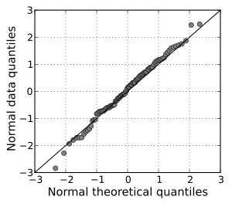
QQ plot

Slide 61
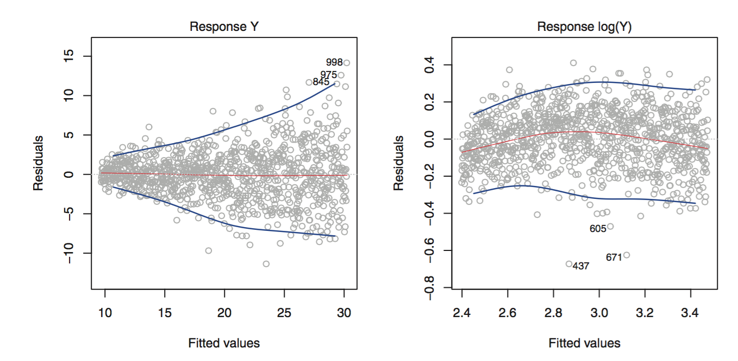
Constant Variance
One of our assumptions was that our noise had constant variance. How can we verify this?
We can plot our fitted values against our residuals (noise estimates)

Slide 62
Extending our Linear Model
Changing the assumptions we made can drastically change the problem we are solving. A few ways to extend the linear model:
Non-constant variance - used in WLS (weighted least squares)
Distribution of error is not Normal - used in GLM (generalized linear models)

