Slide 1
終端機操作設定分享

Slide 2
Bash & Zsh
Bash是Unix Shell ，為大多數Linux 與Mac 預設Shell
https://zh.wikipedia.org/wiki/Bash
Z shell(Zsh) 對Bourne shell做出了大量改進，同時加入了Bash、ksh及tcsh的某些功能
https://zh.wikipedia.org/wiki/Z_shell

Slide 3
Linux 檔案結構
常見目錄操作指令
pwd => 目前所在位置
cd =>切換目錄
. =>目前目錄
.. =>目前目錄的上一層

Slide 4
ls 列表指令
補指令圖
d | rwxr-xr-x | 2 | root | root | 4096 | Jul 30 02:03 | bin
類別 | 屬性 | 連結之節 點數 | 所有人 | 群組 | 大小 | 上次修改 時間 | 名稱
rwx | r-x | r-x
本人屬性 | 群組屬性 | 其他人屬性
http://linux.vbird.org/linux_basic/0220ﬁlemanager.php#ls

Slide 5
chmod 變更屬性
Chmode 755
本人屬性
R | W | X
1 | 1 | 1
7
群組屬性
R | W | X
1 | 0 | 1
5
其他人屬性
R | W | X
1 | 0 | 1
5

Slide 6
其餘常用指令概述(1/2)
cat => 檢視檔案內容
tac => 反向檢視(最後一行開始)
nl => 添加行號列印
more => 一頁一頁翻動
less => 一頁一頁翻動(可使用[pagedown] [pageup])
head => 取出前面幾行資料
tail => 取出後面幾行資料

Slide 7
其餘常用指令概述(2/2)
cp => 複製
mv => 移動(更名)
rm => 刪除
補充危險指令 https://blog.hcl.moe/archives/227
詳細指令說明 http://linux.vbird.org/linux_basic/0220filemanager.php

Slide 8
實作時間

Slide 9
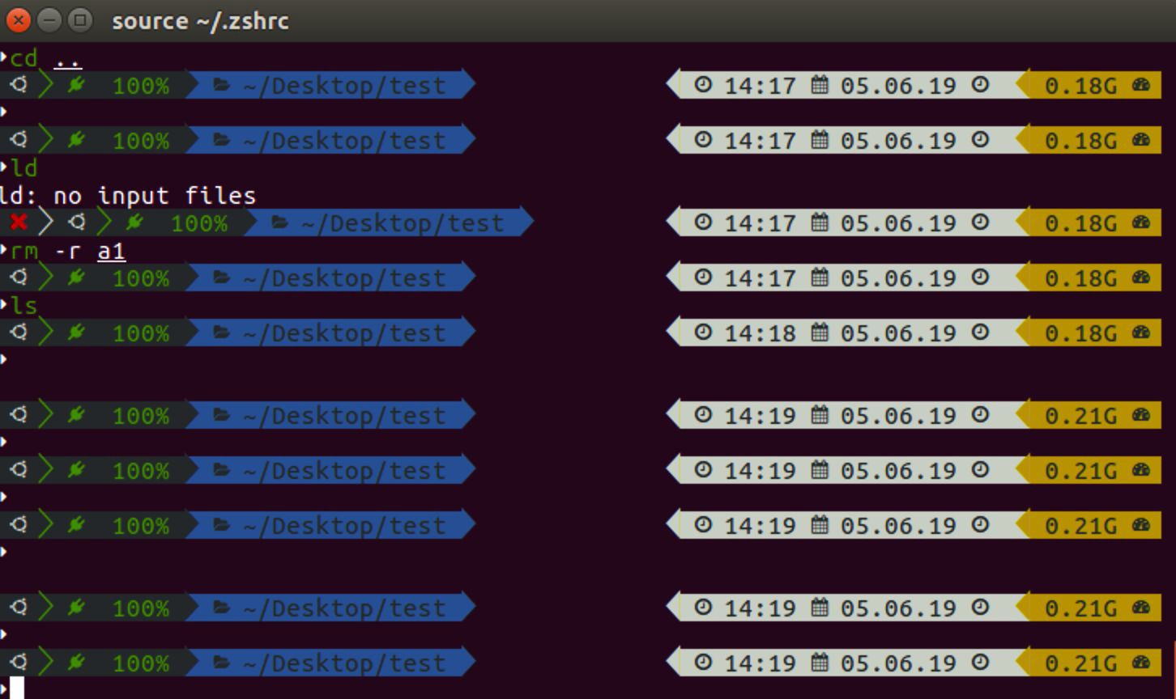

Slide 10
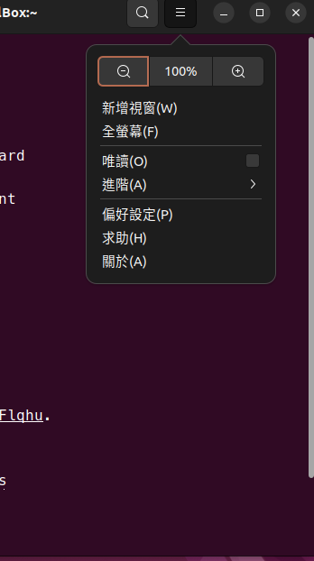
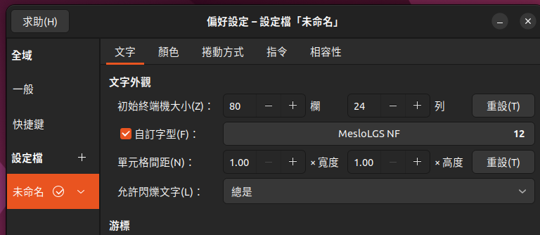
安裝字形
1
MesloLGS NF Regular.ttf
MesloLGS NF Bold.ttf
MesloLGS NF Italic.ttf
MesloLGS NF Bold Italic.ttf
2
3
4

Slide 11
Zsh 安裝步驟
簡介: https://zh.wikipedia.org/zh-tw/Z_shell
sudo apt-get update
sudo apt-get upgrade
sudo apt-get install zsh git curl

Slide 12
Zsh 安裝步驟
查看是否安裝 zsh cat /etc/shells
變更預設 chsh -s /bin/zsh
設定後重新登入
安裝 oh-my-zsh 套件
sh -c "$(curl -fsSL https://raw.github.com/ohmyzsh/ohmyzsh/master/tools/install.sh)"

Slide 13
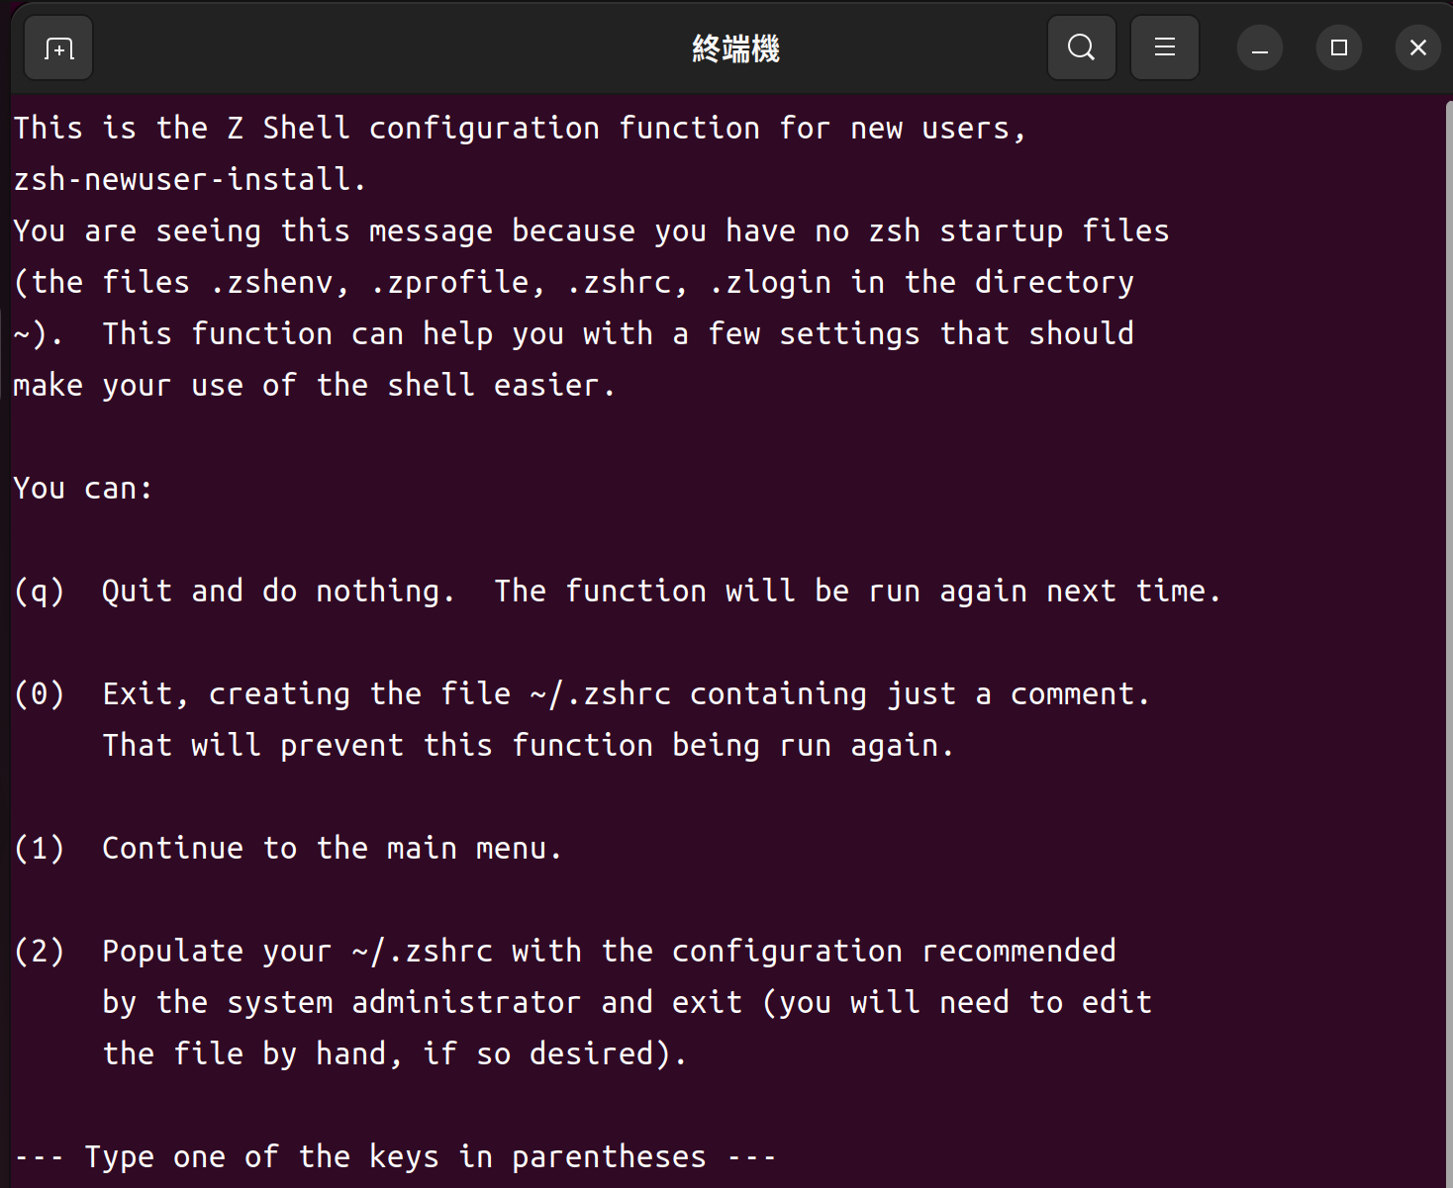
按任意鍵跳過

Slide 14
美化佈景主題
官方主題庫
https://github.com/robbyrussell/oh-my-zsh/wiki/External-themes
使用powerlevel10k
https://github.com/romkatv/powerlevel10k
預設安裝位置
/home/users/.oh-my-zsh/custom/themes

Slide 15
安裝powerlevel10k
git clone --depth=1 https://github.com/romkatv/powerlevel10k.git ${ZSH_CUSTOM:-$HOME/.oh-my-zsh/custom}/themes/powerlevel10k
設定佈景主題使用powerlevel10k
sudo nano ~/.zshrc
找到ZSH_THEME，修改成ZSH_THEME="powerlevel10k/powerlevel10k"
套用
source ~/.zshrc

Slide 16
powerline
sudo apt-get install powerline fonts-powerline
重開終端機
NERD Font （https://github.com/ryanoasis/nerd-fonts） 下載點 https://supr.link/TGDGE
sudo ./install.sh
至zshrc 設置（需在ZSH_THEME="powerlevel9k/powerlevel9k" 之前）
POWERLEVEL9K_MODE='nerdfont-complete'

Slide 17
Segment | Meaning
anaconda | virtual environment from conda
asdf | tool versions from asdf
aws | aws profile
aws_eb_env | aws elastic beanstalk environment
azure | azure account name
background_jobs | presence of background jobs
battery | internal battery state and charge level (yep, batteries literally included)
command_execution_time | duration (wall time) of the last command
context | user@hostname
cpu_arch | CPU architecture
dir | current working directory
direnv | direnv status
disk_usage | disk usage
dotnet_version | dotnet version
fvm | flutter environment from fvm
gcloud | google cloud cli account and project
goenv | go environment from goenv
google_app_cred | google application credentials
go_version | go version
haskell_stack | haskell version from stack
ip | IP address and bandwidth usage for a specified network interface
java_version | java version
jenv | java environment from jenv
kubecontext | current kubernetes context
laravel_version | laravel php framework version
load | CPU load
luaenv | lua environment from luaenv
midnight_commander | midnight commander shell
nix_shell | nix shell indicator
nnn | nnn shell
lf | lf shell
nodeenv | node.js environment from nodeenv
nodenv | node.js environment from nodenv
node_version | node.js version
nordvpn | nordvpn connection status
nvm | node.js environment from nvm
os_icon | your OS logo (apple for macOS, swirl for debian, etc.)
package | name@version from package.json
perlbrew | perl version from perlbrew
phpenv | php environment from phpenv
php_version | php version
plenv | perl environment from plenv
prompt_char | multi-functional prompt symbol; changes depending on vi mode: ❯, ❮, V, ▶ for insert, command, visual and replace mode respectively; turns red on error

Slide 18
proxy | system-wide http/https/ftp proxy
public_ip | public IP address
pyenv | python environment from pyenv
ram | free RAM
ranger | ranger shell
rbenv | ruby environment from rbenv
rust_version | rustc version
rvm | ruby environment from rvm
scalaenv | scala version from scalaenv
status | exit code of the last command
swap | used swap
taskwarrior | taskwarrior task count
terraform | terraform workspace
terraform_version | terraform version
time | current time
timewarrior | timewarrior tracking status
todo | todo items
toolbox | toolbox name
vcs | Git repository status
vim_shell | vim shell (:sh)
virtualenv | python environment from venv
vi_mode | vi mode (you don't need this if you've enabled prompt_char)
vpn_ip | virtual private network indicator
wifi | WiFi speed
xplr | xplr shell

Slide 19
Powerlevel10K修改
修改顏色
應用 source ~/.p10k.zsh
for i in {0..255}; do print -Pn "%K{$i} %k%F{$i}${(l:3::0:)i}%f " ${${(M)$((i%6)):#3}:+$'\n'}; done
https://blog.csdn.net/qq_36835255/article/details/128101588

Slide 20
安裝第三方套件
官方套件推薦列表
https://github.com/robbyrussell/oh-my-zsh/wiki/Plugins
https://github.com/robbyrussell/oh-my-zsh/wiki/Plugins-Overview

Slide 21
安裝第三方套件
zsh-autosuggestions
https://github.com/zsh-users/zsh-autosuggestions/blob/master/INSTALL.md
zsh-completions
https://github.com/zsh-users/zsh-completions
zsh-syntax-highlighting
https://github.com/zsh-users/zsh-syntax-highlighting/blob/master/INSTALL.md

Slide 22
zsh-completions
安裝方式
git clone https://github.com/zsh-users/zsh-completions ${ZSH_CUSTOM:=~/.oh-my-zsh/custom}/plugins/zsh-completions

Slide 23
zsh-autosuggestions
安裝方式
git clone https://github.com/zsh-users/zsh-autosuggestions ${ZSH_CUSTOM:-~/.oh-my-zsh/custom}/plugins/zsh-autosuggestions

Slide 24
zsh-syntax-highlighting
安裝方式
git clone https://github.com/zsh-users/zsh-syntax-highlighting.git ${ZSH_CUSTOM:-~/.oh-my-zsh/custom}/plugins/zsh-syntax-highlighting

Slide 25
設定套件
開啟設定.zshrc
Sudo nano ~/.zshrc
找到 plugins 字樣新增套件名稱
plugins=( git
zsh-syntax-highlighting
zsh-autosuggestions
zsh-completions )
重新載入
source ~/.zshrc

Slide 26
指令練習 1/3
mkdir test
cp ~/.bashrc test/bashrc
cd test
ls -l
mv bashrc bashrc1 ls -l
cat bashrc1
tail bashrc1

Slide 27
指令練習 2/3
cp bashrc1 bashrc2
ls -l
mkdir a1
ls-l
mv bashrc1 bashrc2 a1
cd a1
ls -l

Slide 28
指令練習 3/3
cd ..
rm -r a1

Slide 29
使用git 測試成果
下載程式碼
git clone https://github.com/yuanfu8899/Digital-rain.git
CD Digital-rain
執行
firefox index.html
修改成自己的風格(index.html ; index.jsp)

