Slide 1

Relation Structure-Aware
Heterogeneous Information Network Embedding
Yuanfu Lu¹, Chuan Shi¹, Linmei Hu¹, Zhiyuan Liu²
¹Beijing University of Posts and Telecommunications, Beijing, China
²Tsinghua University, Beijing, China

Slide 2
CONTENTS
1
Background
2
RHINE
3
Experiments
4
Conclusions

Slide 3
CONTENTS
1
Background
2
RHINE
3
Experiments
4
Conclusions

Slide 4
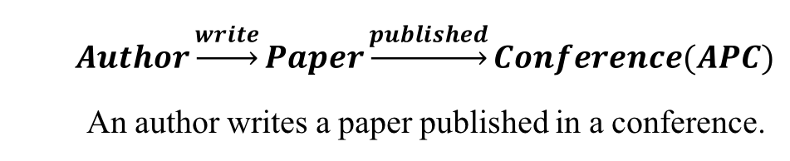
1
Background
Heterogeneous Information Network
Heterogeneous Information Network (HIN)
Multiple types of nodes or links
Flexible to characterize heterogeneous data
Rich semantic information
Composite Relations (Meta-path)
A relation sequence connecting two objects in HIN
Extract structural features
Embody semantics information
$$Author\underset{→}{write}Paper\underset{→}{published}Conference(APC)$$
An author writes a paper published in a conference.
1

Slide 5




1
Background
Heterogeneous Information Network Embedding
Heterogeneous Information Network Embedding
Model heterogeneous structural information
multiple types of nodes or links
Capture rich semantic information
various semantic relations
$$d$$
Network Mining Tasks
Node classification
Link (relation) prediction
Recommendation
…
$$f\left(v\right):V→ℝ^{d}$$
$$X_{a_{1}}$$
$$N$$
Representation Matrix X
2

Slide 6
1
Background
Conventional Models
Existing methods
Meta-path based random walk (e.g., metapath2vec, HIN2vec, ESim, …)
Decompose based models (e.g., PTE, EOE, HERec, …)
Neural network based methods (e.g., HNE, SHINE , BL-MNE, …)
3

Slide 7
1
Background
Motivation
Drawbacks
An assumption that one single model can handle all relations and nodes.
Without distinguishing the structural characterizes of relations.
Our idea
Explore the structural characteristics of relations.
Different models speciﬁcally tailored to handle various relations.
Relation structure-aware Heterogeneous Information Network Embedding (RHINE)
5

Slide 8
CONTENTS
1
Background
2
RHINE
3
Experiments
4
Conclusions

Slide 9
1
RHINE
Challenges
How to distinguish the structural characteristics of relations in an HIN?
How to capture the distinctive structural characteristics of different relations?
Different models should be easily and smoothly combined to ensure simple optimization in a uniﬁed manner.
4

Slide 10
2
RHINE
Overall
Two structure-related measures
Two categories : Afﬁliation Relations (ARs) Interaction Relations (IRs)
Two models: Euclidean distance Translation-based distance
6

Slide 11
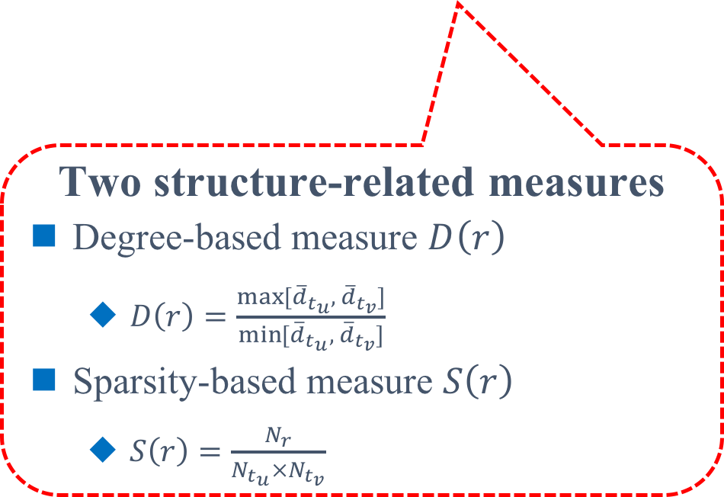
2
RHINE
Two Structure-related Measures
The degree of nodes can well reﬂect the structures of networks.
A large value of D(r)
inequivalent structural roles
stronger afﬁliation relationships.
Affiliation Relations (ARs)
A small value of D(r)
compatible structural roles
stronger interaction relationships.
Interaction Relations (IRs)
Two structure-related measures
Degree-based measure $D\left(r\right)$
$D\left(r\right)=\frac{\max{⁡[{\overline{d}}_{t_{u}}, { \overline{d}}_{t_{v}}]}}{\min{⁡[{\overline{d}}_{t_{u}}, { \overline{d}}_{t_{v}}]}}$
Sparsity-based measure $S\left(r\right)$
$S\left(r\right)=\frac{N_{r}}{N_{t_{u}}×N_{t_{v}}}$
7

Slide 12
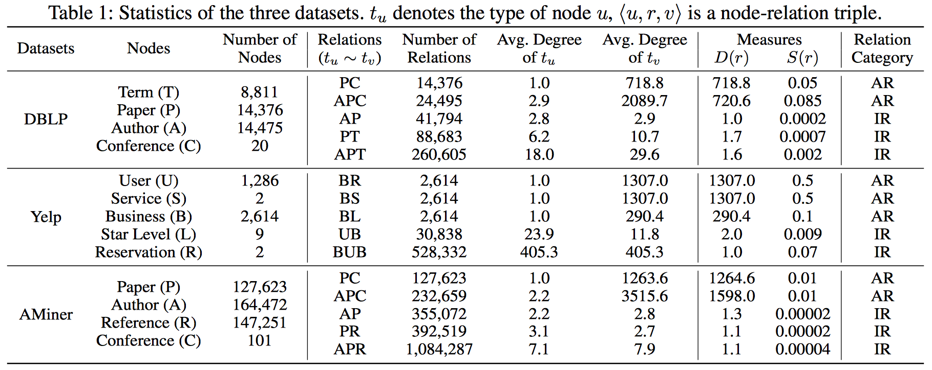
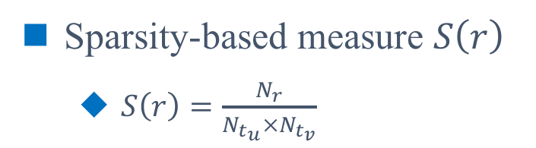
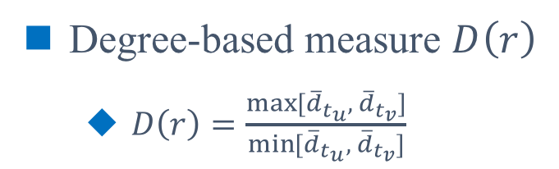
2
RHINE
Two Structure-related Measures
Degree-based measure $D\left(r\right)$
$D\left(r\right)=\frac{\max{⁡[{\overline{d}}_{t_{u}}, { \overline{d}}_{t_{v}}]}}{\min{⁡[{\overline{d}}_{t_{u}}, { \overline{d}}_{t_{v}}]}}$
Sparsity-based measure $S\left(r\right)$
$S\left(r\right)=\frac{N_{r}}{N_{t_{u}}×N_{t_{v}}}$
8

Slide 13
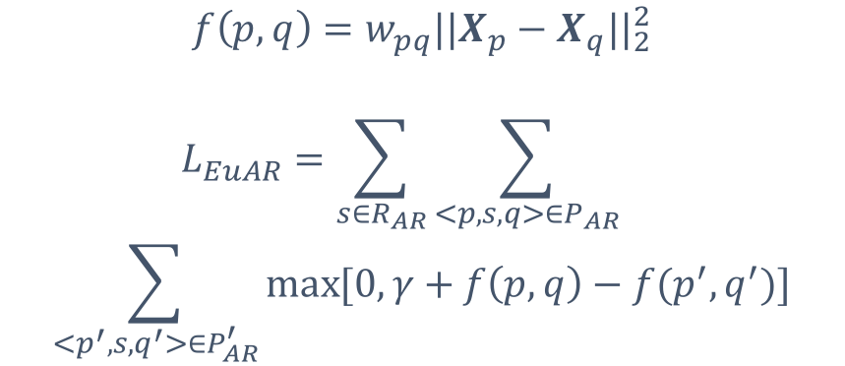
2
RHINE
Two Models for ARs and IRs
Euclidean Distance for ARs
Euclidean distance
for ARs
Afﬁliation structures between nodes sharing similar properties.
Euclidean distance meets the condition of the triangle inequality.
$$f\left(p,q\right)={w_{pq}||X_{p}−X_{q}||}_{2}^{2}$$
$$L_{EuAR}=\sum_{s∈R_{AR}}{\sum_{<p,s,q>∈P_{AR}}{}}$$
$$\sum_{<p^{′},s,q^{′}>∈P_{AR}^{′}}{\max{[0, γ+f\left(p,q\right)−f(p^{′}, q^{′})]}}$$
9

Slide 14
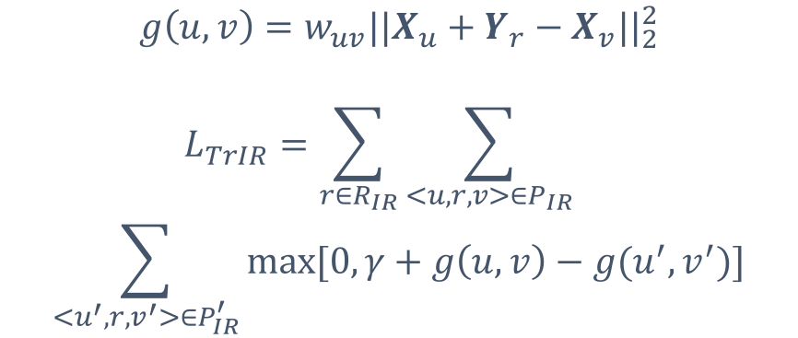
2
RHINE
Two Models for ARs and IRs
Translation-based Distance for IRs
Strong interaction structure between compatible nodes.
Structural information in IRs.
The translation based distance is consistent with the Euclidean distance in the mathematical form.
$$g\left(u,v\right)={w_{uv}||X_{u}+Y_{r}−X_{v}||}_{2}^{2}$$
$$L_{TrIR}=\sum_{r∈R_{IR}}{\sum_{<u,r,v>∈P_{IR}}{}}$$
$$\sum_{<u^{′},r,v^{′}>∈P_{IR}^{′}}{\max{[0, γ+g\left(u,v\right)−g(u^{′}, v^{′})]}}$$
Translation-based distance for IRs
10

Slide 15
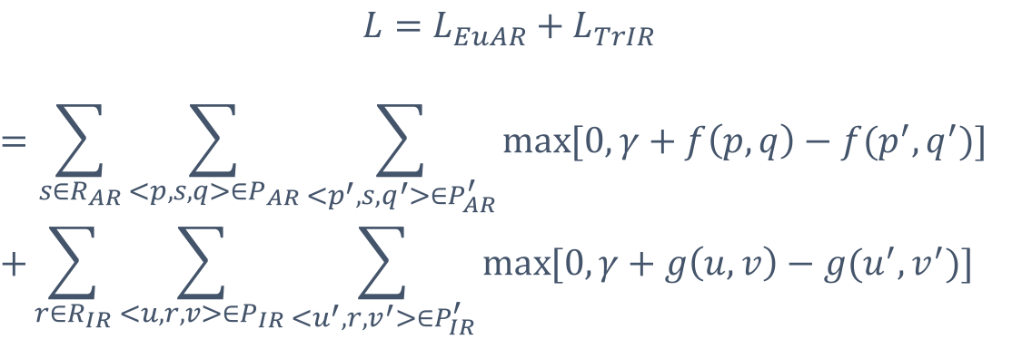
2
RHINE
A Uniﬁed Model for HIN Embedding
Objective Function
$$L=L_{EuAR}+L_{TrIR}$$
$$=\sum_{s∈R_{AR}}{\sum_{<p,s,q>∈P_{AR}}{\sum_{<p^{′},s,q^{′}>∈P_{AR}^{′}}{\max{[0, γ+f\left(p,q\right)−f(p^{′}, q^{′})]}} }}$$
$$+\sum_{r∈R_{IR}}{\sum_{<u,r,v>∈P_{IR}}{\sum_{<u^{′},r,v^{′}>∈P_{IR}^{′}}{\max{[0, γ+g\left(u,v\right)−g(u^{′}, v^{′})]}}}}$$
Sampling Strategy
Draw positive samples according to their probability distributions.
Construct a set of negative node-relation triples $P_{u,r,v}^{′}=\left\{\left(u^{′},r,v\right) | u^{′}∈V\right\}∪\{(u,r,v^{′})|v^{′}∈V\}$.
11

Slide 16
CONTENTS
1
Background
2
Proposed Method
3
Experiments
4
Conclusions

Slide 17
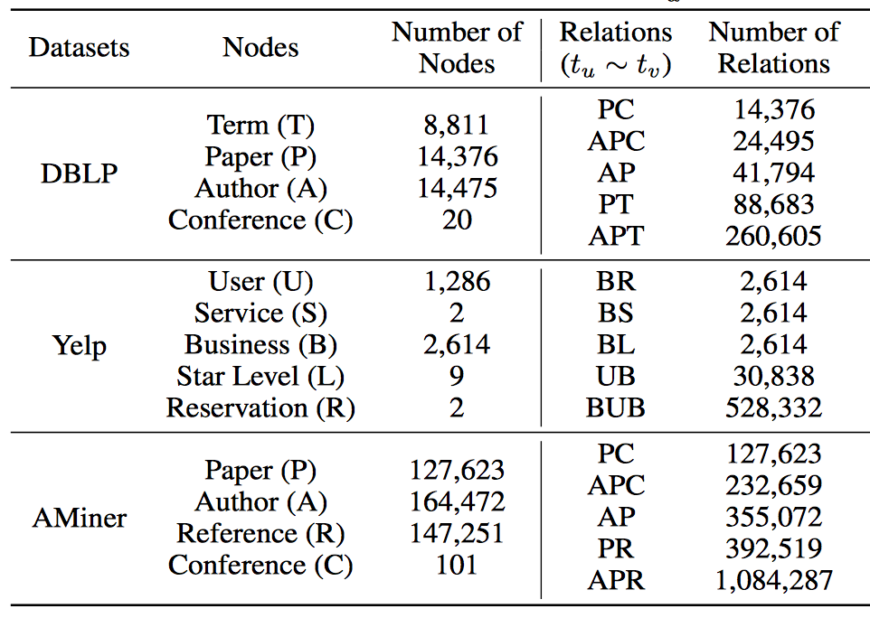
3
Experiments
Datasets & Baselines & Tasks
Datasets
Baselines
ESim
HIN2Vec
Metapath2vec
DeepWalk
LINE
PTE
Tasks
Node Clustering
Link Prediction
Multi-Class Classiﬁcation
Visualization
12

Slide 18
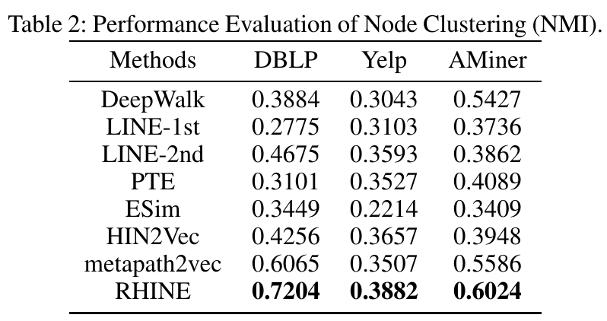
3
Experiments
Node Clustering
Compared with the best competitors
18.79% improvement on DBLP
6.15% improvement on Yelp
7.84% improvement on AMiner
13

Slide 19
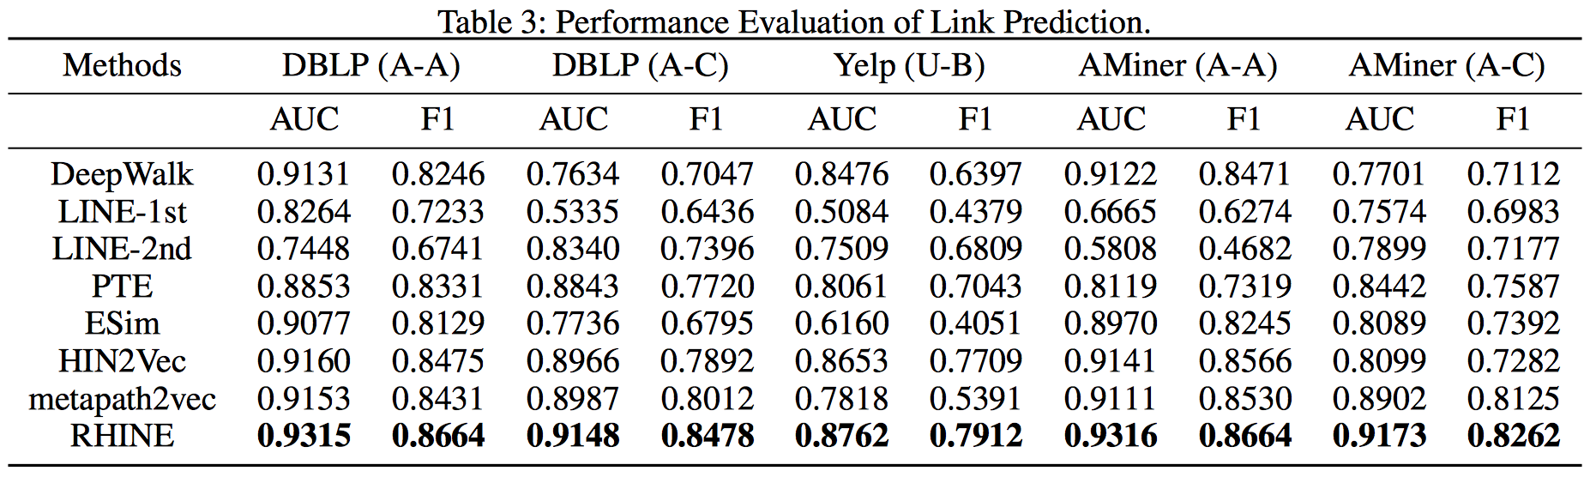
3
Experiments
Link Prediction
The ﬁrst-order and second-order proximities.
Distinguishing relations w.r.t. structural characteristics.
14

Slide 20
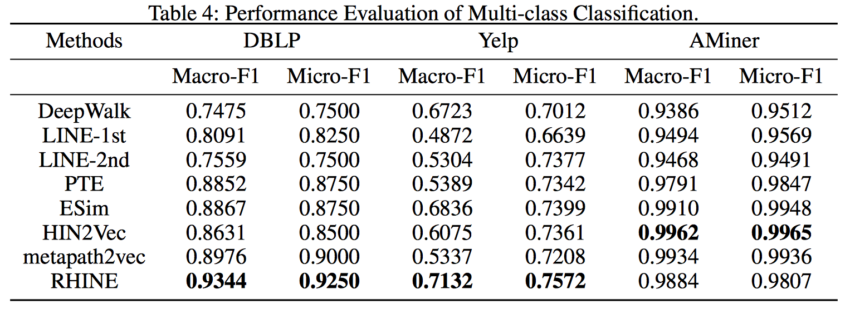
3
Experiments
Multi-Class Classiﬁcation
RHINE achieves better performance than all baseline methods in most case.
The respect of distinct characteristics of various relations.
15

Slide 21
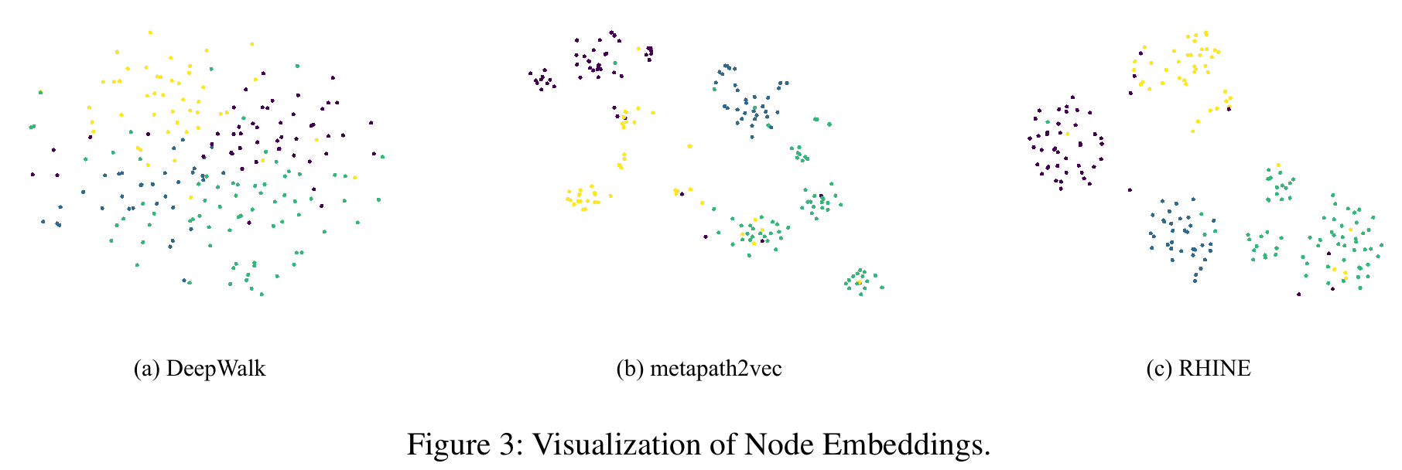
3
Experiments
Visualization
RHINE clearly clusters the paper nodes into four groups.
17

Slide 22
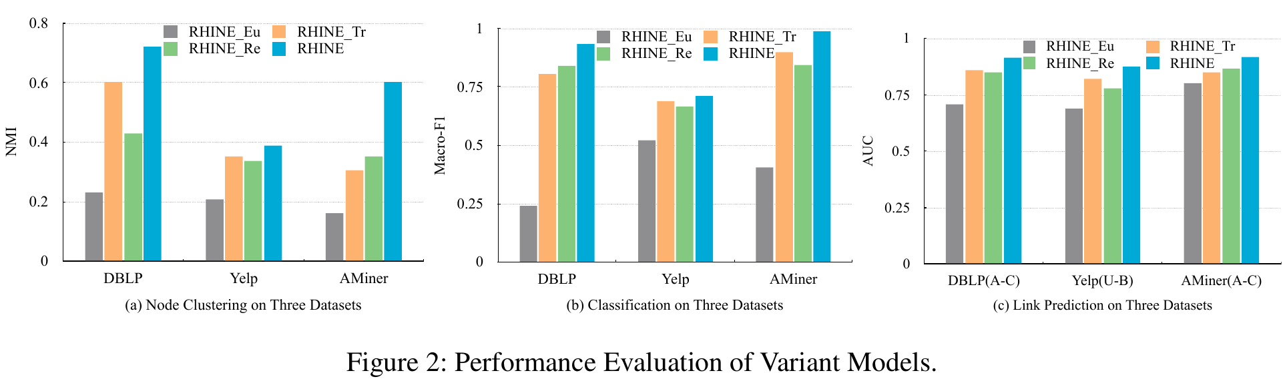
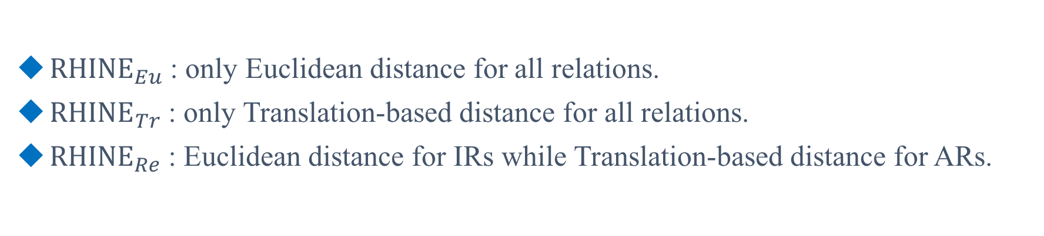
3
Experiments
Variant Models
Verify the rationality of distinguishing the structural characteristics of relations.
${RHINE}_{Eu}$: only Euclidean distance for all relations.
${RHINE}_{Tr}$: only Translation-based distance for all relations.
${RHINE}_{Re}$: Euclidean distance for IRs while Translation-based distance for ARs.
16

Slide 23
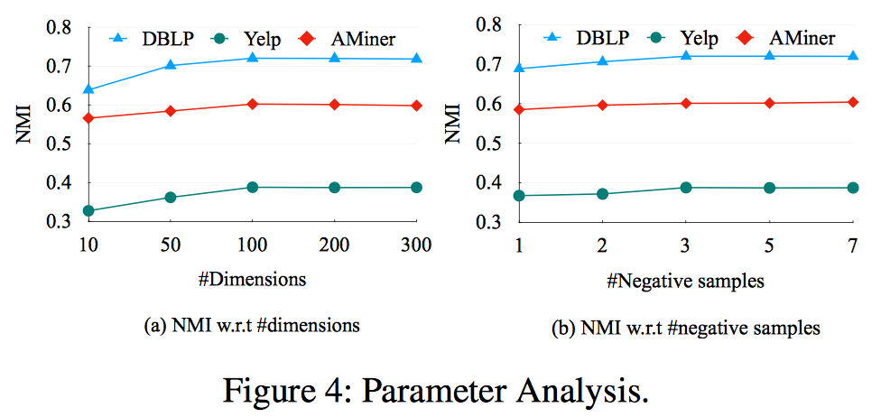
3
Experiments
Parameter Analysis
The dimension of the representation is around 100.
The number of negative examples is around 3.
18

Slide 24
CONTENTS
1
Background
2
Proposed Method
3
Experiments
4
Conclusions

Slide 25
4
Conclusions
We make the ﬁrst attempt to explore and distinguish the structural characteristics of relations for HIN embedding.
We present two structure-related measures and a novel relation structure-aware HIN embedding model (RHINE).
Experimental results demonstrate that RHINE outperforms state-of-the-art baselines in various tasks.
19

Slide 26
Thank you !
Q&A
More materials in http://shichuan.org

