Slide 2






























+
$b_{1}+$ $w_{1,1}$ $x_{1}+$ $w_{1,2}$ $x_{2}+ w_{1,3} x_{3}=$ $r_{1}$
$$w_{1,1}$$
$$x_{1}$$
$$w_{1,2}$$
$$b_{1}$$
$$w_{1,3}$$
$$1$$
$$w_{2,1}$$
+
$b_{2}+$ $w_{2,1}$ $x_{1}+$ $w_{2,2}$ $x_{2}+ w_{2,3} x_{3}=r_{2}$
$$w_{2,2}$$
$$x_{2}$$
$$w_{2,3}$$
$$b_{2}$$
$$1$$
$$w_{3,1}$$
$$w_{3,2}$$
+
$b_{3}+$ $w_{3,1}$ $x_{1}+$ $w_{3,2}$ $x_{2}+ w_{3,3} x_{3}=r_{3}$
$$w_{3,3}$$
$$w_{4,1}$$
$$b_{3}$$
$$x_{3}$$
$$1$$
$$w_{4,2}$$
$$w_{4,3}$$
+
$b_{4}+$ $w_{4,1}$ $x_{1}+$ $w_{4,2}$ $x_{2}+ w_{4,3} x_{3}$ $=r_{4}$
$$b_{4}$$
$$1$$
$$3 features$$
$$4 sigmoid$$
$$r=b+Wx$$

Slide 3
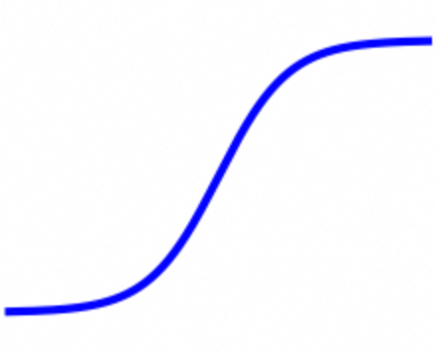













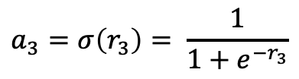





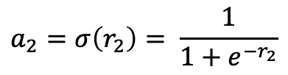








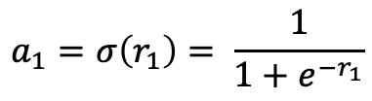







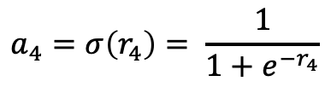


+
$$r_{1}$$
$$a_{1}=σ\left(r_{1}\right)= \frac{1}{1+e^{−r_{1}}}$$
$$w_{1,1}$$
$$x_{1}$$
$$w_{1,2}$$
$$b_{1}$$
$$w_{1,3}$$
$$1$$
$$c_{1}$$
$$w_{2,1}$$
+
$$a_{2}=σ\left(r_{2}\right)= \frac{1}{1+e^{−r_{2}}}$$
$$r_{2}$$
$$w_{2,2}$$
$$c_{2}$$
$$x_{2}$$
$$w_{2,3}$$
$$b_{2}$$
+
$$y$$
$$w_{3,1}$$
$$1$$
$$c_{3}$$
$$w_{3,2}$$
+
$$a_{3}=σ\left(r_{3}\right)= \frac{1}{1+e^{−r_{3}}}$$
$$b$$
$$r_{3}$$
$$w_{3,3}$$
$$c_{4}$$
$$1$$
$$b_{3}$$
$$x_{3}$$
$$w_{4,1}$$
$$1$$
$$w_{4,2}$$
$$w_{4,3}$$
+
$$a_{4}=σ\left(r_{4}\right)= \frac{1}{1+e^{−r_{4}}}$$
$$r_{4}$$
$$b_{4}$$
$$1$$
$$3 features$$
$$4 sigmoid$$
$$a= σ\left(r\right)$$
$$y=b+c^{T}a$$

Slide 4




























+
+
…
$$w_{1,1}$$
$$a_{1}$$
$$x_{1}$$
$$w_{1,2}$$
$$b_{1}$$
$$w_{1,3}$$
$$1$$
$$1$$
$$c_{1}$$
$$w_{2,1}$$
+
+
…
$$a_{2}$$
$$w_{2,2}$$
$$c_{2}$$
$$x_{2}$$
$$w_{2,3}$$
$$b_{2}$$
+
$$y$$
$$w_{3,1}$$
$$1$$
$$1$$
$$c_{3}$$
$$w_{3,2}$$
+
+
…
$$b$$
$$a_{3}$$
$$w_{3,3}$$
$$c_{4}$$
$$1$$
$$b_{3}$$
$$x_{3}$$
$$w_{4,1}$$
$$1$$
$$w_{4,2}$$
$$1$$
$$w_{4,3}$$
+
+
…
$$a_{4}$$
$$b_{4}$$
$$1$$
$$1$$
$$W^{0}$$
$$b^{0}$$
$$W^{1}$$
$$b^{1}$$
$$c$$
$$b$$

Slide 5
























+
$$h_{1}$$
$$w_{1,1}$$
$$w_{1,2}$$
$$u_{1,1}$$
+
$$x_{1}$$
$$b_{1}$$
$$g_{1}$$
$$u_{1,2}$$
$$1$$
$$v_{1}$$
$$u_{1,3}$$
$$d_{1}$$
+
$$\hat{y}$$
$$w_{2,1}$$
+
$$1$$
$$h_{2}$$
$$u_{2,1}$$
$$v_{2}$$
$$w_{2,2}$$
$$b$$
$$u_{2,2}$$
+
$$g_{2}$$
$$b_{2}$$
$$1$$
$$x_{2}$$
$$1$$
$$u_{2,3}$$
$$w_{3,1}$$
$$d_{2}$$
$$w_{3,2}$$
+
$$h_{3}$$
$$1$$
$$b_{3}$$
$$1$$

Slide 6










































$$u_{11}$$
/
/
/
$$p_{3}$$
/
$$p_{5}$$
$$z_{1}$$
$$p_{1}$$
$$h_{1}$$
$$p_{2}$$
$$u_{12}$$
$$t_{1}$$
$$g_{1}$$
$$×, +$$
$$σ$$
$$u_{13}$$
$$×, +$$
$$σ$$
/
$$p_{7}$$
$${\hat{y}}^{1}$$
$$p_{15}$$
$$d_{1}$$
/
$$p_{4}$$
/
$$p_{6}$$
$$×, +$$
$${({\hat{y}}^{1}−1.5)}^{2}$$
$$w_{11}$$
$$t_{2}$$
$$g_{2}$$
$$w_{12}$$
$$×, +$$
$$σ$$
$$v_{1}$$
$$p_{17}$$
$$u_{21}$$
$$\frac{a+b}{2}$$
$$b_{1}$$
/
/
/
/
$$p_{12}$$
$$v_{2}$$
$$z_{1}$$
$$p_{8}$$
$$h_{1}$$
$$p_{9}$$
$$u_{22}$$
$$t_{1}$$
$$p_{10}$$
$$g_{1}$$
$$×, +$$
$$σ$$
$$×, +$$
$$σ$$
$$b$$
$$u_{23}$$
/
$$p_{14}$$
$$p_{16}$$
$${\hat{y}}^{2}$$
$$d_{2}$$
/
/
$$p_{13}$$
$$×, +$$
$${({\hat{y}}^{2}−0.9)}^{2}$$
$$z_{2}$$
$$h_{2}$$
$$t_{2}$$
$$p_{11}$$
$$g_{2}$$
$$w_{21}$$
$$×, +$$
$$σ$$
$$×, +$$
$$σ$$
$$w_{22}$$
$$z_{2}$$
$$h_{2}$$
$$b_{2}$$
$$×, +$$
$$σ$$
样本 1 计算路径
$$z_{3}$$
$$h_{3}$$
样本 2 计算路径（未画全）
$$w_{31}$$
$$×, +$$
$$σ$$
模型参数
$$w_{32}$$
$$z_{3}$$
$$h_{3}$$
$$b_{3}$$
计算节点
$$×, +$$
$$σ$$

Slide 7


















$$u_{11}$$
/
/
/
$$p_{3}=1.8042$$
/
$$p_{5}=0.8587$$
$$z_{1}$$
$$p_{1}=2.3$$
$$h_{1}$$
$$p_{2}=0.9089$$
$$u_{12}$$
$$t_{1}$$
$$g_{1}$$
$$×, +$$
$$σ$$
$$u_{13}$$
$$×, +$$
$$σ$$
/
$$p_{7}=1.5362$$
$${\hat{y}}^{1}$$
$$p_{15}=0.001310$$
$$d_{1}$$
/
$$p_{4}=2.2108$$
/
$$p_{6}=0.9012$$
$$×, +$$
$${({\hat{y}}^{1}−1.5)}^{2}$$
$$w_{11}$$
$$t_{2}$$
$$g_{2}$$
$$w_{12}$$
$$×, +$$
$$σ$$
$$v_{1}$$
$p_{17}$=0.1756
$$u_{21}$$
$$\frac{a+b}{2}$$
$$b_{1}$$
/
/
/
/
$p_{12}$=0.8220
$$v_{2}$$
$$z_{1}$$
$$p_{8}=1.07$$
$$h_{1}$$
$$p_{9}=0.7446$$
$$u_{22}$$
$$t_{1}$$
$$p_{10}=1.5302$$
$$g_{1}$$
$$×, +$$
$$σ$$
$$×, +$$
$$σ$$
$$b$$
$$u_{23}$$
/
$$p_{14}=1.4915$$
$$p_{16}=0.349872$$
$$x^{1}=[3.0,2.0]$$
$${\hat{y}}^{2}$$
$$d_{2}$$
/
/
$$p_{13}=0.8729$$
$$×, +$$
$${({\hat{y}}^{2}−0.9)}^{2}$$
$$x^{2}=[0.5,1.2]$$
$$z_{2}=3.1$$
$$h_{2}=0.9569$$
$$t_{2}$$
$$p_{11}=1.9265$$
$$g_{2}$$
$$×, +$$
$$σ$$
$$×, +$$
$$σ$$
$$w_{21}$$
$$z_{2}=1.54$$
$$h_{2}=0.8235$$
$$w_{22}$$
$$σ$$
$$×, +$$
$$b_{2}$$
样本 1 计算路径
$$z_{3}=3.5$$
$$h_{3}=0.9707$$
样本 2 计算路径（未画全）
$$w_{31}$$
$$×, +$$
$$σ$$
模型参数
$$w_{32}$$
$$z_{3}=1.42$$
$$h_{3}=0.8053$$
$$b_{3}$$
计算节点
$$×, +$$
$$σ$$

Slide 8

























0$.00313×σ\left(z_{1}\right)[1−σ\left(z_{1}\right)]$=0.00026
$$u_{11}$$
0.0217$×σ\left(t_{1}\right)[1−σ\left(t_{1}\right)]$=0.00263
/
/
/
$$p_{3}$$
/
$$p_{5}$$
$$z_{1}$$
$$p_{1}$$
$$h_{1}$$
$$p_{2}$$
$$u_{12}$$
$$t_{1}$$
$$g_{1}$$
$$\frac{1}{2}2\left({\hat{y}}^{1}−1.5\right)=0.0362$$
$$×, +$$
$$σ$$
$$u_{13}$$
$0.00263 × u_{11}$=0.00184
$$×, +$$
$$σ$$
/
$$p_{7}$$
0.00078+0.00595=0.00673
$0.0362 × v_{1}$=0.0217
$${\hat{y}}^{1}$$
$$p_{15}$$
$0.00026 × x_{1}$=0.00078
0.00184+0.00129=0.00313
$$d_{1}$$
$$×, +$$
/
$$p_{4}$$
/
$$p_{6}$$
$${({\hat{y}}^{1}−1.5)}^{2}$$
$$w_{11}$$
$0.00258 × u_{21}$=0.00129
$$t_{2}$$
$$g_{2}$$
$0.0362 × v_{2}$=0.0290
$$w_{12}$$
$0.01190 × x_{1}$=0.00595
$$×, +$$
$$σ$$
$$\frac{1}{2}$$
$$p_{17}$$
$$u_{21}$$
$$v_{1}$$
0$.06260×σ\left(z_{1}\right)[1−σ\left(z_{1}\right)]$=0.01190
$$0.0362 × 1$$
$$\frac{a+b}{2}$$
$$b_{1}$$
/
/
$$p_{9}$$
0.0290$×σ\left(t_{2}\right)[1−σ\left(t_{2}\right)]$=0.00258
$$v_{2}$$
$$z_{1}$$
$$p_{8}$$
$$h_{1}$$
$$u_{22}$$
$$×, +$$
$$σ$$
$$b$$
/
$$\frac{1}{2}$$
$$u_{23}$$
$${\hat{y}}^{2}$$
$$p_{14}$$
$$p_{16}$$
0.03635+0.02625=0.06260
$$d_{2}$$
0.3549$×σ\left(t_{1}\right)[1−σ\left(t_{1}\right)]$=0.05193
$$0.5915 × 1$$
$$z_{2}$$
$$h_{2}$$
/
/
$$p_{12}$$
$$×, +$$
$${({\hat{y}}^{2}−0.9)}^{2}$$
$0.05193 × u_{11}$=0.03635
$$t_{1}$$
$$p_{10}$$
$$g_{1}$$
$0.5915 × v_{1}$=0.3549
$$w_{21}$$
$$×, +$$
$$σ$$
$$×, +$$
$$σ$$
$$\frac{1}{2}2\left({\hat{y}}^{2}−0.9\right)=0.5915$$
$$w_{22}$$
$0.05250 × u_{21}$=0.02625
$0.5915 × v_{2}$=0.4732
/
/
$$p_{13}$$
$$z_{2}$$
$$h_{2}$$
$$t_{2}$$
$$p_{11}$$
$$g_{2}$$
$$b_{2}$$
$$×, +$$
$$σ$$
$$×, +$$
$$σ$$
0.4732$×σ\left(t_{2}\right)[1−σ\left(t_{2}\right)]$=0.05250
关注的backward路径
$$z_{3}$$
$$h_{3}$$
未关注的backward路径
$$w_{31}$$
$$×, +$$
$$σ$$
模型参数
$$w_{32}$$
$$z_{3}$$
$$h_{3}$$
$$b_{3}$$
计算节点
$$×, +$$
$$σ$$

Slide 9




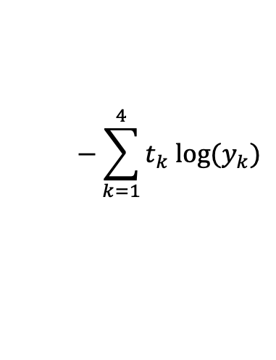







+
0
$$w_{1,1}$$
$$y_{1}$$
$$x_{1}$$
$$w_{1,2}$$
$$b_{1}$$
$$w_{1,3}$$
$$1$$
$$w_{2,1}$$
+
$$y_{2}$$
1
$$w_{2,2}$$
Cross Entropy
$$x_{2}$$
$$w_{2,3}$$
$$b_{2}$$
$$w_{3,1}$$
$$1$$
$$softmax$$
$$w_{3,2}$$
+
$$−\sum_{k=1}^{4}{t_{k}{ log⁡(y}_{k})}$$
$$y_{3}$$
0
$$w_{3,3}$$
$$b_{3}$$
$$x_{3}$$
$$w_{4,1}$$
$$1$$
$$w_{4,2}$$
$$w_{4,3}$$
+
0
$$y_{4}$$
$$b_{4}$$
$$1$$
$$x$$
$$W$$
$$b$$
$$y$$
$$t$$

Slide 10



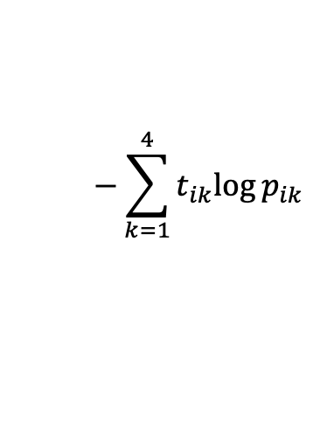







+
0
$$w_{1,1}$$
$$p_{i1}$$
$$x_{i1}$$
$$w_{1,2}$$
$$b_{1}$$
$$w_{1,3}$$
$$1$$
$$w_{2,1}$$
+
$$p_{i2}$$
1
$$w_{2,2}$$
Cross Entropy
$$x_{i2}$$
$$w_{2,3}$$
$$b_{2}$$
$$w_{3,1}$$
$$1$$
$$softmax$$
$$w_{3,2}$$
+
$$−\sum_{k=1}^{4}{t_{ik}{log⁡p}_{ik}}$$
$$p_{i3}$$
0
$$w_{3,3}$$
$$b_{3}$$
$$x_{i3}$$
$$w_{4,1}$$
$$1$$
$$w_{4,2}$$
$$w_{4,3}$$
+
0
$$p_{i4}$$
$$b_{4}$$
$$1$$
$$x_{i}$$
$$W$$
$$b$$
$$p_{i}$$
$$t_{i}$$

Slide 11

















+
$$w_{1,1}$$
$$y_{1}$$
$$x_{1}$$
$$w_{1,2}$$
$$b_{1}$$
$$w_{1,3}$$
$$1$$
$$w_{2,1}$$
+
$$y_{2}$$
$$w_{2,2}$$
$$x_{2}$$
$$w_{2,3}$$
$$b_{2}$$
$$w_{3,1}$$
$$1$$
$$softmax$$
$$w_{3,2}$$
+
$$y_{3}$$
$$w_{3,3}$$
$$b_{3}$$
$$x_{3}$$
$$w_{4,1}$$
$$1$$
$$w_{4,2}$$
$$w_{4,3}$$
+
$$y_{4}$$
$$b_{4}$$
$$1$$
$$x$$
$$W$$
$$b$$
$$y$$

Slide 12
3 x 3 x 3
weights
…
…
Receptive
Field
0 | 1 | 0 | 0 | 1 | 0
0 | 0 | 1 | 1 | 0 | 0
1 | 0 | 0 | 0 | 1 | 0
0 | 1 | 0 | 0 | 1 | 0
0 | 0 | 1 | 0 | 1 | 0
bias
0 | 1 | 0 | 0 | 1 | 0
0 | 0 | 1 | 1 | 0 | 0
1 | 0 | 0 | 0 | 1 | 0
0 | 1 | 0 | 0 | 1 | 0
0 | 0 | 1 | 0 | 1 | 0
1 | 0 | 0 | 0 | 0 | 1
0 | 1 | 0 | 0 | 1 | 0
0 | 0 | 1 | 1 | 0 | 0
1 | 0 | 0 | 0 | 1 | 0
0 | 1 | 0 | 0 | 1 | 0
0 | 0 | 1 | 0 | 1 | 0
1
…

Slide 13
3 x 3 x 3 weights
Receptive
Field
0 | 1 | 0 | 0 | 1 | 0
0 | 0 | 1 | 1 | 0 | 0
1 | 0 | 0 | 0 | 1 | 0
0 | 1 | 0 | 0 | 1 | 0
0 | 0 | 1 | 0 | 1 | 0
0 | 1 | 0 | 0 | 1 | 0
0 | 0 | 1 | 1 | 0 | 0
1 | 0 | 0 | 0 | 1 | 0
0 | 1 | 0 | 0 | 1 | 0
0 | 0 | 1 | 0 | 1 | 0
1 | 0 | 0 | 0 | 0 | 1
0 | 1 | 0 | 0 | 1 | 0
0 | 0 | 1 | 1 | 0 | 0
1 | 0 | 0 | 0 | 1 | 0
0 | 1 | 0 | 0 | 1 | 0
0 | 0 | 1 | 0 | 1 | 0

Slide 14
3 x 3 x 3
weights
…
…
0 | 1 | 0 | 0 | 1 | 0
0 | 0 | 1 | 1 | 0 | 0
1 | 0 | 0 | 0 | 1 | 0
0 | 1 | 0 | 0 | 1 | 0
0 | 0 | 1 | 0 | 1 | 0
bias
0 | 1 | 0 | 0 | 1 | 0
0 | 0 | 1 | 1 | 0 | 0
1 | 0 | 0 | 0 | 1 | 0
0 | 1 | 0 | 0 | 1 | 0
0 | 0 | 1 | 0 | 1 | 0
1 | 0 | 0 | 0 | 0 | 1
0 | 1 | 0 | 0 | 1 | 0
0 | 0 | 1 | 1 | 0 | 0
1 | 0 | 0 | 0 | 1 | 0
0 | 1 | 0 | 0 | 1 | 0
0 | 0 | 1 | 0 | 1 | 0
1
…
Parameter sharing
3 x 3 x 3
weights
…
…
bias
1
…

Slide 15
64
0 | 1 | 0 | 0 | 1 | 0
0 | 0 | 1 | 1 | 0 | 0
1 | 0 | 0 | 0 | 1 | 0
0 | 1 | 0 | 0 | 1 | 0
0 | 0 | 1 | 0 | 1 | 0
64
0 | 1 | 0 | 0 | 1 | 0
0 | 0 | 1 | 1 | 0 | 0
1 | 0 | 0 | 0 | 1 | 0
0 | 1 | 0 | 0 | 1 | 0
0 | 0 | 1 | 0 | 1 | 0
1 | 0 | 0 | 0 | 0 | 1
0 | 1 | 0 | 0 | 1 | 0
0 | 0 | 1 | 1 | 0 | 0
1 | 0 | 0 | 0 | 1 | 0
0 | 1 | 0 | 0 | 1 | 0
0 | 0 | 1 | 0 | 1 | 0
……
……
64
……

Slide 16
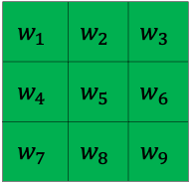
3 x 3 x 3
weights
…
…
Receptive
Field
0 | 1 | 0 | 0 | 1 | 0
0 | 0 | 1 | 1 | 0 | 0
1 | 0 | 0 | 0 | 1 | 0
0 | 1 | 0 | 0 | 1 | 0
0 | 0 | 1 | 0 | 1 | 0
b
0 | 1 | 0 | 0 | 1 | 0
0 | 0 | 1 | 1 | 0 | 0
1 | 0 | 0 | 0 | 1 | 0
0 | 1 | 0 | 0 | 1 | 0
0 | 0 | 1 | 0 | 1 | 0
1 | 0 | 0 | 0 | 0 | 1
0 | 1 | 0 | 0 | 1 | 0
0 | 0 | 1 | 1 | 0 | 0
1 | 0 | 0 | 0 | 1 | 0
0 | 1 | 0 | 0 | 1 | 0
0 | 0 | 1 | 0 | 1 | 0
1
…
 | 1 | -1
 | -1 | 1
 | 1 | -1
 | -1 | 1
$$w_{1}$$ | $$w_{2}$$ | $$w_{3}$$
$$w_{4}$$ | $$w_{5}$$ | $$w_{6}$$
$$w_{7}$$ | $$w_{8}$$ | $$w_{9}$$
b
filter

Slide 17
Fully-Connected Layer
Receptive Field
Parameter Sharing
Convolutional Layer

Slide 18
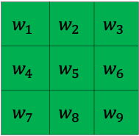
 | 1 | -1
 | -1 | 1
 | 1 | -1
 | -1 | 1
$$w_{1}$$ | $$w_{2}$$ | $$w_{3}$$
$$w_{4}$$ | $$w_{5}$$ | $$w_{6}$$
$$w_{7}$$ | $$w_{8}$$ | $$w_{9}$$
0 | 1 | 0 | 0 | 1 | 0
0 | 0 | 1 | 1 | 0 | 0
1 | 0 | 0 | 0 | 1 | 0
0 | 1 | 0 | 0 | 1 | 0
0 | 0 | 1 | 0 | 1 | 0
b
0 | 1 | 0 | 0 | 1 | 0
0 | 0 | 1 | 1 | 0 | 0
1 | 0 | 0 | 0 | 1 | 0
0 | 1 | 0 | 0 | 1 | 0
0 | 0 | 1 | 0 | 1 | 0
1 | 0 | 0 | 0 | 0 | 1
0 | 1 | 0 | 0 | 1 | 0
0 | 0 | 1 | 1 | 0 | 0
1 | 0 | 0 | 0 | 1 | 0
0 | 1 | 0 | 0 | 1 | 0
0 | 0 | 1 | 0 | 1 | 0
filter
一个filter派生出多个neuron，每个neuron “观察”一个receptive field；
一个filter扫描所有receptive field (convolve over the input image)

Slide 19
1 | 0 | 0 | 0 | 0 | 1
0 | 1 | 0 | 0 | 1 | 0
0 | 0 | 1 | 1 | 0 | 0
1 | 0 | 0 | 0 | 1 | 0
0 | 1 | 0 | 0 | 1 | 0
0 | 0 | 1 | 0 | 1 | 0
3
-1
-3
-1
1 | -1 | -1
-1 | 1 | -1
-1 | -1 | 1
-3
1
0
-3
-3
-3
0
1
filter1
3
-2
-2
-1

Slide 20
1 | -1 | -1
-1 | 1 | -1
-1 | -1 | 1
64 channels
3
-1
-3
-1
1 | 0 | 0 | 0 | 0 | 1
0 | 1 | 0 | 0 | 1 | 0
0 | 0 | 1 | 1 | 0 | 0
1 | 0 | 0 | 0 | 1 | 0
0 | 1 | 0 | 0 | 1 | 0
0 | 0 | 1 | 0 | 1 | 0
filter1
…
…
…
…
-1
-1
-1
-1
-1 | 1 | -1
-1 | 1 | -1
-1 | 1 | -1
-3
1
0
-3
-1
-1
-2
1
-3
-3
0
1
filter2
-1
-1
-2
1
3
-2
-2
-1
……
…
-1
0
-4
3
-1 | 1 | -1
-1 | 1 | -1
-1 | 1 | -1
feature map
filter64

Slide 21
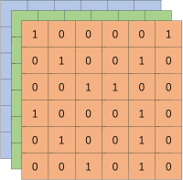
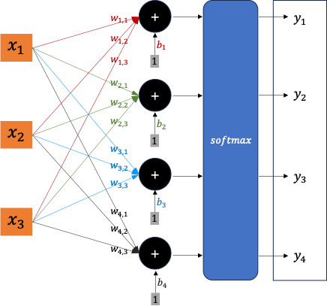
Convolution
Convolution
Convolution
Pooling
Convolution
Pooling
……
Flatten
fully-connected network

Slide 22
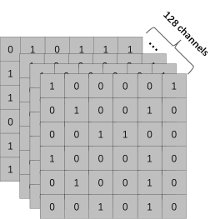
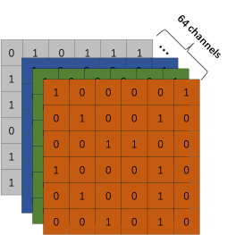
…
3 x 3 x 64
一个receptive field
3 x 3 x 3
一个receptive field
…
…
…
…
…
3 x 3 x 64
一个receptive field
…
…
3 x 3 x 3
一个receptive field
…
…
…
…
3 x 3 x 64
一个receptive field
……
…
98 x 98 x 64 feature map
96 x 96 x 128 feature map
…
……
…
3 x 3 x 3
一个receptive field
…
3 x 3 x 64
一个receptive field
…
…
…
…
98 x 98 个
receptive field
98 x 98 x 64 个 neuron
输出 98 x 98 x 64 feature map
96 x 96 个
receptive field
96 x 96 x 128 个 neuron
输出 96 x 96 x 128 feature map

Slide 23
3 x 3 x 64
一个receptive field
64 channels
…
0 | 1 | 0 | 1 | 1 | 1
1 | 1 | 0 | 0 | 1 | 0
1 | 0 | 1 | 1 | 0 | 0
0 | 0 | 0 | 0 | 1 | 0
1 | 1 | 0 | 0 | 1 | 0
1 | 0 | 1 | 0 | 1 | 0
…
1 | 0 | 0 | 0 | 0 | 1
0 | 1 | 0 | 0 | 1 | 0
0 | 0 | 1 | 1 | 0 | 0
1 | 0 | 0 | 0 | 1 | 0
0 | 1 | 0 | 0 | 1 | 0
0 | 0 | 1 | 0 | 1 | 0
…
1 | 0 | 0 | 0 | 0 | 1
0 | 1 | 0 | 0 | 1 | 0
0 | 0 | 1 | 1 | 0 | 0
1 | 0 | 0 | 0 | 1 | 0
0 | 1 | 0 | 0 | 1 | 0
0 | 0 | 1 | 0 | 1 | 0
1 | 0 | 0 | 0 | 0 | 1
0 | 1 | 0 | 0 | 1 | 0
0 | 0 | 1 | 1 | 0 | 0
1 | 0 | 0 | 0 | 1 | 0
0 | 1 | 0 | 0 | 1 | 0
0 | 0 | 1 | 0 | 1 | 0
128 channels
0 | 1 | 0 | 1 | 1 | 1
1 | 1 | 0 | 0 | 1 | 0
1 | 0 | 1 | 1 | 0 | 0
0 | 0 | 0 | 0 | 1 | 0
1 | 1 | 0 | 0 | 1 | 0
1 | 0 | 1 | 0 | 1 | 0
…
1 | 0 | 0 | 0 | 0 | 1
0 | 1 | 0 | 0 | 1 | 0
0 | 0 | 1 | 1 | 0 | 0
1 | 0 | 0 | 0 | 1 | 0
0 | 1 | 0 | 0 | 1 | 0
0 | 0 | 1 | 0 | 1 | 0
1 | 0 | 0 | 0 | 0 | 1
0 | 1 | 0 | 0 | 1 | 0
0 | 0 | 1 | 1 | 0 | 0
1 | 0 | 0 | 0 | 1 | 0
0 | 1 | 0 | 0 | 1 | 0
0 | 0 | 1 | 0 | 1 | 0
1 | 0 | 0 | 0 | 0 | 1
0 | 1 | 0 | 0 | 1 | 0
0 | 0 | 1 | 1 | 0 | 0
1 | 0 | 0 | 0 | 1 | 0
0 | 1 | 0 | 0 | 1 | 0
0 | 0 | 1 | 0 | 1 | 0

Slide 24







$$y$$
$$r$$
$$t$$
$$hight=distance$$
$$s$$
$$x$$
$$distance$$

Slide 25



























$$w_{11}$$
$$w_{12}$$
$$w_{13}$$
$$w_{14}$$
$$softmax$$
$$α_{11}$$
$$α_{12}$$
$$α_{13}$$
$$α_{14}$$
$$\frac{1}{\sqrt{d_{k}}}$$
$$\frac{1}{\sqrt{d_{k}}}$$
$$\frac{1}{\sqrt{d_{k}}}$$
$$\frac{1}{\sqrt{d_{k}}}$$
$$q_{1}$$
$$k_{1}$$
$$k_{2}$$
$$k_{3}$$
$$k_{4}$$
$$W^{Q}$$
$$W^{K}$$
$$W^{K}$$
$$W^{K}$$
$$W^{K}$$
$$e_{1}$$
$$e_{2}$$
$$e_{3}$$
$$e_{4}$$

Slide 26
























$$o_{1}$$
$$w_{11}$$
$$×$$
$$w_{12}$$
$$×$$
$$w_{13}$$
$$×$$
$$w_{14}$$
$$×$$
$$softmax$$
$$α_{11}$$
$$α_{12}$$
$$α_{13}$$
$$α_{14}$$
$$\frac{1}{\sqrt{d_{k}}}$$
$$\frac{1}{\sqrt{d_{k}}}$$
$$\frac{1}{\sqrt{d_{k}}}$$
$$\frac{1}{\sqrt{d_{k}}}$$
$$q_{1}$$
$$k_{1}$$
$$v_{1}$$
$$k_{2}$$
$$v_{2}$$
$$k_{3}$$
$$v_{3}$$
$$k_{4}$$
$$v_{4}$$
$$W^{Q}$$
$$W^{K}$$
$$W^{V}$$
$$W^{K}$$
$$W^{V}$$
$$W^{K}$$
$$W^{V}$$
$$W^{K}$$
$$W^{V}$$
$$e_{1}$$
$$e_{2}$$
$$e_{3}$$
$$e_{4}$$

Slide 27


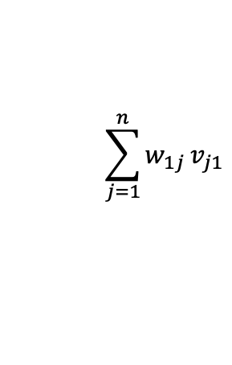
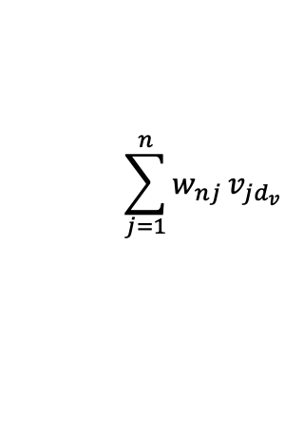

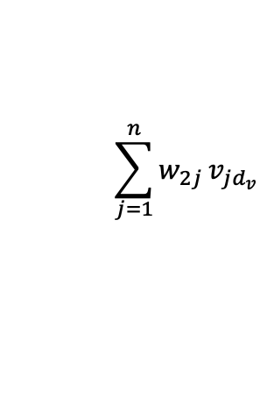





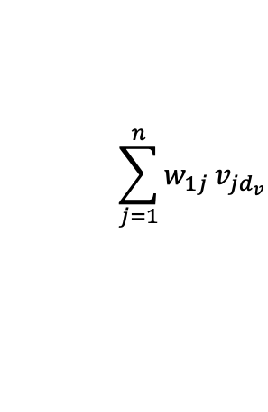




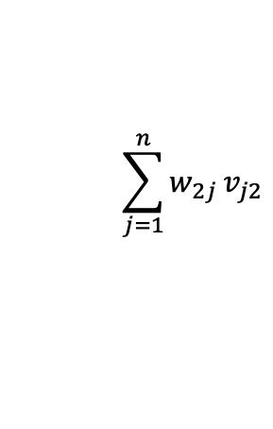
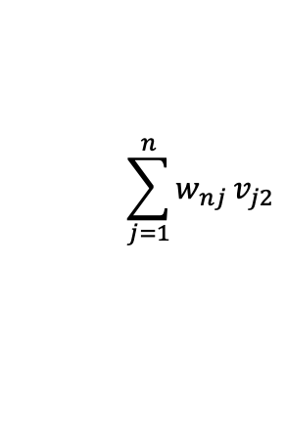




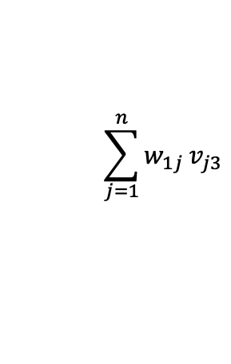
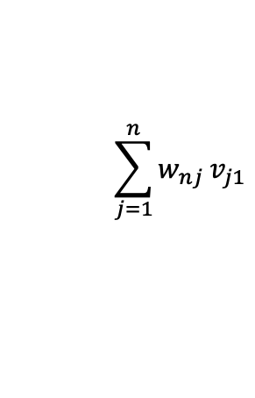


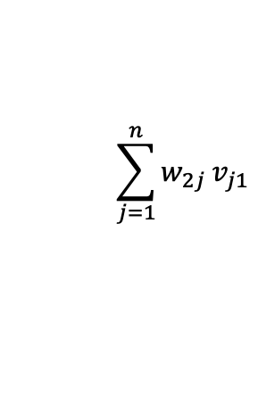




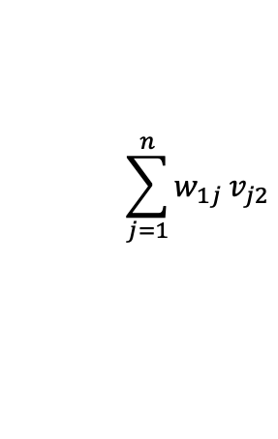






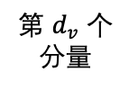
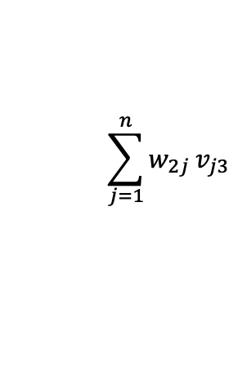
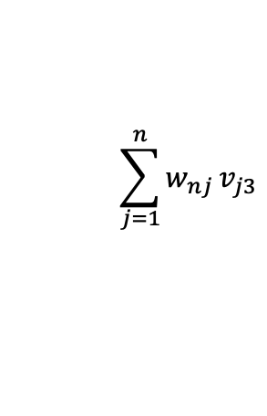
第 1 个
分量
第 2 个
分量
第 3 个
分量
第 $d_{v}$ 个
分量
$$v_{11}$$
$$v_{12}$$
$$v_{13}$$
$$⋯$$
$$v_{1d_{v}}$$
第 1 个token 的 value 向量
$$v_{21}$$
$$v_{22}$$
$$v_{23}$$
$$⋯$$
$$v_{2d_{v}}$$
第 2 个token 的 value 向量
$$v_{31}$$
$$v_{32}$$
$$v_{33}$$
$$⋯$$
$$v_{3d_{v}}$$
第 3 个token 的 value 向量
$$⋮$$
$$⋮$$
$$⋮$$
$$⋱$$
$$⋮$$
$$v_{n1}$$
$$v_{n2}$$
$$v_{n3}$$
$$⋯$$
$$v_{nd_{v}}$$
第 n 个token 的 value 向量
按 $e_{1}$的注意力权重
组合
$$\sum_{j=1}^{n}{w_{1j}}v_{j1}$$
$$\sum_{j=1}^{n}{w_{1j}}v_{j2}$$
$$\sum_{j=1}^{n}{w_{1j}}v_{j3}$$
$$\sum_{j=1}^{n}{w_{1j}}v_{jd_{v}}$$
$$⋯$$
第 1 个token 的自注意力 output
按 $e_{2}$的注意力权重
组合
$$\sum_{j=1}^{n}{w_{2j}}v_{j1}$$
$$\sum_{j=1}^{n}{w_{2j}}v_{j2}$$
$$\sum_{j=1}^{n}{w_{2j}}v_{j3}$$
$$\sum_{j=1}^{n}{w_{2j}}v_{jd_{v}}$$
$$⋯$$
第 2 个token 的自注意力 output
$$⋮$$
$$⋮$$
$$⋮$$
$$⋮$$
$$⋱$$
$$⋮$$
$$\sum_{j=1}^{n}{w_{nj}}v_{j1}$$
$$\sum_{j=1}^{n}{w_{nj}}v_{j2}$$
$$\sum_{j=1}^{n}{w_{nj}}v_{j3}$$
$$\sum_{j=1}^{n}{w_{nj}}v_{jd_{v}}$$
按 $e_{n}$的注意力权重
组合
$$⋯$$
第 n 个token 的自注意力 output

