Slide 1


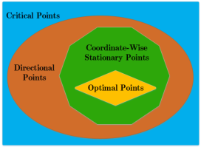
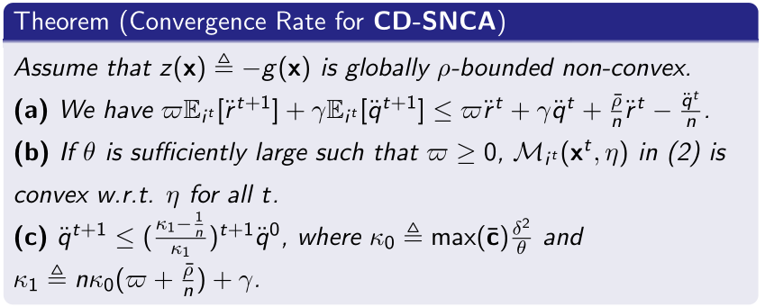

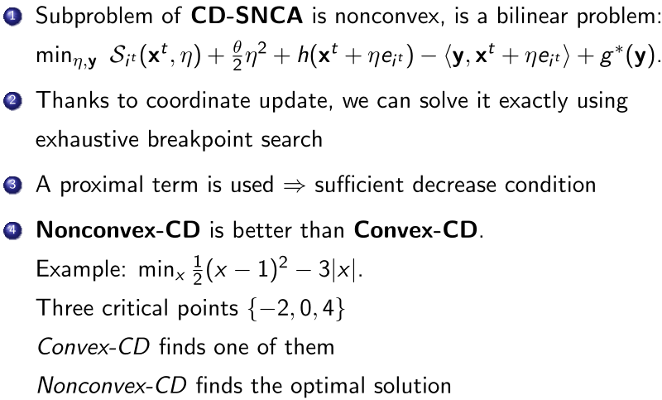
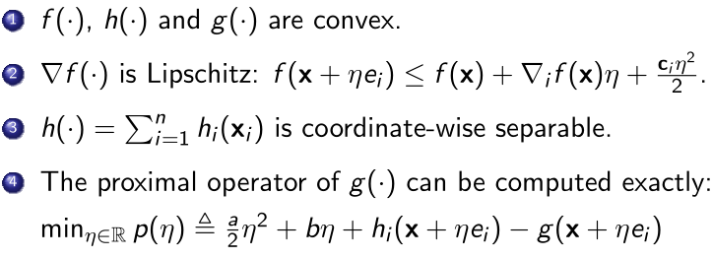
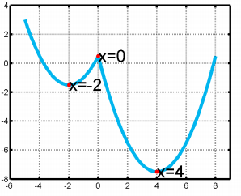
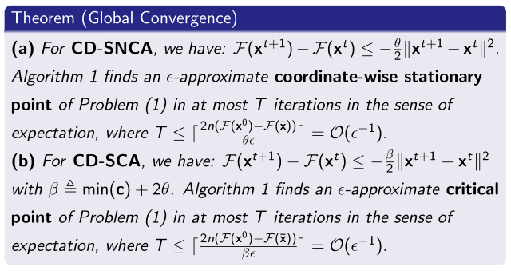






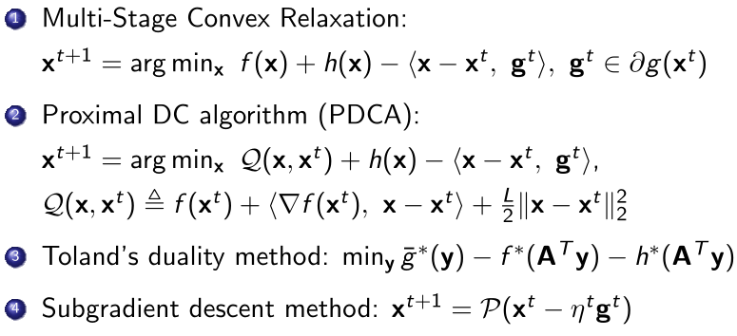
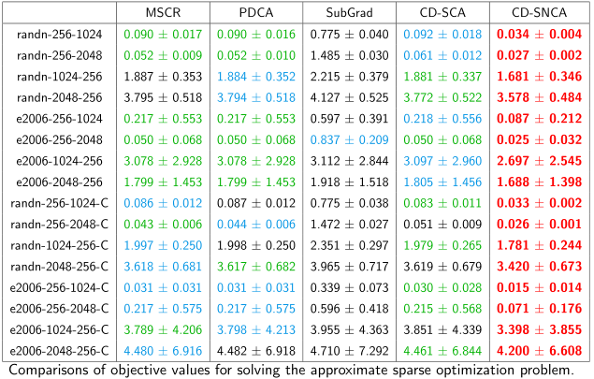
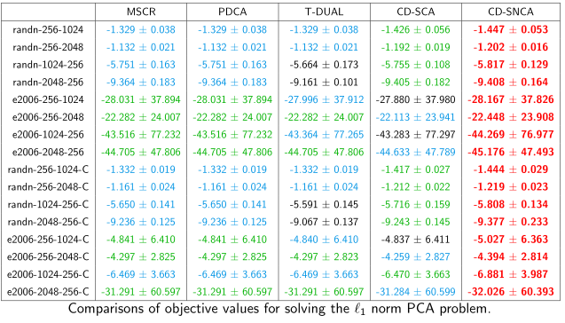
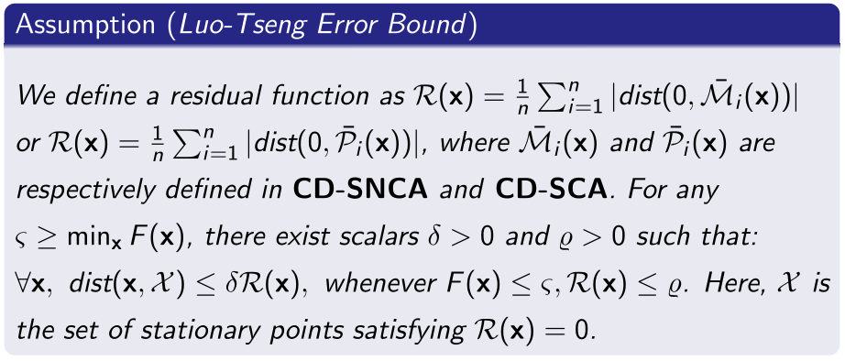


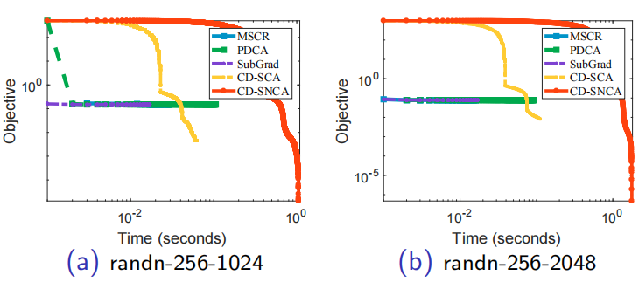

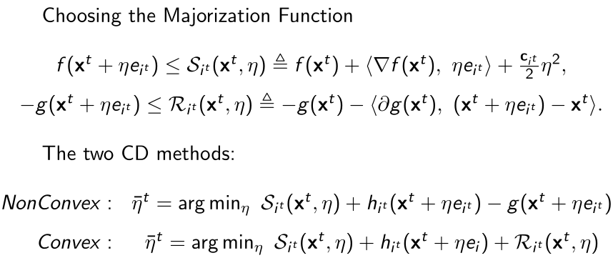
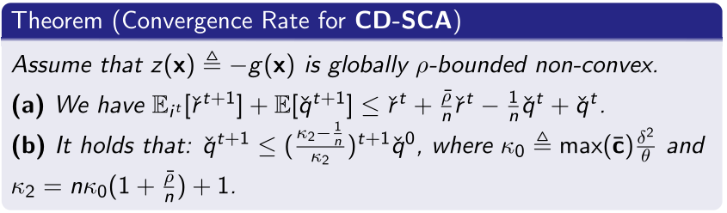
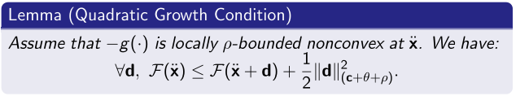
Coordinate Descent Methods for DC Minimization:Optimality Conditions and Global Convergence Ganzhao Yuan Peng Cheng Laboratory, China
The DC Minimization Problem
Assumptions
3. Applications
1. Lp Norm Eigenvalue Problem
2. Nonlinear Regression
3. Approximate Sparse Optimization
4. Approximate Binary Optimization
4. Related DC Algorithm
5. The Proposed CD Methods
6. Features
7. Breakpoint Searching Procedure
(a) First: Identify all the possible critical points / breakpoints for the univariate function
(b) Then: Pick the solution that leads to the lowest value as the optimal solution.
(c) It solves the univariate problem globally.
(d) Some typical examples:
8. Optimality Analysis
9. Weak Convergence Results
10. Strong Convergence Results
Conclusions:
(a) Both CD-SNCA and CD-SCA achieve Q-linear convergence rate.
(b) For high-dimensional problems (n is large), CD-SNCA becomes much faster than CD-SCA.
11. Experiments for L1 Norm PCA and Approximate Sparse Optimization
Conclusions:
(a) CD-SNCA consistently gives the best erformance.
(b) CD-SNCA takes a little more time to converge.
(c) CD-SNCA generally achieves higher accuracy.
Conclusion:
The newly-introduced coordinate-wise optimality condition is always stronger than the critical / directional point condition.
Lp norm :
Top-s norm:
RELU function:

