Slide 1



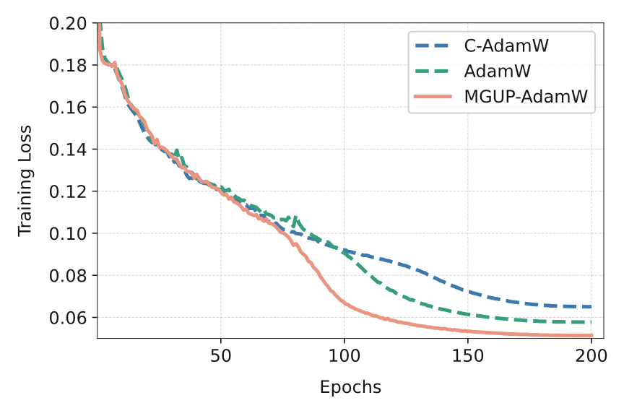
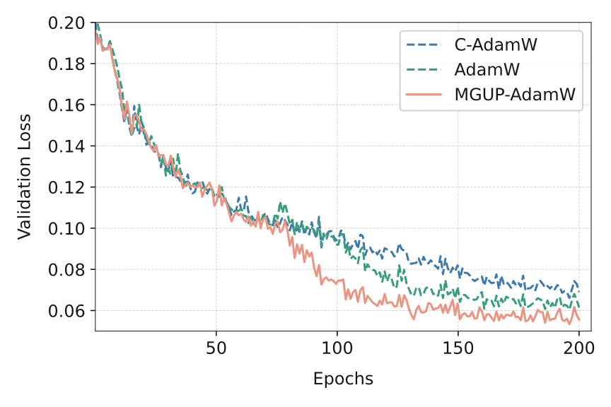
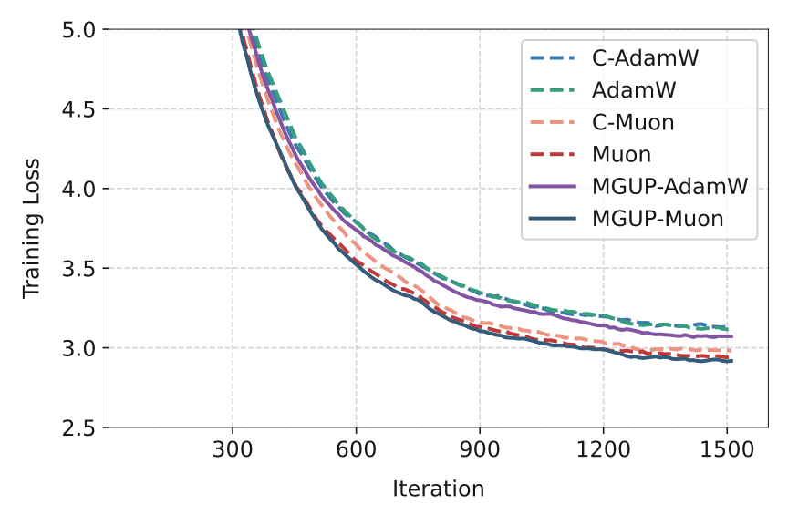
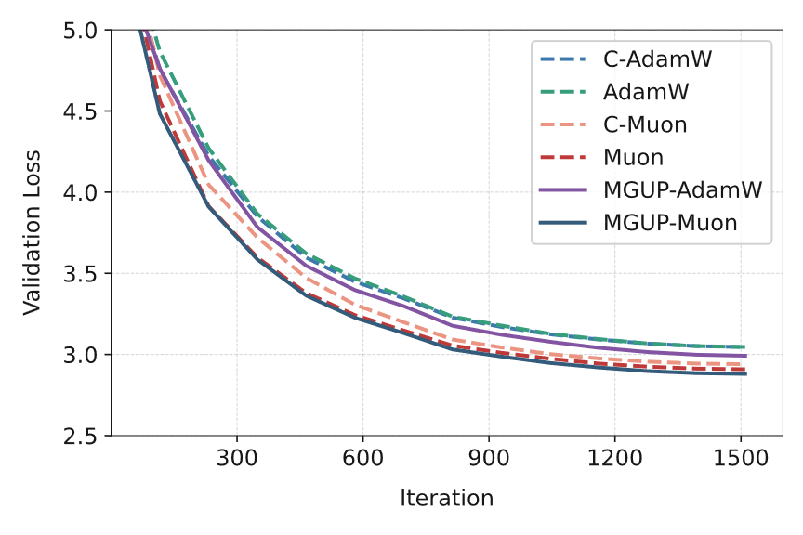
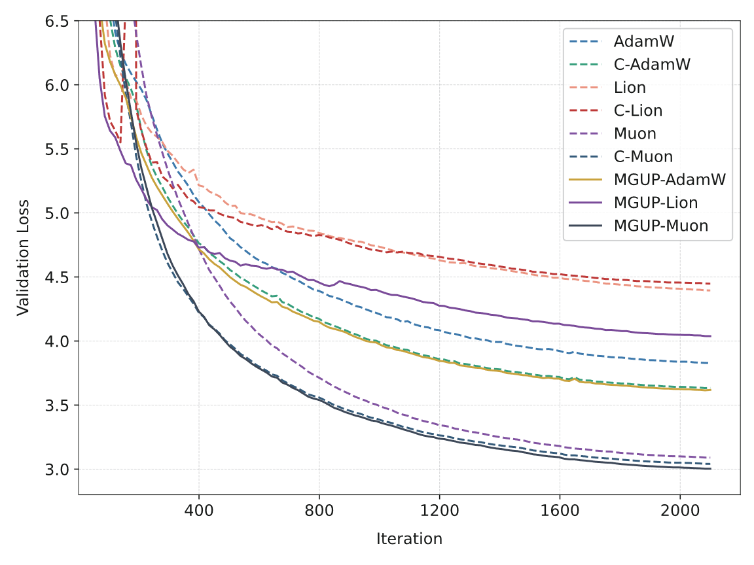
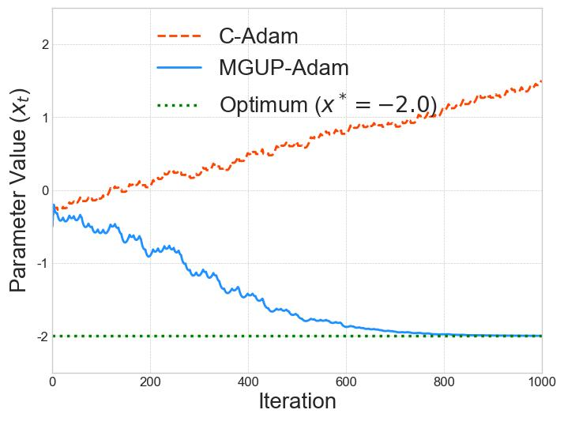
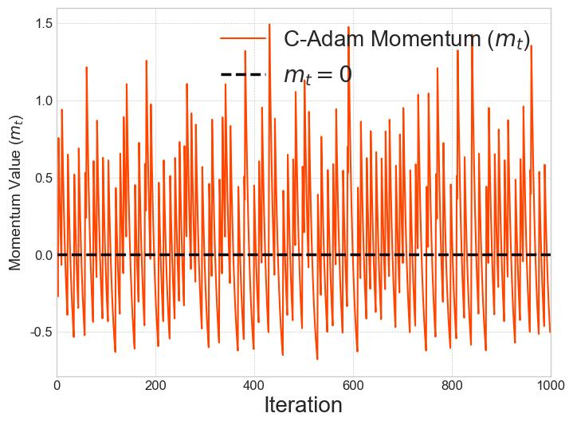
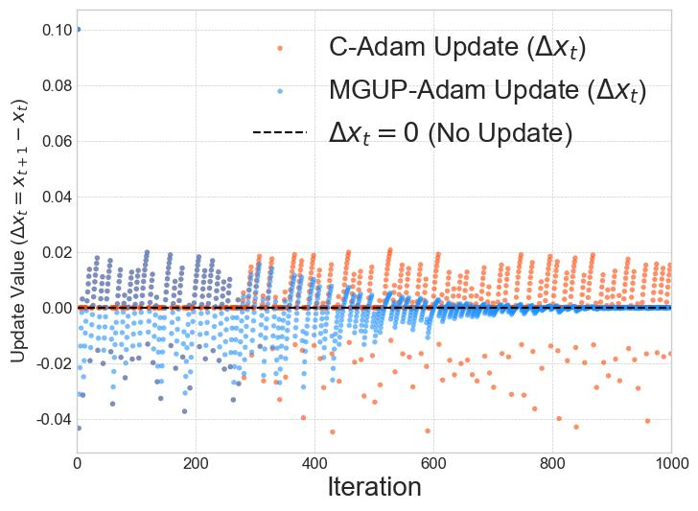
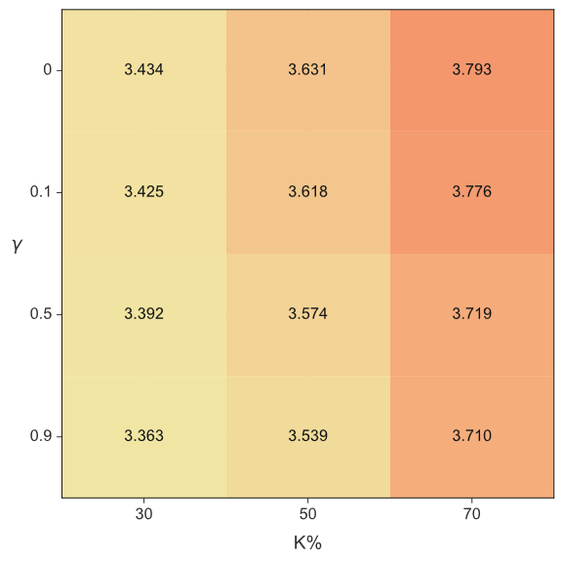
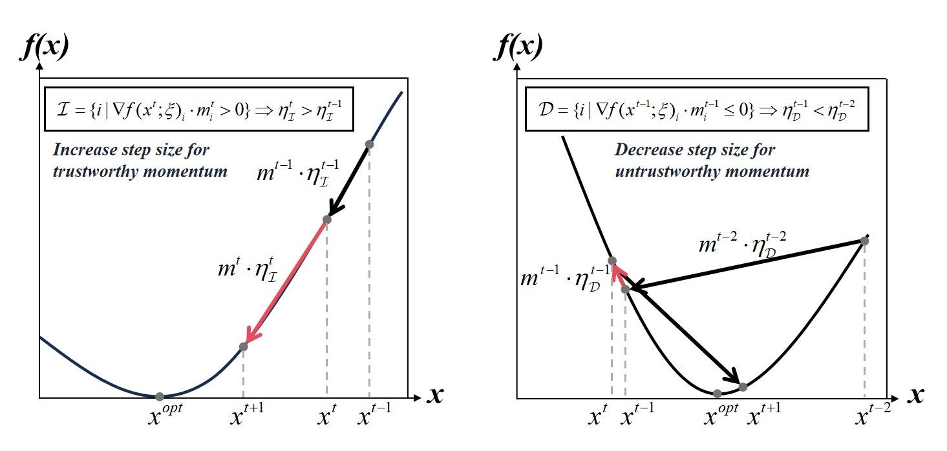
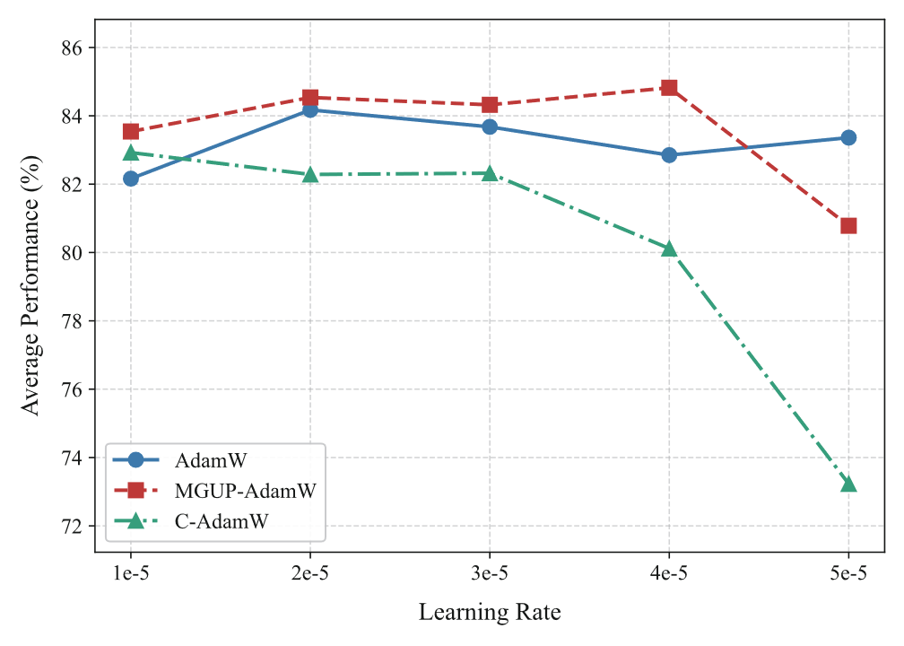
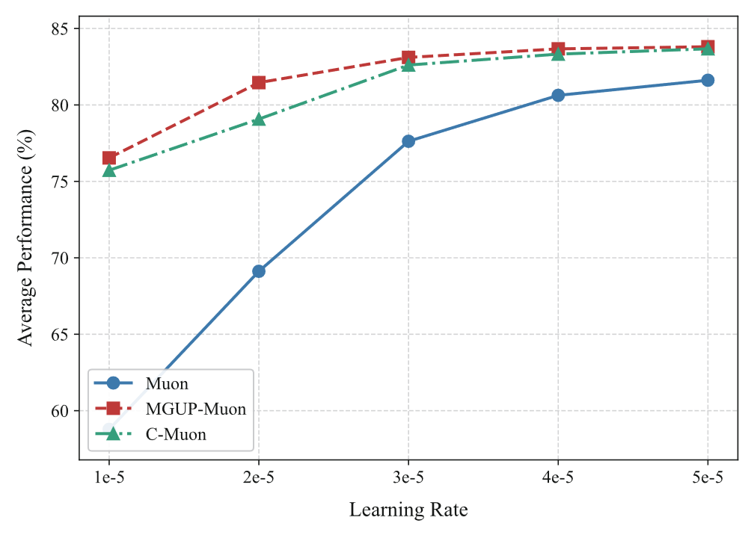
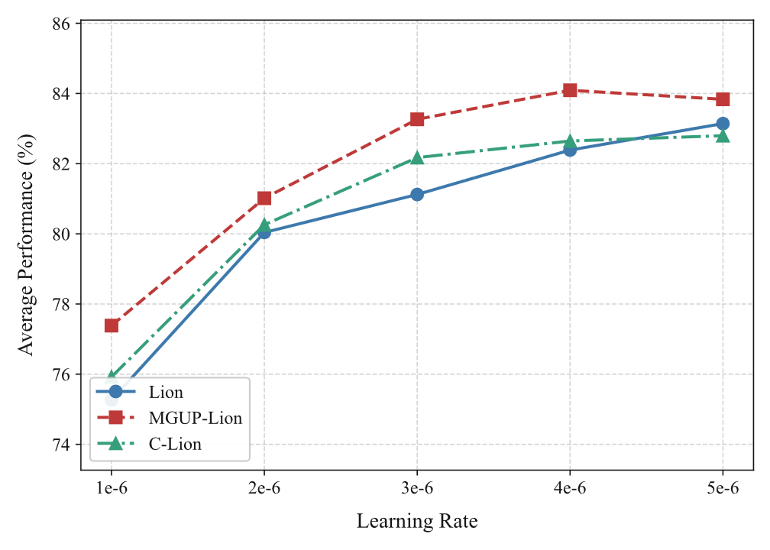
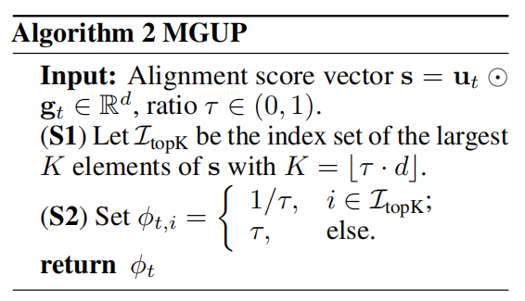
MGUP: A Momentum-Gradient Greedy Alignment Update Policy for Stochastic Optimization
NeurIPS 2025 Spotlight (Top 3%)
Da Chang, Ganzhao Yuan Shenzhen Institute of Advanced Technology, China
Shenzhen University of Advanced Technology, China
Convergence Risk of Adam's Zero-Steps
Theoretical Guarantee
Our Results
Stochastic Optimization:
Assumptions
ViT-27M MAE Pre-training on CIFAR10
Cautious update rule (Liang et al.2024)
may fail convergence in Stochastic Optimization setting..
MGUP-AdamW achieved better training loss and validation loss during the training process. In contrast, C-AdamW may be gradually inferior to AdamW.
Counterexample (Zhang et al.2022)
Qwen2.5-150M/LLaMA2-71M Pre-training on Wikitext-103
Theorem for MGUP-Adam
Expectation Convergence
MGUP-AdamW demonstrated a higher speedup than standard AdamW and better generalization than C-AdamW.
Unified momentum-gradient aligned mask:
Red Line (Diverging): Cautious Adam ( )
Blue Line (Converging): MGUP-Adam ( )
Setting misaligned updates to zero can cause divergence.
Hyperparameter sensitivity analysis on Wikitext-103
Remark 1
While the optimal value may vary slightly depending on the specific setting (e.g., task type, model size, or base optimizer), strong performance is typically maintained within the range
, suggesting that extensive tuning is unnecessary in practice.
High Probability Convergence
MGUP: Convergence via Non-Zero Steps & Fixed Proportion
Cautious-MGUP can be used as an adaptive alternative in practical tasks！
RoBERTa Fine-Tuning on GLUE
The key idea of MGUP involves adaptively adjusting the learning rate by leveraging the element-wise product of the stochastic gradient and momentum.
We use the surrogate stepsizes within the proof is informed by the methodology presented in (hong et al. 2024).
Remark 2
Update Rule:
S1(Score): Calculate alignment scores
S2(Rank): Identify the top-K parameters by score.
S3(Differentiate):
Apply a larger step size to the top K parameters
Apply a smaller, but non-zero, step size to the rest
Not updating in the previous step causes the denominator to divide by zero!
References
Combining Remark 1 and Remark 2, for Adam variants employing a mask, simply nullifying the update step when momentum and gradient directions misalign (tantamount to setting ) markedly alters the convergence properties of stochastic optimization.
Liang, Kaizhao, et al. "Cautious optimizers: Improving training with one line of code." arXiv preprint arXiv:2411.16085 (2024).
Zhang, Yushun, et al. "Adam can converge without any modification on update rules." Advances in neural information processing systems 35 (2022): 28386-28399.
Hong, Yusu, and Junhong Lin. "On convergence of adam for stochastic optimization under relaxed assumptions." Advances in Neural Information Processing Systems 37 (2024): 10827-10877.

