Slide 1

Analysis on Heart-Disease Data
Group1

Slide 2
Introduction
The dataset come from the CDC and is a major part of the Behavioral Risk Factor Surveillance System (BRFSS), which conducts annual telephone surveys to gather data on the health status of U.S. residents.
The most recent dataset (as of February 15, 2022) includes data from 2020. It consists of 401,958 rows and 279 columns. The vast majority of columns are questions asked to respondents about their health status.

Slide 3
Part1 Data Process and Description

Slide 4
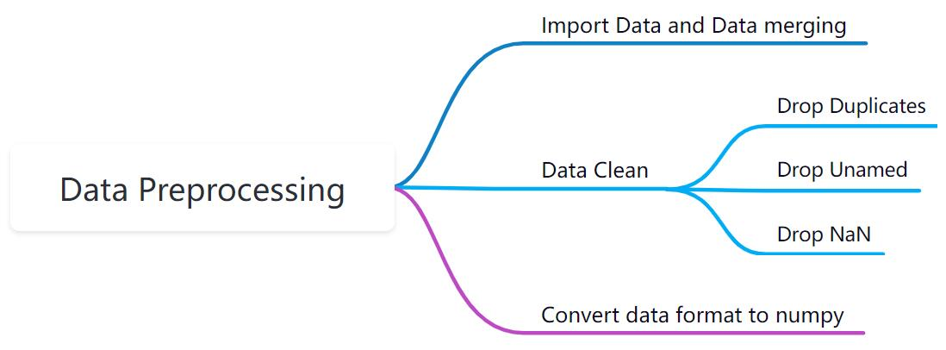
1.1 Data Preprocessing

Slide 5
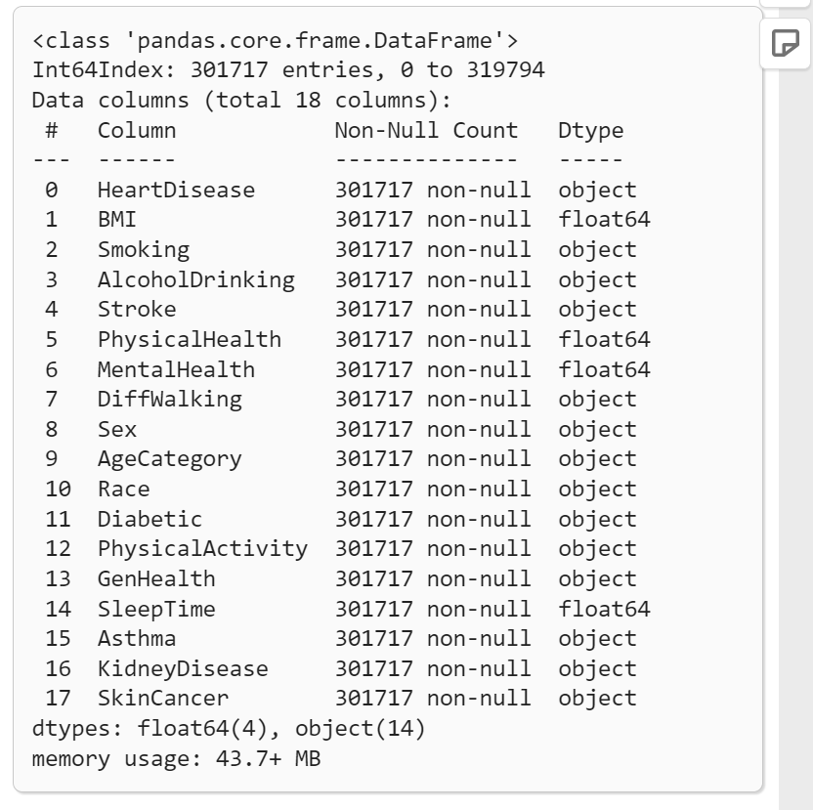
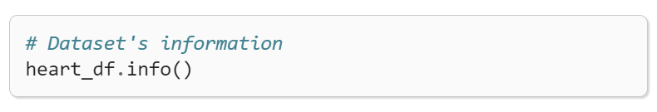
1.2 Preliminary data analysis

Slide 6
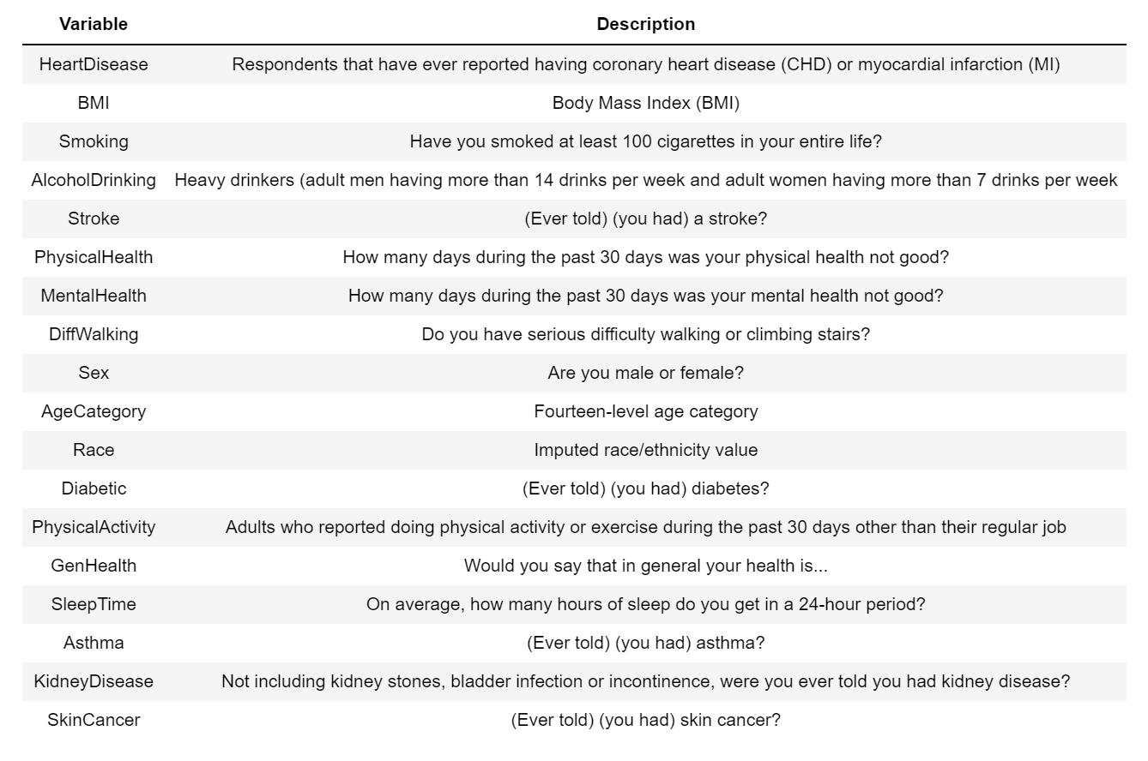
1.2 Description of Variables

Slide 7
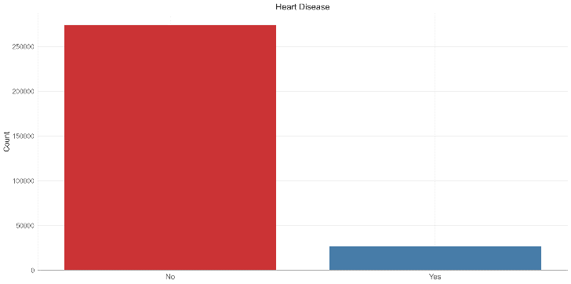
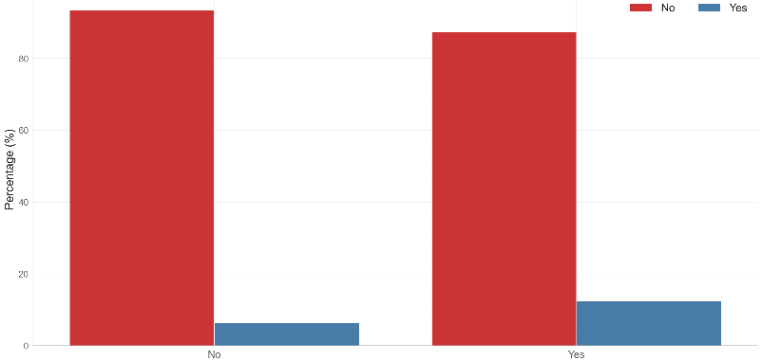
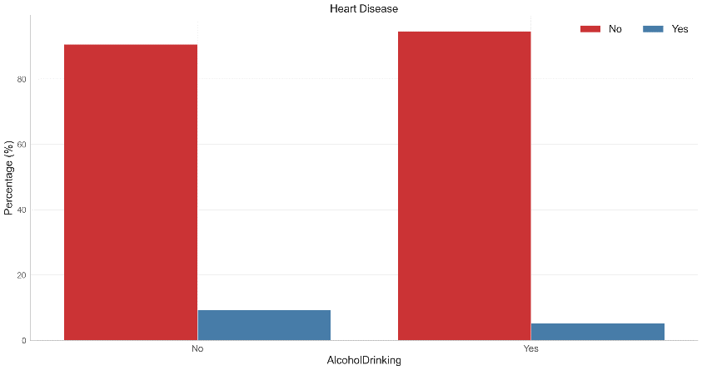
1.3 Preliminary data analysis
The first chart above shows a significant imbalance between people with and without heart disease in the data set.
The Second chart shows the significant prevalence of heart disease in people with smoking habits.
According to the third chart, we can know that people who don't drink alcoholic have a higher risk of heart disease.
Heart Disease
No Yes
Smoking
Alcoholic Drinking

Slide 8
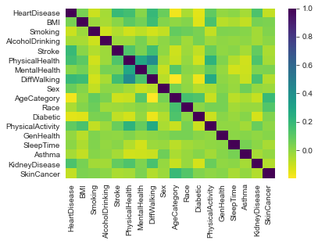
1.4 Visualization of correlation coefficient matrix
The heat map uses color to reflect the positive and negative correlation coefficients, which can help us intuitively understand the correlation between variables through the color depth.

Slide 9
Part2 Model Prediction

Slide 10

2.1 Data Reprocessing
It is obvious that the numbers of the target value is signifciantly unbalanced, almost 10:1.
we use under sampling to solve the problem of data imbalance

Slide 11
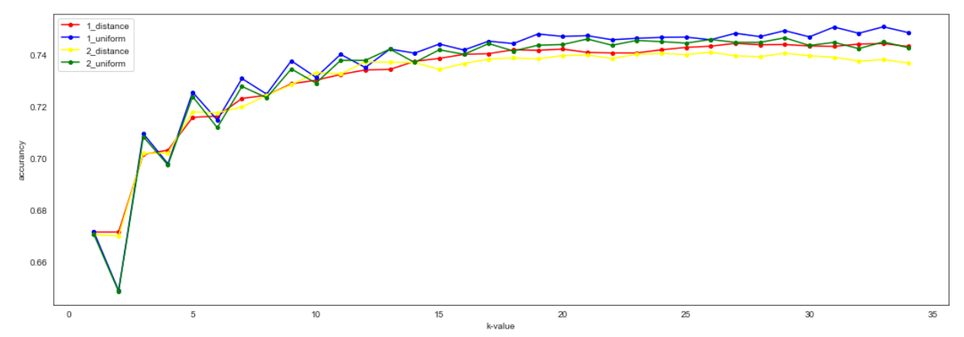
2.2 KNN
in the KNN model,we consider 3 important parameter to optimize the model:
n_neighbors: the number of neighbors for each point in the prediction
p: determines the distance metric to be used in the model: p=1 ==> manhattan_distance, and p=2 ==> euclidean_distance
weights: weight type used in KNN model, distance as weight standard and uniform

Slide 12
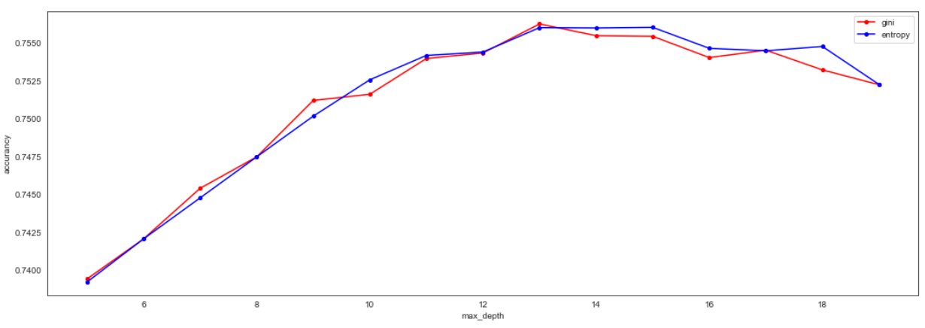
2.3 Random Forest
in the random forest model,we mainly consider 2 important parameters to optimize the model:
criterion: The function to measure the quality of a split. Supported criteria are “gini” for the Gini impurity and “entropy” for the information gain.
max_depth: The maximum depth of the tree. If None, then nodes are expanded until all leaves are pure or until all leaves contain less than min_samples_split samples.

Slide 13
2.4 PCA
Principal component analysis is a algorithm that can reduce the dimension of the dataset with
the minimum loss of the information. And we should select a proper dimension to maximizes
the variance of the data. Generally, there are several steps:
1. Calculate Gaussian
2. Eigen decomposition of the covariance matrix
3. Sort the eigenvector according to the corresponding eigenvalue
4. Use the first k eigenvectors to project the original dataset into lower dimension

Slide 14
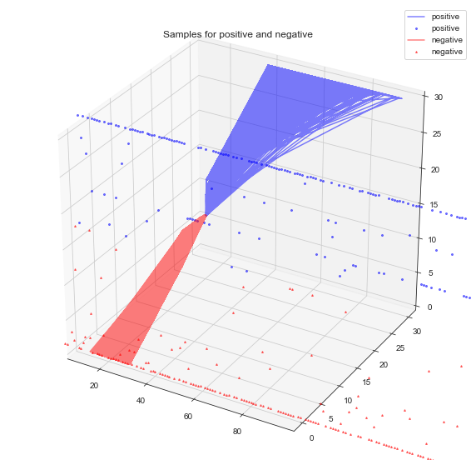
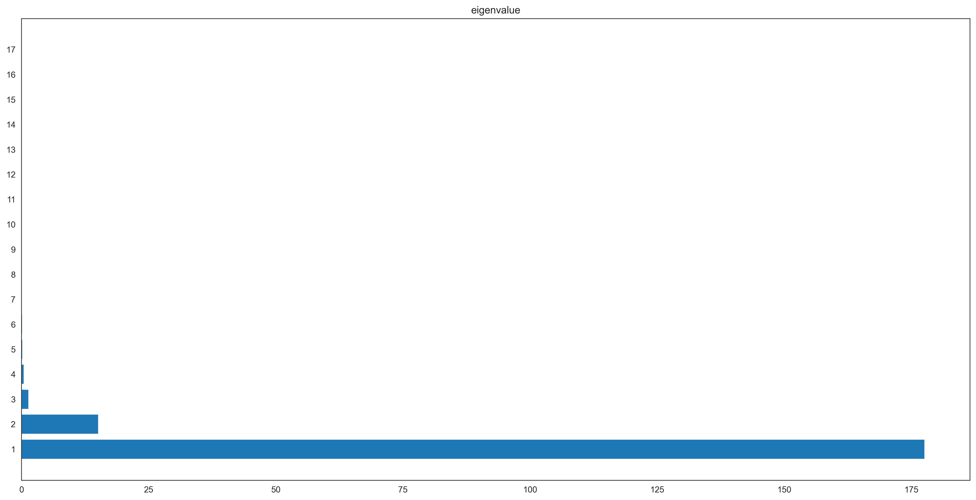
2.4 PCA
Original dataset visualized in 4 dimension
Eigenvalues from the eigen decomposition of covariance matrix

Slide 15
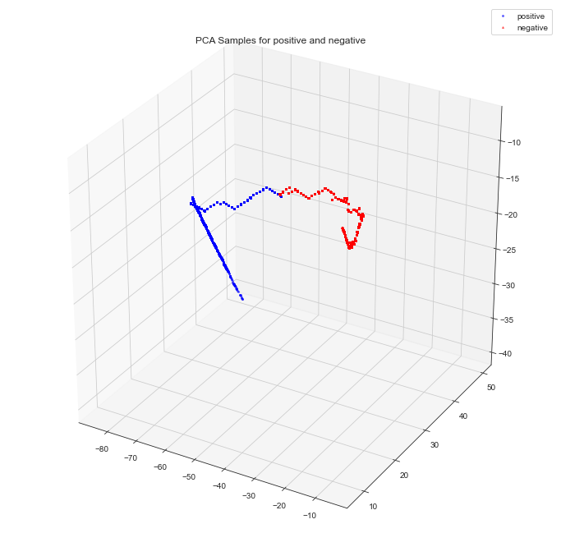
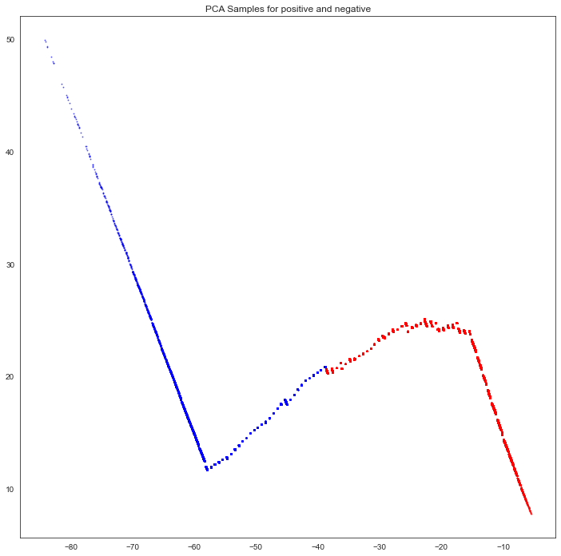
2.4 PCA
Project the data into 3 dimension
Project the data into 2 dimension

Slide 16
2.5 K-Means
K-means clustering algorithm is a method based on similarity or distance measurement
between samples, which belongs to unsupervised learning method. There are several
Steps:
Randomly select k samples as mean values.
2. Calculate the distance and assign the class to the other samples.
3. Recalculate the mean values of each class.
4. Repeat 2 & 3 until convergence.

Slide 17
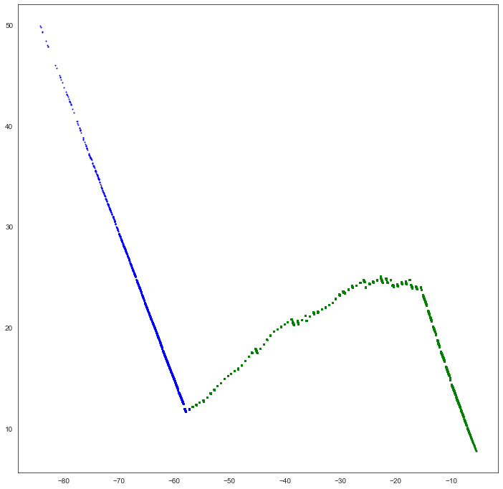
2.5 K-Means
Clustering result from K-Means
Real result

Slide 18
Part3 Conclusion & Evaluation

Slide 19
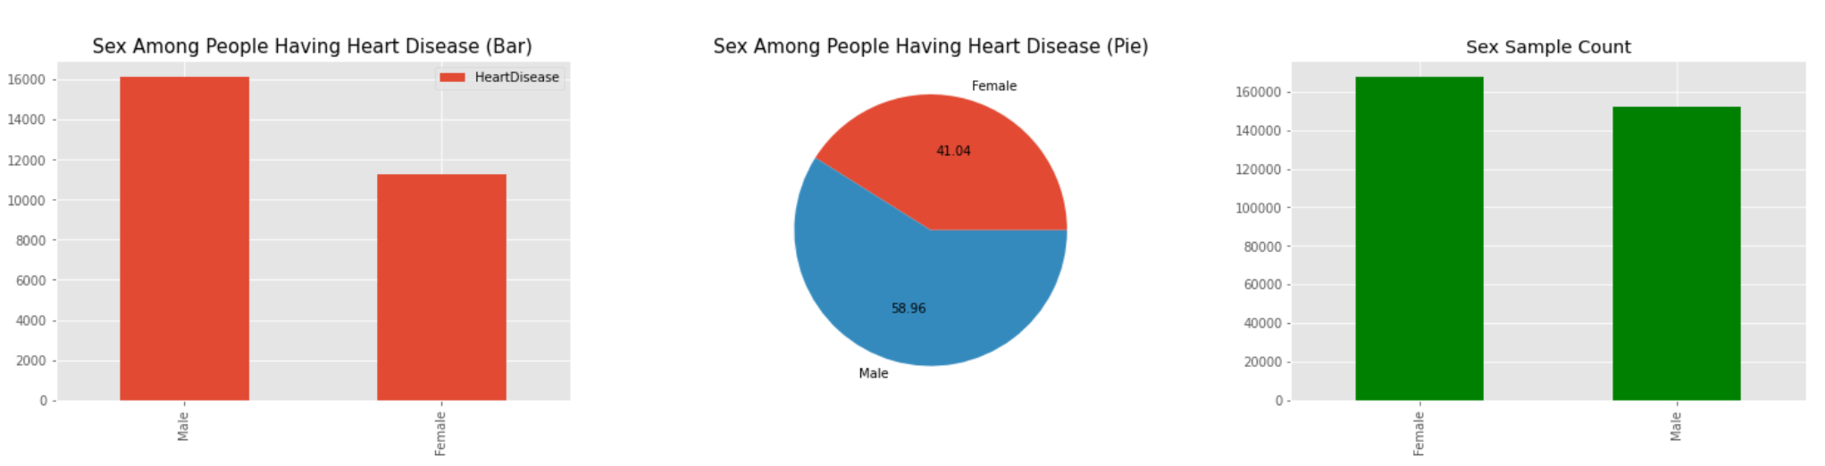
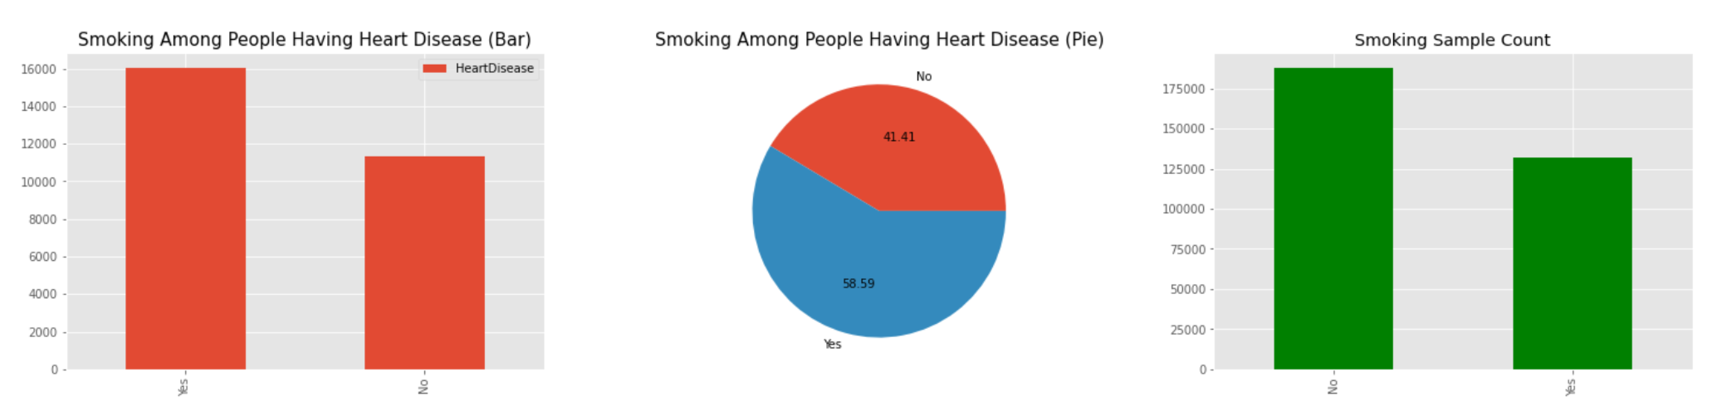
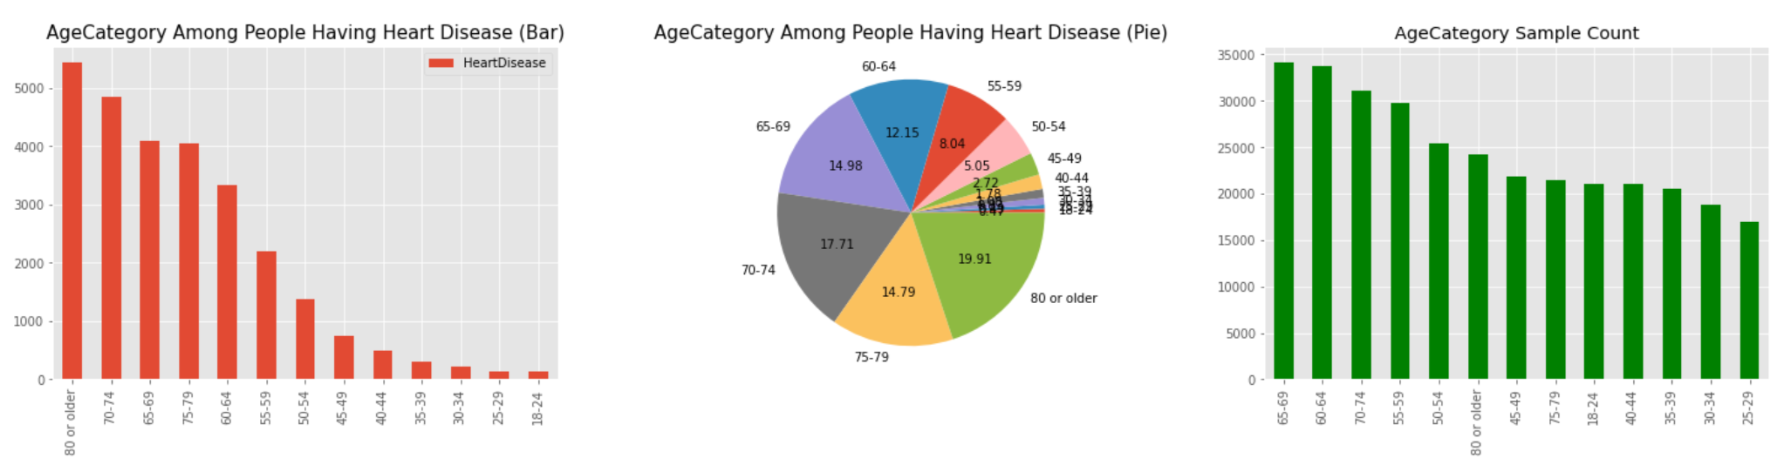
3.1 conclusion

Slide 20
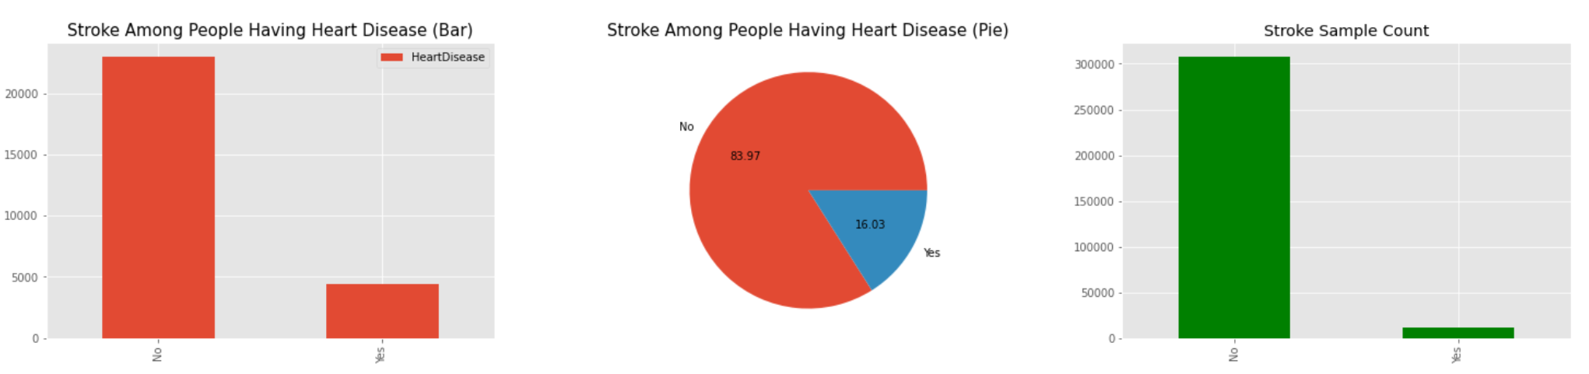
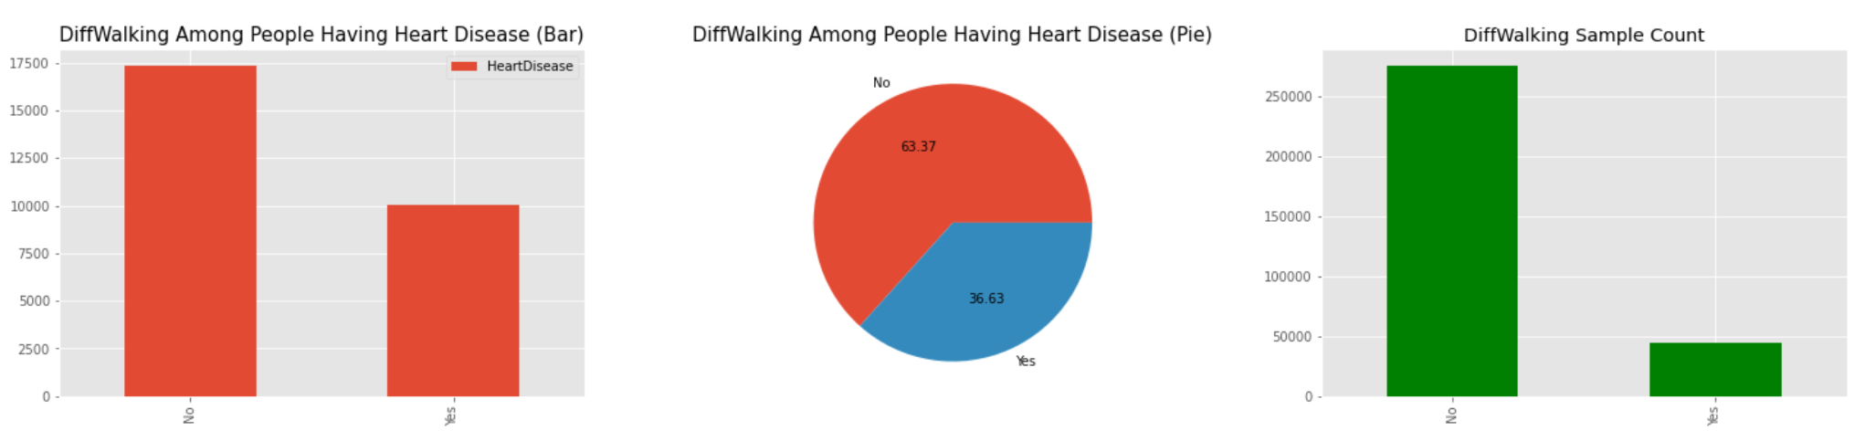
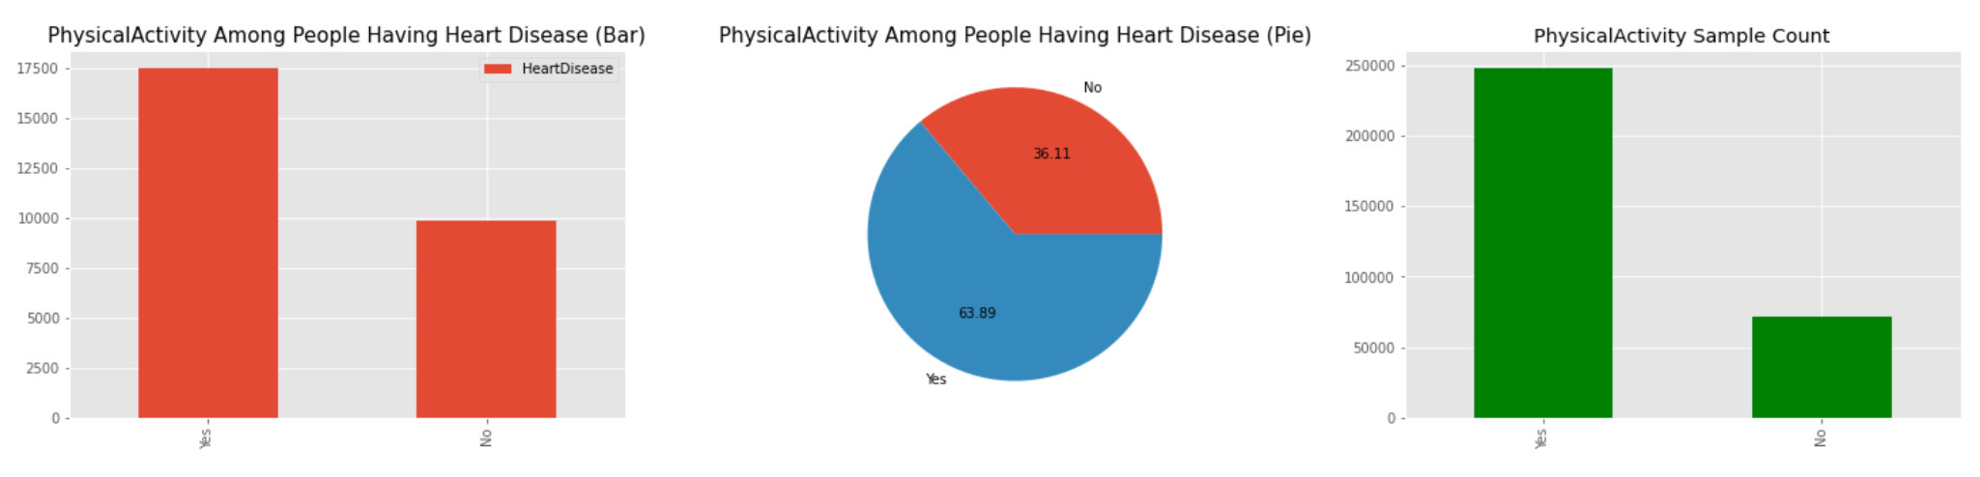
3.1 conclusion

Slide 21

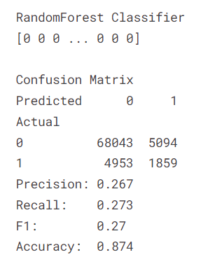
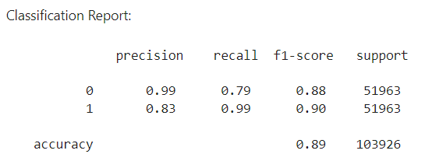
3.2 Evaluation
F1 score, also known as balanced F score, is defined as the harmonic average of accuracy rate and recall rate.

Slide 22
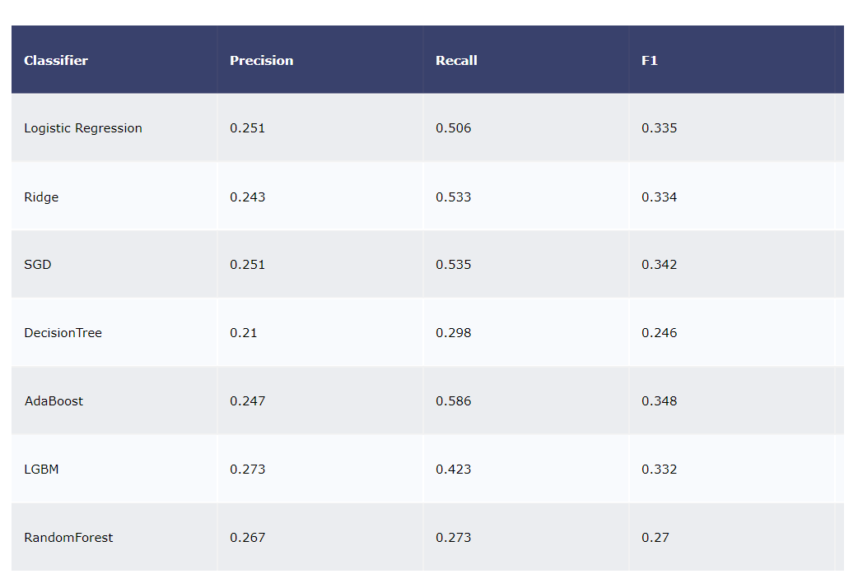
3.2 Evaluation

Slide 23
Thank you!

