Slide 1



Digital Memcomputing Machines:
Numerical Stability of Simulations
Yuan-Hang Zhang
Y.-H. Zhang and M. Di Ventra, arXiv:2102.03547

Slide 2
What is Memcomputing?
Computing in and with memory

Slide 3
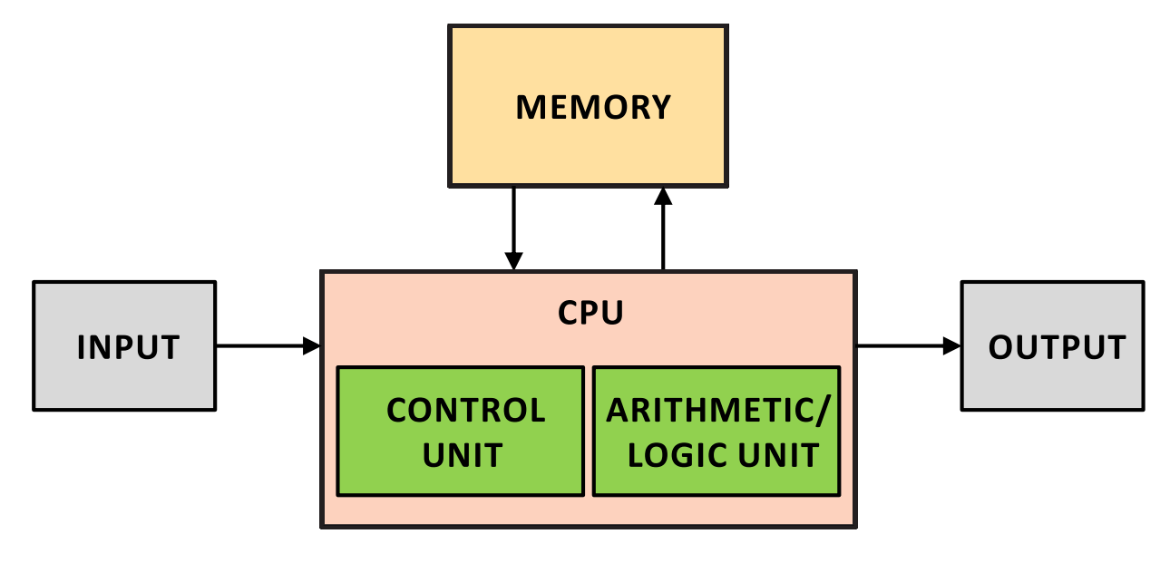
What is Memcomputing?
Von Neumann architecture
F. Traversa and M. Di Ventra, IEEE transactions on neural networks and learning systems 26.11 (2015)

Slide 4
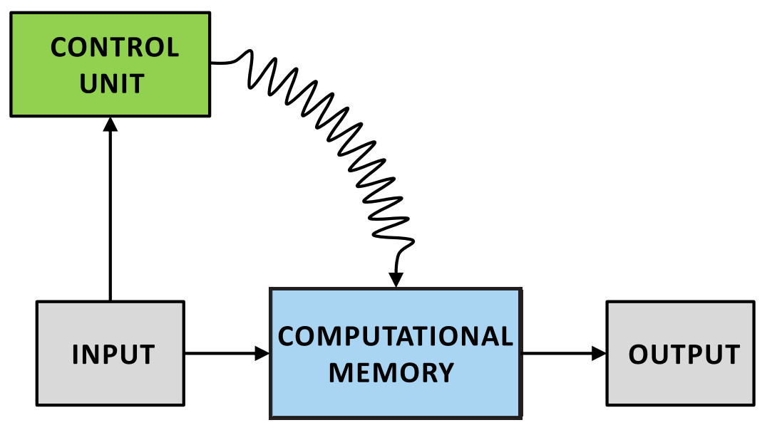
What is Memcomputing?
Memcomputing architecture
F. Traversa and M. Di Ventra, IEEE transactions on neural networks and learning systems 26.11 (2015)

Slide 5



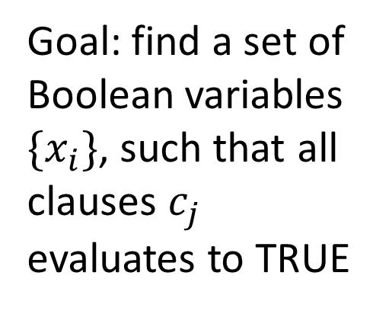


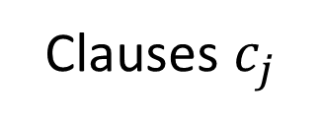

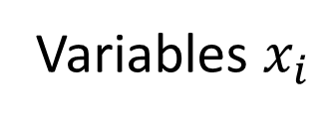


Solving Boolean satisfiability (SAT) problems
Variables $x_{i}$
$$x_{1} x_{2} x_{3}$$
Goal: find a set of Boolean variables $\{x_{i}\}$, such that all clauses $c_{j}$ evaluates to TRUE
$$x_{1}∨x_{2}∨x_{3}$$
$${¬x}_{1}∨{¬x}_{2}∨x_{3}$$
$$x_{1}∨{¬x}_{2}∨¬x_{3}$$
Clauses $c_{j}$
$$c_{1}$$
$$c_{2}$$
$$c_{3}$$
$$c_{1}=x_{1}∨x_{2}∨x_{3}$$
S. Bearden, Y. R. Pei, and M. Di Ventra, Scientific reports 10.1 (2020)

Slide 6



Solving Boolean satisfiability problems
Variables $x_{i}$
$$x_{1} x_{2} x_{3}$$
Self-organizing logic gate(SOLG):
receives input in either side, self-organize into logically consistent solutions
Clauses $c_{j}$
$$1$$
$$1$$
$$1$$
$$c_{1}=x_{1}∨x_{2}∨x_{3}$$
S. Bearden, Y. R. Pei, and M. Di Ventra, Scientific reports 10.1 (2020)

Slide 7
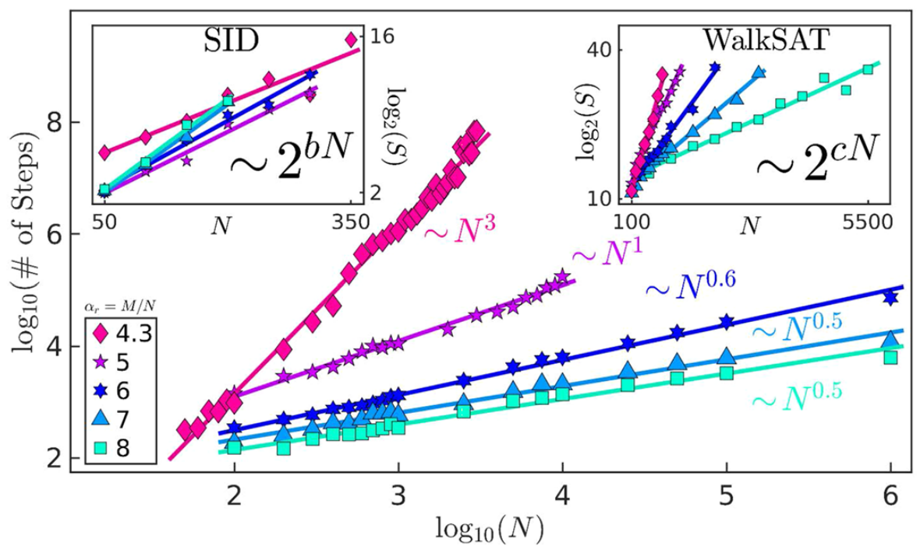
Solving Boolean satisfiability problems
S. Bearden, Y. R. Pei, and M. Di Ventra, Scientific reports 10.1 (2020)

Slide 8
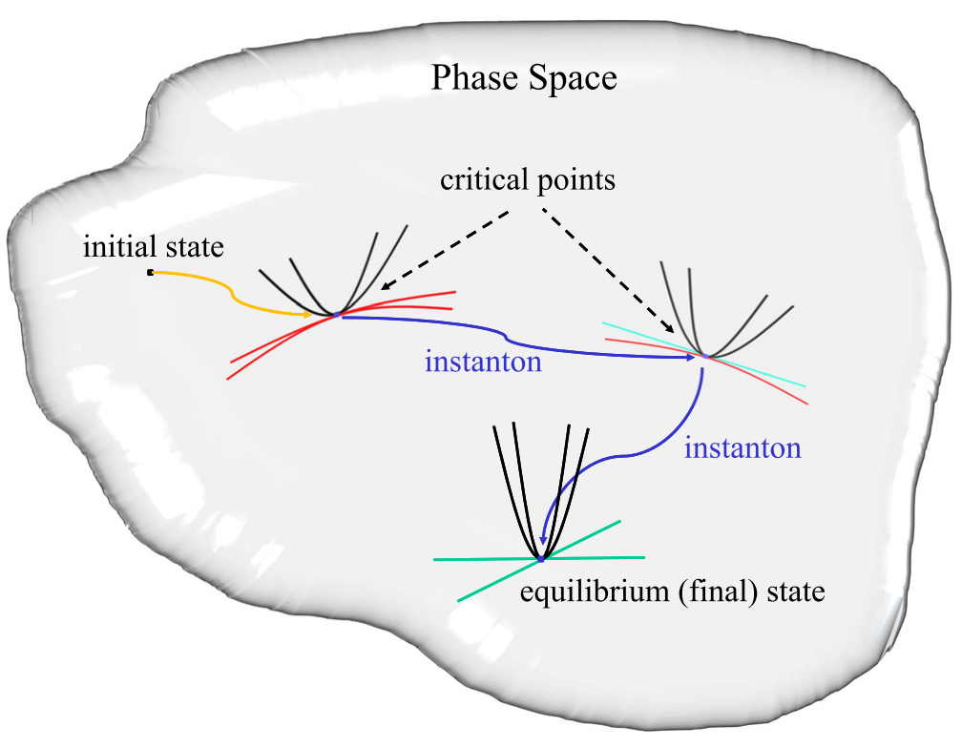
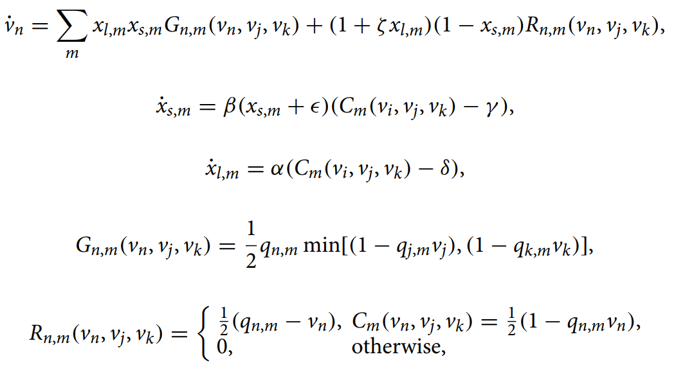
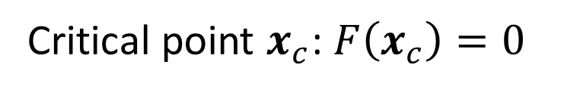
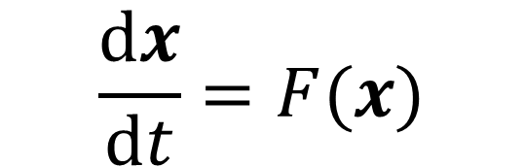
Computing with instantons
$$\frac{dx}{dt}=F(x)$$
Critical point $x_{c}$: $F\left(x_{c}\right)=0$
M. Di Ventra and F. Traversa, Journal of Applied Physics 123.18 (2018)

Slide 9

Simulating Memcomputing machines
$$\frac{dx}{dt}=F(x)$$
$$⇒x_{t+1}−x_{t}=F\left(x_{t}\right)Δt$$
Discretization introduces numerical errors

Slide 10
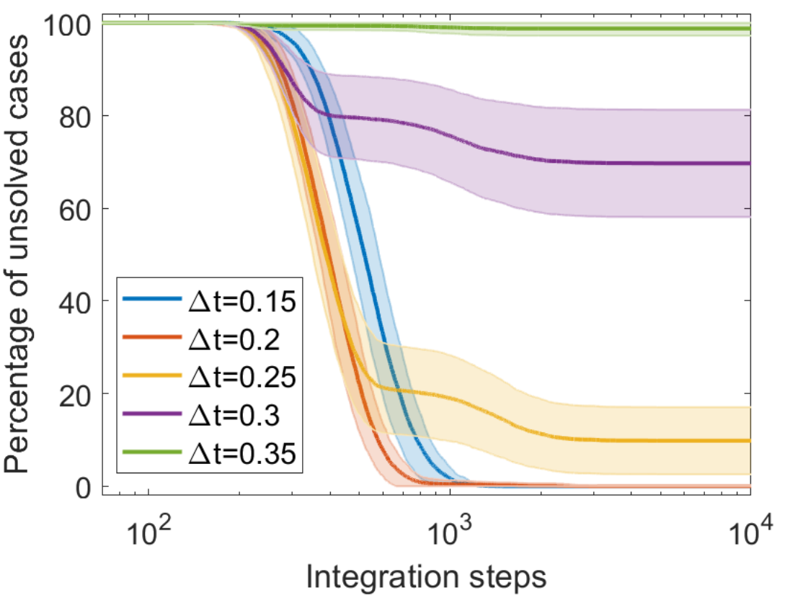
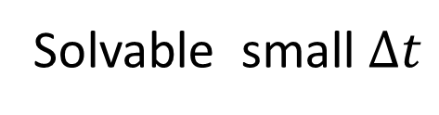
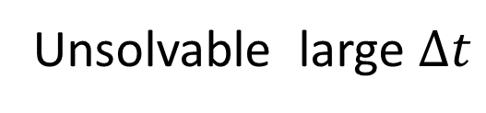
Simulating Memcomputing machines
Unsolvable large $Δt$
Solvable-unsolvable transition
Solvable small $Δt$
Y.-H. Zhang and M. Di Ventra, arXiv:2102.03547

Slide 11
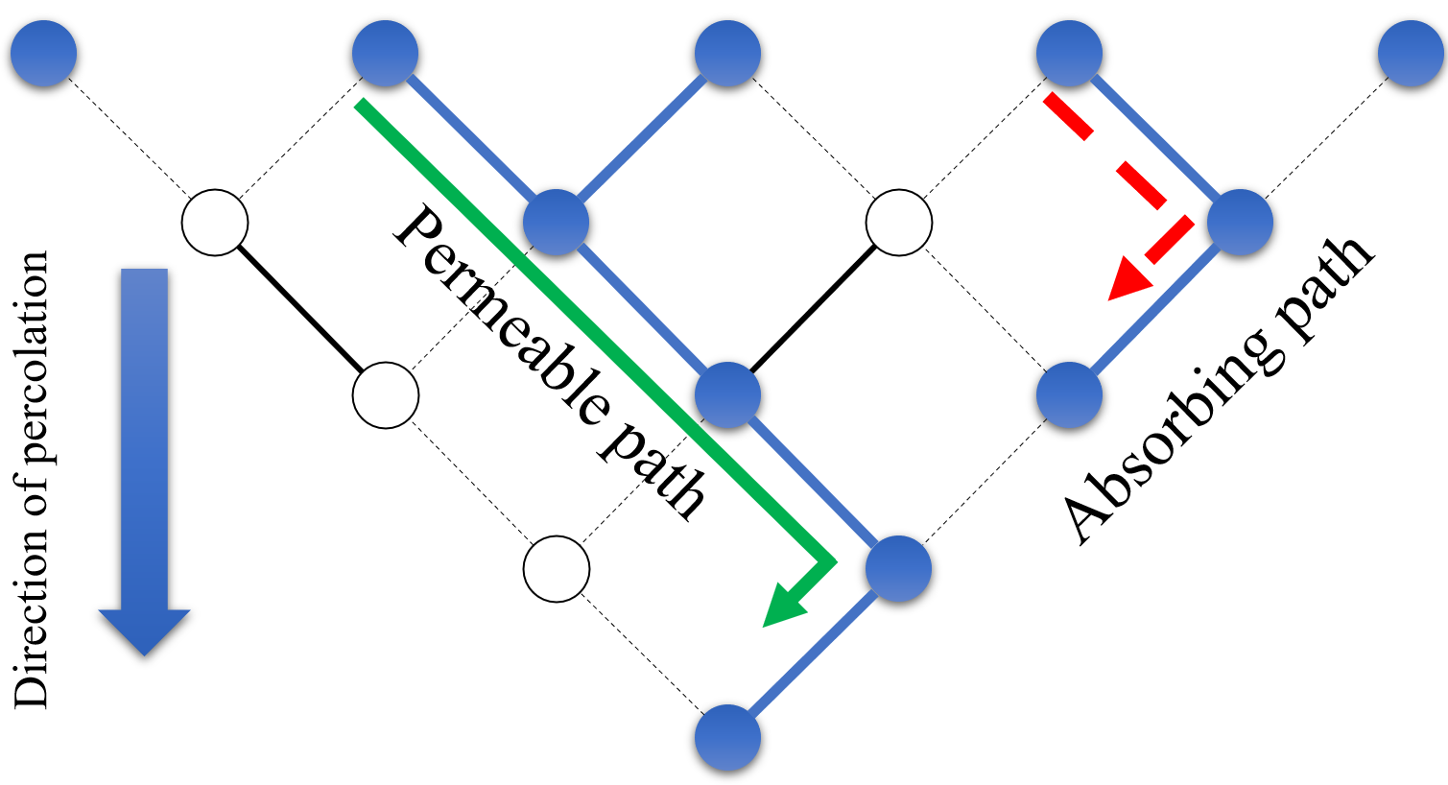
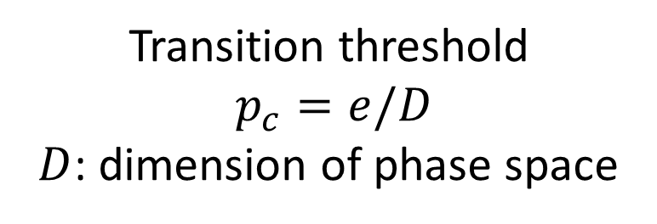
Directed percolation of state trajectory
Instanton “destroyed” by numerical noise
Unachievable critical point
Critical point
Transition threshold
$p_{c}=e/D$
$D$: dimension of phase space
Instanton
Y.-H. Zhang and M. Di Ventra, arXiv:2102.03547

Slide 12
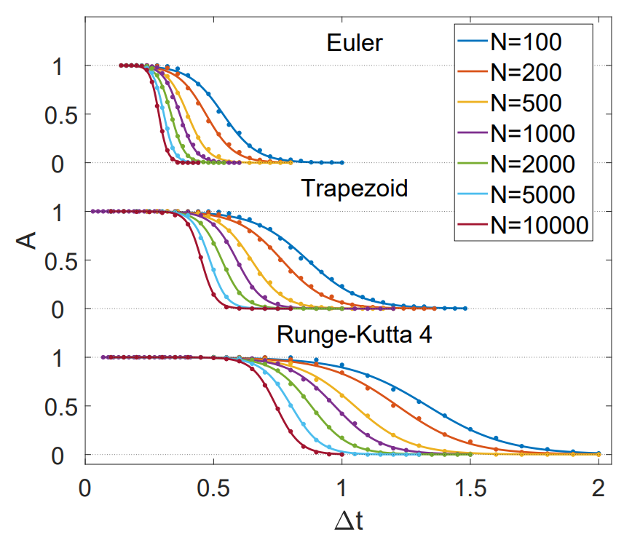
Simulating Memcomputing machines
Percentage of solved cases
Y.-H. Zhang and M. Di Ventra, arXiv:2102.03547

Slide 13
Thank you!
Yuan-Hang Zhang
UC San Diego
arXiv:2102.03547
(minor mistake in the current version, will fix soon)

