Slide 1




Towards a General-Purpose Model
for Quantum Many-Body Problems
Yuanhang Zhang
Y.-H. Zhang and M. Di Ventra
Phys. Rev. B 107, 075147 (2023)

Slide 2

Schrödinger equation
$iℏ\frac{d}{dt}\left|Ψ\left(t\right)\right\rangle =\hat{H}|Ψ\left(t\right)⟩$
Time-independent version: $\hat{H}\left|Ψ\right\rangle =E\left|Ψ\right\rangle$

Slide 3
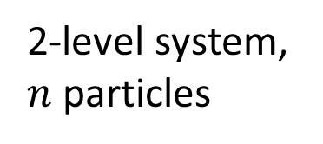




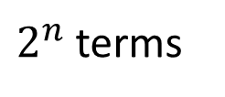
Many-body wave function
$\left|Ψ\right\rangle =c_{00⋯0}\left|00⋯0\right\rangle +c_{00⋯1}\left|00⋯1\right\rangle +⋯+c_{11⋯1}\left|11⋯1\right\rangle$
$2^{n}$ terms
$2^{n}$ columns
$$\hat{H}=\left(\begin{matrix}H_{11} & ⋯ & ⋯ & H_{1N} \\ ⋮ & ⋱ & ⋱ & ⋮ \\ ⋮ & ⋱ & ⋱ & ⋮ \\ H_{N1} & ⋯ & ⋯ & H_{NN}\end{matrix}\right)$$
2-level system, $n$ particles
$2^{n}$ rows

Slide 4
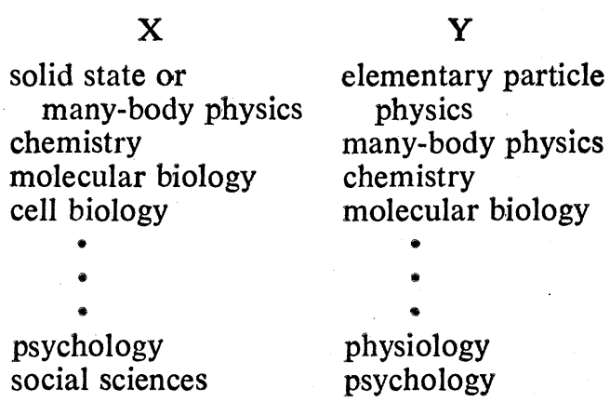
“More is different”
“The elementary entities of science X obeys the laws of science Y”
Anderson, Philip W. "More is different: broken symmetry and the nature of the hierarchical structure of science." Science 177.4047 (1972): 393-396.

Slide 5
Many-body wave function
Many-body Hilbert space
The corner that we can efficiently handle

Slide 6


Variational wave functions
$\left|Ψ(θ)\right\rangle =c_{00⋯0}(θ)\left|00⋯0\right\rangle +c_{00⋯1}(θ)\left|00⋯1\right\rangle +⋯+c_{11⋯1}(θ)\left|11⋯1\right\rangle$
$E_{ground}≈\min_{θ}⟨Ψ(θ)|\hat{H}\left|Ψ(θ)\right\rangle$
Hilbert space
$$\left|Ψ(θ)\right\rangle$$

Slide 7

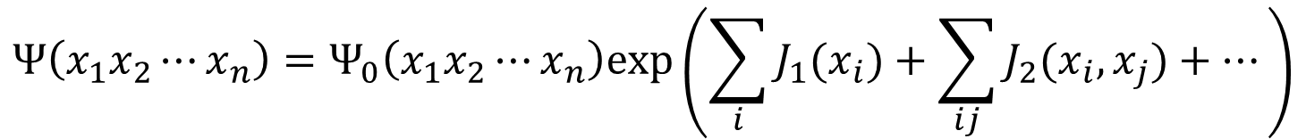
Early approaches
Jastrow factor
Bethe ansatz
$⋯⋯$
$$Ψ\left(x_{1}x_{2}⋯x_{n}\right)=Ψ_{0}\left(x_{1}x_{2}⋯x_{n}\right)exp\left(\sum_{i}{J_{1}(x_{i}})+\sum_{ij}{J_{2}(x_{i}, x_{j})}+⋯\right)$$

Slide 8






Matrix Product State
$Ψ\left(x_{1}x_{2}⋯x_{n}\right)=Tr(A_{1}^{x_{1}}A_{2}^{x_{2}}⋯A_{n}^{x_{n}})$
Bounded entanglement entropy
$$A_{1}$$
$$A_{2}$$
$$A_{3}$$
$$A_{4}$$
$$A_{5}$$

Slide 9
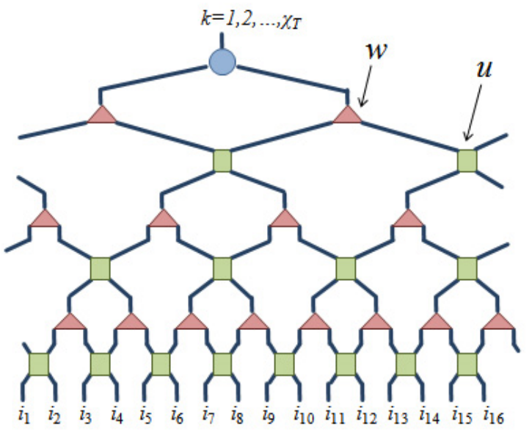
Tensor networks
PEPS
Entanglement area law
#P-hard to exactly evaluate
MERA
Entanglement area law
Polynomial, but expensive
Verstraete, Frank, Valentin Murg, and J. Ignacio Cirac. "Matrix product states, projected entangled pair states, and variational renormalization group methods for quantum spin systems." Advances in physics 57.2 (2008): 143-224
Evenbly, Glen, and Guifré Vidal. "Algorithms for entanglement renormalization." Physical Review B 79.14 (2009): 144108.

Slide 10







Neural network quantum state
$\left|Ψ(θ)\right\rangle =ψ\left(x_{1}x_{2}⋯x_{n};θ\right)|x_{1}x_{2}⋯x_{n}⟩$
$ψ\left(x_{1}x_{2}⋯x_{n};θ\right)$ parameterized with a neural network
Entanglement volume law
$$x_{1}$$
$$x_{2}$$
$$x_{3}$$
$$ψ$$
$$x_{4}$$
$$x_{5}$$
Deng, Dong-Ling, Xiaopeng Li, and S. Das Sarma. "Quantum entanglement in neural network states." Physical Review X 7.2 (2017): 021021.

Slide 11


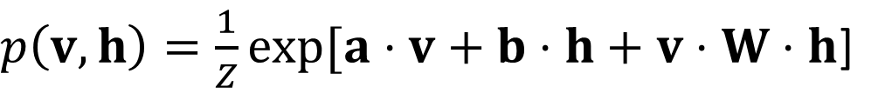








Neural network quantum state
Restricted Boltzmann machine
$p\left(v, h\right)=\frac{1}{Z}exp[a⋅v+b⋅h+v⋅W⋅h$]
$$p\left(v\right)=\frac{1}{Z}\sum_{h}{p(v, h)}$$
$$v_{1}$$
$$v_{2}$$
$$h_{1}$$
$$v_{3}$$
$$h_{2}$$
$$ψ\left(v\right)=\sqrt{p(v)}$$
$$v_{4}$$
$$h_{3}$$
$$v_{5}$$
Carleo, Giuseppe, and Matthias Troyer. "Solving the quantum many-body problem with artificial neural networks." Science 355.6325 (2017): 602-606.

Slide 12
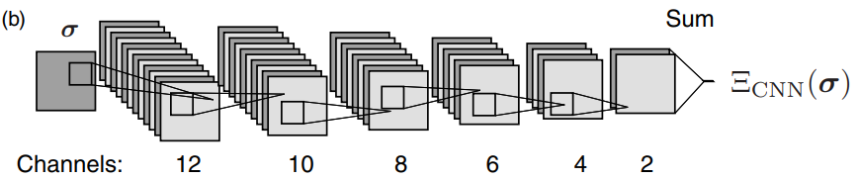
Neural network quantum state
Convolutional neural network
Choo, Kenny, Titus Neupert, and Giuseppe Carleo. "Two-dimensional frustrated J1− J2 model studied with neural network quantum states." Physical Review B 100.12 (2019): 125124.

Slide 13
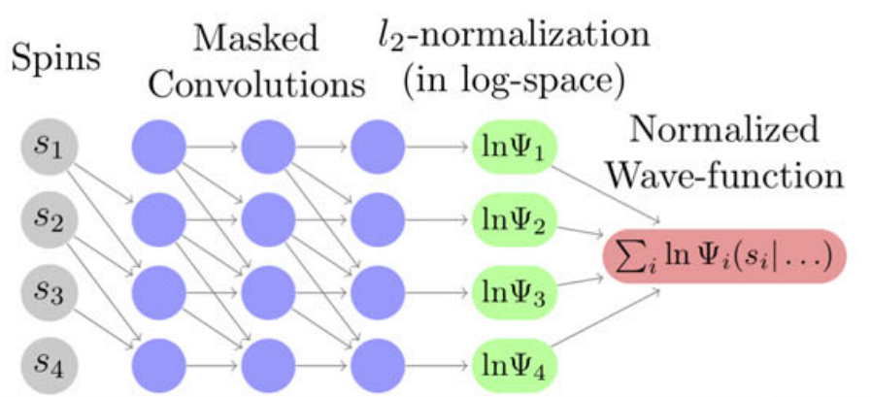
Neural network quantum state
Autoregressive neural network
Sharir, Or, et al. "Deep autoregressive models for the efficient variational simulation of many-body quantum systems." Physical review letters 124.2 (2020): 020503.

Slide 14
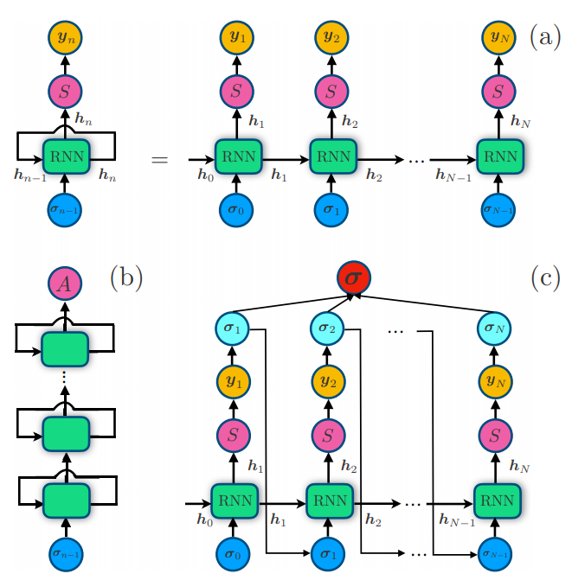
Neural network quantum state
Recurrent neural network
Hibat-Allah, Mohamed, et al. "Recurrent neural network wave functions." Physical Review Research 2.2 (2020): 023358.

Slide 15
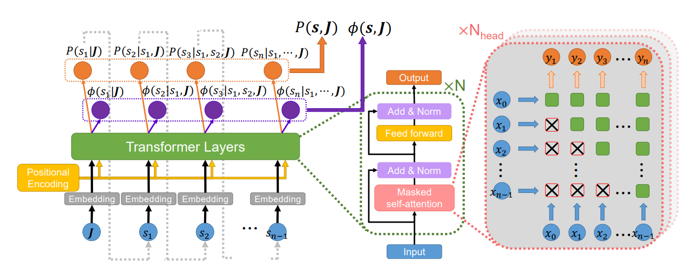
Neural network quantum state
Transformer
Zhang, Yuan-Hang, and Massimiliano Di Ventra. "Transformer Quantum State: A Multi-Purpose Model for Quantum Many-Body Problems." arXiv preprint arXiv:2208.01758 (2022).

Slide 16
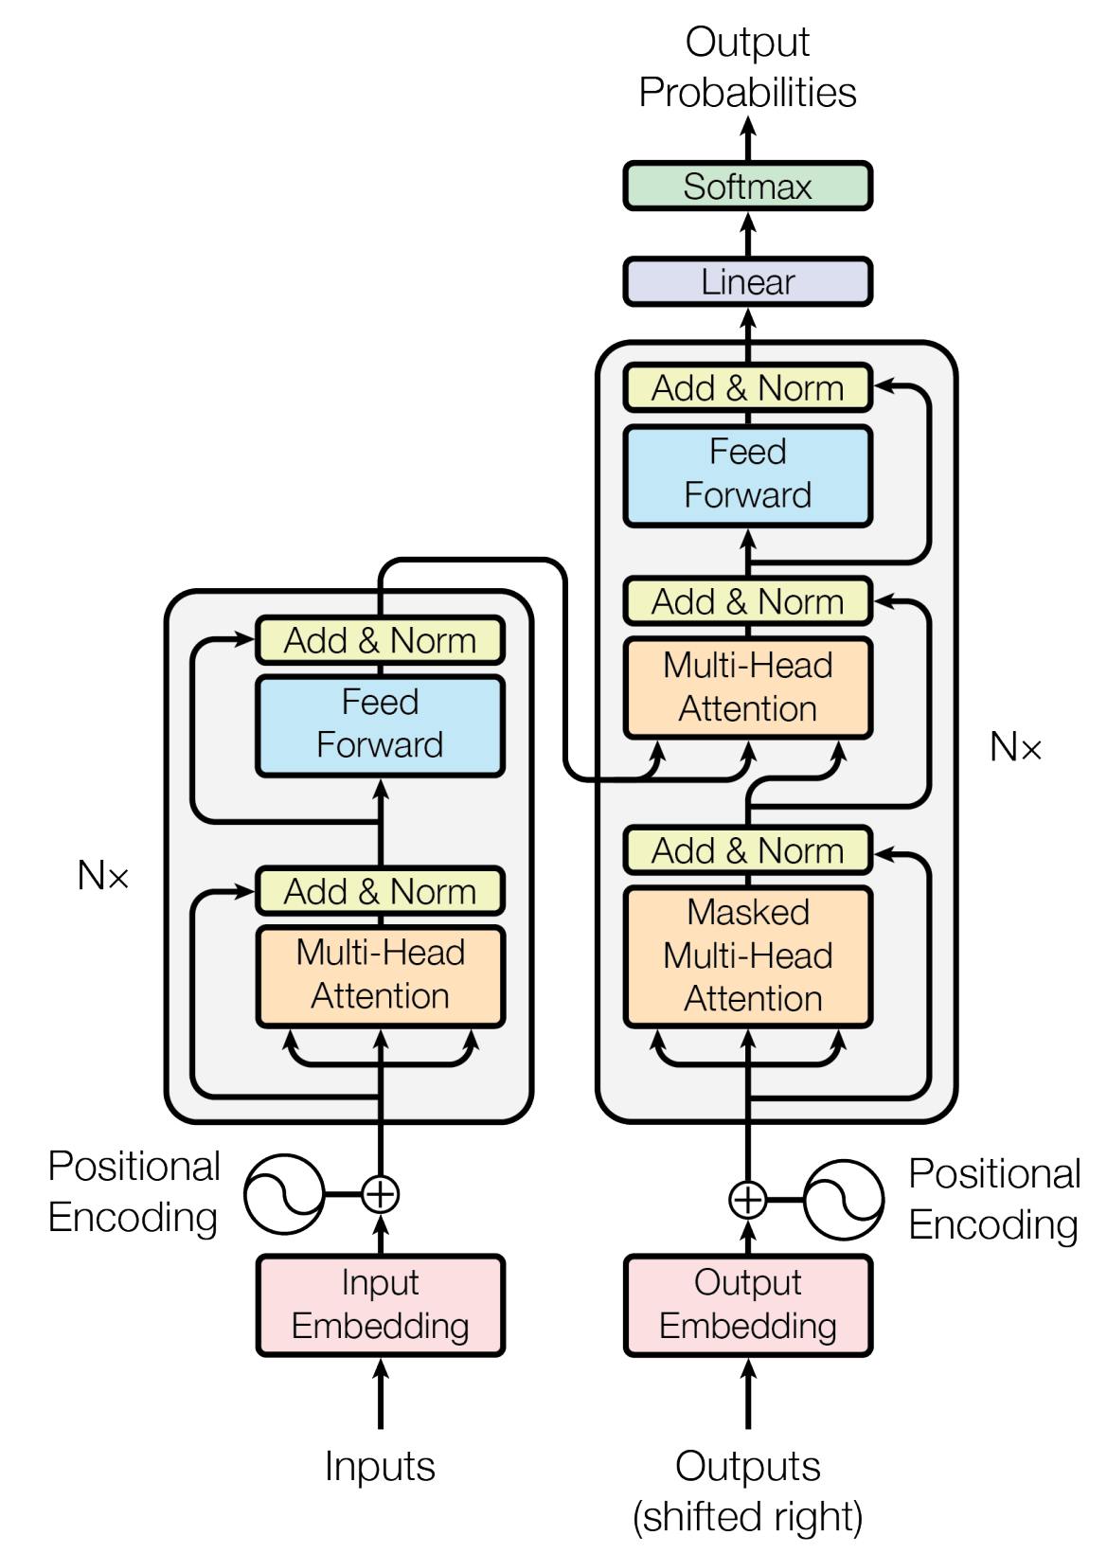
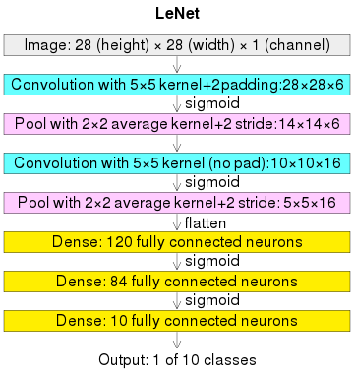
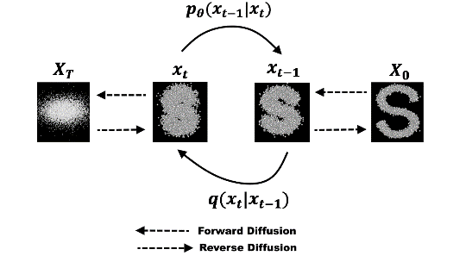
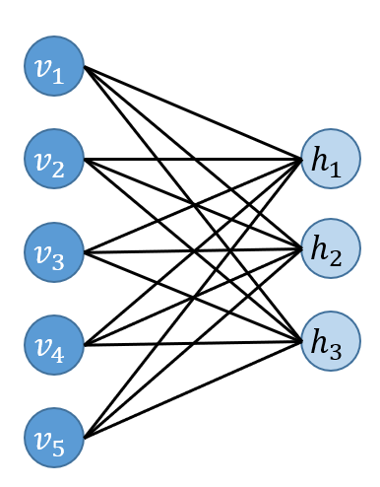
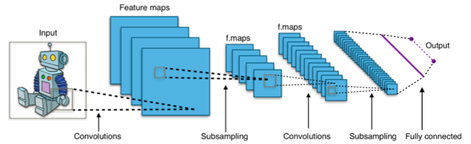
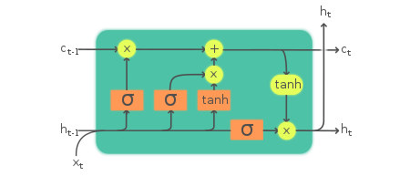
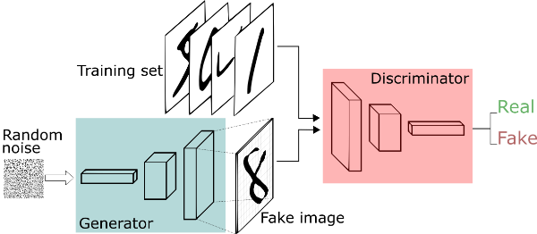
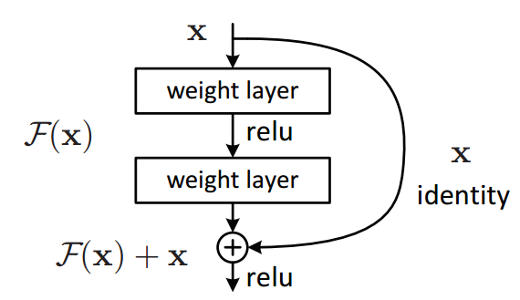
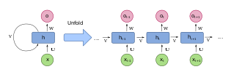
Roadmap
Diffusion model
CNN
RBM
LeNet-5
Transformer
1980
1982
1986
1995
1998
2014
2015
2017
RNN
LSTM
GAN
ResNet

Slide 17
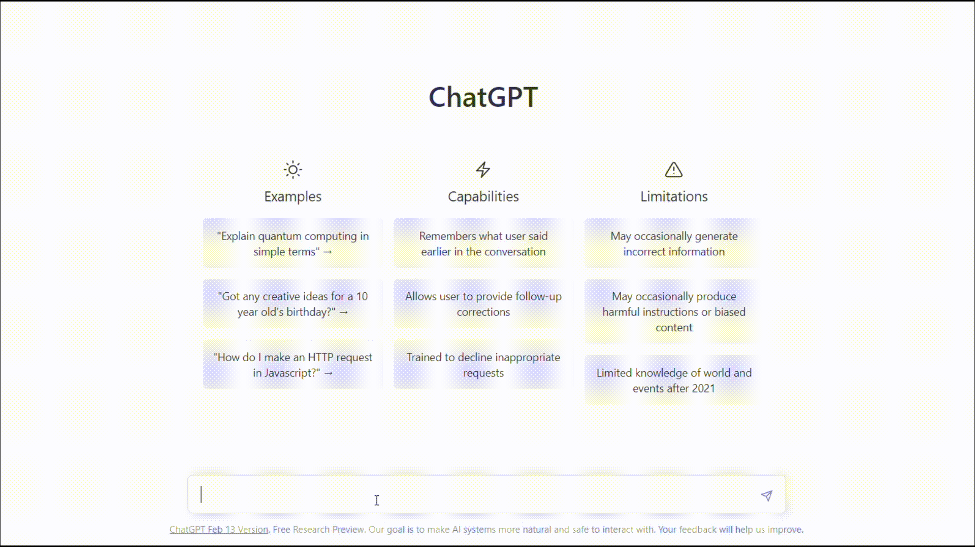

Slide 18






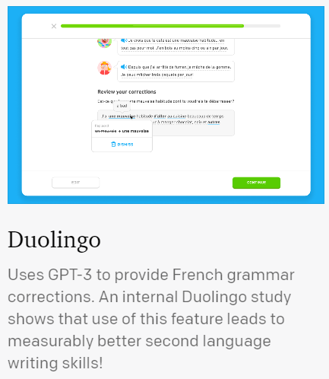


General purpose language model
$$⋯$$
Fine- tuning
Books
ChatGPT
45 TB text data
Code Generation
Pre-training
Study Partner
175 Billion Parameters
$$⋯⋯$$
Brown, Tom, et al. "Language models are few-shot learners." Advances in neural information processing systems 33 (2020): 1877-1901.

Slide 19


General purpose physics model?
Various Hamiltonians
Fine- tuning
New materials
Ground States
Pre-training
Excited States
Quantum Simulation
Open Systems
Quantum Dynamics
Quantum Tomography
Quantum Circuits
$$⋯⋯$$
$$⋯⋯$$

Slide 20
Transformer quantum state
Phase Diagram
Family of Hamiltonians
Pre-training
Finite-size Scaling
Parameter Prediction
$$⋯⋯$$

Slide 21

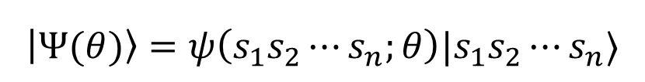
Transformer quantum state
Family of quantum states $|ψ\left(J\right)⟩$
Variable input length $n$
$$\left|Ψ(θ)\right\rangle =ψ\left(s_{1}s_{2}⋯s_{n};θ\right)|s_{1}s_{2}⋯s_{n}⟩$$

Slide 22
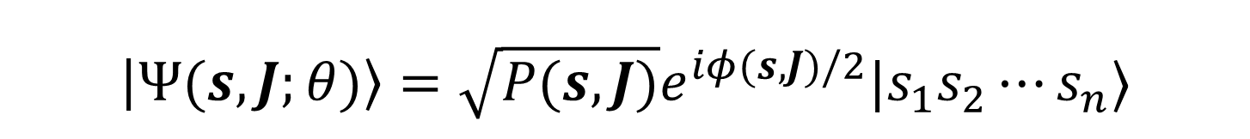
Transformer quantum state
$$\left|Ψ(s,J;θ)\right\rangle =\sqrt{P(s,J)}e^{iφ(s,J)/2}|s_{1}s_{2}⋯s_{n}⟩$$

Slide 23

Transformer quantum state
With $P\left(s, J\right)$, we can predict $J$ from measurements $s$!
Maximize log-likelihood $ℒ\left(J\right)=\sum_{k}{\log{P(s_{k}|J)}}$

Slide 24
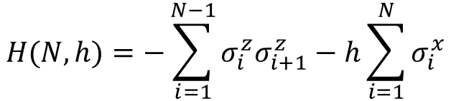
Transformer quantum state
Example: transverse field Ising model
$$H(N, h)=−\sum_{i=1}^{N−1}{σ_{i}^{z}σ_{i+1}^{z}}−h\sum_{i=1}^{N}{σ_{i}^{x}}$$

Slide 25
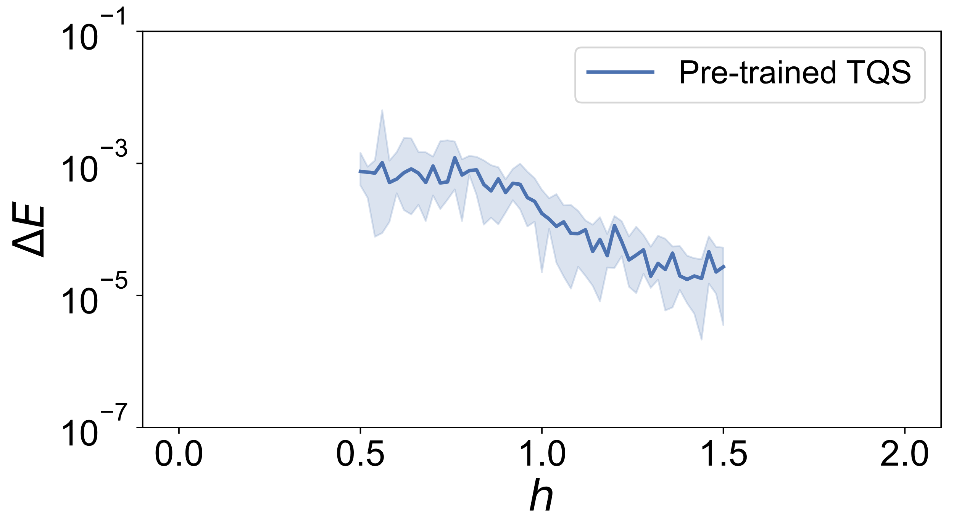
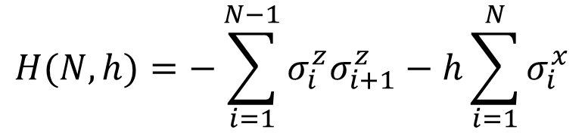
Transformer quantum state
$$H(N, h)=−\sum_{i=1}^{N−1}{σ_{i}^{z}σ_{i+1}^{z}}−h\sum_{i=1}^{N}{σ_{i}^{x}}$$

Slide 26
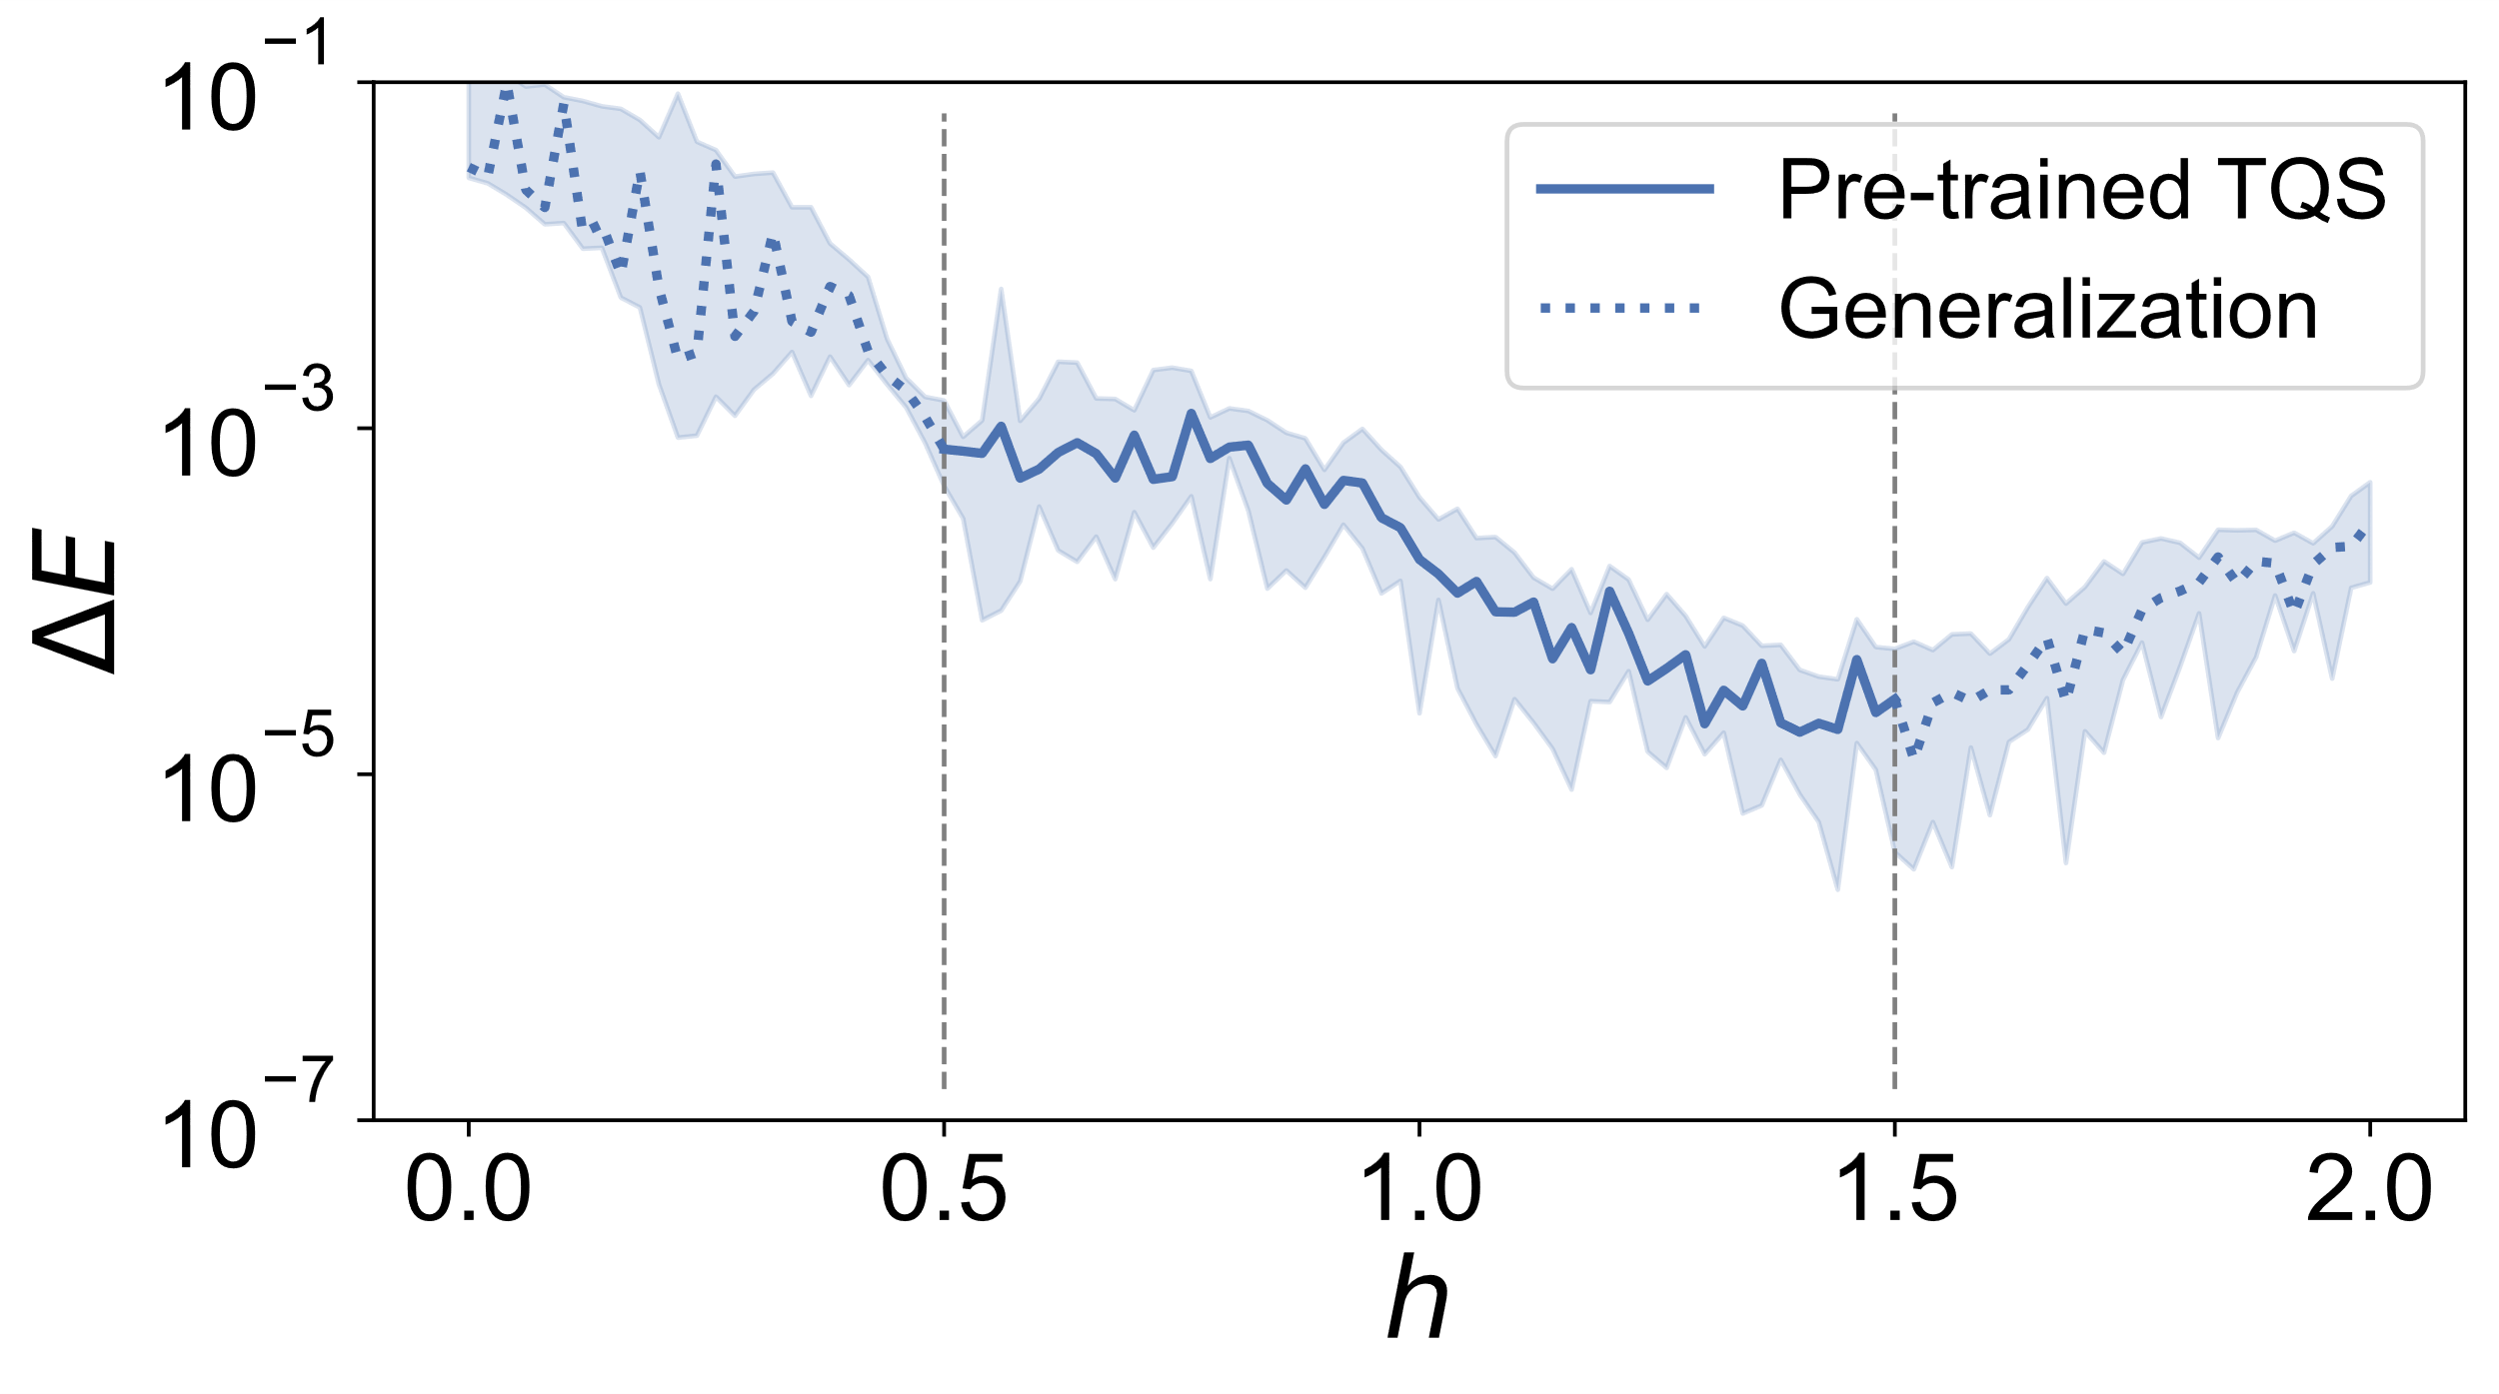
Transformer quantum state
$$H(N, h)=−\sum_{i=1}^{N−1}{σ_{i}^{z}σ_{i+1}^{z}}−h\sum_{i=1}^{N}{σ_{i}^{x}}$$

Slide 27
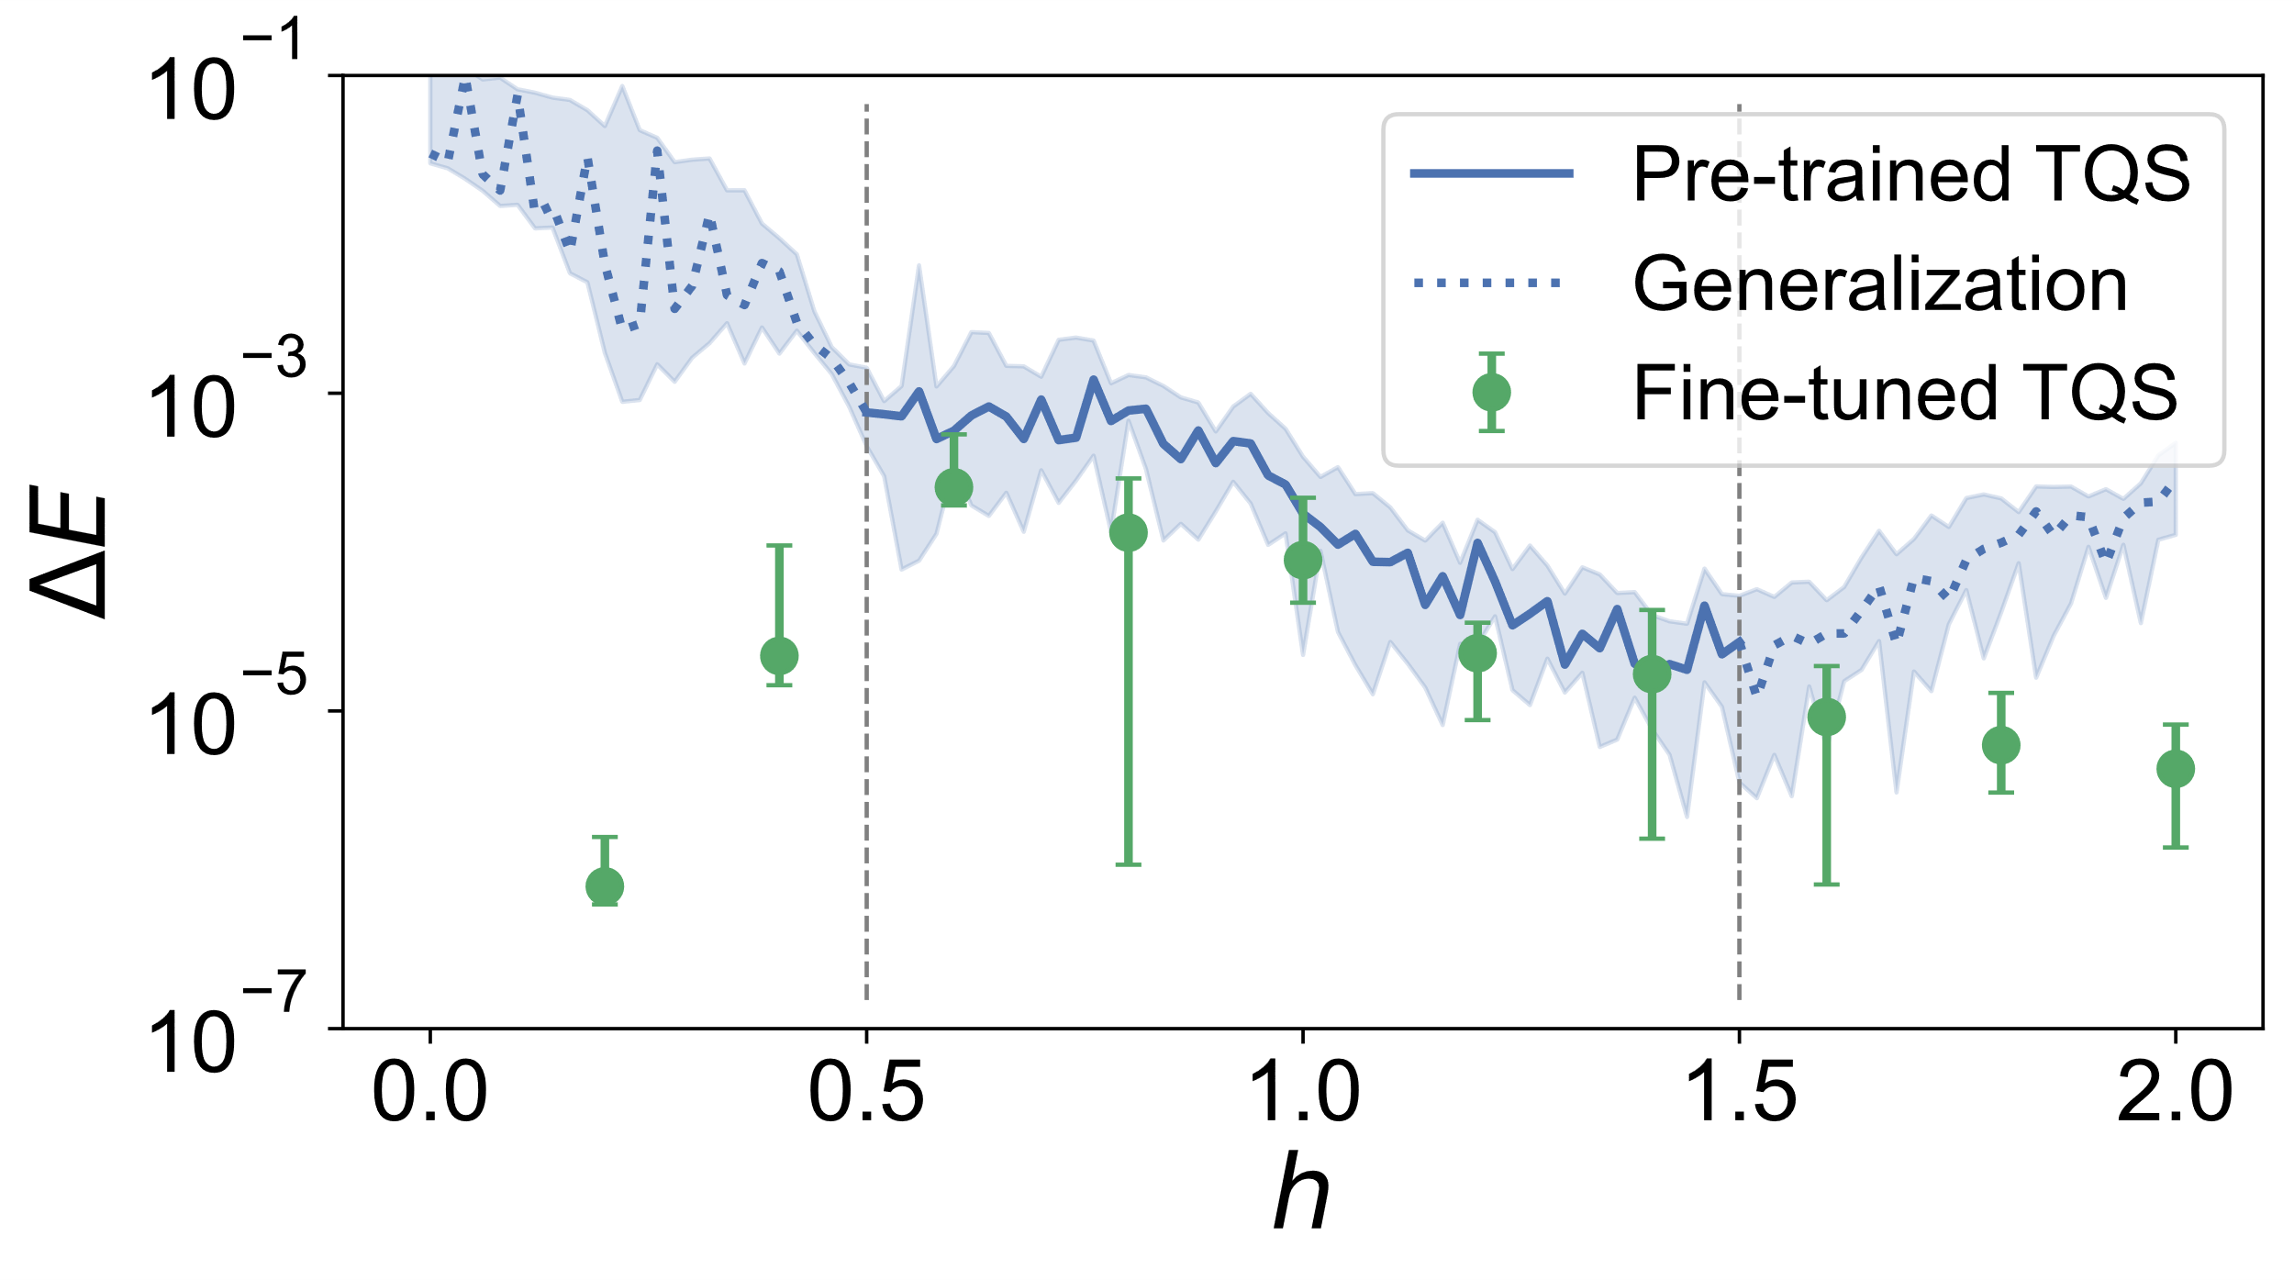
Transformer quantum state
$$H(N, h)=−\sum_{i=1}^{N−1}{σ_{i}^{z}σ_{i+1}^{z}}−h\sum_{i=1}^{N}{σ_{i}^{x}}$$

Slide 28
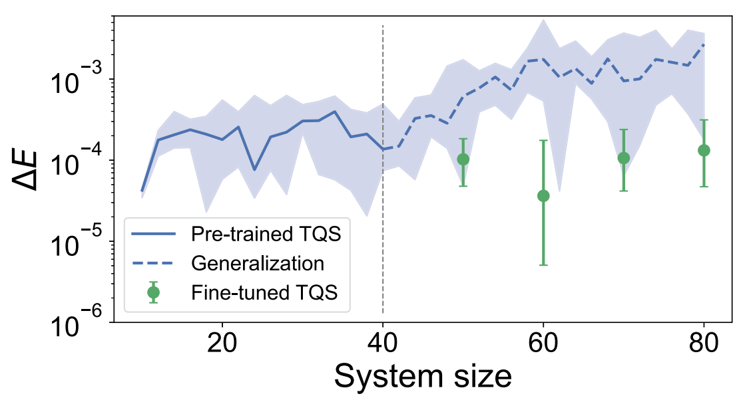
Transformer quantum state
$$H(N, h)=−\sum_{i=1}^{N−1}{σ_{i}^{z}σ_{i+1}^{z}}−h\sum_{i=1}^{N}{σ_{i}^{x}}$$

Slide 29
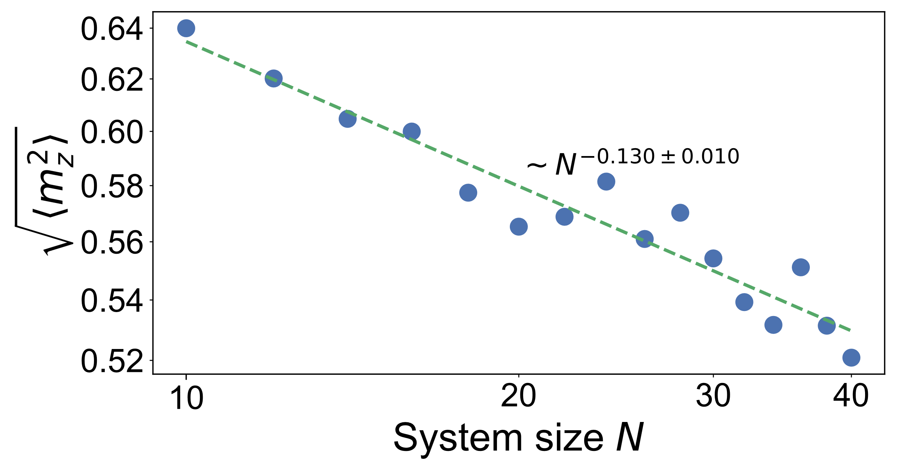
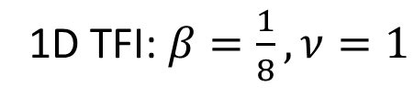
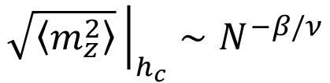
Finite-size scaling
$$\sqrt{\left\langle m_{z}^{2}\right\rangle }{\left.​\right|}_{h_{c}}∼N^{−β/ν}$$
1D TFI: $β=\frac{1}{8},ν=1$

Slide 30
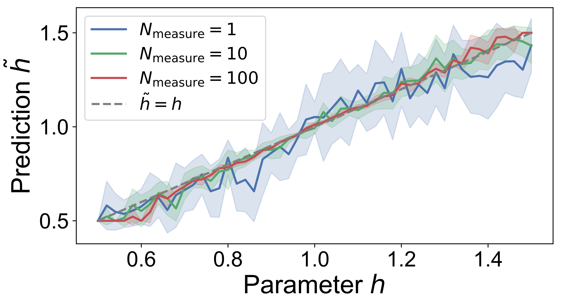
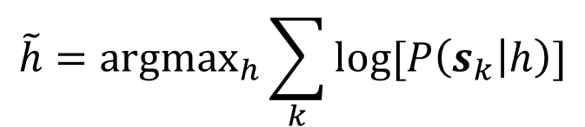

Predicting field strength
Estimate $h$ from projective measurements $s$
$$\tilde{h}={argmax}_{h}\sum_{k}{log[P\left(s_{k} | h\right)]}$$

Slide 31
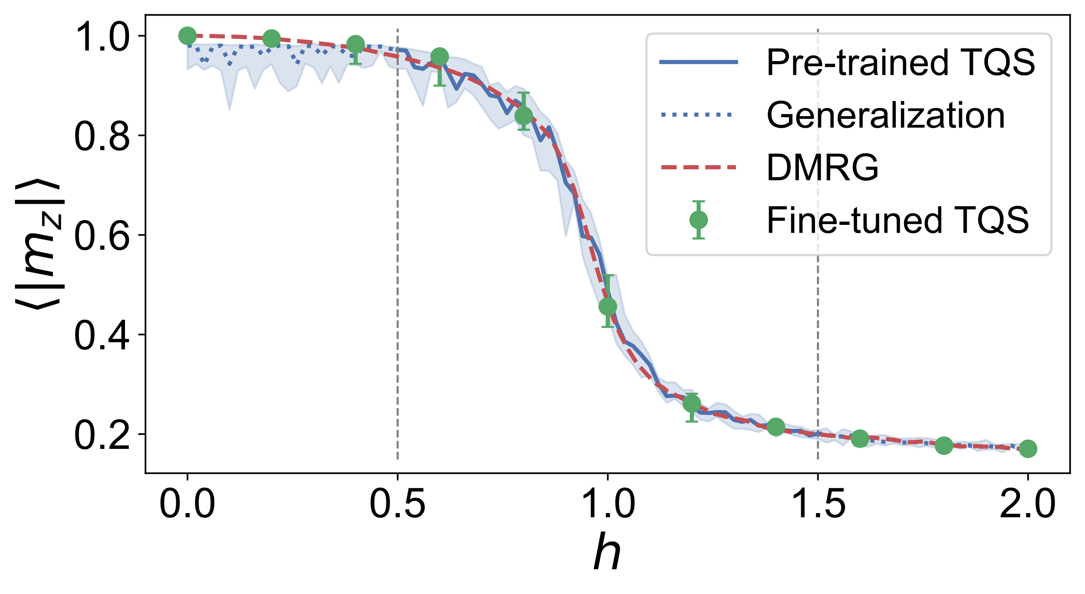
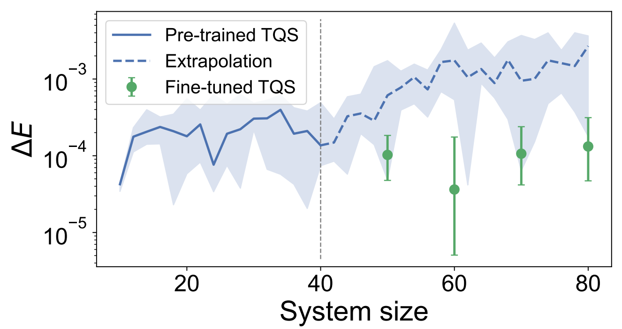
Conclusion
Family of quantum states
  Phase diagram
  Finite-size scaling
  Parameter prediction
  Knowledge transfer
All within one model!

Slide 32
Future works
Towards a general-purpose model
  More Hamiltonians
  General operator encodings
  Foundation model for physics
  Integration into multimodal language models
  Towards AGI for science

Slide 33
Thank you!
Y.-H. Zhang and M. Di Ventra
Phys. Rev. B 107, 075147 (2023)

