Slide 1
跟我一起学Flutter
欧阳锋工作室

Slide 2
第十课、列表数据的处理

Slide 3
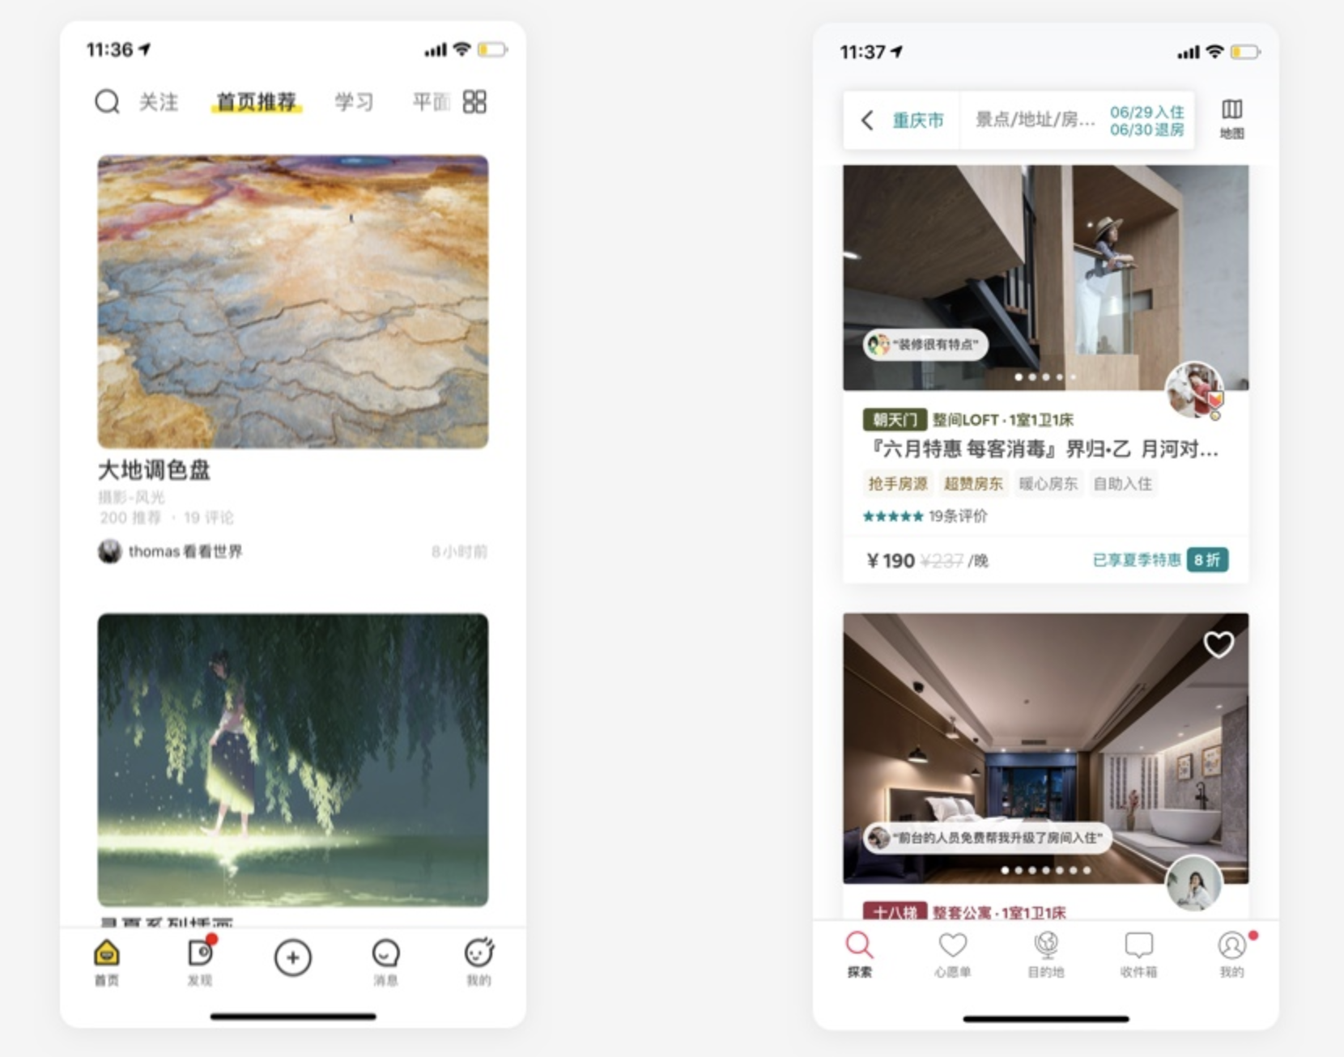

Slide 4
如何展示列表数据
https://10wallpaper.com/wallpaper/1920x1080/1512/Ferocious_lion-Animal_Photo_HD_Wallpaper_1920x1080.jpg
https://img1.baidu.com/it/u=903829763,2925435307&fm=253&fmt=auto&app=138&f=JPEG?w=889&h=500
https://img0.baidu.com/it/u=1751808597,1886318187&fm=253&fmt=auto&app=138&f=JPEG?w=750&h=500
https://img0.baidu.com/it/u=3476293439,478517026&fm=253&fmt=auto&app=138&f=JPEG?w=500&h=889
https://gimg2.baidu.com/image_search/src=http%3A%2F%2Fss2.meipian.me%2Fusers%2F598964%2F4e90446aa2f648cb931e0db1d210c3b0.jpg%3Fmeipian-raw%2Fbucket%2Fivwen%2Fkey%2FdXNlcnMvNTk4OTY0LzRlOTA0NDZhYTJmNjQ4Y2I5MzFlMGRiMWQyMTBjM2IwLmpwZw%3D%3D%2Fsign%2F91f37d176c8e2802169648c80539c5d3.jpg&refer=http%3A%2F%2Fss2.meipian.me&app=2002&size=f9999,10000&q=a80&n=0&g=0n&fmt=auto?sec=1712323627&t=93b1788036d3d43f91c525ceca10ff80

Slide 5
附录
课件And源码：https://github.com/yuanhoujun/flutter-basic-tutorial.git
QQ交流群：329673958
微信公众号1：欧阳锋工作室
微信公众号2：1XCode

