Slide 1
Stanford Federal Credit Union
Cindy Huang

Slide 2
Summary
How to track e-mail marketing

Slide 3
PCBA Spend Tracking Dashboard

Slide 4
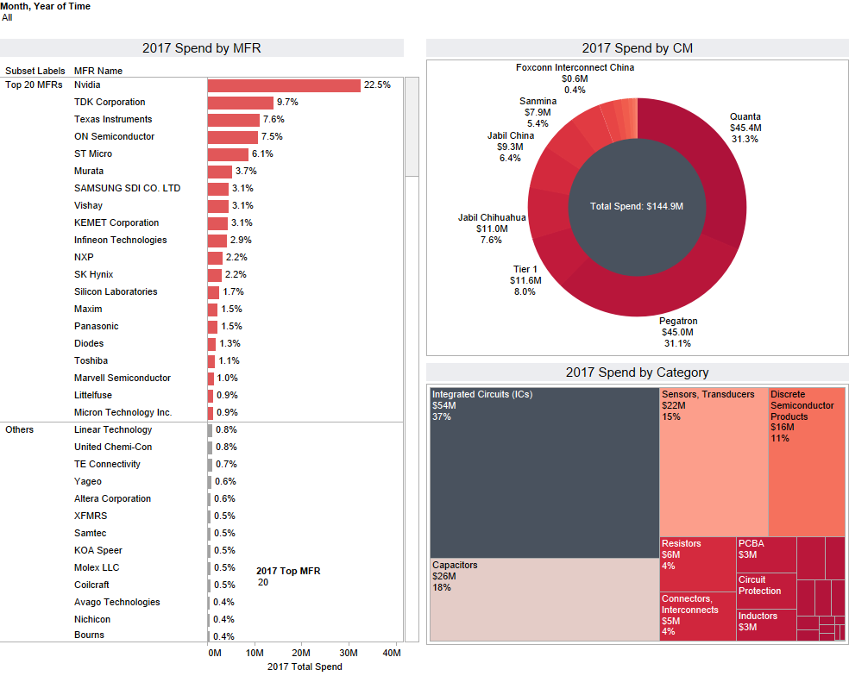
Tesla PCBA Spend Tracking Dashboard(1/2)

Slide 5
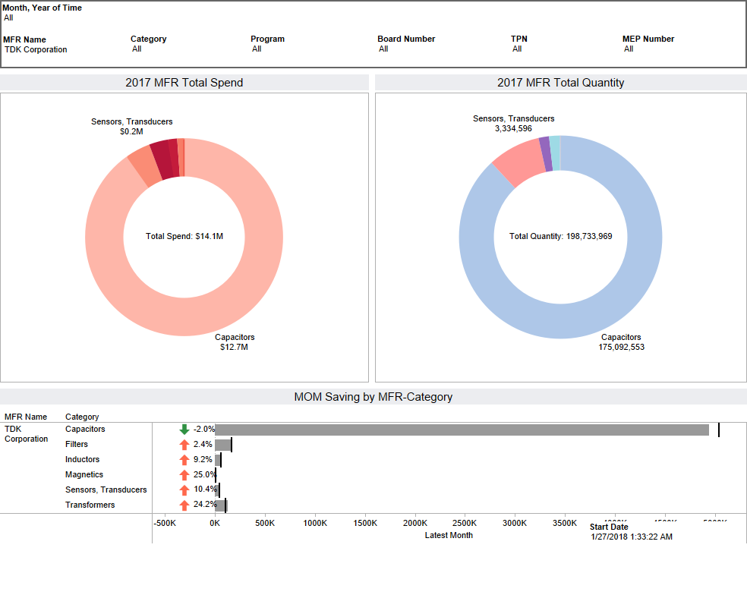
Tesla PCBA Spend Tracking Dashboard(2/2)

Slide 6
Lending Club Risk Adjusted Interest Rate Prediction
Data Size: 890K records / 75 variables

Slide 7
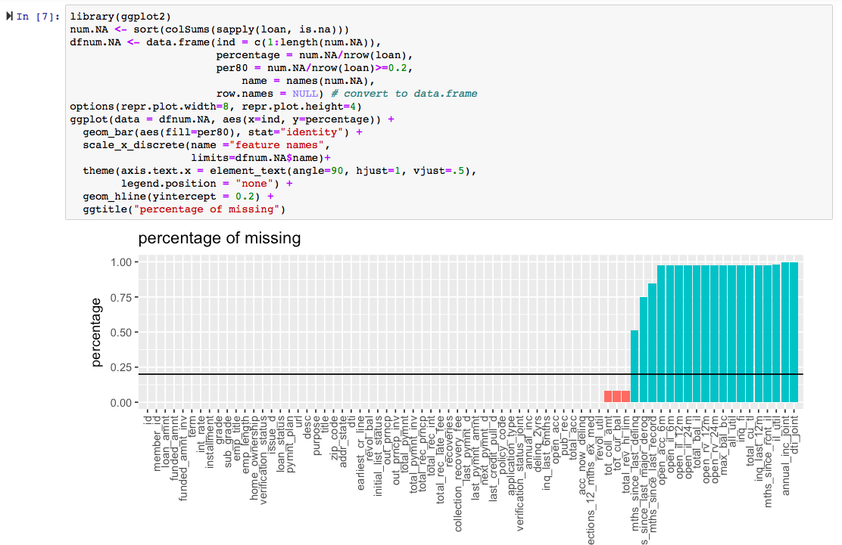
Data Cleaning

Slide 8
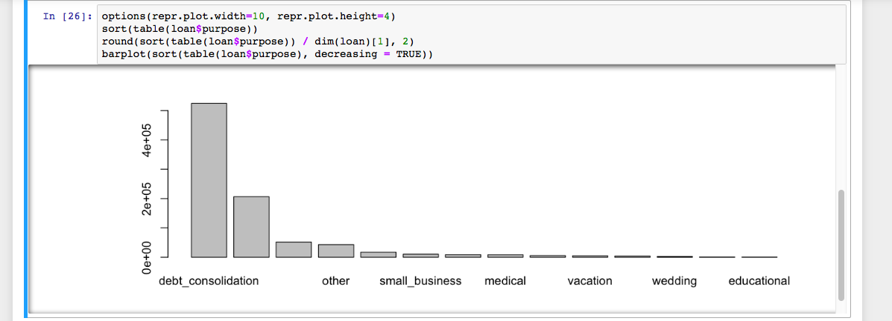
EDA: Purpose to Use Lending Club Service

Slide 9
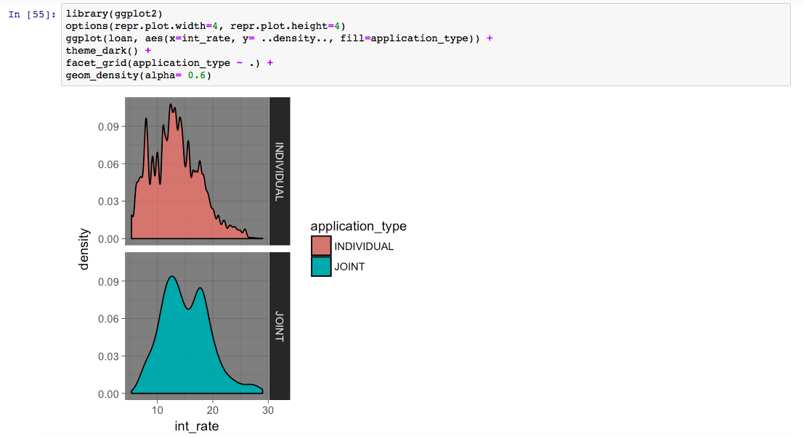
EDA: Individual vs Joint Account

Slide 10
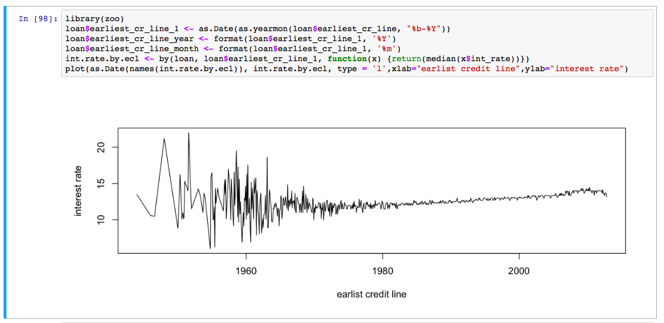
Feature Engineering(1/3)
Notes:
The number of account with earliest credit line before year 1976 are too small, which may result in large error in the model fitting.
Thus, trim the data before 1976 and do the chi-square test

Slide 11
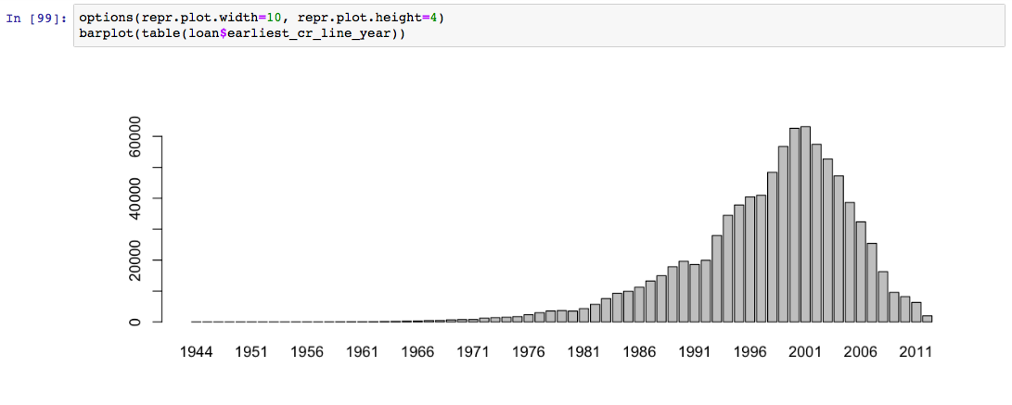
Feature Engineering(2/3)

Slide 12
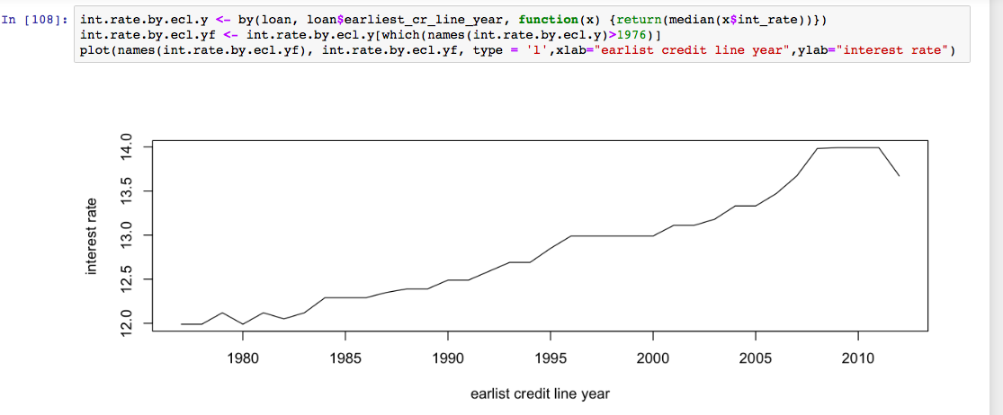
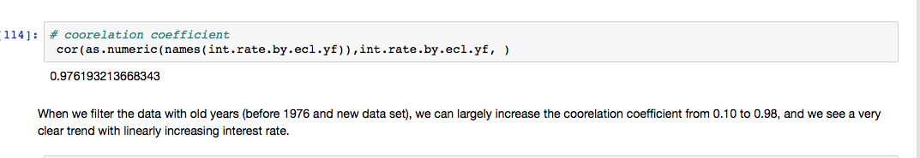
Feature Engineering(3/3)
Notes:
When filter out the data with old years, we can largely increase correlation coeffiecient from 0.1 to 0.96
And we can see a very clear trend with linearly increasing interest rate.

Slide 13
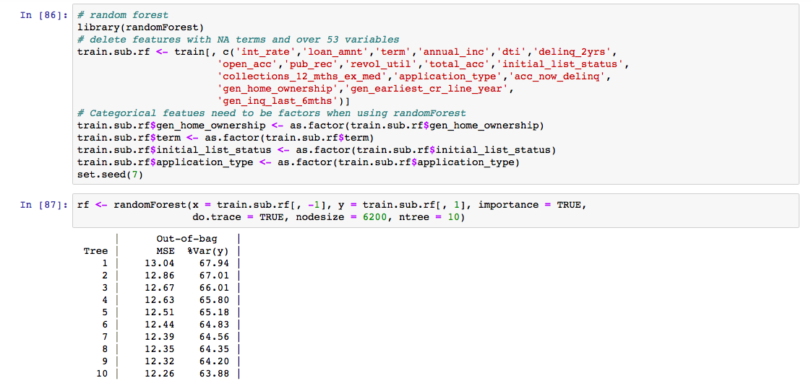
Machine Learning Models (Random Forest)

Slide 14
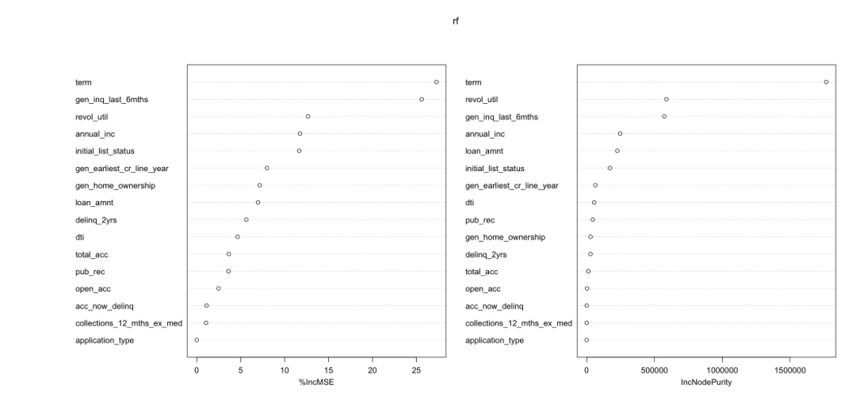
Important Variance

Slide 15
In-Gaming Recommender Engine https://github.com/yuanhsin8311/Recommender-Engine
Input Data: 5000 Steam User ID
API Source: Valve Developer Community / SteamSpy.com
Output: 15,295 records in JSON format and 1602 app id

Slide 16
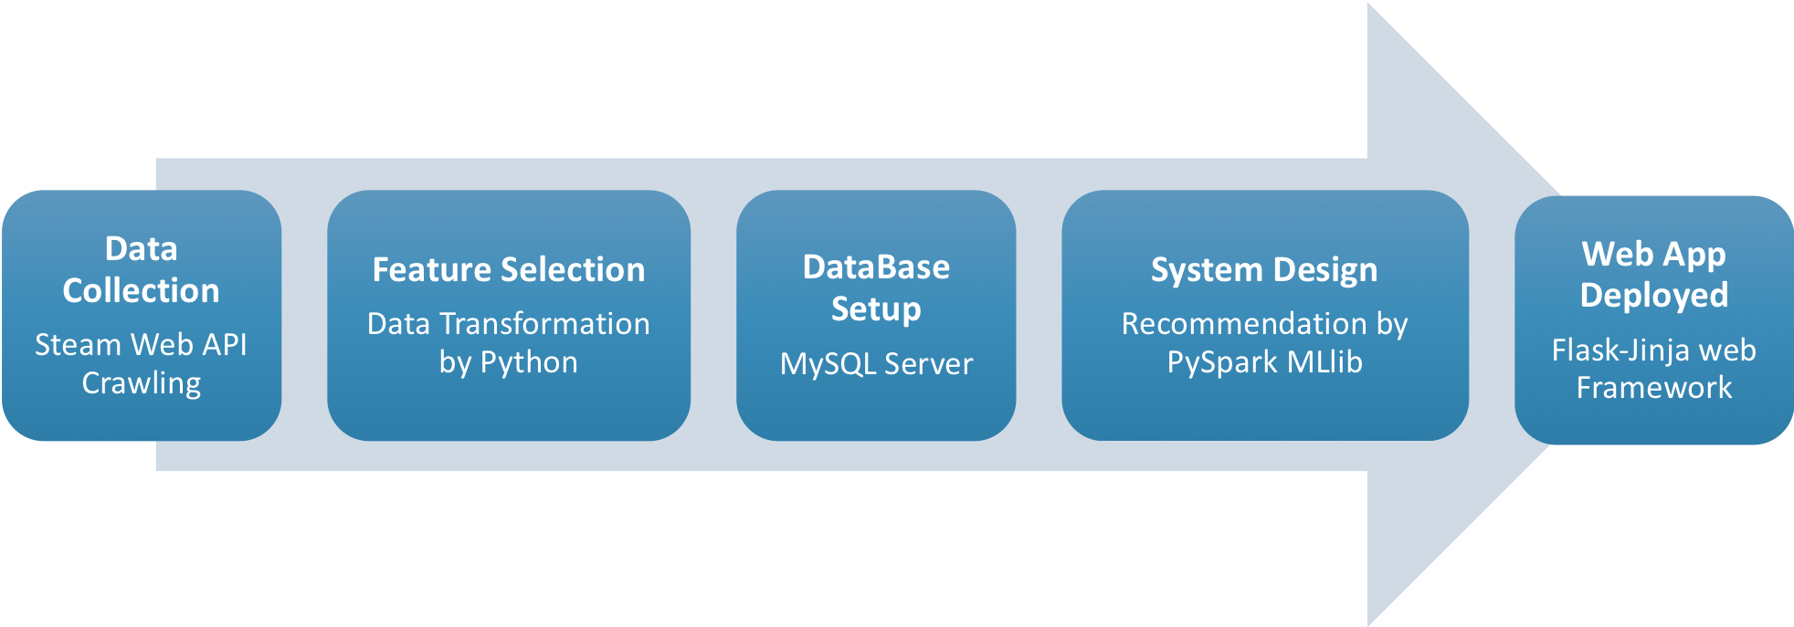
Workflow
Notes:
To establish a popularity-based recommender engine for players to navigate the trending games based on others play times and behaviors on the Steam.
The system can help with new users cold start problem and enhance engagement between players but ignore the new games exposure and not change recommended list too frequently.

Slide 17
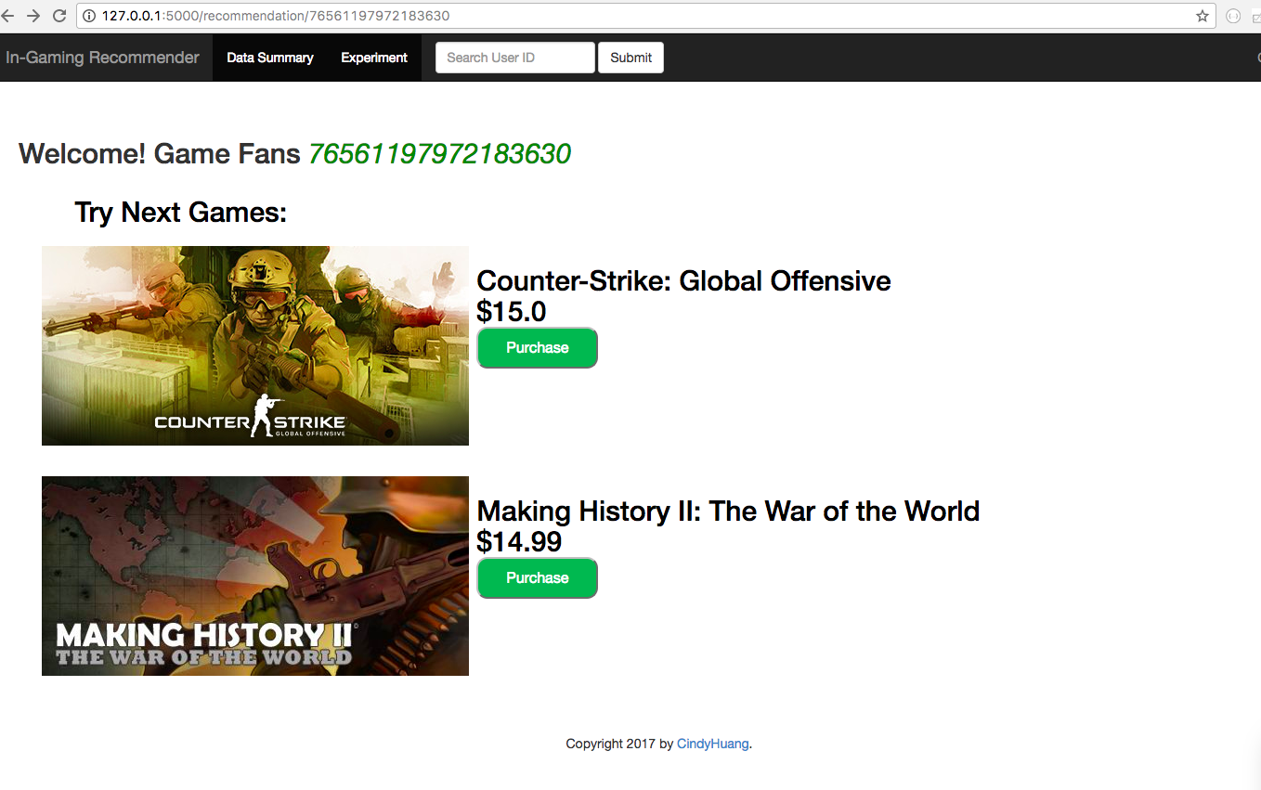
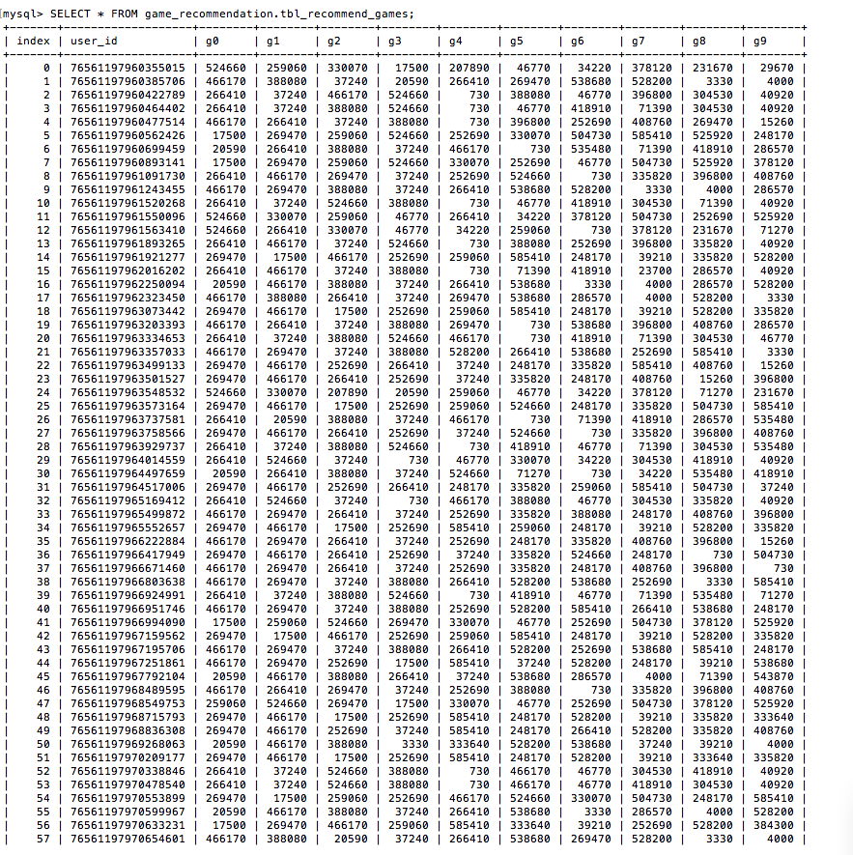

Recommender Mini Site (1/4)
Notes:
To import Python scripts in Flask framework and use annotations to associate service end-points with Python functions.
The system wrapped recommendation model around some of these end-points and interchange JSON formatted data with web client; the visualization was mainly called HighCharts
Spark MLlib library for Machine Learning provides a Collaborative Filtering implementation by using Alternating Least Squares(ALS).
The model applied root-mean-square error (RMSE) to get optimal input parameter for model(rank=3).

Slide 18
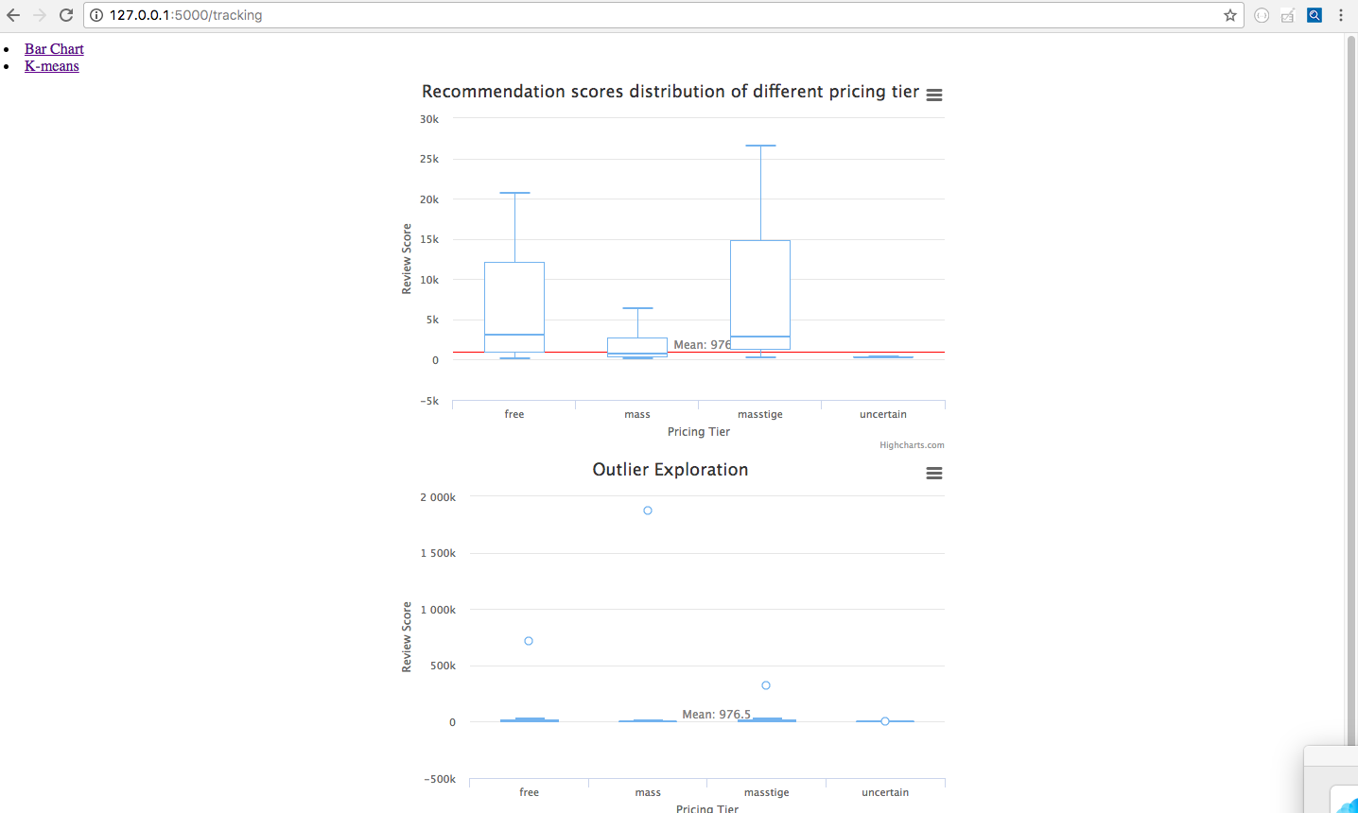
Recommender Mini Site (2/4)
Notes:
Review scores distribution of free and high-price(>$30) games are right-skewness so their review scores are more variable than mass.
Mass pricing tier has one outlier with highest recommendation scores (Counter-Strike: Global Offensive $15); it is a mutli-player first-person shooter video game launched in 2012.
Dota 2 is the free-to-play multiplayer online battle arena video game released in 2013 with most review scores.
Grand Theft Auto V ($59.99) is an action adventure video game with best reviews among masstige category.

Slide 19
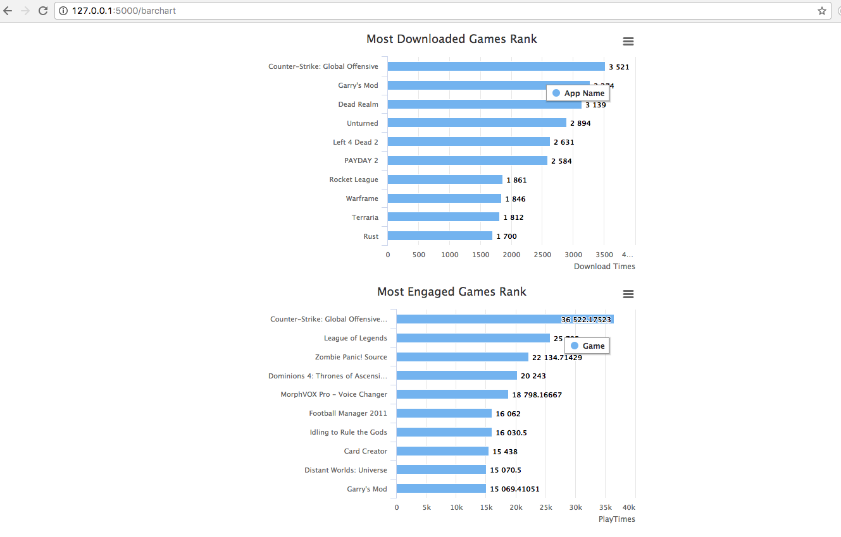
Recommender Mini Site (3/4)

Slide 20
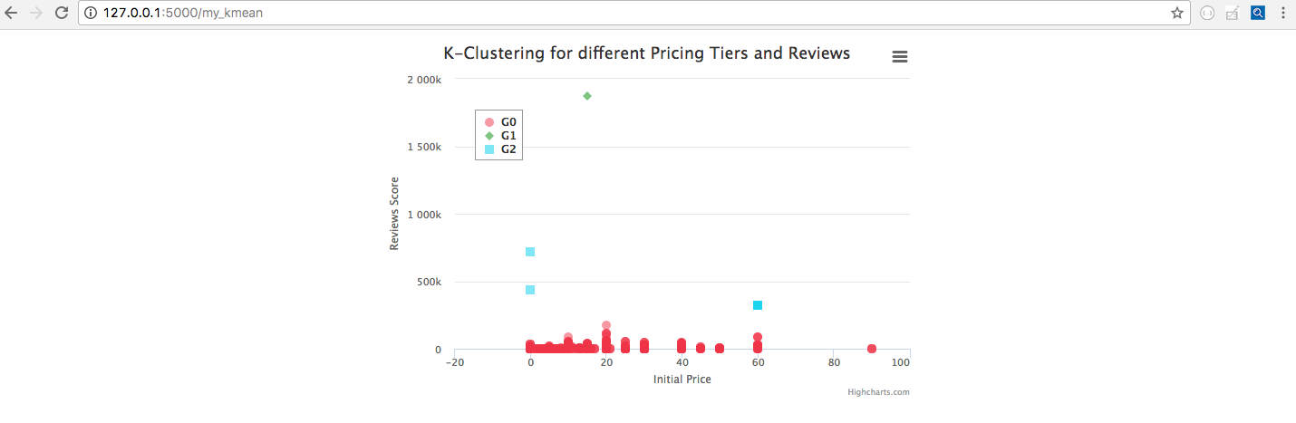
Recommender Mini Site (4/4)
Notes:
To initiate K-Means Clustering method for dimensionality reduction and use nearby points within distance to centroid formed k=three feature groups.
Scale of review scores made significant difference among games rather than pricing range.
RMSE of this model is large which represents poor predictive ability due to asymmetrical outliers
Aim of this model is to trigger players purchase imminent from a pleasure browsing experience; therefore, online experiments(A/B Testing) was the more critical evaluation method to study the recommender interface rather than accuracy of algorithm.

Slide 21
Thank You

