Slide 1


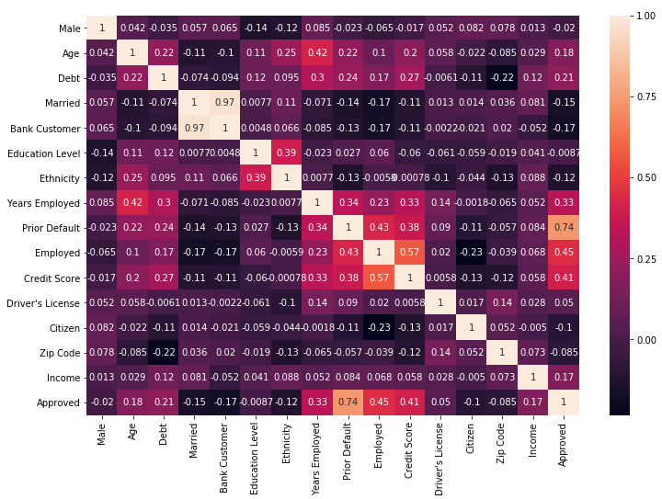
Instant Credit Card Approval
Shitij Seth YuanJea Hew Muhammad Salim Deryck Ma
Project Description
As more and more people are moving towards digital cashless methods of payment, credit cards have been the top choice of consumers in the US which results in tons of applications for banks to make decisions on.
The ultimate goal of the project was to build an algorithm which predicts a decision for an application instantly and one which can actually be used by a bank in the real world.
The scope of this project is to: (a) replicate results from the refence paper. [1] (b) compare the accuracy from different algorithms (c) determine the features that most affect card approval
Challenges
A number of supervised machine learning algorithms were analyzed in approaching the project goals. Each had different pros and cons.
For instance, SVM provides high accuracy but takes a long time to run.
Therefore, developing an algorithm which provides the best combination of accuracy and run time was the biggest challenge.
Potential Applications
Banks can utilize machine learning algorithms to analyze customer data to decide credit card applications.
These algorithms can be used to assess any type of credit applications such as loans.
Data Analysis
Feature : [values]
Male: a,b
Married: u,y,l
Bank Customer: g,p
Education: c,d,I,j,k,m,r,q,w,x,e,aa,ff
Ethnicity: v,h,bb,j,n,z,dd,ff,o
Prior Default: t,f
Employed: t,f
Drivers License: t,f
Citizen: g,p,s
Approval: +,-
[Data Transformation]
0,1
0,1,2
0,1
0,1,2,3,4,5,6,7,8,9,10,11,12
0,1,2,3,4,5,6,7,8
1,0
1,0
1,0
0,1,2
1,0
Glossary of Technical Terms
Logistic function: Common S-shaped curve used to bring non-linearity to predictions
Train-test split: Data is segmented into training and testing set based on this percentage divide
Results
Laws prohibit credit discrimination on the basis of race, color, religion, national origin, sex, marital status and age. [2]
Only top 4 most important features used based on the correlation matrix (bottom left)
Individual Algorithm Comparison-
Best model: Ensemble of LR, RF and DT with 94% accuracy
Our model’s accuracy tops accuracy of the model used in the reference paper which had 84% accuracy.
Comparison from baselines-
 | Age | Debt | Year Employed | Credit Score | Income
Mean | 31.50 | 4.83 | 2.24 | 2.50 | 1013.76
Median | 28.42 | 2.84 | 1.00 | 0.00 | 5.00
Max | 76.75 | 28.0 | 28.50 | 67.00 | 2000.00
Min | 13.75 | 0.00 | 0.00 | 0.00 | 0.00
Algorithm | Percentage Accuracy (%) | Run Time (s)
ANN | 92.96 | 0.035865
LR | 93 | 0.004508
SVM | 88 | 0.010412
KNN | 93 | 0.004109
DT | 91 | 0.222498
RF | 90.56 | 0.001875
Methodology
Artificial Neural Network (ANN)
Data points interconnected in layers forming a network similar to ones inside the human brain
Logistic Regression (LR)
Maximizes the likelihood to find best parameters and predicts using the logistic function
Support Vector Machine (SVM)
Fits multi-dimensional non-linear planes to create decision boundary
Decision Trees (DT)
Uses a bunch of yes-no question to classify
Random Forest (RF)
Uses the majority vote from a combination of several decision trees
K-Nearest Neighbors (KNN)
Selects the k number of nearest neighbors surrounding a query point and picks majority vote as its prediction
Ensembling
Uses the majority vote from ensembled algorithms
Grid Search
Exhaustive search of the parameter space to find optimum hyperparameter values was used for all algorithms using 85-15 as the train-test split
 | Percentage Accuracy (%) | Run Time (s)
Data Baseline | 55 | N/A
Default Parameter Baseline | 86.52 | 0.0628
Final Model | 94 | 0.0539
References
Kuhn. Analysis of Credit Approval Data. Internethttp://rstudio-pubs-static.s3.amazonaws.com/73039_9946de135c0a49daa7a0a9eda4a67a72.html
“Your Equal Credit Opportunity Rights.” Consumer Information, 13 Mar. 2018, www.consumer.ftc.gov/articles/0347-your-equal-credit-opportunity-rights.
Acknowledgments
This project was mentored by Dr. Christina Duron, whose help is acknowledged with great appreciation.
Support from our instructor, Dr. Calvin Zhang-Molina is also gratefully acknowledged.

