Slide 1
Gameholic website
Team: Fabulous Four
Member: Chuxuan Wang, Han Zhang, Yuanjie Yue, Yaling Liu

Slide 2
Overview:
Gameholic is an online retailer platform that provides game purchasing, downloading and installing, for video game and board game lovers.

Slide 3
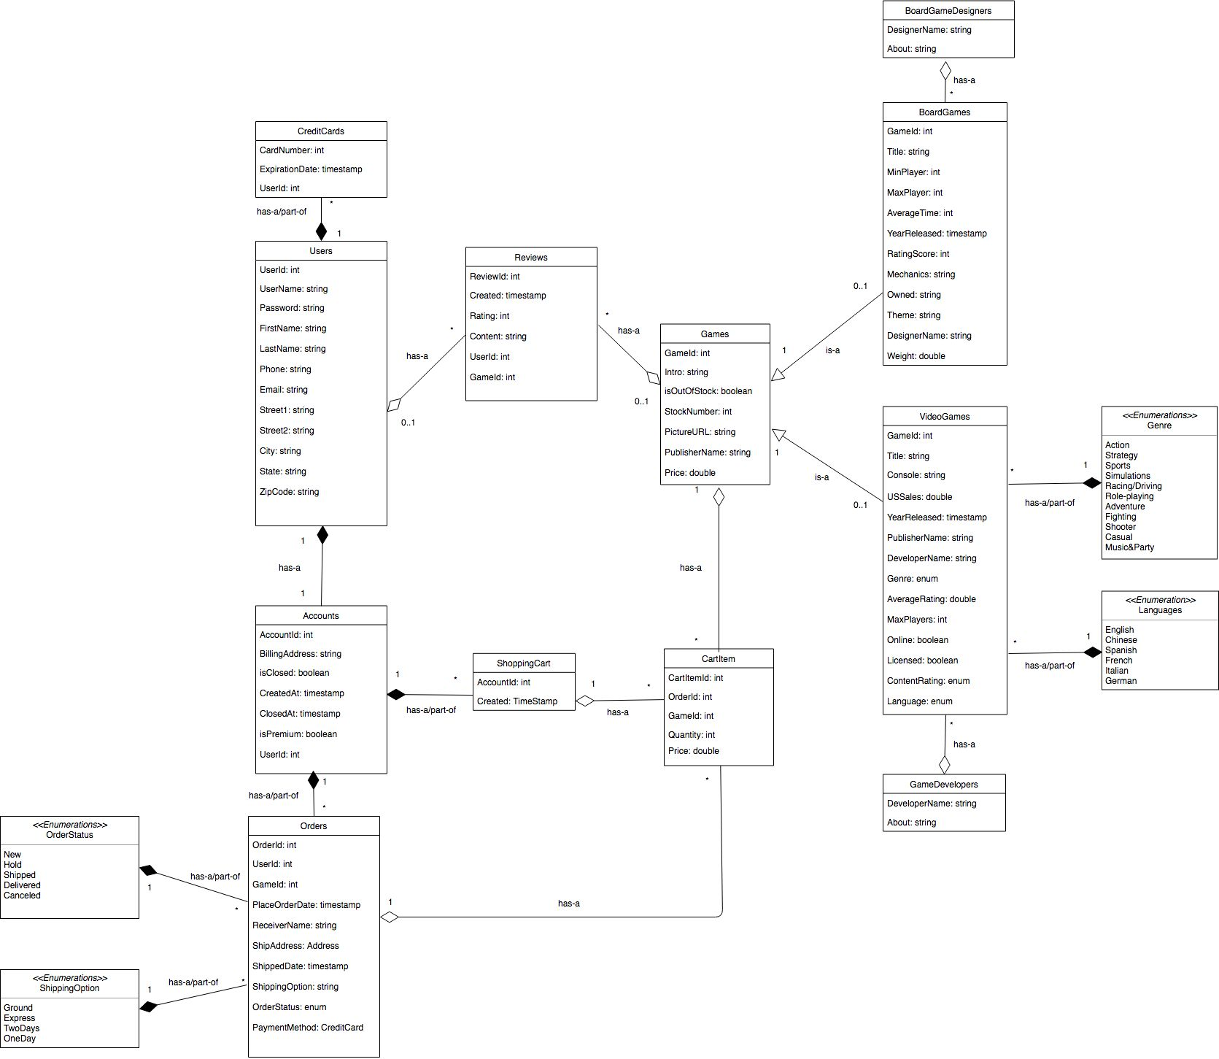
UML for Gameholic Relational Model

Slide 4
Models and Data Access
Models:
VideoGames
BoardGames
Orders
Users
CartItem
Accounts
Genres
Languages
CreditCards
Reviews
JDBC daos:
VideoGamesDao
BoardGamesDao
OrdersDao
UsersDao
CartItemDao
AccountsDao
GenresDao
LanguagesDao
CreditCardsDao
ReviewsDao

Slide 5
Frontpage
Features we have now:
Search board games by year released
Search video games by year released
User Register
Place/Cancel online orders

Slide 6
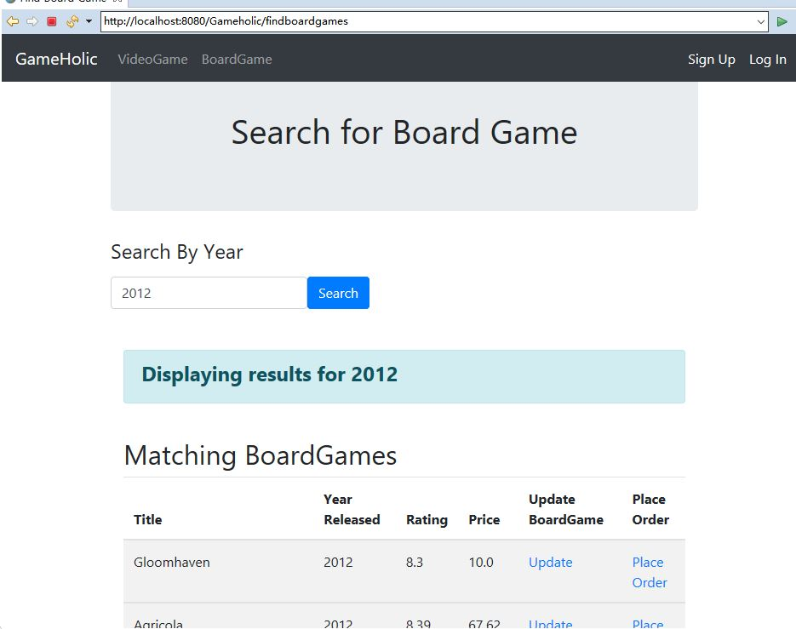
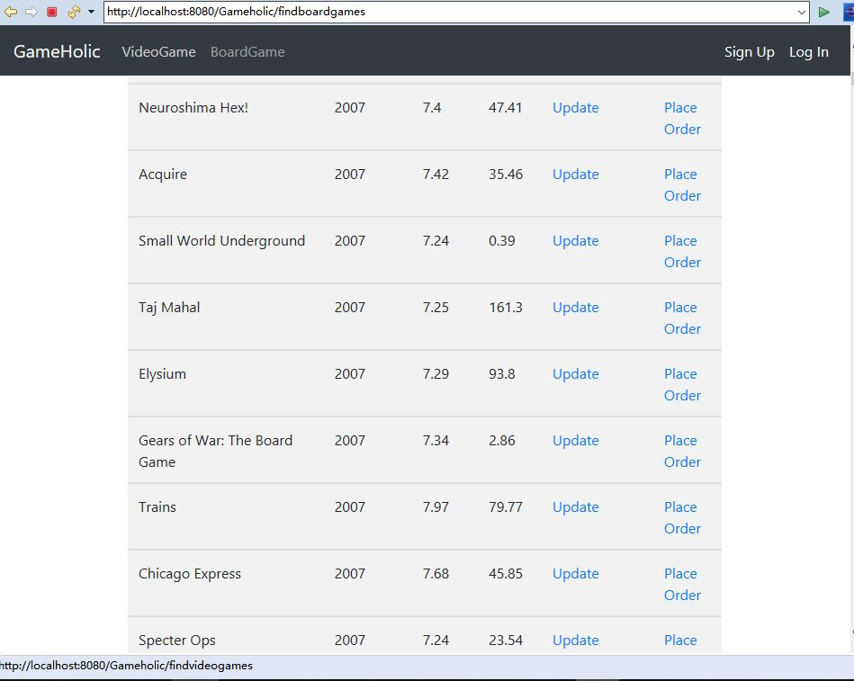
Search for Board Games

Slide 7
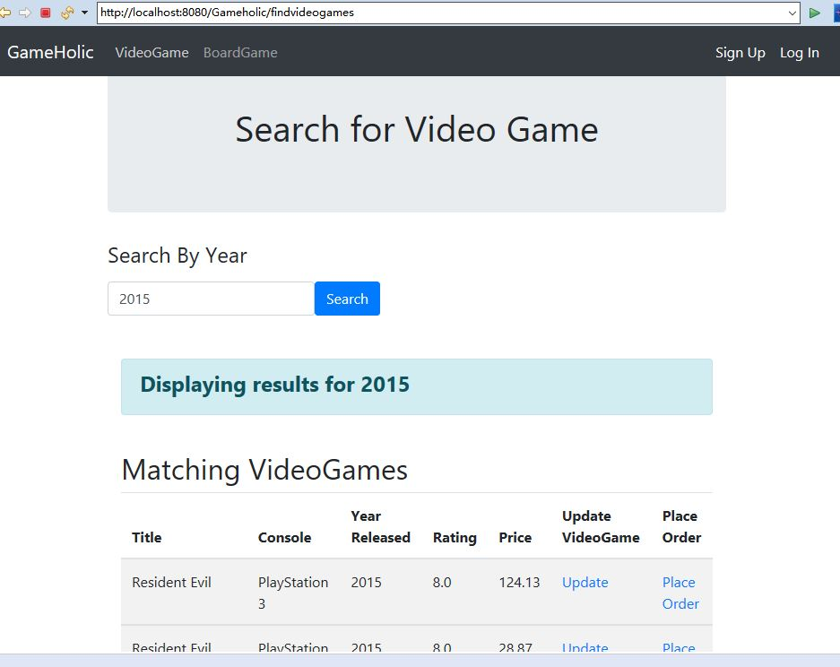
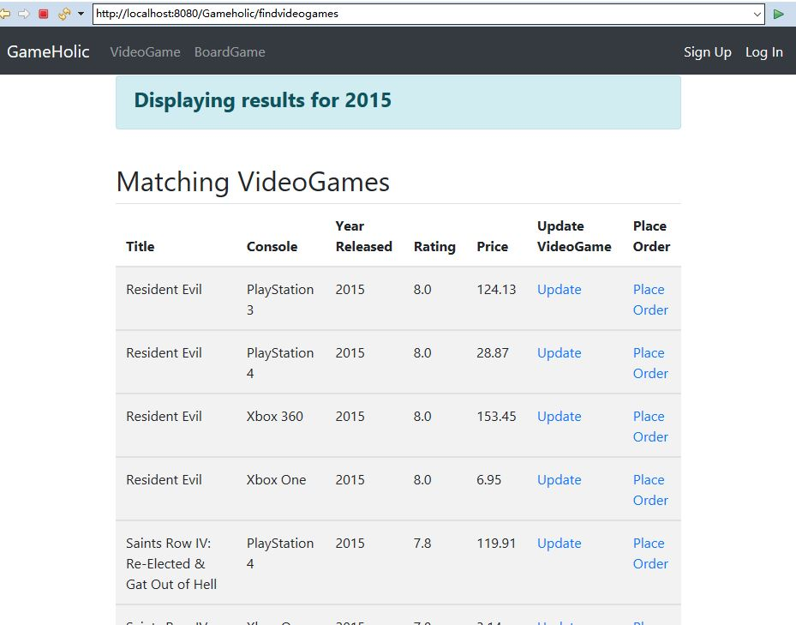
Search for Video Games

Slide 8
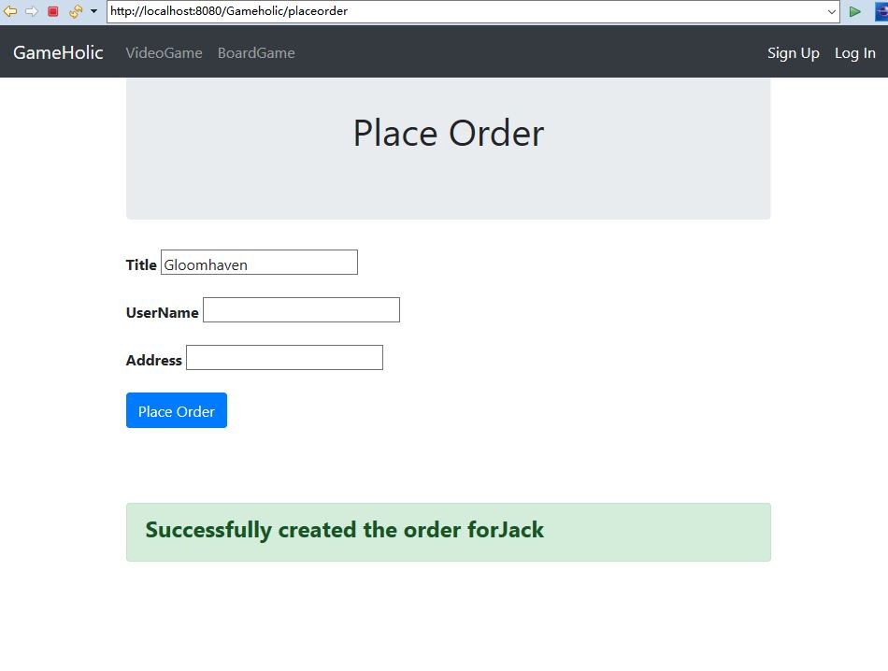
Place online orders

Slide 9
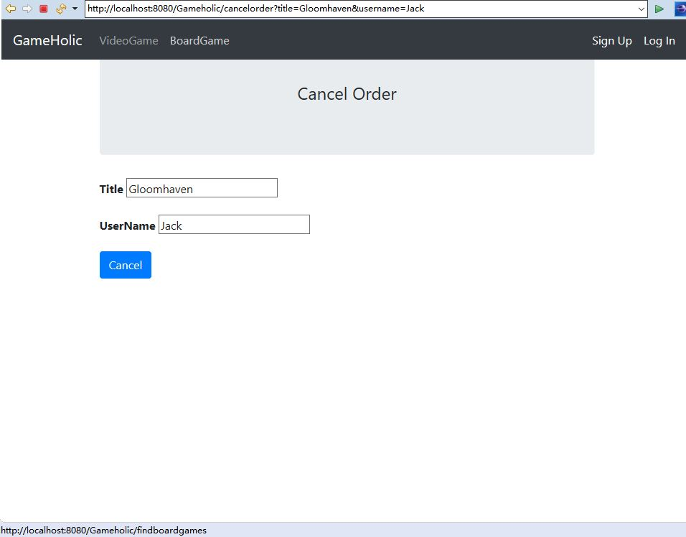
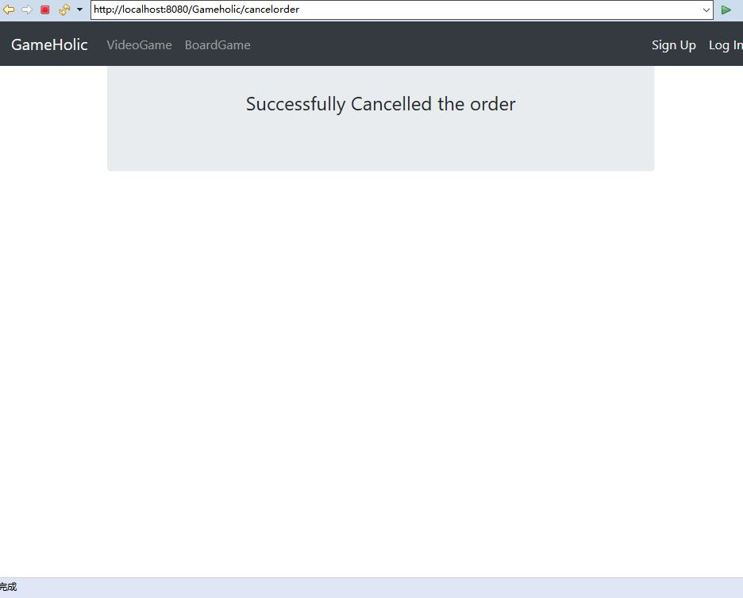
Cancel online orders

Slide 10
Conclusion
Initial plan:
Find, buy, deliver, remove, review and release games
Done:
A basic game-trade website frame and basic retailing functionalities.
Search video games and boardgames
Place orders and cancel orders
User register

Slide 11
What would you do differently?
Design core classes according to dataset attributes
Use most recent dataset
Use datasets from one source
Use popular web frameworks to build the front-end

Slide 12
What to add in the future
Add game pictures and game descriptions
Add secure payment functionality
Add game publishers information
Add game recommendation features

Slide 13
Data source:
https://www.kaggle.com/tamber/steam-video-games
https://www.kaggle.com/rush4ratio/video-game-sales-with-ratings
https://www.kaggle.com/mrpantherson/board-game-data

Slide 14
Thank you

