Slide 1
Human-in-the-loop LLM-based Algorithm Design for Physics-aware Robotic Palletization with Stacking and Destacking
First Team Report
22.12.2025

Slide 2
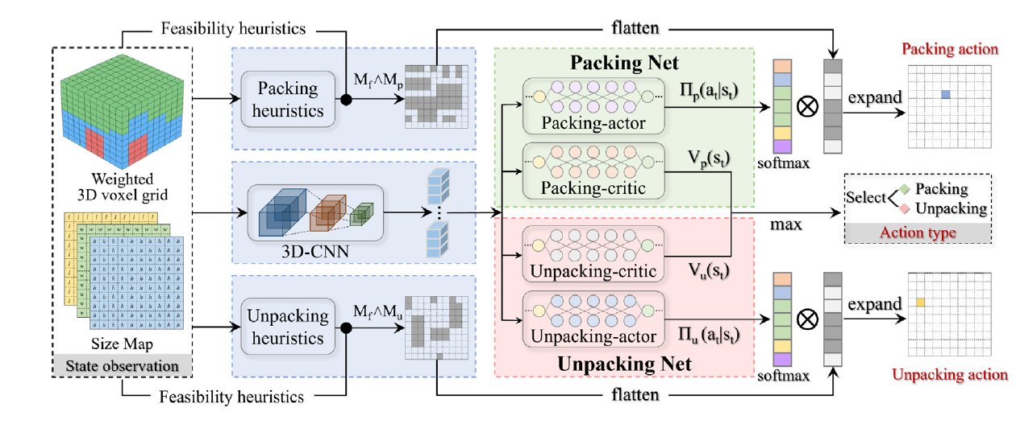
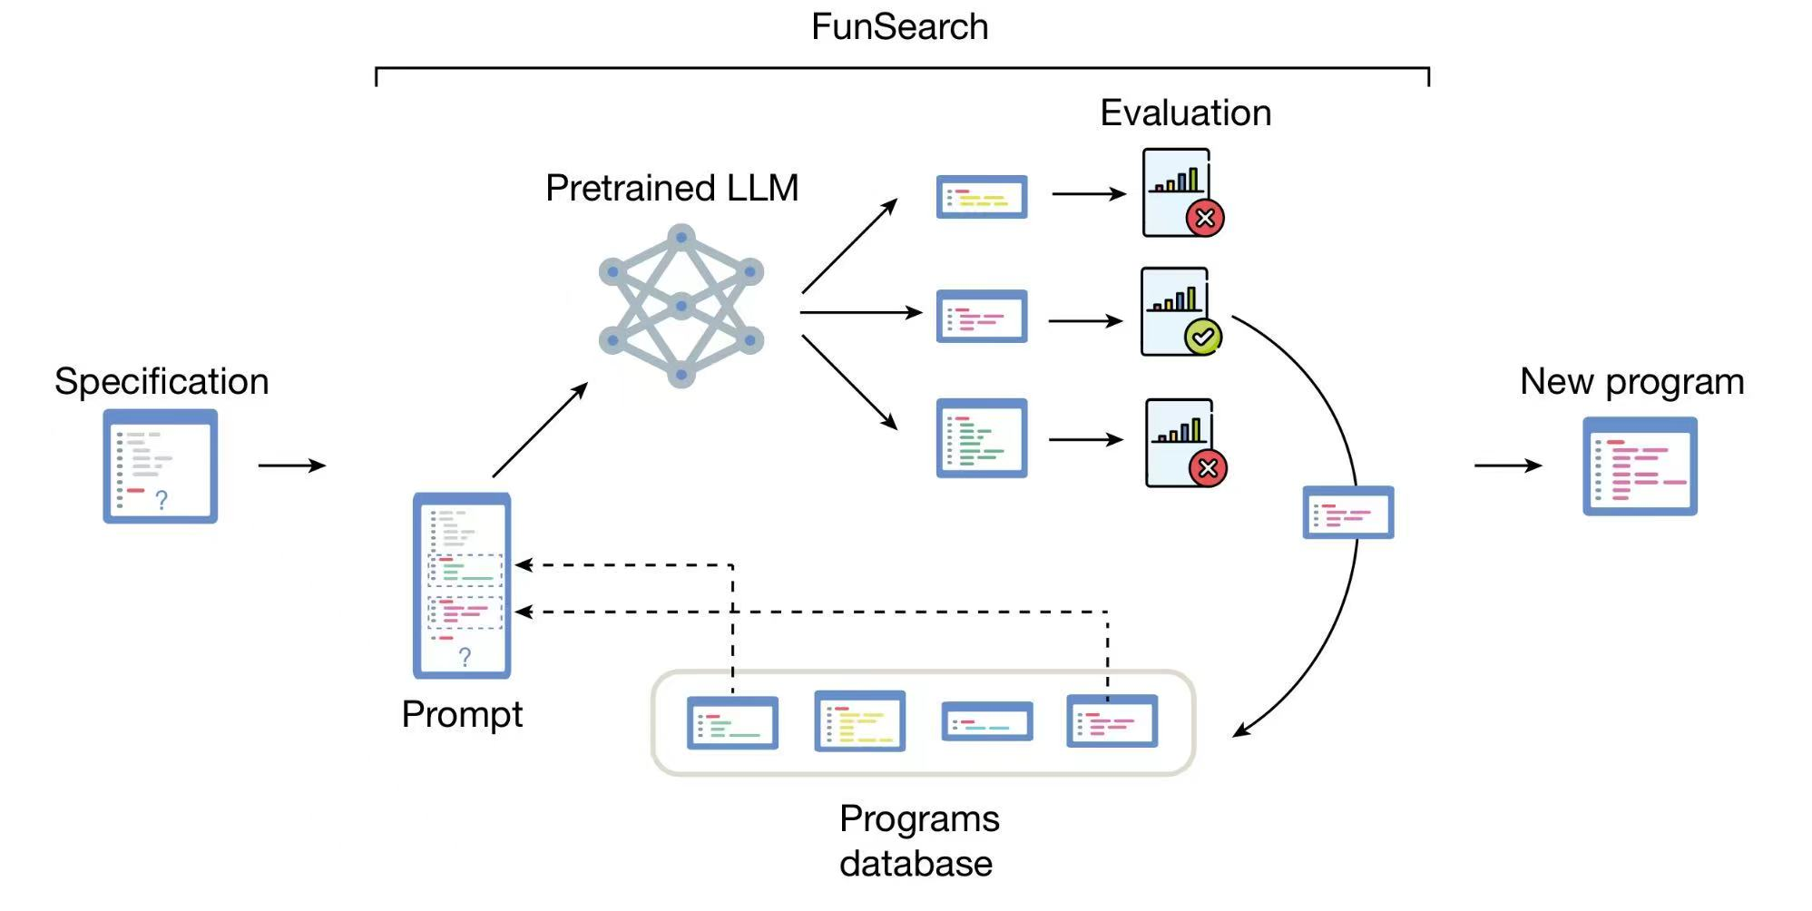
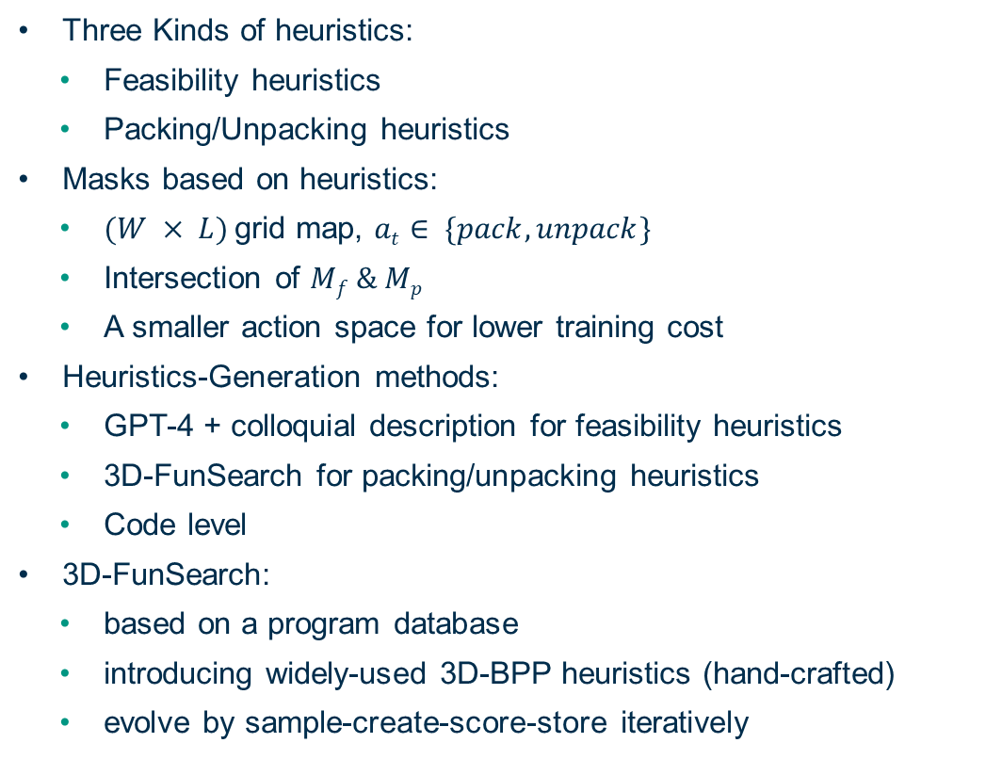
Background & Motivation – LLM-guided DRL for 3D-BPP
Three Kinds of heuristics:
  Feasibility heuristics
  Packing/Unpacking heuristics
Masks based on heuristics:
  $(W × L)$grid map, $at$ $∈ \{pack,unpack\}$
  Intersection of $Mf \& Mp$
  A smaller action space for lower training cost
Heuristics-Generation methods:
  GPT-4 + colloquial description for feasibility heuristics
  3D-FunSearch for packing/unpacking heuristics
  Code level
3D-FunSearch:
  based on a program database
  introducing widely-used 3D-BPP heuristics (hand-crafted)
  evolve by sample-create-score-store iteratively
Heuristic masks
One action chosen
3D-FunSearch

Slide 3
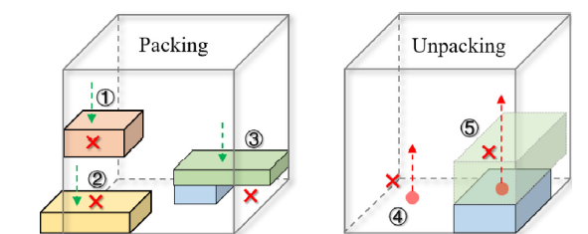
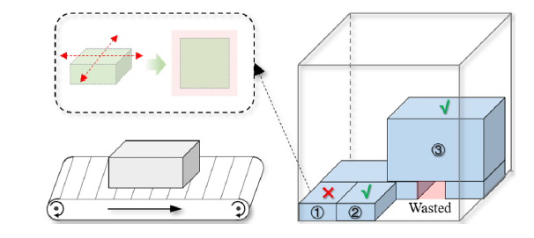
Background & Motivation –Heuristics for 3D-BPP
Hand-Crafted packing heuristics:
  Column Building
  Floor Building
  First Fit
  Corner Point
  Extreme Point
  Empty Max Space
LLM-Based Heuristics:
  Human Feedback
  Evolution of Heuristics (EoH)
Learning-Based Heuristics
Feasibility heuristics based on physical rules
unpacking heuristics
Human-in-the-loop LLM-based algorithm generation and Implementation of heuristic solution framework for robotic palletization
Compare with the widely used Hand-Crafted Heuristics
No “learning” in the framework

Slide 4
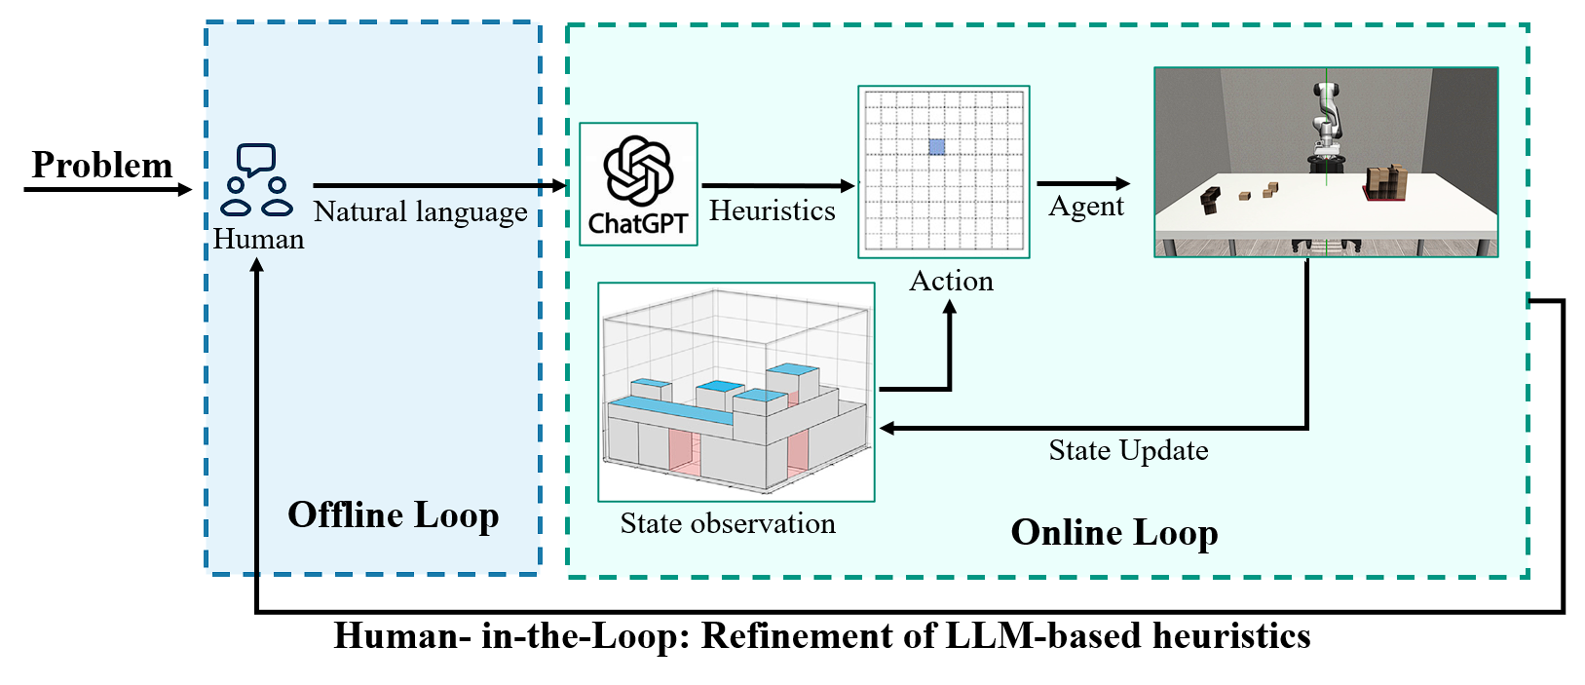
Project Objectives – Our Framework
Colloquial description based on the problem
  Human-guided
LLM-generated heuristics
  Code-level
Human-in-the-loop offline feedback
  Iteratively improve LLM-generated heuristics
No Deep Reinforcement Learning
Advantages and Limitations:
Computationally efficient compared to learning-based methods
Non-expert friendly: can be tuned without coding expertise
LLM-based heuristics have the potential to outperform handcrafted heuristics
Non-optimal solution: Heuristics are based on fixed rules, lacks the optimization process
Not end-to-end: human involvement is required for offline heuristic refinement
Heuristic-based methods are unlikely to surpass reinforcement learning in terms of ultimate performance

Slide 5
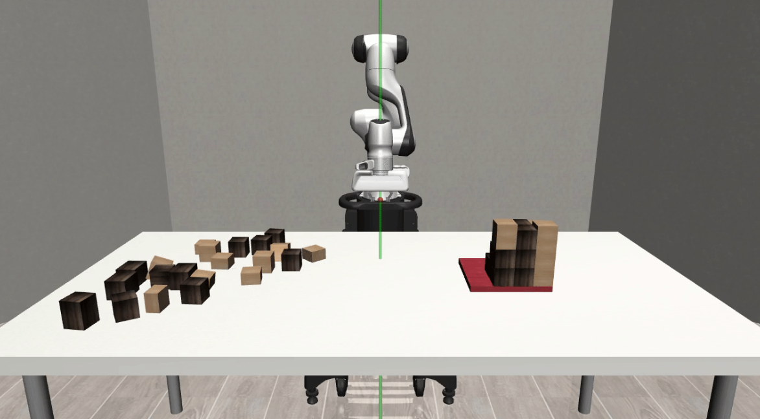
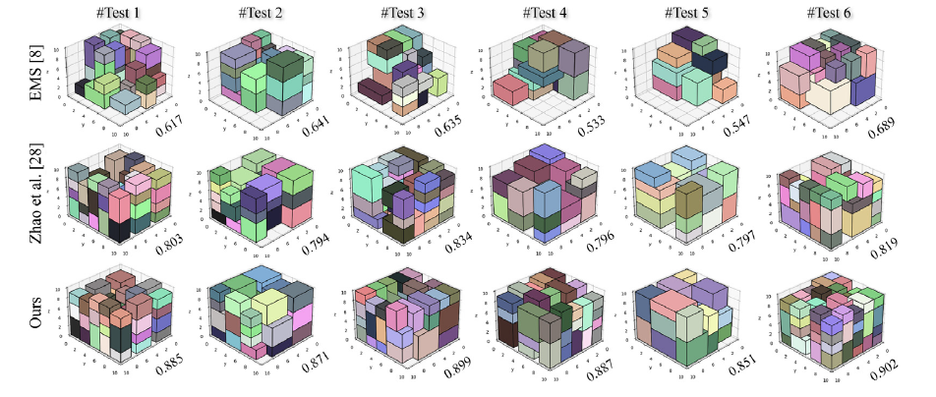
Our Initial Idea about the Task
Simulation Platform Setup
  Reproducing the simulation environment of Paper 1
  Building an interface between heuristic algorithms and the simulation environment
Heuristic Generation Platform
  Input: problem specifications and natural-language guidance
  Output: executable programs for mask generation
Framework Integration & Heuristic Optimization
  Running the complete framework
  Iterative optimization of heuristics based on execution results
Experimental Evaluation
  Conducting experiments and comparing against handcrafted heuristics
Simulation Platform
Experiment Examples

Slide 6
Our Questions
Should unpacking actions be included in the action space? This sounds unfair for the hand-crafted heuristics, since most of them only considered packing actions. Shouldn’t we control variables?
Which evaluation metrics would you recommend for assessing solution quality?
  Our current plan is to adopt metrics from Paper 2, including space utilization, average number of stacks, and standard deviation.
  Should we compare our framework with learning based methods? (will discuss later in detail)
Given the relatively small codebase of the project, should the main effort focus on experimental evaluation?
  Our preliminary estimate of workload distribution is:
      Reproduction: 30%
      Heuristic tuning: 20%
      Experiments and analysis: 50%
      with the goal of conducting a systematic comparison between handcrafted heuristics and LLM-based heuristics.

Slide 7
Pitch Pre
Project roadmap
Measuring results
Splitting the work

Slide 8
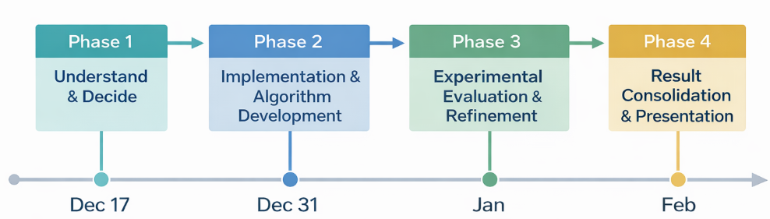
Project roadmap

Slide 9
Phase1 - Understand & Decide
  17.12 - 31.12
  Familiarization with existing approaches
      Study learning-based robotic packing & palletization
      Understand how heuristics, DRL, and physics simulation interact
    Supervisor Discussion
      Presented our understanding & initial idea
      Clarified:
    Direction & Planning
      Clear project direction
      Preliminary task division
    Key references
      Learning packing-and-unpacking synergistic policy via LLM-guided DRL for robust online robotic packing – ScienceDirect
      Physics-Aware Robotic Palletization With Online Masking Inference | IEEE Conference Publication | IEEE Xplore
    Phase 1 Result
      A shared understanding
      A focused research direction
      A concrete execution plan

Slide 10
Phase2 - Implementation & Algorithm Development
  31.12 – 21.01
  Simulation & Data Pipeline Setup
      Implement data preprocessing and simulation based on the available code of Paper 1
    Human-in-the-loop LLM-based Heuristic Generation
      Design a human-guided, LLM-based heuristic generation pipeline
    Heuristic Solution Framework for Robotic Palletization
      Integrate heuristics with feasibility checks and simulation interface
    GOAL
      Get familiar with the simulation platform and ensure correct execution
      Generate initial executable heuristic algorithms
      Ensure end-to-end execution from heuristic generation to simulation rollout
    Phase 2 Result
      A functional end-to-end pipeline where LLM-generated palletization heuristics can be executed within a physics-based simulation environment.

Slide 11
Phase3 - Experimental Evaluation & Refinement
  21.01 – 18.02
  Design experiments based on: Data foundation, Baselines, Evaluation strategy
    Run experiments and collect logs/results in the simulator
    Iteratively refine heuristics / LLM prompts based on observed failure cases and performance
    Consolidate results into tables/plots and summarize key findings
    GOAL
      Get familiar with the simulation platform and ensure correct execution
      Generate initial executable heuristic algorithms
      Ensure end-to-end execution from heuristic generation to simulation rollout
    Phase 2 Result
      A functional end-to-end pipeline where LLM-generated palletization heuristics can be executed within a physics-based simulation environment.

Slide 12
Pitch Pre
Project roadmap
Measuring results
Splitting the work

Slide 13
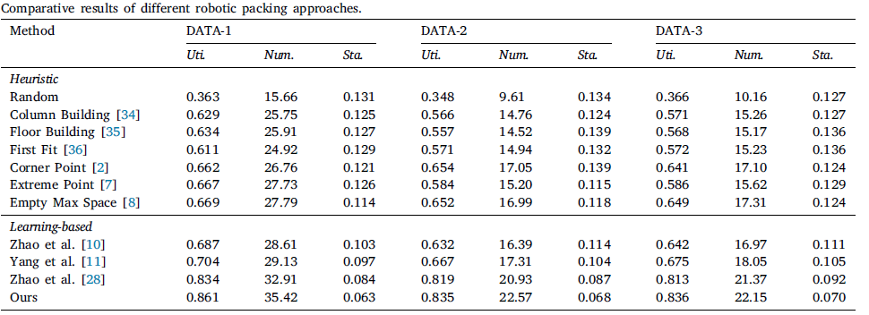
Measuring Results - Quantity Metrics
Form:
  Table
Components:
  Data foundation
  Baselines
  Evaluation strategy
    Describe the table:
      Based on (which DATAx), compared with (which Baselines?) ,the performance in (which Evaluation strategy).

Slide 14
Measuring Results - Data foundation
Dataset1
  Generated by directly partitioning a 𝐿×𝑊×𝐻 bin
  All items are regular cuboids
  Item sizes are relatively uniform, with no extremely flat or elongated shapes
  The item order is randomly shuffled
Dataset2
  Generated from a predefined set of item templates
  Item sizes range from (1,1,1) to (5,5,5)
  Includes flat or elongated items (with at most one dimension equal to 1)
  Item volumes are balanced across small, medium, and large categories
  Items are arranged using a fixed ordering rule
Dataset3
  Uses the same set of items as Dataset-2
  Item sizes and shape distribution are identical
  The only difference is the item ordering, which follows a different sorting rule
Characteristic
  Dataset1
      Simple and regular item shapes, mainly used to evaluate basic packing capability.
  Dataset2
      More diverse item shapes, closer to real logistics scenarios, with structured item ordering.
  Dataset3
      Same item shapes as Dataset-2, but used to test robustness against different item sequences.

Slide 15
Measuring Results - Baselines
Baselines
    DRL-based heuristics(To-be-decided)
    Handcrafted heuristics(paper2))
      Column Building
      Floor Building
      First Fit
      Corner Point
      Extreme Point
      Empty Max Space
Characteristic and reason(why we select them?)
  DRL heuristics
  Handcrafted heuristics

Slide 16
Measuring Results - Evaluation strategy
Space Utilization (Uti.)
  The ratio of the total volume of packed items to the volume of the bin.
Average Number of Packed Items (Num.)
  The average number of items successfully packed into the bin per episode.
Standard Deviation of Space Utilization (Sta.)
  The standard deviation of space utilization across different episodes.

Slide 17
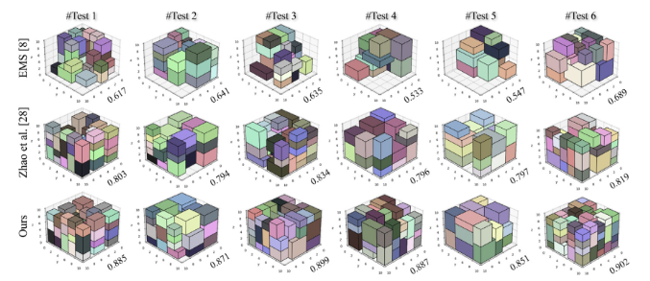
Measuring results
Quality
    Picture
    What is it?
    E.g. Based on DATA-1, we constructed six different test cases, whose visualized results are shown in Fig. 7.
    How does it looks like?
    Video
    What is it?
    How does it looks like?

Slide 18
Pitch Pre
Project roadmap
Measuing results
Splitting the work

Slide 20
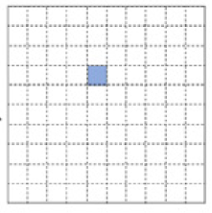
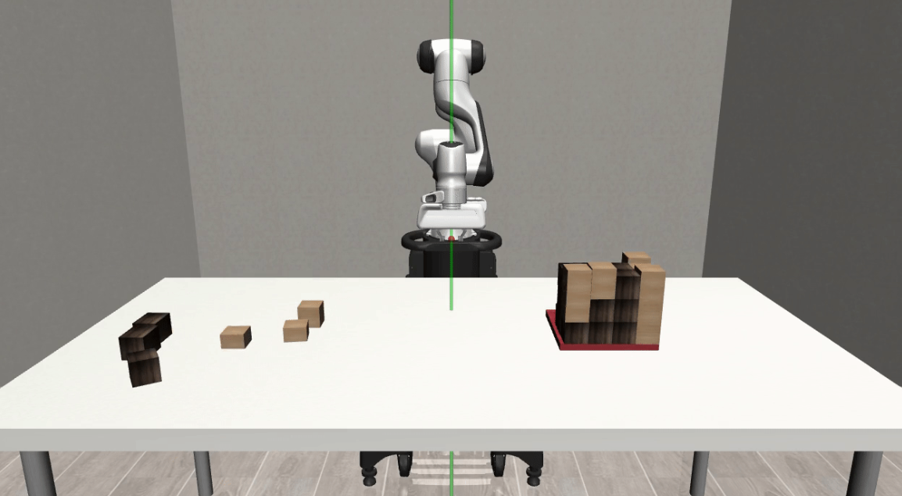

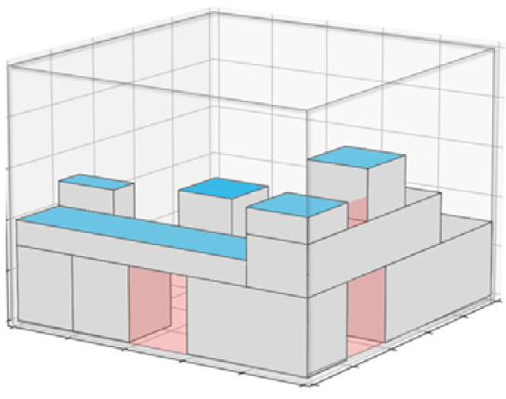
Problem
Natural language
Heuristics
Agent
Human
Action
State Update
Offline Loop
State observation
Online Loop
Human- in-the-Loop: Refinement of LLM-based heuristics

Slide 21


Design elements
Highlight Box
Lines
Text box
Highlight Box
Highlight Box
  Standard text box with bullet point
  Standard text box with bullet point
Highlight Box
Highlight Box
Highlight Box
Highlight Box
© Picture source top
Highlight Box
                1
                1
© Picture source bottom
Source: I am a dummy text. And I've always been a dummy text

