Slide 1
Introduction to MINA
A Multipurpose
Infrastructure
for Network
Applications
April 2005, Trustin Lee, ASF

Slide 2
Contents
Overview
How to Program
Filter Mechanism
Proof of Productivity
Architecture Review
Conclusion

Slide 3
Overview

Slide 4
What is MINA?
A network application framework
  Feature-rich
  Extensible
  Designed for agile client/server programming
    Client- or server-less unit testing
    Very high reusability and maintainability
  Yet scalable / high performance

Slide 5
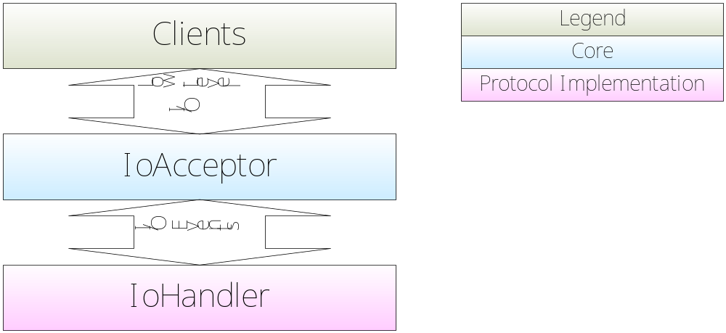
Architecture: I/O Layer
MINA abstracts all low-level I/O via abstract API.
IoHandlers get notified when I/O events occur.
You communicate by reading and writing data buffers.

Slide 6
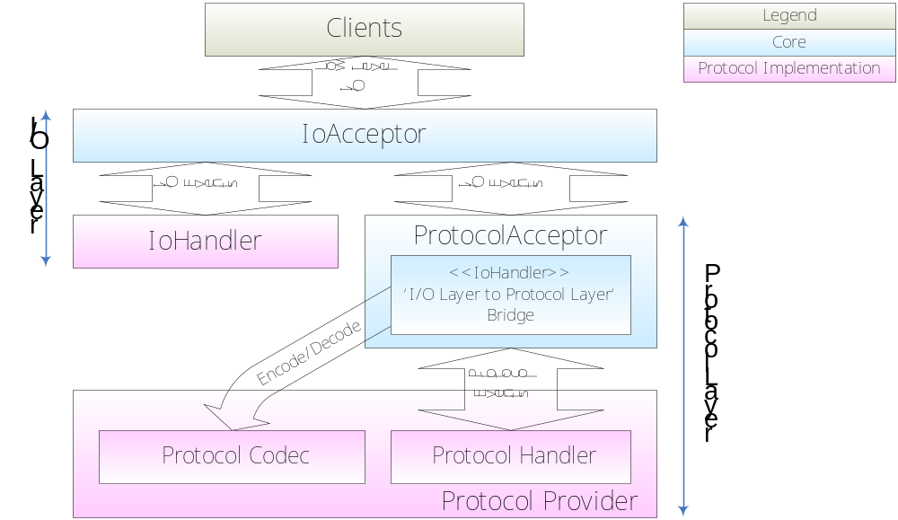
Architecture: Protocol Layer
Built upon I/O layer
Good when you implement complex protocols
You communicate by sending and receiving message objects..

Slide 7
MINA Abstract API
Single API for various transport types
Highly extensible
Unit-test your server using mock objects.
  no real clients anymore!

Slide 8
MINA Abstract API (Cont’d)
Once a protocol implemented, it works for:
  NIO sockets
    TCP/IP
    UDP/IP
  In-VM pipe
  Coming soon:
    Non-NIO sockets
    Serial port
    Parallel port
    Multicast (when Mustang is ready)

Slide 9
How to Program

Slide 10
What MINA Does For You
You NEVER need to program...
  Stream I/O
  NIO
  Thread management
  Buffer management
because it does ALL of them for you!
Then what do you have to do?

Slide 11
What You Should Do
The first way to implement your protocol:
  Using I/O Layer: IoHandler
    You communicate by reading and writing data buffers.

Slide 12
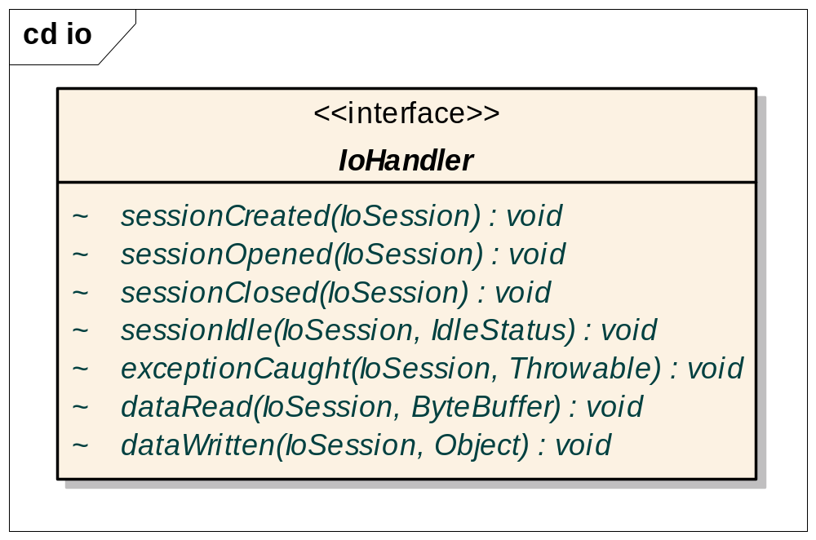
What You Should Do (Cont’d)

Slide 13
What You Should Do (Cont’d)
The second way to implement your protocol:
  Using Protocol Layer: ProtocolProvider
    You communicate by exchanging objects (POJO).
    Your codec performs transformations between
    data buffers and message objects.
      Reusable
      Pluggable (thanks to polymorphism)
    You take full advantage of OOP for message objects
      Inheritance

Slide 14
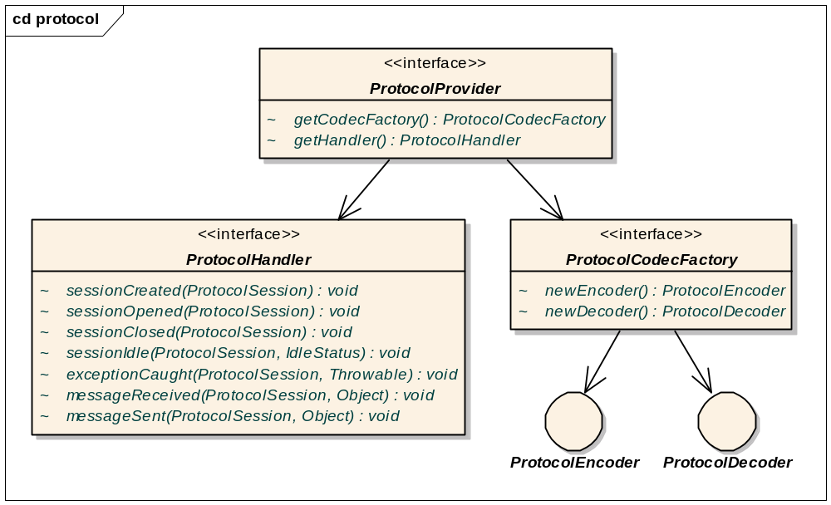
What You Should Do (Cont’d)

Slide 15
Filter Mechanism

Slide 16
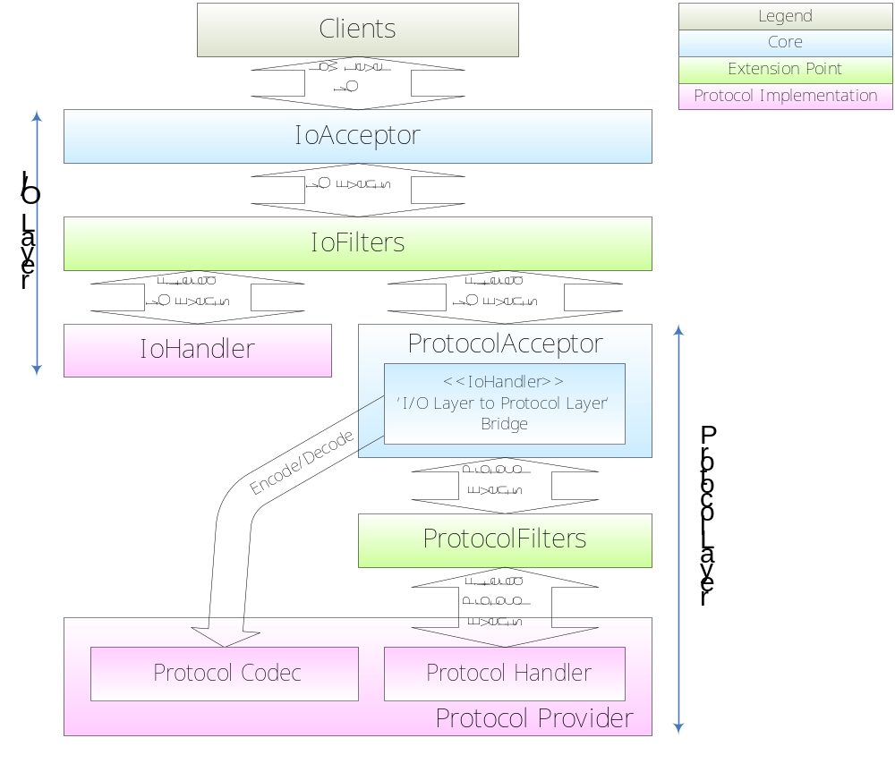
Architecture (with Filters)

Slide 17
What is Filter
A reusable event interceptor
  Similar to Servlet filters
Can be added and removed “on-the-fly”
Works in both coarse- and fine-grained way:
  Per Server Port
  Per Individual Session

Slide 18
Filter Use Cases
Implemented filters:
  Thread pool (= customizable thread model!)
  SSL
  Client blacklisting
Coming soon:
  Logging, Profiling, StartTLS, Peak Point Control, Traffic throttling, Firewall, and many more ...
  Any contributions are welcome!

Slide 19
Filter Use Cases (Cont’d)
Customizable thread models
  MINA runs in single thread mode by default
    Good for low-latency apps
  Add a ThreadPoolFilter to make MINA multi-threaded
    Good for high-scalability apps

Slide 20
Proof of Productivity

Slide 21
Comparison
 | Plain NIO | MINA
Echo server | 109 lines* | 50 lines (45%)
Reusability | Poor | All reusable: Filters, Codecs, Handlers
Maintainability | Poor | Very good
*) A Core Java Tech Tips example
  100% CPU consumption while socket buffer is full. (doesn’t register for OP_WRITE)
  No SSL support (never trivial)

Slide 22
More Complex Protocols
Even echo server is hard to maintain.
  Writing complex protocols with plain NIO is the beginning of your nightmare.
MINA Protocol Layer is your cozy pillow.
Known implementations:
LDAP SMTP DNS | Kerberos IMAPv4 NTP

Slide 23
Architecture Review

Slide 24
Architecture Review

Slide 25
Conclusion

Slide 26
Conclusion
MINA is
a flexible and extensible
network application framework
that boosts developer productivity.

Slide 27
How to Contribute
MINA is a subproject of
the Apache Directory Project
  Homepage:
  http://directory.apache.org/subprojects/network
  Mailing List:
  dev@directory.apache.org (Use ‘[mina]’ prefix)

