Slide 1
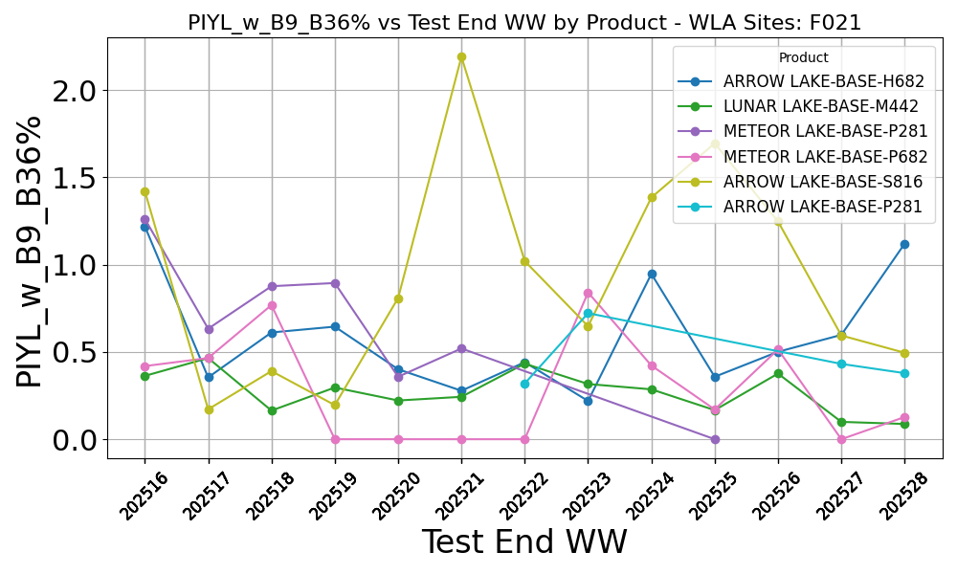
PIYL_w_B9_B36% vs Test End WW by Product

Slide 2
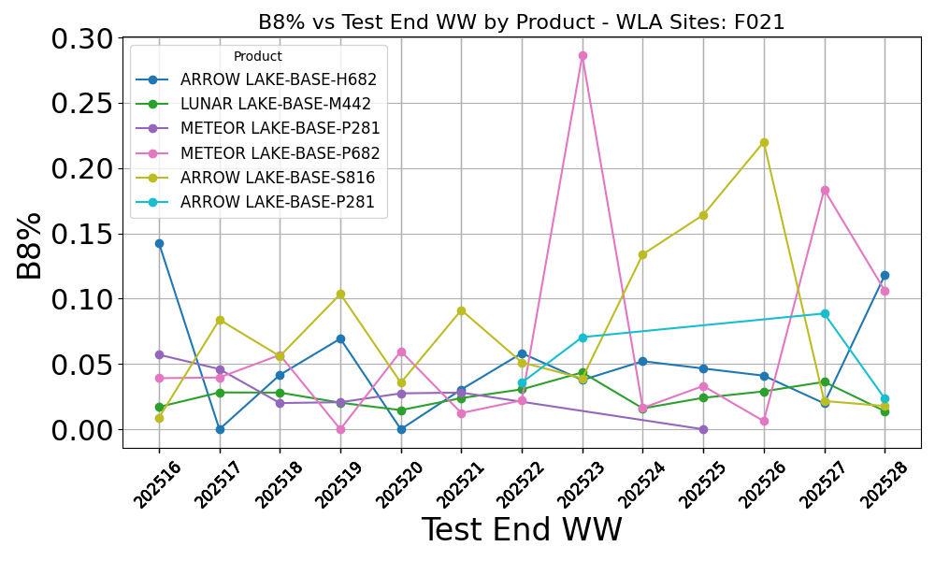
B8% vs Test End WW by Product

Slide 3
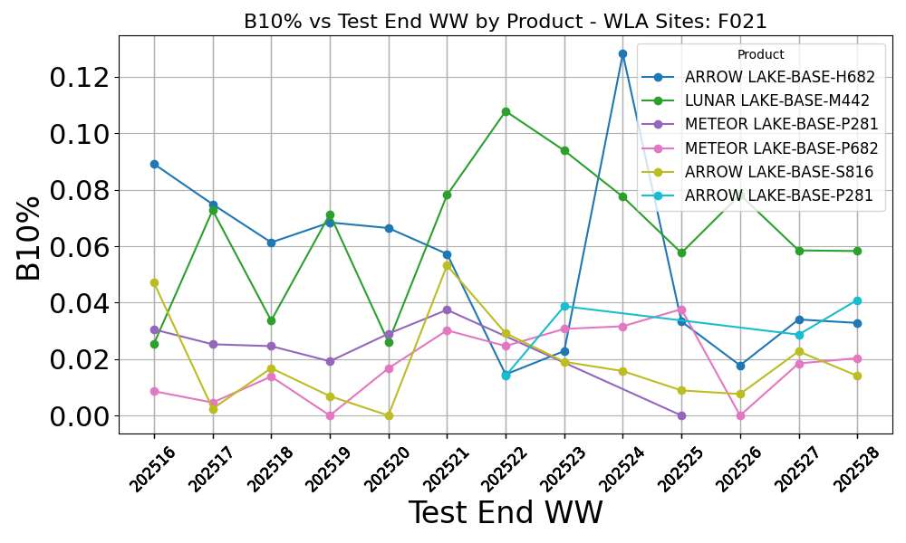
B10% vs Test End WW by Product

Slide 4
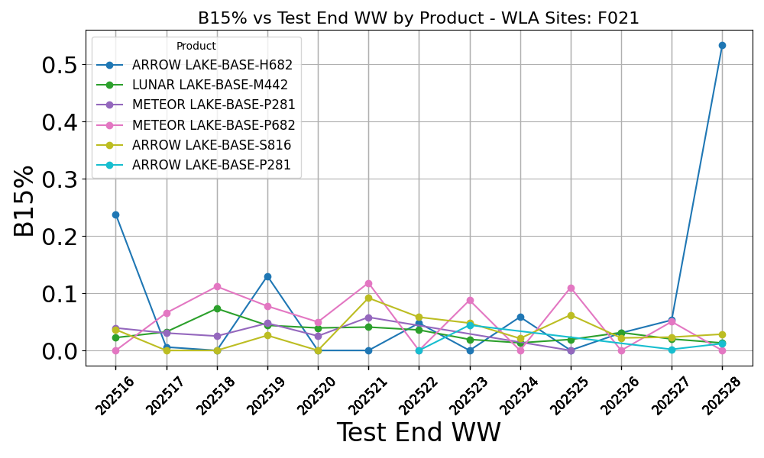
B15% vs Test End WW by Product

Slide 5
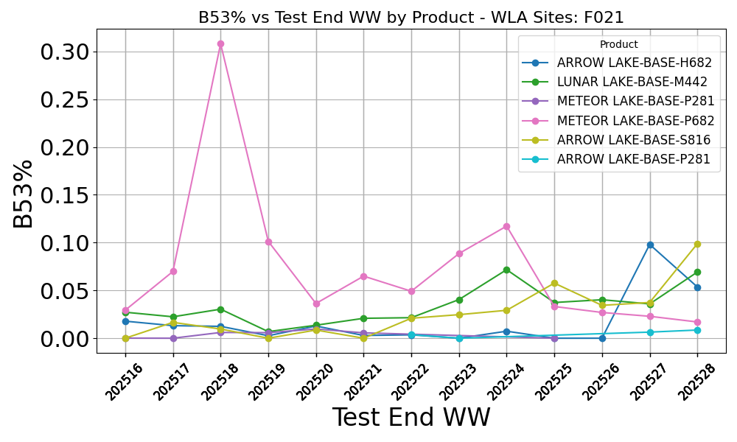
B53% vs Test End WW by Product

Slide 6
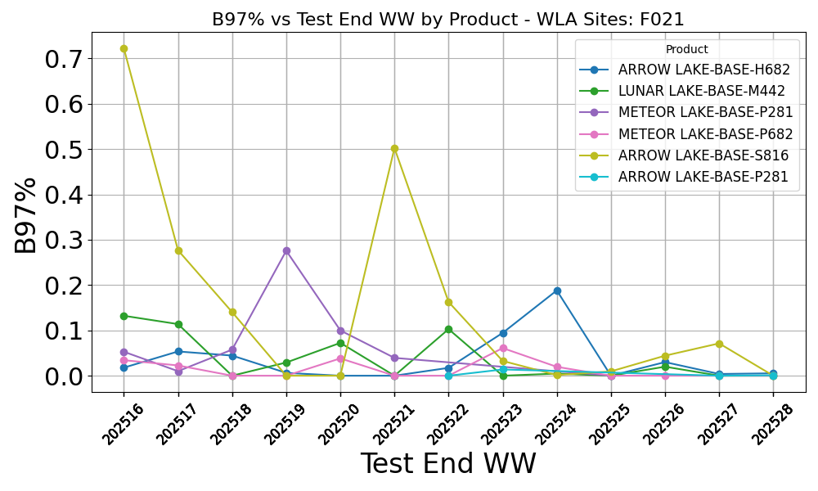
B97% vs Test End WW by Product

Slide 7
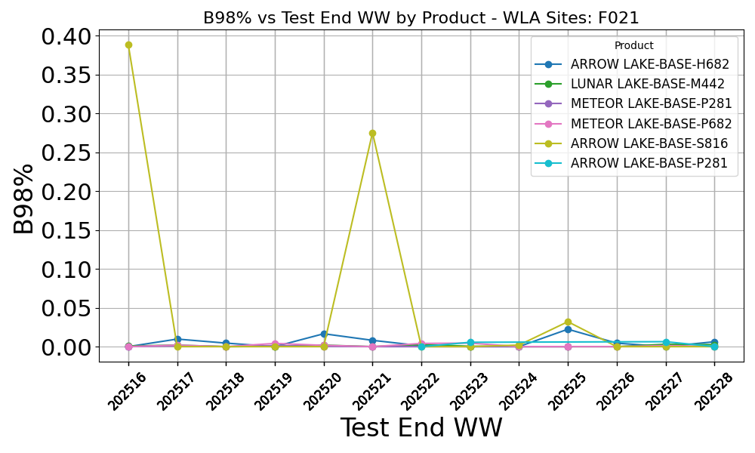
B98% vs Test End WW by Product

Slide 8
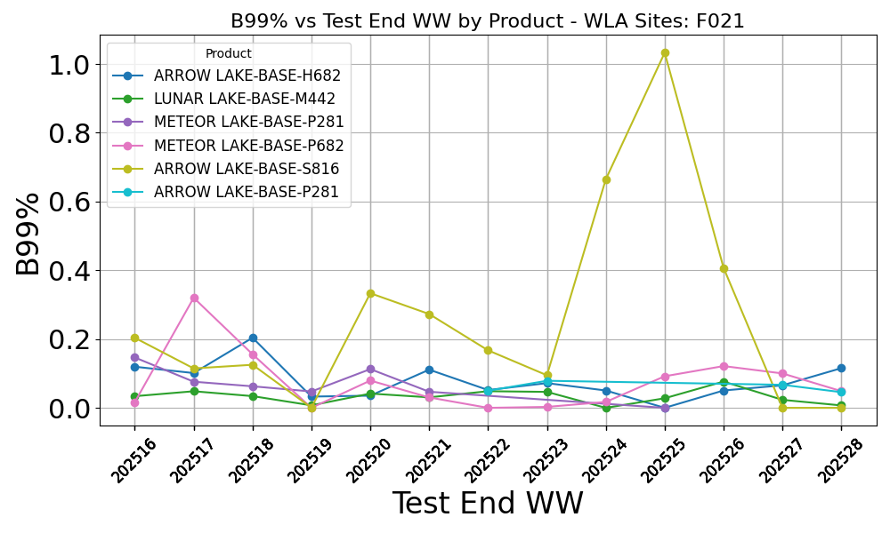
B99% vs Test End WW by Product

Slide 9
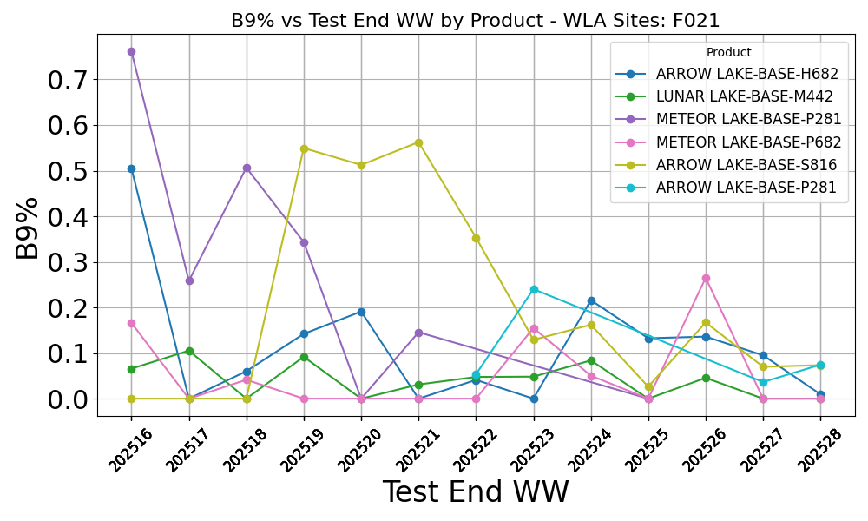
B9% vs Test End WW by Product

Slide 10
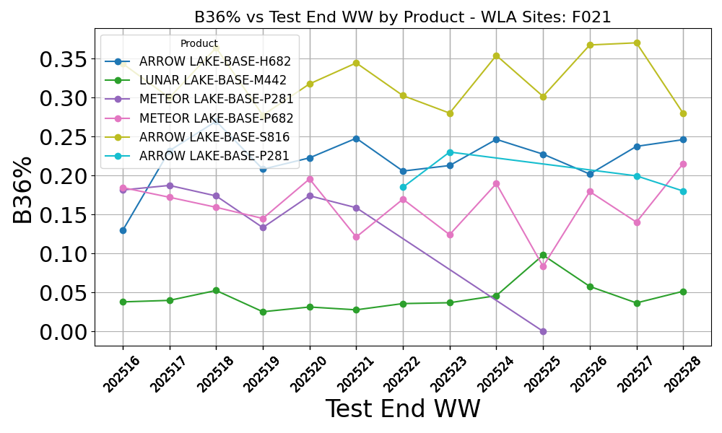
B36% vs Test End WW by Product

Slide 11
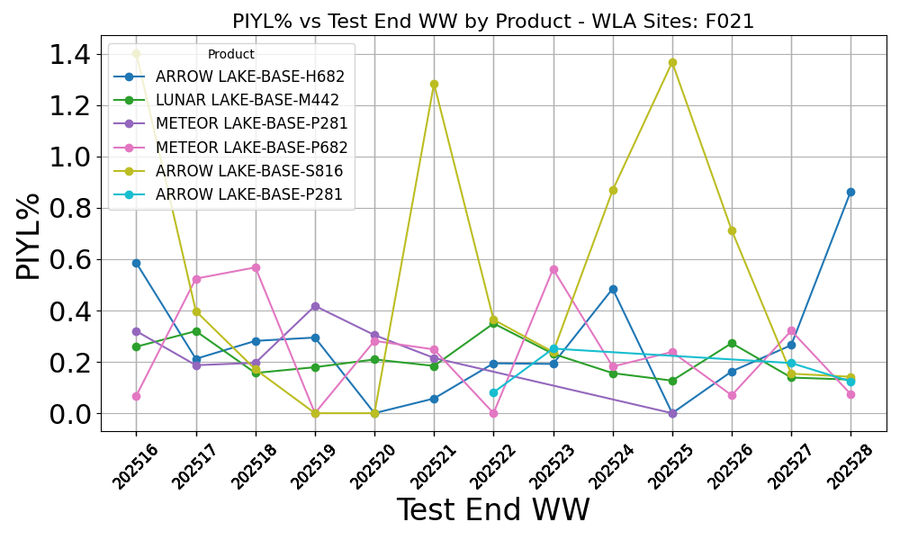
PIYL% vs Test End WW by Product

