Slide 1
Detecting Bias in Loan Default Prediction using Classical and Quantum-Hybrid Approach
Tan Dai Ngo, Jeremy Perkins, Naomi Phan, Joyce van de Vegte, Yuanming Wang, Da Zhang
Notes:
We should NOT read the title :)!

Slide 2
Problem Formulation
✓
The Data
The Task
The Constraint
45,000 Kaggle loan defaults
12 features: 5 categorical + 7 numerical
Binary classification
Predict loan_status: repaid (0) or defaulted (1)
Success is not accuracy alone
Balance FNR & FPR disparity and stay fair across age & income
Notes:
Don’t need to read out all the features.

Slide 3
Motivation
Banks use loan-default predictions to drive real approval decisions.
!
</>
The Bank's Risk — FNR
The Client's Risk — FPR
Predicting “no default” for someone who defaults
The bank loses money on a missed defaulter
Directly drives lending losses
Predicting “default” for someone who would repay
The client is unfairly denied a loan
Erodes trust in the model
How we act on it: Fairlearn constrains models to perform equally across age & income groups through weighting client harm vs. bank harm
Notes:
Don’t need to read out all the features.

Slide 4
Pipeline Overview
</>
✓
Raw Data
45k loan applications
Preprocessing
clean + SMOTE + QELM features
Model Training
XGBoost & Neural Network
Fairness Layer
Max-Min Disparity ≤ 5%
on FPR/FNR (age & income)
XGBoost — 7 variants
Neural Network — 6 variants
Baseline ✓
SMOTE ✓
Baseline ✓
SMOTE ✓
QELM+SMOTE ✓
Weighted —
QELM+SMOTE ✓
13 experiments, same test set, each tuned via 5-fold RandomizedSearchCV (40 iterations XGBoost, 20 NN). ✓ = Fairlearn-wrapped, — = standalone.
Notes:
E.g. > 144 years old. What is isolation forest. iForest trained on training data only. Remind what is SMOTE. Also, why it was important to split off test before iForest and SMOTE.

Slide 5
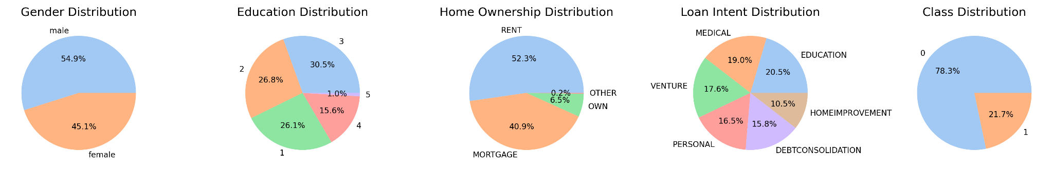
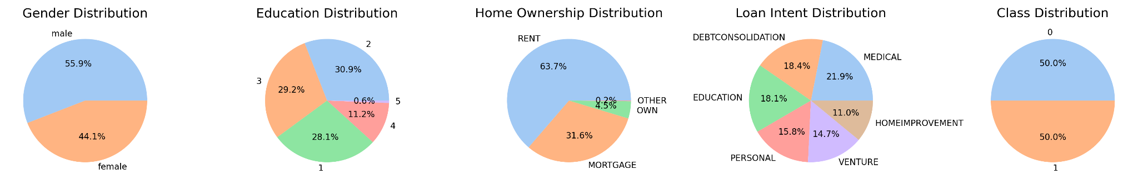
Effect of SMOTE on Categorical Features
What is SMOTE? For each minority class sample, SMOTE finds nearby minority class neighbors and generates new synthetic rows along the line between them, instead of duplicating rows or discarding data.
Before SMOTE
After SMOTE
“Previous loan defaults on file” was dropped, meaning every defaulting sample had no prior flag, a leakage risk SMOTE would have amplified.
Notes:
Very brief on these two slides. Note that class distribution for targets is now 50/50, but some shifting in other distributions…

Slide 6
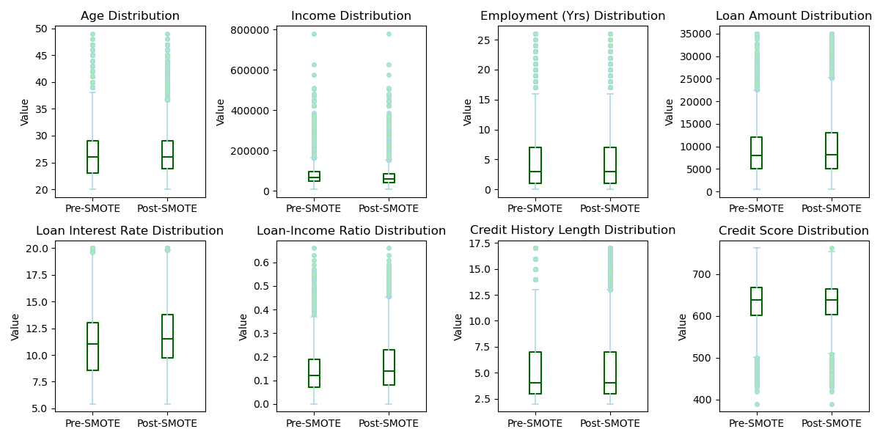
Effect of SMOTE on Numerical Features
Why the numbers barely move: synthetic points are interpolated between real neighbors, not randomly generated, so SMOTE reshapes class balance, not the underlying feature distributions.
But model performance still shifts (F1)
0.781
0.788
0.728
0.680
XGB
Before
XGB
After
NN
Before
NN
After
Helps XGBoost, hurts Neural Network
Age, income, credit score, and other numerical features stay nearly identical pre/post-SMOTE.
Notes:
…more noticeable for numerical features.

Slide 7
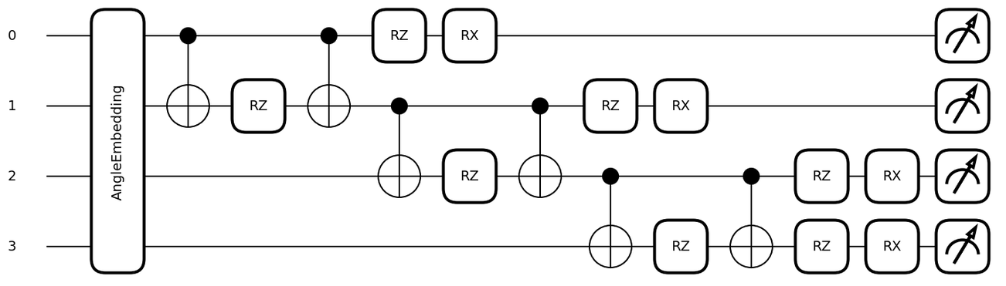
Quantum feature engineering
QELM:
Quantum Extreme Learning Machine
Categorical and numerical features are encoded as angles.
Rotation and entanglement in quantum circuit reveals correlations between features.
For 12 qubits (12 features) quantum states exist in 2¹² = 4096 dimensions.
At output, quantum states collapse to classical bits according to a probability distribution.
Observables (expectation values) create 78 quantum features.
Notes:
Entangling gates capture nonlinear correlations across multiple features. One layer is shown. Layers can be chained together for more expressivity.

Slide 8

One-slide quantum primer
Computational basis states for 1 qubit: |0⟩ and |1⟩
3-qubit quantum state in superposition
When measured, a quantum state collapses to classical bits.
Probability of measuring 000 is 0.7 and probability of measuring 110 is 0.3 (Born’s rule).
Observable detects patterns of qubits and interactions between qubits:
Probabilities determine expected values of observables.

Slide 9
XGBoost, AdaBoost, and Gradient Boost
Comparison of AdaBoost and Gradient Boosting:
Both are power sequential ensemble techniques
Both focuses on current ensemble’s misclassified examples
AdaBoost: changes the sample weights for the next learner
Gradient Boost: calculates the negative gradient of loss for the next learner
  Current negative gradient of loss value for each example
  —> the responses for the next learner (residual learning)

Slide 10
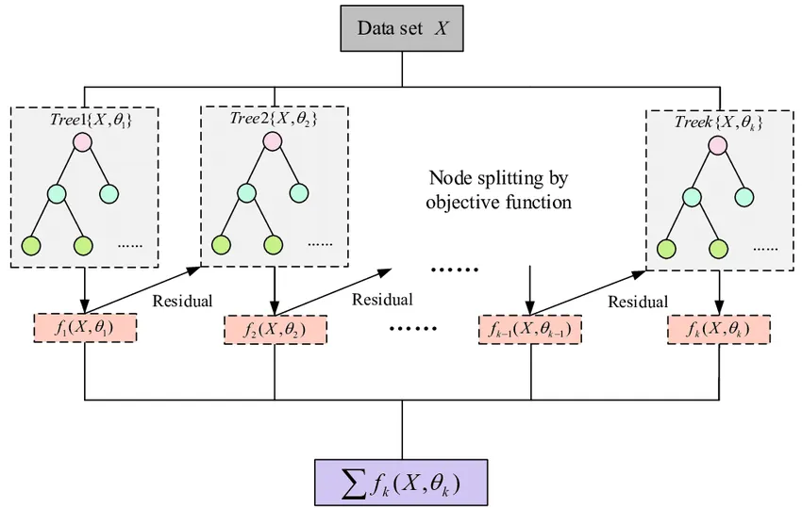
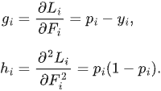

XGBoost Algorithm
XGBoost is an optimized implementation and extension of Gradient Boost
The next learner uses both gradient and hessian information of each example
Think of XGB as a Newton-Style second order correction on top of the Gradient Boosting

Slide 11
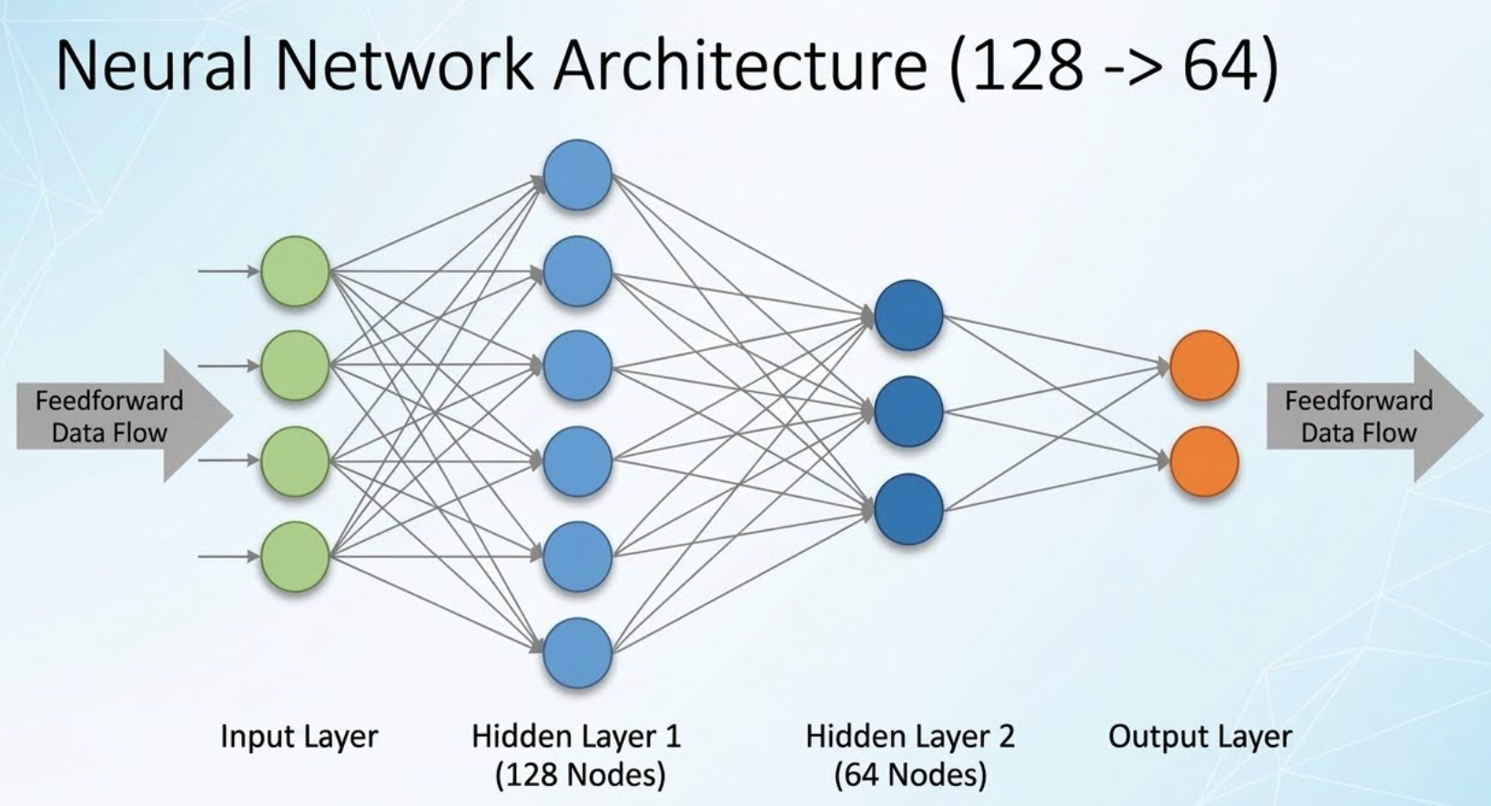

Neural Network model
Model setup
Feed-forward Multilayer Perceptron
Numeric features standardized; Categorical features one-hot encoded
Early stopping to reduce overfitting
Selected baseline architecture
Two hidden layers: 128 → 64
tanh activation, Adam optimizer
Compared baseline, SMOTE, and QELM variants
Notes:
We also train a neural network which gives us a flexible nonlinear comparison to XGBoost.
Beyond the baseline network, we also tested SMOTE and QELM(Quantum Extreme Learning Machine) variants to see whether performance improves more from class balancing or from richer feature representations.

Slide 12
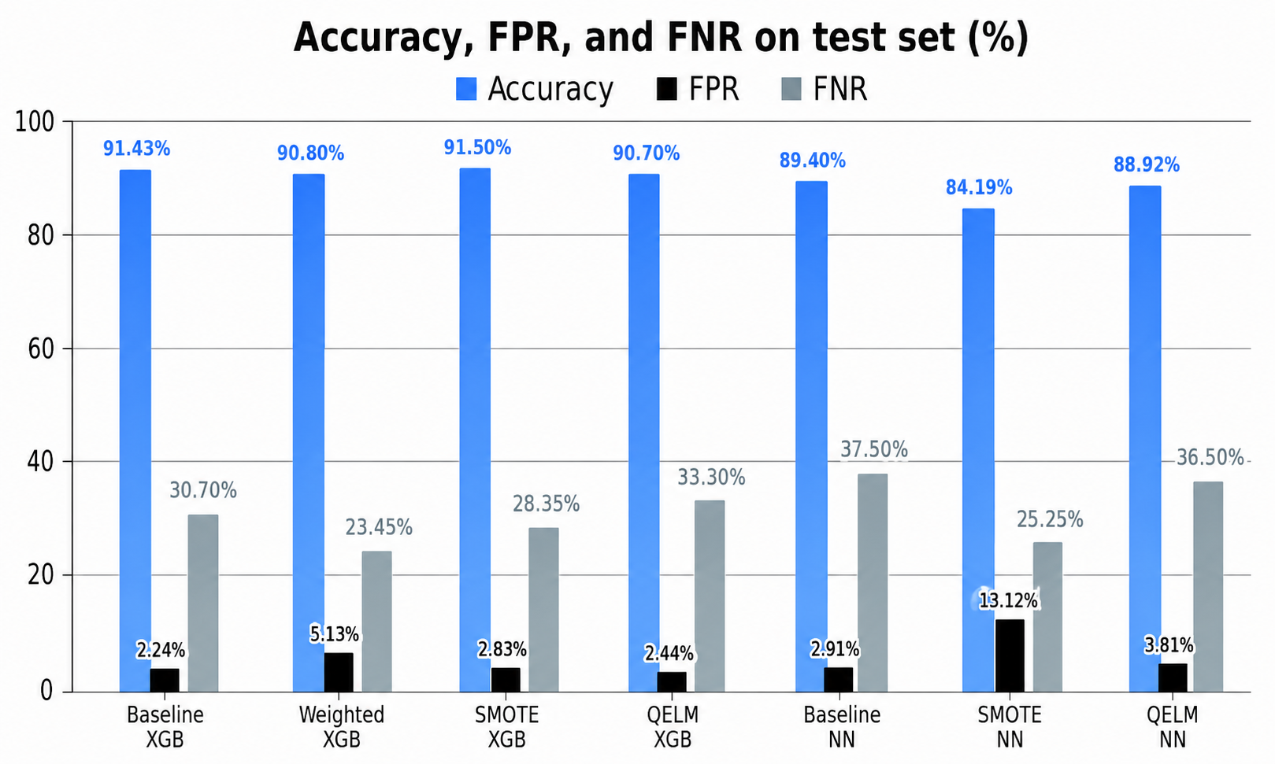
Model results
Main findings
XGBoost remains the strongest overall baseline: about 91% accuracy.
Weighted XGBoost reduces FNR, but raises FPR.
SMOTE NN lowers FNR, but FPR rises sharply.
QELM is competitive, but does not beat baseline/SMOTE.
The final choice depends on the cost of bank risk vs. borrower risk.
Notes:
The main takeaway is trade-off rather than a single best model.
QELM(Quantum Extreme Learning Machine) is competitive, especially with XGBoost, but it does not clearly outperform the strongest classical setup.
Weighted XGBoost gives the lowest missed-default rate, while SMOTE helps the neural network catch more defaults at the cost of many more false alarms.
So the best choice depends on whether we care more about bank risk or borrower risk.

Slide 13





Fairlearn-Constrained Debiasing
Age
Open-source
Identify & mitigate biases in models
Constraint models to perform equally well across groups
Model bias
If one group is more often misclassified
Unable to reverse bias in data collection process
Age + Income
Constraint on FPR and FNR (5%)
Max - Min Disparity
Accuracy Declines
1
2
3
Income
1
2
3
Notes:
We did not know about this at the start

Slide 14
Methodology for Assessing Fairness Objective
Debiasing Objective: Satisfy equalized odds.
  Each demographic group should experience the same FNR & FPR.
Reduce the disparity (Max Rate – Min Rate) between levels of features for both FNR and FPR: ∆ FNR, ∆ FPR
  Numerical features partitioned into 4 to 6 quantile-based bins (equal sample sizes per bin)
  Calculate FNR & FPR separately per feature level, then get disparity for the feature.

Slide 15
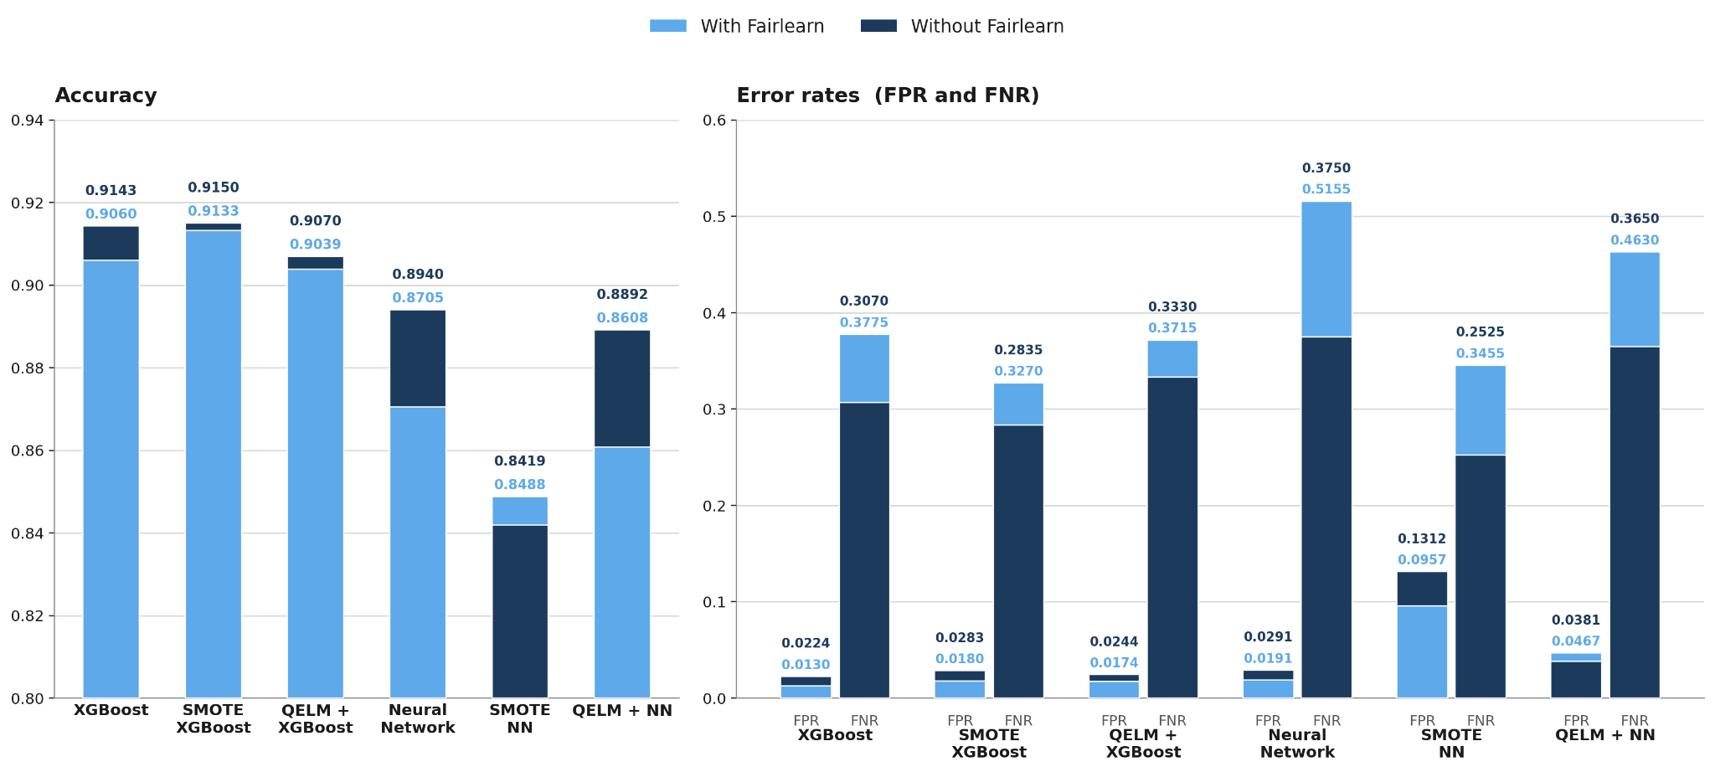
Fairlearn Overall Results

Slide 16
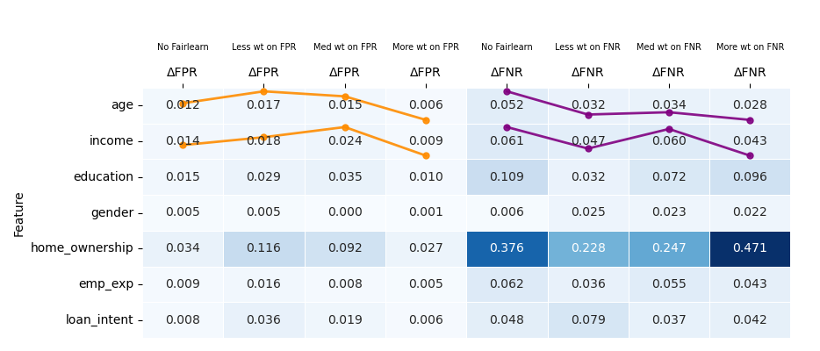
FPR/FNR disparity heatmap: Fairlearn with NN (No SMOTE)
Method: Applied Fairlearn constraints to the Neural Network.
Mechanism: Weighted FPR or FNR disparity more heavily via a custom cost matrix.
Outcome: Successfully reduced bias on specific features (age & income)

Slide 17
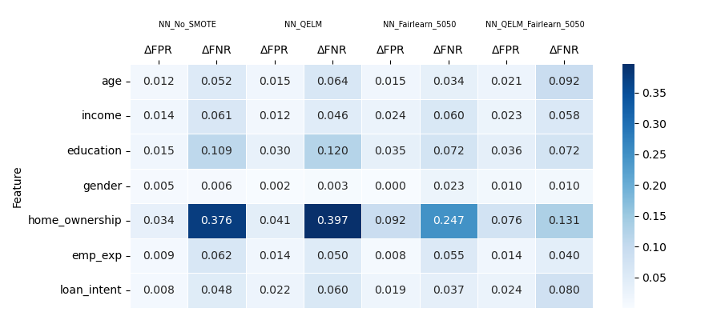
FPR/FNR disparity heatmap: QELM Fairlearn 50/50 (NN)
Quantum feature engineering & Fairlearn produces a lower bias model overall.
Did not improve ∆ FNR,
∆ FPR for constrained features.

Slide 18

Questions?

Slide 19
XGBoost Hyperparameters and Tuning
Key Hyperparameters:
n_estimators
max_depth
learning_rate
min_child_weight
reg_lambda: L2 regularization
reg_alpha: L1 regularization
Tuning Strategy:
RandomizedSearchCV(): Randomized search + K-fold CV

Slide 20
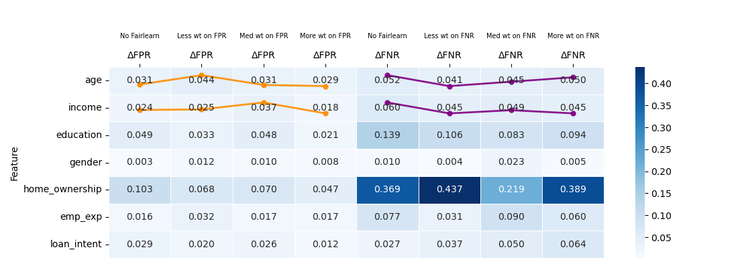
FPR/FNR disparity heatmap: Fairlearn & SMOTE with NN
With SMOTE, disparity reduction not as effective.
Satisfying constraints on synthetic data does not translate well to test set.

Slide 21
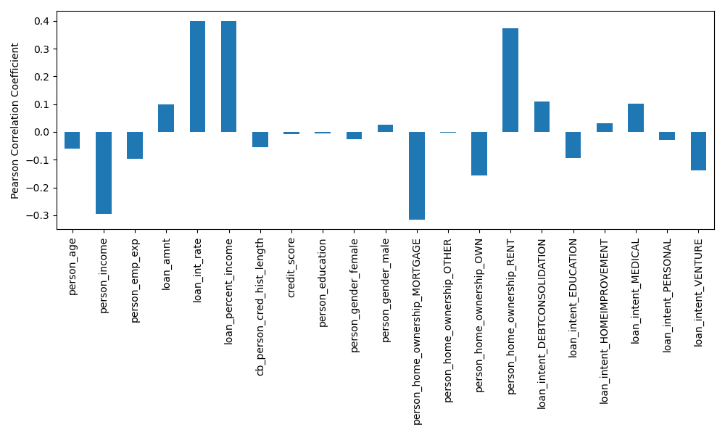
Correlation of features with target

Slide 22
All models
Model | Accuracy | F1-score | Precision | Recall | TPR | TNR | FPR | FNR
Baseline XGBoost | 0.9143 | 0.7824 | 0.8983 | 0.6930 | 0.6930 | 0.9776 | 0.0224 | 0.3070
Fairlearn XGBoost | 0.9060 | 0.7464 | 0.9319 | 0.6225 | 0.6225 | 0.9870 | 0.0130 | 0.3775
QELM Fairlearn XGBoost | 0.9039 | 0.7440 | 0.9115 | 0.6285 | 0.6285 | 0.9826 | 0.0174 | 0.3715
Weighted XGBoost | 0.9080 | 0.7871 | 0.8101 | 0.7655 | 0.7655 | 0.9487 | 0.0513 | 0.2345
SMOTE XGBoost | 0.9150 | 0.7893 | 0.8786 | 0.7165 | 0.7165 | 0.9717 | 0.0283 | 0.2835
SMOTE Fairlearn XGBoost | 0.9133 | 0.7753 | 0.9144 | 0.6730 | 0.6730 | 0.9820 | 0.0180 | 0.3270
Baseline NN | 0.8940 | 0.7238 | 0.8597 | 0.6250 | 0.6250 | 0.9709 | 0.0291 | 0.3750
Fairlearn NN | 0.8705 | 0.6246 | 0.8785 | 0.4845 | 0.4845 | 0.9809 | 0.0191 | 0.5155
QELM Fairlearn NN | 0.8608 | 0.6316 | 0.7666 | 0.5370 | 0.5370 | 0.9533 | 0.0467 | 0.4630
SMOTE NN | 0.8419 | 0.6775 | 0.6196 | 0.7475 | 0.7475 | 0.8688 | 0.1312 | 0.2525
SMOTE Fairlearn NN | 0.8488 | 0.6580 | 0.6614 | 0.6545 | 0.6545 | 0.9043 | 0.0957 | 0.3455

Slide 23
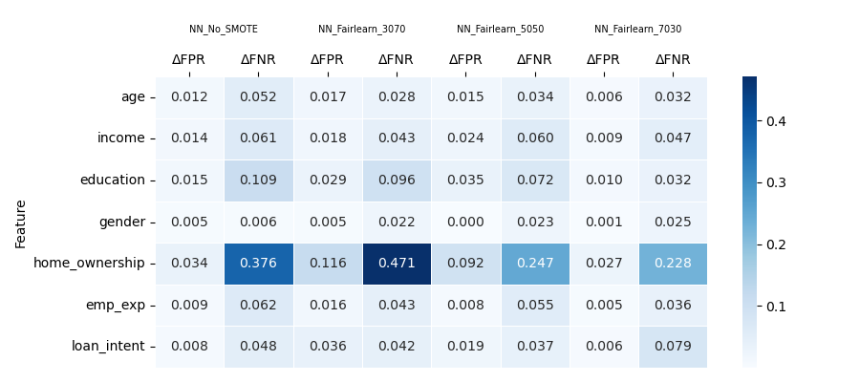
FPR/FNR disparity heatmap: Fairlearn with NN (No SMOTE)
increasing weight on FPR disparity
increasing weight on FNR disparity
Method: Applied Fairlearn constraints to the Neural Network.
Mechanism: Weighted FPR or FNR disparity more heavily via a custom cost matrix.
Outcome: Successfully reduced bias on specific features (age & income)

Slide 24
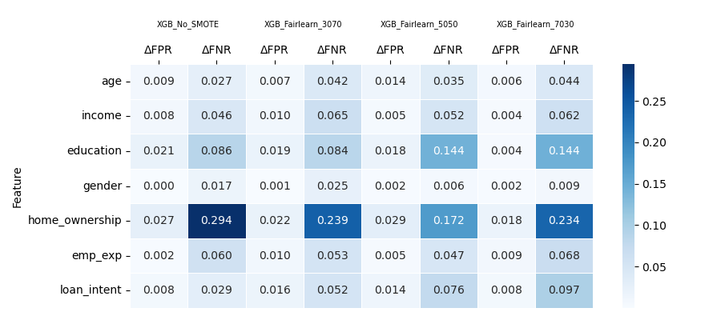
FPR/FNR disparity heatmap: Fairlearn with XGBoost (No SMOTE)
increasing weight on FP error
increasing weight on FN error
Fairlearn does not behave predictably for XGBoost.
Shifts due to Fairlearn constraints may cause variance in tree structure leading to complex optimization surface.

Slide 25
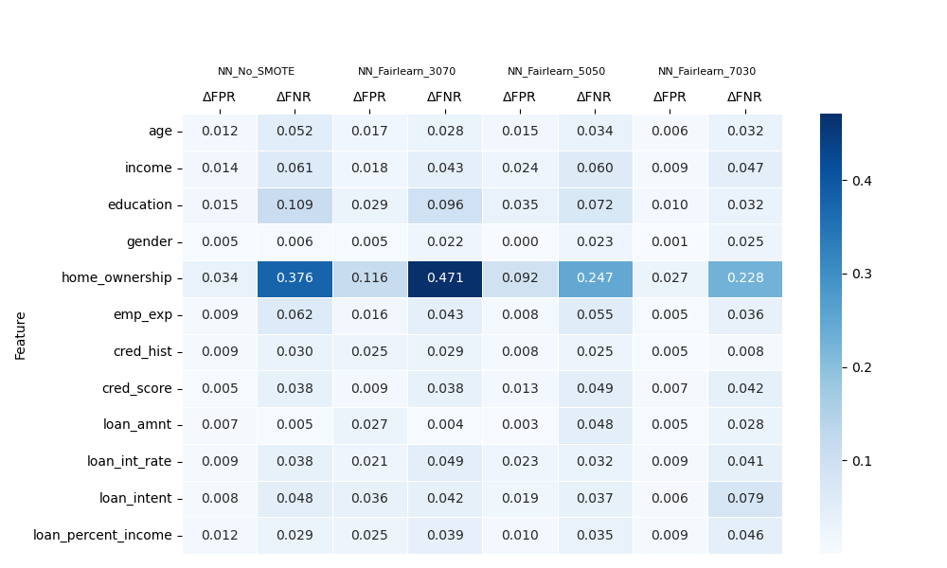
FPR/FNR disparity heatmaps: No SMOTE Fairlearn (NN)
increasing weight on FPR disparity
increasing weight on FNR disparity
By weighting FPR disparity or FNR disparity more heavily through cost matrix, Fairlearn constraints can reduce bias on designated features in neural network.

Slide 26
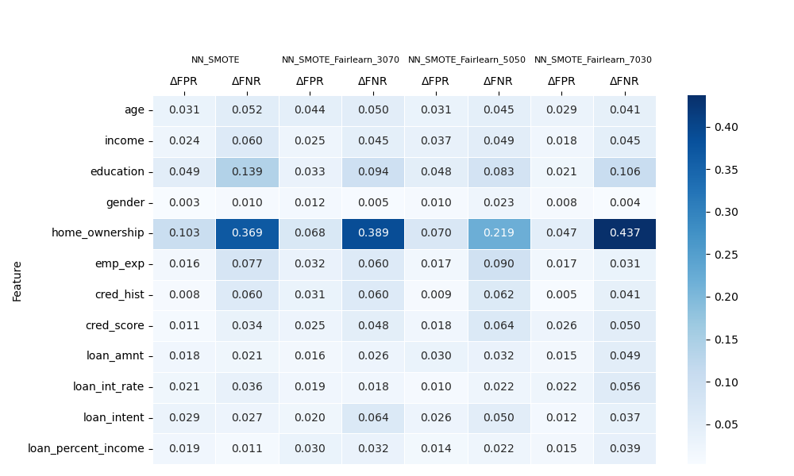
FPR/FNR disparity heatmaps: SMOTE Fairlearn (NN)
increasing weight on FPR disparity
increasing weight on FNR disparity
Effects of Fairlearn constraints are reduced when SMOTE is applied to training data. SMOTE dilutes sensitivity to decision boundaries.
Satisfying constraints on synthetic data does not translate well to test set.

Slide 27
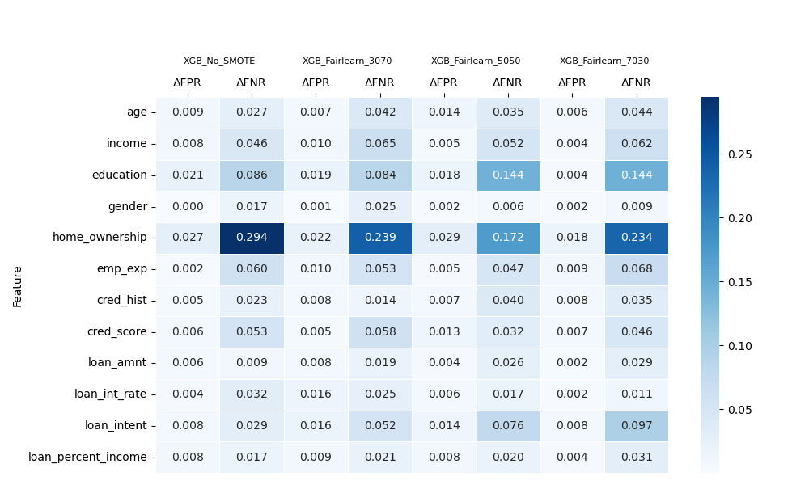
FPR/FNR disparity heatmaps: No SMOTE Fairlearn (XGBoost)
increasing weight on FPR disparity
increasing weight on FNR disparity
Fairlearn does not behave predictably for XGBoost models.
Shifts due to Fairlearn constraints may cause variance in tree structure leading to complex optimization surface.

Slide 28
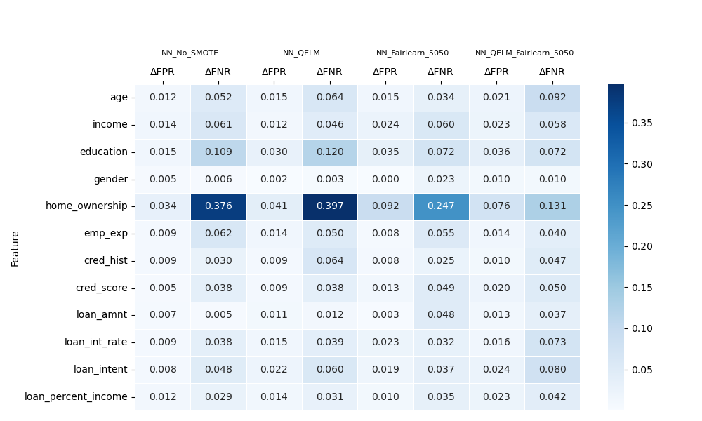
FPR/FNR disparity heatmaps: QELM Fairlearn 50/50 (NN)
QELM feature engineering combined with Fairlearn produces a lower bias model overall, though not for constrained features and in an inexplicable manner.

Slide 29
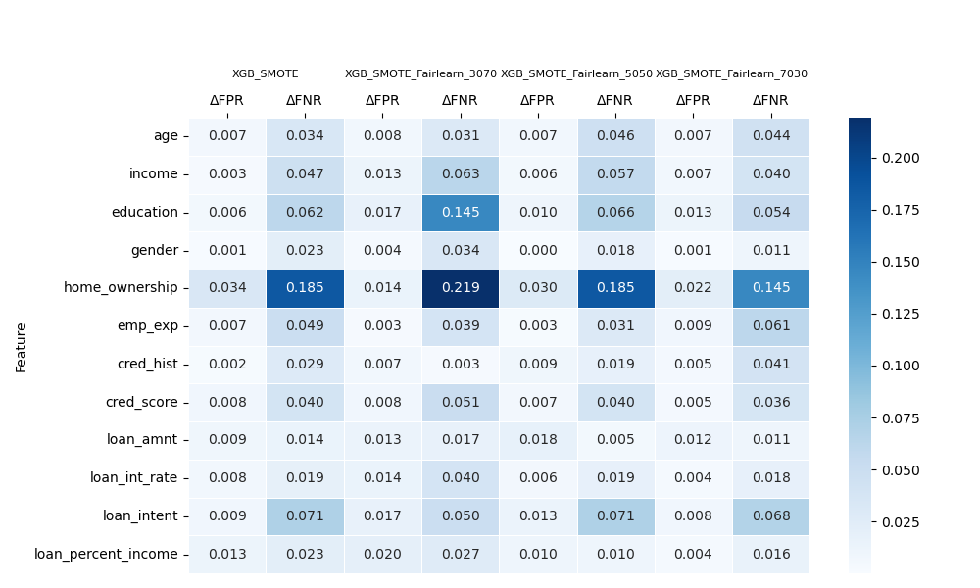
FPR/FNR disparity heatmaps: SMOTE Fairlearn (XGBoost)

Slide 30
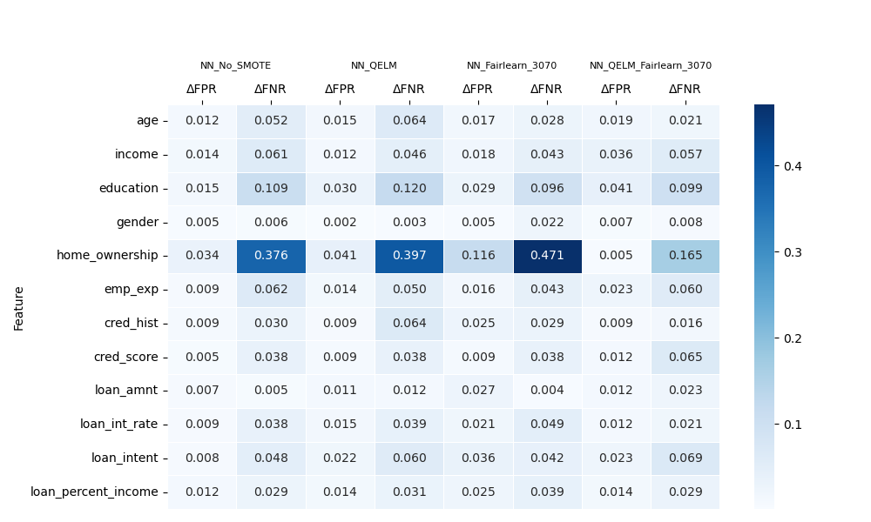
FPR/FNR disparity heatmaps: QELM 30/70 (NN)

Slide 31
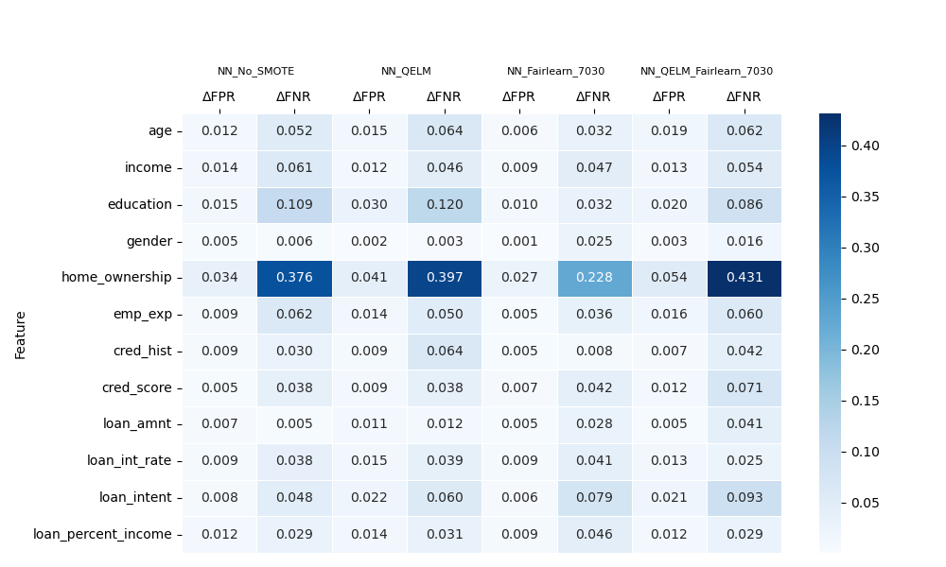
FPR/FNR disparity heatmaps: QELM 70/30 (NN)

Slide 32
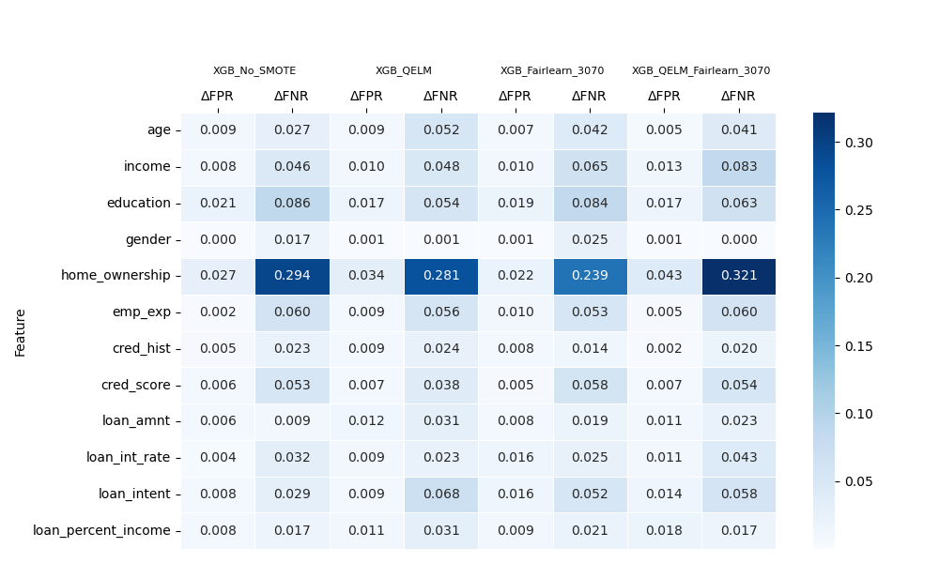
FPR/FNR disparity heatmaps: QELM 30/70 (XGBoost)

Slide 33
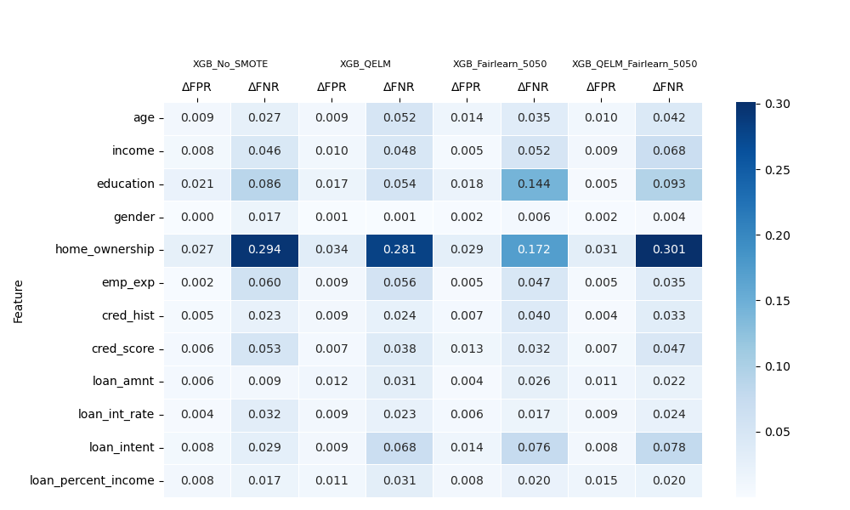
FPR/FNR disparity heatmaps: QELM 50/50 (XGBoost)

Slide 34
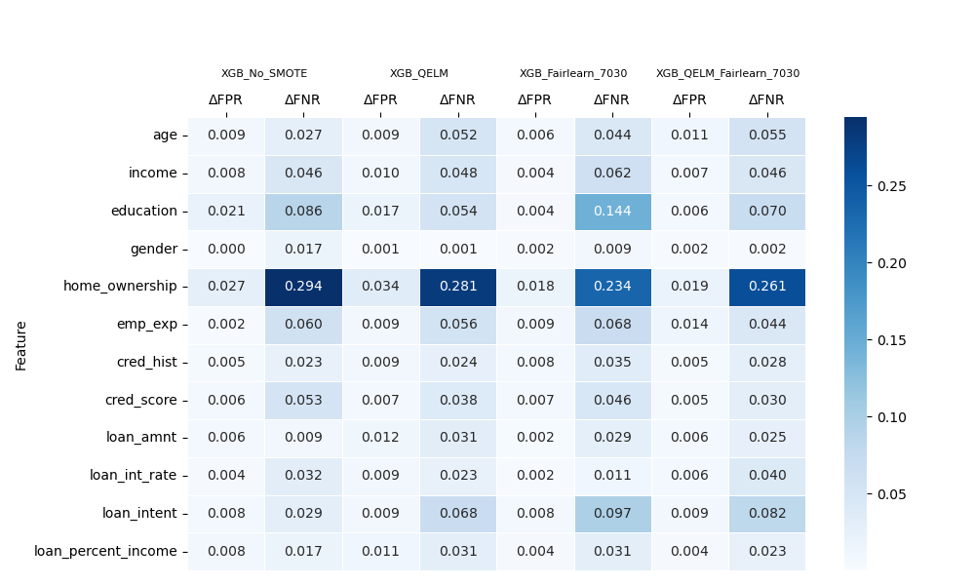
FPR/FNR disparity heatmaps: QELM 70/30 (XGBoost)

Slide 35
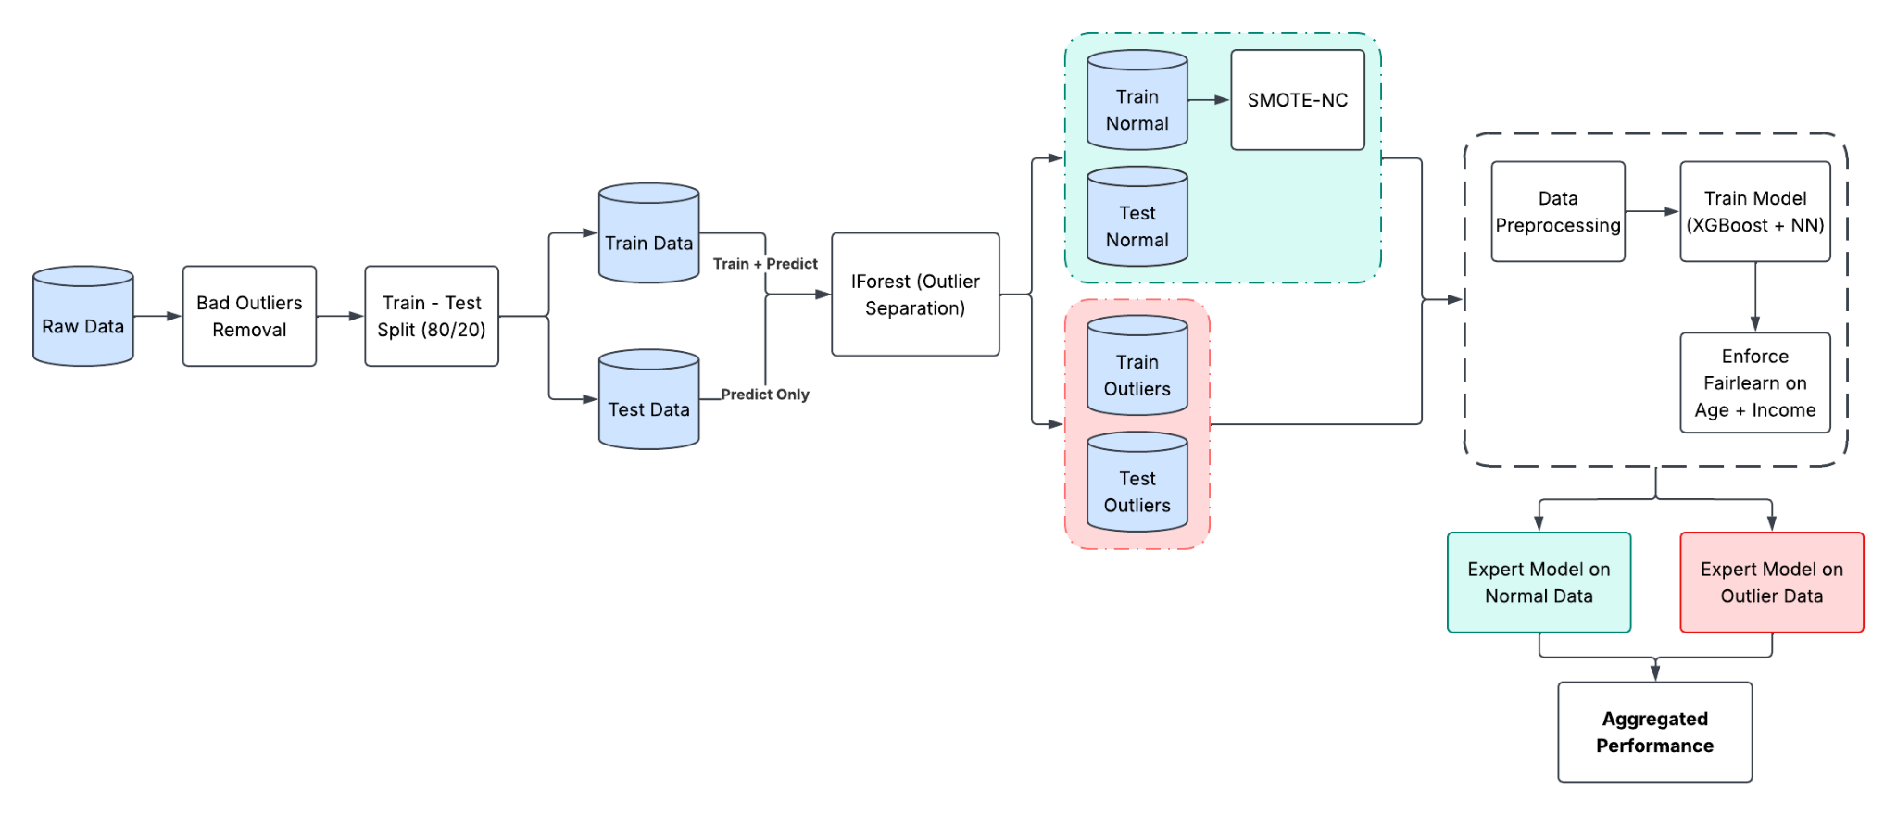
Key pipeline elements
Notes:
E.g. > 144 years old. What is isolation forest. iForest trained on training data only. Remind what is SMOTE. Also, why it was important to split off test before iForest and SMOTE.

