Slide 1
s-SNOM Measurements
October 25, 2017
Leaky wave antenna, design #4 (more asymmetric)
Under linear polarization
k vector parallel to TL

Slide 2
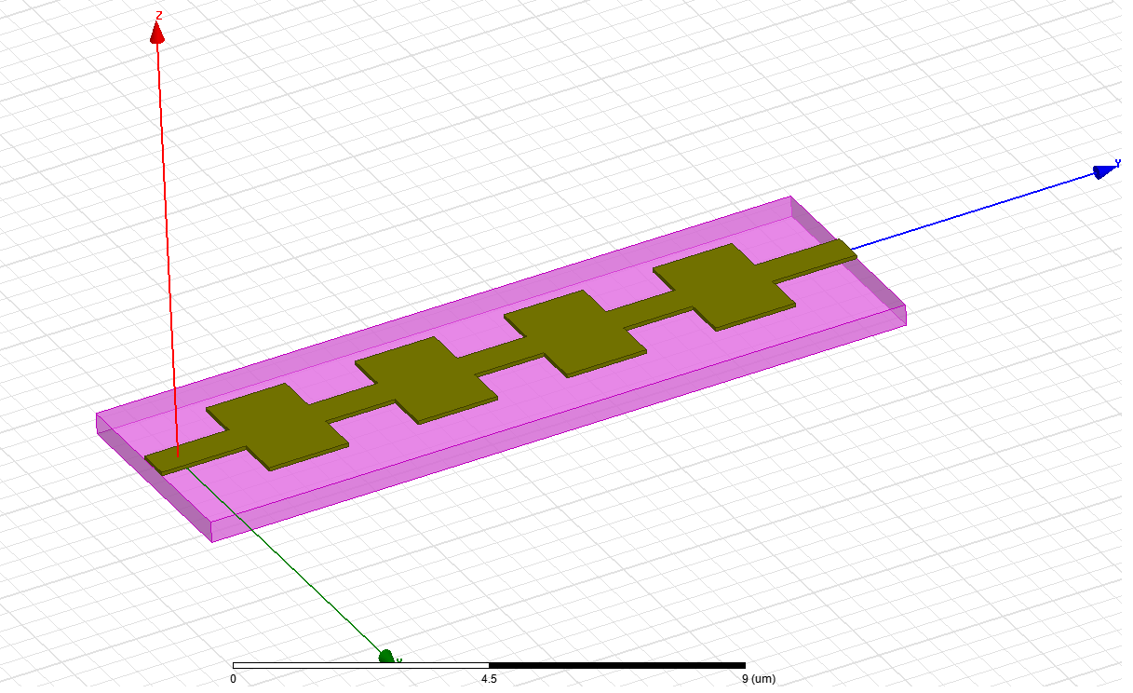
Illumination conditions
Z
E_{i}
Incident wave θ = 60º
Light: linear polarization
Incidence: p-polarization (k and E vectors are in the YZ plane)
Structure A4
Y
θ
k-vector
X

Slide 3
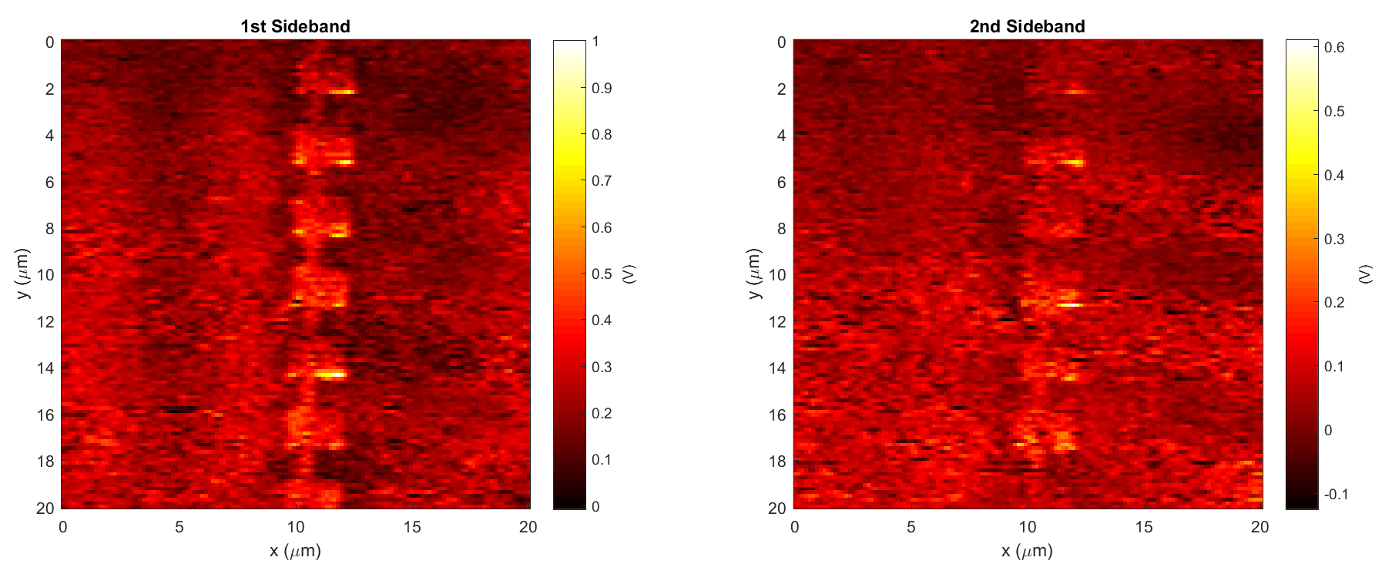
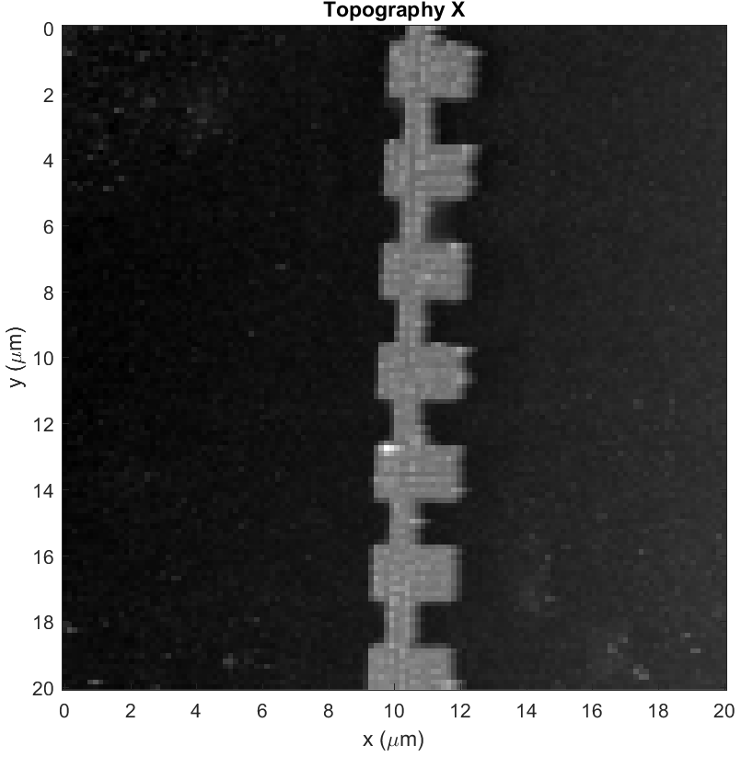
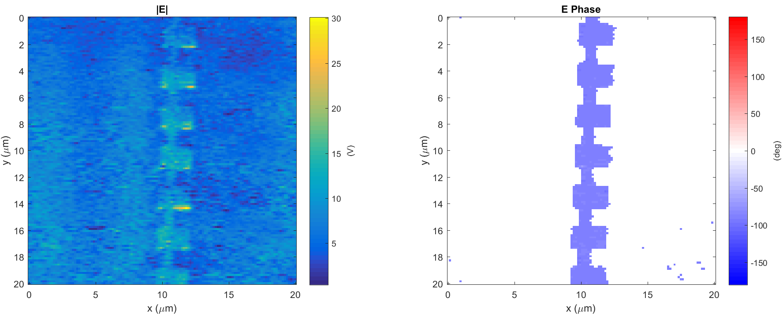
Leaky wave antenna, design #4 (A4)
Data: 2017-10-25_leaky_A4_PH_X_1
k
Light incident from below

Slide 4
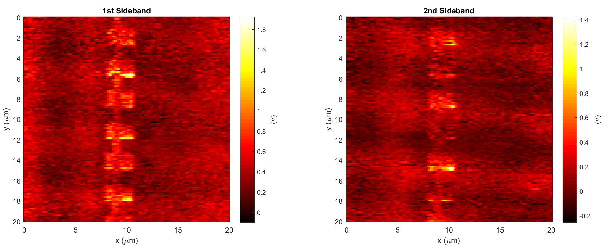
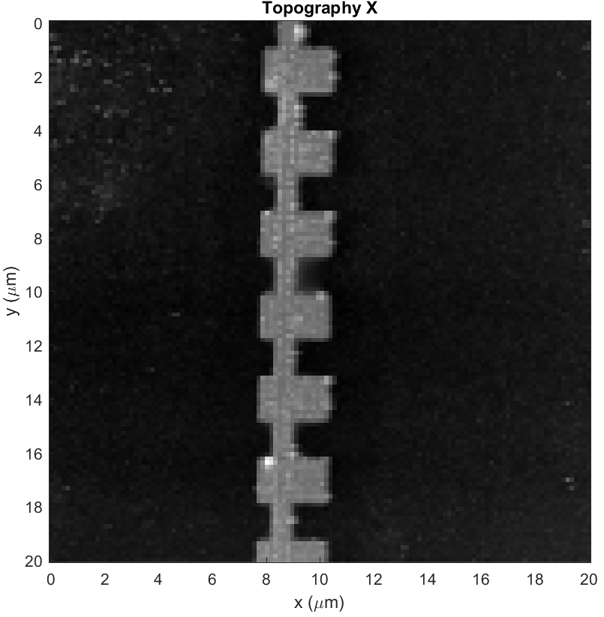
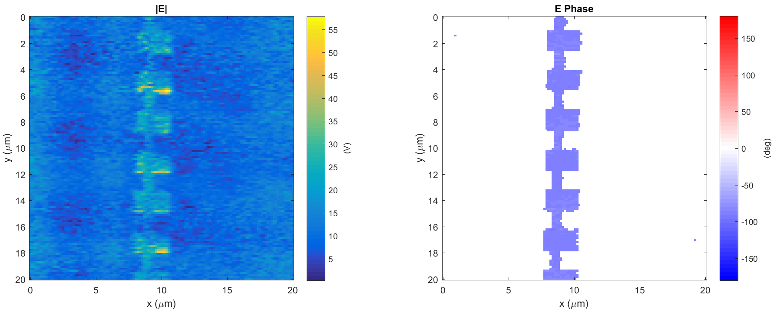
Leaky wave antenna, design #4 (A4)
Data: 2017-10-25_leaky_A4_PH_X_5
k
Light incident from below

Slide 5
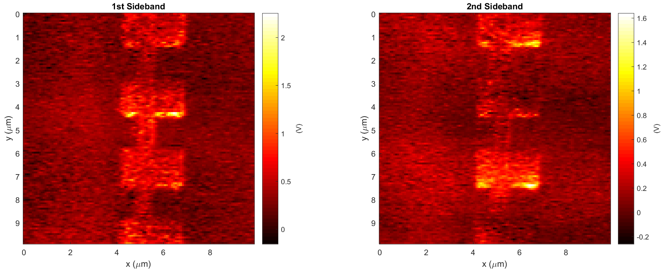
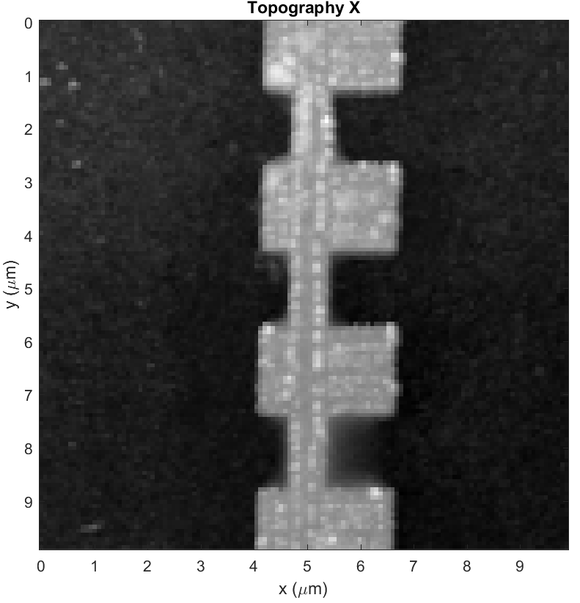
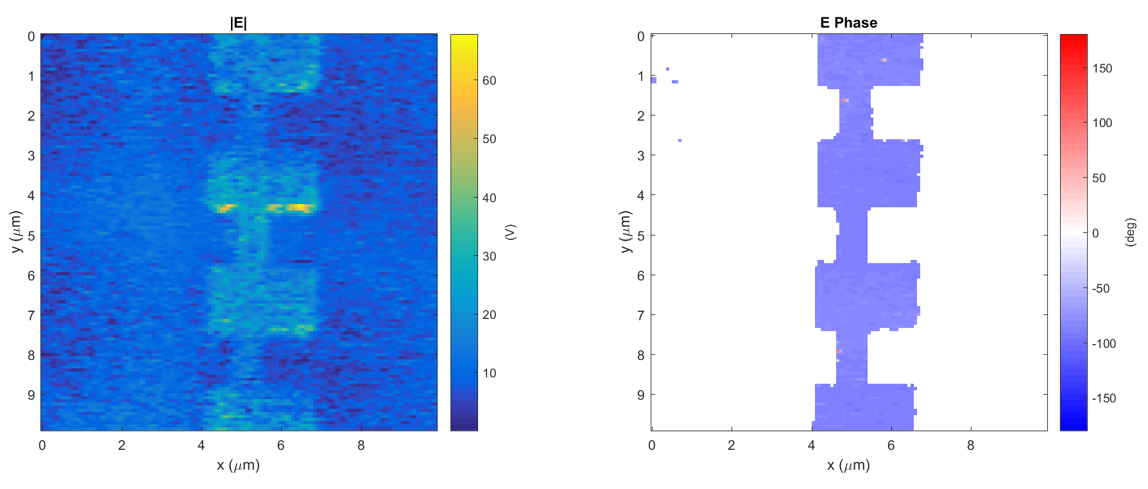
Leaky wave antenna, design #4 (A4)
Data: 2017-10-25_leaky_A4_PH_X_6
k
Light incident from below

