Slide 1
s-SNOM Measurements
November 2, 2017
Leaky wave antenna, design #4 (more asymmetric)
Under linear polarization
k vector parallel to TL

Slide 2
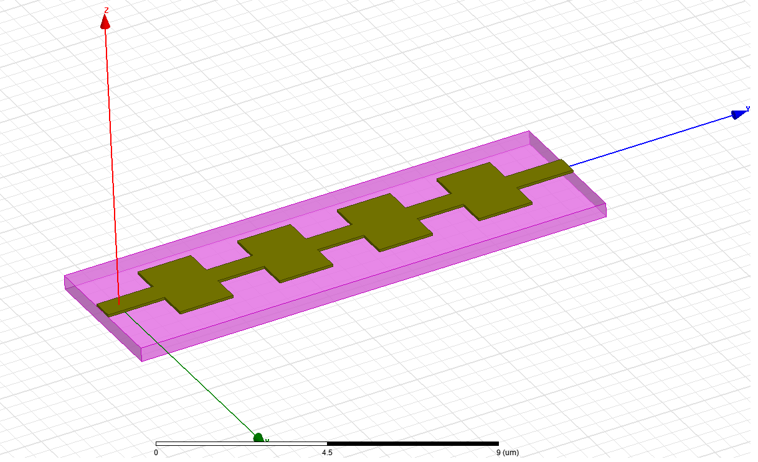
Illumination conditions
Z
E_{i}
Incident wave θ = 60º
Light: linear polarization
Incidence: p-polarization (k and E vectors are in the YZ plane)
Structure A4
Y
θ
k-vector
X

Slide 3
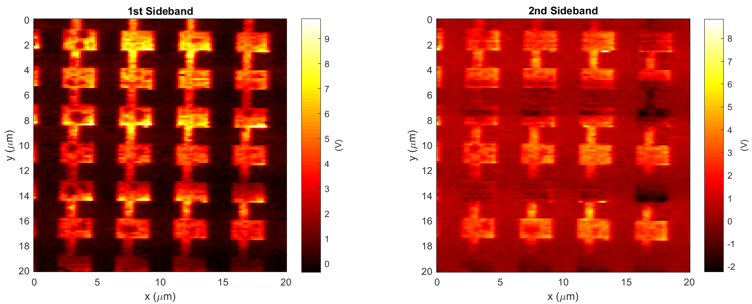
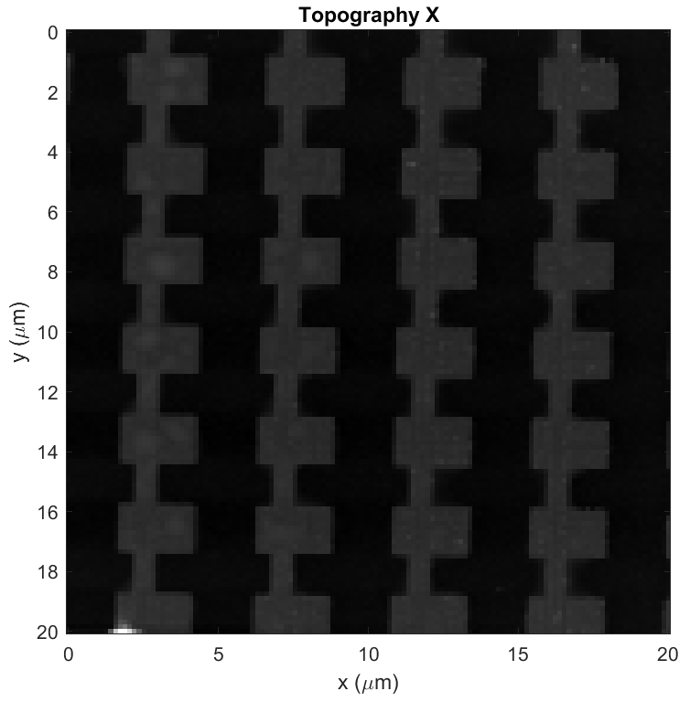
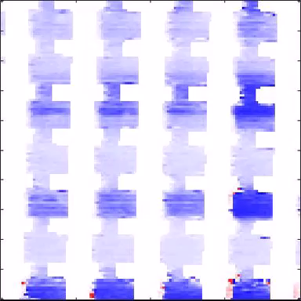
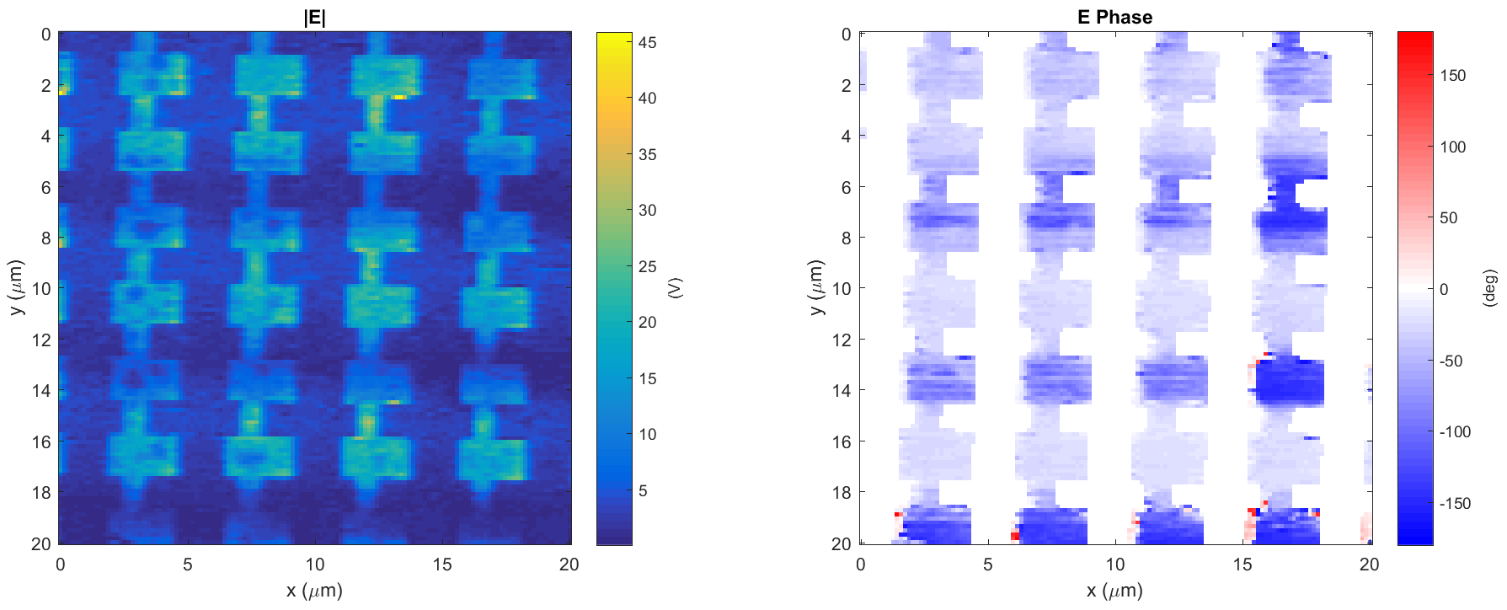
Leaky wave antenna, design #4 (E4)
Data: 2017-11-02_leaky_E4_PH_X_4
k
Light incident from below

Slide 4
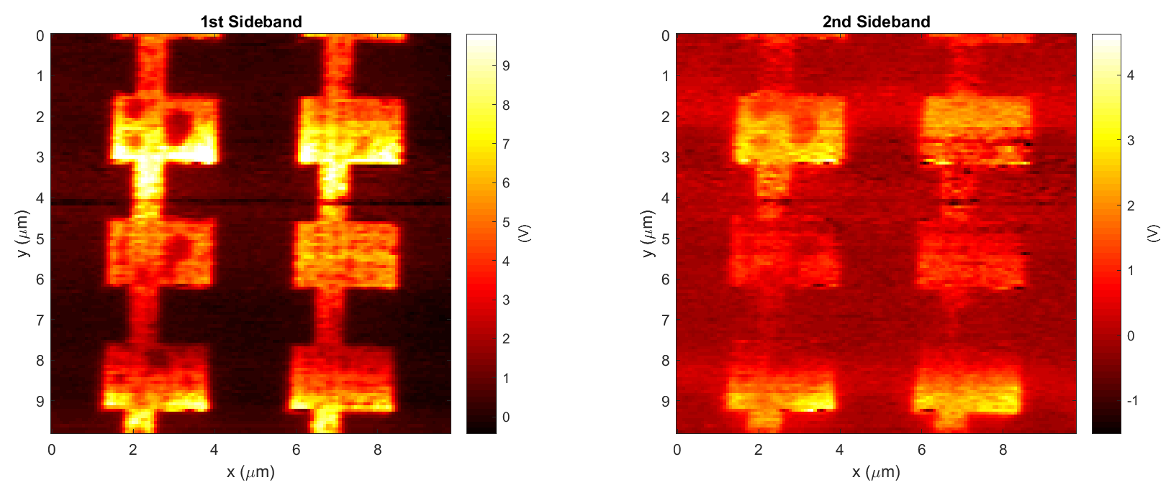
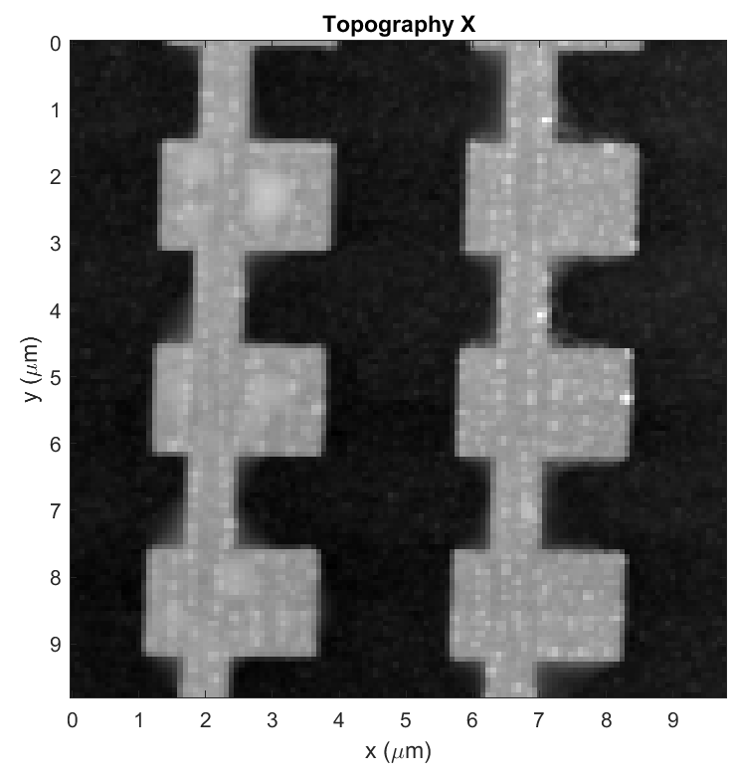
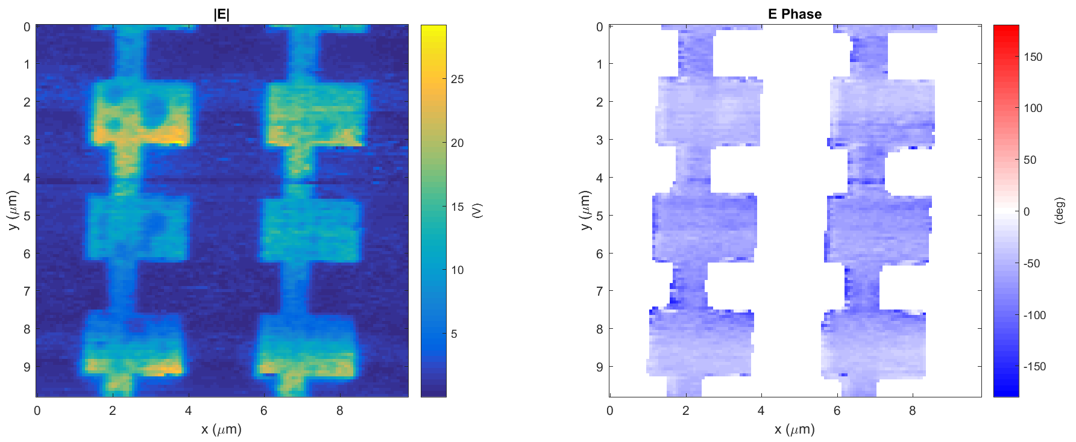
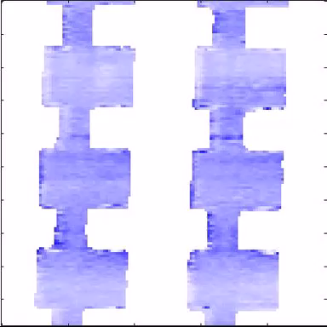
Leaky wave antenna, design #4 (E4)
Data: 2017-11-02_leaky_E4_PH_X_5
k
Light incident from below

Slide 5
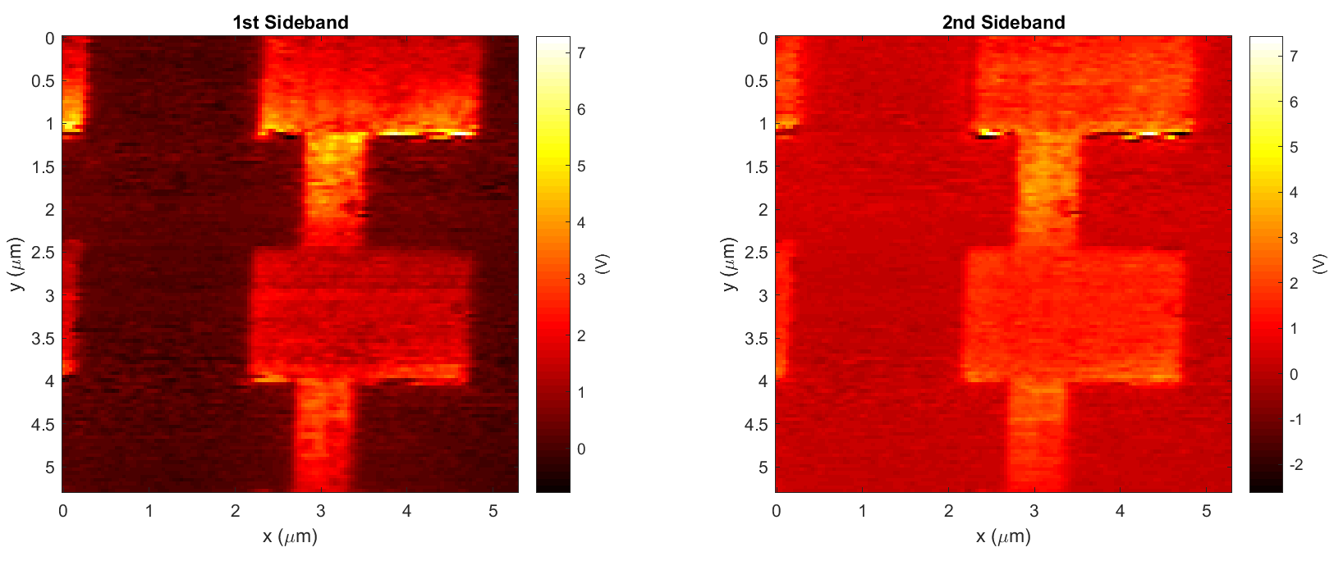
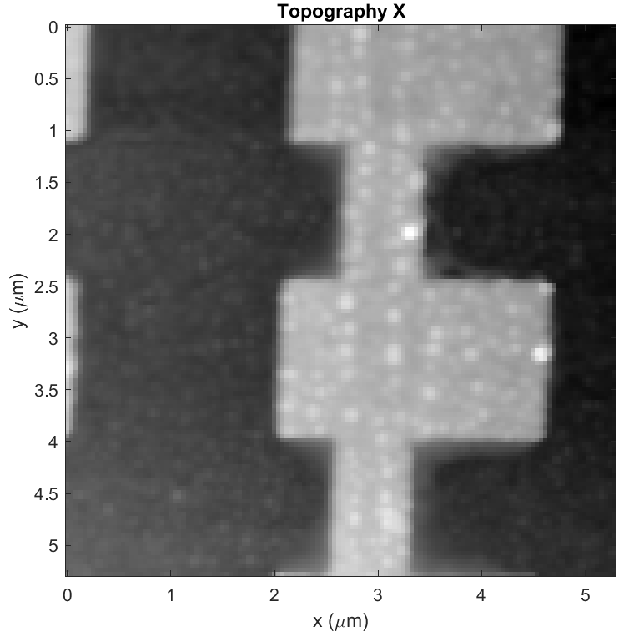
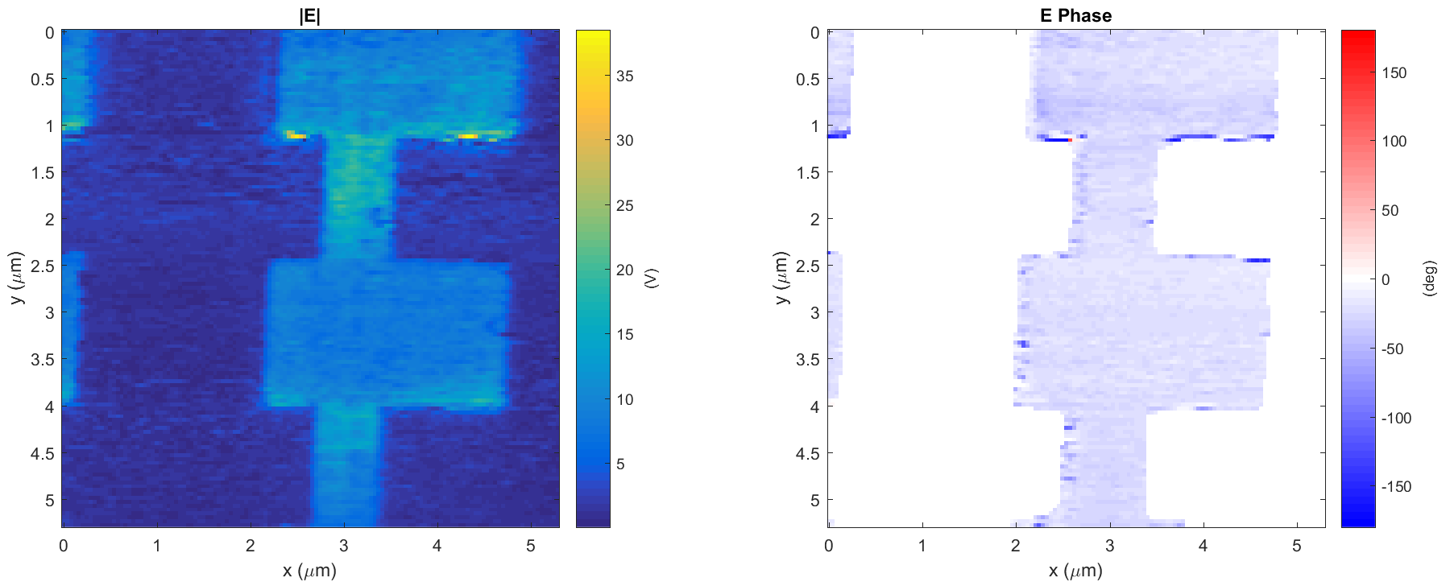
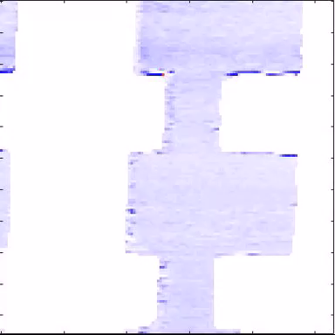
Leaky wave antenna, design #4 (E4)
Data: 2017-11-02_leaky_E4_PH_X_7
k
Light incident from below

