Slide 1
Handling User Input

Slide 2
Objectives
In this chapter, you will:
Learn about autoglobal variables
Build XHTML Web forms
Process form data
Handle submitted form data
Create an All-in-One form
Display dynamic data based on a URL token

Slide 3
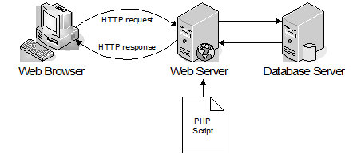
Recall
Dynamic Web Page: generated by server-side program/script
  Page can change each time viewed
    Based on user submissions or database
  Application: interactive web applications, e-commerce.

Slide 4
Dynamic Web Page (Cont.)
  Application Mapping: Server looks at extension of webpage to figure out what application server should handle request.
    Step 1) Web Server forwards the request

Slide 5
Dynamic Web Page (Cont.)
  Step 2) Application Server:
    retrieves script from hard drive & loads data user submitted → executes script → request other data from database server [if necessary] → generates webpage
    Step 3) Sends webpage back to webserver

Slide 6
Dynamic Web Page (Cont.)
  Step 4) Webserver then sends response (generated page) to the browser.
  Browser is unaware if page is static or dynamic

Slide 7
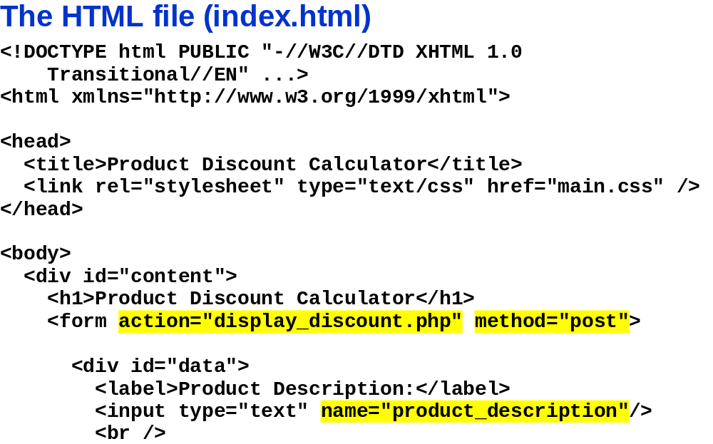
Recall
Document Type Definition (DTD)
XML NameSpace
CSS file
<div> tag
  Used by CSS for formatting
  has 3 id attributes: content, data, buttons

Slide 8
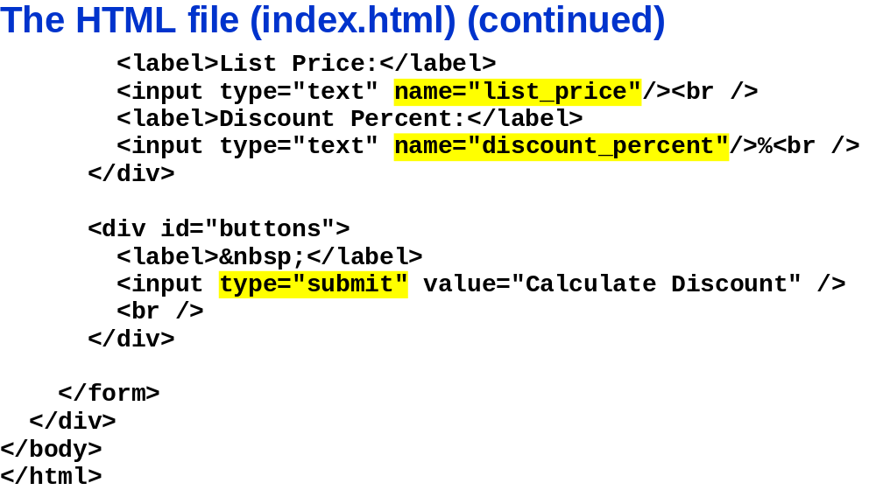

Slide 9
HTML Basics
Elements
individual component of HTML file
represent semantics (meaning)
E.g.:
  Normal Element have start and end tags
    E.g., <title> [Content] </title>
  Void elements don’t have end tag
    E.g., <br>
element can have:
  Attribute
    specified on the start tag
      E.g., <abbr title=“Extensible Markup Language">XML</abbr>
        <abbr> this is the abbreviations tag
  content
    (including other elements and text)

Slide 10
HTML Basics
Inline Tags
element that define text or data
  E.g., </strong> , </q>
  don't start new lines
  Can contain:
    inline tags
    Text
    Data
    nothing (e.g., <br />)

Slide 11
HTML Basics
Block Tags
element that creates large blocks of content
  E.g. </p>, </div>, </blockquote>
  starts new line of text
  can contain:
    blocks
    inline elements
    text
    data

Slide 12
HTML Basics
Anchor tag = Link = Hyperlink
<a> used in two ways:
  href attribute: create link to another document
  name attribute: create a bookmark inside document
Attributes:
  Target: says where to open linked document
    E.g., <a href="http://www.mysite.com" target="_blank">Great Course</a>
    Values:
      _blank (Opens in a new window or tab)_
      parent (Opens in parent frame)
      _self (Opens in same frame (default ))_
      top (Opens in full body of window)
        framename (Opens in named frame)

Slide 13
HTML Basics
<label> element
Defines a label for an <input> element
Doesn’t render
Clicking on text within <label> toggles control
  More usable w/ mouse
for attribute should be equal to the id attribute of the related element
  to bind them together.
<form>
<label for="male">Male</label>
<input type="radio" name="sex" id="male" />
<br />
<label for="female">Female</label>
<input type="radio" name="sex" id="female" />
</form>

Slide 14
HTML Basics
<!DOCTYPE>
instruction NOT XHTML tag
  Tells browser the Document Type Definition (DTD).
    DTD: rules for the markup language
      Version of the markup language
      browsers need it to render the content correctly.

Slide 15
HTML Basics
<!DOCTYPE> (Cont.)
XHTML 1.0 Strict
    all HTML elements and attributes EXCEPT:
      presentational
      or deprecated elements (e.g., font).
    Framesets NOT allowed.
    Markup must be written as well-formed XML
    <!DOCTYPE html PUBLIC "-//W3C//DTD XHTML 1.0 Strict//EN" "http://www.w3.org/TR/xhtml1/DTD/xhtml1-strict.dtd">
  XHTML 1.1
    XHTML 1.0 Strict + lets you add modules
      E.g., to provide ruby support for East-Asian languages
    <!DOCTYPE html PUBLIC "-//W3C//DTD XHTML 1.1//EN" "http://www.w3.org/TR/xhtml11/DTD/xhtml11.dtd">

Slide 16
HTML Basics
<!DOCTYPE> (Cont.)
XHTML 1.0 Transitional
    all HTML elements and attributes
      Includes depreciated and presentational elements
    No Frameset
    Written in well formed XML
    <!DOCTYPE html PUBLIC "-//W3C//DTD XHTML 1.0 Transitional//EN" "http://www.w3.org/TR/xhtml1/DTD/xhtml1-transitional.dtd">
  XHTML 1.0 Frameset
    = XHTML 1.0 Transitional + Frameset
    <!DOCTYPE html PUBLIC "-//W3C//DTD XHTML 1.0 Frameset//EN" "http://www.w3.org/TR/xhtml1/DTD/xhtml1-frameset.dtd">

Slide 17
XHTML Basics
<!DOCTYPE>
+
<html xmlns="http://www.w3.org/1999/xhtml">
+
Head
+
Body

Slide 18
XHTML Basics
Tags And Attribute Names are Lowercase
Attribute Values in “ ”
NO Empty Tags
  e.g., <hr> → <hr /> [Horizontal Rule / Line]
  <br> → <br /> [break]
  <img> … />
        E.g., <p> <img src="images/Course.jpg" width="100" height="150" alt="Photo: Professor" /> </ p>
        alt: alternative text displayed or read by screen reader when img is not available

Slide 19
XHTML Basics
No attribute minimisation
  E.g., <input readonly> → <input readonly="readonly" />

Slide 20
In Class Assignment
Make a simple html file
  Use all parts of the format shown above
  Ensure all relevant tags are closed
  Have:
    1 heading
    1 paragraph
    1 list
  View file in browser to make sure it works

Slide 21
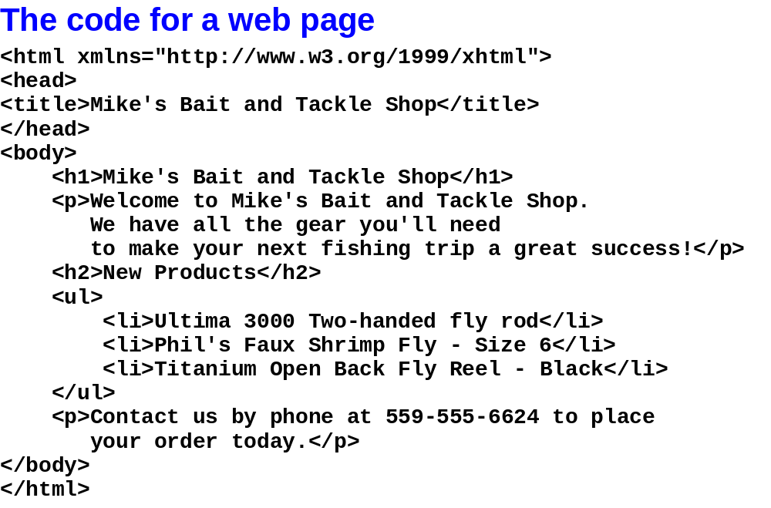

Slide 22
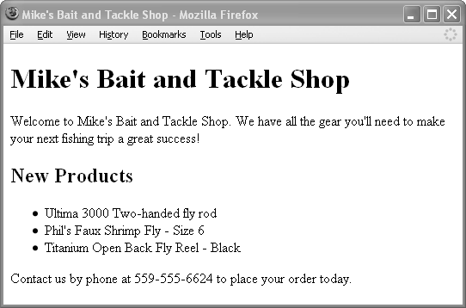

Slide 23
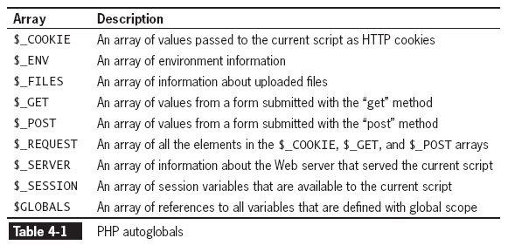
Using Autoglobals
Autoglobals / Superglobals
predefined global arrays
  that provide information about:
    Server
    Environment
    user input
Are associative arrays

Slide 24
Using Autoglobals (continued)
associative arrays
  Array whose elements are referred to with alphanumeric key instead of an index number.
  To access values
    place element’s key in single or double quotes inside the array brackets.
    $_SERVER["SCRIPT_NAME"];
      displays the path and name of the current script
      application: creating backlink
      Above displays the SCRIPT_NAME element of the $_SERVER autoglobal

Slide 25
$_SERVER autoglobal has info about:
  Server
  PHP scripting engine
  Current web page
  Elements depend on server executing script
  Has a predefined list of elements
  E.g.,
    $_SERVER[“SERVER_SOFTWARE"];
      Displays server software that executed script
    $_SERVER[“SERVER_PROTOCOL"];
      Displays server protocol that requested script

Slide 26
Environment Variables
  Variables that programs use to interact with the system
  Elements change depending on OS and machine configuration
global Keyword
  MUST use to reference global variable when in function
  Alternatively, use $GLOBALS autoglobal array
    To refer to global version of variable from inside a function
      Use “VariableName” or ‘VariableName’

Slide 27
Exercises
Write code that displays what the current script is, the software that executed it, and the protocol that requested it.
Write a short program that:
  Stores a string in a global variable
    Use any string
  Prints the contents of the global variable from inside a function
    Call the function to see if it will work

Slide 28
Building XHTML Web Forms
Web form
  interactive controls that allow users to:
    enter
    and submit
  data to a processing script
  Controls
    E.g., text input boxes, radio buttons, selection lists, text area boxes
  Has standard XHTML markups
  2 required attributes in the opening <form> tag:
    Action attribute:
      Identifies program processing form data when submitted
        Prog. Is on the Web server
<form action="http://www.example.com/HandleFormInput.php">
    Method attribute:
      Specifies how the form data will be sent to the processing script

Slide 29
Adding the method Attribute
The value MUST be either “post” or “get”
  “post” method
    embeds the form data in the request message
    $_POST array
      PHP automatically creates and populates it
  “get” method
    appends the form data to the URL specified in the form’s action attribute
    $_GET array
      PHP creates and populates it
  Memory aid: Post is like posting a letter. Get is like getting it (opening)

Slide 30
Adding the method Attribute (continued)
name/value pair
  Form fields sent to Web server in a pair
  name portion
    becomes the key of an element in $_POST or $_GET array
      depending on method used to submit data
  value portion
    populated by the data that the user enters

Slide 31
Adding the method Attribute (continued)
URL tokens
  Name/value pairs appended to the URL
    Recall: form data is appended to URL specified by action attribute
      - When using “get” method
  question mark (?)
    separates form data from the URL
  ampersand (&)
    separates individual elements
  equal sign (=)
    separates element name from value
  plus signs (+)
    Represents spaces in the name and value fields
  percent sign (%) followed by 2-digit hex. representation of character’s ASCII value
    Encodes all other characters
      except letters, numbers, hyphens (-), underscores (_) and periods (.)

Slide 32
Adding the method Attribute (continued)
http://www.example.net/process_Scholarship.php?fName=John&lName=Smith&Submit=Send+Form
    question mark (?)
      separates form data from the URL
    ampersand (&)
      separates individual elements
    equal sign (=)
      separates element name from value
    plus signs (+)
      Represents spaces in the name and value fields
    percent sign (%) followed by 2-digit hex. representation of character’s ASCII value
      Encodes all other characters
        except letters, numbers, hyphens (-), underscores (_) and periods (.)
Value assigned to submit button
Name of submit button

Slide 33
Adding the method Attribute (continued)
“get” method
  appends form data to the URL specified in the form’s action attribute
  Limitations for submitting form data
    Restricts number of characters that can be appended to a single variable to 100
    form values are in plain text
      appended to URL in plain text
      Stored in log files on:
        Client
        Server
        ANY machine between client and server
      makes a URL request insecure
  Advantage for submitting form data
    Good for debugging
      Passed values are visible in the Address Bar of the browser

Slide 34
Processing Form Data
form handler
  a program or script that processes the information submitted from a Web form
  performs the following:
    Verifies that the user entered a minimum amount of data
    Validates form data
    Works with the submitted data
    Returns appropriate output as a Web page

Slide 35
Retrieving Submitted Data
$_POST array
  values stored can be accessed and displayed
$firstName = $_POST['fName'];
$lastName = $_POST['lName'];
echo "Thank you for filling out the scholarship form, ".$firstName." ".$lastName . ".";

Slide 36
Exercise
Step 1
Make a short XHTML file
  Include the:
    !DOCTYPE declaration
    <html> element
    Header info.
    <body>
    Use strict DTD
    <title>
  In the body:
    Have a centered heading
    Make a form with the name funding and action attribute loan.php. Use the post method
    Make text boxes for each part of the applicants name
    Make 2 buttons, one to clear the form and another to submit it.
Step 2
Make a processing file
  Add the appropriate “filler” at the top of the file
  In <?PHP … ?> add code that retrieves the data sent with the form and stores it in the appropriate variables
  Echo a statement to the console that uses the data submitted
Make sure the XHTML file sends the data to the server and that it is processed by the PHP file and that the output is correct.

Slide 37
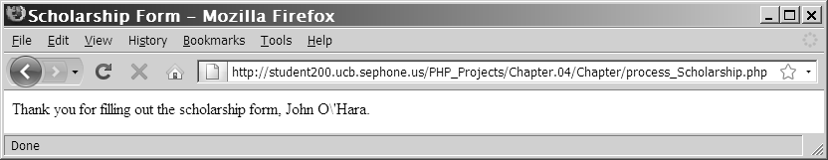
Handling Special Characters
Should use escape sequences for special characters in text strings
  b/c can cause problems for PHP scripting engine
    When it determines end of string
Magic Quotes
  automatically add a backslash character to any:
    single quote
    double quote
    NULL character
  contained in form data that a user submits to a PHP script
\ displayed b/c variable was echoed
  Magic quotes puts the escape character in the variable
Form input string with magic quotes

Slide 38
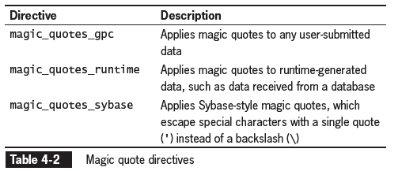
Handling Special Characters
(continued)
Magic Quotes (Cont.)
  Enabled in php.ini config. File
  Magic_quotes_pgc is default
  Prob: easy to forget about them
    Causes debugging issues → can’t find problem because you can’t see the \ being added.
    Sol’n Disable magic quotes and use addslashes() function

Slide 39
Handling Special Characters
(continued)
addslashes() function
  adds a backslash before a:
    single
    or double quote
    or a NULL character
  in user input
  alternative to escaping character
    Do before saving to a text file or database
  Takes a single argument:
    Sting to escape
  Returns
    Escaped string

Slide 40
Handling Special Characters
(continued)
stripslashes() function
  removes a backslash before:
    single
    or double quote
    or NULL character
  in user input
  if magic quotes is enabled:
    this is required before outputting a string with the echo statement
      Removes the \ in the screenshot below.
Form input string WITH magic quotes

Slide 41
Handling Submitted Form Data
validate Web form data
  to ensure PHP can use it
  optimal way
    only allow user to enter acceptable response
  Examples of data validation
    verifying user did not leave any required fields blank
    Check if e-mail address entered in correct format
    user did not exceed word limit in comment box

Slide 42
Determining if Form Variables Contain Values
all controls get sent to the server with the “post” or “get” method
  even if they do not contain data
    except unchecked radio buttons and checkboxes
empty() function
  used to determine if a variable contains a value
  returns
    FALSE
      if the variable being checked has a nonempty and nonzero value
    TRUE
      if the variable has an empty or zero value

Slide 43
empty() only checks variables
  anything else will result in a parse error.
  i.e., this won’t work: empty(trim($name)).
Empty. following things are considered to be:
"" (an empty string)
0 (0 as an integer)
0.0 (0 as a float)
"0" (0 as a string)
NULL
FALSE
array() (an empty array)
var $var; (a variable declared, but without a value in a class)

Slide 44
Validating Entered Data
Validating form data
  Some data needs to be:
    A specific type
      E.g., integer or decimal
    A specific format
      E.g., date, email, website address
  Verifying that value entered a field is appropriate
    for the data type that should have been entered
  Best way
    build the Web form with controls that only let you select valid responses
      such as check boxes, radio buttons, and selection lists
  Unique information must be validated
    such as user name, password, or e-mail

Slide 45
Validating Numeric Data
All data in a Web form is string data
PHP automatically converts string data to numeric data if the string is a number
  is_numeric() function
    used to determine if a variable contains a number
  round() function
    can be used to see if appropriate number of decimal places
    round(numberToBeRounded, [numberOfDigitsAfterDecimalPoint])

Slide 46
Validating String Data
Regular expression functions are some of the best tools for verifying string data
  E.g., meets the strict formatting required for e-mail addresses, Web page URLs, or date values
    stripslashes() function
      removes the leading slashes for escape sequences
    trim() function
      removes any leading or trailing white space from a string

Slide 47
Handling Multiple Errors
When processing a Web form best to:
  track any errors on the form during processing
  and then redisplay the form for the user
    to correct all the errors at one time

Slide 48
Redisplaying the Web Form
sticky form
  used to redisplay the form
    controls set to the values the user entered the last time the form was submitted
  use the value attribute
    to display previous submitted values in sticky form:
<p>First Name: <input type="text" name="fName" value="<?php echo $firstName; ?>" /></p>

Slide 49
Redisplaying the Web Form
To redisplay form
  Add XHTML form elements to output of PHP script
    Should be part of error handling routine
    Can put into a function
      To issolate it from rest of script

Slide 50
Redisplaying the Web Form
Advanced Escaping From XHTML
  How:
    Close a section of PHP → insert XHTML elements → start new PHP script
    XHTML is considered output
    If closing tag is:
      in f’n or control block for a conditional
        Then XHTML displayed when:
        - function is called
        - or conditional executed
      In control block of looping structure
        XHTML did played with each iteration
  Most convenient way to embed large portions of XHTML in PHP script
  When you insert PHP script section you escape from XHTML

Slide 51
Redisplaying the Web Form
Advanced Escaping From XHTML (Cont.)
  E.g.,
    Function ShowLink() {
    ?>
    <p>
    <a href=“index.php”><img src=“images/homelink.gif” /></a>
    <br />
    <a href=“index.php”>Home Page</a>
    </p>
    <?php
    }

Slide 52
Emailing the Web Form
mail() function
  sends an e-mail message containing form data in PHP
  syntax:
mail(recipient(s), subject, message)
  Recipient
    > = 1
    Written in form of Address Specifier
      defines format of e-mail addresses that can be entered as the recipient argument
        Plain e-mail address: jdoe@example.net
        Recipients name and e-mail address: Mary Smith mary.smith@example.com
  message argument
    a text string
    must be in plain text

Slide 53
Emailing the Web Form
(continued)
  subject argument
    MUST include only plain text
      with no XHTML tags or character entities
        unless a special MIME format is used
  additional_headers argument
    optional
    can include headers that are standard in most e-mail editors
      From, Cc, Bcc and Date.
    Each header must be on its own line
    Each line must:
      start with the header name
      followed by a colon, a space, and the value of the header element
Date: Fri, 03 Apr 2009 16:05:50 -0400
    From: Linda M. Jones linda@jones.example.com
    CC: Mary R. Jones <mary@jones.example.com>
returns TRUE: if a successful e-mail message

Slide 54
Creating an All-in-One Form
two-part form
  one page displays form
  and one page processes form data
All-in-One form
  a single script used display a Web form and process its data
  For simple forms that require only minimal processing
  PHP script can have 2 conditionals:
    1) determines if data submitted / needs validation
    2) determines if form needs redisplay

Slide 55
Validating an All-in-One Form
use conditional to determine if the form:
  has been submitted
  or is being viewed for the first time
  isset() function
    used to determine if $_POST[‘Submit’] variable has been set
      i.e. if submit button pressed
      if (isset($Submit)) {
      // Validate the data
      }
    argument
      the name assigned to the Submit button in the Web form
        (e.g., name=‘Submit’)
      if (isset($_POST[‘Submit’])) {
      // Validate the data
      }
      //same as code on left

Slide 56
Validating an All-in-One Form
  isset() function (Cont.)
    Not inverse of empty()
      b/c variable can be set to an empty value (e.g., “”, NULL, FALSE)
        Empty() returns TRUE b/c variable is set to empty value
        Isset() returns TRUE b/c variable is initialised
        Set: variable declared and initialised

Slide 57
Redisplaying the Web Form
All-in-One form will redisplay the Web form
  If the submitted data did not:
    pass all validation checks
    or no data has been entered
  So user can enter data for the first time or re-enter data
  if (isset ($_POST['Submit'])) {
  // Process the data
  }
  else {
  // Display the Web form
  }

Slide 58
Displaying Dynamic Content Based on a URL Token
Many different types of information can be displayed from same script
  By passing URL tokens to a PHP script,
single PHP script can produce the same content as multiple static XHTML pages
  By using a Web page template with static sections and a dynamic content section

Slide 59
Using a Web Page Template
Web template
  a single Web page that is divided into separate sections such as
    Header
    Button Navigation
    Dynamic Content
    Footer
The contents of the individual sections are populated using include files

Slide 60
Using Text Hyperlinks for Navigation
When user clicks hyperlink the contents in the dynamic data section are replaced by the contents referenced by the href attribute
name/value pair
  appended to the index URL
  (this attribute and value will be referenced in the dynamic data section of the index.php file)
  The name is user defined
  The value is user defined
<a href = "index.php?page=home_page">Home</a>

Slide 61
Using Form Image Buttons
for Navigation
Buttons MUST be enclosed by opening and closing <form> tag
<input type = "image" src = "home.jpg" name = "home" style = "border:0" alt= "Home" />
x- and y- coordinates are sent in the form “Button.x” and “Button.y” where “Button” is the value of the name attribute (home)
  In PHP, the periods are replaced by underscores for the $_GET or $_POST array indexes
    The $_GET and $_POST array would have two elements “home_x” and “home_y”

Slide 62
Displaying the Dynamic Content
$_REQUEST autoglobal
  can be used to access the results from form data
    sent using either the “get” or “post” methods
  The syntax to save the value of the page attribute to a variable is shown below:
$displayContents = $_REQUEST["page"];
dynamic content section of the index.php file
  contains code to determine which content page to display
    i.e. what include files to display

Slide 63
Displaying the Dynamic Content (continued)
if (isset($_GET['page'])) {
switch ($_GET['page']) {
case 'About Me':
include('inc_about.html');
break;
case 'home'://display the default page
include('inc_home.html');
break;
default:
include('inc_home.html');
break;
}
}

Slide 64
Assignment
Make a dynamic XHTML-PHP document
  Include all the “filler” at the top
  Write code to:
    Make a form where the user enters his name in different boxes. Include the appropriate buttons
    Retrieve the name submitted in the form
    Make sure that magic quotes slashes are removed
    Give feedback to the user: e.g., Thank you for filling the form.
    Check if the field is empty
      Display an error message if it is.
      Clean it otherwise and store the result in the appropriate variable.
      Keep track of the number of errors
      Give feedback to the user: e.g., reenter data., e.g., Thank-you.
    Redisplay the form IFF there are errors

Slide 65
Summary
PHP includes various predefined global arrays, called autoglobals or superglobals, which contain client, server, and environment information that you can use in your scripts
Web forms are standard XHTML Web pages with interactive controls that allow users to enter data

Slide 66
Summary (continued)
The <form> tag requires an action attribute to identify the script that will process the submitted data and a method attribute to identify whether the data will be sent using the “get” or “post” method
The $_POST autoglobal contains data submitted from a form using the “post” method; the $_GET autoglobal contains data submitted from a form using the “get” method or through a hyperlink

Slide 67
Summary (continued)
Web forms may have two components: the data entry form page and the data processing script
If Magic Quotes is enabled, the PHP scripting engine inserts an escape character before a single quotation mark, double quotation mark, or NULL character in any submitted form data
Magic quotes may be enabled for a PHP server

Slide 68
Summary (continued)
The addslashes() function inserts an escape character before a single quotation mark, double quotation mark, or NULL character in a string
The stripslashes() function removes the escape character before a single quotation mark, double quotation mark, or NULL character in a string
The first step in processing form data is to validate the input

Slide 69
Summary (continued)
The empty()function determines if the entered value has an empty or zero value
The is_*() family of functions determines if the entered value is of the required data type
Regular expressions determine if an entered string value is formatted correctly for the required type of entry
The user should be notified of all errors in the values entered into the form

Slide 70
Summary (continued)
Sticky forms are forms that redisplay after an error has been found
The fields in a sticky form are populated with the values the user entered previously.
Advanced escaping from XHTML is a convenient way to display XHTML code within a PHP code block

Slide 71
Summary (continued)
The mail() function is used to send mail from PHP; it can be used to send form data via e-mail when the form has been successfully completed and validated
All-in-One Web forms combine the data entry form page and the data processing script into a single script
The isset() function determines if the entered value has been initialized (or set)

Slide 72
Summary (continued)
URL tokens
  use the “get” method and additional data appended to the URL to submit information to a PHP script
Web templates combine:
  static elements
  and dynamic content section
within a Web page
  Web templates can use the include() function within a conditional or switch statement to display dynamic content from different include files within the same section of the template

