Slide 1
Working with Files
and Directories

Slide 2
Objectives
In this chapter, you will:
Understand file type and permissions
Work with directories
Upload and download files
Write data to files
Read data from files
Open and close a file stream
Manage files and directories

Slide 3
Understanding File Types and Permissions
File types affect how information is stored in files and retrieved from them
File permissions determine the actions that a specific user can and cannot perform on a file

Slide 4
Understanding File Types
binary file
  series of characters or bytes for which PHP attaches no special meaning
  Structure is determined by the application that reads or writes to the file
text file
  has only:
    printable characters
    and a small set of control or formatting characters
  Text files translate the end-of-line character sequences such as \n or \r\n to carriage returns
Notes:
http://stackoverflow.com/questions/1761051/difference-between-n-and-r

Slide 5
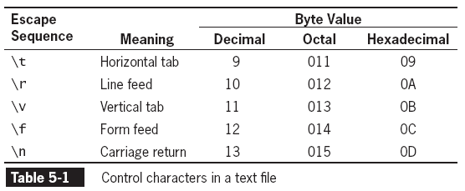
Understanding File Types
(continued)

Slide 6
Understanding File Types
(continued)
Different operating systems use different escape sequences to identify the end of a line:
  \n
    end a line on a UNIX/Linux operating system
    E.g., SQL is awesome\n
  \n\r (pair)
    end a line on a Windows operating system
    E.g., The best things in life are PHP\n\r
  \r
    end a line on a Macintosh operating system
    OS X has a Linux Core\r

Slide 7
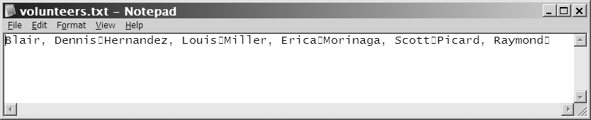
Understanding File Types
(continued)
Scripts written in a UNIX/Linux text editor display differently when opened in a Windows-based text editor
  Empty box (non-displayable character) in place of /n
Figure 5-1 Volunteer registration form

Slide 8
Working with File Permissions
Files and directories have three levels of access:
  User
  Group
  Other
The three typical permissions for files and directories are:
  Read (r)
  Write (w)
  Execute (x)

Slide 9
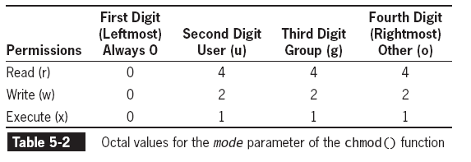
Working with File Permissions (continued)
File permissions are calculated using a four-digit octal (base 8) value
  Octal values
    uses the digits 0 to 7
    encode three bits per digit
      matches the three permission
      bits per level of access
  first digit is always 0
    notifies PHP that the number is octal.
  second digit provides permissions for the owner
  third is for the group
  last is for all other users.
  To assign more than one value to an access level, add the values of the permissions together
    example: "0755" means?
      0 indicates it is octal.
      (7) gives the owner permission to read (4), write (+2), and execute (+1).
      group, & other users (5) have permission to read (4) & execute (+1).

Slide 10
Working with File Permissions
(continued)

Slide 11
Working with File Permissions
(continued)
chmod() function
  Changes permissions or modes of a file or directory
chmod($filename, $mode)
    $filename
      name of the file to change
    $mode
      integer specifying the permissions for the file
  E.g., chmod(“index.html, 0644)
    What is this?
      Read permission to all users, only user has write permission
  What happens if a user has read permission on a file but not on a folder?
    Can read file only if know the path. Can’t see it through directory listing of folder

Slide 12
Checking Permissions
fileperms() function
  reads permissions associated with a file
    But has more info
  takes one argument
    file name
  returns an integer bitmap of permissions associated with the file
    Bitmap / bitset / bit string / bit vector
      Mapping to bits (i.e., {0, 1})
        (usually from integers but can be any domain)
      Array used to store bits compactly
    More useful to display as octal
      decoct() function
        converts decimal value to an octal value

Slide 13
Checking Permissions (cont.)
fileperms() function (cont)
  Contains more information than just file permissions
    Permissions can be extracted
      using arithmetic modulus operator with an octal value of 01000 (leading 0 indicates value is octal)
        E.g.: $modes = fileperms($fileName)
      $modes = decoct($modes % 01000)
      echo “the file permissions are: 0” . $modes;

Slide 14
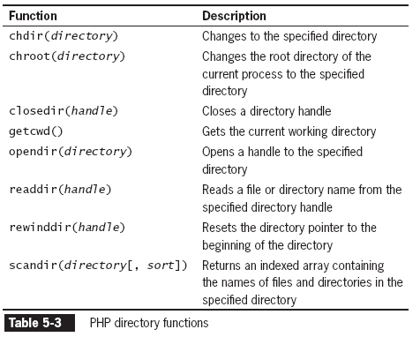
Reading Directories
The following table lists the PHP functions that read the names of files and directories
Security
Chroot
Changes the root dir. of current process and its children.
  AKA jail
    filesystem appears smaller than it is to an application
    usually far fewer system privileges
  Purpose: to limit damage by:
    Awry application
    Cracker
Notes:
http://unixwiz.net/techtips/chroot-practices.html

Slide 15
Reading Directories (continued)
3 steps:
opendir(directory) function
  Opens handle to directory
    used to iterate through entries in a directory
    handle
      special type of variable that PHP uses to represent a resource
        such as a file or a directory
  Resets directory pointer
    directory pointer
      special type of variable that refers to the currently selected record in a directory listing
      Way of keeping track of where you are in directory

Slide 16
Reading Directories (continued)
2) readdir(handle) function
  Returns
    file and directory names of an open directory
    False at end of directory
  Each time called it moves directory pointer to next entry in directory
3) closedir() function
  used to close the directory handle
The following code lists the files in the open directory & closes the directory.
$Dir = "/var/html/uploads";
$DirOpen = opendir($Dir);
    while ($CurFile = readdir($DirOpen)) {
echo $CurFile . "<br />\n";
}
closedir($DirOpen);
[Logic: opendir()’s handle is stored and then used in readdir to read file and dir. Names. Since it is in a while(), the loop continues until function returns FALSE]

Slide 17
Reading Directories (continued)
The PHP scripting engine returns the navigation shortcuts when it reads a directory
  (“.” (current dir.) and “..” (parent dir.))
  The strcmp() function can be used to exclude those entries
…
while ($CurFile = readdir($DirOpen))
if ((strcmp($CurFile, '.') != 0) &&
(strcmp($CurFile, '..') != 0))
echo "<a href=\"files/" . $CurFile . "\">" . $CurFile . "</a><br />";
}
…

Slide 18
Reading Directories
(continued)
scandir() function
  returns names of the entries in a directory to an array
    sorted in:
      Ascending alphabetical order [default]
      Descending order
        By passing 1 as the 2nd argument: scandir (Directory, 1);
    Contains
      ONLY file / directory name
        NOT path
      Automatic directories (. And ..)
  DON’T need opendir(), readdir(), closedir()
$Dir = "/var/html/uploads";
$DirEntries = scandir($Dir);
foreach ($DirEntries as $Entry) {
echo $Entry . "<br />\n";
}

Slide 19
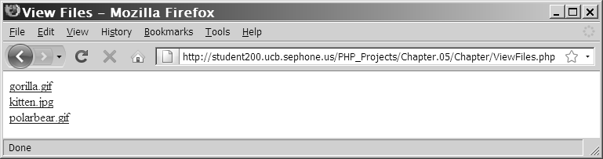
Reading Directories
(continued)
Listing of the “files” subdirectory
using the scandir() function

Slide 20
Creating Directories
mkdir() function
  creates a new directory
  To create a new directory in current directory:
    Pass name of new directory to the mkdir() function
  e.g., mkdir("volunteers");
  To create new directory NOT in current directory:
    Use a relative or an absolute path
      mkdir("../event");
      mkdir("/bin/PHP/utilities");

Slide 21
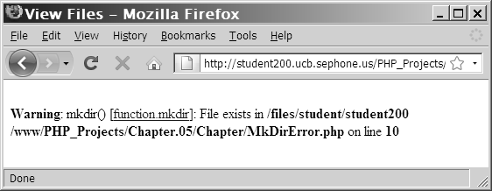
Creating Directories (continued)
  Warning that appears if a directory already exists

Slide 22
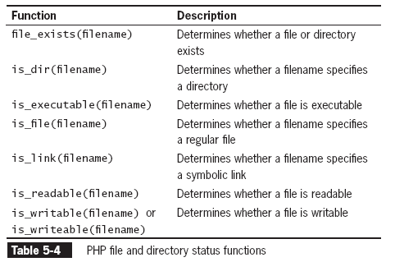
Obtaining File and Directory Information
These Check permissions

Slide 23
Obtaining File and Directory Information
Dir, file, and links are the 3 most common entries.
These functions let you differentiate between them.
Symbolic Link – a reference to a file elsewhere

Slide 24
Obtaining File and Directory Information
All the other functions return False if file not found, so file_exists() not required with them
USE these f’ns before working with file / directory
  Ensures script will work

Slide 25
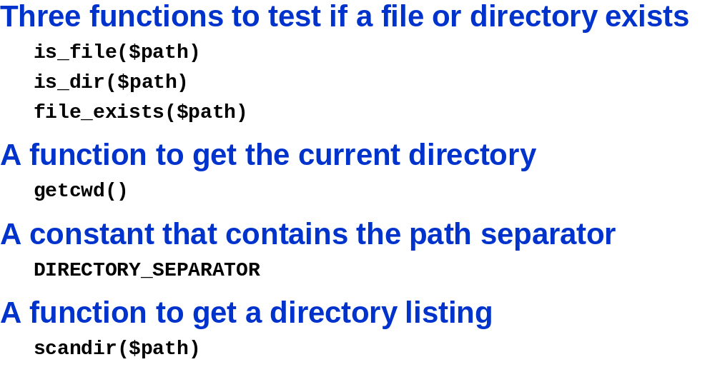
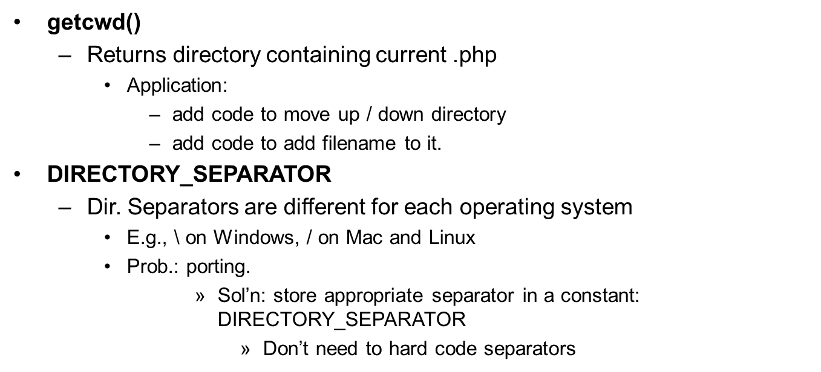
Slide <number>

Slide 26
Exercise
Make a webpage that displays the contents of a subdirectory (lets say one called LastName)
  Do not display the navigation shortcuts (.. And .)
  Make each file display a hotlink
  Use both the scandir() approach and the older approach (opendir(), readdir(), closedir())
  Then display a list of only the files (no directories)
    Show the full pathnames and make the code portable.

Slide 27
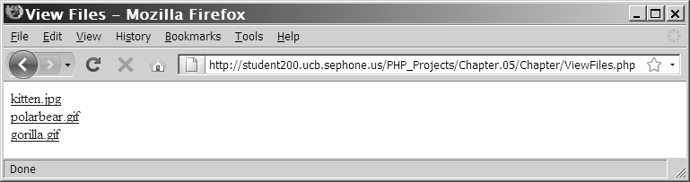
Exercise - Output
(continued)
The following Figure shows the directory listing for three files: kitten.jpg, polarbear.jpg, and gorilla.gif
Listing of the “files” subdirectory using the opendir(), readdir(), and closedir() functions

Slide 28
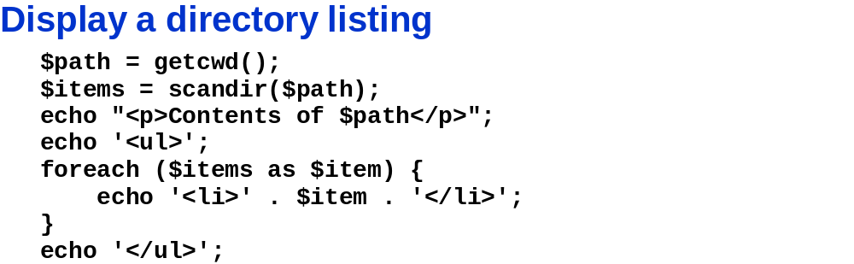
Slide <number>

Slide 29
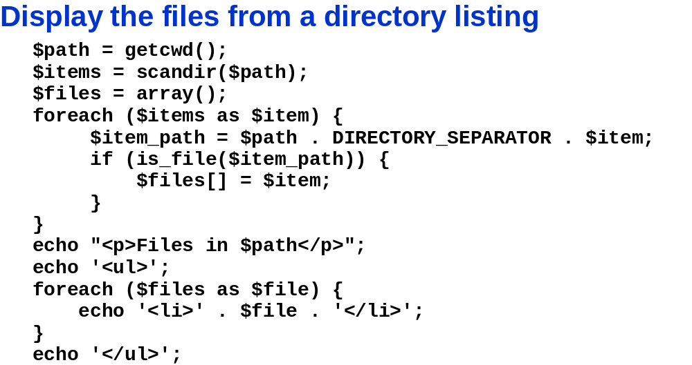
Slide <number>

Slide 30
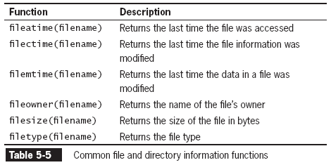
Obtaining File and Directory Information (continued)

Slide 31
Obtaining File and Directory Information (cont.)
$Dir = "/var/html/uploads";
if (is_dir($Dir)) {
echo "<table border='1' width='100%'>\n";
echo "<tr><th>Filename</th><th>File Size</th>
    <th>File Type</th></tr>\n";
    $DirEntries = scandir($Dir);
foreach ($DirEntries as $Entry) {
$EntryFullName = $Dir . "/" . $Entry;
echo "<tr><td>" . htmlentities($Entry) . "</td><td>" .
filesize($EntryFullName) . "</td><td>" .
filetype($EntryFullName) . "</td></tr>\n";
}
echo "</table>\n";
}
else
echo "<p>The directory " . htmlentities($Dir) . " does not
exist.</p>";
Notes:
htmlentities() converts characters to html entities
html entity: some characters are reserved (if you use them the browser might think you are refering to a tag, e.g., <, >). To display them use html entity [code] (i.e., &entityName or &#entityNumber. e.g., &lt; &#60 (numbers have more support))

Slide 32
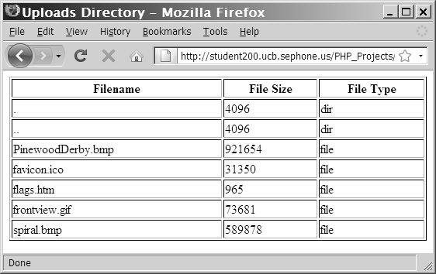
Obtaining File and Directory Information (continued)
Figure 5-5 Output of script with file and directory
information functions

Slide 33
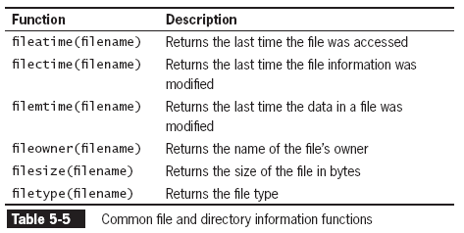
Obtaining File and Directory Information (continued)
The following table returns additional information about files and directories:

Slide 34
Uploading and Downloading Files
Web applications allow visitors to transfer files
  to and from their local computer (client)
  may be:
    simple text files
    or more complex file types
      E.g., images, documents, or spreadsheets

Slide 35
Selecting the File
Files are uploaded through an XHTML form using the “post” method
enctype attribute
  in the opening form tag MUST have a value of “multipart/form-data”
    instructs browser to post multiple sections
      one for regular form data
      and one for the file contents
  e.g., <form action="FileUploader.php" method="POST" enctype="multipart/form-data">

Slide 36
Selecting the File
(continued)
file input field
  creates a Browse button
    for user to navigate to the appropriate file to upload
    <input type="file" name="FileName" />
MAX_FILE_SIZE (uppercase) attribute of a hidden form field
  specifies max. number of bytes allowed in uploaded file
  MUST appear BEFORE the FILE INPUT field
  Should be type hidden to prevent it from being:
    Seen or
    Changed
  e.g., <input type="hidden" name="MAX_FILE_SIZE" value="25000" />

Slide 37
Retrieving the File Information
$_FILES autoglobal array
  information for the uploaded file stored here
    When the form is posted
  contains five elements:
    $_FILES['FileName']['error']
      Contains error code associated with file
    $_FILES['FileName']['tmp_name']
      Contains temporary location of file contents

Slide 38
Retrieving the File Information
(continued)
  $_FILES['FileName']['name']
    Contains the name of the original file
  $_FILES['FileName']['size']
    Contains size of uploaded file in bytes
  $_FILES['FileName']['type']
    Contains the type of the file

Slide 39
Storing the Uploaded File
  Uploaded files are either:
    public
    or private
    depending on whether they should be:
    immediately available
    or verified first
      E.g. to make sure it is virus free, right type, etc.
      Stored in sandbox area (outside publicly accessible folders)
    Public files
      are freely available to anyone visiting the Web site
    Private files
      are only available to authorized visitors

Slide 40
Storing the Uploaded File (continued)
move_uploaded_file() function
  moves uploaded file
    from its temporary location to a permanent destination
bool move_uploaded_file(string $filename, string $destination)
$filename
  is the contents of $_FILES[‘FileName']['tmp_name']
$destination
  is location where the file will be stored
    Give the path and filename

Slide 41
Storing the Uploaded File (continued)
returns
  TRUE
    if the move succeeds
  FALSE
    if the move fails
if (move_uploaded_file($_FILES['FileName']['tmp_name'], "uploads/" . $_FILES['FileName']['name']) === FALSE)
  echo "Could not move uploaded file to \"uploads/" . htmlentities($_FILES['FileName']['name']) . "\"<br />\n";
else
  echo "Successfully uploaded \"uploads/" . htmlentities($_FILES['FileName']['name']) . "\"<br />\n";
uploaded file Default:
  is owned by user acct. that owns web server process.
  Has only Read and Write access

Slide 42
Exercise
Modify the if statement so that a uploaded file is readable and writeable by users, and only readable by groups and others.
if (move_uploaded_file($_FILES['FileName']['tmp_name'], "uploads/" . $_FILES['FileName']['name']) === FALSE)
  echo "Could not move uploaded file to \"uploads/" . htmlentities($_FILES['FileName']['name']) . "\"<br />\n";
else
  echo "Successfully uploaded \"uploads/" . htmlentities($_FILES['FileName']['name']) . "\"<br />\n";
Sol’n:
…
else
  chmod("uploads/" . $_FILES['FileName']['name'], 0644);
  echo "Successfully uploaded \"uploads/" . htmlentities($_FILES['FileName']['name']) . "\"<br />\n";

Slide 43
Downloading Files
Normally don’t need PHP to download files.
  Files in the public XHTML directory structure
    can be downloaded with an XHTML hyperlink
      i.e., <a> anchor tag
  Files outside the public XHTML directory
    Use PHP
    require a three-step process:
      Tell the script which file to download
        Use URL token and the $GET[] autoglobal array
        -lets you embed download in hyperlink using <a>
        -can use PHP to validate correct user and file availability
      Provide the appropriate headers
        Header: info server sends to browser that states what data is being sent.
        - Tells client browser that response contains more than just webpage
        MUST be sent before Webpage content
        - else header considered part of text of page
      Send the file
        Use PHP’s readfile()

Slide 44
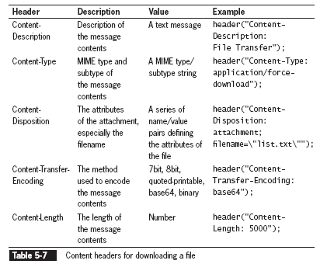
Downloading Files (continued)
header() function
  used to return header information to the Web browser

Slide 45
Content-Type Header
  Use 2 ways
    File to appear in browser like a normal file
      Use MIME type for the file
        E.g., “image/jpeg”
        - this displays the picture
    File to be saved to disk
      Use MIME type “application/force-download”
        Opens save file dialog box
Send the file
  Use PHP’s readfile()
    Returns
      On success: # of bytes sent
      On failure: FALSE
    E.g., readfile(“path/FileName”)
  DON’T send web page after headers sent and file downloaded
    b/c they will become part of the downloaded file info.
    Code should CHECK headers and file NOT sent

Slide 46
Exercise
Create a file downloader
  Have code that:
    Checks if file exists and is readable
      Use
        Isset()
        $_GET[‘filename’])
        is_readable()
    Sends headers
    Reads the file
    Displays an error page if the download doesn’t work

Slide 47
Writing an Entire File
PHP supports two basic functions for writing data to text files:
  file_put_contents() function
    writes or appends a text string to a file
      Creates files only, NOT directories
        use is_dir()
        - tests if specified file name is directory
    returns
      number of bytes written to the file
      0
        If no data was written to the file
    file_put_contents (filename, string[, options])
  fwrite() function
    incrementally writes data to a text file

Slide 48
Writing an Entire File
(continued)
$EventVolunteers = " Blair, Dennis\n ";
$EventVolunteers .= " Hernandez, Louis\n ";
$EventVolunteers .= " Miller, Erica\n ";
$EventVolunteers .= " Morinaga, Scott\n ";
$EventVolunteers .= " Picard, Raymond\n ";
$VolunteersFile = " volunteers.txt ";
file_put_contents($VolunteersFile, $EventVolunteers);

Slide 49
Writing an Entire File
(continued)
If no data was written to the file, the function returns a value of 0
Use the return value to determine whether data was successfully written to the file
if (file_put_contents($VolunteersFile, $EventVolunteers) > 0)
echo "<p>Data was successfully written to the
$VolunteersFile file.</p>";
else
echo "<p>No data was written to the $VolunteersFile file.</p>";

Slide 50
Writing an Entire File
(continued))
FILE_USE_INCLUDE_PATH constant
  searches for the specified filename
    in path assigned to the include_path directive
      (in php.ini configuration file)
FILE_APPEND constant
  appends data to existing contents in specified filename
    instead of overwriting it

Slide 51
Exercise
Write code for a visitors comments section on a website
  Check if the directory exists
  Assume that the comment was posted
    So use $_POST[…]
  Check if the person left his name
    If not call him “unknown”
    If he did, remove the backslashes if any and store the name in a string variable
  Add his email, the formatted date, and the comment to the string variable
  Save this string in a file and make sure there were no write errors.
    Display the appropriate messages.
  Make sure you add the XHTML code for the form: name, email, comments, and buttons.

Slide 52
Exercise
Make a registration form that requires: First Name and Last Name.
Write code that:
  checks if both names are entered
  Store the names in a variable
  Use the File_APPEND constant along with file_put_contents() to add the new registrant to an existing file.
    Display an appropriate message based on if the write was successful.

Slide 53
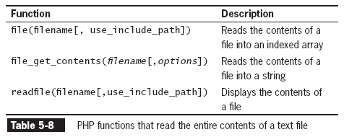
Reading an Entire File

Slide 54
Reading an Entire File
(continued)
file_get_contents function
  reads the entire contents of a file into a string (i.e., writes)
E.g.,
Write string to a file:
  $DailyForecast = "<p><strong>San Francisco daily weather
  forecast</strong>: Today: Partly cloudy. Highs from the 60s to mid 70s. West winds 5 to 15 mph. Tonight: Increasing clouds. Lows in the mid 40s to lower 50s. West winds 5 to 10 mph.</p>";
  file_put_contents("sfweather.txt", $DailyForecast);
Read contents of string into a variable:
  $SFWeather = file_get_contents("sfweather.txt");
  echo $SFWeather;

Slide 55
Reading an Entire File
(continued)
readfile() function
  displays the contents of a text file along with the file size to a Web browser
readfile("sfweather.txt");

Slide 56
Reading an Entire File (continued)
Text files can be used to store individual lines of data.
  each line is 1 unit of info.
  file() function
    reads the entire contents of a file into an indexed array
    Auto. recognises the \n, \r, \n\r
      Each line becomes element of array

Slide 57
Reading an Entire File
(continued)
E.g.,
Writes temperatures to a file:
  $January = " 61, 42, 48\n ";
  $January .= "62, 41, 49\n ";
  $January .= " 62, 41, 49\n ";
  $January .= " 64, 40, 51\n ";
  $January .= " 69, 44, 55\n ";
  $January .= " 69, 45, 52\n ";
  $January .= " 67, 46, 54\n ";
  file_put_contents("sfjanaverages.txt", $January);
Reads temp. of file:
  $JanuaryTemps = file("sfjanaverages.txt");
Split each element into another array using explode() and the delimiter “,” and display high, low, and mean temp.:
  for ($i=0; $i<count($JanuaryTemps); ++$i) {
  $CurDay = explode(", ", $JanuaryTemps[$i]);
  echo "<p><strong>Day " . ($i + 1) . "</strong><br />";
  echo "High: {$CurDay[0]}<br />";
  echo "Low: {$CurDay[1]}<br />";
  echo "Mean: {$CurDay[2]}</p>";
  }

Slide 58
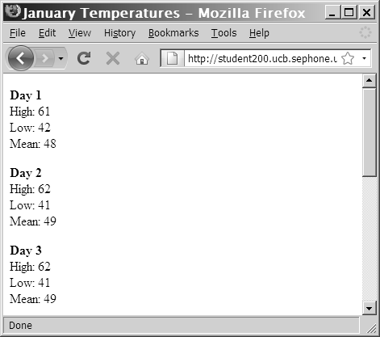
Reading an Entire File
(continued)
Figure 5-13 Output of individual lines in a text file

Slide 59
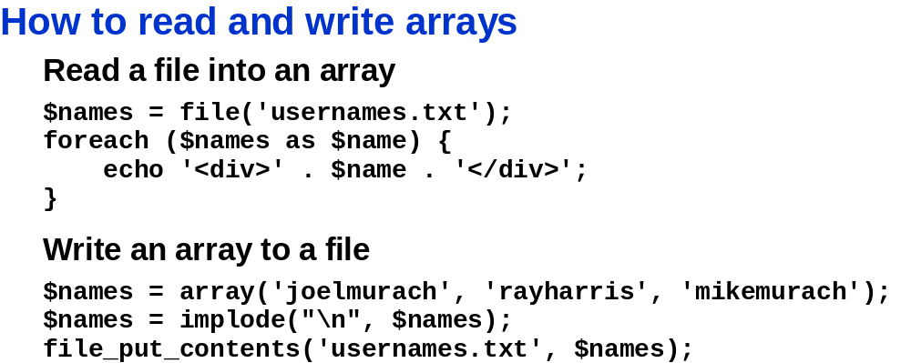
Recall:
implode(separator,array)
  returns a string from the elements of an array
  e.g. Array elements: array(‘This’, ‘is’, ‘my’, ‘home’) → become the string: This is my home.

Slide 60
Exercise
Make a webpage that shows all of the user comment in the file you created earlier.
  Format the results so they look nice
    E.g., separate them with underlines, or make important parts bold, etc.
  Aside: you can use microtime() to make unique filenames.
    It returns a string with 2 values separated by a space
      1st: Decimal value showing current fraction of a second
      2nd: current date and time in seconds.
    Scandir() can be used to sort the files.

Slide 61
Opening and Closing File Streams
A stream is a channel used for accessing a resource that you can read from and write to
The input stream reads data from a resource (such as a file)
The output stream writes data to a resource
  1. Open the file stream with the fopen() function
  2. Write data to or read data from the file stream
  3. Close the file stream with the fclose() function

Slide 62
Opening a File Stream
A handle is a special type of variable that PHP uses to represent a resource such as a file
The fopen() function opens a handle to a file stream
The syntax for the fopen() function is:
open_file = fopen("text file", " mode");
A file pointer is a special type of variable that refers to the currently selected line or character in a file

Slide 63
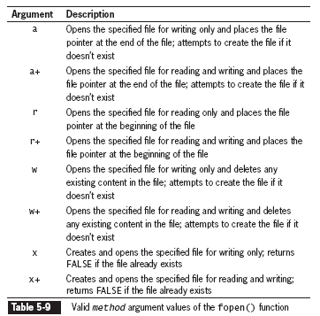
Opening a File Stream
(continued)

Slide 64
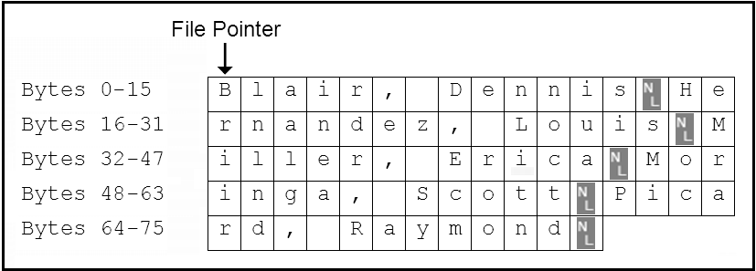
Opening a File Stream
(continued)
$VolunteersFile = fopen(“volunteers.txt", “r+");
Figure 5-15 Location of the file pointer when the fopen() function uses a mode argument of “a+”

Slide 65
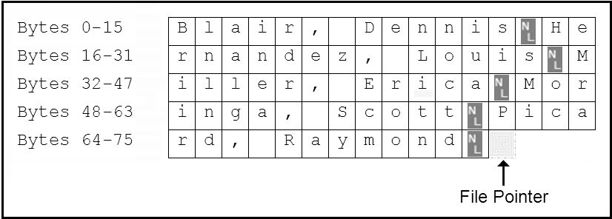
Opening a File Stream (continued)
$VolunteersFile = fopen(“volunteers.txt", “a+");
Figure 5-16 Location of the file pointer when the fopen() function uses a mode argument of “a+”

Slide 66
Closing a File Stream
Use the fclose function when finished working with a file stream to save space in memory
Use the statement fclose($handle); to ensure that the file doesn’t keep taking up space in your computer’s memory and allow other processes to read to and write from the file

Slide 67
Writing Data Incrementally
Use the fwrite() function to incrementally write data to a text file
The syntax for the fwrite() function is:
fwrite($handle, data[, length]);
The fwrite() function returns the number of bytes that were written to the file
If no data was written to the file, the function returns a value of 0

Slide 68
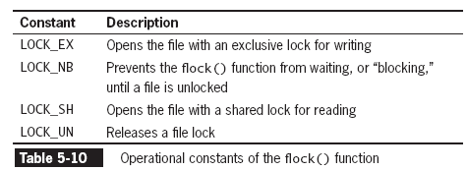
Locking Files
To prevent multiple users from modifying a file simultaneously use the flock() function
The syntax for the flock() function is:
flock($handle, operation)

Slide 69
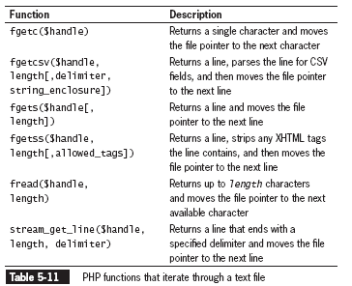
Reading Data Incrementally
The fgets() function uses the file pointer to iterate through a text file

Slide 70
Reading Data Incrementally (continued)
You must use fopen() and fclose() with the functions listed in Table 5-10
Each time you call any of the functions in Table 5-10, the file pointer automatically moves to the next line in the text file (except for fgetc())
Each time you call the fgetc() function, the file pointer moves to the next character in the file

Slide 71
Managing Files and Directories
PHP can be used to manage files and the directories that store them
Among the file directory and management tasks for files and directories are
  Copying
  Moving
  Renaming
  Deleting

Slide 72
Copying and Moving Files
Use the copy() function to copy a file with PHP
The function returns a value of TRUE if it is successful or FALSE if it is not
The syntax for the copy() function is:
  copy(source, destination)
For the source and destination arguments:
  Include just the name of a file to make a copy in the current directory, or
  Specify the entire path for each argument

Slide 73
Copying and Moving Files (continued)
if (file_exists(" sfweather.txt ")) {
if(is_dir(" history ")) {
if (copy(" sfweather.txt ",
" history\\sfweather01-27-2006.txt "))
echo " <p>File copied successfully.</p> ";
else
echo " <p>Unable to copy the file!</p> ";
}
else
echo (" <p>The directory does not exist!</p> ");
}
else
echo (" <p>The file does not exist!</p> ");

Slide 74
Renaming Files and Directories
Use the rename() function to rename a file or directory with PHP
The rename() function returns a value of true if it is successful or false if it is not
The syntax for the rename() function is: rename(old_name, new_name)

Slide 75
Removing Files and Directories
Use the unlink() function to delete files and the rmdir() function to delete directories
Pass the name of a file to the unlink() function and the name of a directory to the rmdir() function
Both functions return a value of true if successful or false if not
Use the file_exists() function to determine whether a file or directory name exists before you attempt to delete it

Slide 76
Summary
In PHP, a file can be one of two types: binary or text
A binary file is a series of characters or bytes for which PHP attaches no special meaning
A text file has only printable characters and a small set of control of formatting characters
A text file translates the end-of-line character sequences in code display
The UNIX/Linux platforms end a line with the \n sequence

Slide 77
Summary (continued)
The Windows platforms end a line with the \n\r sequence
The Macintosh platforms end a line with the \r sequence
Files and directories have three levels of access: user, group, and other
Typical file and directory permissions include read, write, and execute
PHP provides the chmod() function for changing the permissions of a file within PHP

Slide 78
Summary (continued)
The syntax for the chmod()function is chmod($filename, $mode)
The chmod() function uses a four-digit octal value to assign permissions
The fileperms(), which takes filename as the only parameter, returns a bitmap of the permissions associated with a file
The opendir() function iterates through the entries in a directory

Slide 79
Summary (continued)
A handle is a special type of variable that represents a resource, such as a file or directory
To iterate through the entries in a directory, you open a handle to the directory with the opendir() function
Use the readdir() function to return the file and directory names from the open directory
Use the closedir() function to close a directory handle

Slide 80
Summary (continued)
The scandir() function returns an indexed array of the files and directories ( in ascending alphabetical order) in a specified directory
The mkdir(), with a single name argument, creates a new directory
The is_readable(), is_writeable(), and is_executable() functions check the the file or directory to determine if the PHP scripting engine has read, write, or execute permissions, respectively

Slide 81
Summary (continued)
A symbolic link, which is identified with the is_link() is a reference to a file not on the system
The is_dir() determines if a directory exists
Directory information functions provide file access dates, file owner, and file type
Uploading a file refers to transferring the file to a Web server

Slide 82
Summary (continued)
Setting the enctype attribute of the opening from tag to multipart/form-data instructs the browser to post one section for regular form data and one section for file contents
The file input type creates a browse button that allows the user to navigate to a file to upload
To limit the size of the file upload, above the file input field, insert a hidden field with an attribute MAX_FILE_SIZE and a value in bytes

Slide 83
Summary (continued)
An uploaded file’s information (error code, temporary file name, filename, size, and type) is stored in the $_FILES array
MIME (Multipurpose Internet Mail Extension) generally classifies the file upload as in “image.gif”, “image.jpg”, “text/plain,” or “text/html”
The move_uploaded_file() function moves the uploaded file to its permanent destination

Slide 84
Summary (continued)
The file_put_contents() function writes or appends a text string to a file and returns the number of bytes written to the file
The FILE_APPEND constant appends data to any existing contents in the specified filename instead of overwriting it
The file_get_contents() and readfile() functions read the entire contents of a file into a string

Slide 85
Summary (continued)
A stream is a channel that is used for accessing a resource to which you may read, and write.
The input stream reads data from a resource, such as a file
The output stream writes data to a resource, such as a file
The fopen() opens a handle to a file stream using the syntax $open_file = fopen("text file", "mode");

Slide 86
Summary (continued)
A file pointer is a variable that refers to the currently selected line or character in a file
Mode arguments used with the fopen() function specifies if the file is opened for reading, writing, or executing, and the indicates the location of the file pointer
The fclose() function with a syntax of fclose($handle); is used to close a file stream

Slide 87
Summary (continued)
The fwrite() incrementally writes data to a text file
To prevent multiple users from modifying a file simultaneously use the flock() function
A number of PHP functions are available to iterate through a text file by line or character
Use the copy() function to copy a file with PHP
Use the rename() function to rename a file or directory with PHP

Slide 88
Summary (continued)
The unlink() function is used to delete files and the rmdir() function is used to delete directories
In lieu of a move function, the rename() function renames a file and specifies a new directory to store the renamed file

