Slide 1
Viewing
CS418 Computer Graphics
John C. Hart

Slide 2
Graphics Pipeline
Model Coords
Model Xform
World Coords
Viewing Xform
Viewing Coords
Perspective Distortion
Still Clip Coords.
Clipping
Clip Coords.
Homogeneous Divide
Window
Coordinates
Window
to
Viewport
Viewport
Coordinates

Slide 3
Graphics Pipeline
Model Coords
Model Xform
World Coords
Viewing Xform
Viewing Coords
Perspective Distortion
Homogeneous Divide
Still Clip Coords.
Clipping
Clip Coords.
Window
Coordinates
Window
to
Viewport
Viewport
Coordinates

Slide 4
Graphics Pipeline
Model Coords
Model Xform
World Coords
Viewing Xform
Viewing Coords
Perspective Distortion
Homogeneous Divide
Still Clip Coords.
Clipping
Clip Coords.
Window
Coordinates
Window
to
Viewport
Viewport
Coordinates
M

Slide 5

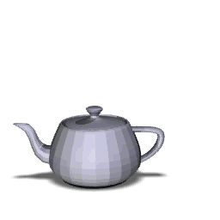
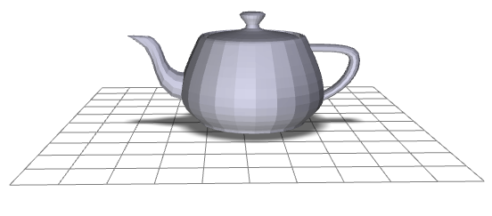
Transformation Order
glutSolidTeapot(1);
glRotate3f(-90, 0,0,1);
glTranslate3f(0,1,0);
glutSolidTeapot(1);
glTranslate3f(0,1,0);
glRotate3f(-90, 0,0,1);
glutSolidTeapot(1);
y
x
z
M
M
M
R
T
T
R

Slide 6
Viewing Transformation
Model Coords
Model Xform
World Coords
Viewing Xform
Viewing Coords
Perspective Distortion
Homogeneous Divide
Still Clip Coords.
Clipping
Clip Coords.
Window
Coordinates
Window
to
Viewport
Viewport
Coordinates

Slide 7
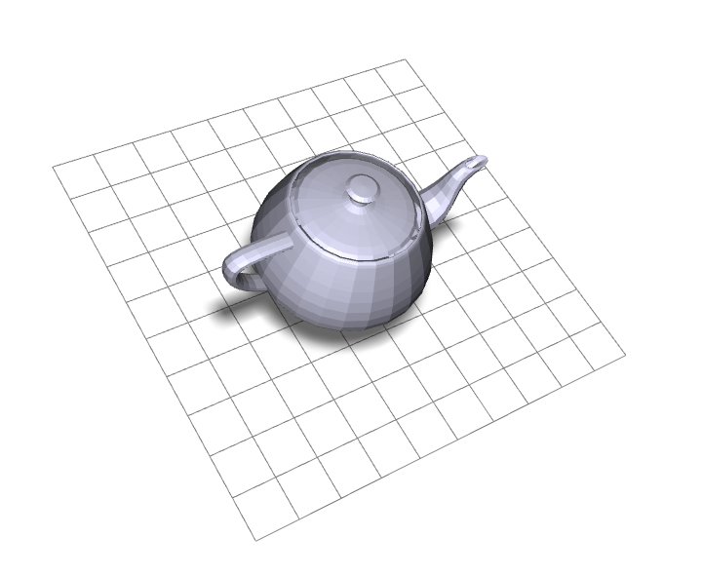
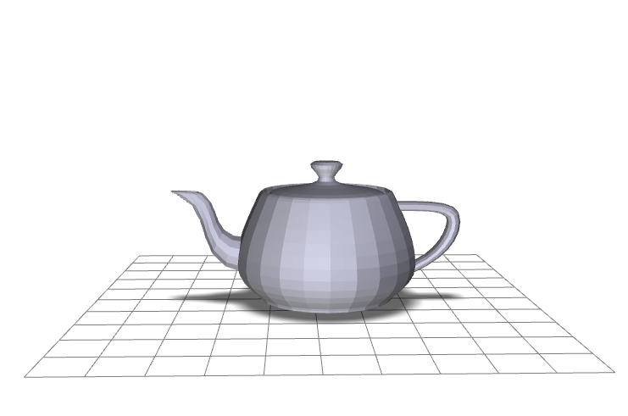
Viewing Transformation
eye point
lookat point
y
y
x
x
z
Screen Coords
Clip Coords
Viewing Coords
World Coords
Model Coords

Slide 8
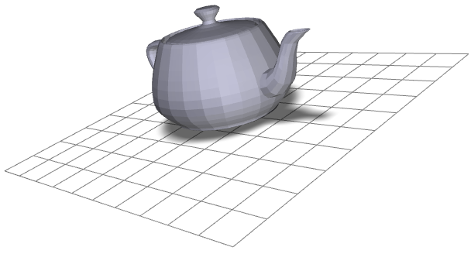
World Coordinates
Viewing Coordinates
y
lookat point
eye point
eye point
(at origin)
lookat point
(along –z axis)
z
y
x
x
z

Slide 9
World Coordinates
Viewing Coordinates
y
lookat point
eye point
lookat point
(along –z axis)
y
x
x
z

Slide 10
World Coordinates
Viewing Coordinates
y
lookat point
eye point
Why not these axes?
y'
x'
y
x
x
z

Slide 11
World Coordinates
Viewing Coordinates
Specify up direction in world coordinates
Transform up vector into viewing coordinates
Rotate about z-axis until up vector in x-y plane.
up
y
lookat point
eye point
z
y
x
x
z
up vector
up vector

Slide 12
World Coordinates
Viewing Coordinates
Specify up direction in world coordinates
Transform up vector into viewing coordinates
Rotate about z-axis until up vector in x-y plane.
y
up
lookat point
eye point
z
y
x
z
x
up vector
up vector

Slide 13
Lookat Transformation
up vector
eye point
lookat point
y
x
z

Slide 14
Lookat Transformation
Translate the eye point to the origin
y
x
z

Slide 15
Lookat Transformation
y
z
Translate the eye point to the origin
Rotate the view vector into the negative z-axis
x
y
x
z

Slide 16
Easier Way
y
Orthogonalize lookat vector system
up
v
x
z

Slide 17
Easier Way
y
Orthogonalize lookat vector system
Let r = v × up/||v×up||
up
v
x
r
z

Slide 18
Easier Way
y
Orthogonalize lookat vector system
Let r = v × up/||v×up||
Let u = r × v
up
u
v
x
r
z

Slide 19

Easier Way
y
Orthogonalize lookat vector system
Let r = v × up/||v×up||
Let u = r × v
Create rotation matrix from <r,u,-v> to <x.y,z>
R r = x, R u = y, R v = -z
up
u
v
x
r
$$\text{R}=\left[\begin{matrix}\text{r} & & & 0 \\ \text{u} & & & 0 \\ −\text{v} & & & 0 \\ & & & 1\end{matrix}\right]$$
z

Slide 20
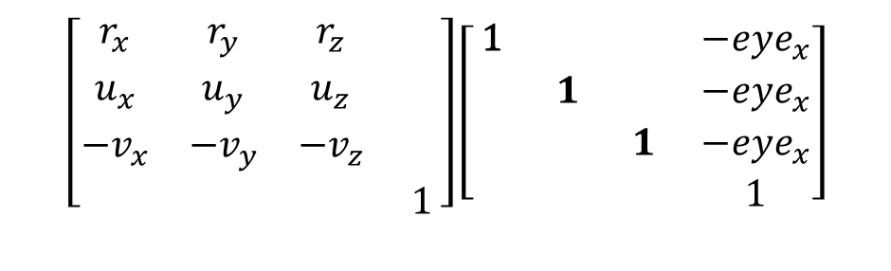
Construct Lookat
eye point
lookat point
up vector
Translate eye point to origin
Rotate view into -z axis
Let v = (lookat - eye)/||lookat - eye||
Let r = v × up/||v×up||
Let u = r × v
y
x
z
$$\left[\begin{matrix}r_{x} & r_{y} & r_{z} & \\ u_{x} & u_{y} & u_{z} & \\ {−v}_{x} & {−v}_{y} & {−v}_{z} & \\ & & & 1\end{matrix}\right]\left[\begin{matrix}\text{1} & & & −{eye}_{x} \\ & 1 & & −{eye}_{x} \\ & & 1 & −{eye}_{x} \\ & & & 1\end{matrix}\right]$$
y
z
x

Slide 21
Viewing Transformation
eye point
y
lookat point
x
y
z
x
z
Screen Coords
Clip Coords
Viewing Coords
World Coords
Model Coords

