Slide 1

PATTERN RECOGNITION
AND MACHINE LEARNING
CHAPTER 3: LINEAR MODELS FOR REGRESSION

Slide 2
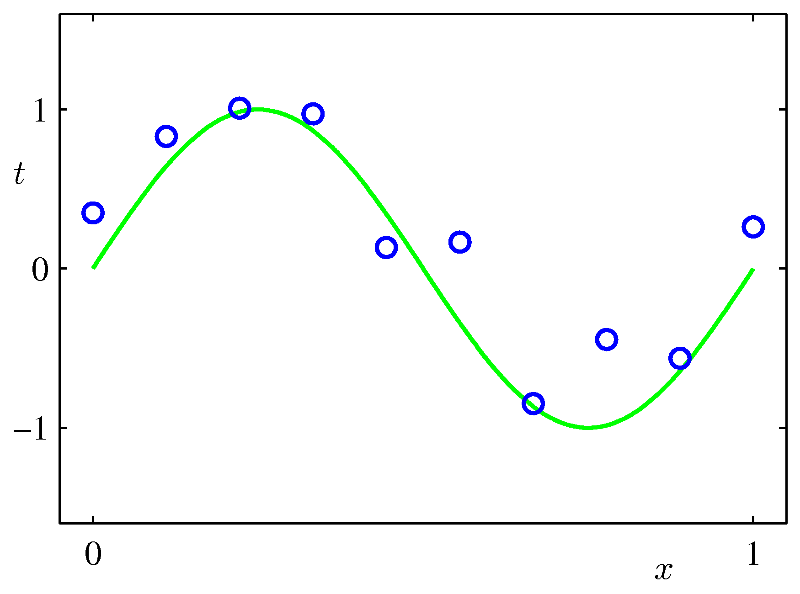
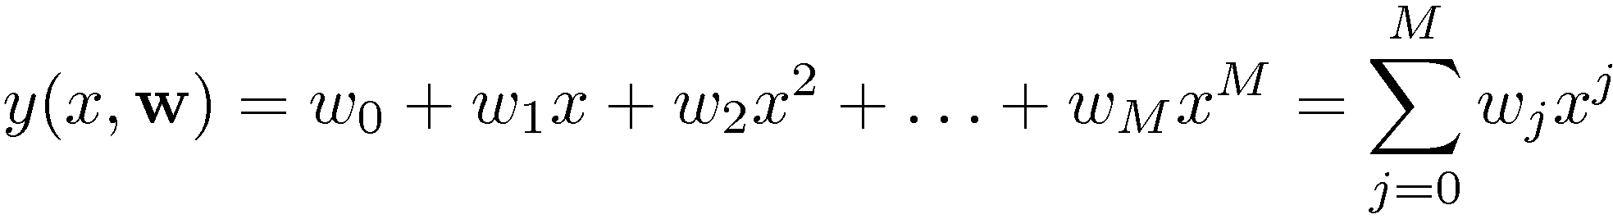
Linear Basis Function Models (1)
Example: Polynomial Curve Fitting

Slide 3
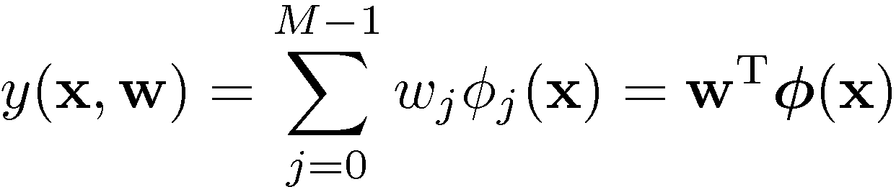
Linear Basis Function Models (2)
Generally
where  are known as basis functions.
Typically,   , so that  acts as a bias.
In the simplest case, we use linear basis functions :   .

Slide 4
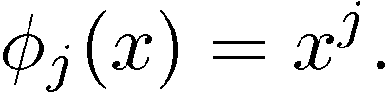
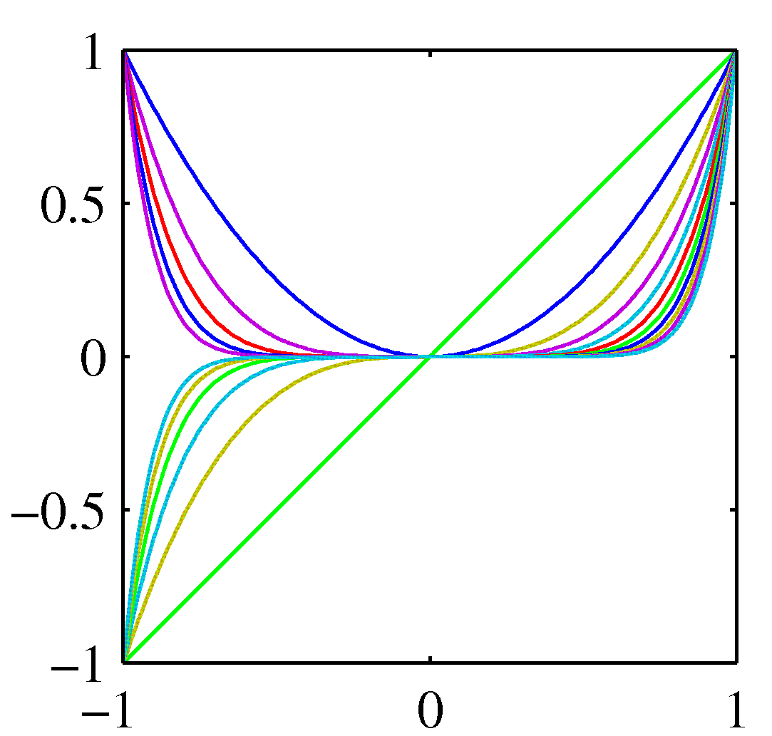
Linear Basis Function Models (3)
Polynomial basis functions:
These are global; a small change in  affect all basis functions.

Slide 5
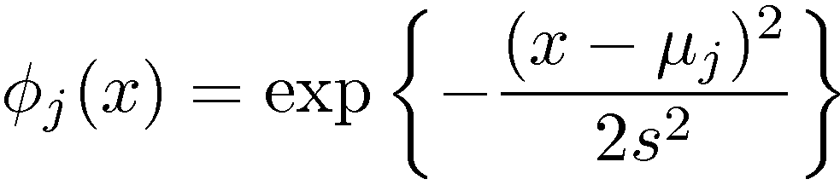
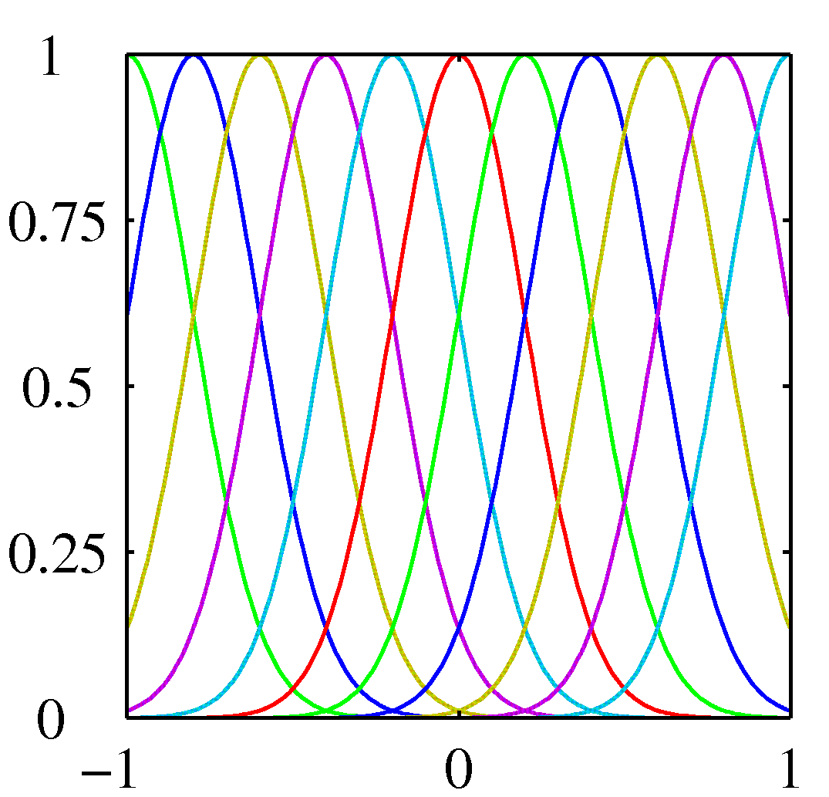
Linear Basis Function Models (4)
Gaussian basis functions:
These are local; a small change in  only affect nearby basis functions.  and  control location and scale (width).

Slide 6
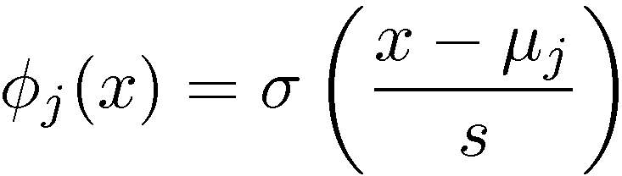
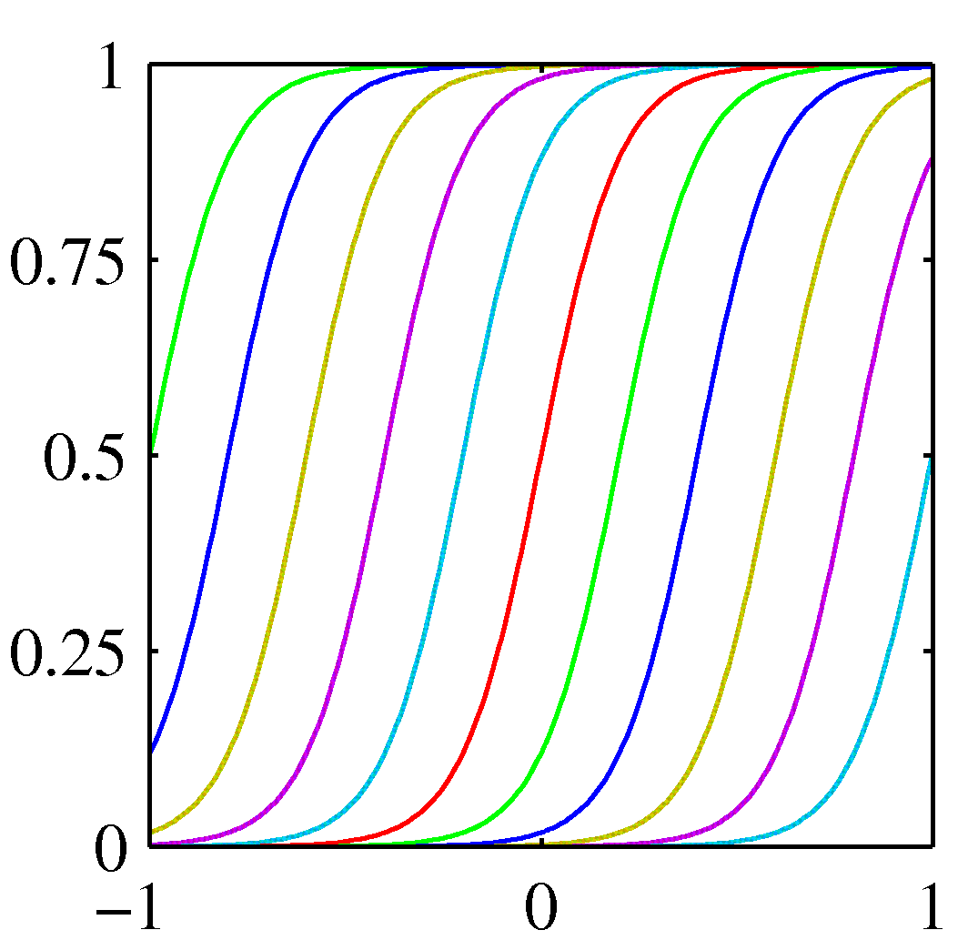
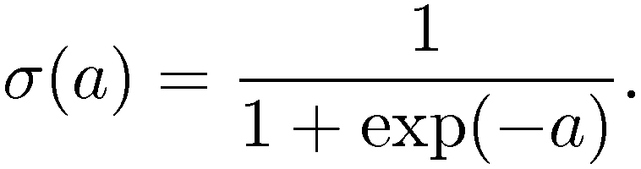
Linear Basis Function Models (5)
Sigmoidal basis functions:
where
Also these are local; a small change in  only affect nearby basis functions.  and  control location and scale (slope).

Slide 7

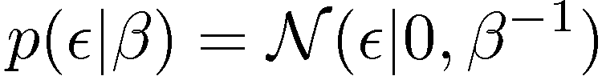

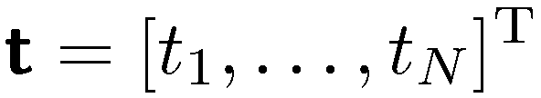
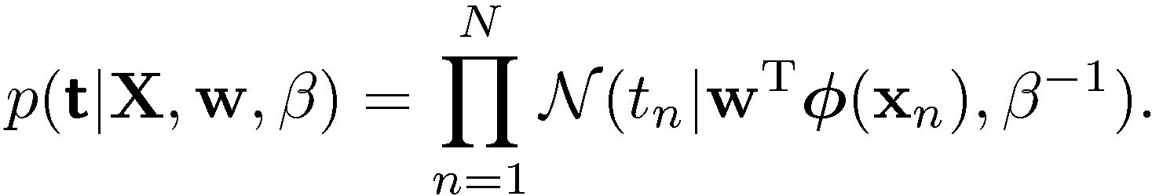
Maximum Likelihood and Least Squares (1)
Assume observations from a deterministic function with added Gaussian noise:
which is the same as saying,
Given observed inputs, , and targets,
, we obtain the likelihood function
where

Slide 8
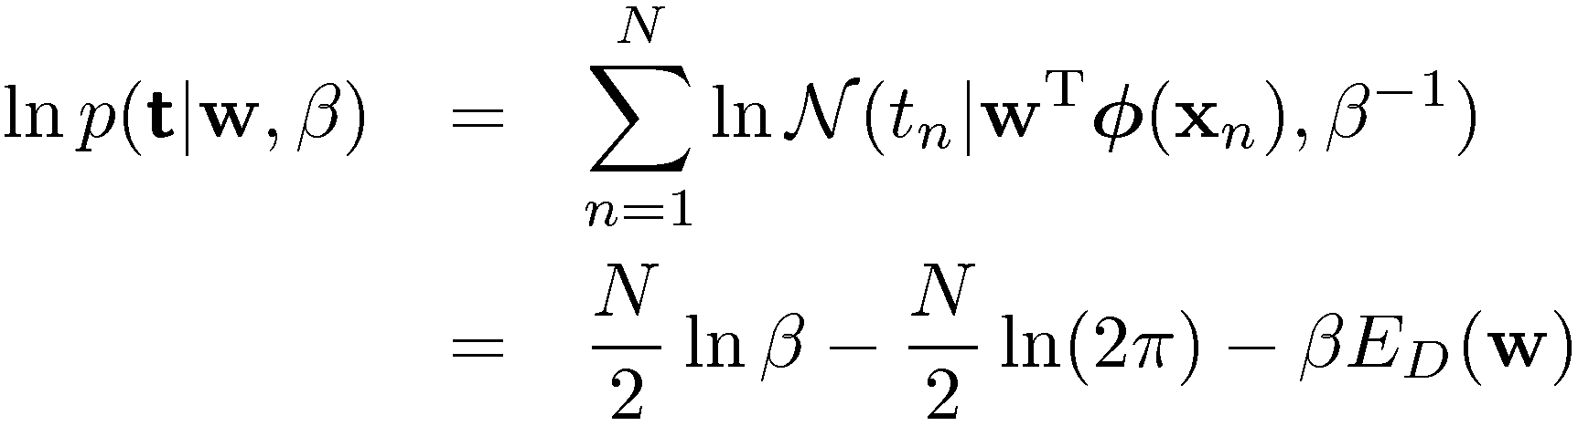
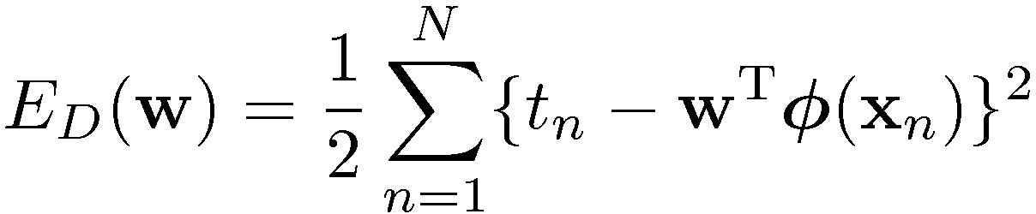
Maximum Likelihood and Least Squares (2)
Taking the logarithm, we get
where
is the sum-of-squares error.

Slide 9
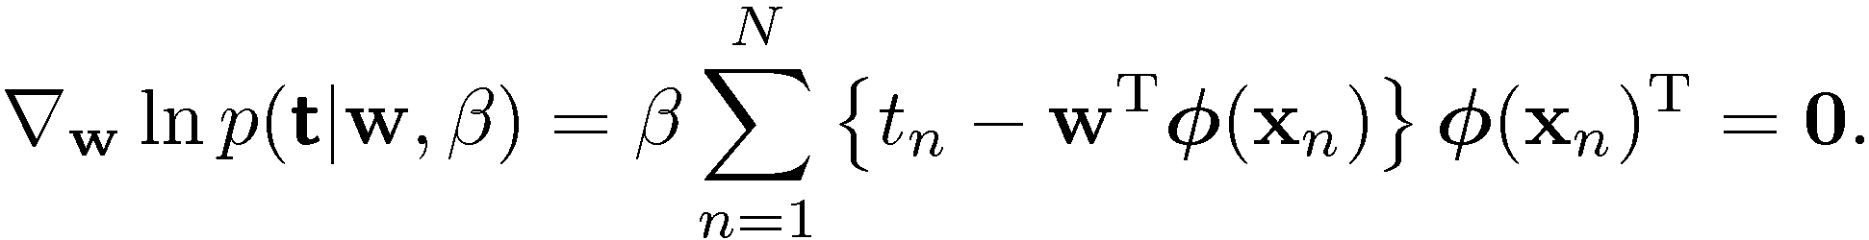


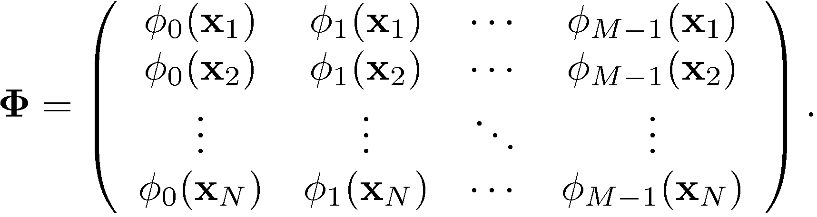
Maximum Likelihood and Least Squares (3)
Computing the gradient and setting it to zero yields
Solving for , we get
where
The Moore-Penrose pseudo-inverse, .

Slide 10
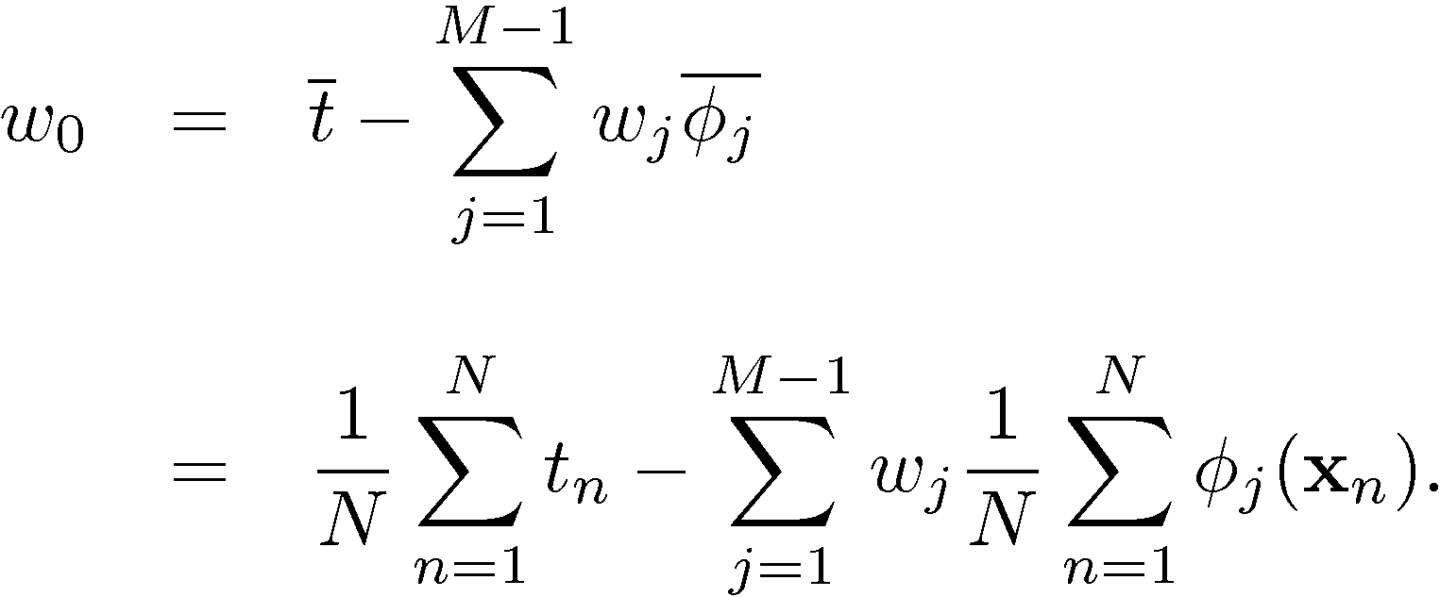
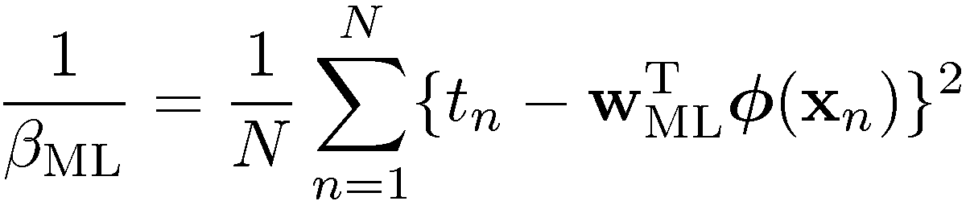
Maximum Likelihood and Least Squares (4)
Maximizing with respect to the bias, , alone, we see that
We can also maximize with respect to , giving

Slide 11
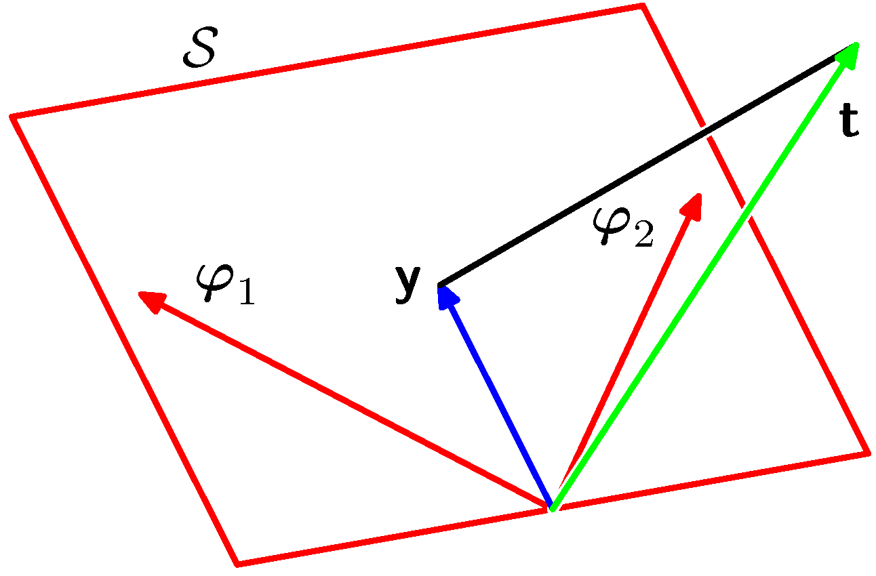


Geometry of Least Squares
Consider
 is spanned by .
☹ minimizes the distance between  and its orthogonal projection on , i.e. .
-dimensional
-dimensional

Slide 12
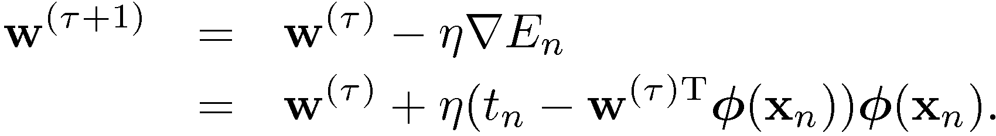
Sequential Learning
Data items considered one at a time (a.k.a. online learning); use stochastic (sequential) gradient descent:
This is known as the least-mean-squares (LMS) algorithm. Issue: how to choose ?

Slide 13

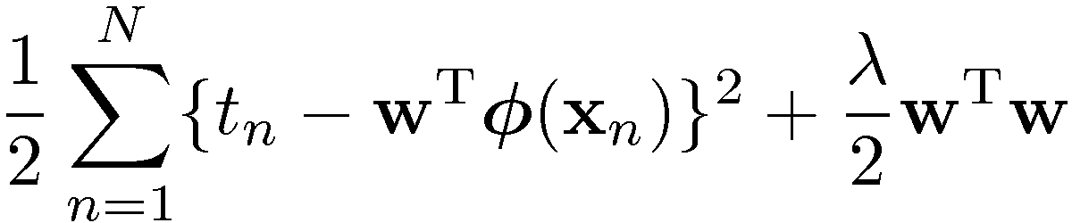
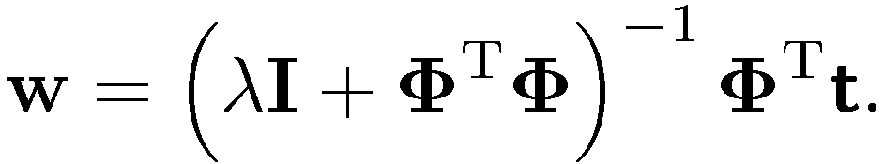
Regularized Least Squares (1)
Consider the error function:
With the sum-of-squares error function and a quadratic regularizer, we get
which is minimized by
Data term + Regularization term
 is called the regularization coefficient.

Slide 14
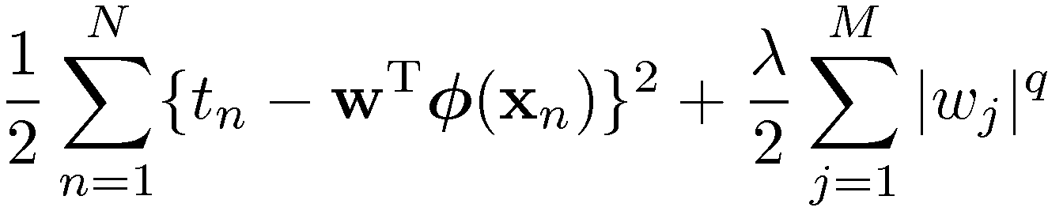
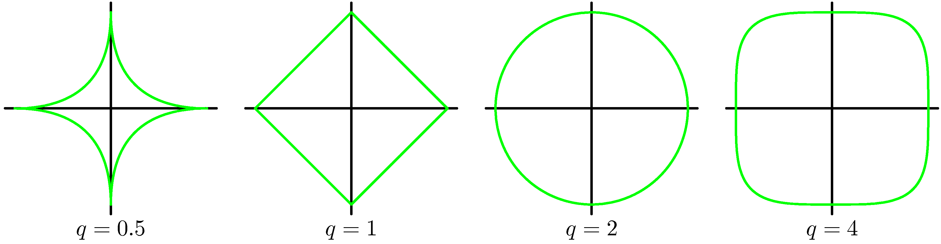
Regularized Least Squares (2)
With a more general regularizer, we have
Lasso
Quadratic

Slide 15
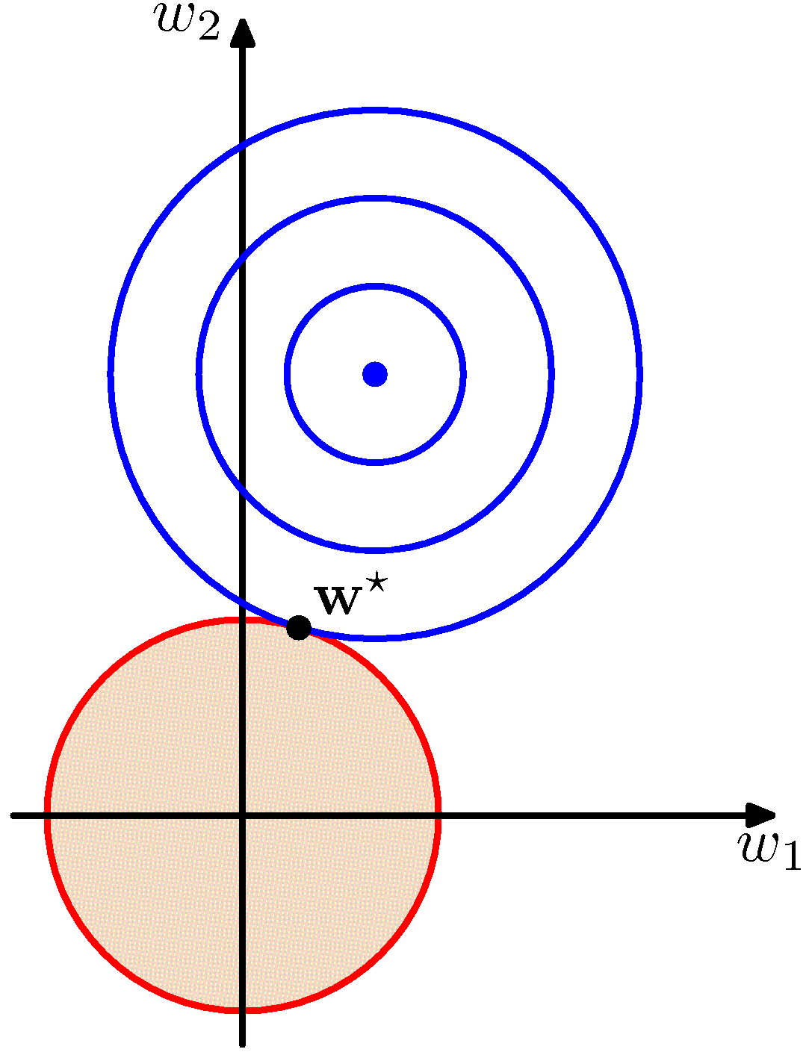
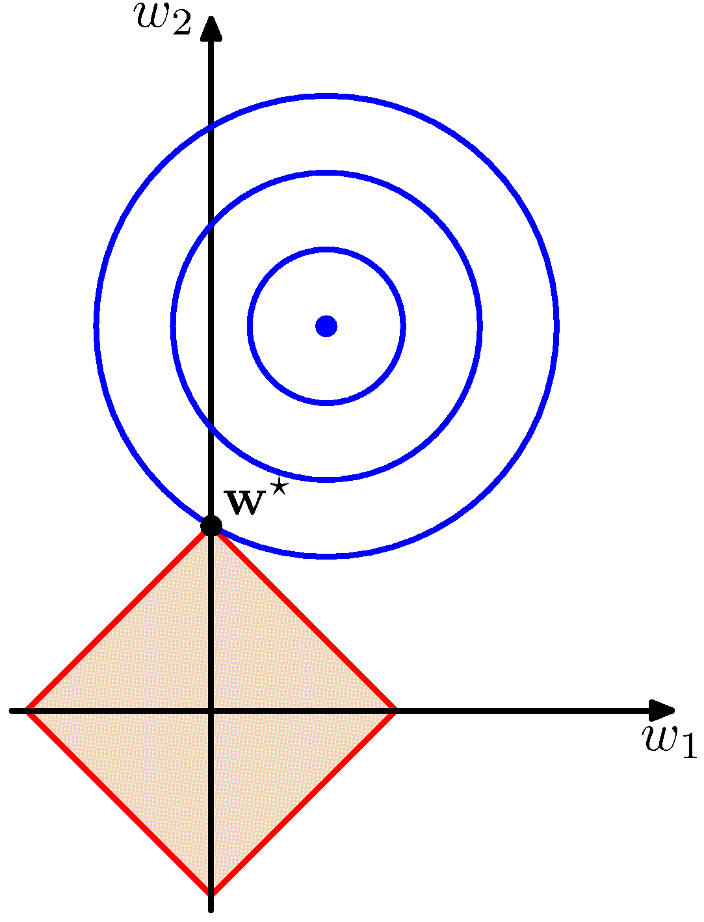
Regularized Least Squares (3)
Lasso tends to generate sparser solutions than a quadratic
regularizer.

Slide 16
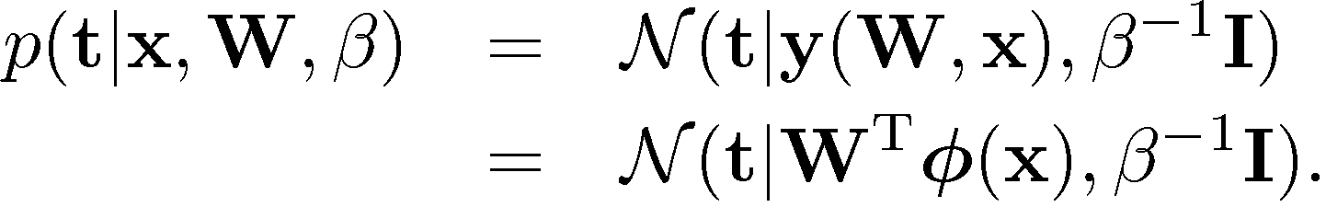
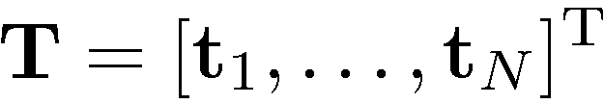
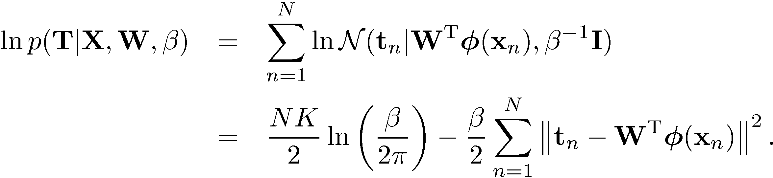
Multiple Outputs (1)
Analogously to the single output case we have:
Given observed inputs, , and targets,
, we obtain the log likelihood function

Slide 17

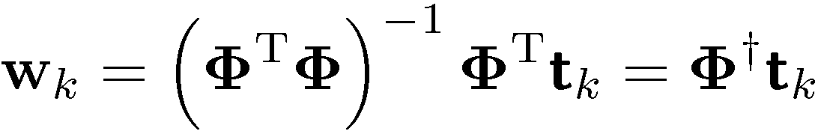
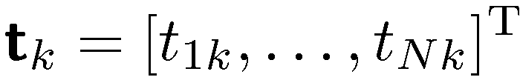
Multiple Outputs (2)
Maximizing with respect to , we obtain
If we consider a single target variable, , we see that
where , which is identical with the single output case.

Slide 18
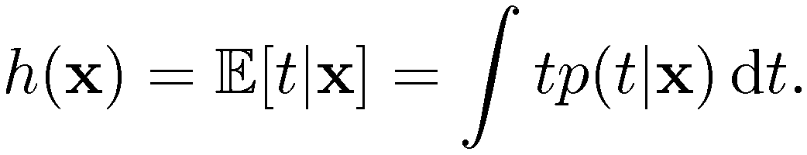
The Bias-Variance Decomposition (1)
Recall the expected squared loss,
where
The second term of E☹ corresponds to the noise inherent in the random variable .
What about the first term?

Slide 19
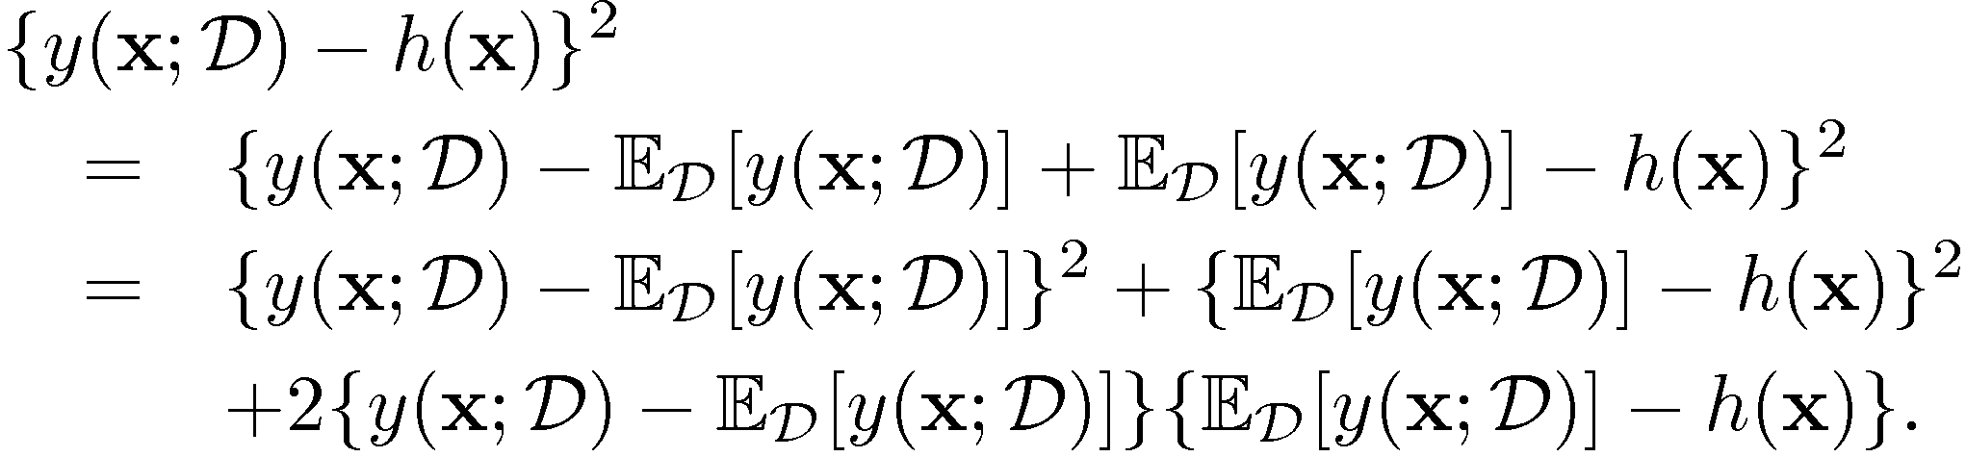
The Bias-Variance Decomposition (2)
Suppose we were given multiple data sets, each of size . Any particular data set, , will give a particular function . We then have

Slide 20
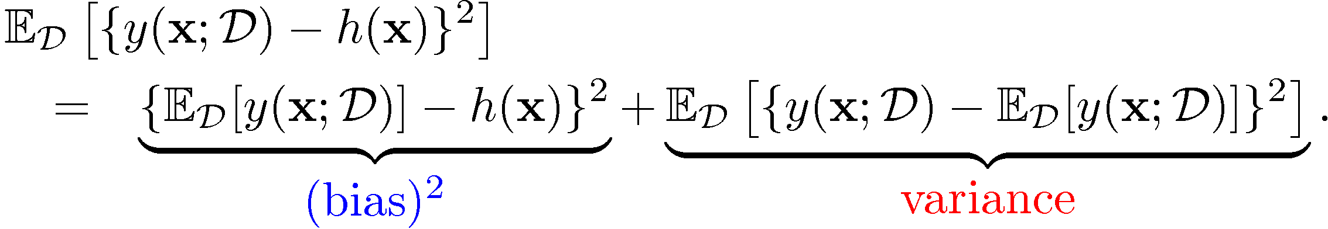
The Bias-Variance Decomposition (3)
Taking the expectation over  yields

Slide 21
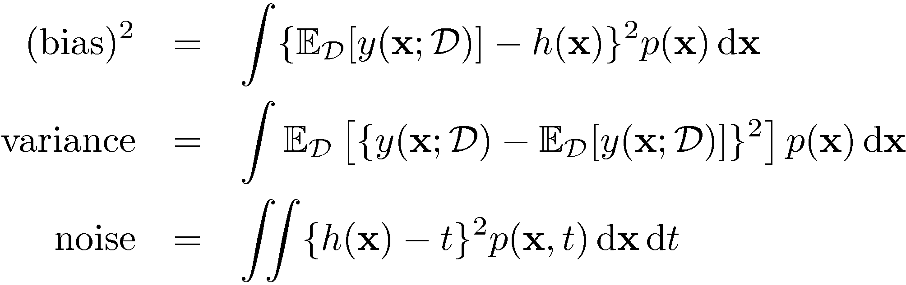
The Bias-Variance Decomposition (4)
Thus we can write
where

Slide 22
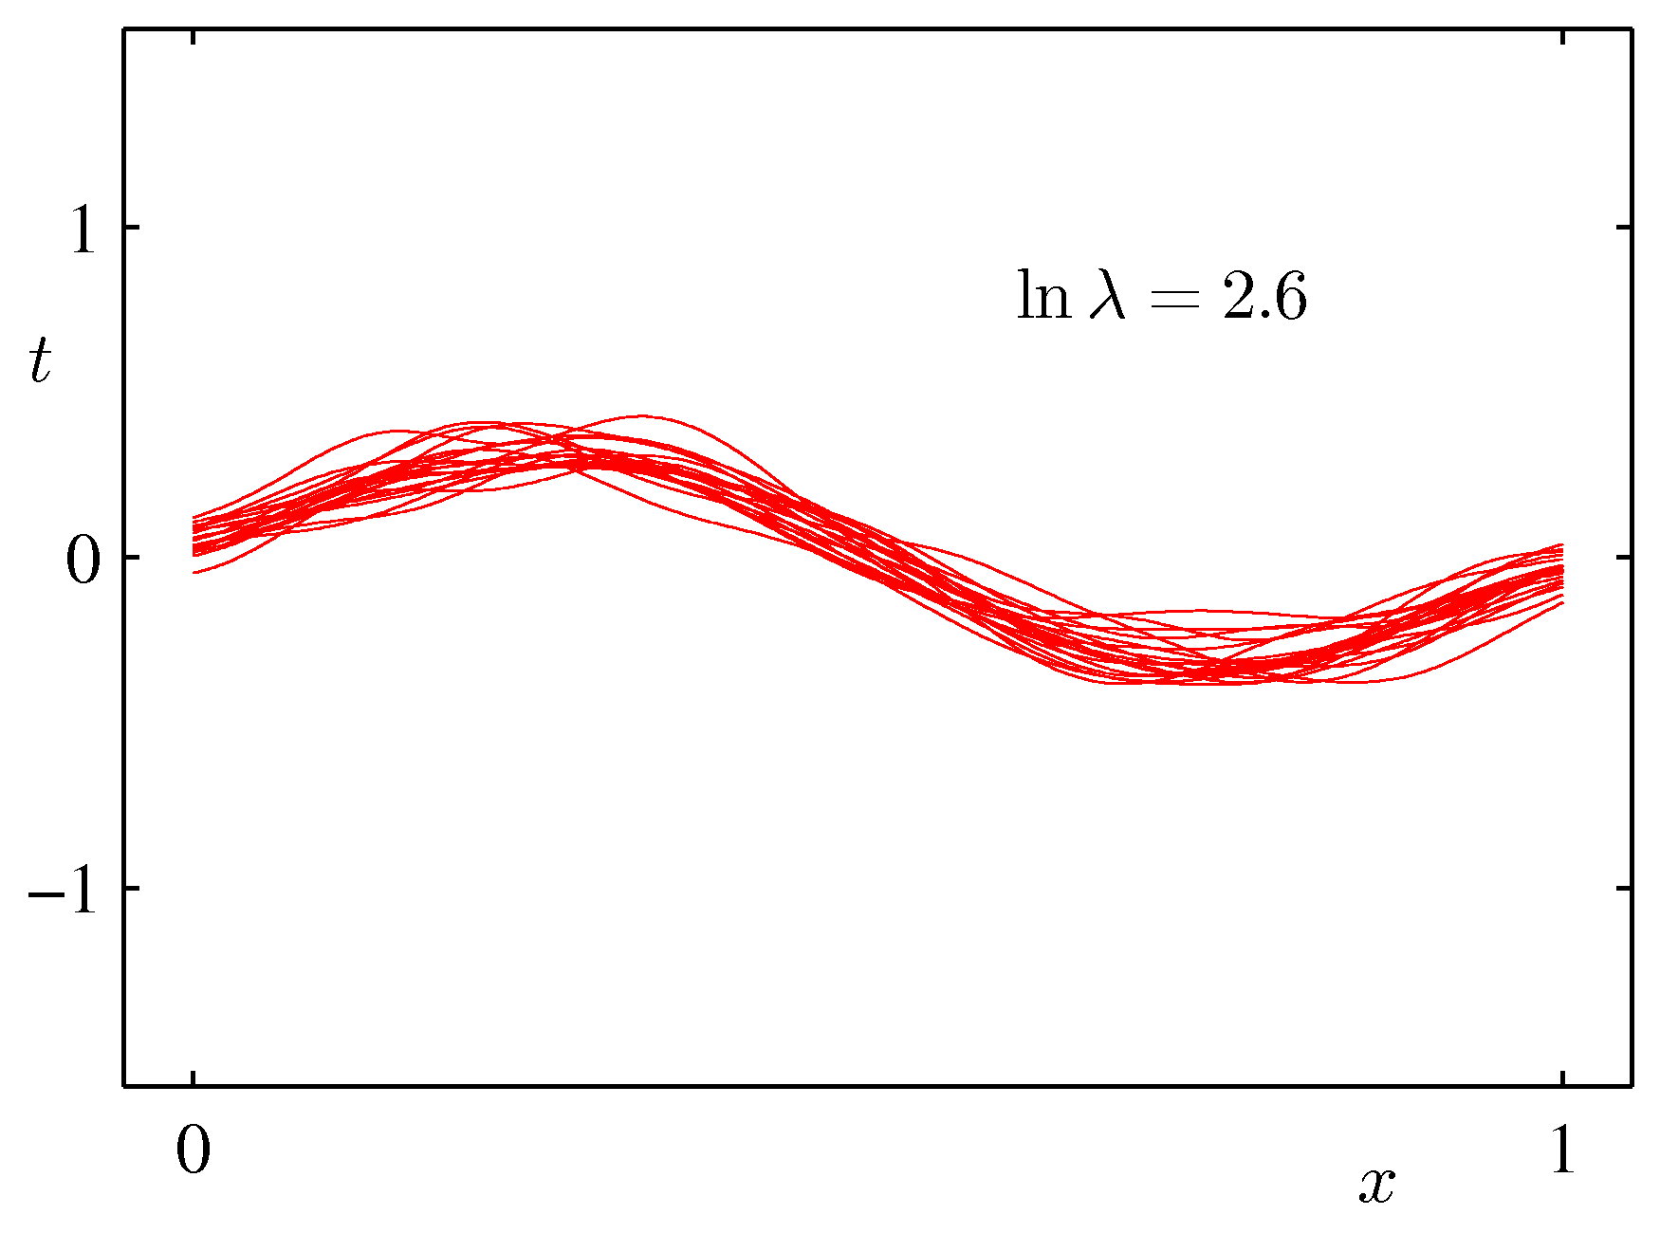
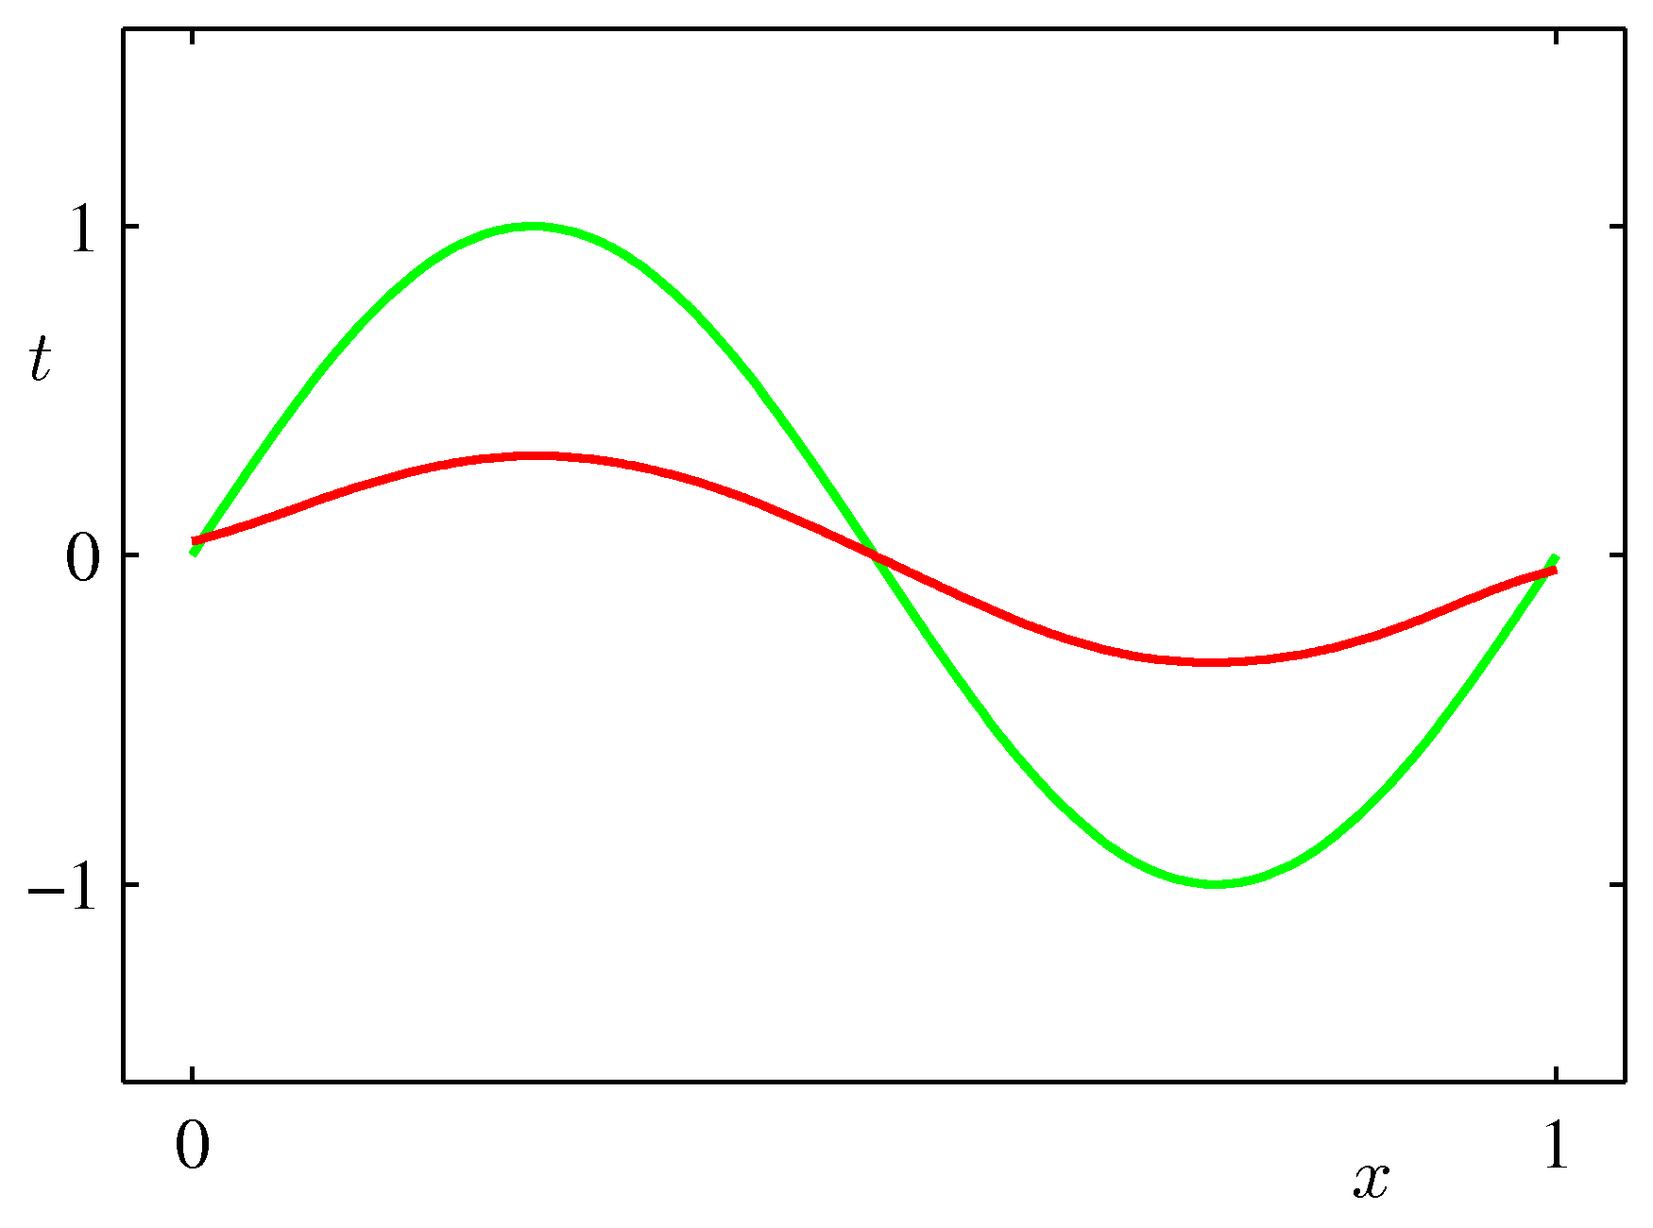
The Bias-Variance Decomposition (5)
Example: 25 data sets from the sinusoidal, varying the degree of regularization, .

Slide 23
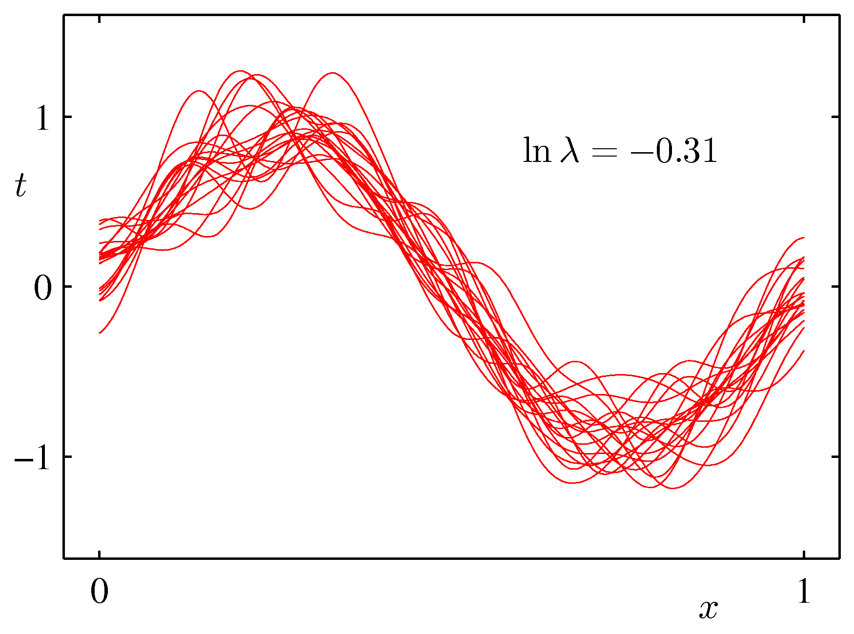
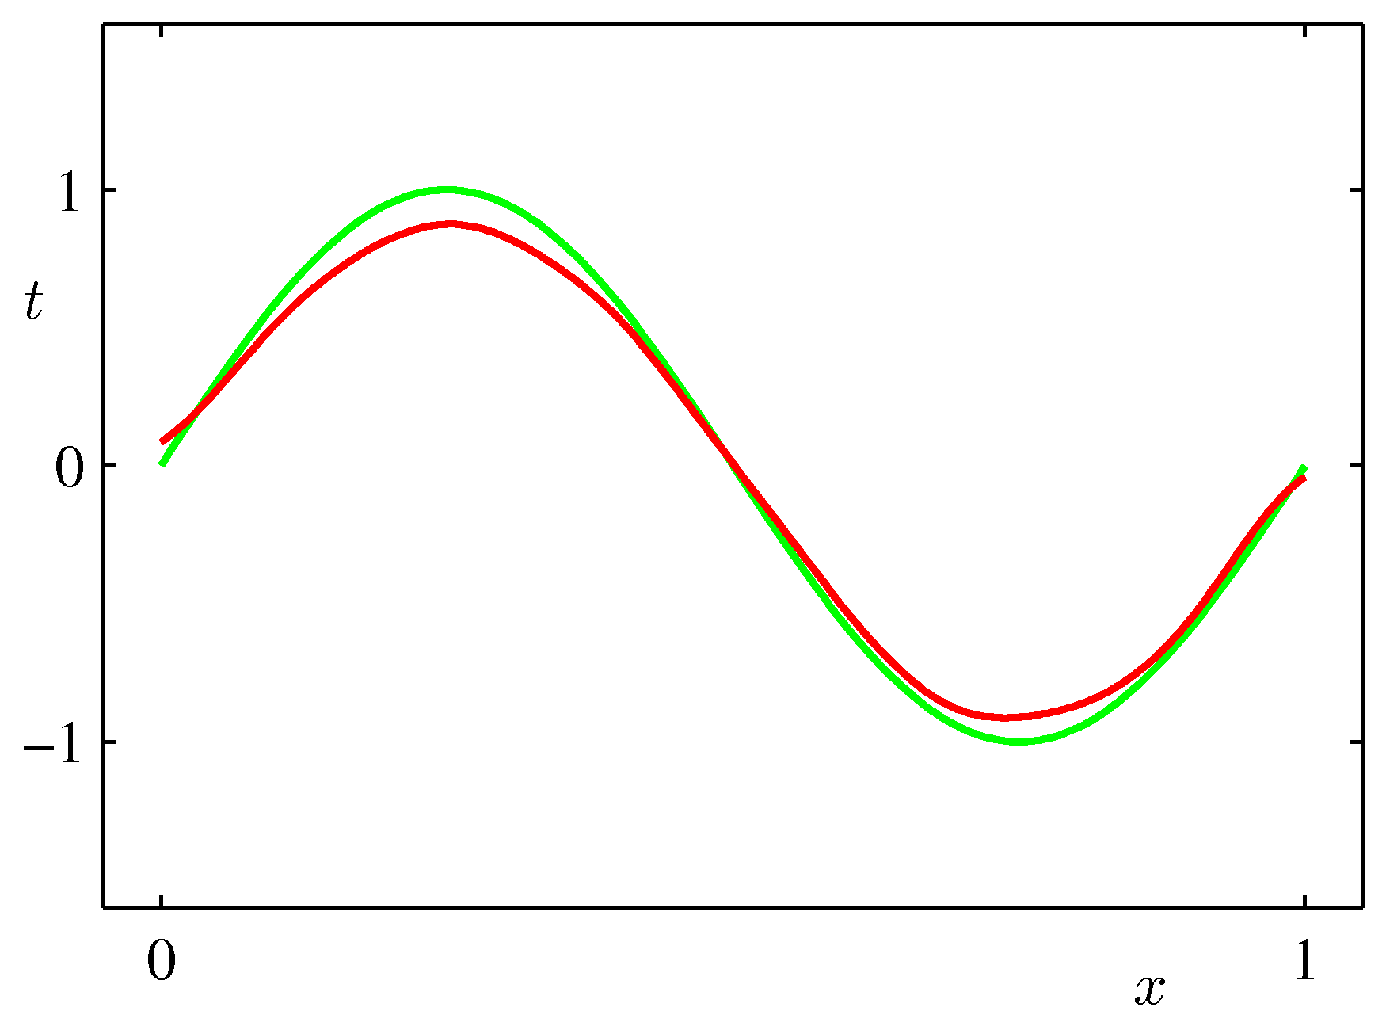
The Bias-Variance Decomposition (6)
Example: 25 data sets from the sinusoidal, varying the degree of regularization, .

Slide 24
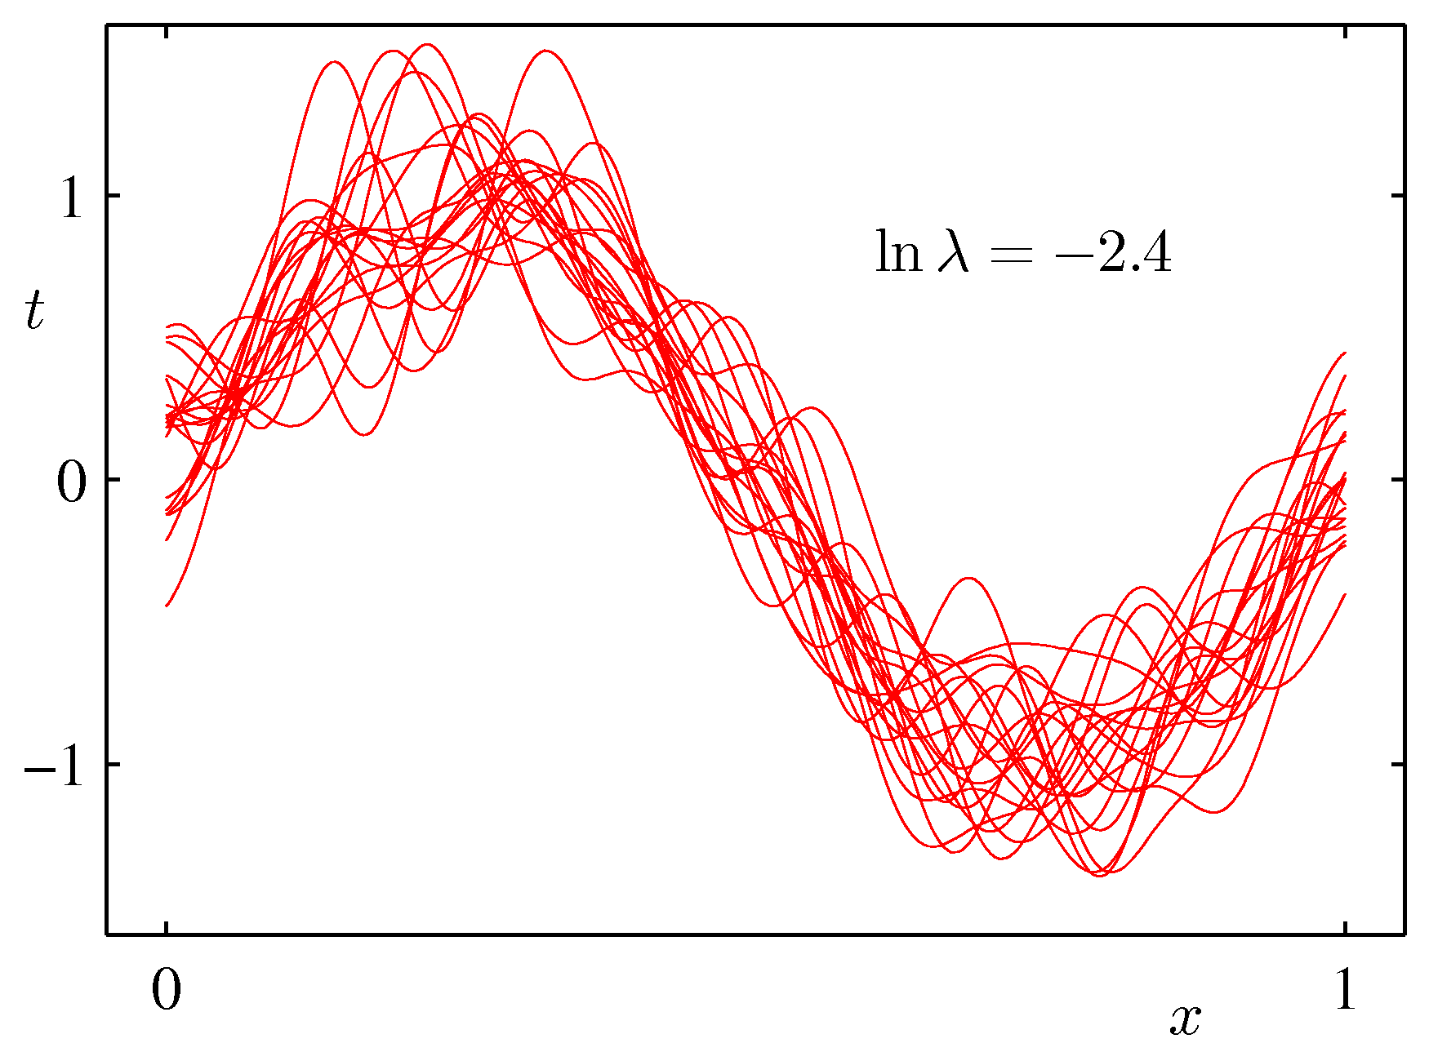
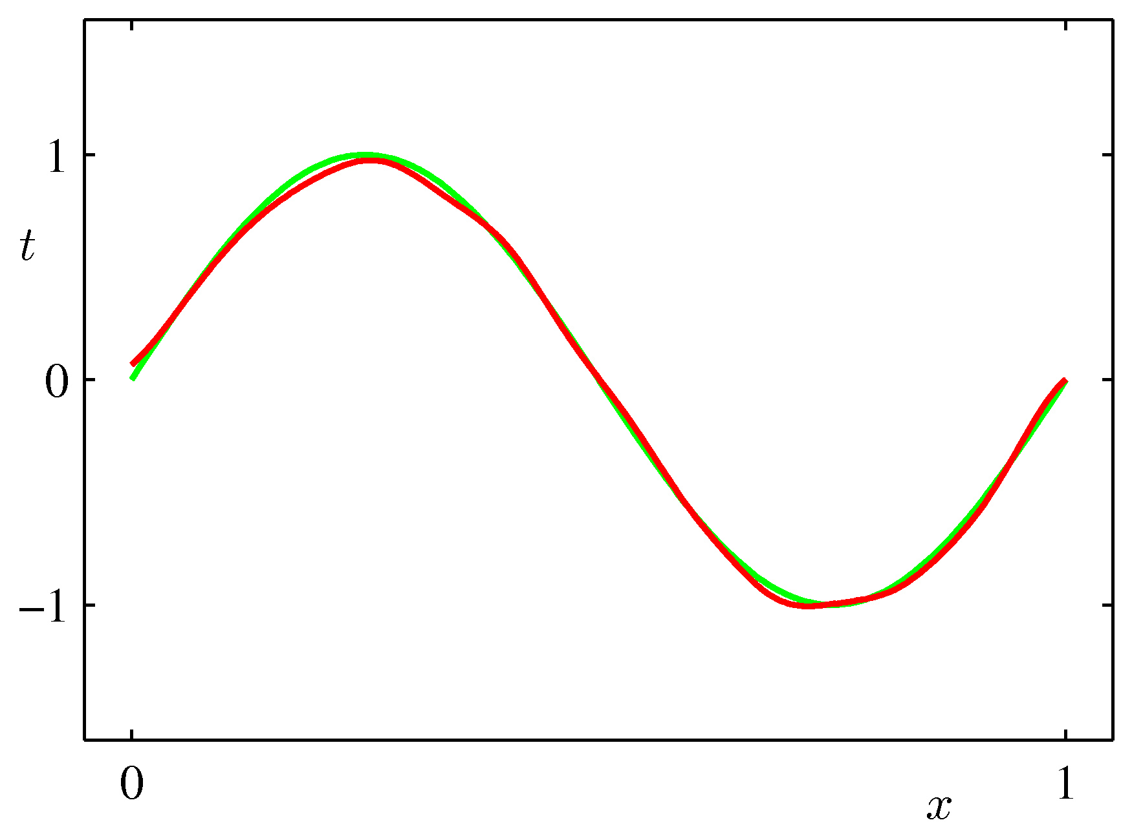
The Bias-Variance Decomposition (7)
Example: 25 data sets from the sinusoidal, varying the degree of regularization, .

Slide 25
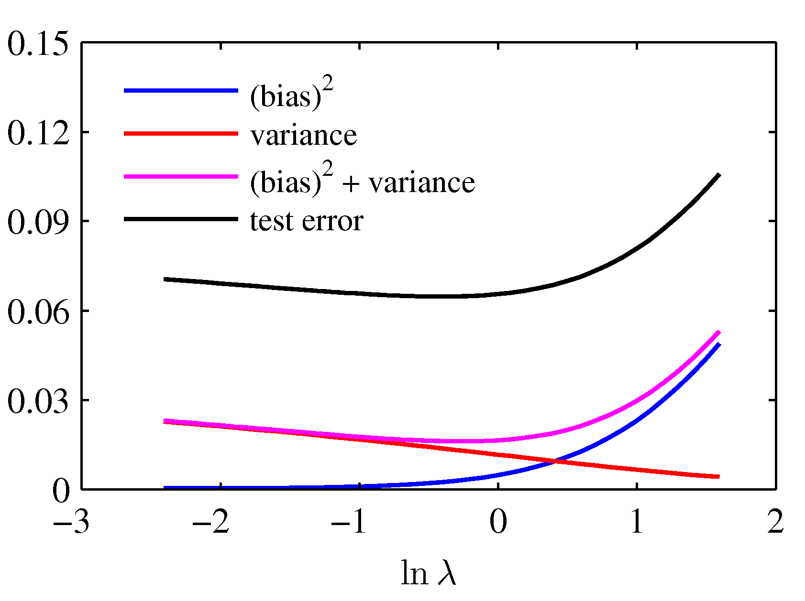
The Bias-Variance Trade-off
From these plots, we note that an over-regularized model (large ) will have a high bias, while an under-regularized model (small ) will have a high variance.

Slide 26


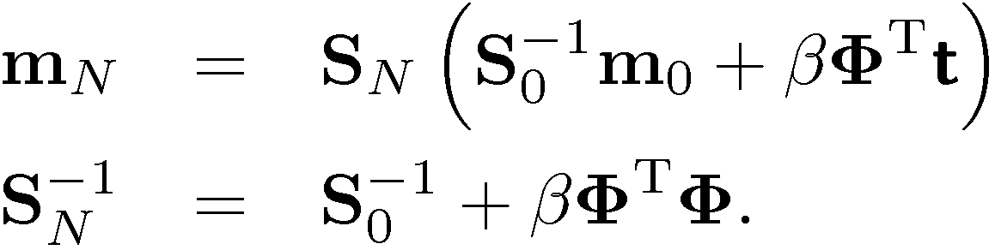
Bayesian Linear Regression (1)
Define a conjugate prior over 
Combining this with the likelihood function and using results for marginal and conditional Gaussian distributions, gives the posterior
where

Slide 27
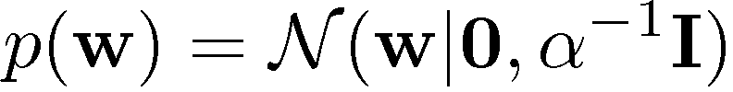
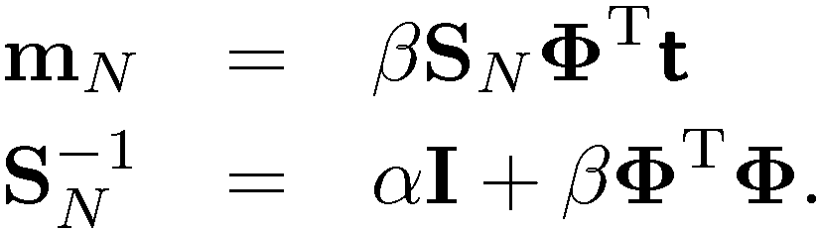
Bayesian Linear Regression (2)
A common choice for the prior is
for which
Next we consider an example …

Slide 28
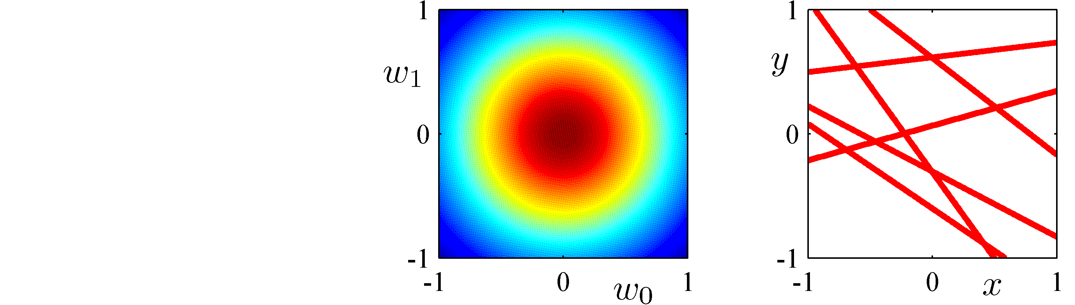
Bayesian Linear Regression (3)
0 data points observed
Prior
Data Space

Slide 29
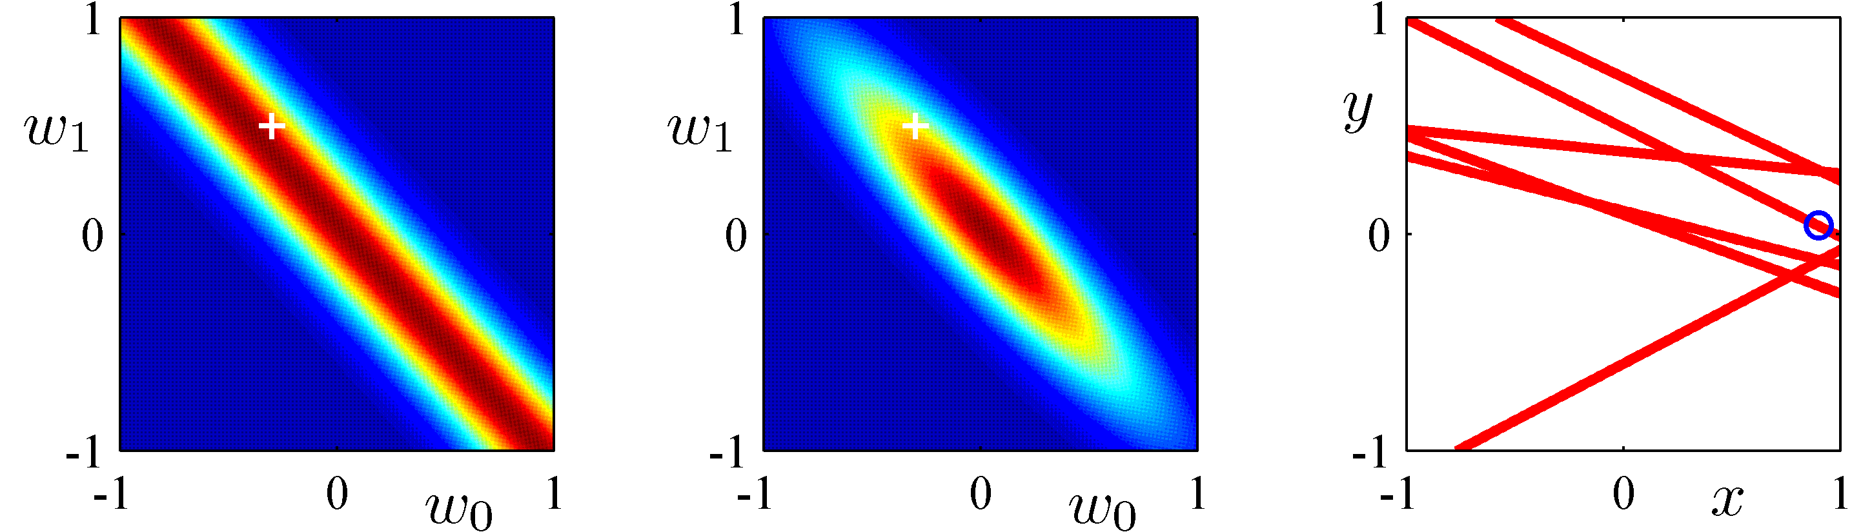
Bayesian Linear Regression (4)
1 data point observed
Likelihood
Posterior
Data Space

Slide 30
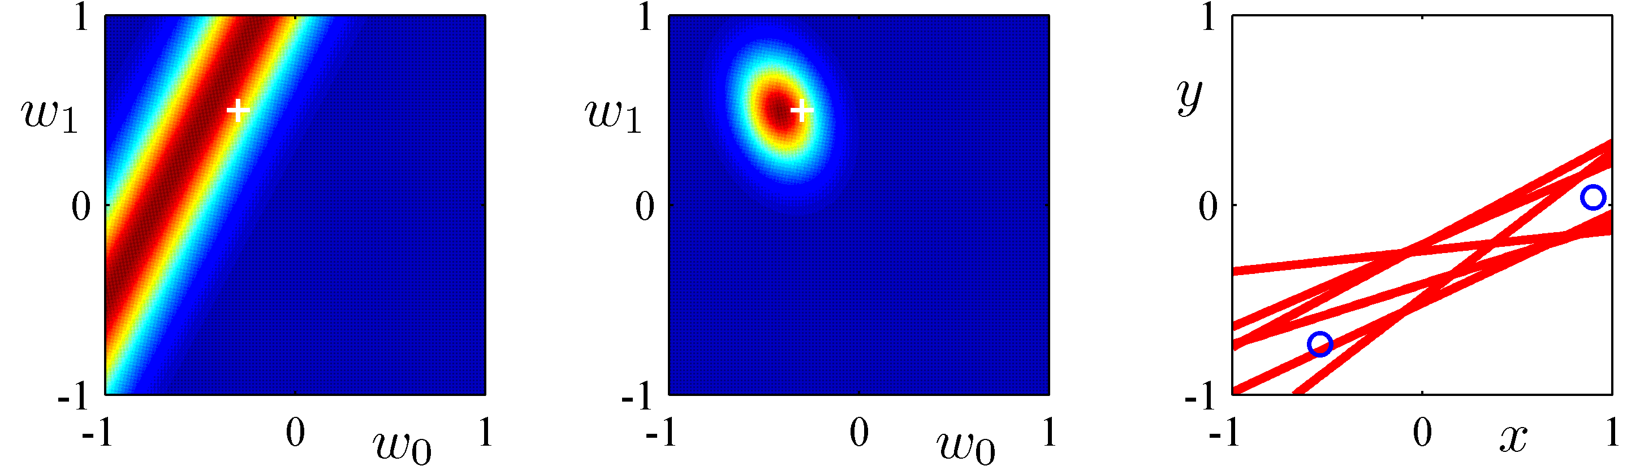
Bayesian Linear Regression (5)
2 data points observed
Likelihood
Posterior
Data Space

Slide 31
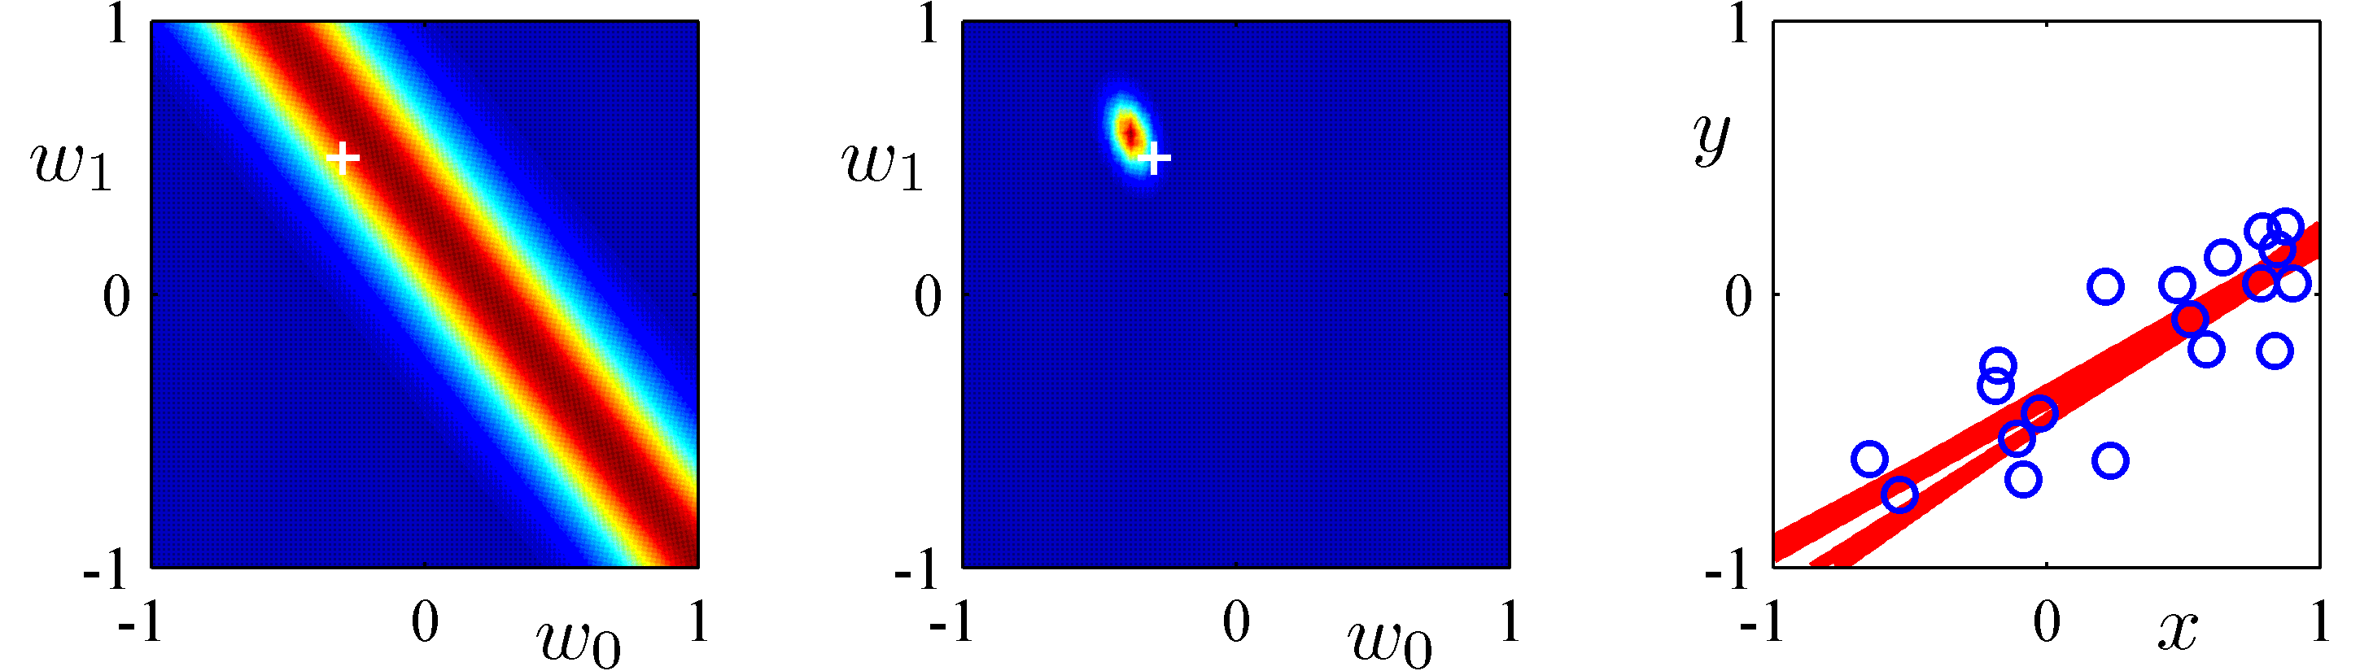
Bayesian Linear Regression (6)
20 data points observed
Likelihood
Posterior
Data Space

Slide 32


Predictive Distribution (1)
Predict  for new values of  by integrating over :
where

Slide 33


Predictive Distribution (2)
Example: Sinusoidal data, 9 Gaussian basis functions, 1 data point

Slide 34


Predictive Distribution (3)
Example: Sinusoidal data, 9 Gaussian basis functions, 2 data points

Slide 35


Predictive Distribution (4)
Example: Sinusoidal data, 9 Gaussian basis functions, 4 data points

Slide 36


Predictive Distribution (5)
Example: Sinusoidal data, 9 Gaussian basis functions, 25 data points

Slide 37

Equivalent Kernel (1)
The predictive mean can be written
This is a weighted sum of the training data target values, .
Equivalent kernel or smoother matrix.

Slide 38







Equivalent Kernel (2)
Weight of  depends on distance between  and ; nearby  carry more weight.

Slide 39


Equivalent Kernel (3)
Non-local basis functions have local equivalent kernels:
Polynomial
Sigmoidal

Slide 40

Equivalent Kernel (4)
The kernel as a covariance function: consider
We can avoid the use of basis functions and define the kernel function directly, leading to Gaussian Processes (Chapter 6).

Slide 41



Equivalent Kernel (5)
for all values of ; however, the equivalent kernel may be negative for some values of .
Like all kernel functions, the equivalent kernel can be expressed as an inner product:
where .

Slide 42

Bayesian Model Comparison (1)
How do we choose the ‘right’ model?
Assume we want to compare models   …☹, using data ; this requires computing
Bayes Factor: ratio of evidence for two models
Posterior
Prior
Model evidence or marginal likelihood

Slide 43

Bayesian Model Comparison (2)
Having computed , we can compute the predictive (mixture) distribution
A simpler approximation, known as model selection, is to use the model with the highest evidence.

Slide 44


Bayesian Model Comparison (3)
For a model with parameters , we get the model evidence by marginalizing over 
Note that

Slide 45


Bayesian Model Comparison (4)
For a given model with a single parameter, , con-sider the approximation
where the posterior is assumed to be sharply peaked.

Slide 46



Bayesian Model Comparison (5)
Taking logarithms, we obtain
With  parameters, all assumed to have the same ratio , we get
Negative
Negative and linear in .

Slide 47

Bayesian Model Comparison (6)
Matching data and model complexity

Slide 48




The Evidence Approximation (1)
The fully Bayesian predictive distribution is given by
but this integral is intractable. Approximate with
where is the mode of , which is assumed to be sharply peaked; a.k.a. empirical Bayes, type II or gene-ralized maximum likelihood, or evidence approximation.

Slide 49

The Evidence Approximation (2)
From Bayes’ theorem we have
and if we assume  to be flat we see that
General results for Gaussian integrals give

Slide 50



The Evidence Approximation (3)
Example: sinusoidal data,    ^{th} degree polynomial,

Slide 51


Maximizing the Evidence Function (1)
To maximise w.r.t.  and , we define the eigenvector equation
Thus
has eigenvalues   .

Slide 52


Maximizing the Evidence Function (2)
We can now differentiate w.r.t.  and , and set the results to zero, to get
where
N.B.  depends on both  and .

Slide 53



Effective Number of Parameters (3)
 is not well determined by the likelihood
 is well determined by the likelihood
 is the number of well determined parameters
Likelihood
Prior

Slide 54



Effective Number of Parameters (2)
Example: sinusoidal data, 9 Gaussian basis functions,   .

Slide 55


Effective Number of Parameters (3)
Example: sinusoidal data, 9 Gaussian basis functions,   .
Test set error

Slide 56

Effective Number of Parameters (4)
Example: sinusoidal data, 9 Gaussian basis functions,   .

Slide 57


Effective Number of Parameters (5)
In the limit ,    and we can consider using the easy-to-compute approximation

Slide 58
Limitations of Fixed Basis Functions
 basis function along each dimension of a -dimensional input space requires  basis functions: the curse of dimensionality.
In later chapters, we shall see how we can get away with fewer basis functions, by choosing these using the training data.

