Slide 1


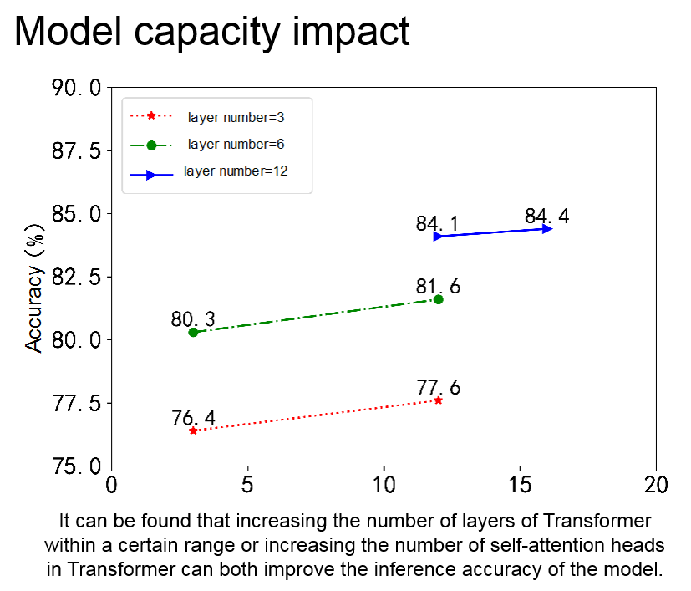
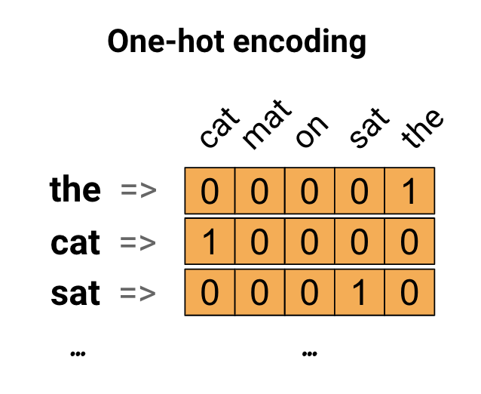
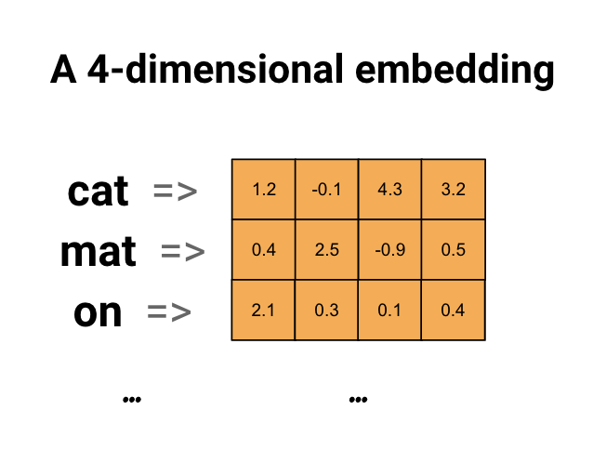
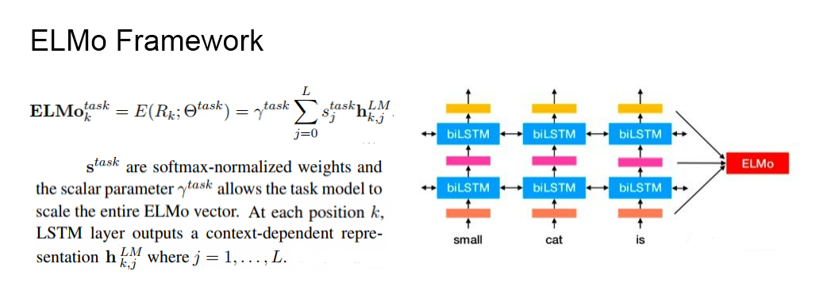
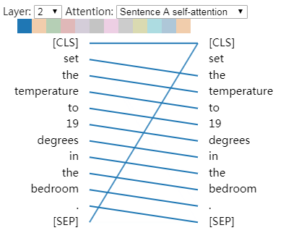
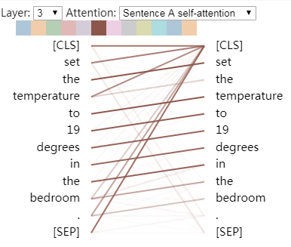
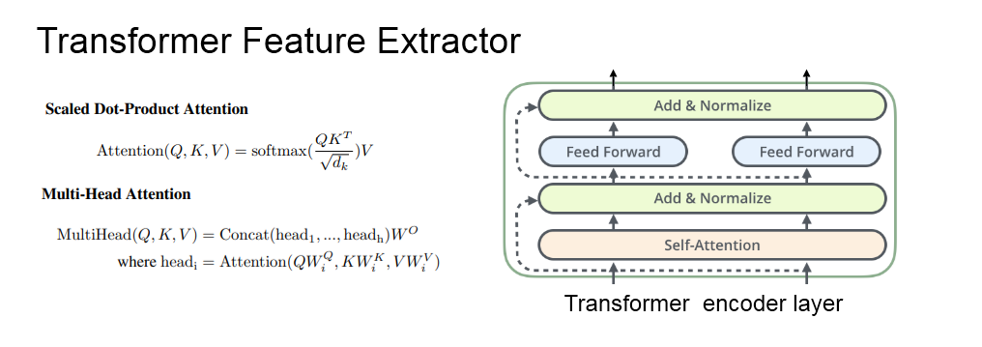
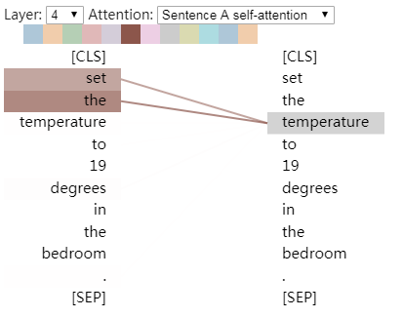
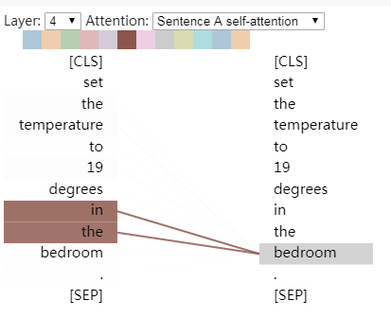
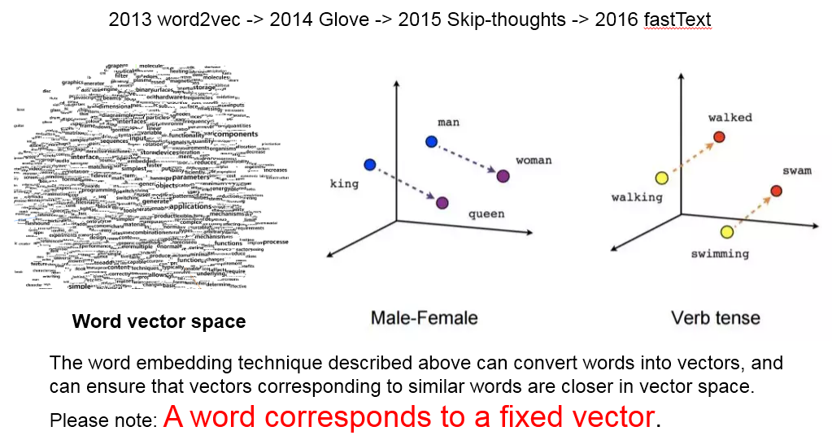
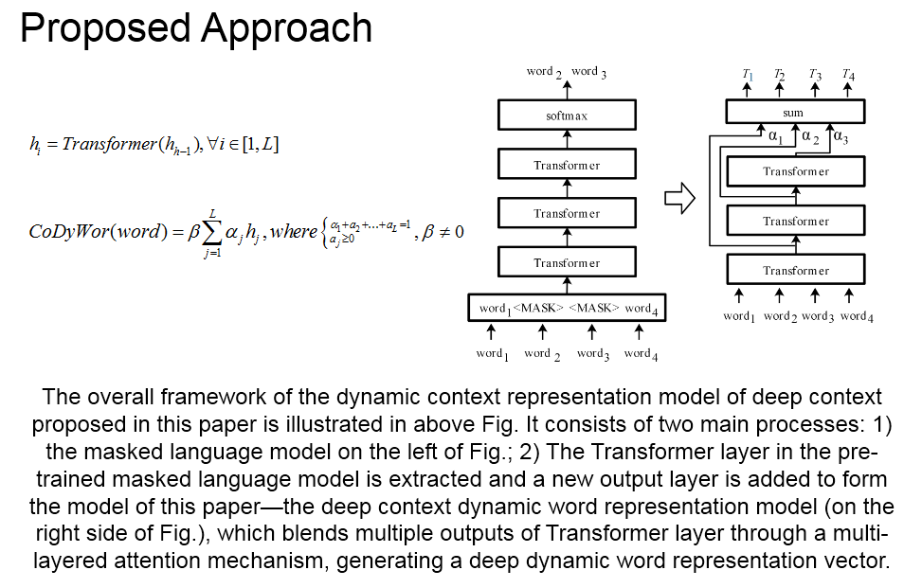
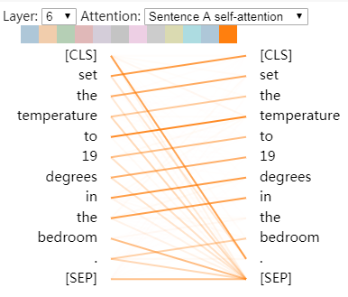
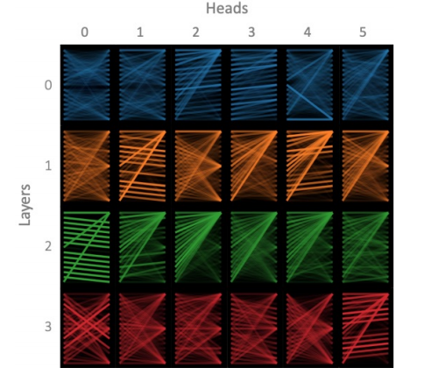
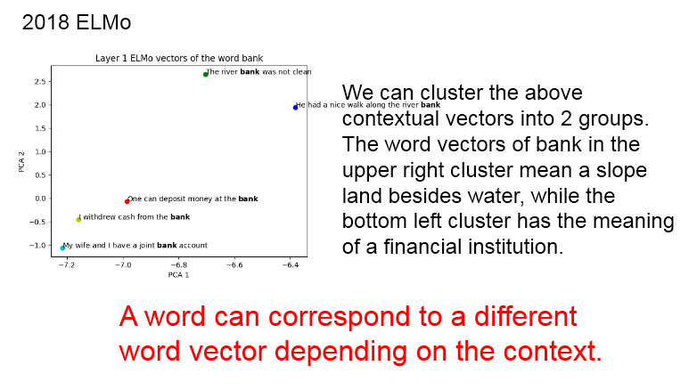
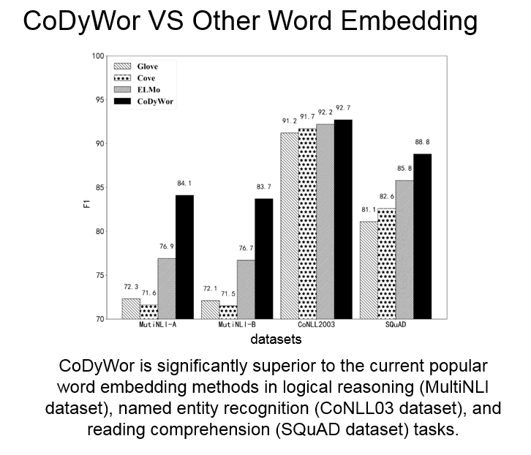
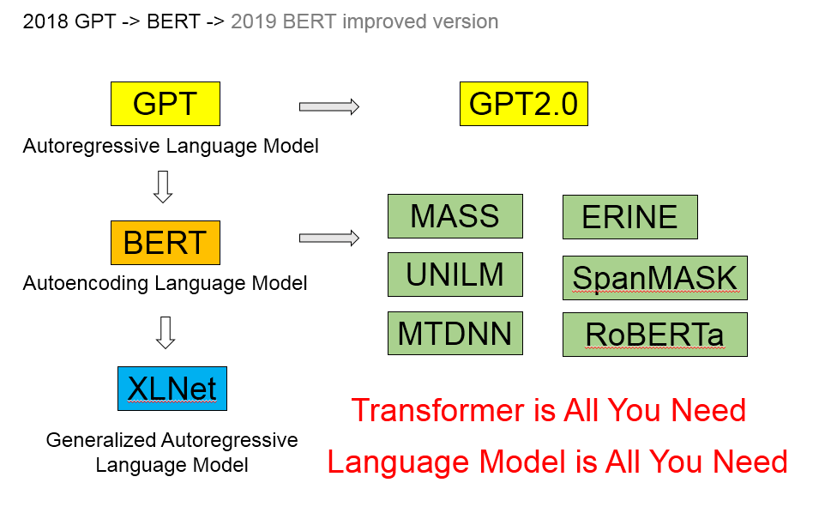
A Dynamic Word Representation Model Based on Deep Context
Xiao Yuan, Xi Xiong*, Shenggen Ju,
Zhengwen Xie and Jiawei Wang
flyxiongxi@gmail.com
Introduction
Method
The currently used word embedding techniques use fixed vectors to represent words without the concept of context and dynamics. This paper proposes a deep neural network CoDyWor to model the context of words so that words in different contexts have different vector representations of words. CoDyWor is a deep contextualized word representation that models both (1) complex characteristics of word use (e.g., syntax and semantics), and (2) how these uses vary across linguistic contexts (i.e., to model polysemy).
The method in this paper adopts the depth Neural Network Language Model (NNLM), meanwhile, it absorbs the idea of generating the word vector from the internal state of NNLM in ELMo, and replaces the BiLSTM encoder in the model with the Transformer encoder with concurrent computing and contextual coding capability, and introduces a multi-layer attention mechanism, blending word representation information of different levels in neural network, and generating the word vector with contextual meanings.
Aim
Approach = ELMo Framework + Transformer Feature Extractor
Visualizing Attention in the Transformer
The NLP system available based on deep learning usually first converts the text input into a vectorized word representation, i.e. the word embedding vector, and then proceeds to be processed next. We need vectorized representations of words with more a priori information. These a priori information includes: word meaning, syntax, common sense, and so on.
Attention to next word
Attention to previous word
Technological Evolution
Attention to identical/related words
Attention to delimiter tokens
Attention across all of the model’s layers and heads
Conclusion
This paper proposes an efficient, simply-structured deep context dynamic word representation model CoDyWor that can be widely used in natural language processing tasks. The context dynamic word representation generated by the model can be used for natural language processing tasks such as logical reasoning, named entity recognition and reading comprehension and so forth, and may be universally utilized to a certain extent. The context dynamic word representation generated by the CoDyWor model in the above tasks performs better than the current mainstream static word representations.
Results
Acknowledgements
The work was partially supported by the China Postdoctoral Science Foundation under Grant No. 2019M653400; the Sichuan Science and Technology Program under Grant Nos. 2018GZ0253, 2019YFS0236, 2018GZ0182, 2018GZ0093 and 2018GZDZX0039.

