Slide 1


A Mathematical Introduction to Data Science Lecture 2: Generalized MDS/PCA
Yuan Yao
Peking University
2015.5.6.

Slide 2
Main Content
Lecture 1: Sample mean and Covariance (PCA/MDS): Fisher’s Principle of Maximum Likelihood Estimate, yet things might go wrong --
Stein’s phenomenon and shrinkage
Random matrix theory and failure of PCA
Lecture 2: Beyond MDS/PCA
Random projections and compressed sensing
Semidefinite Programming (SDP) extensions of MDS/PCA:
MDS with uncertainty (Sensor Network Localization)
Robust PCA
Sparse PCA
Lecture 3: Geometric and Topological structures of data
Manifold learning: ISOMAP/LLE etc.
From graphs to simplicial complexes: persistent homology, Hodge theory, etc.

Slide 3
Random Projections and Compressed Sensing
A Blessing of Dimensionality: Concentration of Measure

Slide 4


Reflection of MDS
Can we find an universal embedding whose metric distortions are uniformly small for all pairs

Slide 5
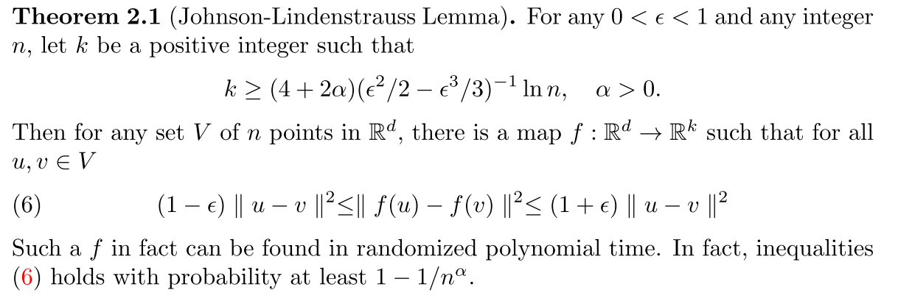
Johnson-Lindenstrauss Lemma

Slide 6
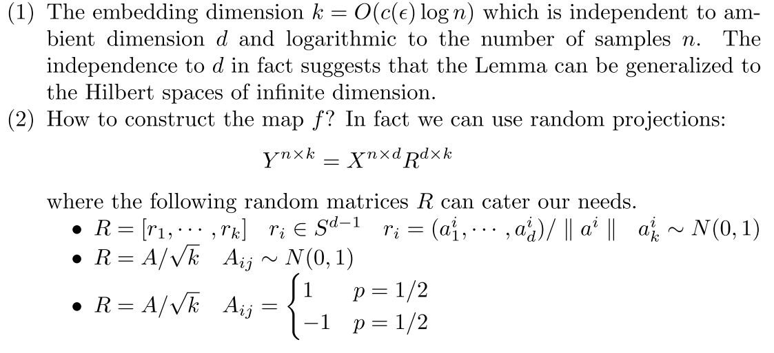
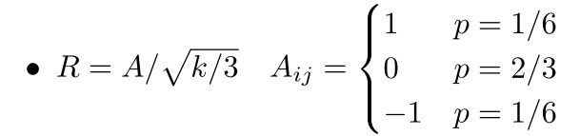
Remarks

Slide 7
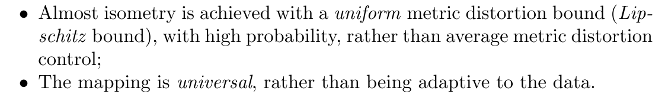
Remarks

Slide 8
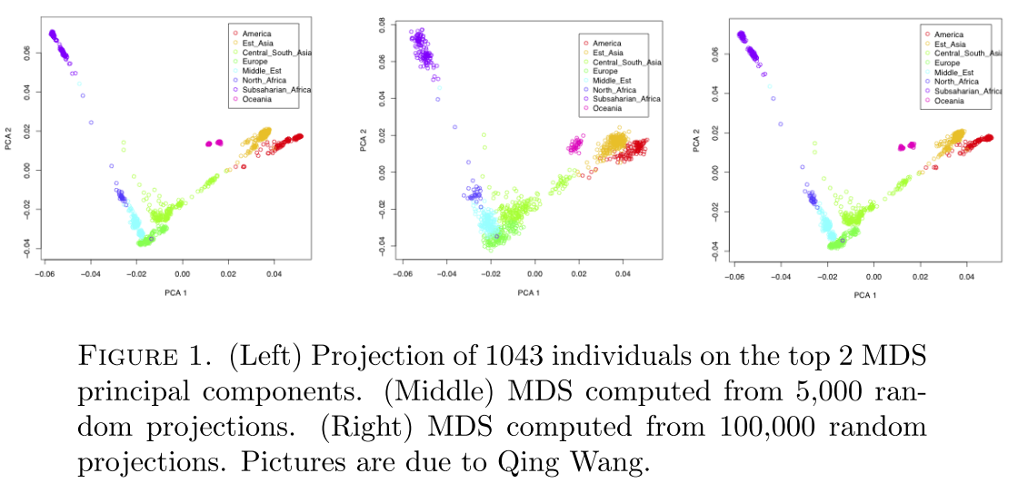
Example: Human Genome Diversity Project

Slide 9
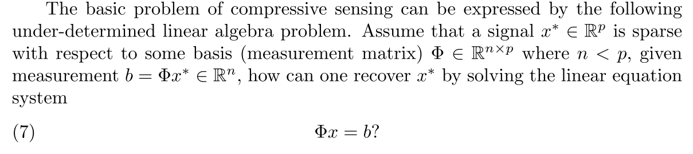
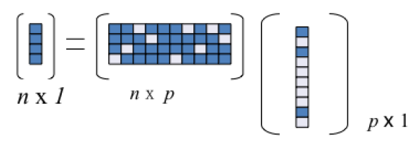
Application: Compressed Sensing

Slide 10
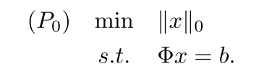
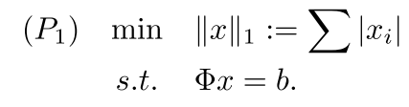
P0 is NP-hard, while P1 is tractable as linear programming
Under what conditions, P0 or P1 have solutions exactly meets the true signal?

Slide 11
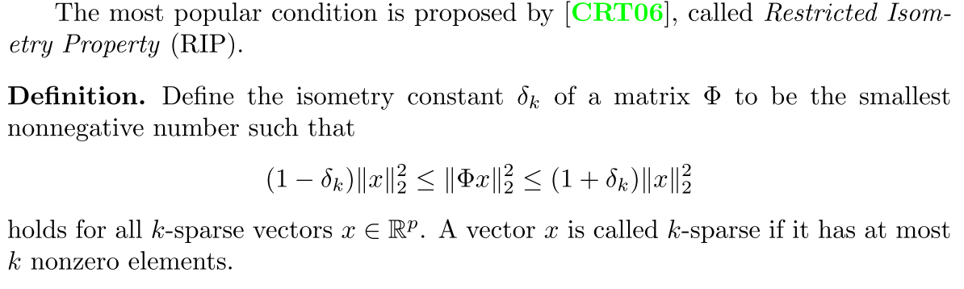
Restricted Isometry Property

Slide 12
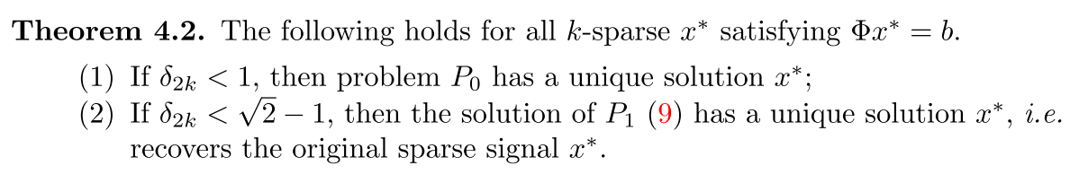
Exact Recovery Theory (e.g. Candes’08)

Slide 13
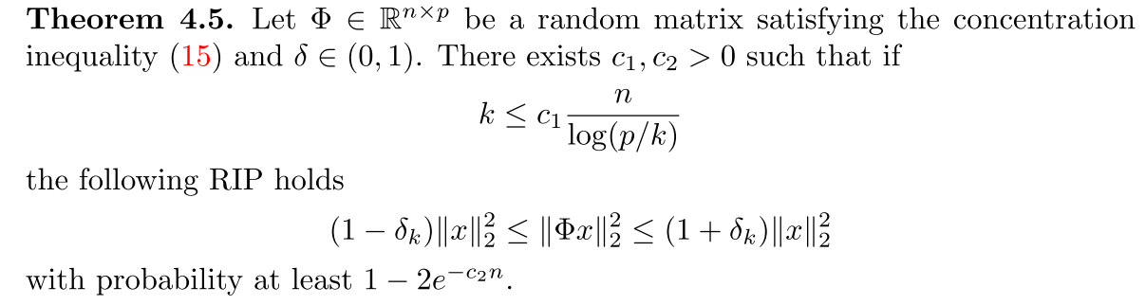
From Johnson-Lindenstrauss to RIP
The key step to establish Johnson-Lindenstrauss Lemma is the following
Then [Baraniuk-Davenport-DeVore-Wakin’2008]

Slide 14
Summary
Johnson-Lindenstrauss Lemma shows that random projections provide
universal basis (non-adaptive) with
almost isometry uniformly for all data pairs (rather than average distortion)
Johnson-Lindenstrauss Lemma implies Restricted Isometry Property in compressed sensing

Slide 15
SDP extensions of MDS/PCA
Incomplete MDS with uncertainty, Robust PCA, Sparse PCA

Slide 16
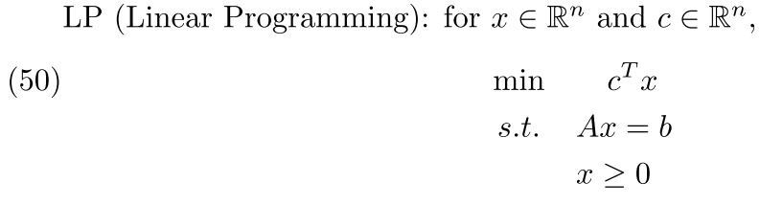
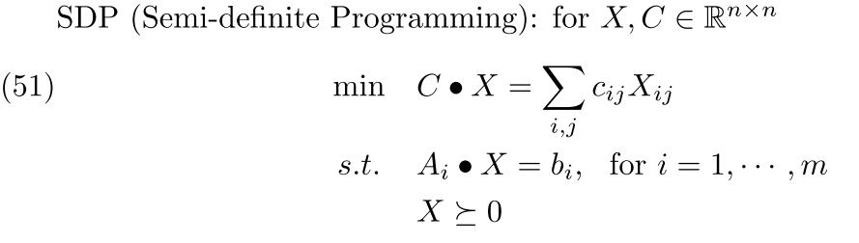
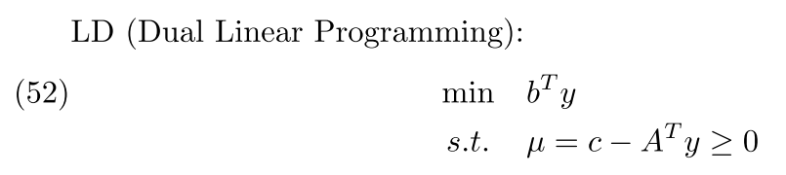
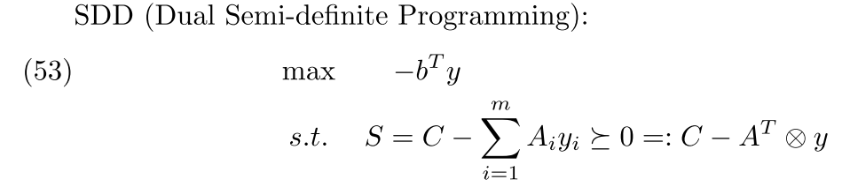
SDP is like LP with Linear Matrix Inequalities
So SDP is a generalization of LP
Tractable in theory, but in practice not easy to deal with large matrices (e.g. 100-by-100 for CVX)

Slide 17
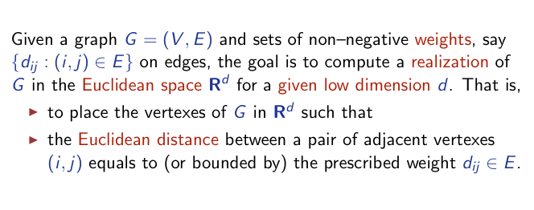
Extension I: MDS with missing values (Graph Realization Problem)
Classical MDS (complete graph with squared distance d_{ij}):
Young/Householder 1938, Shoenberg 1938

Slide 18
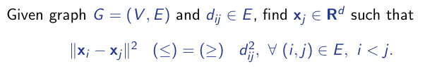
MDS with Uncertainty Quadratic equality and inequality system

Slide 19
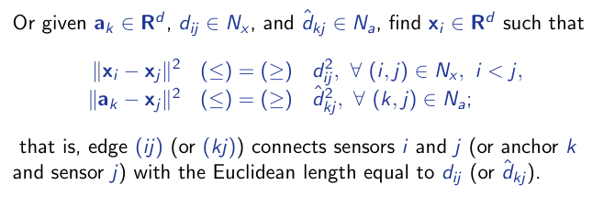
MDS in Sensor Network Localization: anchor points

Slide 20
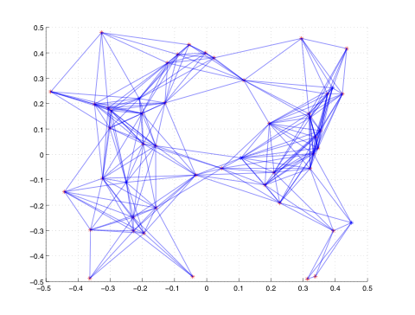
Example: 50-node 2-D Sensor Network Localiztion

Slide 21
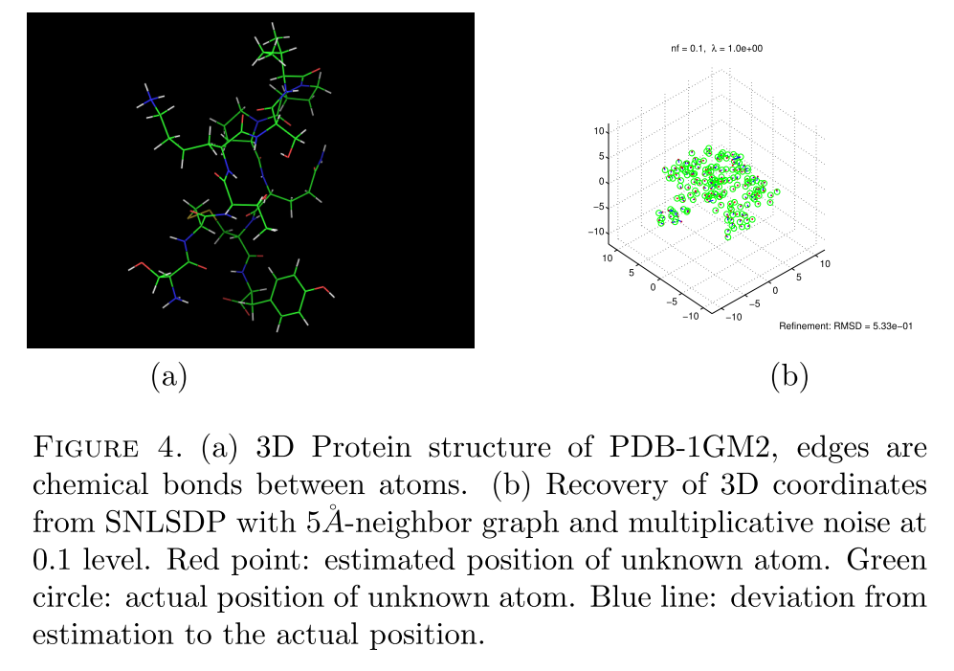
Example: Protein 3D reconstruction

Slide 22
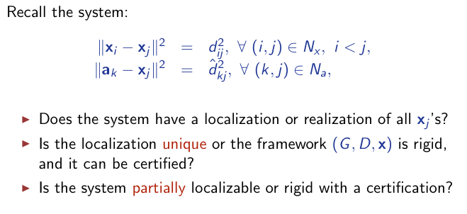
Key Problems

Slide 23
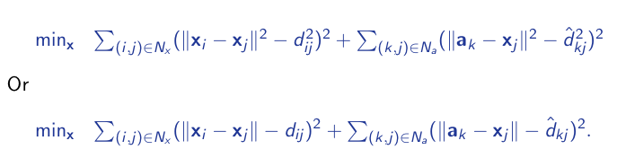
Nonlinear Least Squares
A difficult global optimization problem.

Slide 24
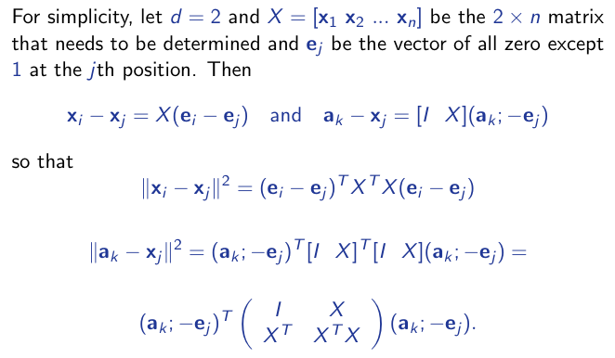
Matrix Represenation I
A difficult global optimization problem.

Slide 25
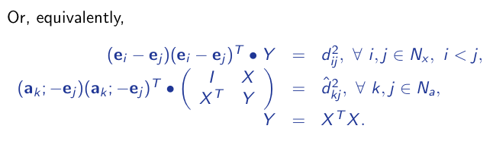
Matrix Represenation II

Slide 26
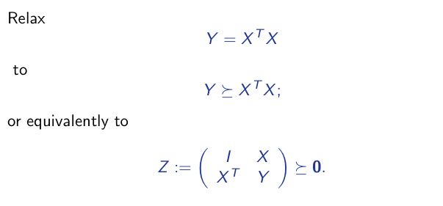
SDP Relaxation [Biswas-Ye 2004]

Slide 27
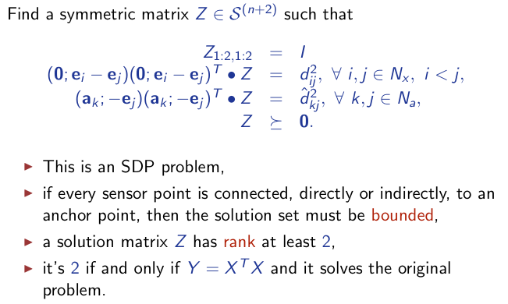
SDP Standard Form [Biswas-Ye 2004]

Slide 28
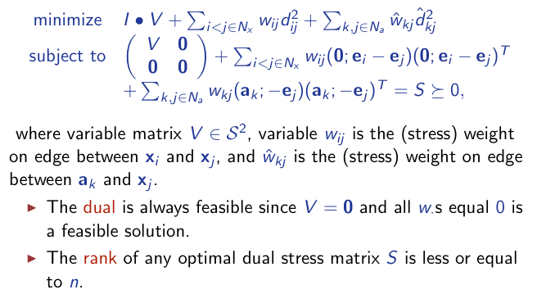
SDP Dual Form [Biswas-Ye 2004]

Slide 29
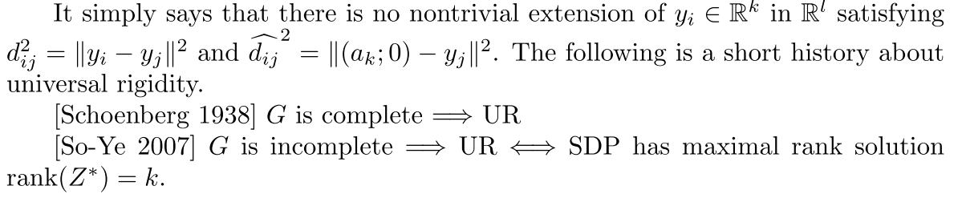
Unique Localizability

Slide 30
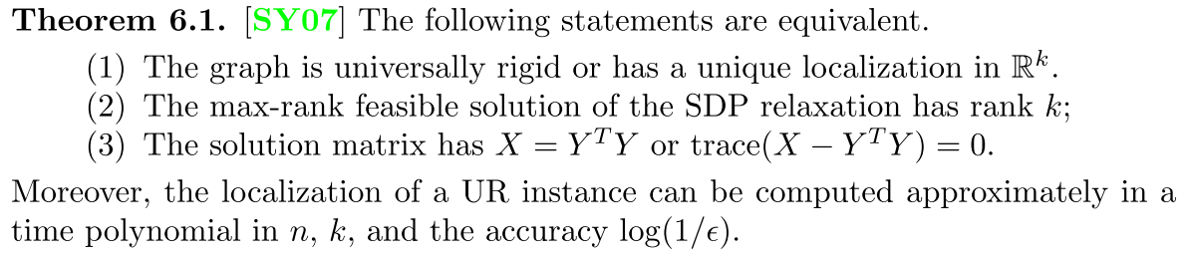
Rank Condition for Universally Rigidity
If we allow uncertainty with pairwise distance inequalities, then arbitrarily small rank solutions are possible [So-Ye-Zhang’2008].

Slide 31
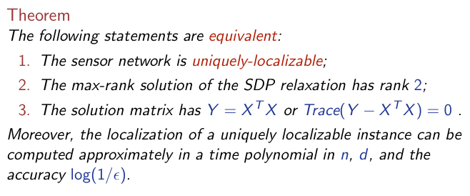
ULP is localizable in polynomial time [So-Ye 2005]

Slide 32
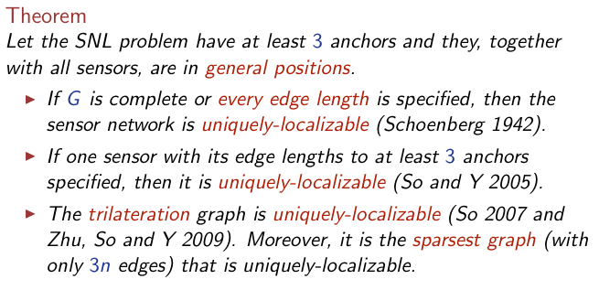
UL Graphs

Slide 33
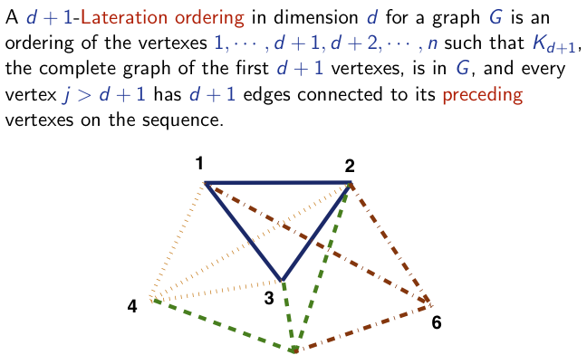
d-lateration Graphs

Slide 34
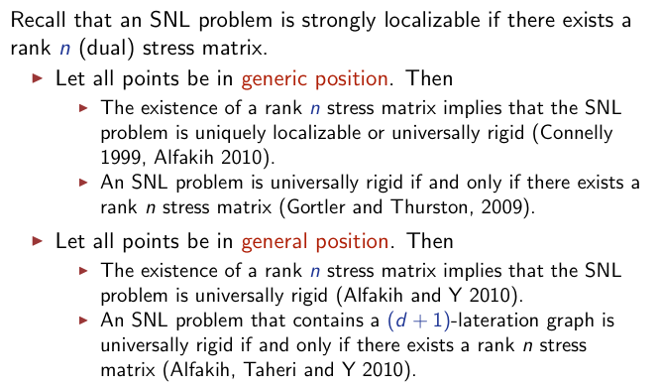
Open Problems in Sensor Network Localization

Slide 35
Reference
Schoenberg, I. J. (1938a) Metric Spaces and Completely Monotone Functions. The Annals of Mathematics 39, 811–841
Schoenberg, I. J. (1938b) Metric Spaces and Positive Definite Functions. Transactions of the American Mathematical Society 44, 522–536
Francois Bavaud (2010) On the Schoenberg Transformations in Data Analysis: Theory and Illustrations, arXiv:1004.0089v2
T. F. Cox and M. A. A. Cox, Multidimensional Scaling. New York: Chapman & Hall, 1994.
Yinyu Ye, Semidefinite Programming and its Low-Rank Theorems, ICCM 2010

Slide 36
Robust PCA
A sad fact is that PCA is sensitive to outliers…

Slide 37
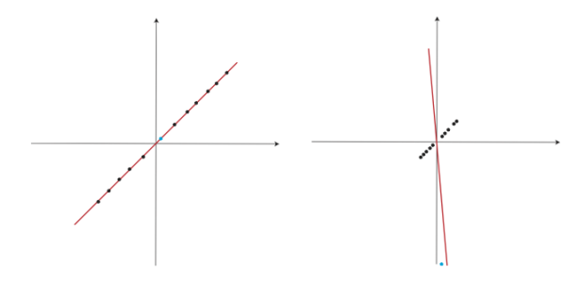
PCA is sensitive to outliers

Slide 38
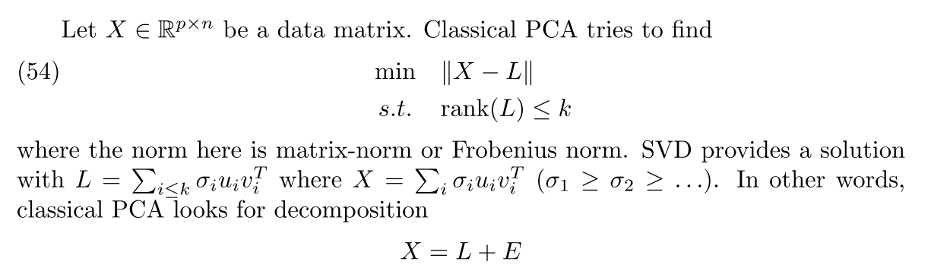
PCA as Low-Rank Approximation
Here error term E is small in Frobenius norm or matrix spectral norm, sensitive to outliers

Slide 39
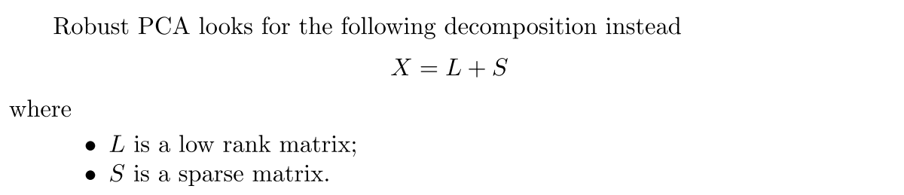
Robust PCA

Slide 40
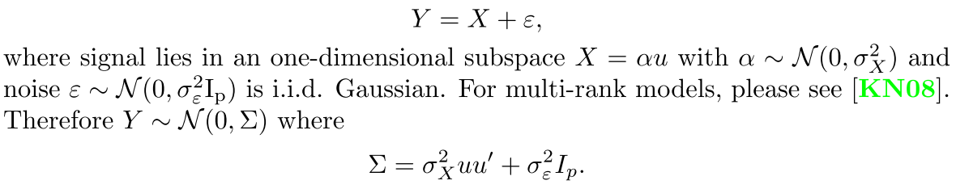
Example: Rank-1 Signal Model

Slide 41
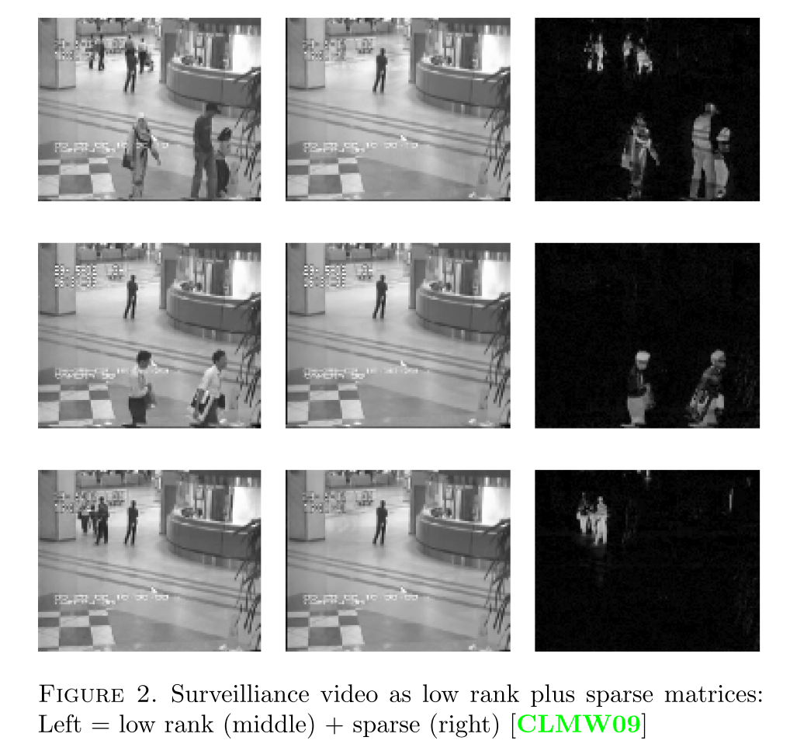
Example

Slide 42
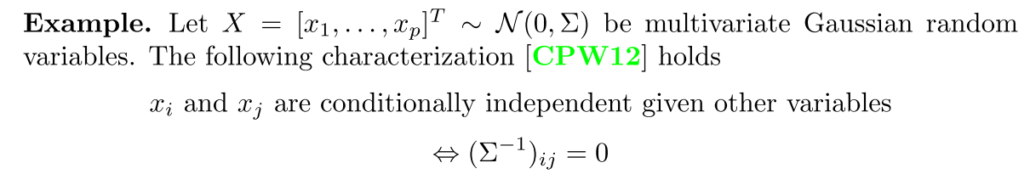
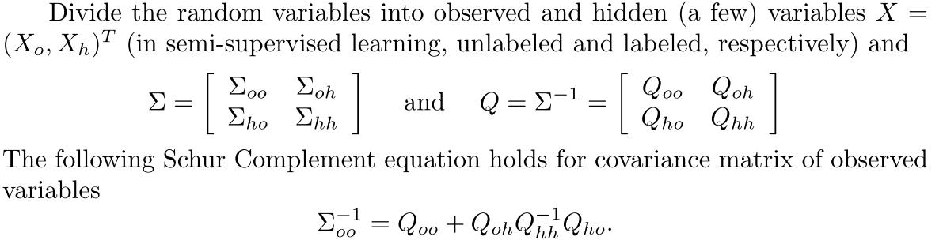
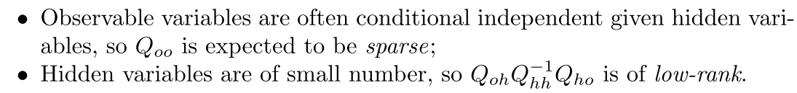
Example: Gaussian Graphical Models

Slide 43


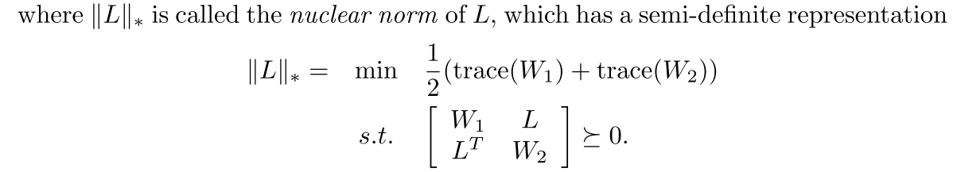
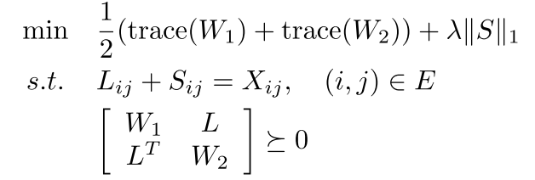
A Convex Relaxation Approach: SDP

Slide 44
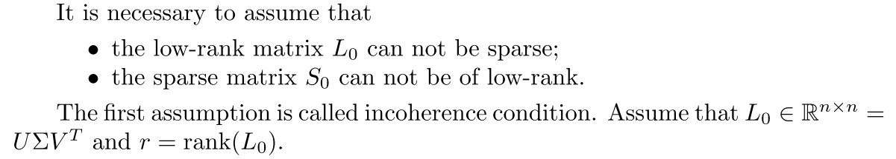
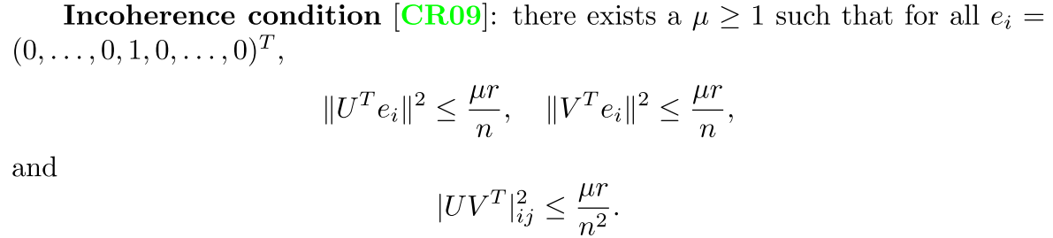
When does it work?

Slide 45
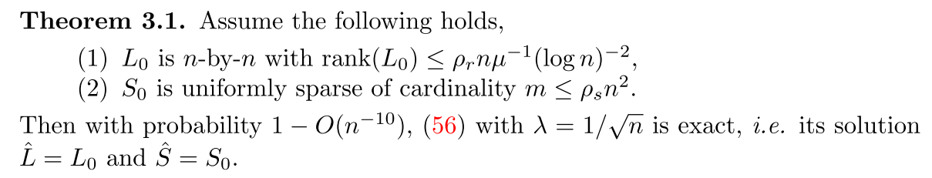
Exact Recovery Theory (Candes-Recht’09,Candes-Tao’10)
It can be generalized to incomplete measurements

Slide 46
Sparse PCA
How about the principle components are sparse, i.e. with many zero elements?

Slide 47
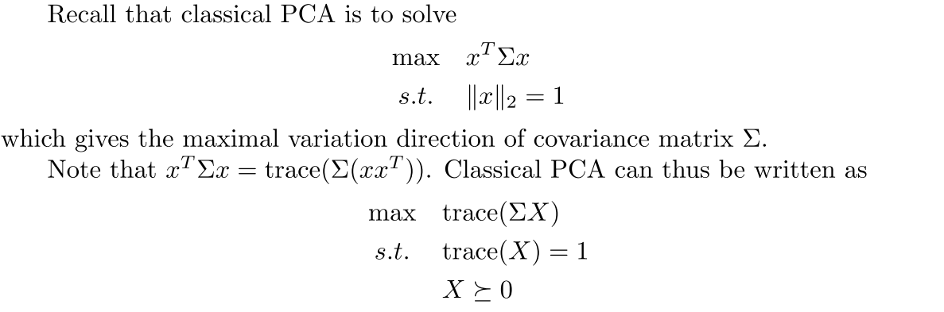
PCA as Maximal Variance Projection

Slide 48
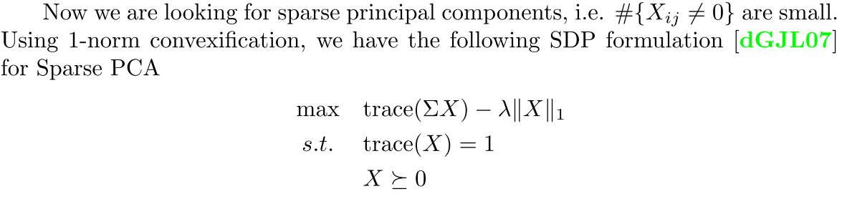
A SDP approach to Sparse PCA

Slide 49
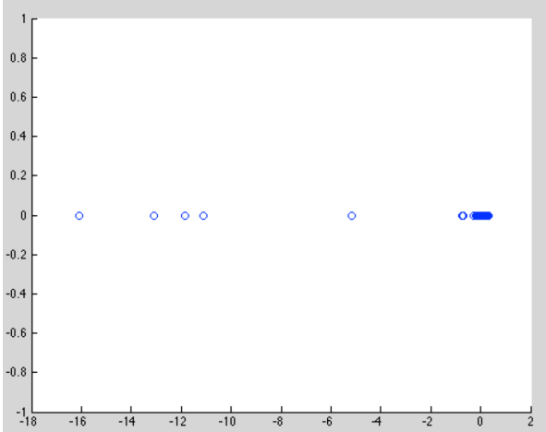


Example: A Journey to the West (provided by Song Mei, Fangyuan Li, Yiding Lu, PKU course 2014.)
Data contains a 302-by-408 (p-by-n) character-scene cooccurance matrix
Figure below: (Left) first principle component; (middle) scores of the top 5 characters; (right) sparse PCA

Slide 50
Summary
Random projections
Universal basis to achieve almost isometry (Johnson-Lindenstrauss Lemma)
Applications in compressed sensing (RIP)
SDP extensions of MDS/PCA
Incomplete MDS (graph realization/sensor network localization)
Robust PCA
Sparse PCA

