Slide 1
Bayesian Deep Learning
Ye Yushi, Mao Hongyu

Slide 2
Prediction is not enough, prediction uncertainty is also important
In May 2016 we tragically experienced the first fatality from an assisted driving system. “Neither Autopilot nor the driver noticed the white side of the tractor trailer against a brightly lit sky, so the brake was not applied.”
In July 2015, an image classification system erroneously identified two African American humans as gorillas, raising concerns of racial discrimination.
From blog: https://alexgkendall.com/computer_vision/bayesian_deep_learning_for_safe_ai/

Slide 3
We want a model which can …
Not only predict accurately (like state-of-the-art DNN models)
But also give prediction confidence on each input data point
For example, in the assisted driving system, if AI finds it can’t make decision very confidently in some situation, it can warn the driver to operate manually for safety.
This is what Bayesian Deep Learning models do!
There are many variants of BDL. We will introduce two of them

Slide 4
Kendall and Gal (2017)
Try to model two types of uncertainty in one model:
Aleatoric uncertainty: capture noise inherent in the observations, i.e. uncertainty which cannot be reduced even if more data points were given.
Epistemic uncertainty: capture the uncertainty in the model parameters. It can be explained away if given enough data.

Slide 5
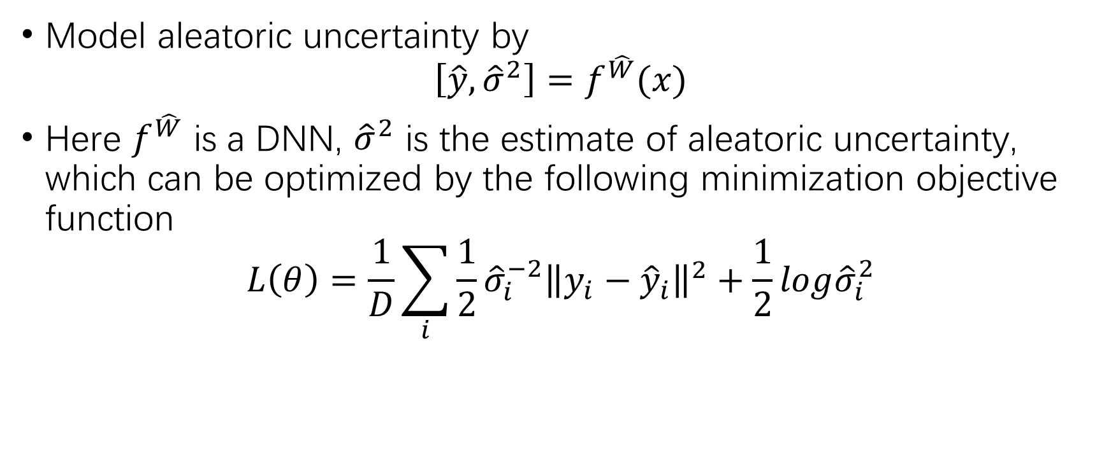
Model aleatoric uncertainty
Model aleatoric uncertainty by
$$\left[\hat{y},{\hat{σ}}^{2}\right]=f^{\hat{W}}(x)$$
Here $f^{\hat{W}}$ is a DNN, ${\hat{σ}}^{2}$ is the estimate of aleatoric uncertainty, which can be optimized by the following minimization objective function
$$L\left(θ\right)=\frac{1}{D}\sum_{i}{\frac{1}{2}{\hat{σ}}_{i}^{−2}{\left\|y_{i}−{\hat{y}}_{i}\right\|}^{2}+\frac{1}{2}log{\hat{σ}}_{i}^{2}}$$

Slide 6

Model epistemic uncertainty
using Monte Carlo dropout sampling
$$Var\left(y\right)≈\frac{1}{T}\sum_{i=1}^{T}{{\hat{y}}_{t}^{2}}−{\left(\frac{1}{T}\sum_{i=1}^{T}{{\hat{y}}_{t}}\right)}^{2}$$
Here ${\{{\hat{y}}_{t}\}}_{t=1}^{T}$ is a set of $T$ dropout sampled outputs.

Slide 7
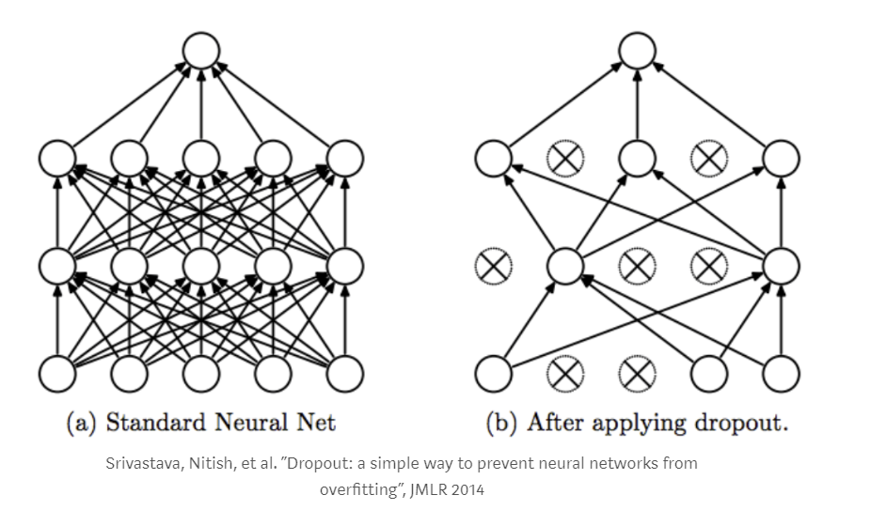
Dropout

Slide 8
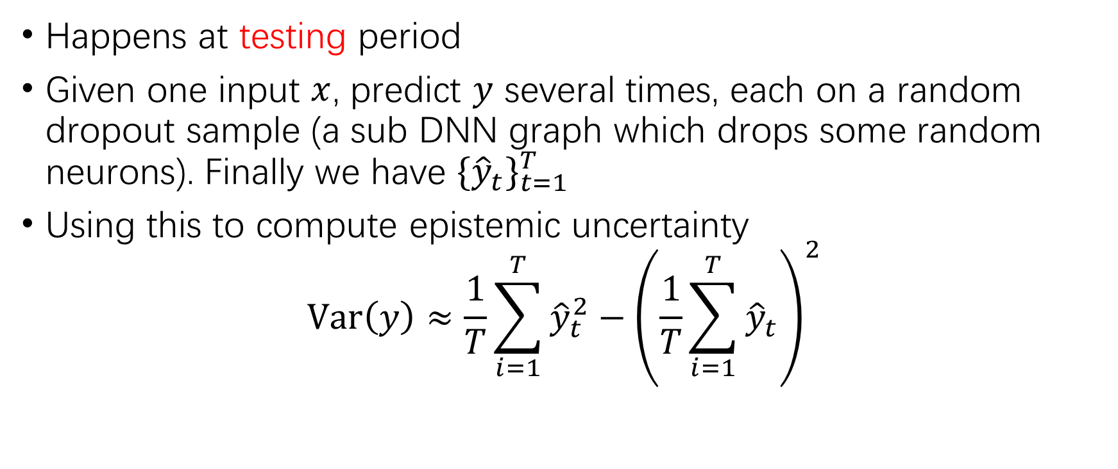
Monte Carlo dropout sampling
Happens at testing period
Given one input $x$, predict $y$ several times, each on a random dropout sample (a sub DNN graph which drops some random neurons). Finally we have ${\{{\hat{y}}_{t}\}}_{t=1}^{T}$
Using this to compute epistemic uncertainty
$$Var\left(y\right)≈\frac{1}{T}\sum_{i=1}^{T}{{\hat{y}}_{t}^{2}}−{\left(\frac{1}{T}\sum_{i=1}^{T}{{\hat{y}}_{t}}\right)}^{2}$$

Slide 9
Some comments
Have good performance on several examples
Computational expensive in testing period (due to Monte Carlo dropout sampling), which may be a problem in some cases such as auto drive system

Slide 10

Natural-Parameter Networks – Wang etc. (2016)
Traditional NN:
$$o^{(l)}=a^{(l−1)}W^{(l)}+b^{(l)}$$
$$a^{(l)}=v(o^{(l)})$$
$$…$$
$W^{(l)}$ is a determinist matrix, $b^{(l)}$ is a normal vector for bias item
$v(∙)$ is a non-linear activation function

Slide 11
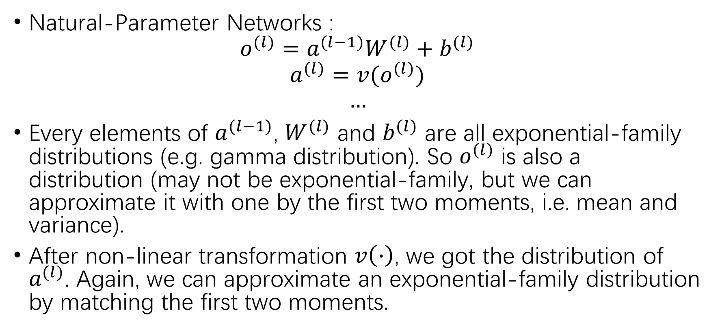
Natural-Parameter Networks – Wang etc. (2016)
Natural-Parameter Networks :
$$o^{(l)}=a^{(l−1)}W^{(l)}+b^{(l)}$$
$$a^{(l)}=v(o^{(l)})$$
$$…$$
Every elements of $a^{(l−1)}$, $W^{(l)}$ and $b^{(l)}$ are all exponential-family distributions (e.g. gamma distribution). So $o^{(l)}$ is also a distribution (may not be exponential-family, but we can approximate it with one by the first two moments, i.e. mean and variance).
After non-linear transformation $v\left(∙\right)$, we got the distribution of $a^{(l)}$. Again, we can approximate an exponential-family distribution by matching the first two moments.

Slide 12
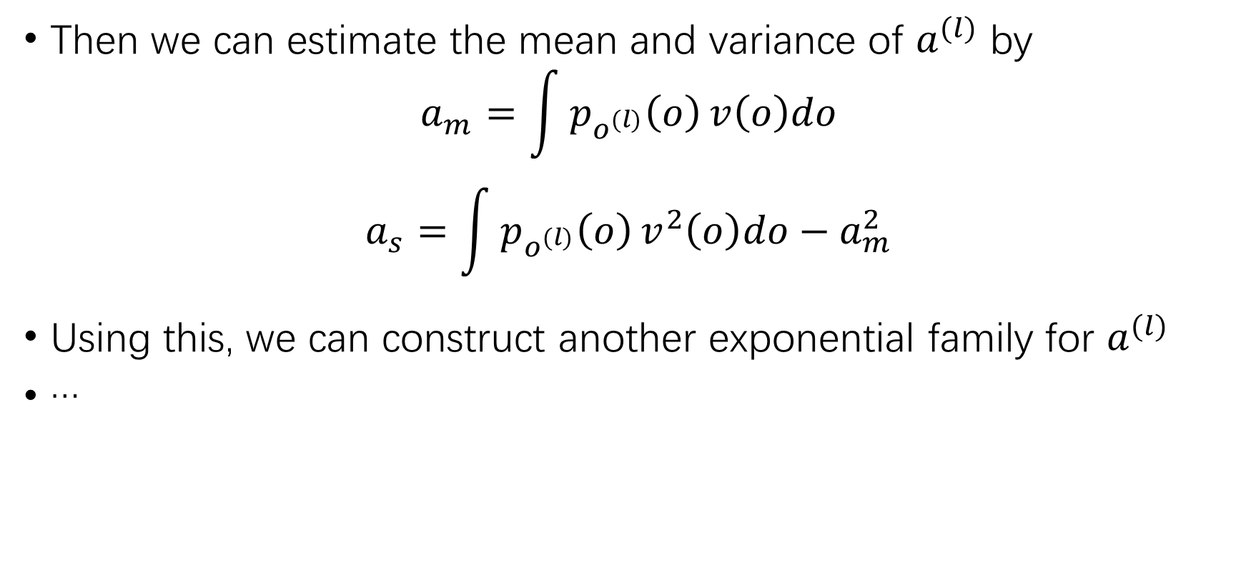
Natural-Parameter Networks – Wang etc. (2016)
Then we can estimate the mean and variance of $a^{(l)}$ by
$$a_{m}=\int{p_{o^{(l)}}\left(o\right)}v\left(o\right)do$$
$$a_{s}=\int{p_{o^{(l)}}\left(o\right)}v^{2}\left(o\right)do−a_{m}^{2}$$
Using this, we can construct another exponential family for $a^{(l)}$
…

Slide 13
Some comments
Can be trained fast since all steps have closed-form formulas (for the integration part we need to select activation function carefully)
The number of parameters are doubled compared with normal NN, and the model can be treated as a complicated version of NN. And as a byproduct, we also have variance information at any prediction point (actually, distribution information)
Drawbacks:
Activation functions are restricted to several specific forms
Hard to tune for non-professional
May overfit since numbers of parameters are doubled

Slide 14
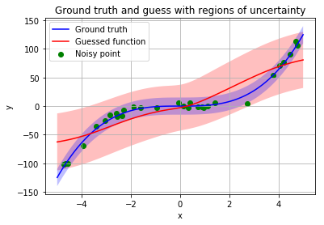

A toy example: $y=x^{3}$ , 100 epochs

Slide 15
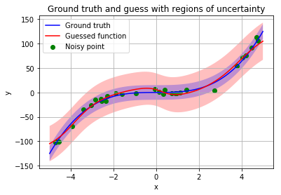

A toy example: $y=x^{3}$ , 500 epochs

Slide 16
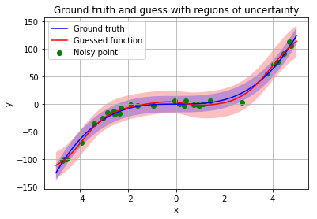

A toy example: $y=x^{3}$ , 1000 epochs

Slide 17
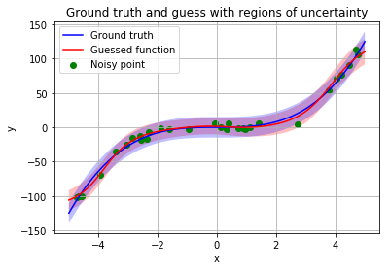

A toy example: $y=x^{3}$ , with regularization

Slide 18
On MNIST data: Traditional NN vs NPN
Two hidden layers, 300+100 neurons
Fully connected
Cross-entropy loss
Learning rate 0.01
Batch size 50
We will show the testing accuracy in the next slides

Slide 19
On MNIST data: Traditional NN vs NPN
 | DNN | NPN
5 epochs | 0.9512 | 0.9631
10 epochs | 0.9666 | 0.9713
15 epochs | 0.9722 | 0.9749
20 epochs | 0.9746 | 0.9778
25 epochs | 0.9764 | 0.9802
30 epochs | 0.9780 | 0.9816
35 epochs | 0.9790 | 0.9825
May need more complicated data to test the power of Bayesian Deep Learning!

Slide 20
Thank you!

